Slide 1
National Farmworker Jobs Program WIOA Implementation
Webinar Date: July 23, 2015
Presented by: The Office of Workforce Investment
U.S. Department of Labor
Employment and Training Administration

Slide 2
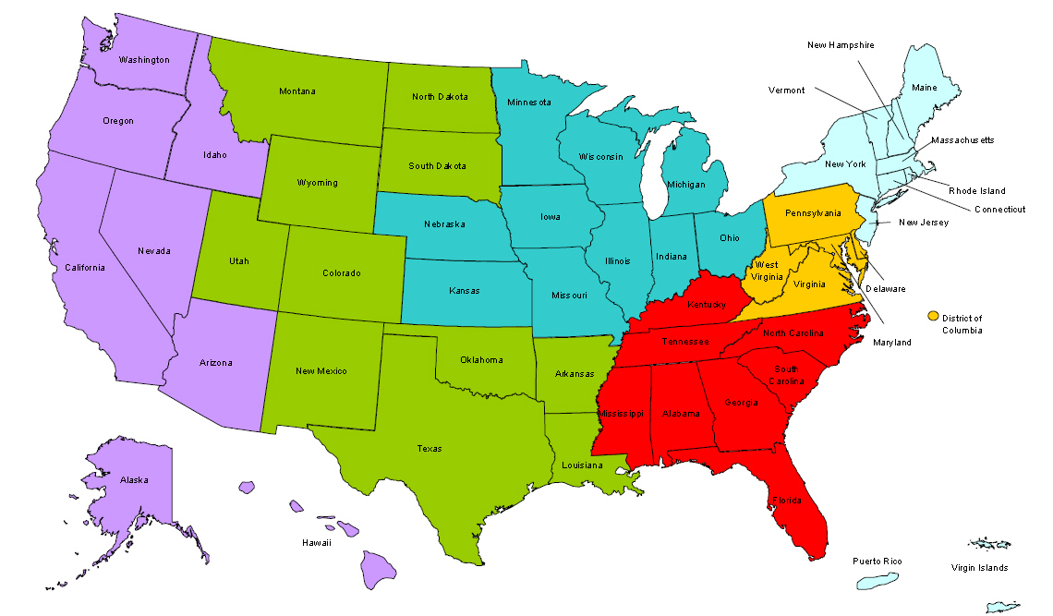
Where are you?
Enter your location in the Chat window – lower left of screen
Notes:
In the Chat Room, please type the name of the your organization, your location, and how many people are attending with you today.

Slide 3
Moderator
Kim Vitelli
Division Chief, National Programs, Tools, and Technical Assistance
Office of Workforce Investment

Slide 4
Here’s what you can expect to get out of this webinar!
Key operational guidance provisions
What has changed
What has stayed the same
Implementation strategies
Your questions answered

Slide 5
Agenda
Welcome
What NFJP operational guidance is...
...And what it is not.
Key operational guidance provisions
WIOA implementation strategies
Question and answer session

Slide 6
Presenters
Gregory Scheib
Workforce Analyst, NFJP
Office of Workforce Investment
Juan Regalado
National Monitor Advocate
Office of Workforce Investment

Slide 7
Presenters
Jennifer Shahan
State Director, Delaware/Maryland
Telamon Corporation
Martin Campos-Davis
Operations Director
Oregon Human Development Corporation

Slide 8
WIOA is now effective!
July 1, 2015 = Effective date of statute:
Except:
Performance provisions
Governors’ option for one-stop allocation
Other operational guidance:
WIOA Vision (TEGL 19-14)
“Money and People” (TEGL 38-14)
Youth Transition (TEGL 23-14)

Slide 9
NFJP Operational Guidance IS...
The Department’s current thinking on the NFJP under WIOA
What will guide the program from July 1, 2015 until the WIOA Final Rule is completed (early 2016)
Intended to provide initial guidance and direction to our NFJP community

Slide 10
NFJP Operational Guidance IS NOT...
Inclusive of the entire NFJP Notice of Proposed Rule Making (NPRM) text
The final NFJP regulations (things may change based on responses to public comments)

Slide 11
Moving Towards the WIOA Final Rule...
Keep an eye out for additional relevant WIOA information:
One-Stop operations (TEGL)
Performance measures (ICR)
We anticipate issuing updated and/or new TEGLs/TENs on:
NFJP eligibility and enrollment
NAICS codes for the WIOA definition of “farmwork”
Revised NFJP reporting forms and requirements

Slide 12
Question
What is your biggest concern about WIOA implementation?

Slide 13
Partnership
NFJP grantees are mandated one-stop partners in the areas they operate.
Grantees must develop an MOU with all the local areas in which they operate.
NFJP grantees are not required to be co-located in one-stops but must provide access to their services in the centers located where they operate.

Slide 14
Outreach and Recruitment
Grantees are responsible for coordinating services - particularly outreach - with State Workforce Agencies and Monitor Advocates.

Slide 15
Eligibility and Enrollment
WIOA changed the definition of eligible seasonal farmworker to a low-income person who faces multiple barriers to economic self-sufficiency.
The definition of “farmwork” has been expanded and fish farming is now an allowable industry for eligibility purposes.
The definition of “dependents” who can be served through NFJP is unchanged under WIOA.

Slide 16
Eligibility and Enrollment
Under TEGL 35-14 “farmwork” includes:
...the production, cultivation, growing, and harvesting of any agricultural or horticultural commodities.
Raising of livestock, bees, fur-bearing animals, or poultry, the farming of fish.
Forestry or lumbering operations performed by a farmer or on a farm as an incident to or in conjunction with such farming operations.

Slide 17
Eligibility and Enrollment
Handling, planting, drying, packing, packaging, processing, freezing, or grading prior to delivery for storage of any agricultural or horticultural commodity in its unmanufactured state.
Any service or activity covered under 20 CFR 655.103(c) and/or 29 CFR 500.20(e).
Any service or activity identified through official Department guidance such as a TEGL.

Slide 18
Eligibility and Enrollment
Fish farming labor includes all occupations included under the following North American Industry Classification System (NAICS) codes:
112511 - Finfish Farms/Fish Hatcheries
112512 - Shellfish Farming
Other “aquaculture” that includes the production, cultivation, growing, and harvesting of any agricultural or horticultural commodities are also included in the definition of “farmwork.”

Slide 19
Eligibility and Enrollment
Male applicants over 18 years old must comply with Selective Service requirements.
NFJP participants must have the right to work in the United States.
Deferred Action for Childhood Arrivals (DACA) participants have the right to work in the United States.

Slide 20
Eligibility and Enrollment
Documentation requirements under WIOA are unchanged.

Slide 21
Questions?

Slide 22
Career Services
Includes workforce investment activities (including youth workforce investment activities) and related assistance described in:
WIOA Sec. 167(d)
WIOA Sec. 134(c)(2)

Slide 23
Career Services
Grantees must provide access to career services through the one-stop delivery system.
Grantees can also provide career services through sources outside the one-stop system.
Career services must be discussed in the required MOU between the Local Workforce Development Board and the grantee.
Grantees may continue to operate under existing MOUs until the grantee and the Local Board sign a new MOU.

Slide 24
Training Services
Grantees must provide the training activities described in WIOA sec. 167(d) and 134(c)(3)(D).
Participants are not required to receive career services prior to receiving training services.

Slide 25
Training Services
Training services must be directly linked to an in-demand industry sector or occupation.
Training activities must encourage the attainment of recognized postsecondary credentials when appropriate for an eligible MSFW.

Slide 26
Training Services
Under WIOA, grantees may reimburse OJT employers for the extraordinary costs of training by up to 50 percent of the wage rate of the participant.
Grantees may also increase the OJT reimbursement rate up to 75 percent of the wage rate of a participant under certain conditions when considering:
The characteristics of the participants
The size of the employer
The quality of employer-provided training and advancement opportunities
Other factors as appropriate

Slide 27
Youth Services
Career services and training
Youth workforce investment activities specified in WIOA sec. 129
Life skills activities which may include self- and interpersonal skills development
Community service projects
Other activities and services that conform to the use of funds for youth activities described in WIOA sec. 129
Grantees may provide these services to any eligible MSFW youth, regardless of the participant’s eligibility for WIOA Title I youth activities as described in WIOA sec. 129(a).

Slide 28
Polling Question 1
Do you anticipate enrolling MSFW youth into your program?
Yes
No
Will enroll in partner program
Will only enroll after WIOA youth performance measures are enacted.

Slide 29
Related Assistance
Short-term direct services and activities.
Examples include:
English language and literacy instruction
Pesticide and worker safety training
Housing assistance (including permanent housing)
School dropout prevention and recovery activities
Emergency assistance

Slide 30
Related Assistance
Emergency assistance:
An applicant's self-certification is sufficient documentation of eligibility for emergency assistance
Proof of right to work and Selective Service registration must still be documented
Related assistance is distinct from “supportive services.”

Slide 31
Housing Services
Allowable permanent and temporary housing services remains essentially unchanged under WIOA.
May only be provided when required to meet the needs of eligible MSFWs to occupy a unit of housing for reasons related to seeking or retaining employment, or engaging in training.

Slide 32
Housing Services
Occupancy of year-round and migrant rental units is not restricted only to eligible MSFWs.
However, at least one individual living in the household must be determined eligible for NFJP services.

Slide 33
Polling Question
Do you provide yurts as part of temporary
housing assistance?
Yes
No
What’s a yurt?
Will only offer yurts as temporary housing once I know what it is...

Slide 34
Performance Measures
The WIOA performance accountability system and corresponding primary indicators of performance become effective on July 1, 2016
In PY 2015 NFJP grantees will continue to be evaluated on the following common performance measures:
Entered Employment Rate
Employment Retention Rate
Six-month Average Earnings
Grantee performance goals for PY 2015 are unchanged from PY 2014

Slide 35
Reporting Outcomes
ETA will be utilizing the current program and fiscal reporting forms for PY 2015.
Employment and Training Grantees:
Budget Information Summary - Form 9093
Program Planning Summary - Form 9094
Program Status Summary - Form 9095
Housing Grantees:
Housing Assistance Summary - Form 9164

Slide 36
Reporting Outcomes
Current OMB approved forms do not capture the number of eligible MSFW youth served.
The Department will be revising current program reports to capture the number of eligible MSFWs served and program outcomes starting in PY 2016.
Once a new performance reporting system is established, ETA will issue guidance on capturing and reporting youth outcomes and associated performance levels.
Notes:
Greg
You can voluntarily report to us the number of current participants who qualify as MSFW youth.

Slide 37
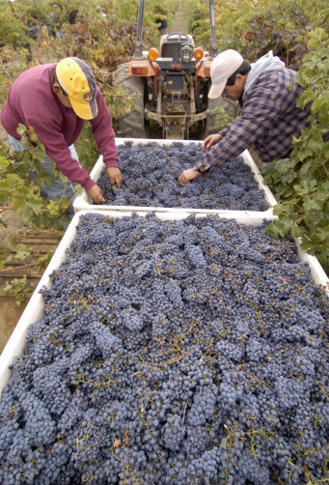
Things to Keep in Mind...
PY 2014 funds can be used in PY 2015.
You must get DOL approval to add, delete, expand, or reduce any part of the program plan or allowable activities.
We encourage you to follow the new Uniform Guidance for all funds.
Can be requested by emailing your FPO
Grant award will be modified to make this change

Slide 38
Questions?

Slide 39
WIOA Implementation in Practice
Jennifer Shahan
State Director, Delaware/Maryland
Telamon Corporation

Slide 40
NFJP Youth Opportunities
Opportunities for NFJP eligible Farmworker Youth are greatly expanded under WIOA by the ability to provide Section 129 Youth Services under Section 167.

Slide 41
NFJP Youth Opportunities under WIOA

Slide 42
Dual Enrollment with Mainline and NFJP under WIA

Slide 43
WIA vs. WIOA Youth Programs
10 Elements vs. 14 Elements

Slide 44
WIA vs. WIOA Youth Programs
25% minimum Out of School vs. 75 % minimum Out of School

Slide 45
WIA vs. WIOA Youth Programs
20% Minimum Work Experience Programs

Slide 46
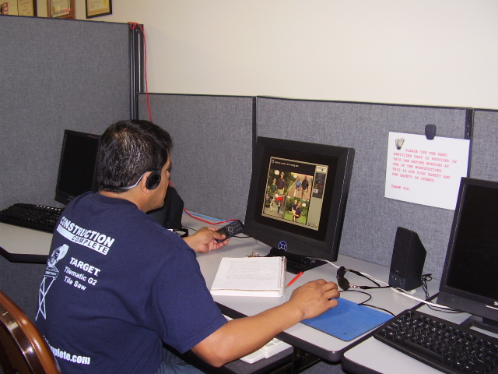
WIA vs. WIOA Youth Programs
English Language Learners

Slide 47
NFJP Youth Programs under WIOA
Future Opportunities

Slide 48
NFJP Youth Programs under WIOA
Potential Questions

Slide 49
NFJP Youth Programs
Questions?

Slide 50
WIOA Implementation in Practice
Martin Campos-Davis
Operations Director
Oregon Human Development Corporation

Slide 51
Oregon/Nevada WIOA Transition Prep
Retention – Longer Term Client Engagement
Employer – Engaging Employers for Success

Slide 52
Oregon/Nevada WIOA Transition Prep
Longer Follow-ups – Retention Qtr – 4th Qtr

Slide 53
Client Engagement – Old Model
Core
Variety of Necessary mandatory services
Intensive
2nd step on progression – Case Management
Training
Deemed necessary in progression model
Exit
Placement
Communication of program was often “Linear”

Slide 54
Client Engagement – WIOA Model
Job Search
Work
Upgrade
Prep Activities
Engagement
Awareness
Describes services with a focus on Client Engagement throughout cycle.

Slide 55
Client Engagement – WIOA Model
Describes services with a focus on Client Engagement throughout cycle.
Language shift – away from steps in progression
Describe this engagement as a cycle
Add-Ins – Skills building activities throughout cycles
Vocabulary Building
On-line scavenger hunts
Negotiating a raise

Slide 56
Employer Engagement
Measured primarily in terms of Entered Employments and Placements
Employer satisfaction
Transition from placement activities to consultative role with employers
Will require greater awareness of services to employers beyond NFJP

Slide 57
Employer Engagement
Yours and Mine – Employer contacts
Getting to “OUR” contacts
Joint training opportunity with our counterparts at DOL – Employment Department
Consultative Approach to Employer Engagement
Further refining our messaging to engage employers

Slide 58
Employer Engagement
Goals:
Increased employer engagement
Lower turn-over costs for employers
B2B referrals from employers
Referrals to services beyond NFJP offerings – be the linkage!
Increased OJTS in OR/NV – target 30% of Placements

Slide 59
Important Dates…
☑ July 1, 2015 – Implementation of WIOA.
~November 2015 – Release of PY 2016 NFJP Funding Opportunity Announcement (FOA)
~April 2016 – PY 2016 NFJP grant awards announced.
July 1, 2016 – Transition to WIOA adult and youth performance measures.

Slide 60
Resources
NFJP Operation Guidance - TEGL 35-14
http://wdr.doleta.gov/directives/corr_doc.cfm?docn=7085
ETA – WIOA Resources
http://www.doleta.gov/wioa/
Innovation and Opportunity Network
https://wioa.workforce3one.org/page/home

Slide 61
Questions?

Slide 62
Speakers’ Contact Information
Kim Vitelli
Division Chief, Division of National Programs, Tools, and Technical Assistance
ETA – Office of Workforce Investment
Vitelli.Kimberly@dol.gov
202.693.3639
Gregory Scheib
Workforce Analyst, NFJP
ETA – Office of Workforce Investment
Scheib.Gregory@dol.gov
202.693.2791
Juan Regalado
National Monitor Advocate
ETA – Office of Workforce Investment
Regalado.Juan@dol.gov
415.625.7904

Slide 63
Speakers’ Contact Information
Jennifer Shahan
State Director Delaware/Maryland
Telamon Corporation
JShahan@telamon.org
443.397.9235
Martin Campos-Davis
Operations Director
Oregon Human Development Corporation
Martin.Campos-Davis@ohdc.org
503.452.6668

Slide 64
THANK YOU!
www.workforce3one.org

