Slide 1
Customer-Centered Design
Implementing WIOA

Slide 2
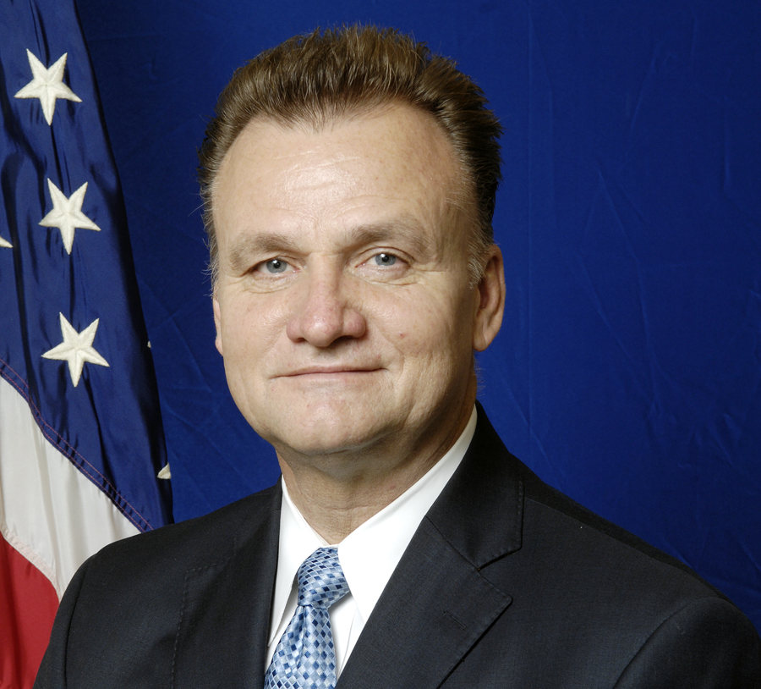
Byron Zuidema Deputy Assistant Secretary, Employment and Training Administration, U.S. Department of Labor
Notes:
Welcome to Customer Centered Design Webinar
WIOA implementation gives us a huge opportunity to step back from business as usual and, with the customer in mind, DESIGN services
Summary of TEGL
Agenda:
Message from the White House
Overview of Customer Centered Design
30 minute panel
Announcement of the Customer Centered Design project
15 Q&A
Introduce Virginia Hamilton

Slide 3
Virginia Hamilton Regional Administrator, Region 6
San Francisco Employment and Training Administration, U.S. Department of Labor

Slide 4
Jake Brewer Senior Policy Advisor, Office of the Chief Technology Officer, Executive Office of the President
Daniel Correa Senior Advisor, Technology and Innovation Division, Office of Science and Technology Policy, Executive Office of the President

Slide 5
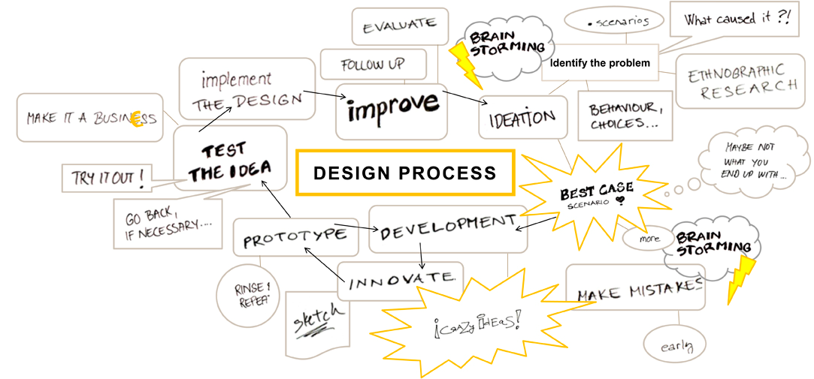
Design Thinking

Slide 6
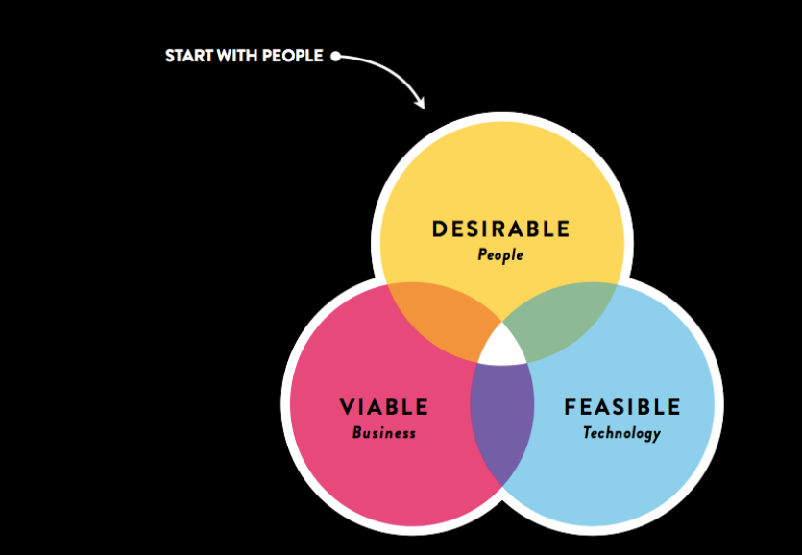
Using Human Centered Design
#

Slide 7
what is human-centered design?
A collaborative, discovery-based journey.
Get inspired by the people you’re serving.
Start by listening to people to get new ideas about how to design for them.
Identify patterns and surprising insights to inspire new opportunities for design.
Brainstorm new ways to serve your customers.
Try out your ideas and get feedback from customers – so you can revise your prototypes and get more feedback.
Try out a pilot program and experiment with ways to implement your new ideas.

Slide 8
what is human-centered design?
Look beyond what people say, to understand what they believe.

Slide 9
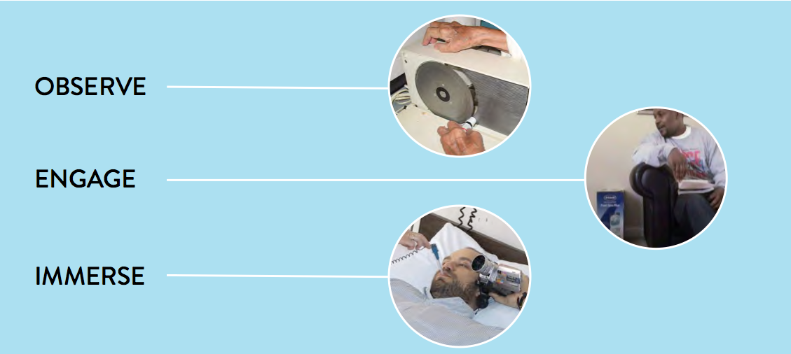
How We Empathize

Slide 10
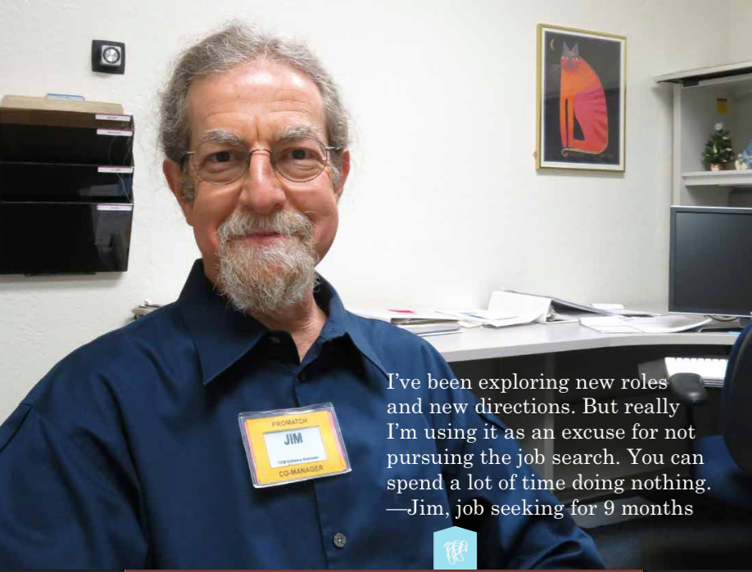

Slide 11
“
I’m copying a friend’s resume, but putting my words to it because I don’t know how to make one.
David, 18
”

Slide 12
“
I’m copying a friend’s resume, but putting my words to it because I don’t know how to make one.
David, 18
”
what if ?
Instead of resume-building classes,
we provided templates for youth to adapt quickly, since a resume is a means to an
end at this stage?

Slide 13
Using Human Centered Design
workshop one
Use empathy and emotion to develop better services
#

Slide 14
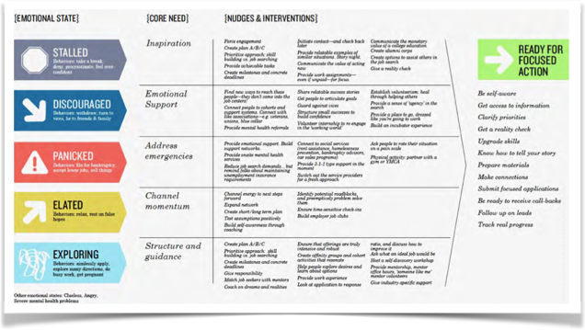
Using Empathy and Emotion
#

Slide 15
how might we …
assume solutions exist

Slide 16
how might we …
reduce commitment

Slide 17
how might we …
do it together

Slide 18
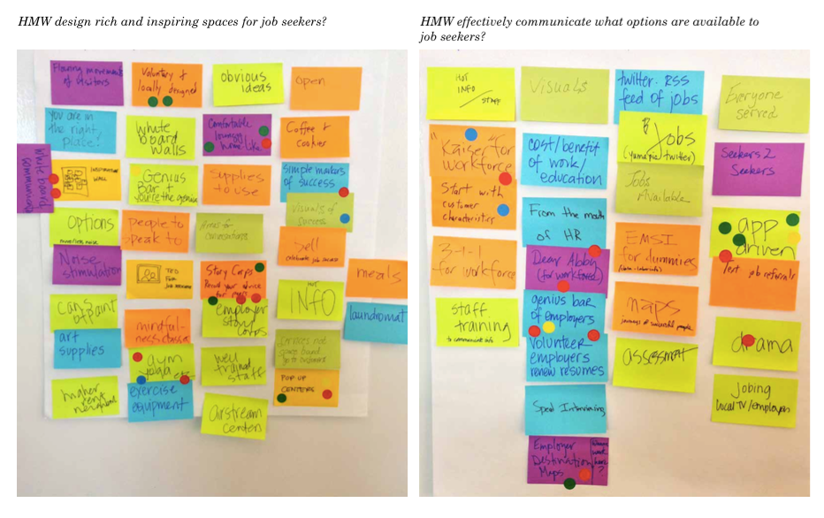
How Might We…?
#

Slide 21
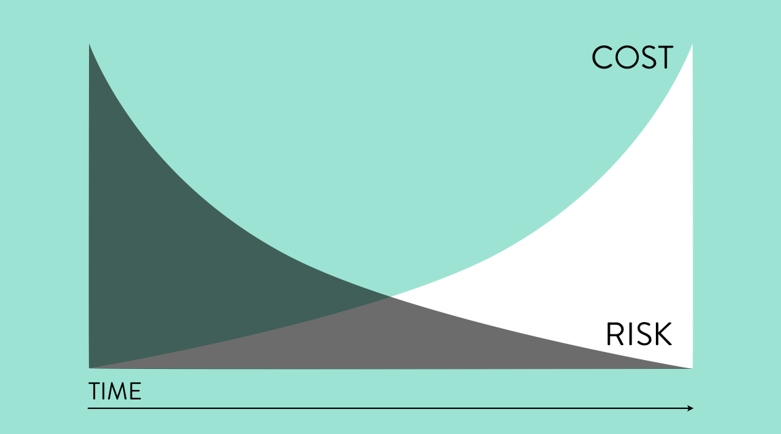

Slide 22
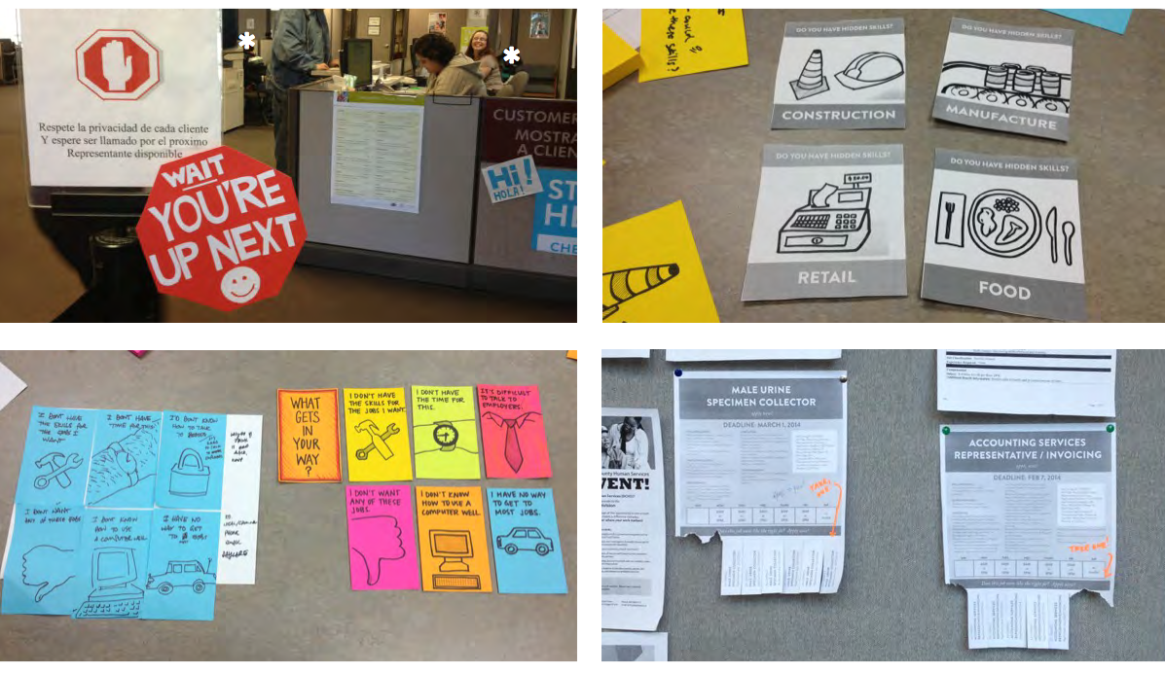

Slide 23
Exciting Opportunities
designing the welcome
tailoring our services
engaging employers
connecting with alumni
fostering wellness
creating community
adapting spaces

Slide 24
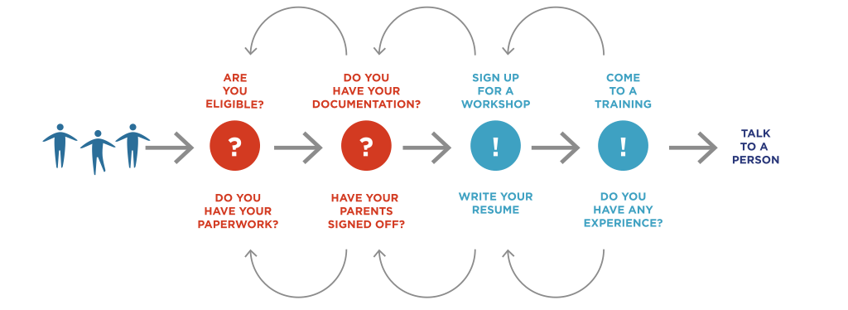
opportunities for design
We start with eligibility.

Slide 25
opportunities for design
What if we started by giving youth a reason to come?
Besides getting job skills.

Slide 26
Nisha
patel Director, Office of Family Assistance, Administration for Children and Families, Department of Health and Human Services (HHS)

Slide 28
Tribal TANF Child Welfare grants
Healthy Marriage and Responsible Fatherhood grants
Health Profession Opportunity grants

Slide 29
THE PROJECT WAS A CATALYST FOR INFORMED ACTION

Slide 30
http://www.acf.hhs.gov/programs/ofa

Slide 31
The Panelists
Robin Purdy
Special Consultant
California Workforce Investment Board
Tim Probst
Director of Workforce Development Strategic Initiatives
Employment Security Department of Washington State
Erick Serrato
Deputy Director
Pacific Gateway Workforce Investment Network

Slide 32
YouthWorks
Catalyst for system-wide change.
Increase system-wide outcomes.
Local design and flexibility.
Anesthesia Technician Program - The students above took part in a hands-on experience with the Renton Technical College.

Slide 33
We listened to the local experts,
and with a $240,000 one-time expenditure,
combined with existing local funding,
we created permanent new capacity for:
Actual Results
2,534 additional students identifying a specific career goal;
887 additional students matched with a mentor;
233 additional students performing on-site internships;
3,589 additional students engaged in other work-based learning activities;
39 additional teachers in on-site business externships.

Slide 34
The Opportunity
Step back from business as usual and, with the customer in mind, DESIGN services
Develop plans in a different way
Produce better outcomes and higher customer satisfaction
There are methods, tools, skills that can be taught and learned.
It’s a step-by-step process that any organization can do

Slide 35
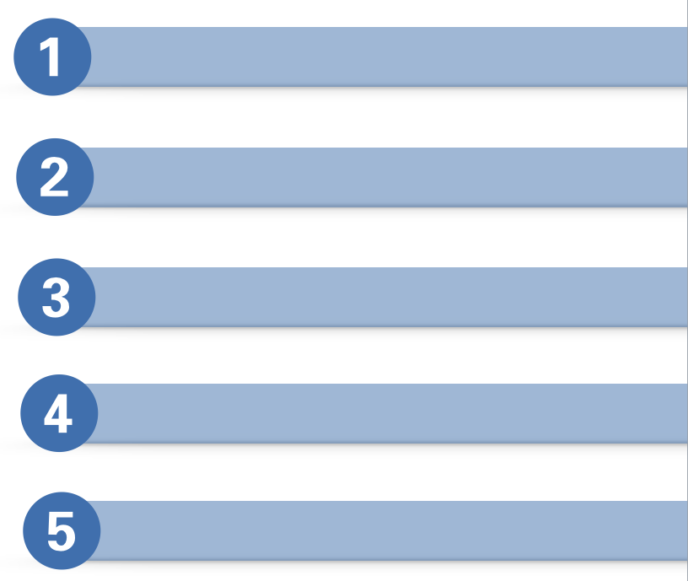
The Project and Five phases
The Launch
The Class
Experimentation and Prototyping
Learning Exchange and Celebration
Peer Mentoring

Slide 36
The TEAMS
organizations implementing WIOA
People who are designing services, writing RFP’s, etc.
Partners who serve a broad range of customers
State and local workforce agencies who want better outcomes
All one-stop partner programs

Slide 37
The Outcomes
Services are designed for employers and job seekers that better meet their needs.
WIOA implementation is transformative, not “check-the-box.”
You and your Team are supported to think outside of what you know, and use tools to make implementation happen in new, creative ways.
Federal, State, and local workforce professionals have a much better understanding of who the customer is.
Service design happens in a collaborative way with all stakeholders participating.
There is capacity in the system for on-going process improvement, and agencies use design thinking as a regular practice.

Slide 38
The Design Challenges
improve the customer experience and outcomes for our shared One-Stop Customers?
How might we
put employers in the center of our sector strategies and career pathway work?
design services and programs for out of school youth that will engage them and produce great outcomes?

Slide 39
The Course
Equip you with the mindsets and methods of human-centered design
Let you experiment
Teach you to identify patterns and opportunities for concept development
Inspire you to approach challenges differently
Give you hands-on experience speaking to, prototyping for, and testing solutions with the people you’re designing for
The seven week online course taught by Acumen and IDEO will:

Slide 40
REGISTRATION
Your team must register for the FREE course which starts August 20th:
http://plusacumen.org/courses/hcd-for-social-innovation/
To participate in the project, register your team by September 3rd:
https://wioa.workforce3one.org/page/CUSTOMER_CENTERED_DESIGN

Slide 41
Questions & Answers

Slide 42
Thank you
for participating in today’s webinar!
Reminder
Access existing technical assistance at: wioa.workforce3one.org
Including:
Quick Start Action Planners
WIOA Action Plan Template
Variety of Resources by Topical Area
Voices of Experience

