Slide 1
WIOA’s Collaborative Partnership Models for Serving Youth with Disabilities
Enough is Known for Action
Webinar Series
July 29, 2015
11am Pacific/2 pm Eastern

Slide 2



WIOA’s Youth with Disabilities Focus
Carmen Rodriguez
U.S. Department of Labor
Employment and Training Administration
Region 1
rodriguez.carmen@dol.gov
U.S. Department of Education
Rehabilitation Services Administration
Cassandra.Shoffler@ed.gov
National Collaborative on Workforce and Disability for Youth
Institute for Educational Leadership
larsonm@iel.org
Cassandra Shoffler
Mindy Larson

Slide 3
Polling Question
On a scale of 1-10, how would you rate your partnerships that serve youth with disabilities?
  10! We’ve been serving youth with disabilities seamlessly for years!
  7 – We’ve been doing better over the last few years, and we’re seeing some good results for our youth with disabilties.
  5 – Unclear, that’s why we’re here today!
  3 – We’ve tried unsuccessfully and need some help!
  1 – Hey, at least we logged on. We’re being honest…
  Other scores and why?

Slide 4
Why This Topic?
New expenditure requirements: spend a minimum of 75% of WIOA Youth funds on OSY and 20% on work experience activities
WIOA places emphasis to increase access for young people with disabilities to high quality workforce services
Youth with a disability is one of the type of barriers that enables one to meet program eligibility
Career Pathways development – leveraging local resources to align education, employment, training, and supportive services
WIOA requires VR agencies to reserve at least 15% of VR program funds for the provision of pre-employment transition services to assist students with disabilities transition from secondary school to postsecondary education programs and employment

Slide 5

Today’s Agenda:
Welcome and Background
Institute for Educational Leadership - National Collaborative on Workforce and Disability for Youth (NCWD/Youth)
Share insights on recently issued “Services to Youth with Disabilities Provided under Title I of WIA: Results from a Survey of LWIBs” report
Panel Presenters
Q and A
Resources

Slide 6


Introduction
Institute for Educational Leadership’s
Center for Workforce Development (IEL CWD)
Promotes career readiness and successful transition
IEL CWD leads the National Collaborative on
Workforce and Disability for Youth (NCWD/Youth)
  National technical assistance center, www.ncwd-youth.info
  Funded by the U.S. Department of Labor’s Office of Disability Employment Policy (ODEP)
  Full access to high quality services in
  integrated settings to gain education,
  employment, and independent living

Slide 7

Guideposts for Success
Comprehensive research-informed framework
What all youth, including youth with disabilities and other disconnected youth, need in 5 areas:
  School-Based Preparatory Experiences
  Career Preparation & Work-Based Learning
  Youth Development and Leadership
  Connecting Activities
  Family Involvement and Supports
Additional things that youth with disabilities need

Slide 8
Collaboration is Essential
It take collective effort to provide what youth need for success. We must work collaboratively!
No one professional or organization can provide it all – you can’t and don’t need to be the expert in all areas
You have something critical to offer every young person, including those with disabilities – welcome them and strive to provide high quality to all
Learn about the expertise, resources, and offerings of other providers; then team up to ensure that all youth can participate and succeed
Be a connector by building relationships with other providers who can meet other needs of the youth you serve

Slide 9
Resources on Serving Youth with Disabilities
& Other Disconnected Youth
NCWD/Youth has free resources online:
  Guideposts for Success Framework, http://www.ncwd-youth.info/guideposts
  Guides, Briefs, Fact Sheets, Tip Sheets, and more
  Archived Webinars
  Professional Development Initiative – Core Competencies, Self-Assessment, Online Study Guide
  Career Development, Individualized Plans, Youth Development
Answers to your questions about serving youth with disabilities and other disconnected youth (juvenile justice, foster care, mental health, learning disabilities)
Contact us: contact@ncwd-youth.info, 1-877-871-0744
Website: www.ncwd-youth.info

Slide 10
Polling Question
Are you already familiar with resources and services that fall under the five Guideposts areas?
  School-Based Preparatory Experiences
  Career Preparation & Work-Based Learning
  Youth Development and Leadership
  Connecting Activities
  Family Involvement and Supports

Slide 11
Data: Services to Youth with Disabilities
Rates of unemployment during calendar year 2014 frame the magnitude of the challenge.
Group | Unemployment
US population¹ | 5.9%
YWD ages 16-19¹ | 41%
YWD ages 20-24¹ | 25.7%
Youth with disabilities are also disproportionally out of the labor force
¹ US Department of Labor/BLS

Slide 12
Services to Youth with Disabilities Provided under Title I of WIA: Results from a Survey of LWIBs
Many factors potentially contribute to the challenges of serving youth with disabilities:
  Understanding the nature and work related implications of various disabilities
  Availability of specialized expertise and resources
  Perceived disincentives to pursue training and employment
  Attitudes and awareness of employers
  Access to services and employment opportunities

Slide 13
Polling Question
Which types of agencies and organizations do you currently collaborate with?
Employers
American Job Centers (workforce)
Vocational Rehabilitation Services
Social Security Administration (e.g. Ticket to Work)
State Education Agency
Local Education Agencies/Schools
Postsecondary Education Institutions
Mental Health/Behavioral Health
Intellectual/Developmental Disabilities
Child Welfare/Foster Care
Juvenile Justice/Corrections
Non-profit organizations
Philanthropic Organizations
Intermediary Organizations (can serve as neutral conveners)
Business/Industry Associations

Slide 14

Presenters
Oz Mondejar, Senior Vice President of Mission and Advocacy, Partners Continuing Care, Inc.; Advisory Committee on Increasing Competitive Integrated Employment for Individuals with Disabilities
Fabricio Balcazar P.h.D., Project Director, Add Us In, Chicago Consortium, University of Illinois at Chicago
Jill Burgess, Project Director, Add Us In, Central Oklahoma, University of Oklahoma, National Center for Disability Education and Training
Dennis Gober, Division Administrator, Community Based Youth Services, Office of Juvenile Affairs
Kim Runion, New Hampshire Department of Education
Katherine Dichard, Director, New Hampshire Jobs for America’s Graduates (JAG)
Eric Woodard, WIA OSY Participant, New Hampshire

Slide 15


Partners Continuing Care
Oz Mondejar
Senior Vice President of Mission and Advocacy
Partners Continuing Care, Inc.

Slide 16
Advisory Committee on Increasing Competitive Integrated Employment for Individuals with Disabilities
Purpose
The Workforce Innovation and Opportunity Act (WIOA) makes significant improvements for individuals with disabilities, including youth with disabilities as they transition from education to employment, by helping to ensure these individuals have opportunities to acquire the skills and training they need to maximize their potential and enter competitive, integrated employment. Among the many new provisions designed to strengthen and improve employment for all individuals with disabilities is the establishment of and Advisory Committee on Increasing Competitive Integrated Employment for Individuals with Disabilities.
Marketplace Dynamics Subcommittee
Transition to Careers Subcommittee
Capacity Building Subcommittee
Complexity and Needs Subcommittee

Slide 17




Partners Continuing Care: Who We Are
Spaulding Rehabilitation Network
596 inpatient beds & 217 skilled nursing facility beds
More than 7,400 inpatients served each year
More than 300,000 outpatients served each year
More than 1,500 skilled nursing patients served each year
Over 100 Active Research Studies and 3 Model Systems
      Partners HealthCare at Home
      Merger of what once were 30 individual agencies
      27,000 admissions per year
      Each day, more than 3,600 people are under care
      400,000 hours of Private Care service each year
A member of Partners HealthCare, largest private employer in MA (+60K emp)
and teaching and research member for Harvard Medical School (over 100 physicians on faculty

Slide 18
Business Reasons
Quality and outcomes
Customer satisfaction
Market share
Community and political support
Productivity
Satisfy accreditation standards
Grant qualification
Good public relations

Slide 19
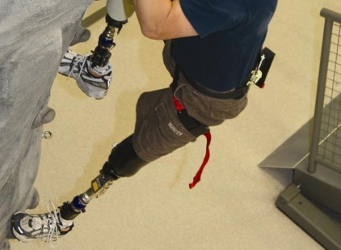




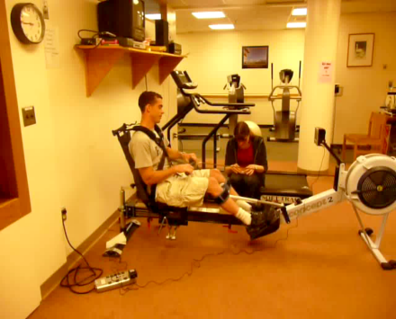

Advocacy Driving Goals Beyond Compliance
Adaptive Sports and Recreation
Vocational Rehabilitation Community Engagement
Inclusive Design
Therapy Wellness
PsychologyMental Health
Assistive Technology
Advocacy
Empowerment
Accessibility

Slide 20
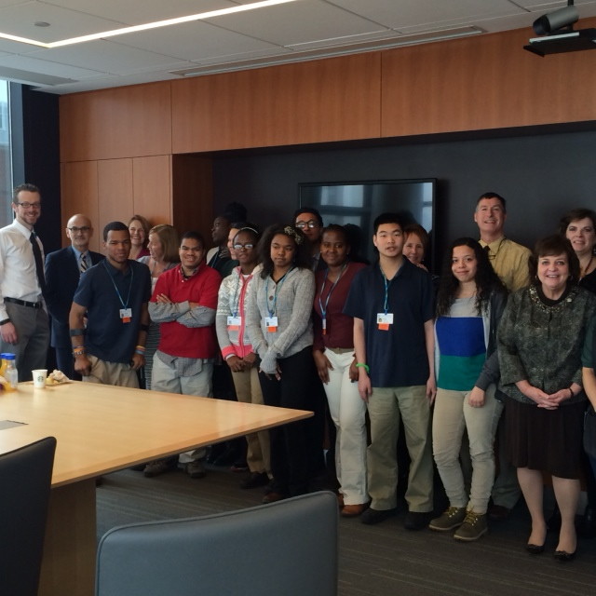

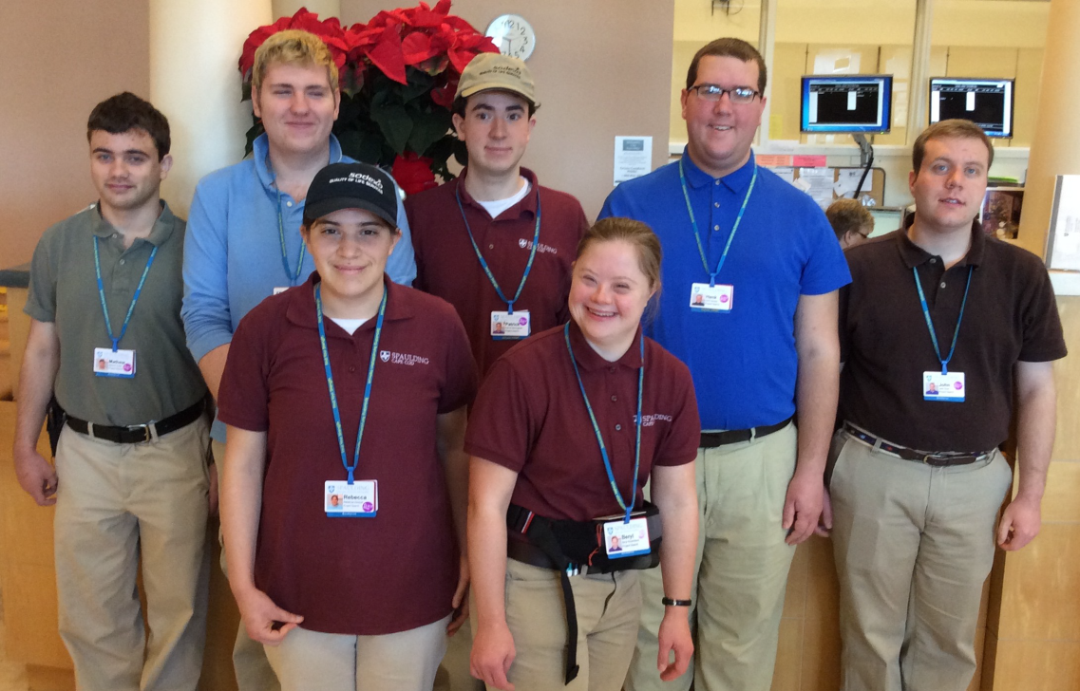

Youth Transition
Project SEARCH provides real-life work experience to help youth with significant disabilities make successful transitions from school to adult life
Partners for Youth with Disabilities provides mentors for youth ranging from ages 6-18
Partnerships with Mass Commission for the Blind, Perkins School for the Blind and Community Work Services

Slide 21
Working Partners
WORKING
PARTNERS
State of Mass
EOHHS
MRC
Coordinating Body
Leads
Task Force
Partners Continuing Care
Spaulding
Consumers VR Svs
OJT/OJE
Job Ready
VR Staff
Counselor
Job Placement
ESS
HR & Community
Relations Staff
Rehab Staff/Nursing
OT/PT/Speech
Case Managers
Support Service

Slide 22

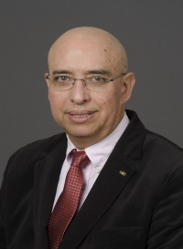
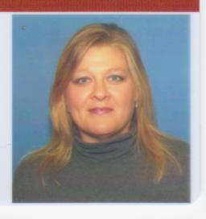

Add Us In Grantee
    Fabricio Balcazar, Ph.D., Director, Center for Capacity Building on Minorities with Disabilities Department of Disability & Human Development, University of Illinois at Chicago, The Chicagoland AUI Consortium
    Jill Burgess, Central Oklahoma Add Us In Project Director University of Oklahoma National Center for Disability Education and Training
    Dennis Gober, Division Administrator, Community Based Youth Services, Office Juvenile Affairs

Slide 23
ChicagoLand Consortium: Best practices &
Systems changes
Fabricio E Balcazar, Ph.D.
University of Illinois at Chicago

Slide 24
Introduction
The Chicagoland Consortia has been running two primary programs:
Certification-internship-employment program through the Youth connection Charter school for dropouts (YCCS)
Entrepreneurship and business incubator program at the Illinois Center for Rehabilitation and Education - Roosevelt (ICRE-R), supported by IL Division of Rehabilitation Services
I will be discussing best practices & systems changes as they apply to transition programs for youth with disabilities from the Chicago Public Schools

Slide 25
1. Youth Connection Charter School
This is a Charter School for Dropouts in which I have been a board member for over 17 years.
The Charter serves up to 4,000 students with an annual budget of almost 40 million Dollars.
The Charter follows a small-school model with 22 locations across the inner city of Chicago
Most students are either African American or Latino
The Charter has over 700 students with IEPs and over 50 special education teachers.
The Charter received funding from VR to operate a transition program as a result of its engagement in the Add Us In partnership

Slide 26
YCCS Employment program Best Practices:
Streamlining the process of opening DRS cases (single point of entry)
YCCS staff provides case management through contract with UIC (as partner in Ad Us In project) and then with DRS
Clear pathway to employment:
    Identifying employers’ needs (skills and labor)
    Students’ training and certification courses (free benefit for students and employers).
    Eight-week paid internships (benefits for employers: free labor, on-the-job training and trial period).
    YCCS is in charge of the payments to students on the basis of supervisors’ weekly reports and timesheets.

Slide 27
CS Best Practices (continued)
Program costs are covered by DRS for both students (trainings) and employers (internships)
Partnering with large multi-site corporations (e.g., Heartland Food LLC (Burger King), McDonalds, TJMax/Marshals, etc.)
Clear program expectation set for employers and students:
  Employers are encouraged to treat interns like any other employee.
  Students are held accountable, real rewards and consequences.
  Employers sign MOU’s to set clear goals (expectation for hiring over 50% of the interns as permanent part-time or full time employees).

Slide 28
YCCS Best Practices (continued)
Case manager is in direct contact with students, family, and VR Counselors
It is important to discuss family members’ concerns regarding potential loss of welfare benefits as some families can prevent their youth from participating
Families are often referred to benefit counselors so they can explain the internship and employment process
VR counselors are asked not to close any case unless the YCSS case manager has had a chance to talk to the student in question and address the issues (this action often prevents the closure of the case)

Slide 29
2. Entrepreneurship and business incubator program
ICRE-R used to be a segregates school for high school youth with severe disabilities in the Chicago Area
The school changed its focus and started a business incubator for the youth and other VR clients from Chicago
VR invested over 1.5 million Dollars in the staffing, equipment and remodeling of the building and is now investing almost 1 million per year to operate the program (guided in part by WIOA new transition policy for VR)
The program started as a pilot project but it has now been formalized as a permanent program

Slide 30
Entrepreneurship program Best Practices:
Comprehensive Vocational Evaluations
  Evaluations are performed at intake and are ongoing
  Knowledge is Power: Identifying individuals’ abilities, attitudes, resources and barriers essential to success.
Moving Target: Employment or Entrepreneurship?
  External factors & internal factors may cause a young adult to vacillate between wanting to find a job or to pursue self-employment
  Participants receive vocational skills that prepare for employment and/or entrepreneurship

Slide 31
Entrepreneurship Best Practices: (continued)
Recruitment Activities
  Working with DRS administrators to change paperwork & policies regarding the entrepreneur application
  Creating flyers, brochures, and informational video to promote incubator program
Business Plan Support
  Business plan writing course
  1-on-1 TA consultation services
  Business plans approved by a review committee outside of ICRE-R
  Mentoring to aspiring entrepreneurs

Slide 32
Provide Resources & Capital Investment in Enterprise
  AUI offers start-up grants ($5,000) and VR funds ($10,000+) make entrepreneurship a viable option for those who were previously left out.
  The Business Incubator provides office space, utilities, clerical support and office equipment for up to 5 years at no cost
  Explore new co-operative business structures (group ownership models) in order to enhance participation of individuals with more severe disabilities

Slide 33
Lessons Learned:
The value of University, school and State partnership:
  Establish model demonstration projects at YCCS and ICRE-R
  Use data and research to sell program ideas to the state agency.
ICRE-R has been upgraded from pilot program to permanent program status in VR.
Employers are unlikely to hire a person with a disability by just listening or talking about it. They need to see that person working in their business to really understand. Therefore, internships are the best way to remove negative perceptions.
Vocational evaluations and training are critical to build a pathway to employment or self-employment

Slide 34
Lessons Learned: (continued)
Being mindful/supportive of youth’s interests is vital
  Staff must provide guidance to help youth set realistic, feasible and attainable goals
Establishing Trust
  Staff must be committed to earning the trust of youth
  Staff should encourage youth to get to know each other and trust each other
    Co-Operative Model offers potential for success but it should be studied in terms of its strengths and potential limitations

Slide 35
MUCHAS GRACIAS!

Slide 36


Central Oklahoma Add Us In
Presented By:
Dennis Gober
Office of Juvenile Affairs Division Director and
Jill Burgess
Add Us In Project Director

Slide 37


Central Oklahoma Add Us In
  Partnerships
    OJA/DRS/Career Tech
    DRS/Oklahoma Works
  Services for Jobseekers
    AUI Project Services
    Transition to WIOA coaches

Slide 38

Partnerships
Office of Juvenile Affairs and Department of Rehabilitative Services and Career Tech
Oklahoma Works and Department of Rehabilitative Services

Slide 39
Services for Jobseekers
  Receive assistance with soft skills
  Referrals to community resources
  Businesses come to Oklahoma Works to interview jobseekers
  Talent and Interest Assessments
  Resume writing
  Mock Interviews
  One on One help

Slide 40

Services for Jobseekers
Transitioning AUI jobseekers to WIOA coaches

Slide 41

Thank You

Slide 42
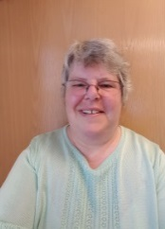
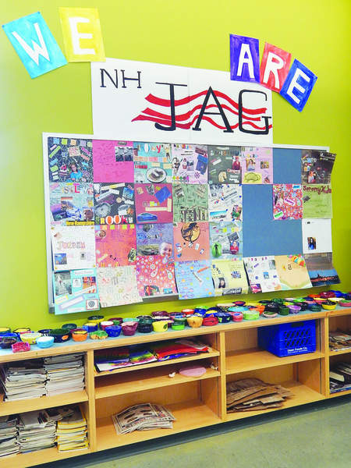

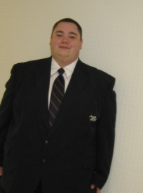
Agency Collaborative Partnership-Participant Success Story
    Kim Runion
New Hampshire Department of Education
    Katie Dichard
New Hampshire Jobs for America’s Graduates
    Eric Woodard
WIA Youth Program Participant

Slide 43
New Hampshire Office of Workforce Innovation and Opportunity Act
WIA Youth housed in the New Hampshire Department of Education
  Competitive subcontract
Building partnerships to best serve youth with disabilities
WIA Youth Model Delivery System
  In-school
  Out-of-school

Slide 44
NH-Jobs for America’s Graduates is a statewide independent non-profit assisting to keep “at-risk” youth in school, decrease dropout rates, improve attendance and academic standing, and prepare students for the real world.
Our goal is to help disadvantaged youth become financially independent, contributing citizens in their NH communities.
Key Components of the program:
Affiliate of a national network – Jobs for America’s Graduates (JAG)
Statewide program serving middle school, high school, and out-of-school youth ages 12-24.
Individualized services which target each student’s needs and goals
Provides a comfortable and welcoming environment for all students.
Focus on workplace skills, academic skills, teamwork, leadership, and community service
Strong connections to employers in the community
Strong connection to the NH Community College System

Slide 45
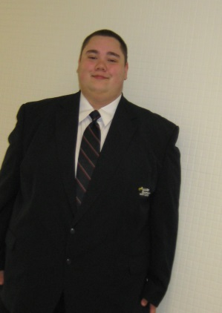
WIA Participant Success Story
Eric Woodard
WIA Youth Program Participant/NH-JAG Out-of-School Program
Manchester Community College
Eric Woodard, a WIA Out-of-School Youth program participant, joined the NH-JAG Out-of-School program at Manchester Community College (MCC) in April of 2009, after dropping out of school 2 years earlier during the 10th grade. In just over one year in our program, Eric earned his GED, completed an internship with the Manchester Police Department, successfully completed 2 college courses at MCC, and secured a job as a security guard. Eric has been employed fulltime since completing the NH-JAG program in 2010.

Slide 46


Slide 47
Resources
Training and Employment Guidance Letter (TEGL) 19-14: Vision for the Workforce System and Initial Implementation of the WIOA http://wdr.doleta.gov/directives/attach/TEGL/TEGL_19-14.pdf
Training and Employment Notice (TEN) 1-15: Promising Practices in Achieving Universal Access and Equal Opportunity: A Section 188 Disability Reference Guide http://www.dol.gov/oasam/programs/crc/TEN%201-15.pdf
Release and Availability of a Report: “Services to Youth with Disabilities Provided under Title I of WIA: Results from a Survey of LWIBs” Final Report: http://wdr.doleta.gov/research/FullText_Documents/ETAOP%202015-02.pdf
Add Us In Initiative: http://youth.gov/feature-article/add-us
Partners for Youth with Disabilities: www.pyd.org
Project Search: www.projectsearch.us

Slide 48
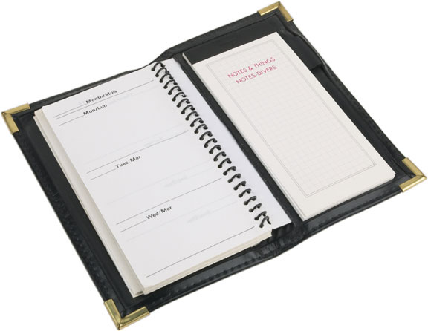
Upcoming Webinars
Last Wednesday of each month
Career Pathways
August 26th - 2:00pmET
Services to Rural Areas
September 30th - 2:00pmET
Temporary Assistance for Needy Families (TANF)
October 28th - 2:00pmET

Slide 49

Thank You!

