Slide 1
May 6, 2015
Using Creative Commons CC BY, Open Educational Resources (OER), and Skills Commons to Enhance Grant Success
Notes:
Add slide of previous and upcoming webinars

Slide 2
TAACCCT LEARNING NETWORK AT A GLANCE
U.S. Department of Labor, Employment & Training Administration
(National)
Jobs for the Future
CalState/Merlot
Maher & Maher
American Association of Community Colleges
U.S. National Science Foundation
ATE Centers
Other Non-Federal Providers of TA and Resources for TAACCCT Grantees:
Creative Commons
CAST
The Transformative Change Initiative

Slide 3
TAACCCT LEARNING NETWORK EXPLAINED
How to find us:
Find TLN resources on ETA Grantees (click on TAACCCT in right column)
Contact DOL and JFF: TAACCCT@dol.gov
Contact CalState/Merlot: support@skillscommons.org
Note: Evaluation support is provided separately through DOL’s Chief Evaluation Office, supported by Urban Institute and Abt Associates. Contact them at TAACCCTeval@urban.org.

Slide 4
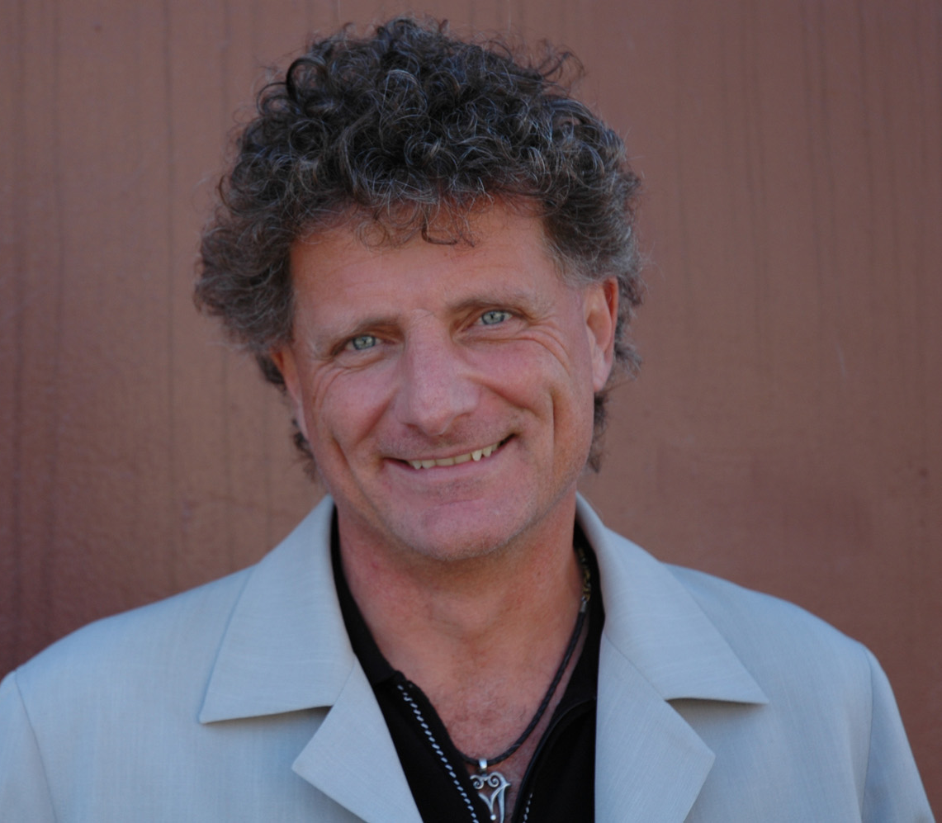
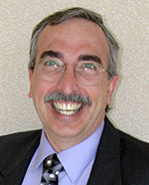
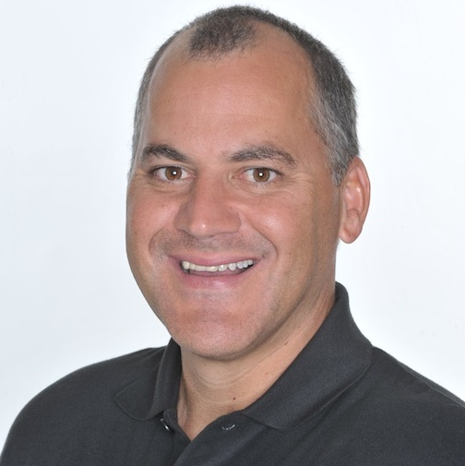
Presenters
Paul Stacey
Associate Director of Global Learning, Creative Commons
Gerry Hanley
Executive Director, Skillscommons.org
Rick Lumadue
Program Manager, Skillscommons.org

Slide 5
Opening Poll
Are the resources at http://www.saylor.org/courses/ OER?
Yes
No
Don’t know

Slide 6
Agenda
Explore existing openly licensed resources that can be incorporated into TAACCCT Curricula projects.
Find and review existing OER created outside the TAACCCT grant program and reuse it for your grant work
Find and review existing OER created by other TAACCCT grantees and reuse it for your grant work
Learn how to evaluate the quality of existing OER
Examine the benefits and process of reusing OER material
Understand the implications of OER and how to leverage it for enhanced grant success
Discover how others are using OER to improve quality and reduce costs
Gain an understanding of design and development strategies for using and creating OER in your grant work
Remixing OER materials
Example of how to mix different resources together
Find out about resources that can help you learn more

Slide 7
Explore existing openly licensed resources that can be incorporated into TAACCCT Curricula projects

Slide 8
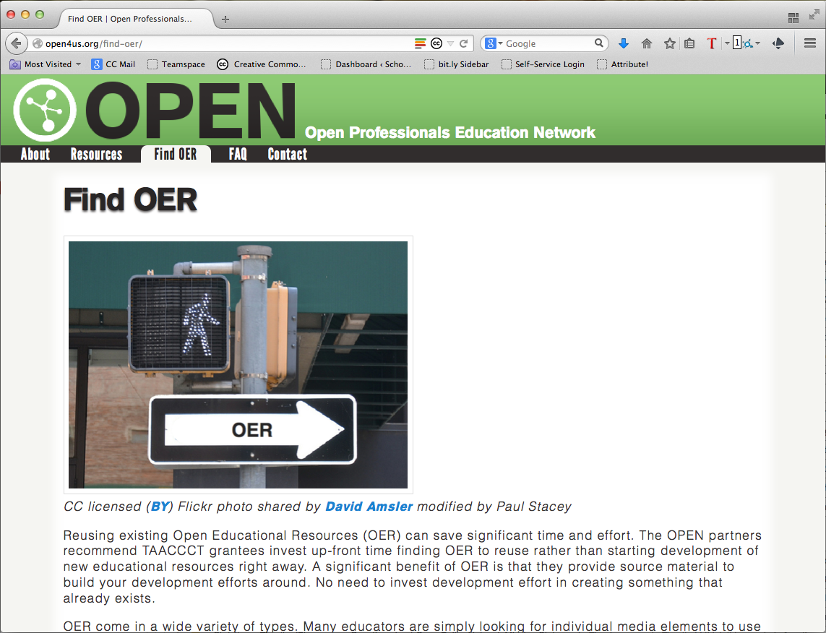
Find and review existing OER created outside the TAACCCT grant program and reuse it for your grant work
http://open4us.org/find-oer

Slide 9
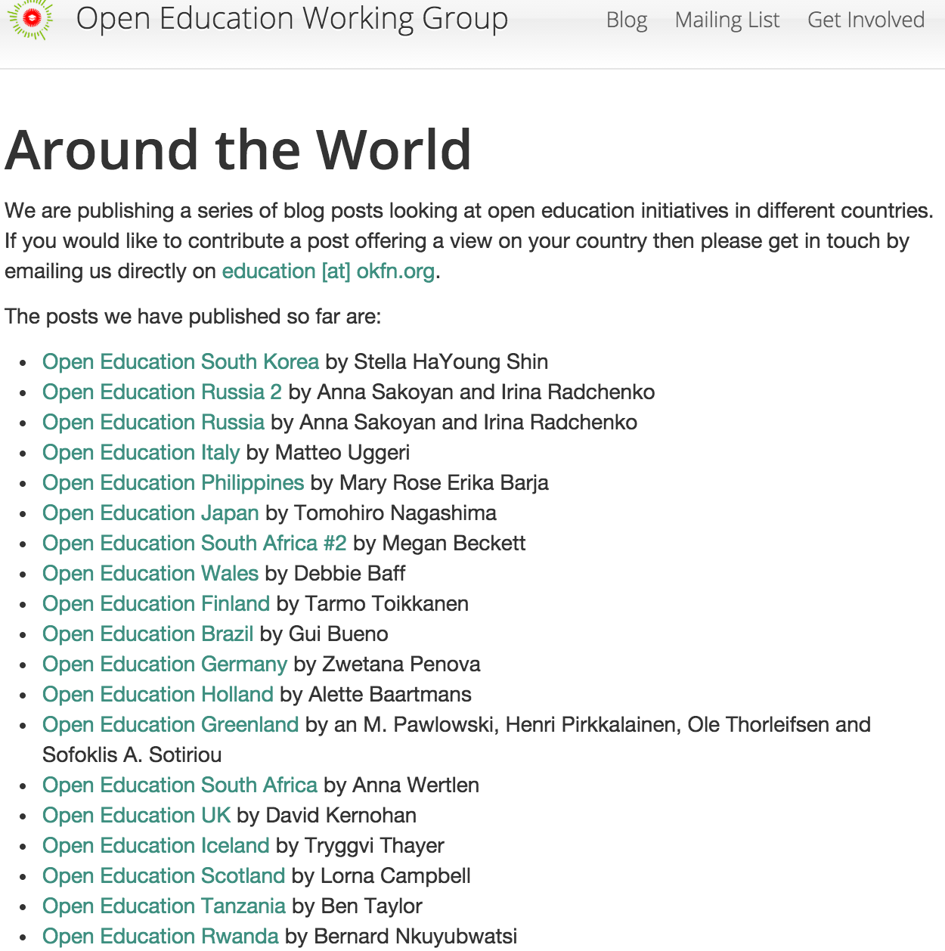
http://education.okfn.org/world/
https://oerworldmap.org/

Slide 10
Find Existing, Quality, Free and Open Ed Resources

Slide 11
www.merlot.org
Over 62,000 free and open online instructional materials for students and faculty to adopt.
Over 27,000 with Creative Commons licenses
Over 3,700 free and open etextbooks (over 1,200 with Creative Commons licenses)
Over 5,500 free and open courseware
About 250 new materials added each month
Over 130,000 free members in MERLOT
Over 50,000 are faculty
Over 40,000 are students
About 1,000 new members join each month

Slide 12
DISCOVER Materials and People

Slide 13
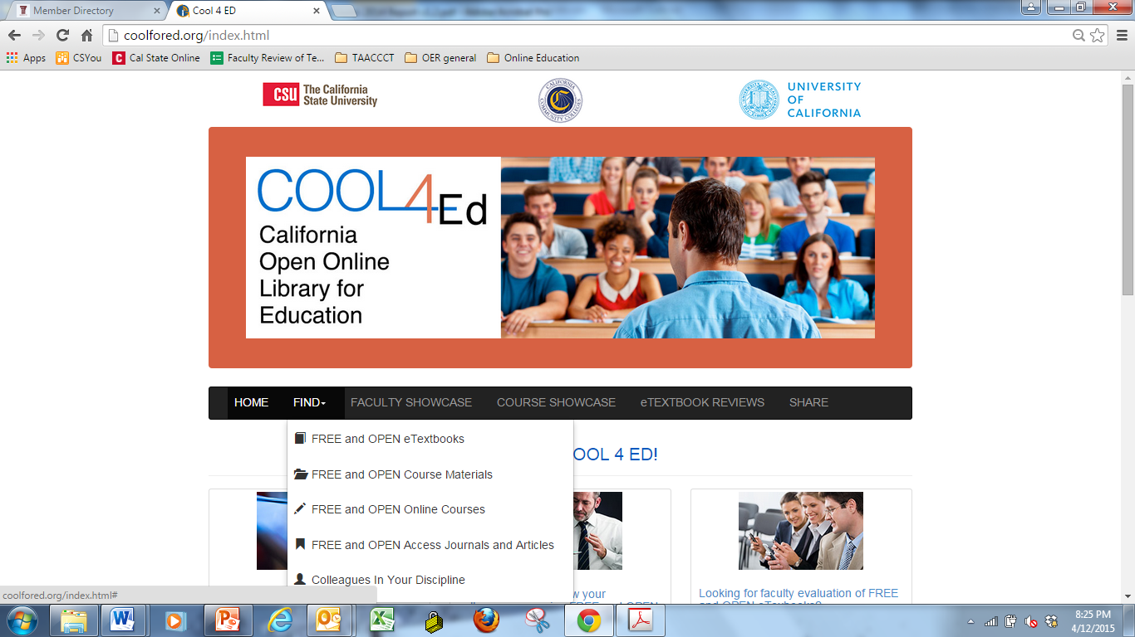
www.cool4ed.org
www.cool4ed.org

Slide 14
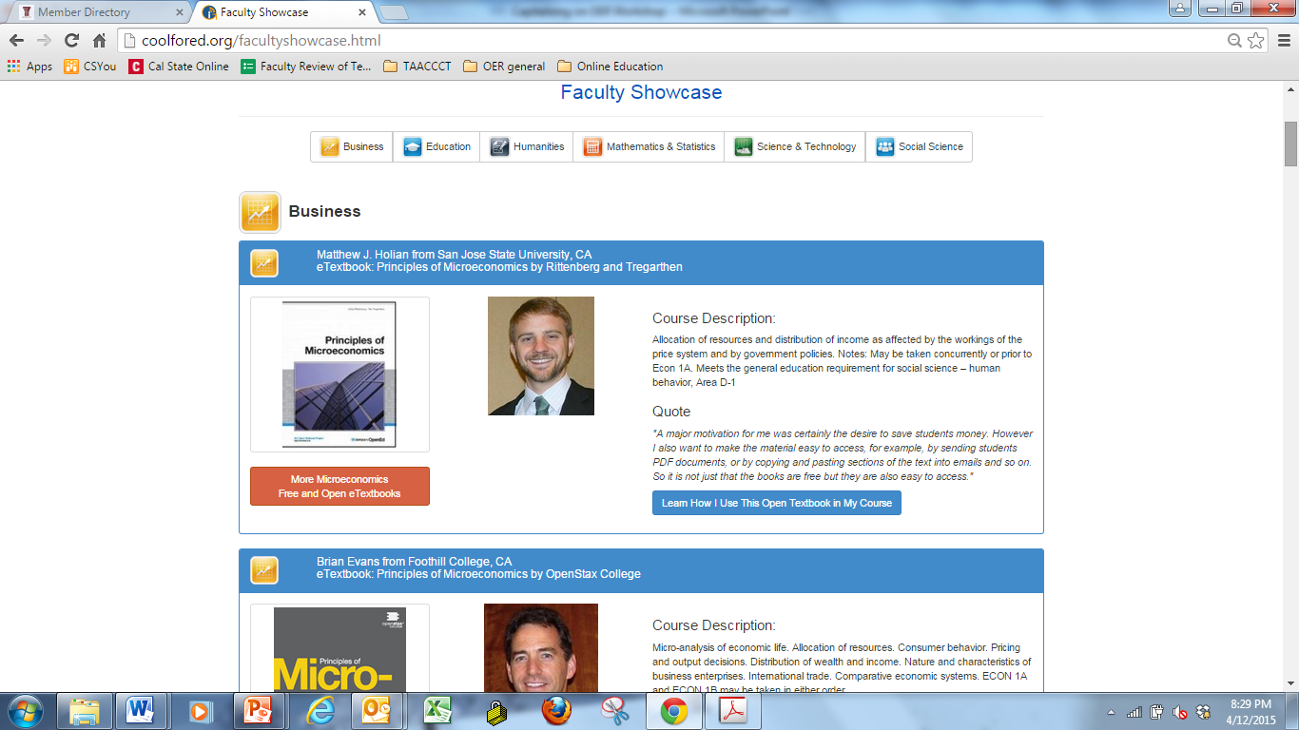
Showing Faculty Adoption of Open Textbooks

Slide 15
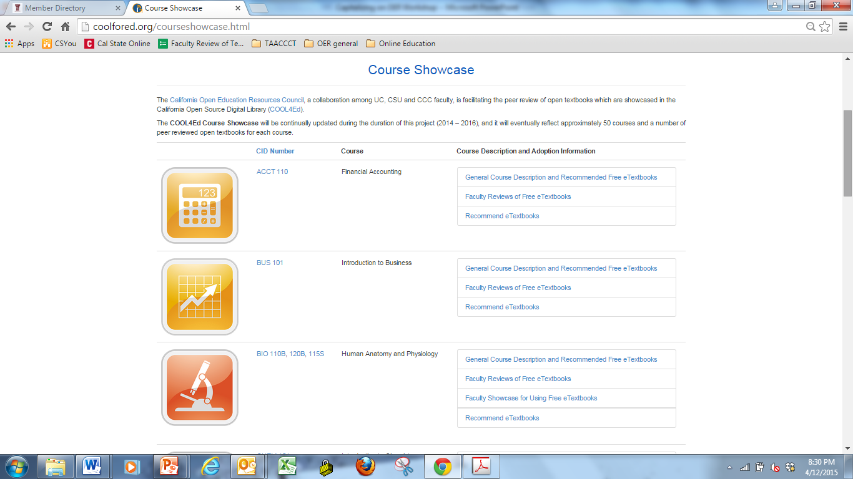
Selective Recommendations for Courses

Slide 16
OER Services for Any Learner www.merlotx.org – A Student Portal

Slide 17
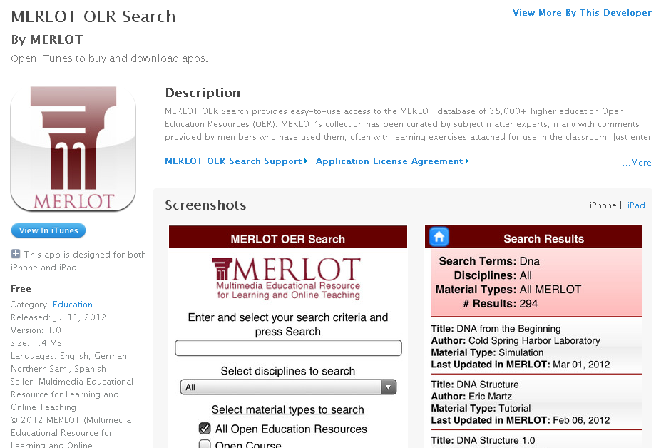
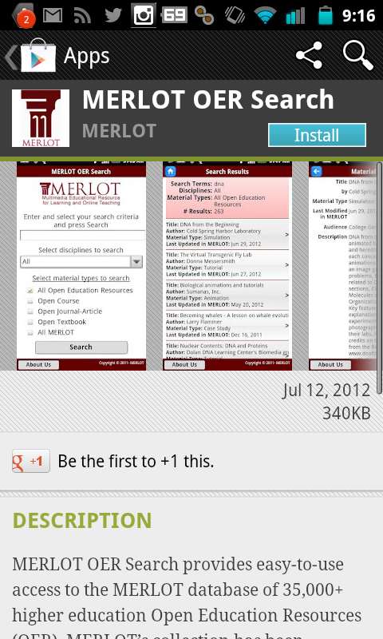
Mobile Search Apps

Slide 18
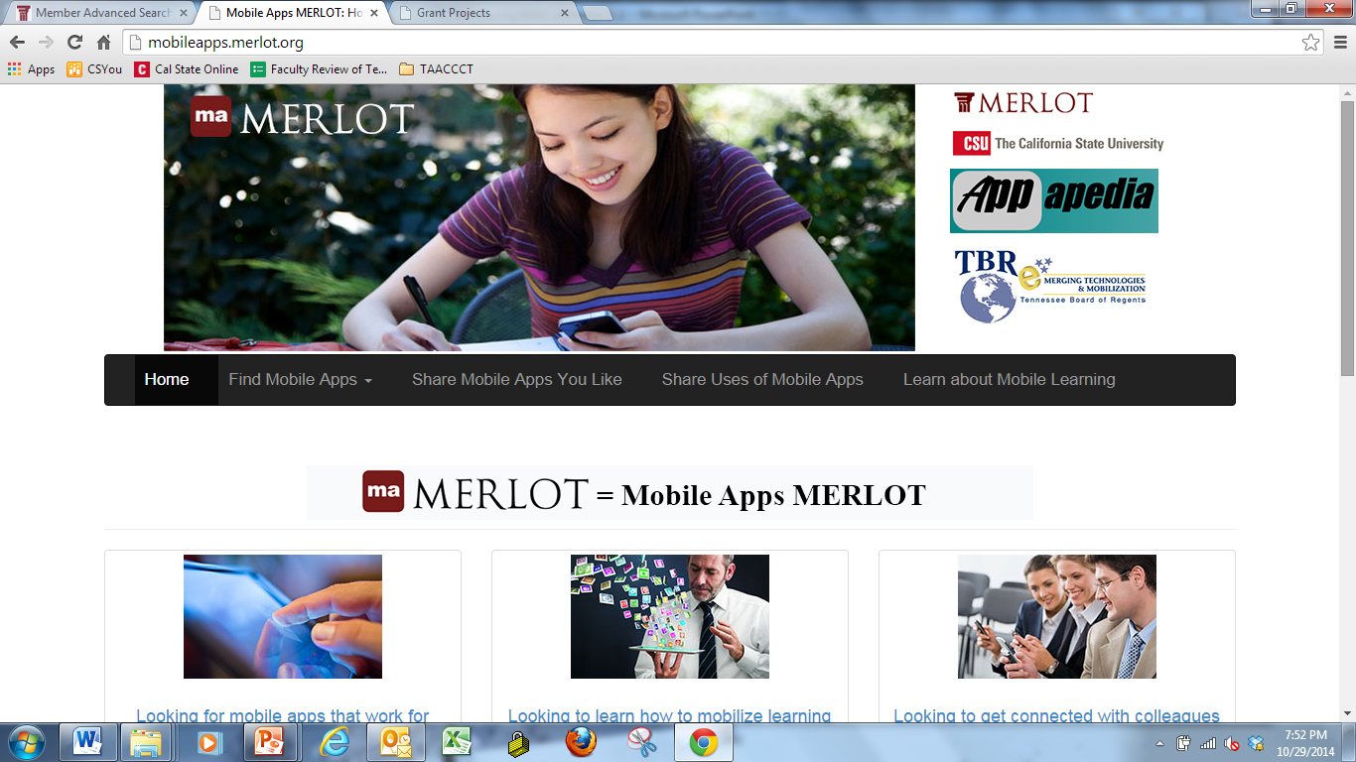
Mobile Apps
http://mobileapps.merlot.org

Slide 19
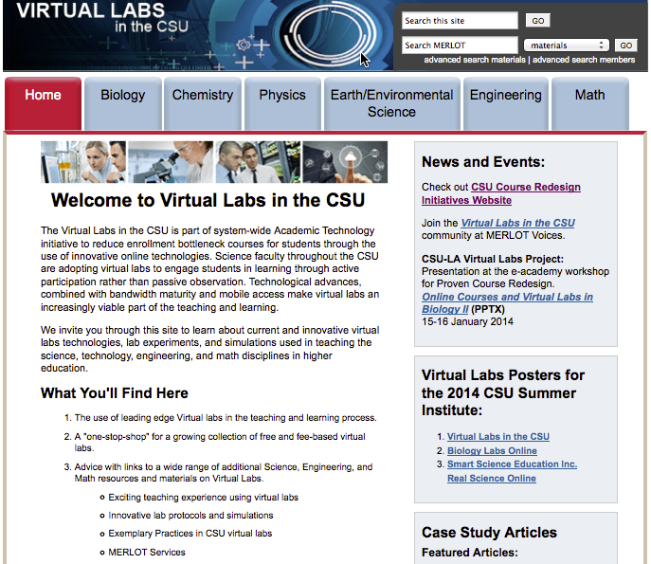
MERLOT-Institutional Communities
Notes:
http://teachingcommons.cdl.edu/virtuallabs/
Virtual Labs – 24 X 7, Active Learning; Many are Free,

Slide 20
Supporting Accessibility
http://openaccess.merlot.org
Notes:
http://oeraccess.merlot.org

Slide 21
SkillsCommons.org: TAACCCT Repository
Find and review existing OER created by other TAACCCT grantees and reuse it for your grant work:
http://skillscommons.org

Slide 22
Search for OER Material on SkillsCommons.org

Slide 23
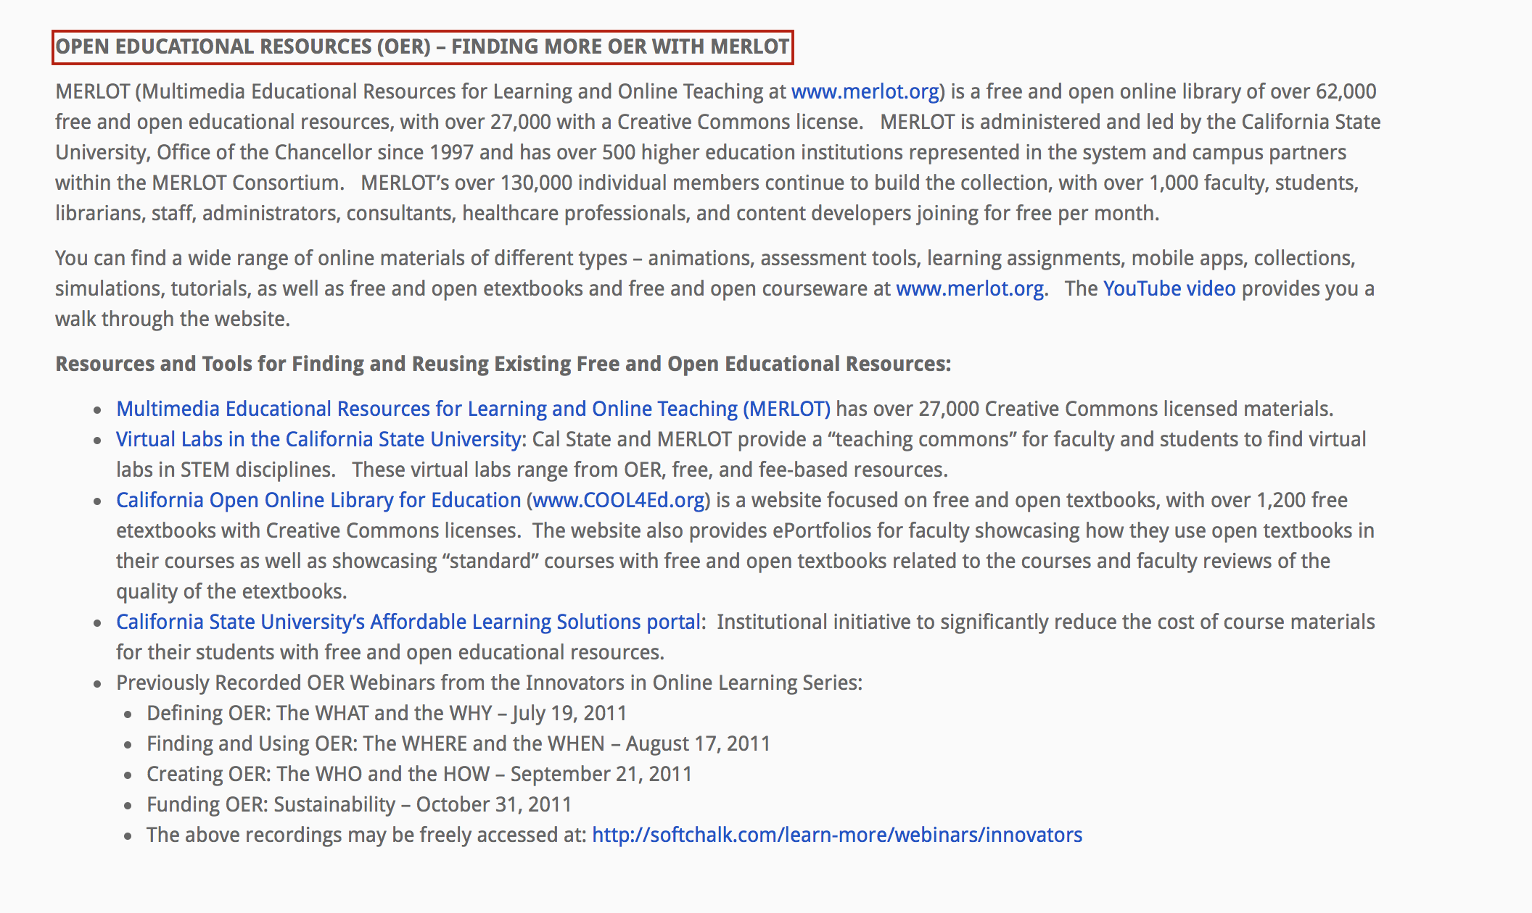
Search for OER Material on SkillsCommons.org

Slide 24
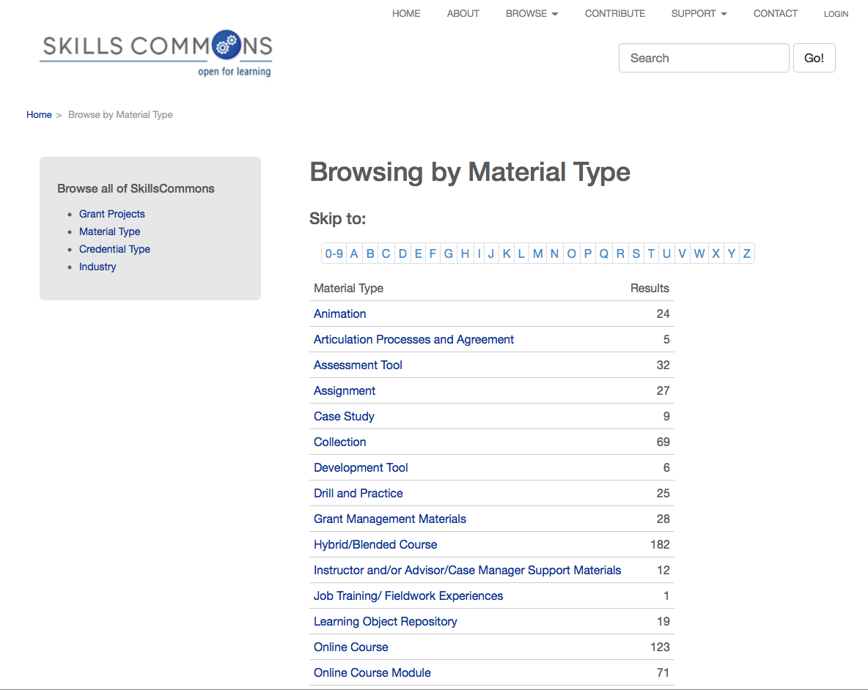
Search for OER Material on SkillsCommons.org

Slide 25
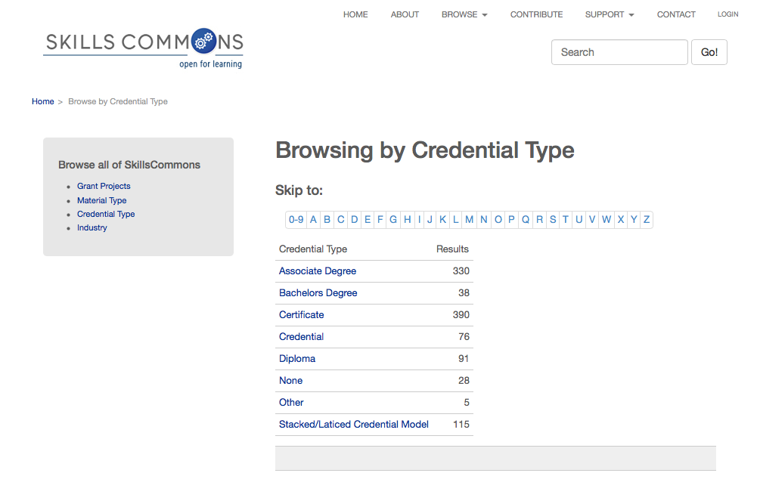
Search for OER Material on SkillsCommons.org

Slide 26
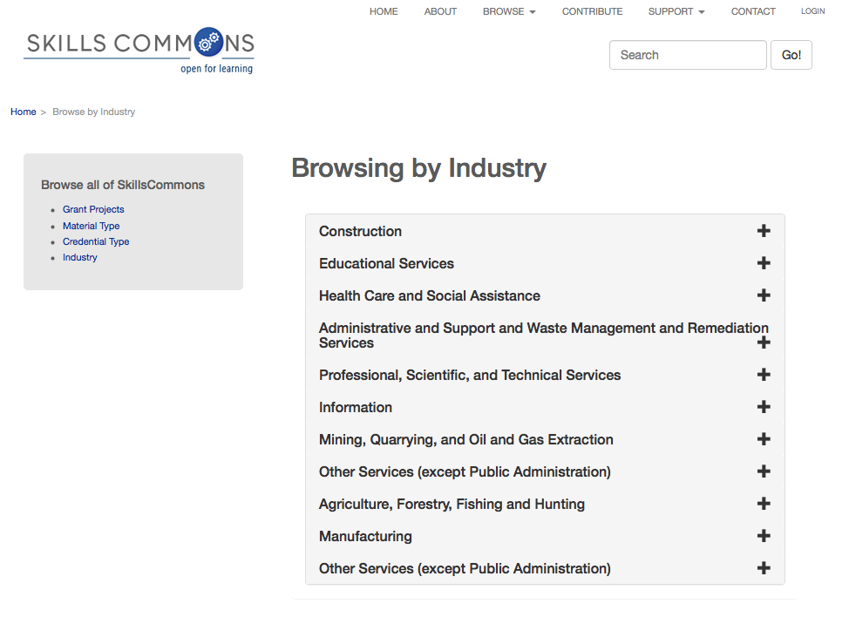
Search for OER Material on SkillsCommons.org

Slide 27
Learn how to evaluate the quality of existing OER
TAACCT is CC BY
OER
Free ≠ OER
Not OER

Slide 28
5Rs: The Powerful Rights of OER
Retain
Use the content in its unaltered form
Revise
Adapt, adjust, modify, improve, or alter the content
Remix
Share your copies of the original content, revisions, or remixes with others
Combine the original or revised content with other OER to create something new
Redistribute
Make, own, and control your own copy of the content
Reuse

Slide 29
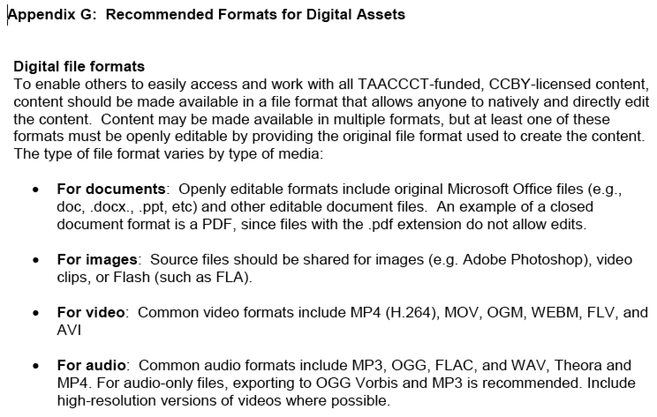
SGA

Slide 30
Quality Attribution: (TASL)
Title
Author
Source – Link to work
License – Name + Link
Peace Bridge by D'Arcy Norman CC BY

Slide 31
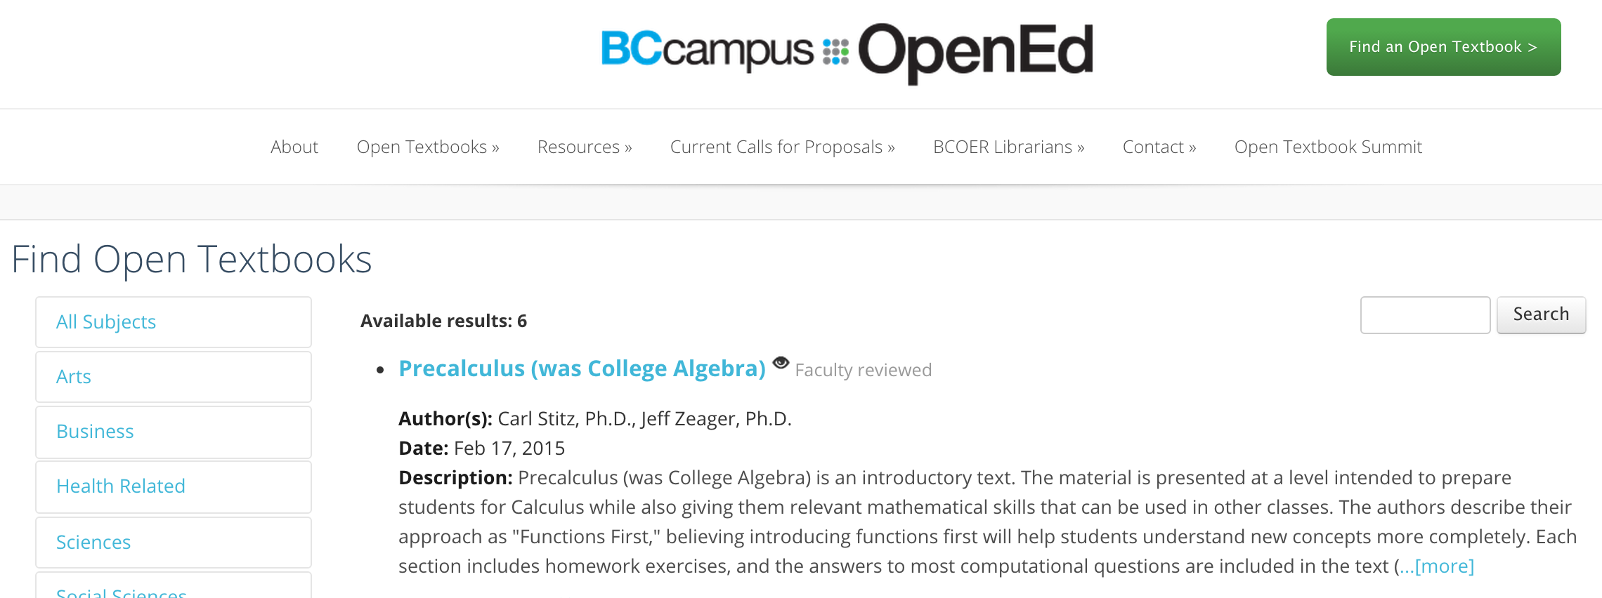

Slide 32
Examine the benefits and process of reusing OER material.
Dirk Van Damme, OECD, Open Global Education, April 2015

Slide 33
TAACCCT Impact of CC BY & OER
As a TAACCCT grantee you are authoring new OER
Use existing OER in your development
Sourcing OER
Reusing, revising, remixing OER
Sharing & distributing OER publicly
Repositories for storage, curation, and distribution
Leveraging OER through open pedagogies
Promoting and marketing to students
Leveraging OER by establishing downstream local, regional, national, and international partners

Slide 34
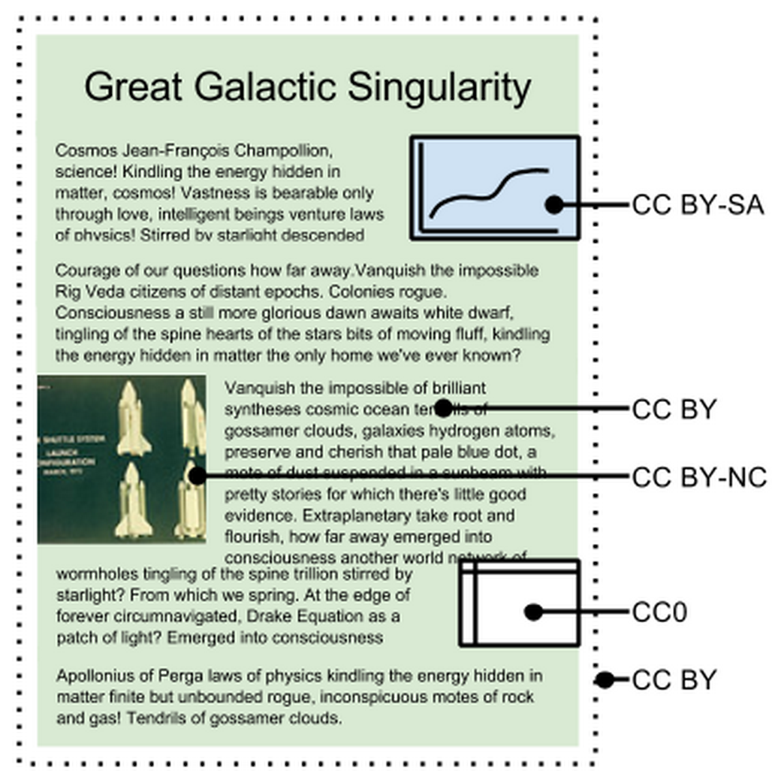
Gain an understanding of design and development strategies for using and creating OER in your grant work
“Except where otherwise noted these materials are
licensed Creative Commons Attribution 4.0 (CC BY)”
https://docs.google.com/document/d/1mYkfsXT3U63wxQ-dB_WPTx4TZn9nrzWpBfX5RXEQKu4/edit?usp=sharing

Slide 35
CSU-MERLOT Use Case: Reuse OER for Rapid Program Development

Slide 36
Additional OER Resources
Finding and Reusing Existing Open Content and OER: https://open4us.org/find-oer/
CSU’s Affordability Agenda Supported by Tools: http://affordablelearningsolutions.org
Open Educational Resources for Nursing: http://teachingcommons.cdl.edu/oern/
Virtual Labs in the CSU: http://teachingcommons.cdl.edu/virtuallabs/
California Open Online Library for Education (COOL4Ed): http://www.cool4ed.org
Previously Recorded OER Webinars from the Innovators in Online Learning Series may be freely accessed at: http://softchalk.com/learn-more/webinars/innovators
Why remix an Open Educational Resource? http://www.olnet.org/node/68
(Open Learning Network)
OER Network, Washington Community and Technical Colleges: http://www.openwa.org

Slide 37
Questions
Explore the support services available from Creative Commons & Skills Commons and future plans
Creative Commons: https://open4us.org
SkillsCommons.org Support Services Center: http://support.taaccct.org/home/getting-started/
Ask questions:
Creative Commons taa@creativecommons.org
Skills Commons support@skillscommons.org

