Slide 1
November 4, 2015
ROUND 2 VIRTUAL CONFERENCE
JOB PLACEMENT: HITTING YOUR NUMBERS

Slide 2
SHOWCASE YOUR INNOVATION: SHARE YOUR STORY!
Send a brief write-up to the TAACCCT mailbox (TAACCCT@dol.gov) responding to the following questions:
In which TAACCCT strategy area(s) have you experienced the greatest success?
Please describe the new policies, practices, or programs that have had the greatest impact on student credential and job attainment.
Of your successful programs, strategies, policies, practices, and partnerships, what will be sustained and/or institutionalized and scaled to reach more students?
Are there other impacts you’d like to share? Any ripple effects/surprising outcomes as a result of your work?
Your impact and legacy to TAACCCT is important. We encourage you to email TAACCCT@dol.gov with prepared documents, videos or other materials that illustrate your TAACCCT story!

Slide 3
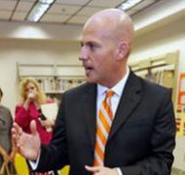
Presenters
Christian Lagarde
Project Manager, Workforce and Economic Development American Association of Community Colleges
Mark Stewart
Consortium Director SC ACCELERATE
Stephanie Oppel
Statewide Project Director Iowa Advanced Manufacturing (I-AM) Consortium

Slide 4
Participant Poll
What do you need most help with in job placement?
Leveraging career center/one-stop job placement resources.
Providing job search assistance.
Strengthening WIB connections.
Additional employer outreach strategies.
Other? (specify in main chat)

Slide 5
AGENDA
Welcome & Introductions
Job Placement Strategies – What You Can Do Now
South Carolina’s SC ACCELERATE
Iowa Advanced Manufacturing (I-AM)
Discussion
Q&A

Slide 6
united...to help prepare our adult learners for employment and career success.

Slide 7
SC ACCELERATE: Education to Career Success
What’s Being Developed Across SC
(Grant Strategies)
Adult Postsecondary Transition Centers (APTCs)
Comprehensive outreach, recruitment, and marketing plan to attract and inform adult learners
Prior Learning Assessment (PLA) Process to award non-traditional credits to accelerate time to completion—via Consortium/CAEL Task Force, Leadership Groups, CAO Project Charter and development of online intake tool
New and redesigned curricula formats that accelerate learning—26 courses
Entrepreneurship Training—via APTCs & Clemson University

Slide 8
SC ACCELERATE: Education to Career Success
Job Placement Strategies
(the Who)
Educate / Inform / Collaborate / Partner / Follow-up . . .
At Member Colleges—On Campus
Career Services
Academic Advisors & Experiential Learning
Programs of Study Deans/Department Chairs
College—Community Advisory Boards
In the Community – Off Campus
Businesses / Employers / Chambers of Commerce
SC Department of Employment and Workforce (DEW)
SC Works Career Centers—incl. Disabled Veteran Outreach Program
Common & Unique (Goodwill, Voc. Rehab, DSS Job Developers, Women in Tech)

Slide 9
SC ACCELERATE: Education to Career Success
Job Placement Strategies
(the What)
Think ‘in the box’ . . . using resources already available
Use College & State Job Central databases (incl. jobs w/24 hr. hold for Vets)
Research / offer cooperative learning opportunities and apprenticeships
Involve business partners in résumé assistance efforts & mock interviews
Leverage job resources available via previously established relationships
Organize on-campus business sponsored career fairs and job recruiting events

Slide 10
SC ACCELERATE: Education to Career Success
Job Placement Strategies
(the What)
. . . And consider innovative, possibly even sustainable, resources ‘outside the box’
Inform participants about job leads & local job fair info—send weekly
Follow-up (post-employment)—offer help with overcoming ‘new’ problems
Connect students with 4-year institution resources in related areas of interest
Offer / sponsor Entrepreneurship workshops & one-on-one info sessions
Use applicable assessment tools to match students with ‘best fit’ career(s)

Slide 12
I-AM
Through I-AM, we have been provided the tremendous opportunity and resources to convene all 15 Iowa Community College districts with the purpose of meeting industry demand and arming Iowans with the skills they need to successfully engage in Iowa’s workforce.
Collectively, we have committed to:
Building stacked and latticed curriculum and career pathways in signature programs, including welding
Building a steady pipeline of skilled workers for Iowa’s in-demand advanced manufacturing occupations
Improve the collaboration and alignment between community college programs, the workforce system and targeted industry employers to keep and create high quality jobs in Iowa
Why do we do what we do? Because it’s required of us? Because we’re crazy?
Because we believe it will make a difference for our students and our communities!

Slide 13
Different Models, Same Result: Success in Placement!
Opportunity Dubuque 5 Step
Orientation
Pre-Enrollment
Interviews
Education
Employment
“Storm Lake” Model
Bridge Program
Education
Employment Interviews

Slide 14
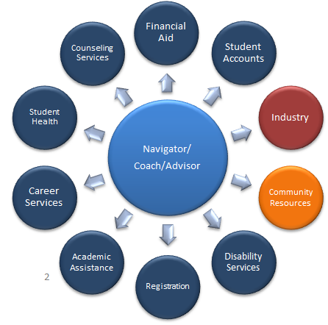
Effective Models share Common Elements:
Know the Region
Create Employer Value
Design to Align
Know your Population
Support Student Success
Organize for Employment

Slide 15
Q&A

Slide 16
Contact us…
Christian Lagarde
clagarde@aacc.nche.edu
Mark Stewart
mark.stewart@gvltec.edu
Stephanie Oppel
sfoppel@dmacc.edu

Slide 17
Thank You!
Find resources for TAACCCT success at:
https://etagrantees.workforce3one.org
Subscribe to TLN resources, ask questions or connect with peers at TAACCCT@dol.gov

