Slide 1
H-1B Ready to Work
H-1B Quarterly Performance Reporting &
HUB Aggregation Rules Webinar
Webinar Date: Nov. 5, 2015; 12:30 p.m.
Presented by: Division of Strategic Investments
U.S. Department of Labor
Employment and Training Administration

Slide 2
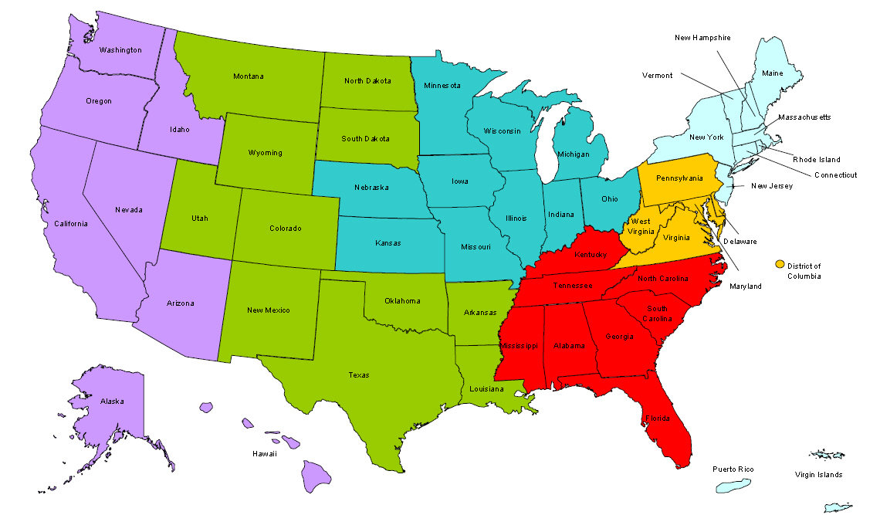
Where are you?
Enter your location in the Chat window – lower left of screen

Slide 3
Polling questions for webinar lobby
Polling Question #1
Let’s get to know who is on your H-1B RTW Performance Reporting TA Team! Using the poll, select the role that you play in your H-1B grant program.
For this grant initiative I am the:
  Authorized Representative:
  Program Director/Manager
  IT Developer
  Database Manager
  Case Manager
  Training Partner
  Employer Partner
  None of the above

Slide 4

Welcome & Agenda
H-1B RTW Performance Reporting
Technical Assistance
HUB Aggregation Rules
H-1B Grants Program Manager
Megan Baird
Performance Reporting TA
Ayreen Cadwallader
Kevin Mauro

Slide 5
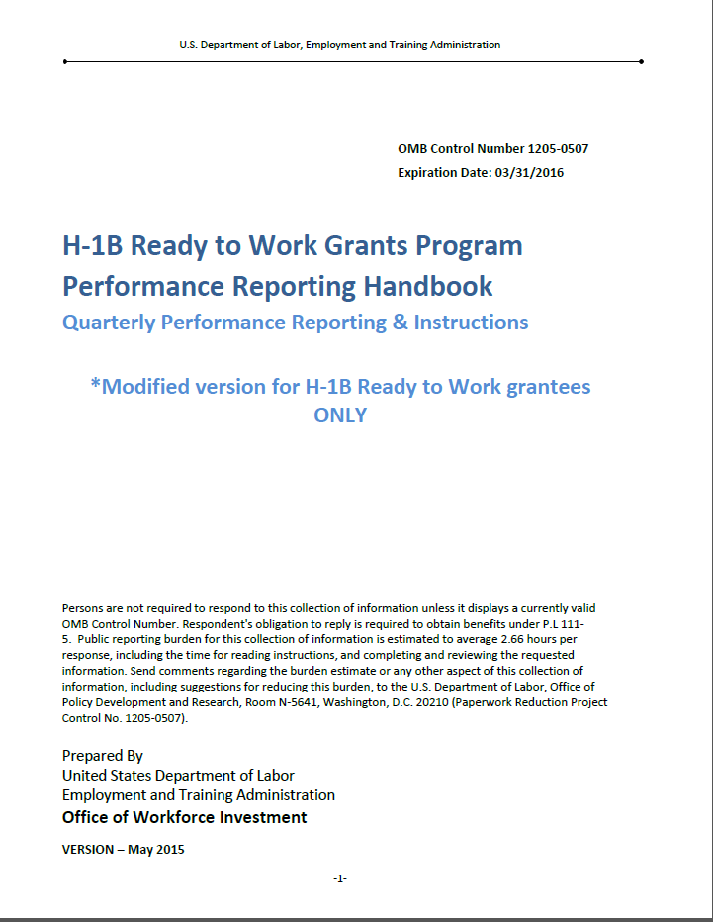
Related Resources
Related Resources:
H-1B RTW Data Elements and Edit Checks (Revised Nov. 2015)
H-1B RTW HUB Aggregation Rules (Nov. 2015)
Section III: Instructions for Completing H-1B Quarterly Performance Reports (QPR) and How ETA Form No. 9166 QPR is Generated (Page 31)
H-1B RTW Performance Reporting Resources
https://etagrantees.workforce3one.org/page/resources/1001517051726450910

Slide 6
H-1B Ready To Work FAQ #1!
H-1B RTW FAQ #1: Key Policy Clarifications (August 2015)
  Provides clarification on:
    LTU definition (based on grantee questions)
    Individuals served with leveraged resources
    Selective Service requirements
    Selective Service status Data Element in HUB
Available Now on the RTW Community of Practice! https://etagrantees.workforce3one.org/view/2001521664781678051/info

Slide 7
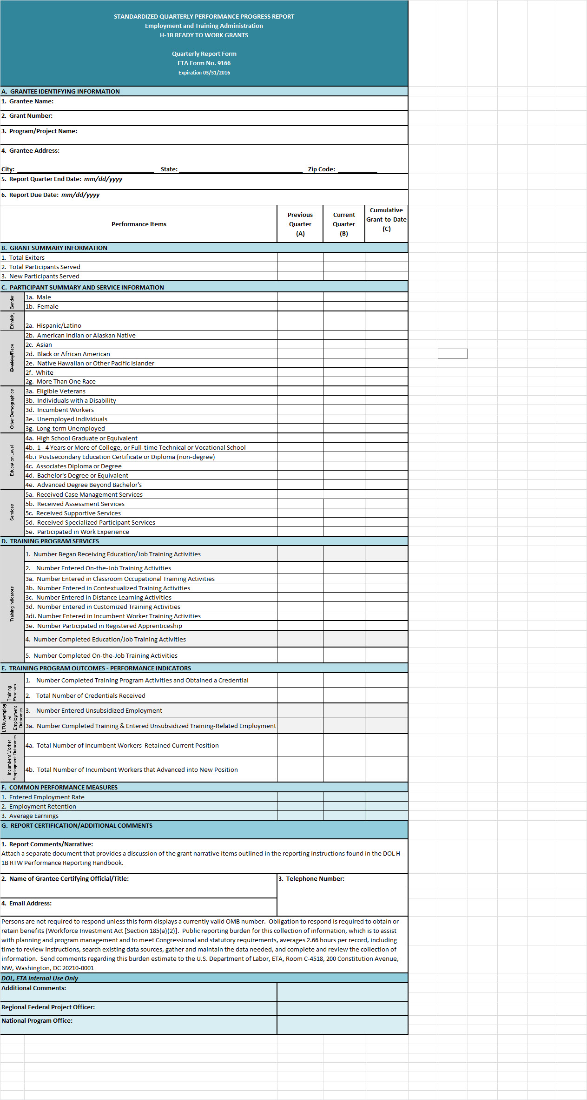
The Quarterly Performance Report (QPR) ETA Form No. 9166
  What is a Quarterly Performance Report (QPR) ETA Form No. 9166?
Indicator of grant program activities: participant training program completion and entered employment outcomes
The basis for ETA reports to Congress, the Secretary of Labor, and various other stakeholders.
HUB-generated QPR form is based on data files of participant records uploaded in HUB.
The RTW QPR ETA Form No. 9166 is generated by HUB!

Slide 8
H-1B RTW HUB
Aggregation Rules
Understanding how the HUB System is populating your QPR ETA Form 9166

Slide 9
Polling questions for webinar lobby
Polling Question #2
Where are you in your process of submitting your Quarterly Performance Reports?!
  We are working on our internal participant database to align with the H-1B RTW Data Elements and Edit Checks. We hope to have a working data file soon!
  We have uploaded our data file in HUB and are resolving our data file errors.
  A QPR has been generated from our data file and I’m not quite sure what it means!
  All of the above

Slide 10
Preparing Data Files Recap
Data files are a comprehensive record of all participants served to date
Preparing Data Files, Uploading Data Files in HUB and Resolving Data File Errors
Reviewing Quarterly Progress Reports to Align with Internal Data
TIPS:
Protect PII! Protect PII! PROTECT PII
Update your master database; NOT your data file
Establish system to track multiple copies of data files uploaded in HUB
Add new participant records as they are enrolled in your program
Update participant records as they move along your program design

Slide 11
RTW HUB Aggregation Rules
How does HUB calculate your QPR Form?
  Your comprehensive data file
    Unique Participant Identifier: SSNs, DOB and Date of Program Participation
  H-1B RTW Aggregation Rules
    Code values entered for each data element
    Key dates entered for each participant activity
  Calculations for Previous, Current, Cumulative Grant-to-Date data

Slide 12
RTW QPR FAQ
How do I generate the QPR form?
Resolve all Format Check and Edit Check Error Reports in your data file FIRST.
My QPR form is generated, what do I do next?
Review your QPR ETA Form No. 9166 and compare them to your internal database to check if the outcomes reported in the QPR reflects your participant records.
How do I understand the outcomes reported in my QPR form?
The QPR ETA Form No. 9166 is calculated using specific aggregation rules.
Review the RTW Performance Reporting Handbook, Section III Instructions for Completing the H-1B QPR and How ETA Form No. 9166 is Generated (pg. 31)

Slide 13
H-1B Ready to Work QPR Form 9166
Section B. Grant Summary
Previous Quarter
  Participant information from previous quarter
Current Quarter
  Participant information for the current reporting quarter
Cumulative Grant-To-Date
  Cumulative total of performance outcomes to-date through the current reporting quarter

Slide 14
H-1B Ready to Work QPR Form 9166
Section A Grantee Information and Section B. Grant Summary
QPR Line | Performance Measure | Related Data Element (DE) and Code Value
1 | Total Exiters | DE 302 Date of Exit YYYYMMDD
2 | Total Participants Served | DE 301 Date of Program Participation
3 | New Participants Served | DE 301 Date of Program Participation

Slide 15
H-1B Ready to Work QPR Form 9166
Section B.1 Total Exiters
 | Performance Items | Previous Quarter (3/31/15) | Current Quarter (6/30/15) | Cumulative Grant-to-Date (6/30/15)
1. | Total Exiters | DE 302: Date of Exit is in the quarter before the previous quarter (12/31/15) | DE 302: Date of Exit is in the previous Quarter (3/31/15) | DE 302: Date of Exit is before the end of the Previous Quarter (3/31/15)
Definition
No longer receiving grant funded services for 90 consecutive days, has no gap in service, and not scheduled for future services; Date of Exit is retroactively applied from the last date of service.
General Tips
Date of exit is reported retroactively.
Date of Exit vs. Exit Date

Slide 16
H-1B Ready to Work QPR Form 9166
Section B1. Total Exiters
“Date of Exit” vs. “Exit Date”
Date of Exit – This is the last date a participant received grant-funded services and “date of exit” is retroactively reported
  Example: A participant receives his/her last grant funded service on March 1, 2015
  After 90 days, “Date of Exit” = March 1, 2015
  If “Date of Exit” is March 1, 2015, then Date of Exit is not reported until the quarter ending September 30, 2015
Exit Date – This is the date that a participant is reported as an exiter, i.e. the 91st day after their “date of exit”
  HUB will report participants that exit in the correct reporting quarter, by capturing those participants that have a “date of exit” that falls within he previous reporting quarter.

Slide 17
Reporting Date of Exit
H-1B Ready to Work QPR Form 9166
Section B1. Total Exiters
Date of First Service or Training Program Activity
Date of Last Service
90th Day of Inactivity
Date of Program Participation/Date of First Service
Date of Exit
Exit
Reported

Slide 18
H-1B Ready to Work QPR Form 9166
Section B. Grant Summary
Total Participants Served
Definition:
Any individual determined eligible to participate and receives a grant-funded service.
Current Quarter – All participants served in the current quarter, including those served in previous quarters.
Cumulative GTD – All participants with a participation that is before the end of the current quarter.
New Participants Served
Definition:
Total number of participants that began their first grant-funded service during the reporting quarter.
Current Quarter – All new participants served in the reporting quarter
Cumulative GTD – All participants with a participation date that is before the end of the current quarter.
Aggregation Rule:
Count of all participant records with a date entered in DE: 301 Date of Program Participation

Slide 19
H-1B Ready to Work QPR Form 9166:
Section B. 2 Total Participants Served
Grantees report TOTAL participants served (new participants for the quarter plus those continuing from previous quarters)
Current Quarter: “Total Participants Served” will always be equal to or greater than “New Participants Served”
Cumulative Grant-To-date: “Total Participants Served” will always equal “New Participants Served”
  In the cumulative “Total Participants Served” field, a participant is only counted once (unique count) regardless of how many current quarters they were reported as continuing to receive grant-funded services.
New participants
Participants continuing from previous quarters
Total Participants Served
19

Slide 20
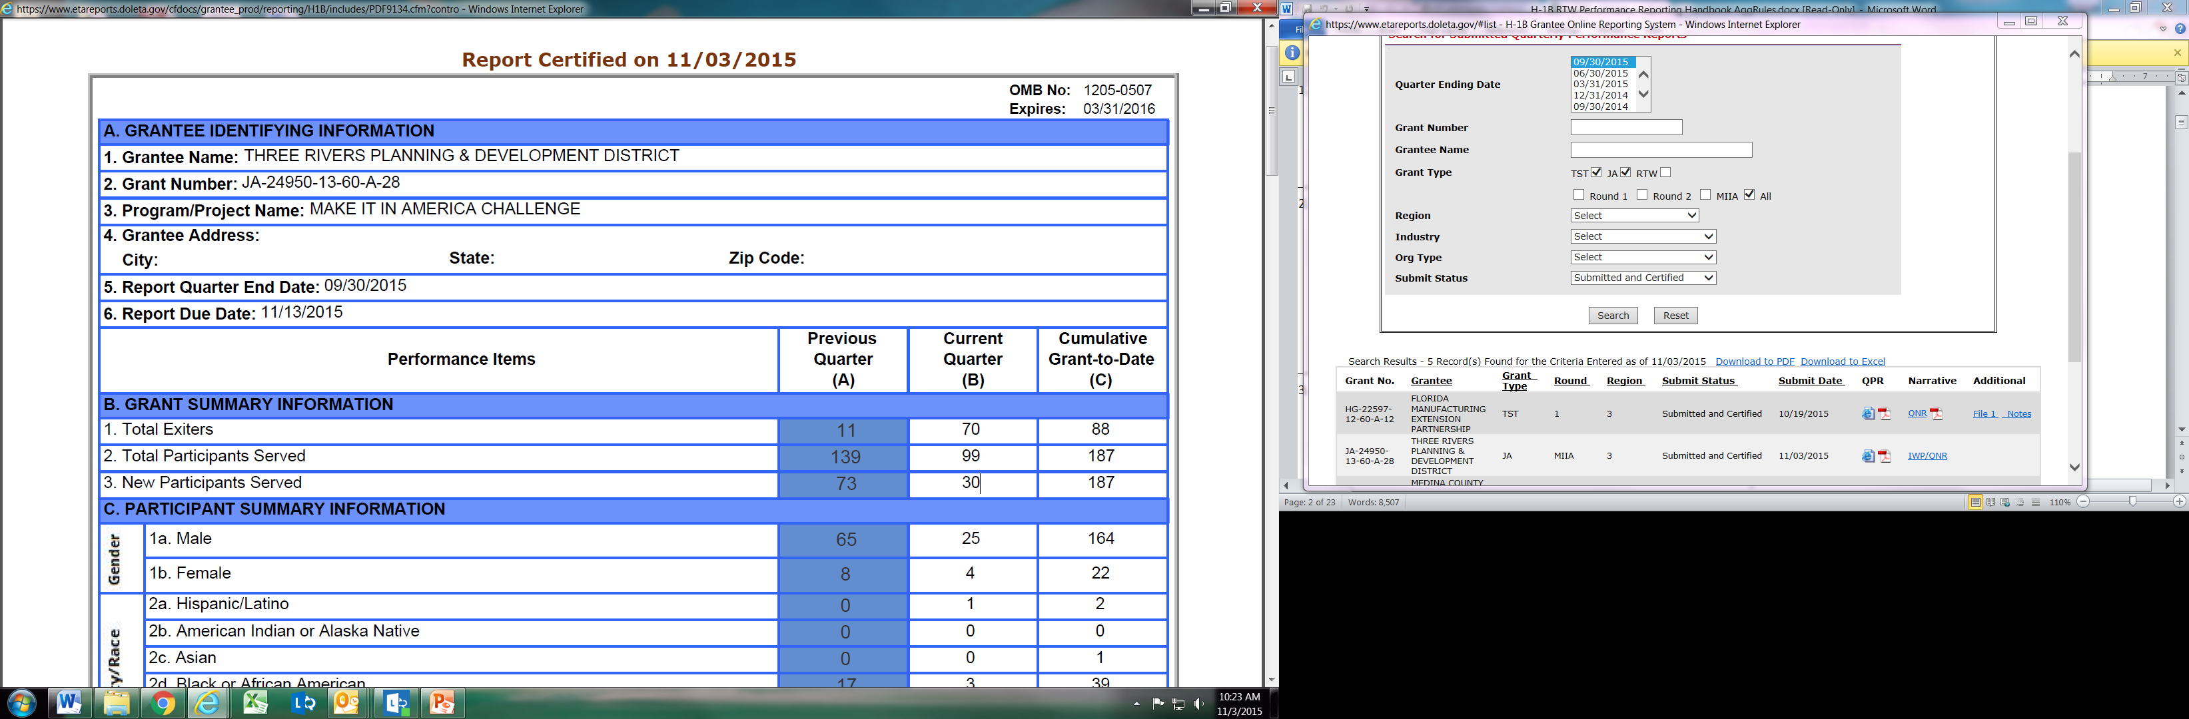
H-1B Ready to Work QPR Form 9166:
Section B. 3 New Participants Served
Grantees report the total of NEW participants who began receiving a service funded by the program that was not reported in previous quarters (i.e. they are new)
A participant is reported as “new” once in the reporting quarter that the participant receive a grant-funded service or enroll in training for the first time.
Current Quarter: “Total Participants Served” will always be equal to or greater than “New Participants Served”
Cumulative Grant-To-date: “Total Participants Served” will always equal “New Participants Served”
20

Slide 21







H-1B Ready to Work QPR Form 9166
Section B. Total Participants Served vs.
New Participants Served
 | Q 12/30/14 | Q 3/31/15 | Q 6/30/15 | Q 9/30/15
RTW Participants
Total Participants Served | 1 | 2 | 3 | 4
Explanation | Tom was provided services | Kevin enrolled in training; Tom continued services | Megan was provided services and enrolled in training; Kevin continued training; Tom continued services and enrolled in training | Ayreen was provided services; Megan continued services and training; Kevin continued training; Tom continued services and training
New Participants Served | 1 | 1 | 1 | 1

Slide 22

Please enter questions in the Chat Room!

Slide 23
Knowledge Check! Date of Exit
Pop Quiz #1: Let’s test your knowledge on Date of Exit
Megan is no longer receiving services, and completed her training program in OJT. Great news! She was hired into full-time employment with the employer that sponsored her OJT program.
Megan’s started her new job on 4/1/2015 and last date of service was on 3/1/15. After 90-days of inactivity, Megan’s date of exit is 3/1/15.
In what QPR reporting period would you report the EXIT Date for Megan’s last date of service/date of exit?
3/31/15
6/30/15
9/30/15

Slide 24
H-1B Ready to Work QPR Form 9166
Section C. Participant Summary and Service Information
Aggregation Rule for Section C:
Count of all participant records with a date entered in DE: 301 Date of Program Participation plus conditions below
 | QPR Line Item | Performance Measure | Related Data Element and Code Value
Gender | 1a. | Male | DE 104 Gender = 1, Male
 | 1b. | Female | DE 104 Gender = 2, Female

Slide 25
H-1B Ready to Work QPR Form 9166
Section C. Participant Summary and Service Information
 | QPR Line Item | Performance Measure | Related Data Element and Code Value
Ethnicity / Race | 2a. | Hispanic/Latino | DE 106 Ethnicity Hispanic / Latino(106) = 1, Yes
 | 2b. | American Indian or Alaskan Native | DE 107 American Indian or Alaska Native = 1, Yes
 | 2c. | Asian | DE 108 Asian = 1, Yes
 | 2d. | Black or African American | DE 109 Black or African American = 1, Yes
 | 2e. | Native Hawaiian or Other Pacific Islander | DE 110 Native Hawaiian or other Pacific Islander = 1, Yes
 | 2f. | White | DE 111 White = 1, Yes
 | 2g. | More Than One Race | This line item will aggregate if multiple data elements (DE 107 – 111) is selected 1 =Yes

Slide 26
H-1B Ready to Work QPR Form 9166
Section C. Participant Summary and Service Information
 | QPR Line Item | Performance Measure | Related Data Element and Code Value
Other Demographics | 3a. | Eligible Veterans | DE 113 Eligible Veteran Status = 1, Yes, <= 180 days OR 2, Yes, Eligible Veteran OR 3, Yes, Other Eligible Person
 | 3b. | Individuals with a Disability | DE 105 Individual with a Disability = 1, Yes

Slide 27
H-1B Ready to Work QPR Form 9166
Section C. Participant Summary and Service Information
Aggregation Rule:
Count of all participant records with a date entered in DE: 301 Date of Program Participation
General Tips:
These data elements impact how your employment outcomes can be reported
These measures track your performance against your targeted populations identified in your SOW

Slide 28
H-1B Ready to Work QPR Form 9166
Section C. Employment Status at Program Participation
 | QPR Line Item | Performance Measure | Related Data Element and Code Value
 | 3d. | Incumbent Workers | DE 201 Incumbent Worker = 1, Yes
Other Demographics | 3e. | Unemployed Individuals | Employment Status at Participation(200) = 2, Employed, but Received Notice of Termination of Employment or Military Separation OR 0, Not Employed AND DE 204 Long-term Unemployed is (0) No, Not Long-term Unemployed OR Blank
 | 3g. | Long-term Unemployed | DE 204 Long-term Unemployed = 1, Yes, Without a job for 27 consecutive weeks or more OR 2, Yes, Underemployed for 27 consecutive weeks or more

Slide 29
H-1B Ready to Work QPR Form 9166
Section C. Participant Summary and Service Information
RTW Performance Measures in Section C, Education Level is reporting participants that have a date in DE 301 Date of Program Participation and have the following code values in DE 114 Highest School Grade Completed
Education Level | QPR Line Item | Performance Measure | Related Data Element and Code Value
 | 4a. | High School Graduate or Equivalent | 87, Attained High School Diploma OR 88, Attained GED or Equivalent
 | 4b. | 1 - 4 Years or More of College, or Full-time Technical or Vocational School | 13 – 15, Number of college, or full-time technical or vocational school years completed
 | 4bi. | Postsecondary Education Certificate or Diploma (non-degree) | 92, Attained postsecondary education, certificate or diploma (non-degree).
 | 4c. | Associates Diploma or Degree | 91, Attained Associates Diploma or Degree
 | 4d. | Bachelor's Degree or Equivalent | 16, Bachelor's degree or equivalent
 | 4e. | Advanced Degree Beyond Bachelor's | 90, Attained Other Post-Secondary Degree or Certification

Slide 30
Please enter questions in the Chat Room!

Slide 31
Knowledge Check!
Pop Quiz #2: Let’s test your knowledge on reporting Long-term Unemployed Workers
Ayreen is an underemployed worker that meets the definition of being underemployed for 27 weeks or more. What data elements will inform how she is reported on the QPR form Line 3g. Long-term Unemployed?
DE 204: 1, Yes (Without a Job for 27 consecutive weeks or more)
DE 204: 2, Yes (Underemployed for 27 consecutive weeks or more)
DE 202: 1, Yes Underemployed Worker) and DE 204: 2, Yes (Underemployed for 27 consecutive weeks or more)

Slide 32
H-1B Ready to Work QPR Form 9166
Section C. Participant Summary and Service Information
RTW Performance Measures in Section C, Services is reporting participants that have a date in DE 301 Date of Program Participation and have CURRENT QUARTER DATES entered in the following code values
 | QPR Line Item | Performance Measure | Related Data Element and Code Value
Services | 5a. | Received Case Management Services | DE 310 Most Recent Date Received Case Management Service
 | 5b. | Received Assessment Services | DE 320 Most Recent Date Received Assessment Services
 | 5c. | Received Supportive Services | DE 330 Most Recent Date Received Supportive Services
 | 5d. | Received Specialized Participant Services | DE 340 Most Recent Date Received Specialized Participant Services
 | 5e. | Participated in Work Experience | DE 350 Most Recent Date Participated in Work Experience
General Tips:
Services are aggregated into the QPR the first time that it occurs for each participant
Grantees should continue to report services provided as it occurs during each quarter to keep their status “active, but they will not count more than once in the previous, current, or cumulative fields.

Slide 33
H-1B Ready to Work QPR Form 9166
Section C. Participant Summary and Service Information
RTW Performance Measures in Section C, Services is reporting participants that have a date in DE 301 Date of Program Participation and data elements with the code value 1 = Yes, Received Services in the PREVIOUS QUARTER.
 | QPR Line Item | Performance Measure (Previous Q) | Related Data Element and Code Value
Services | 5a. | Received Case Management Services | DE 311 Previous Quarter Received Case Management Service = 1, Yes
 | 5b. | Received Assessment Services | DE 321 Previous Quarter Received Assessment Services = 1, Yes
 | 5c. | Received Supportive Services | DE 331 Previous Quarter Received Supportive Services = 1, Yes
 | 5d. | Received Specialized Participant Services | DE 341 Previous Quarter Received Specialized Services = 1, Yes
 | 5e. | Participated in Work Experience | DE 351 Previous Quarter Participated in Work Experience = 1, Yes
General Tip: These data elements are only used to report if services were provided in the previous quarter. It is aggregated in the previous quarter column of your QPR.

Slide 34
Please enter questions in the Chat Room!

Slide 35
Knowledge Check!
Pop Quiz # 3: Let’s test your knowledge on Services Provided.
Tom was provided specialized participant services throughout several quarters, from January 1 – September 1, 2015.
1. TRUE OR FALSE:
HUB will aggregate the total number of all the services that Tom received into the cumulative grant to date column.

Slide 36
H-1B Ready to Work QPR Form 9166
Section D.1 Number Began Receiving Education/Job Training Activities
 | QPR Line Item | Performance Measure | Related Data Element and Code Value
Training Indicators | 1 | Number Began Receiving Education/Job Training Activities | DE 400 Date Entered/Began Receiving Education/Job Training Activities #1 = YYYYMMDD
Definition:
The total number of participants who entered an education or job training program.
Tips:
“Training Program Service” outcomes apply only to participants that are enrolled in training.

Slide 37
H-1B Ready to Work QPR Form 9166
Section D. 2 Number Participated On-the-Job Training Activities
 | QPR Line Item | Performance Measure | Related Data Element and Code Value
Training Indicators | 2 | Number Participated On-the-Job Training Activities | DE 400, DE 410 and DE 420 Date Entered/Began Receiving Education/Job Training Activities #1, #2, #3 DE 402 – 404, DE 412 – 414, DE 422 - 424 Type of Training Service #1, #2, #3 = 1, On-the-Job Training
Tips:
This line item will report participants that are enrolled in OJT as a Training Activity Type under DE 400, 410 and 420: Training Activity #1, #2 or #3.

Slide 38
H-1B Ready to Work QPR Form 9166
Section D. Training Program Services
The First Training Start Date
DE 400, DE 410 and DE 420 Date Entered/Began Receiving Education/Job Training Activities #1, #2, #3
That is associated with a Training Type
DE 402 – 404 Type of Training Service #1
DE 412 – 414 Type of Training Service #2
DE 422 – 424 Type of Training Service #3
 | QPR Line Item | Performance Measure | Related Data Element and Code Value
Training Indicators | 3a. | Number Participated in Classroom Occupational Training Activities | 2 = Classroom Occupational Training
 | 3b. | Number Participated in Contextualized Training Activities | 3 = Contextualized Learning
 | 3c. | Number Participated in Distance Learning Activities | 4 = Distance Learning
 | 3d. | Number Participated in Customized Training Activities | 5 = Customized Learning
 | 3di. | Number Participated in Incumbent Worker Training Activities | 6 = Incumbent Worker Training
 | 3e. | Number Participated in Registered Apprenticeship | 8 = Registered Apprenticeship
Note: HUB will count the first training activity that a participant is enrolled in.

Slide 39
H-1B Ready to Work QPR Form 9166
Section D. 4 Number Completed Education / Job Training Activities
 | QPR Line Item | Performance Measure | Related Data Element and Code Value
Training Indicators | 4 | Number Completed Education/Job Training Activities | DE 304 Date of Training Program Completion AND DE 406 Training Completed #1 = 1, Yes OR DE 416 Training Completed #2 = 1, Yes OR DE 426 Training Completed #3 = 1, Yes
Definition
The total number of participants that entered an education or job training program that completed all the training activities required of the program - i.e. if the training program was a series of classes, they completed all necessary classes.
Tips:
Training Program Completion Outcomes will be aggregated on the QPR once all training activities AND a training program completion date is recorded.
5

Slide 40
H-1B Ready to Work QPR Form 9166
Section D. Training Program Services
 | QPR Line Item | Performance Measure | Related Data Element and Code Value
Training Indicators | 5 | Number Completed On-the-Job Training Activities | DE 406, DE 416 or DE 426, Completed Training Activity #1, #2, #3 = 1, Yes AND DE 402 – 404 Type of Training Service #1 DE 412 – 414 Type of Training Service #2 DE 422 – 424 Type of Training Service #3 = 1, On-the-Job Training
Tips:
OJT Program Completion Outcomes will be reported for those participants that enrolled in OJT training, completed the training, and has a date of training program completion.

Slide 41
H-1B Ready to Work QPR Form 9166
Section E.1 Number Completed Training Activities and Obtained a Credential
Education Outcomes | QPR Line Item | Performance Measure | Related Data Element and Code Value
 | 1 | Number Completed Program Activities and Obtained a Credential | DE 304 Date of Training Program Completion AND DE 601, DE 611 and DE 621 Type of Recognized Credential #1, #2, and #3 > 0
Definition:
The count of the total number of participants who were enrolled and completed an education or training program, who earned all of the credit hours (formal award units) needed for the award of a degree or certificate during the relevant period.
Tips:
The QPR will report outcomes for training program completers that earn at least one (1) credential as a result of their training program.

Slide 42
H-1B Ready to Work QPR Form 9166
Section E2: Total Number of Credentials Earned
Education Outcomes | QPR Line Item | Performance Measure | Related Data Element and Code Value
 | 2 | Total Number of Credentials Received | DE 304 Date of Training Program Completion AND SUM OF DE 601, DE 611 and DE 621 Type of Recognized Credential #1, #2 and #3 > 0
Definition:
The total number of credentials earned by training program completers.
Tips:
This data element all credentials reported for a participant, including their “final” credential and any other earned along the way to completion.
The total number of these credentials are reported in the QPR for all participants once they completed training, not prior to.

Slide 43
Please enter questions in the Chat Room!

Slide 44
Knowledge Check!
Pop Quiz # 4: Let’s test your knowledge on Training Activities.
Mirabel enrolled in education/job training activities and completed her entire training program.
1. Mirabel may have up to how many discrete types of training reflected in the QPR?
3
6
9

Slide 45
H-1B Ready to Work QPR Form 9166
Section E. 3: Number Entered Unsubsidized Employment
 | QPR Line Item | Performance Measure | Related Data Element and Code Value
 | 3 | Number Entered Unsubsidized Employment | DE 501 Date Entered Employment = YYYYMMDD
    Entered Employment Outcomes for Unemployed, Underemployed and LTU Workers
Definition
Entered employment outcomes for E.3 Number Entered Unsubsidized Employment applies to participants that are unemployed, underemployed* and long-term unemployed at participation.
*Underemployed individuals (as defined under Long-term Unemployed) may be reported in this data element, if they are employed in a new position.
Tip: This measure captures employment outcomes for unemployed, underemployed, and long-term unemployed participants that enter a new position of employment. Employment can be reported for these participants at any point after they receive their first grant-funded service.

Slide 46
H-1B Ready to Work QPR Form 9166
Section E. 3a: Number Entered Training Related Employment
 | QPR Line Item | Performance Measure | Related Data Element and Code Value
Employment Outcomes | 3a. | Number Entered Unsubsidized Training-Related Employment | DE 501 Date Entered Employment = YYYYMMDD DE 503 Entered Training-Related Employment = 1, Yes
    Training Program-Related Employment Outcomes
    for Unemployed, Underemployed and LTU Workers
Definition
Participants who were unemployed, underemployed*, and LTU that entered unsubsidized employment after completion of the training program and whose employment is related to the industry, occupation, or skills of the training program that was completed.
*Underemployed individuals may be reported in this data element, if they complete a training program and are employed in a new position, of which is training-related.
Tips:
The QPR will report training-related employment ONLY if the individual was enrolled in training and completed the training program.
Participants that enter employment after only receiving services will not be reported in the QPR.

Slide 47
H-1B Ready to Work QPR Form 9166
Section E4a: Total Number of Incumbent Workers that Retained Current Position
Education Outcomes | QPR Line Item | Performance Measure | Related Data Element and Code Value
Incumbent Worker Outcomes | 4a. | Total Number of Incumbent Workers Retained Current Position | DE 304: Date of Training Program Completion YYYYMMDD DE 201 Incumbent Worker = 1, Yes DE 504, DE 514 and DE 515 Retained Current Position in the 1st, 2nd or 3rd Quarter = 1, yes
Employment Outcomes for Incumbent Workers that Retain their Position
Tips:
Retention outcomes will be reported in the third quarter after training program completion.

Slide 48
H-1B Ready to Work QPR Form 9166
E4b: Total Number of Incumbent Workers that Advanced into New Position
Education Outcomes | QPR Line Item | Performance Measure | Related Data Element and Code Value
Incumbent Worker Outcomes | 4b. | Total Number of Incumbent Workers that Advanced into New Position | DE 304: Date of Training Program Completion YYYYMMDD DE 201 Incumbent Worker = 1, Yes DE 505, DE 515 or DE 525 Advanced to New Employment in the 1st, 2nd or 3rd Quarter = 1, Yes
Employment Outcomes for Incumbent Workers that Advance to a New Position
Tips:
This outcome is reported in the quarter after training program completion.
The QPR will aggregate this outcome in the same quarter in which the advancement to new employment occurs, which could be in the 1st, 2nd or 3rd Quarter.

Slide 49
RTW QPR Form 9166
Section F. Common Measures
Entered Employment Rate: Of those individuals who were not employed at the time of program participation, the percentage who were employed in the first quarter after they exit.
    Includes individuals that were unemployed at participation only
Employment Retention Rate: Of those who were employed in their first quarter after exit, the percentage employed in both the 2nd and 3rd quarters after exit.
    Includes all participants served
Average Earnings: Of those who were employed in their 1st, 2nd, and 3rd quarters after exit, the average gross earnings from the 2nd and 3rd quarters after exit.
    Includes all participants served

Slide 50
Please enter questions in the Chat Room!

Slide 51
Knowledge Check!
Pop Quiz # 5: Let’s test your knowledge on Entered Employment Outcomes
Which of the following statements are true for QPR Section Training Program Outcomes Line 3. Number Entered Unsubsidized Employment
It only applies to those who are unemployed, underemployed and long-term unemployed.
This outcome is reported as soon as an individual gets a job at any time during and/or after program participation.
An individual can enter employment and still continue receiving supportive services and/or training services.
All of the above.

Slide 52
Reporting Components in the HUB System
QNR
Submit & Certify!
QPR
For the Quarter Ending 9/30/15, grantees will submit both a QPR and a QNR in HUB.
HOT RESOURCE!
http://prezi.com/eqvocufoemct/?utm_campaign=share&utm_medium=copy&rc=ex0share

Slide 53
Key Performance Reporting Dates
FRIENDLY REMINDERS!
H-1B RTW Grants
Reporting deadline is Friday, November 13th !
HUB Office Hours
Tuesday, November 10th, from 1:00 p.m. until 3:00 p.m. EST
Friday, November 13th, from 10:30 a.m. until 12:30 p.m. EST
RSVP at RTW@dol.gov
Conference Call-In Line: 866-736-7001
Participant Code: 8206573

Slide 54
H-1B RTW Performance Reporting TA Resources
Performance Reporting and Hub Phase 2 Webinar Summary Resource Brief
This is a high-level summary of the performance reporting webinar, which includes an Appendix of TA Resources referenced during the webinar, including:
  H-1B RTW Performance Reporting Toolkit: As a supplement to the H-1B RTW Performance Reporting Handbook, this toolkit is designed to support H-1B RTW grantees in preparing and submitting their quarterly progress reports.
  RTW HUB Sample Data File and Case Management Files: This is a technical assistance tool to provide grantees with a sample data file and case management system using an Excel spreadsheet.
  RTW Sample Data File (txt format): For technical assistance purposes, this is a sample H-1B RTW Data File. The information provided in this data file is for test purposes only and do not represent real participant data.
RTW Performance Reporting Pre-recorded Tutorials
  Tutorial #1: HUB System Preview
  Tutorial #2: Preparing Data Files
  Tutorial #3: Resolving Data File Errors

Slide 55

H-1B Ready to Work
Community of Practice
http://etagrantees.workforce3one.org

Slide 56

DOL Contacts
Your Federal Project Officers!
Ready to Work Grantee Mailbox
RTW@dol.gov
ETA Help Desk
(for HUB System Technical Questions)
EBSS.Help@dol.gov

Slide 57

H-1B Ready to Work
Performance Reporting Webinar
Thank you!

Slide 58
Polling question
As a result of this webinar…
  I’m a rockstar! I learned everything I need to review my data files and check my QPR for quarterly progress reporting.
  In training! I have a few questions that I would like to address in future TA opportunities.
  Lost and confused! I have so many questions, I don’t know where to start?
  Performance Guru! I did not learn anything new that I didn’t already know from TST and JA Reporting.

