Slide 1
November 6, 2015
ROUND 2 VIRTUAL CONFERENCE
SUSTAINING YOUR IMPACT (PART 1): DIVERSIFYING YOUR FUNDING STRATEGIES

Slide 2
SHOWCASE YOUR INNOVATION: SHARE YOUR STORY!
Send a brief write-up to the TAACCCT mailbox (TAACCCT@dol.gov) responding to the following questions:
In which TAACCCT strategy area(s) have you experienced the greatest success?
Please describe the new policies, practices, or programs that have had the greatest impact on student credential and job attainment.
Of your successful programs, strategies, policies, practices, and partnerships, what will be sustained and/or institutionalized and scaled to reach more students?
Are there other impacts you’d like to share? Any ripple effects/surprising outcomes as a result of your work?
Your impact and legacy to TAACCCT is important. We encourage you to email TAACCCT@dol.gov with prepared documents, videos or other materials that illustrate your TAACCCT story!

Slide 3
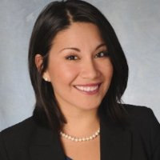
MODERATOR & PRESENTER
Alexandra Waugh
Senior Program Manager Jobs for the Future
Erica Acevedo
Senior Program Manager Jobs for the Future

Slide 4
AGENDA
Welcome & Introductions
Introduction to Braided Funding for Career Pathways
Braided Funding as a Sustainability Strategy
Partnerships, Collaboration, Team Building
Toolkit Demo
Examples of Braided Funding Strategies
Question & Answer

Slide 5
CORE COMPONENTS OF CAREER PATHWAYS
Acceleration
Credit Pathways
Scale
Comprehensive Supports
Stackable Credentials
Integrated Instruction
Sustainability
Family-Supporting Careers
Student Success
Labor Market Alignment

Slide 6
WHAT IS BRAIDED FUNDING?

Slide 7
WHAT IS BRAIDED FUNDING?
Braided funding refers to:
the weaving together of federal, state, and private funding streams; and
the development of funding strategies to support integrated pathways and the students enrolled in them.

Slide 8
FUNDING STREAMS
Streams: Existing, multi-year sources of funding from federal programs, state programs, and private dollars.
Examples include:
Workforce Innovation & Opportunity Act
Perkins
TANF
Community Service Block Grant
State Financial Aid
Grant Dollars

Slide 9
FUNDING STRATEGIES
Strategies: Ways to create more funding opportunities independent of specific funding streams, including: (1) Reducing costs; (2) Raising new revenue; or (3) Redirecting existing revenue.
Examples include: State funding allocations
Fee waivers
Online technology to reduce costs
Employer tuition reimbursements

Slide 10
FUNDING STREAMS & STRATEGIES
Streams and Strategies are equally important.
We focus on both.

Slide 11
POLL: BRAIDED FUNDING
Are you currently using braided funding strategies to support your programs and students?
Using braided funding to support programs
Using braided funding to support students
Both
I am not currently using braided funding strategies

Slide 12
WHY IS BRAIDED FUNDING IMPORTANT?

Slide 13
WHY IS BRAIDED FUNDING IMPORTANT?
THE REALITY
Reductions in federal, state, and even private foundation funding will continue for the foreseeable future.
Performance-based funding will continue to tie funding to outcomes.
Per-student educational costs must come down.
THE BENEFITS
Build new partnerships
Sustainability: institutional transformation, leadership support, investment priorities
Improved competitiveness for grants
Efficiency and effectiveness
Do more with less

Slide 14
BRAIDED FUNDING IS A COLLABORATIVE EFFORT

Slide 15
KEY AGREEMENTS
Clear vision
Designated leads at each organization
Shared goals and outcomes
Collaborative work required!

Slide 16
SAMPLE TEAM MAKEUP
INTERNAL MEMBERS
EXTERNAL MEMBERS
Finance/Financial Aid
Grants & Development
Workforce/CTE
Registrar
Student Services
Senior Administration
Career pathway lead/coordinator
Adult Education
Academic Deans
Transfer Department
American Job Center
Employers/Industry Partners
CBOs
Nonprofits
TANF office
Dept. of Corrections
Community Action Agency
Veteran Affairs

Slide 17
STEPS TO BRAIDING FUNDS

Slide 18
STEPS TO BRAIDING FUNDS
1. Braided Funding for What?
Focus on a single model, population or collaborative structure.
Why do you think braided funding is important?
2. Identifying Funding Priorities
Break down your model/population/structure by need, impact, and cost.
Where do you have the most need?
Prioritize which pieces you want to fund, and in what order.

Slide 19
STEPS TO BRAIDING FUNDS
3. List Funding Possibilities
Brainstorm about funding sources for each high-priority goal.
Identify questions you need answered, and who might answer them. Reach out!
4. Develop a Pitch
Partnerships to braid funds must benefit everyone.
Integrate evidence.
Customize to the customer.

Slide 20
STEPS TO BRAIDING FUNDS
5. Develop a Work Plan
Set goals for the short, medium, and long term.
Identify leads for each piece of the plan.
Include a timeline.
6. Go Go Go!
It is okay to move slowly.
Keep focused, and keep the effort moving.
Pay attention to new funding sources that may emerge.

Slide 21
http://application.jff.org/braided_funding_toolkit/
BRAIDED FUNDING TOOLKIT DEMO

Slide 22
BRAIDED FUNDING EXAMPLES

Slide 23
PARTICIPANT POLL: BRAIDED FUNDING PARTNERS
What types of organizations and stakeholders are you partnering with to develop braided funding strategies? Please check all that apply.
Workforce system
TANF, SNAP, and other social welfare agencies
Community-based organizations
State agencies
Other (specify in main chat)

Slide 24
ILLINOIS COMMUNITY COLLEGE EXAMPLE
Instruction:
TAACCCT Round 3 Grant
Institutional Funds
Accelerating Opportunity Grant Funds
State Adult Education & Family Literacy Funds
Department of Education Title III Strengthening Institution Funds
Tuition:
YouthBuild
Federal Financial Aid
Supplies:
State Carl Perkins Funds
Accelerating Opportunity Grant Funds
YouthBuild
Administration:
Transitions Coordinator: Adult Education and Family Literacy; Truant’s Alternative and Optional Education Program; Accelerating Opportunity Grant Funds; Department of Education Title III Strengthening Institution Funds
ABE Counselor: Adult Education & Family Literacy; AO Grant Funds; Institutional Funds
Other Counseling/Advising: In Kind

Slide 25
ILLINOIS COMMUNITY COLLEGE EXAMPLE
Instruction:
State Adult Education & Family Literacy Funds
Institutional Funds
Administration:
In Kind
Coordinator
Existing Adult Education Advisors
Tuition:
College Foundation Funds
Private Donors
Title 1 WIA/WIOA funds
Division of Rehabilitation Services
Federal Financial Aid
Supplies:
State Adult Education & Family Literacy Funds

Slide 26
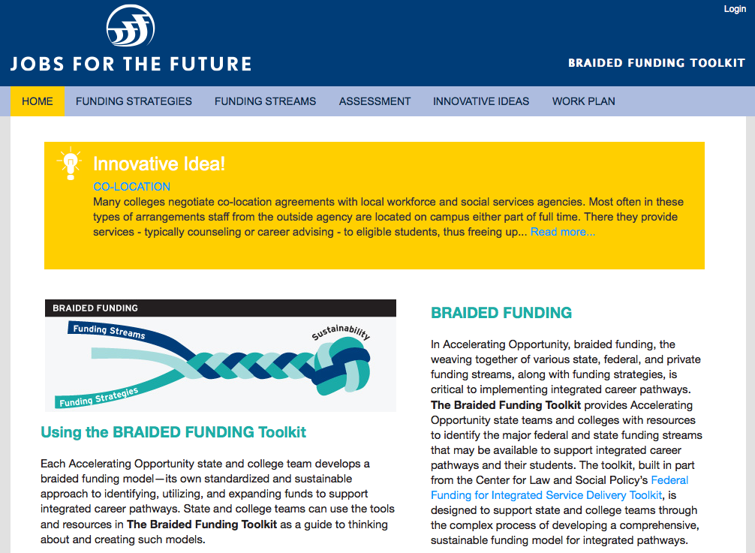
ACCESSING JFF’S BRAIDED FUNDING TOOLKIT
To log on to the toolkit, go to http://application.jff.org/
Click on “Request Access” next to “Accelerating Opportunity Braided Funding”
Click on the link for “Accelerating Opportunity Braided Funding”
Click “Log In” in the top right corner and then click on “click here to register”
Submit your registration request
Once approved, you will choose your username and password

Slide 27
Q & A

Slide 28
Contact us…
Alexandra Waugh
awaugh@jff.org
Erica Acevedo
eacevedo@jff.org

Slide 29
Thank You!
Find resources for TAACCCT success at:
https://etagrantees.workforce3one.org
Subscribe to TLN resources, ask questions or connect with peers at TAACCCT@dol.gov

