Slide 1
Update: Submission of Unified or Combined State Plans
Webinar Date: Nov. 9, 2015
Presented by:
U.S. Department of Labor
U.S. Department of Education

Slide 2
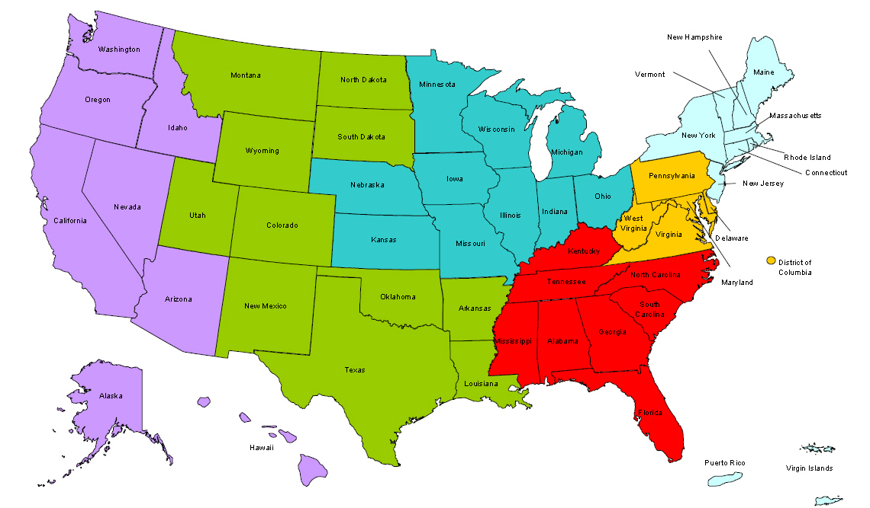
Where are you?
Enter your location in the Chat window – lower left of screen

Slide 3
Presenters
Heather Fleck
Unit Chief, Governance
Employment and Training Administration, U.S. Department of Labor
Karla Ver Bryck Block
Team Leader, Monitoring and Administration Team
Office of Career, Technical and Adult Education, U.S. Department of Education

Slide 4
Presenters
Jim Doyle
V.R. Program Specialist
Rehabilitation Services Administration, U.S. Department of Education
Brian Miller
V.R. Program Specialist
Rehabilitation Services Administration, U.S. Department of Education

Slide 5
Here’s what you can expect to get out of this webinar!
Federal timeline for key planning products
Preview of submission process and online portal
Identification of important state actions

Slide 6
Agenda
Update on Federal Agency Activities
Sneak Peek: Submission Portal
What States Can be doing Now
Before you submit…
Q and A

Slide 7
Disclaimer
The State Plan Information Collection Request (ICR) is not yet final and is subject to change based on public comment and review by the Office of Management and Budget.
No State Plan submission will be required until the ICR is finalized.
The purpose of this webinar is to provide guidance to assist states as they begin planning pending publication of the final ICR.

Slide 8
Unified vs. Combined State Plan
A Unified State Plan must include the following six core programs:
Adult program (title I)
Dislocated Worker program (title I)
Youth program (title I)
Adult Education and Family Literacy Act program (title II)
Wagner-Peyser Services program (title III)
Vocational Rehabilitation program (title IV)

Slide 9
Unified vs. Combined State Plan
If the State elects to submit a Combined State Plan, the plan must include the six core programs, mentioned previously, as well as one or more of the following programs:
Career and technical education programs authorized under the Carl D. Perkins Career and Technical Education Act of 2006 (ED)
Temporary Assistance for Needy Families program (HHS)
Program Employment and Training Programs under the Supplemental Nutrition Assistance Program Work programs (USDA)
Work programs authorized under section 6(o) of the Food and Nutrition Act of 2008 (USDA)
Trade Adjustment Assistance for Workers Programs (DOL)

Slide 10
Unified vs. Combined State Plan (Cont.)
Jobs for Veterans State Grants Program (DOL)
Unemployment Insurance Programs (DOL)
Senior Community Service Employment Program (DOL)
Employment and training activities carried out by the Department of Housing and Urban Development (HUD)
Community Services Block Grant (HHS)
Reintegration of Ex-Offenders Program (DOL)

Slide 11
Unified vs. Combined State Plan
All plans are due no later than March 3, 2016
For Unified State Plans, DOL and ED must approve plans covering the core programs within 90 days.
For Combined State Plans, DOL and ED must approve the portions of plans covering the core programs and any optional programs within their purview within 90 days.
For Combined State Plans with optional programs that are not under the Departments of Labor or Education, the portions of the plans with those optional programs must be approved by the appropriate Secretary within 120 days.

Slide 12
Update on Federal Agency Activities: State Plan Information Collection
Public Comment period for State Plan Information Collection Request (ICR) closed October 5th
Departments working through comments received; updating state plan information collection, as appropriate, pursuant to the comments received
Departments must submit revised state plan information collection to Office of Management and Budget; will publish for additional 30 day comment period
Target timeline for final publication: Winter

Slide 13
State Plan Contents Overview
I. WIOA State Plan Type
II. Strategic Elements
Economic, Workforce, and Workforce Development Activities Analysis
State Strategic Vision and Goals
State Strategy
III. Operational Planning Elements
State Strategy Implementation
State Operating Systems and Policies
IV. Coordination with Combined State Plan Programs
V. Common Assurances
VI. Program-Specific State Plan Requirements for Core Programs
Appendix 1: Performance Goals for the Core Programs
VII. Program-Specific Requirements for Combined State Plan Partner Programs

Slide 14
Update on Federal Agency Activities: Joint Guidance on Unified and Combined State Plans
The Departments intend to publish joint guidance on Unified and Combined State Plans
Overview of content:
Departments’ vision for planning
Instructions on State Plan submission process
Deadline for submission
Announcement of final State Plan information collection
Key planning reminders
Target Timeline: Winter

Slide 15
Update on Federal Agency Activities: Submission Portal Preview
The Departments are in the process of creating an online portal through which States will submit a Unified or Combined State Plan. Benefits of this portal include:
Access to users throughout the State
Uniformity for all portions of the plan
Identifies all required common elements of a Unified or Combined State Plan
Ensures section 508 compliance
Allows for all Departments to receive the plan at the same time.

Slide 16
Portal Overview
The portal will allow States to submit all required information for a State Plan, which includes both the common elements and the program-specific elements for all core programs.

Slide 17
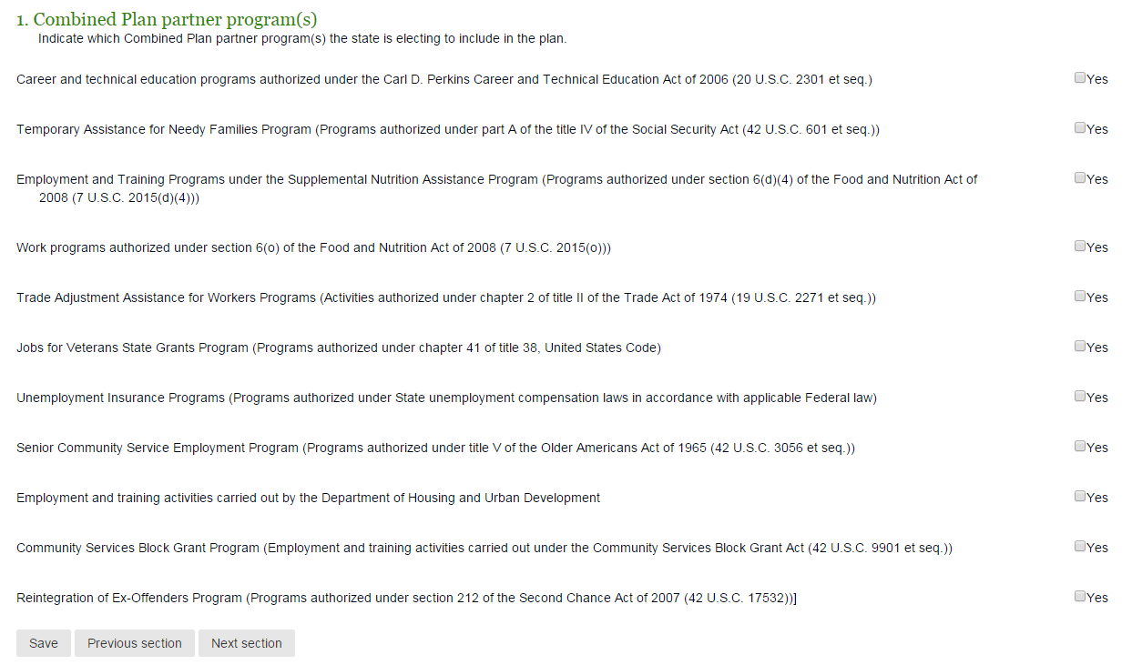
Portal Overview
The portal will also allow States to have the option to include any of the Combined Plan partners.

Slide 18
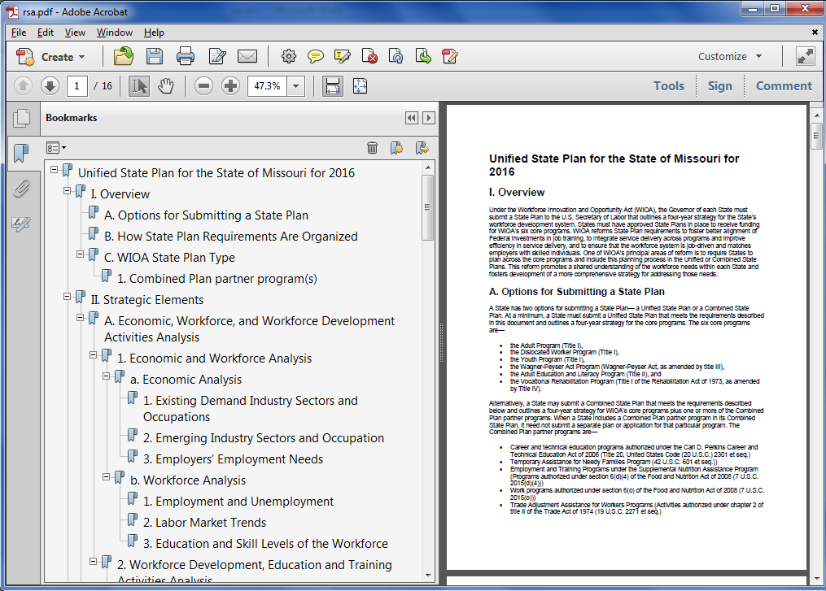
Portal Overview
Multiple staff and departments throughout the State will have the ability to enter and save information during the development of the Plan until the Plan is formally submitted.

Slide 19
Portal Overview: Availability of State Plan Portal
The portal will be consistent with the final Information Collection instrument once approved.
The portal is expected to go live upon final approval of the State Plan information collection instrument. It is important to note, however, that additional changes may become necessary to both the portal and Information Collection instrument once the final regulations are published.
Additional guidance from the Departments will be provided on:
How to access the portal;
General overview of the portal;
Obtaining the appropriate user’s permissions to edit a plan;
Functionality of the portal; and
How to formally submit the State plan.

Slide 20
Portal Overview: Development of State Plan
Material developed prior to the portal’s availability can be copied into the appropriate sections of the portal
The portal will allow users to paste and save content into the appropriate section of a Plan.
Saving information into one section of a Plan will not effect users working on other sections of the plan.

Slide 21
Portal Overview: Development of State Plan

Slide 22
Portal Overview: Development of State Plan
Users will have access to the relevant sections of the Plan. The program-specific elements within each Plan can be completed by staff within the State independent of the other sections of the Plan.
For example, the Adult Education & Literacy Program’s section of the State Plan can be developed by the authorized staff in the State.

Slide 23
Portal Overview: Development of State Plan

Slide 24
Portal Overview: Plan Submission
Once the State is finished developing its Unified or Combined State Plan, the State will be able to submit the entire plan to the Departments through the portal.
Once submitted, the plan will be available to the Department of Labor, the Department of Education and any other Federal agency that may be included in the Plan.
The submission date and date the plan is received will be the same.

Slide 25
What States Can be Doing Now
Ensure State Workforce Development Boards become WIOA-compliant.
Engage Boards in planning responsibilities now.

Slide 26
What States Can be Doing Now
Ensure all appropriate stakeholders are at the planning table – e.g., hold joint conversations, rather than separate ones.
Build new and strengthen existing partnerships.
Find new ways to align core and combined programs, as well as required and optional partners in WIOA’s one-stop delivery system.

Slide 27
What States Can be Doing Now
Use the WIOA statute, Notice of Proposed Rulemaking, and proposed Information Collection Request (ICR) as a guide for discussions and preliminary planning until the final ICR is available

Slide 28
What States Can be Doing Now
Conduct an economic and labor market analysis of the State and its regions.
Using the above analysis, develop the essential elements of the State’s vision and strategic plan.

Slide 29
What States Can be Doing Now
Become familiar with the program-specific requirements, regardless of whether a State is submitting a Unified or Combined State Plan, such as public hearings, public comment timeline, or input from stakeholders.

Slide 30
What States Can be Doing Now
Reassess the one-stop delivery system together with your core programs and combined program partners.
Reassess the State and Local Workforce Development Boards duties and responsibilities

Slide 31
What States Can be Doing Now
Identify proven and new, innovative approaches to:
increase services to disconnected, out-of-school youth; and
reconnect youth to education and jobs.

Slide 32
What States Can be Doing Now
Become familiar with the Uniform Requirements:
2 CFR Part 200
2 CFR Part 3474
Review the Performance ICR

Slide 33
What States Can be Doing Now
Identify any barriers your State may have with the implementation of WIOA so it can develop the necessary plans and strategies to overcome these barriers.

Slide 34
Submissions Before Federal Products are Available
If your state intends to submit its plan prior to release of Federal guidance and portal availability, ensure the following:
Planning was conducted with all required parties and a WIOA-compliant board
Plan was posted for public comment
Plan meets 508 accessibility requirements
Identification of the right signatory for the State that can submit for all included partner programs
Must submit to Department of Labor—contact your Federal Departments for information
May be required to modify your plan once the final ICR is published
May be required to enter your plan into the online portal once the portal is available (after publication of the final ICR)

Slide 35
Resources
Innovation & Opportunity Network
https://wioa.workforce3one.org/
ETA WIOA page
www.doleta.gov/wioa
Resources on Adult Education and WIOA
http://www2.ed.gov/about/offices/list/ovae/pi/AdultEd/wioa-reauthorization.html
Resources available through RSA
http://rsa.ed.gov

Slide 36
Please enter your questions in the Chat Room!

Slide 37
www.workforce3one.org

