Slide 1
November 9, 2015
ROUND 2 VIRTUAL CONFERENCE
SKILLSCOMMONS SUPPORT SERVICES CENTER:
PREPARING AND SHARING YOUR DELIVERABLES

Slide 2

SHOWCASE YOUR INNOVATION:
SHARE YOUR STORY!
Send a brief write-up to the TAACCCT mailbox (TAACCCT@dol.gov) responding to the following questions:
In which TAACCCT strategy area(s) have you experienced the greatest success?
Please describe the new policies, practices, or programs that have had the greatest impact on student credential and job attainment.
Of your successful programs, strategies, policies, practices, and partnerships, what will be sustained and/or institutionalized and scaled to reach more students?
Are there other impacts you’d like to share? Any ripple effects/surprising outcomes as a result of your work?
Your impact and legacy to TAACCCT is important. We encourage you to email TAACCCT@dol.gov with prepared documents, videos or other materials that illustrate your TAACCCT story!

Slide 3
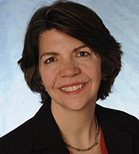
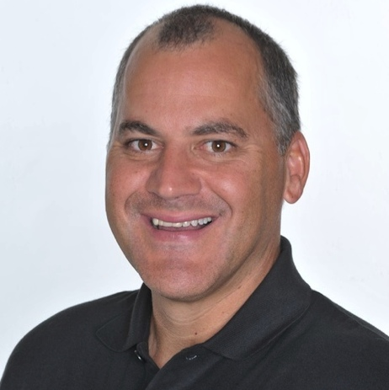
MODERATOR & PRESENTER
Jennifer Freeman
Program Director, TLN
Jobs for the Future
Rick Lumadue
Program Manager/Grantee Relations, Skillscommons.org

Slide 4

PARTICIPANT POLL
Have you uploaded any products into SkillsCommons yet?
Yes
No
What type of files will you be uploading to SkillsCommons? (select all that apply)
MS Word, PPT and/or Excel
Video
LMS Export
IMS Common Cartridge
SCORM
Other

Slide 5
AGENDA
Explore Updated Support Services Center
  Organizational Structure of Support Services
  New Features of Support Services
    Contribute & Manage Materials
    Discover & Reuse Materials
    Reuse & Revise Open Educational Resources
Explore Resources for Completing & Closing Out Your Grant
  Guidance for Grant Project Managers Assessing Contributions
  SGA Voluntary Templates
    Accessibility
    CC-BY Licensing
    Subject Matter Expert Review
    Metadata Standards Summary

Slide 6
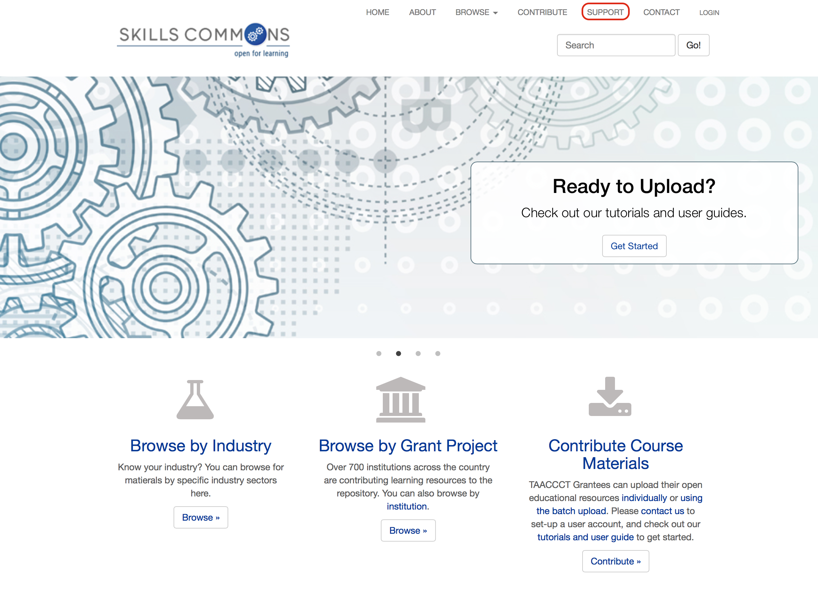
Explore SkillsCommons Updated Support Services Center

Slide 7
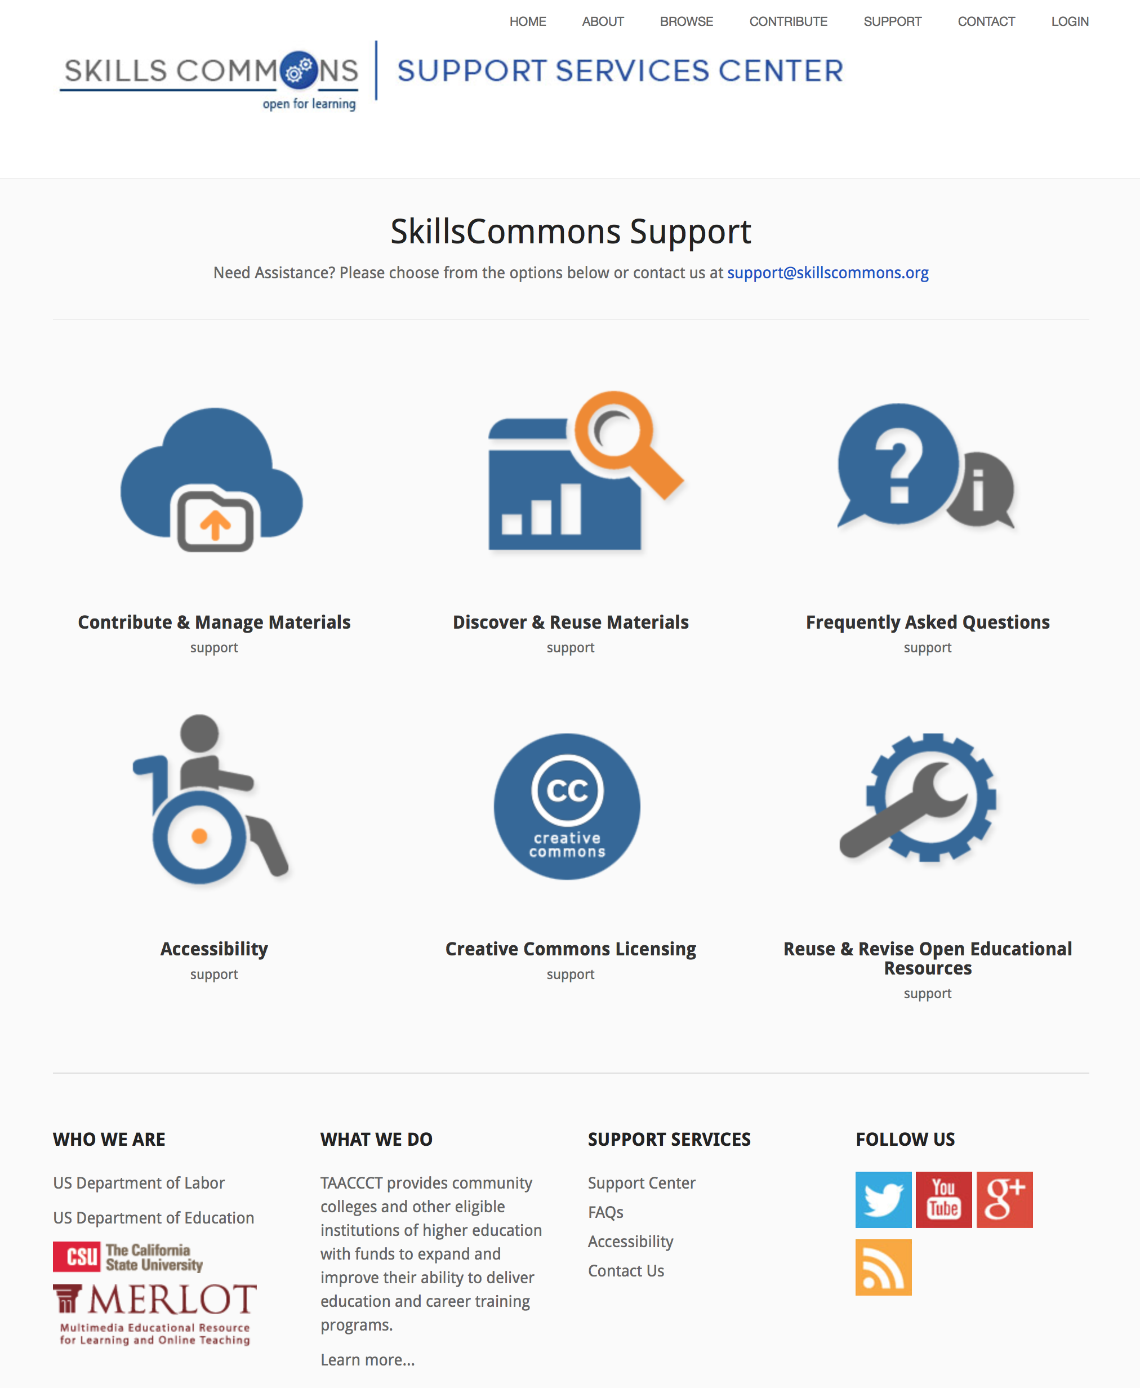
Organizational Structure of SkillsCommons Support Services Center

Slide 8
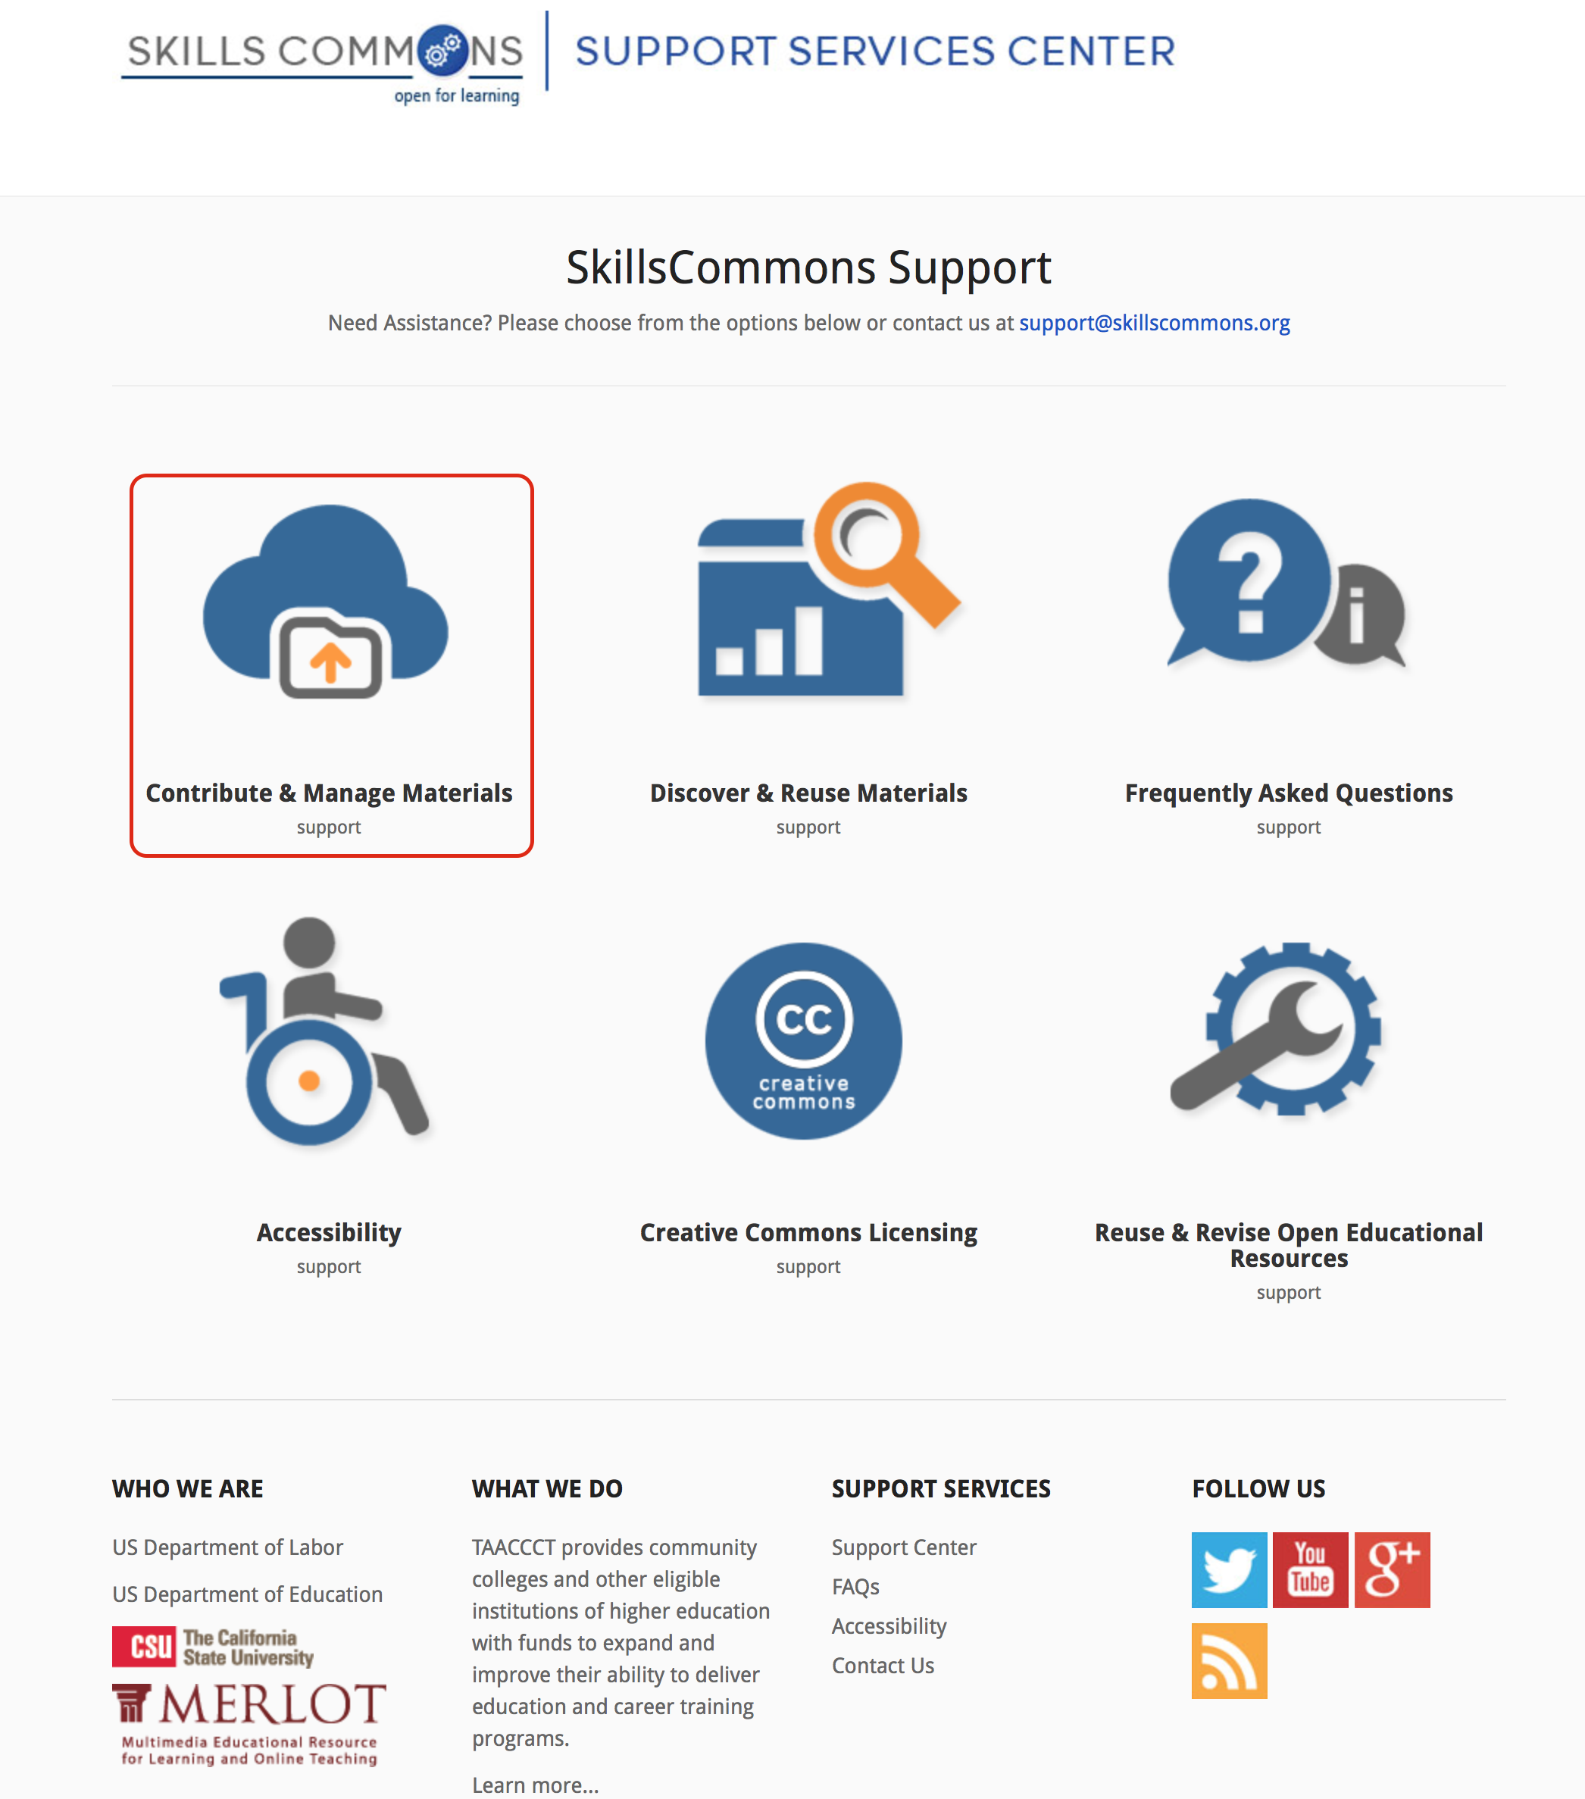
Contribute & Manage Materials

Slide 9
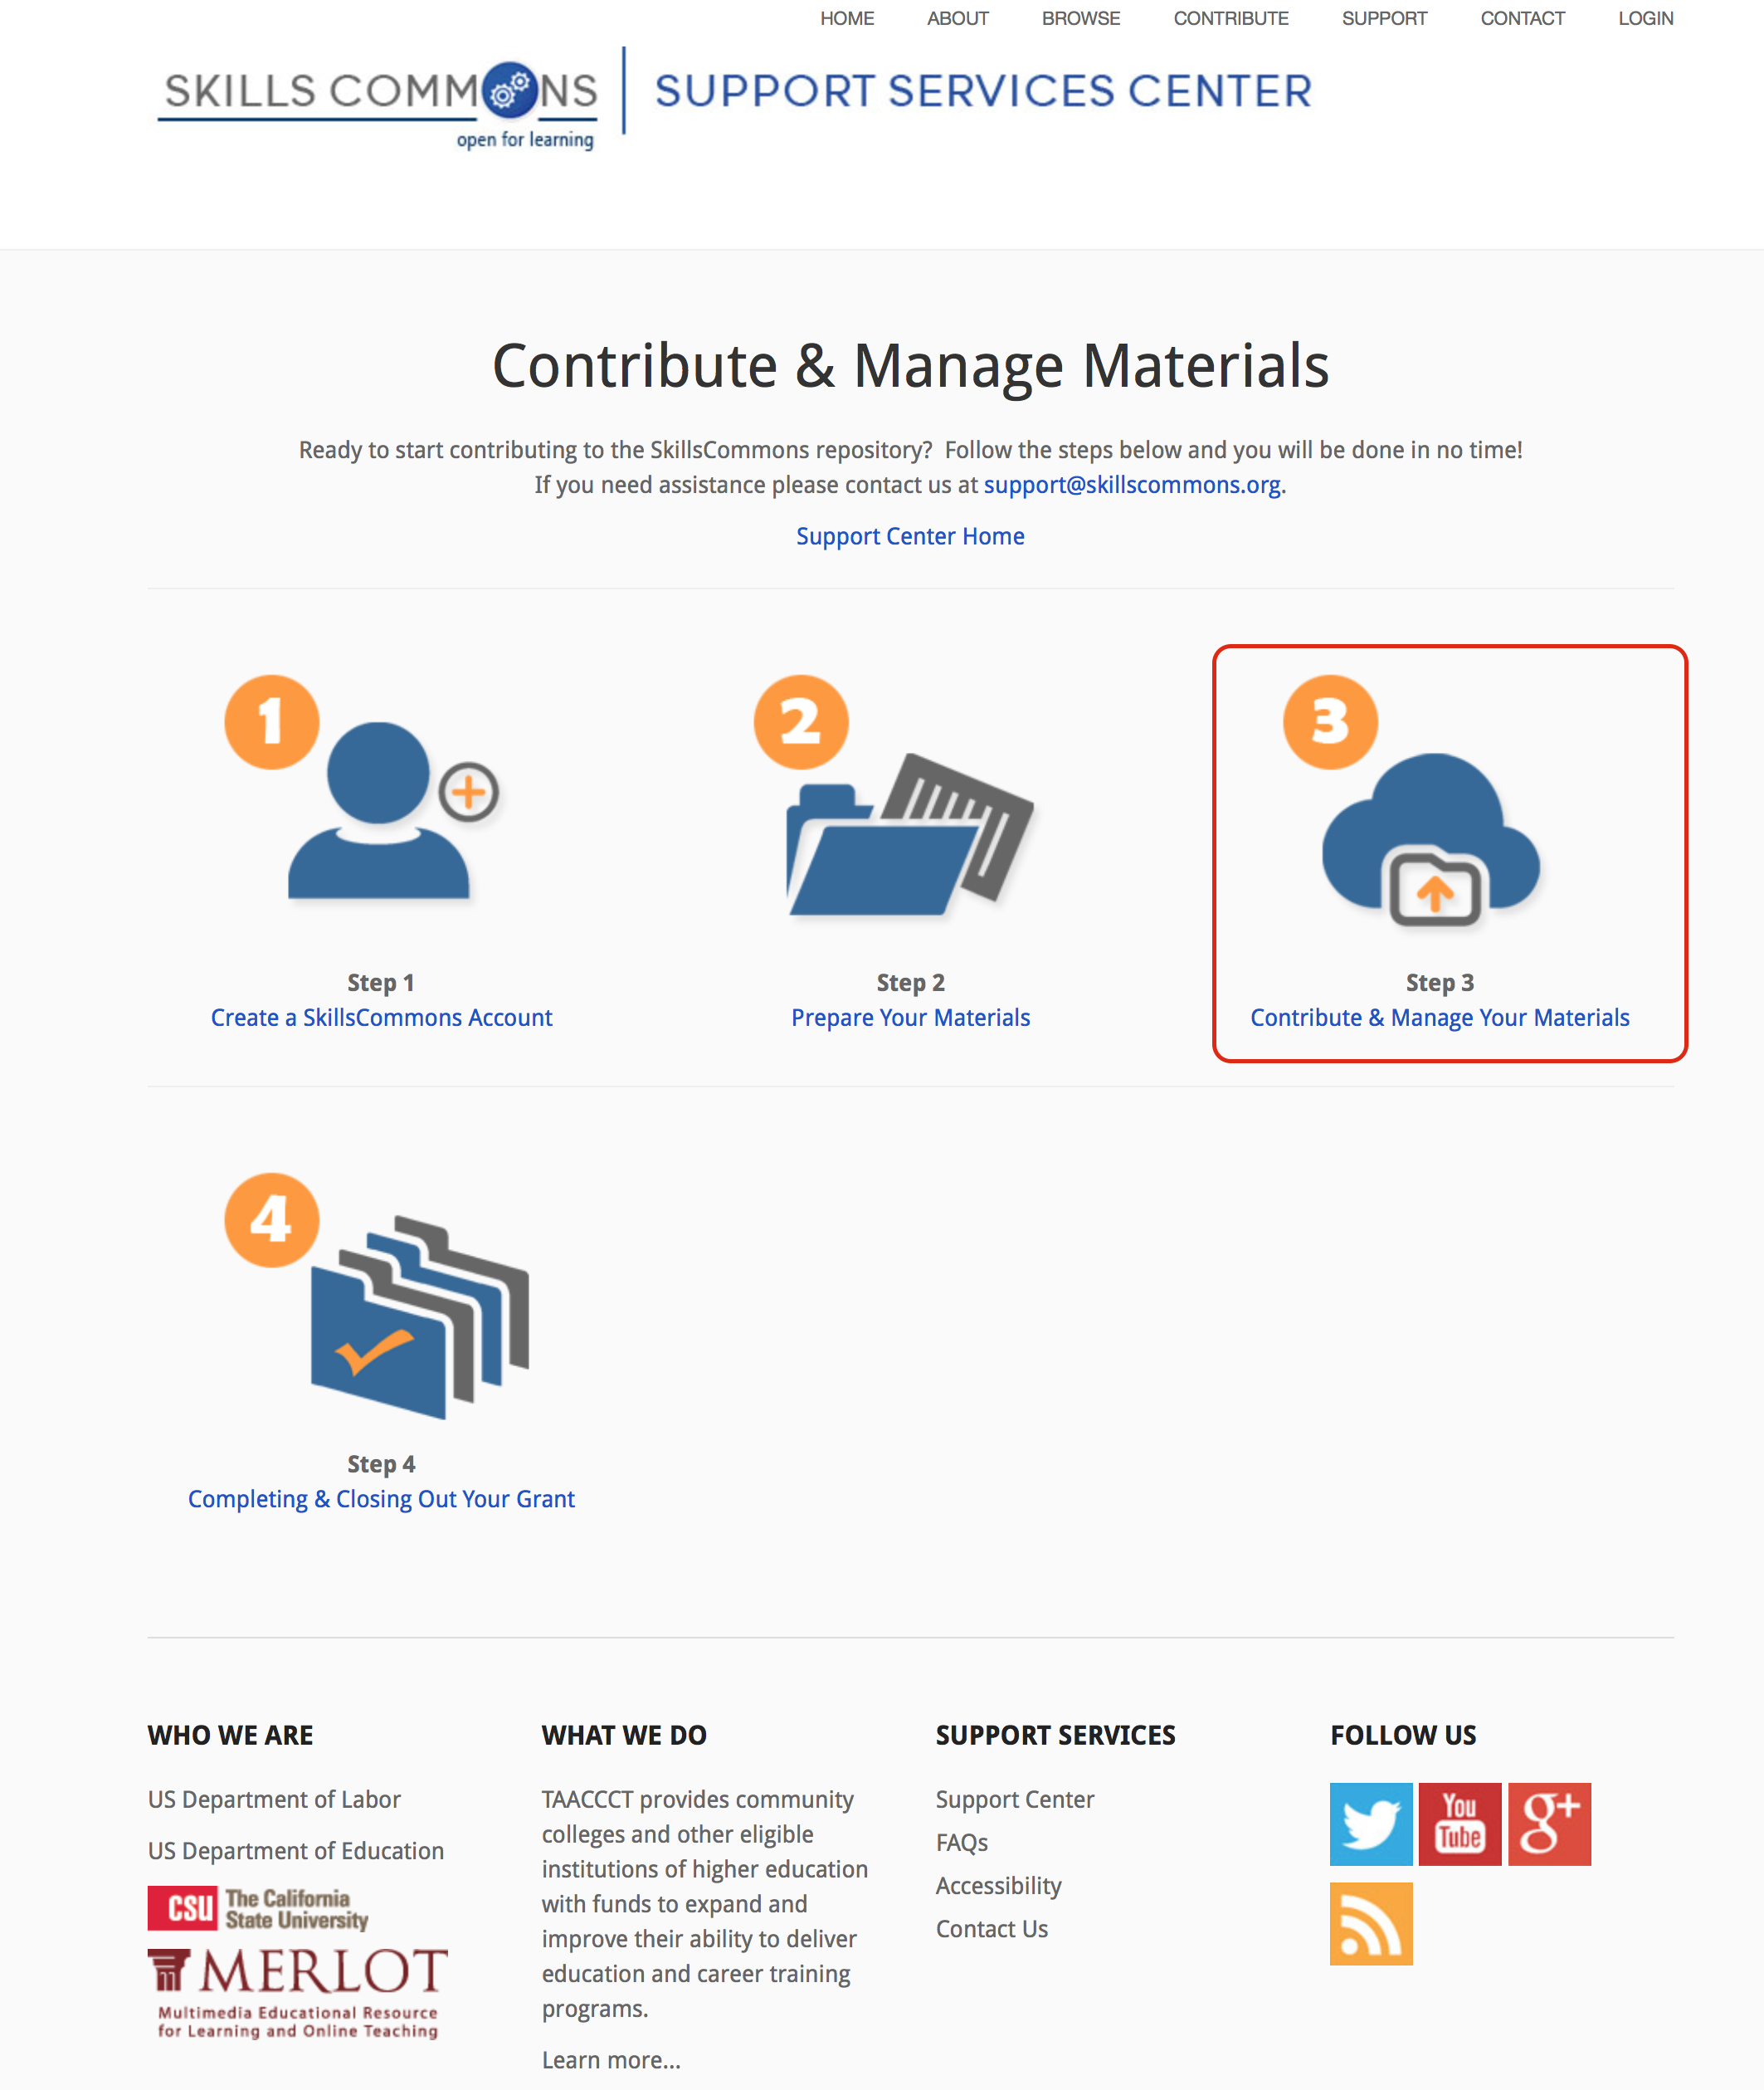
Contribute & Manage Materials

Slide 10
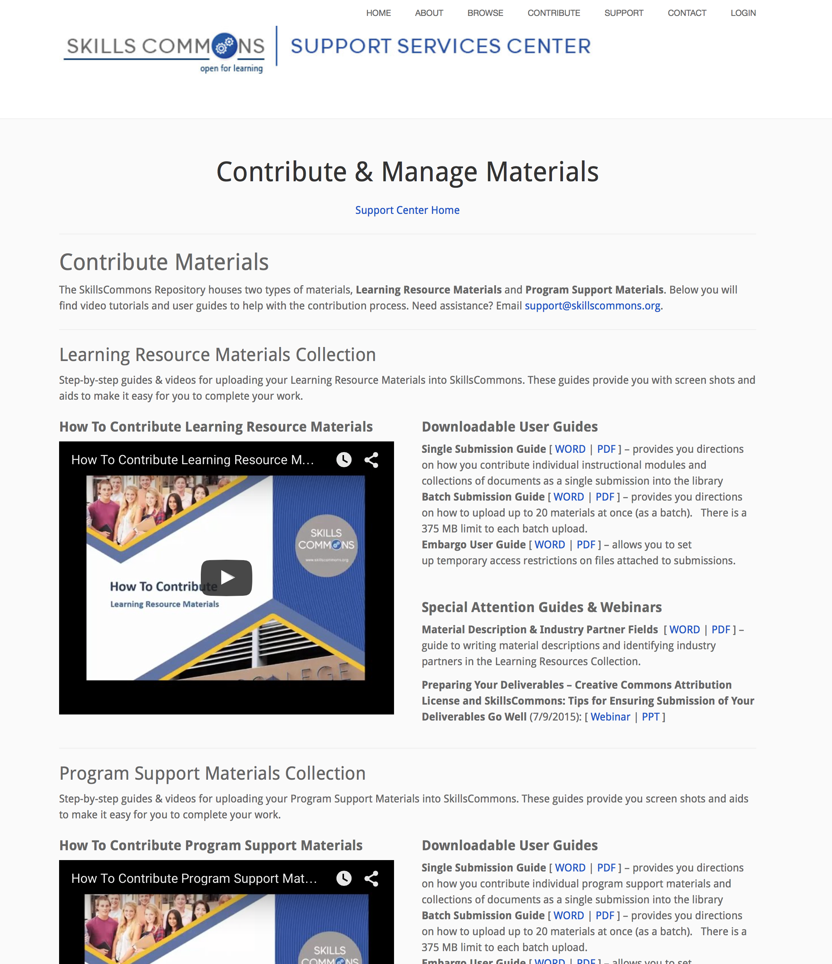
Contribute & Manage Materials

Slide 11
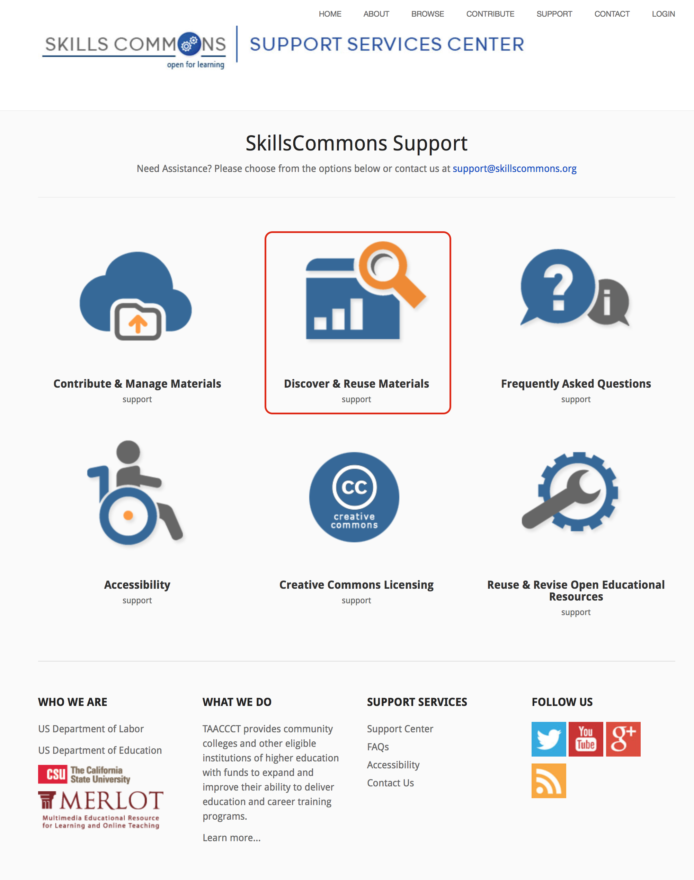
Discover & Reuse Materials

Slide 12
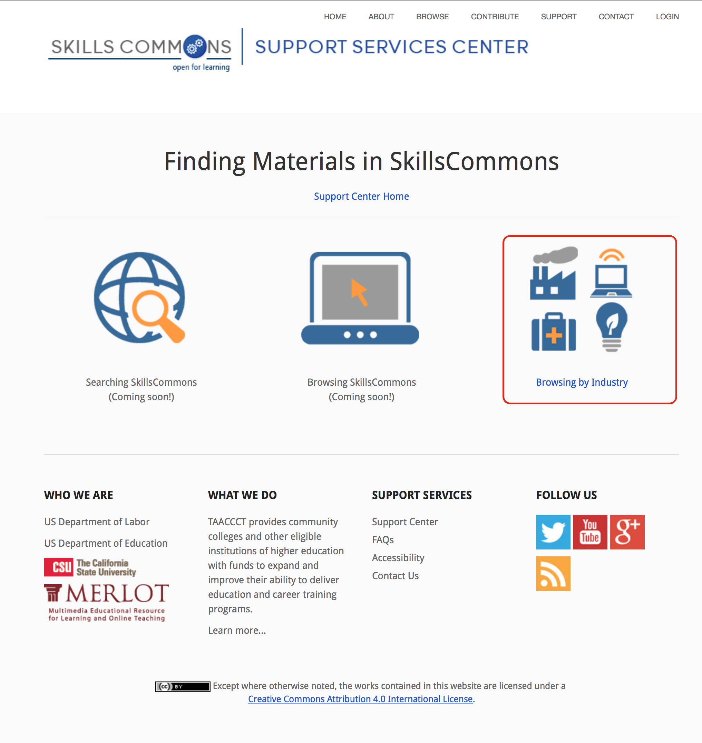
Discover & Reuse Materials

Slide 13
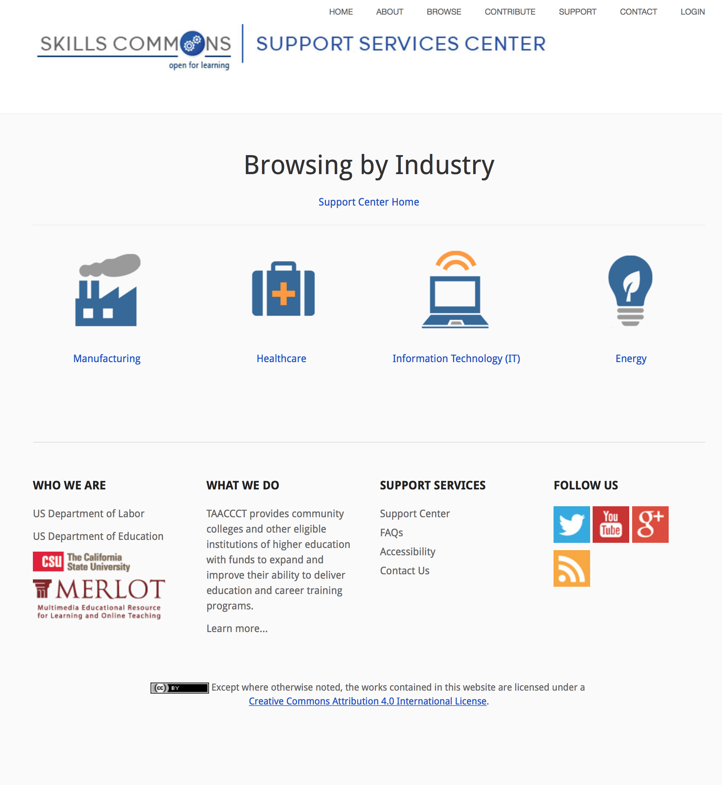
Browsing by Industry

Slide 14
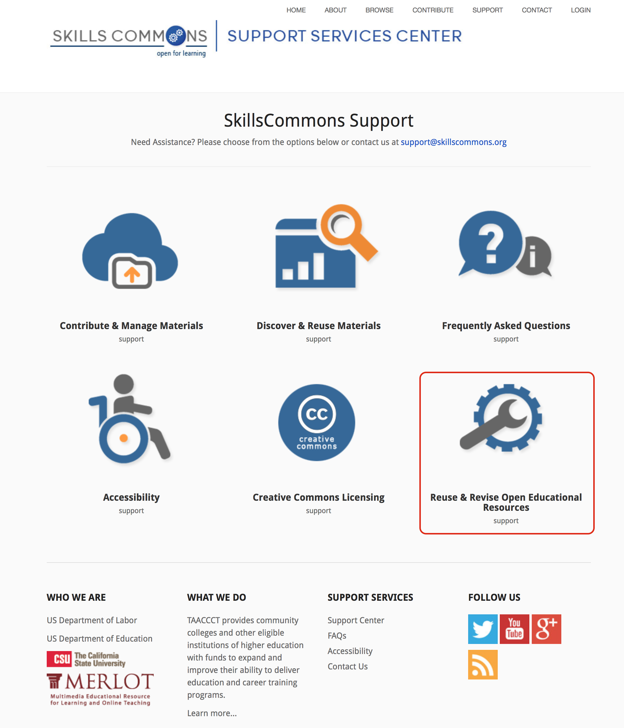
Reuse & Revise Open Educational Resources

Slide 15
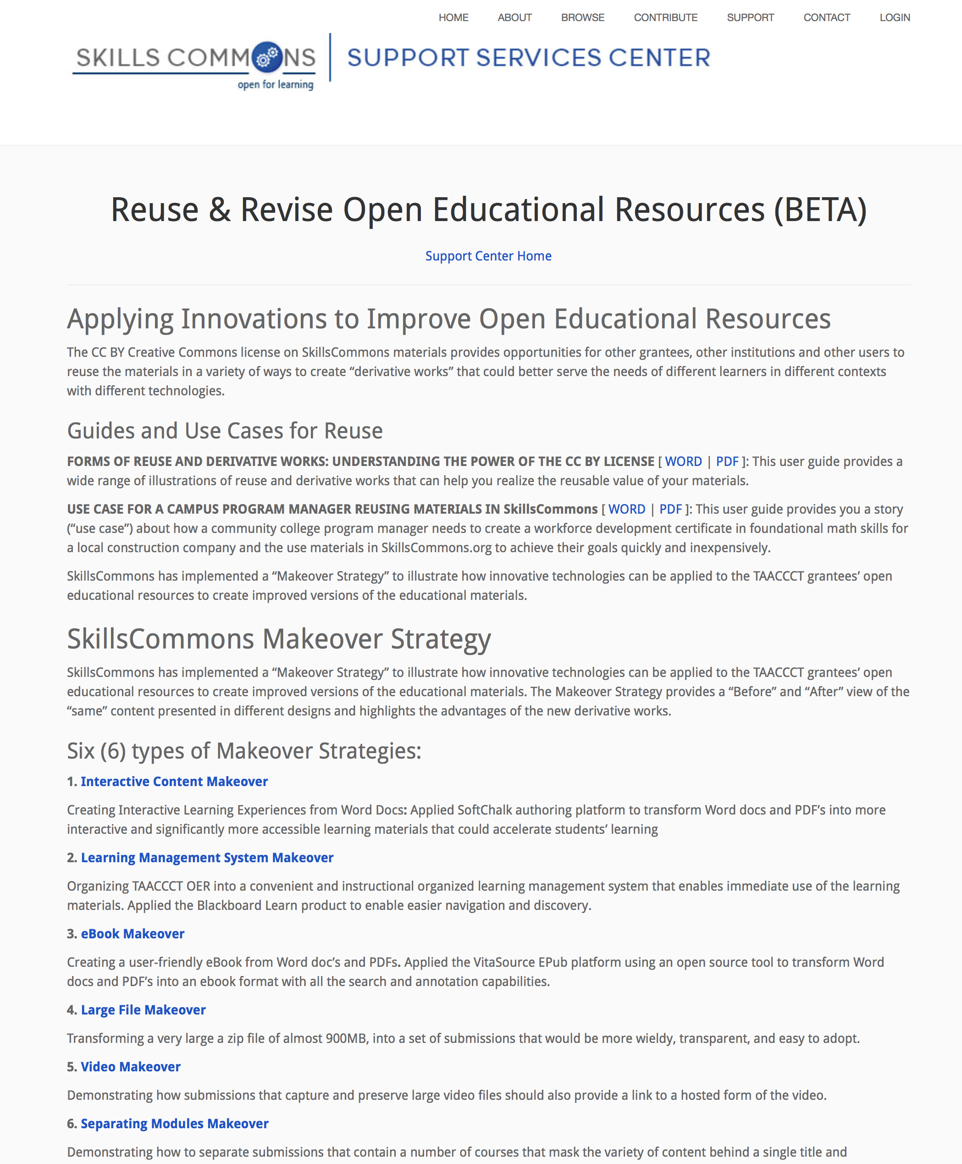
Reuse & Revise Open Educational Resources

Slide 16
Q&A

Slide 17
Explore Resources for Completing & Closing Out Your Grant

Slide 18
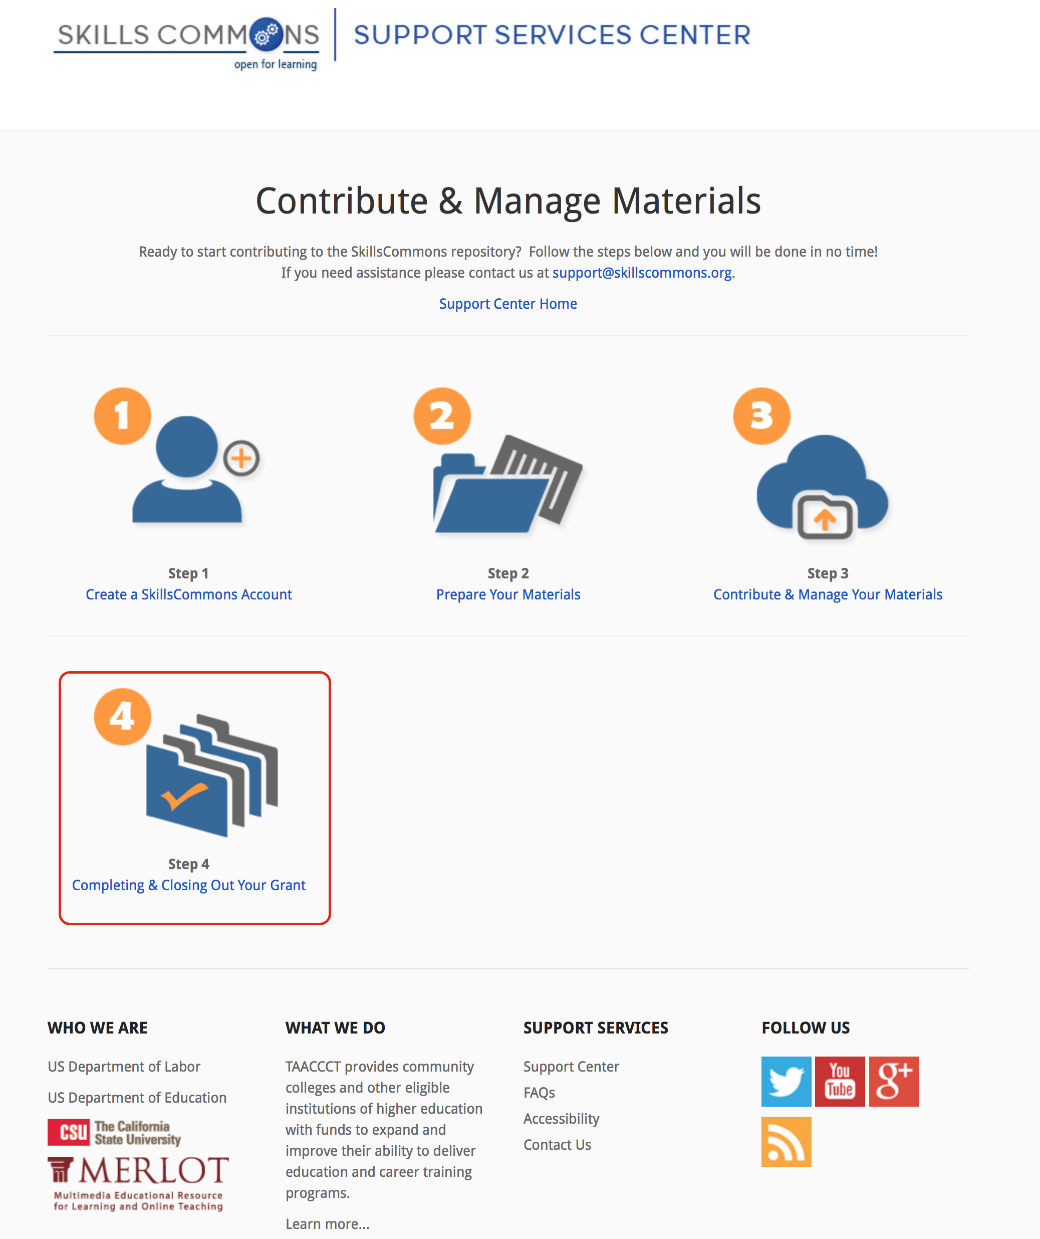
Explore Resources for Completing & Closing Out Your Grant

Slide 19
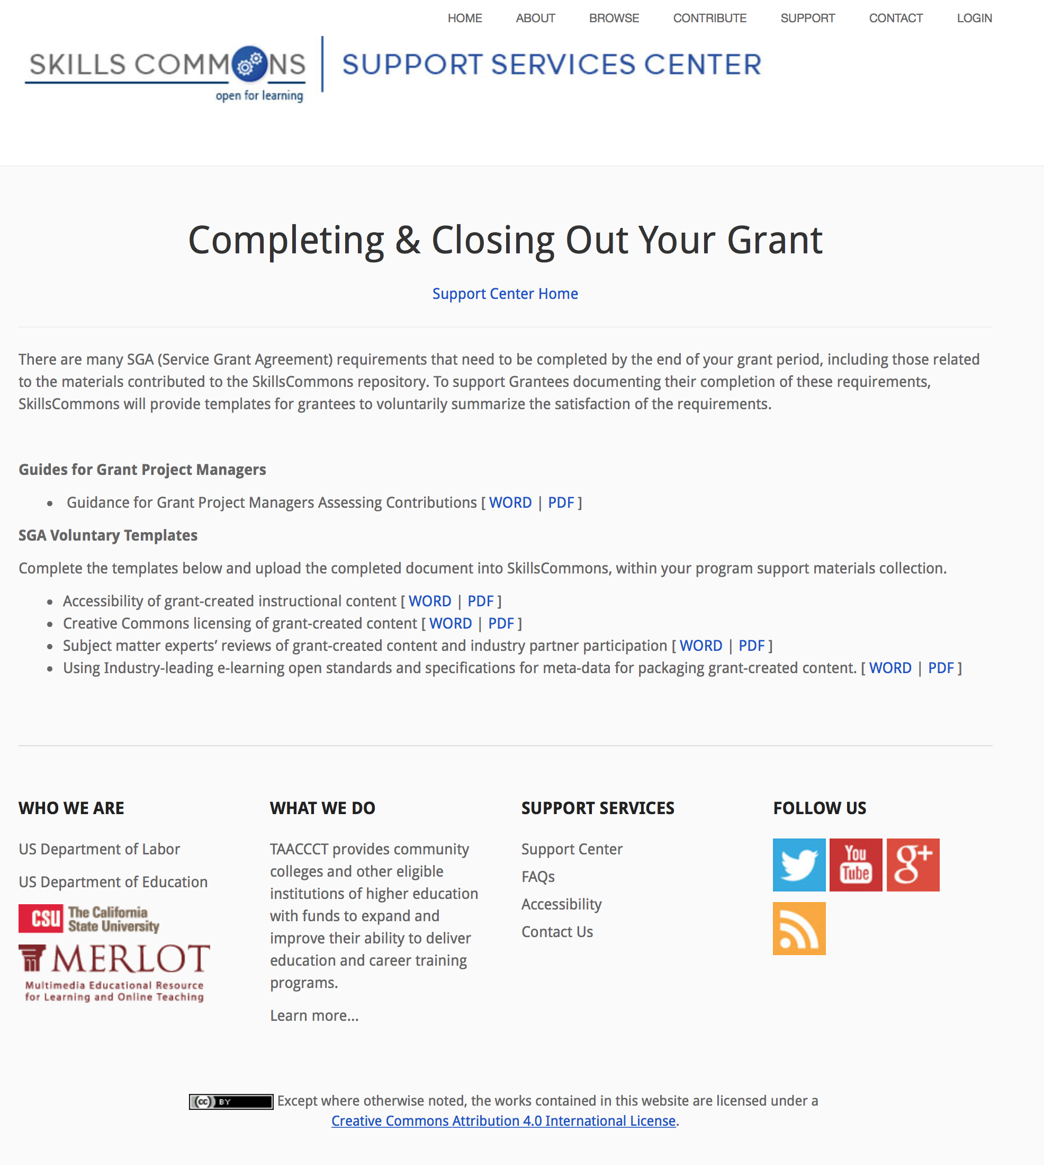
Explore Resources for Completing & Closing Out Your Grant

Slide 20
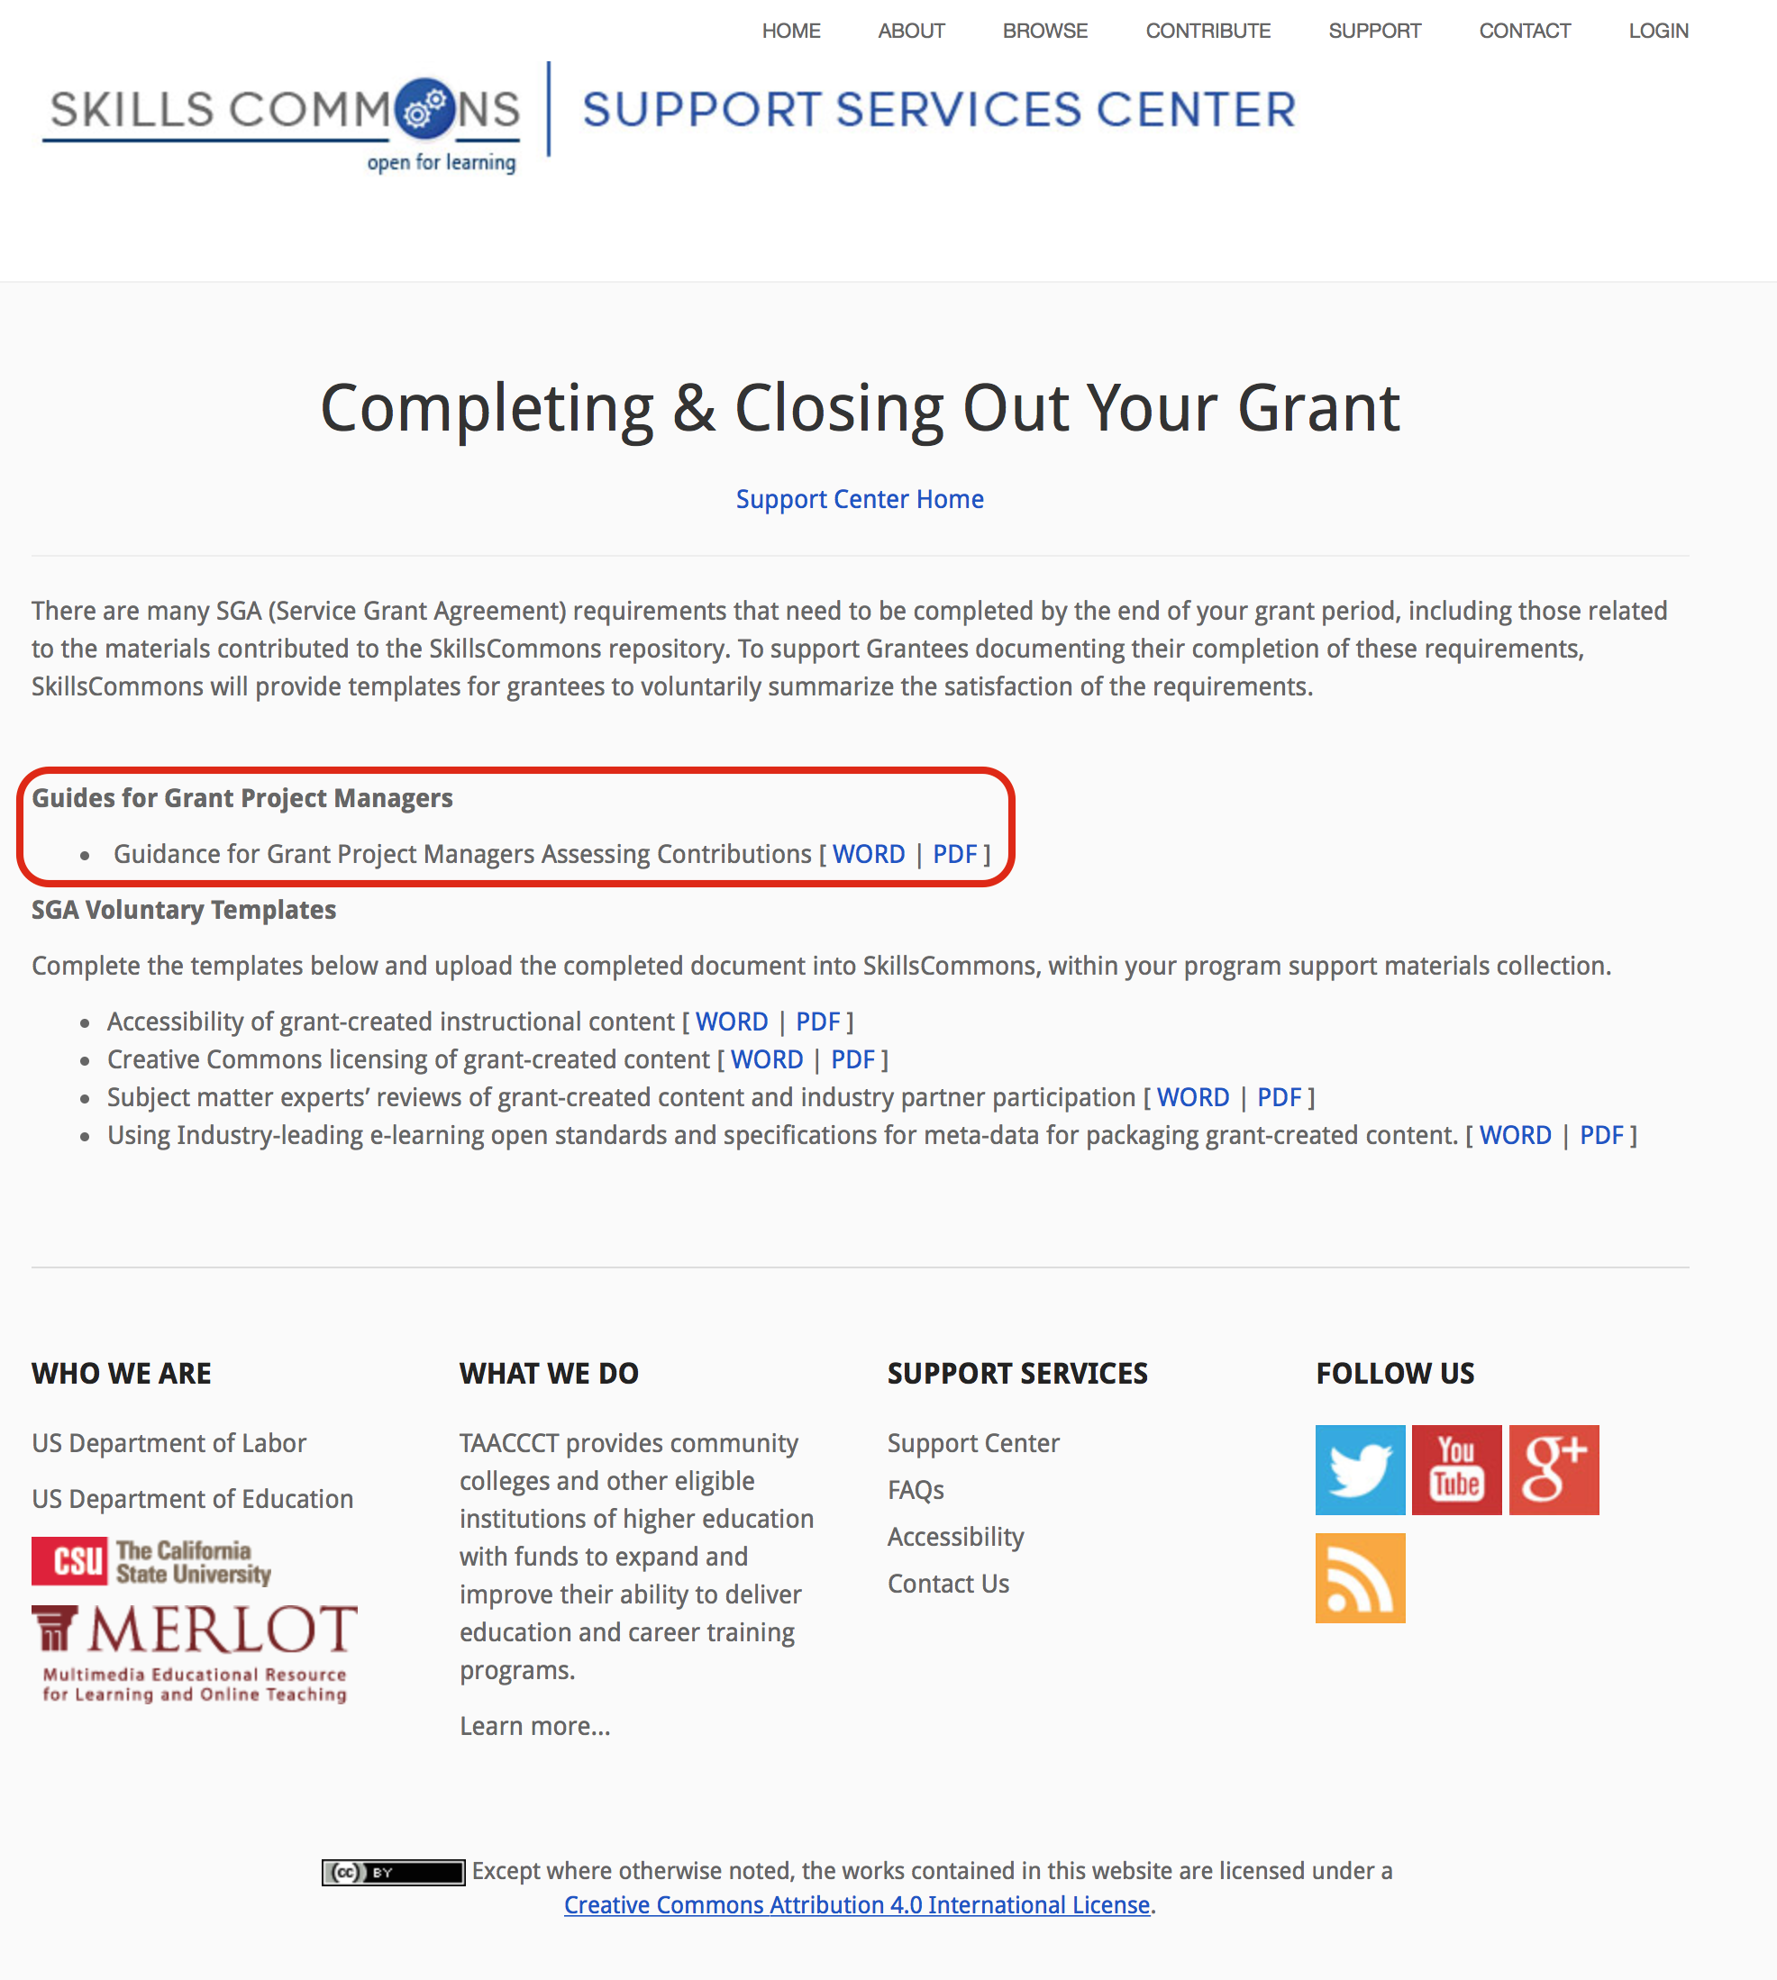
Guidance for Grant Project Managers to Assess TAACCCT Grantee Contributions

Slide 21

Guidance for Grant Project Managers to Assess TAACCCT Grantee Contributions

Slide 22
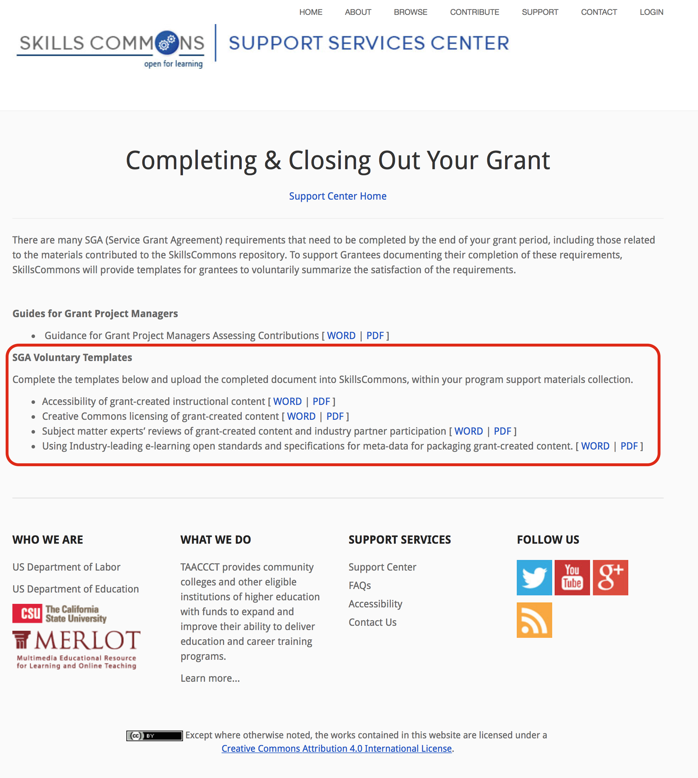
SGA Voluntary Templates

Slide 23
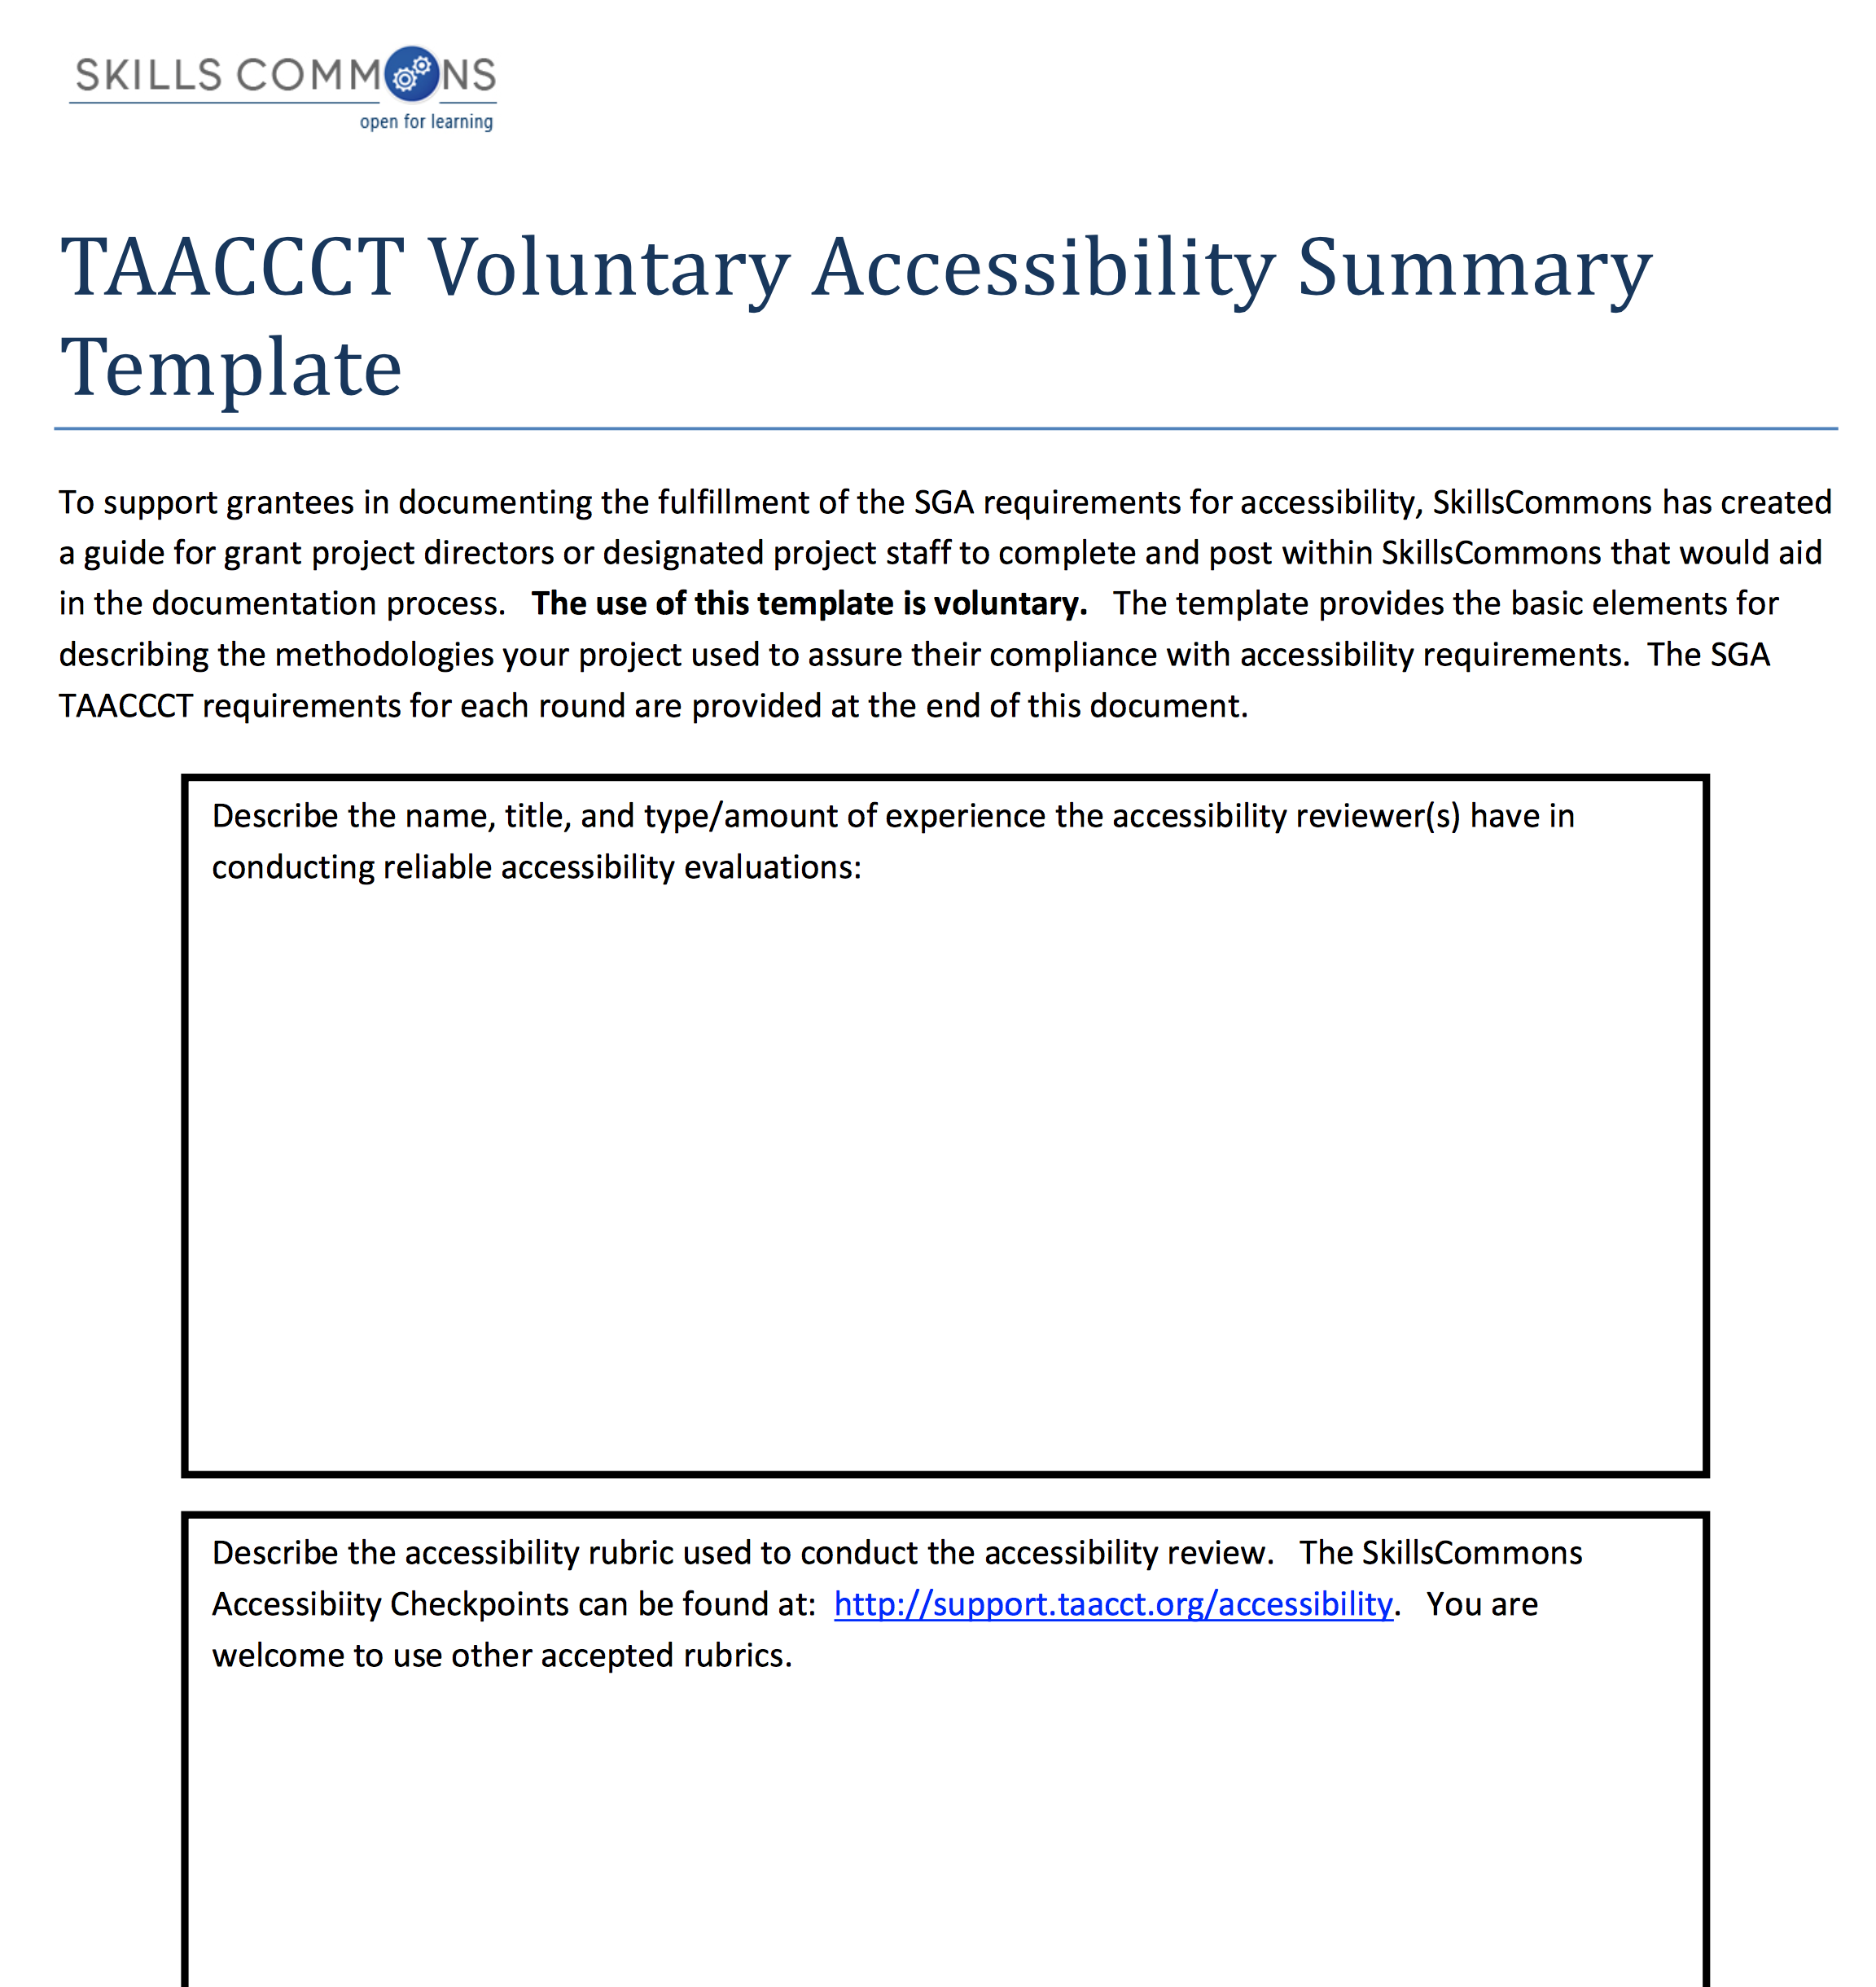
Accessibility – Voluntary Template

Slide 24
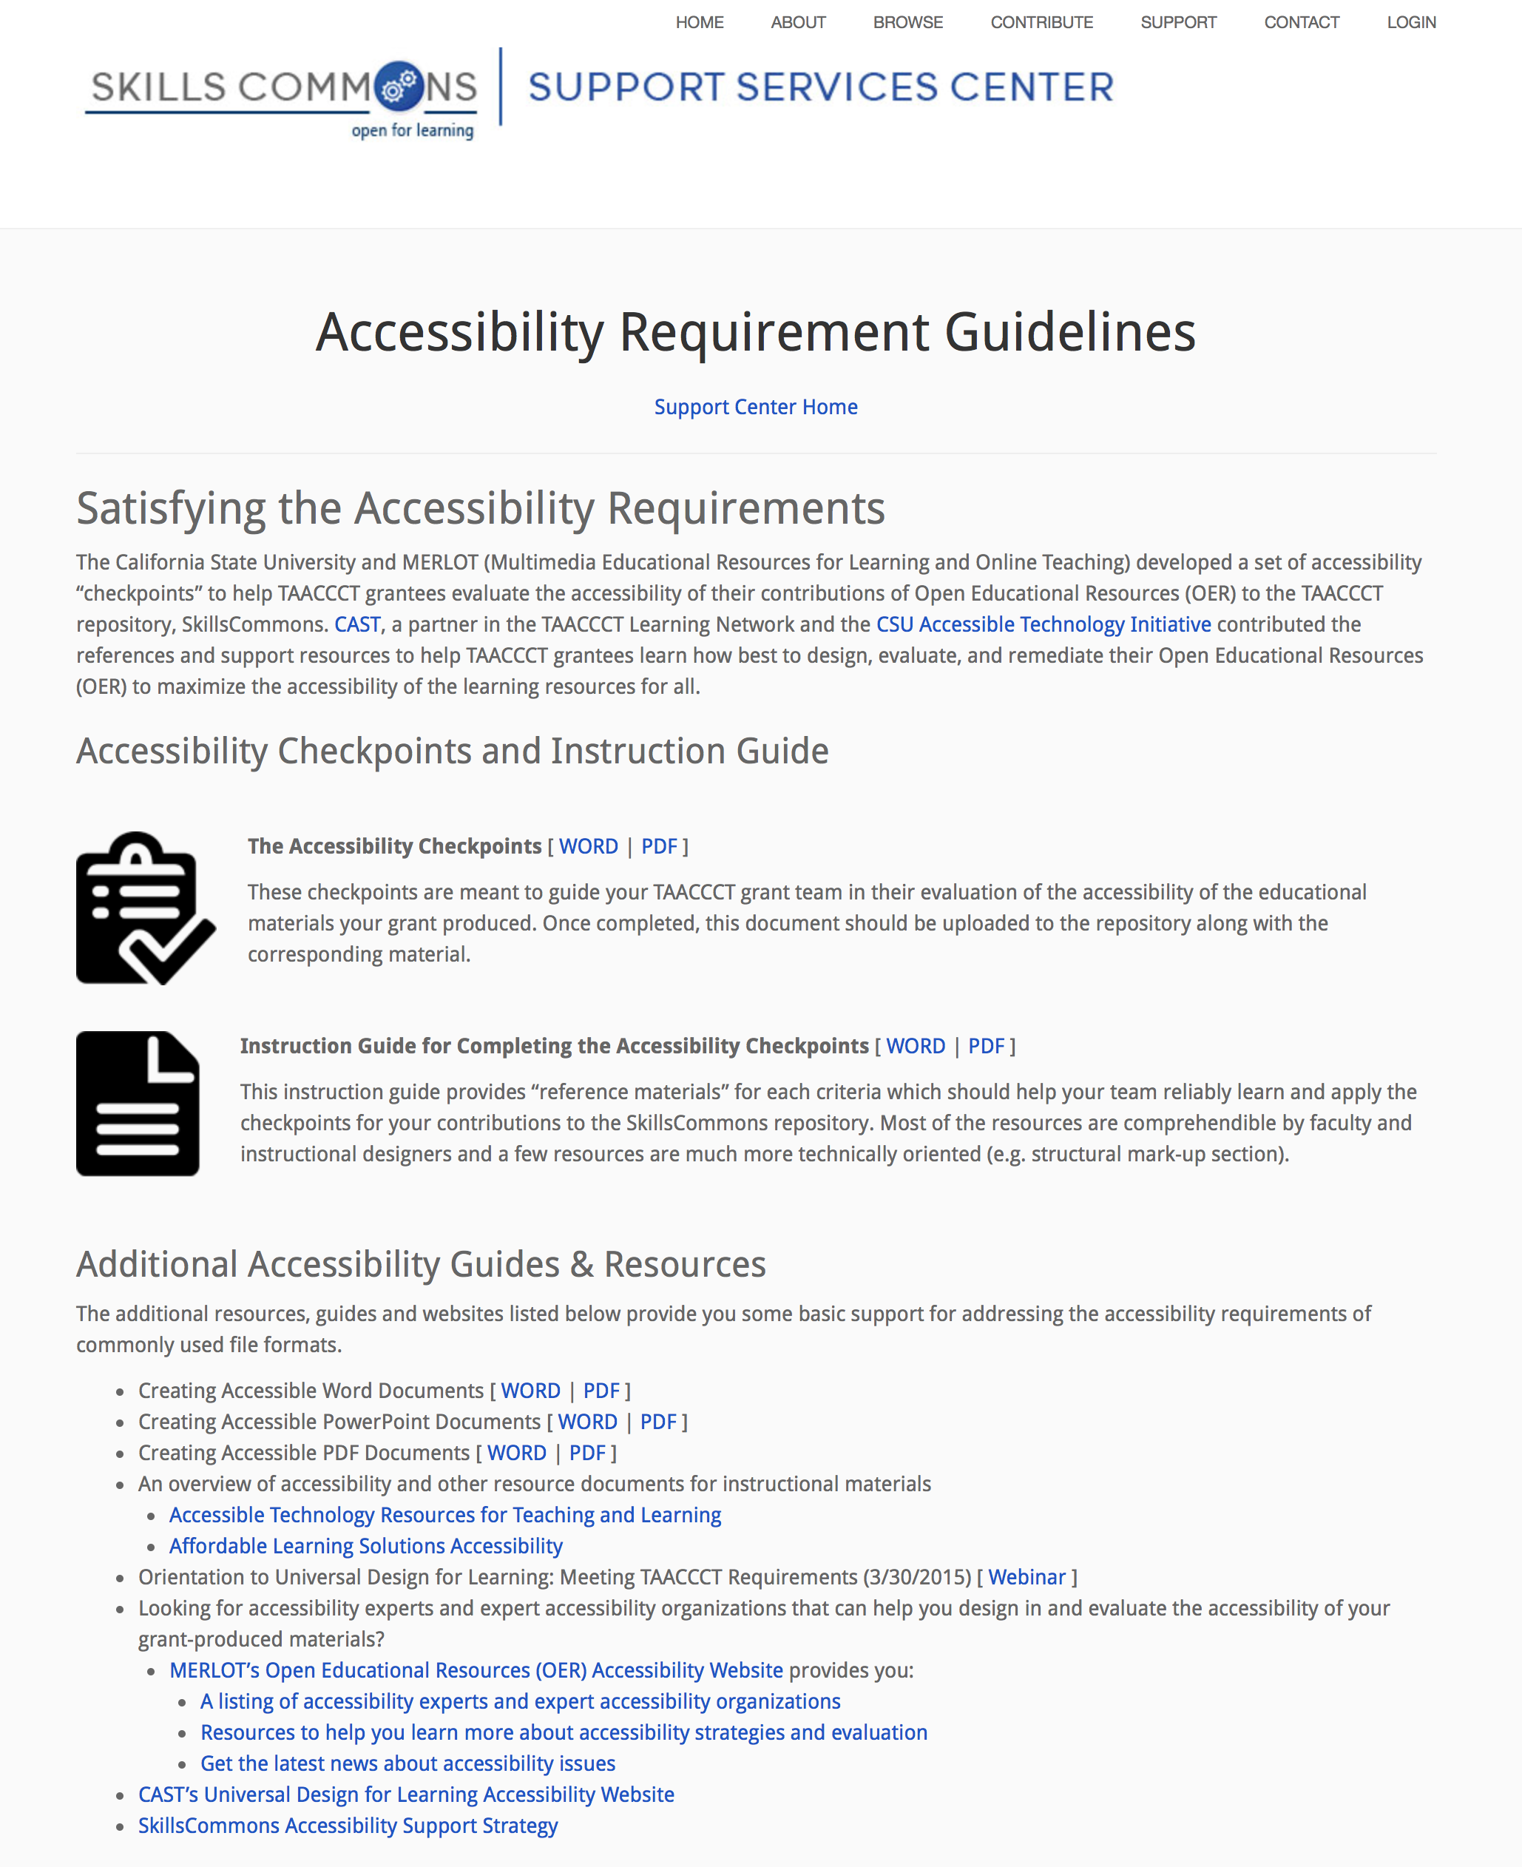
Accessibility Guidelines

Slide 25
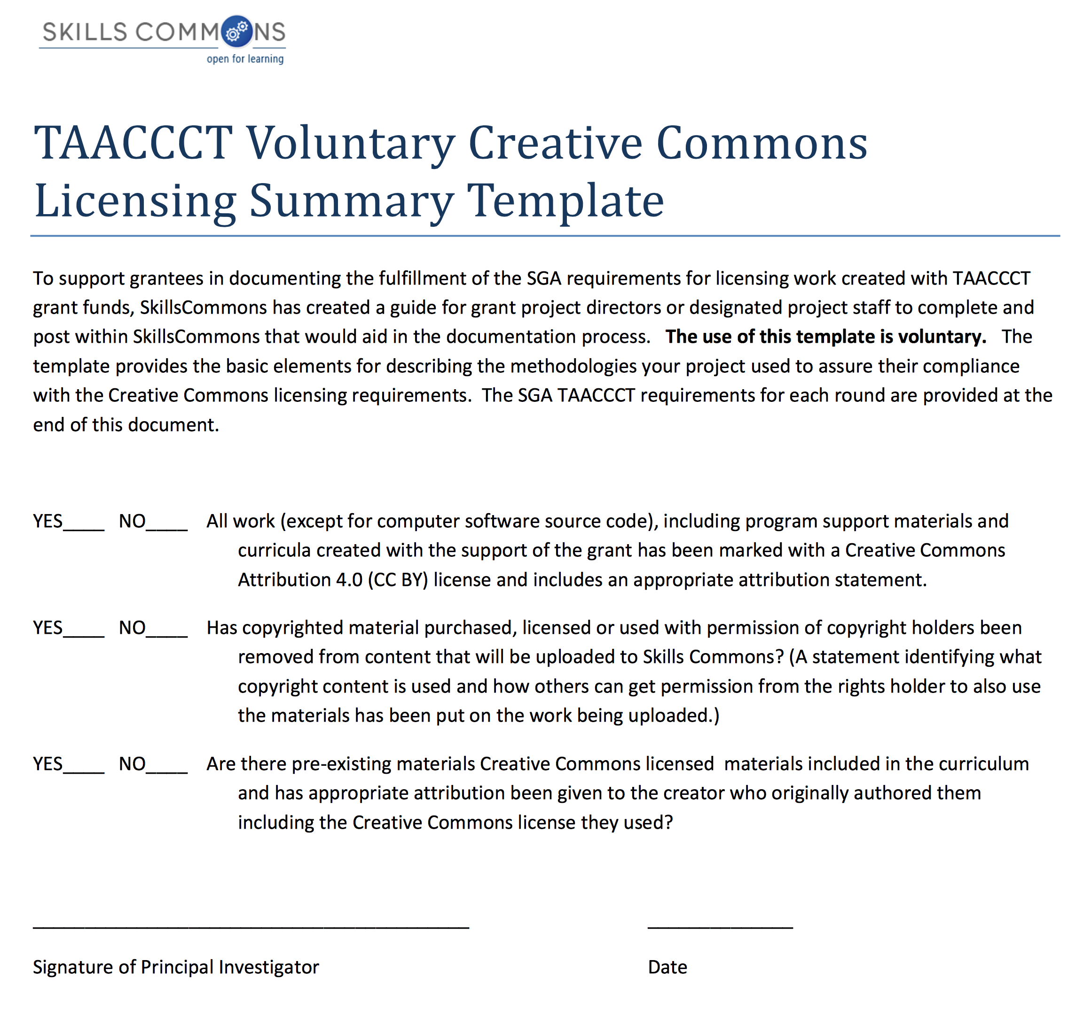
CC-BY Licensing – Voluntary Template

Slide 26
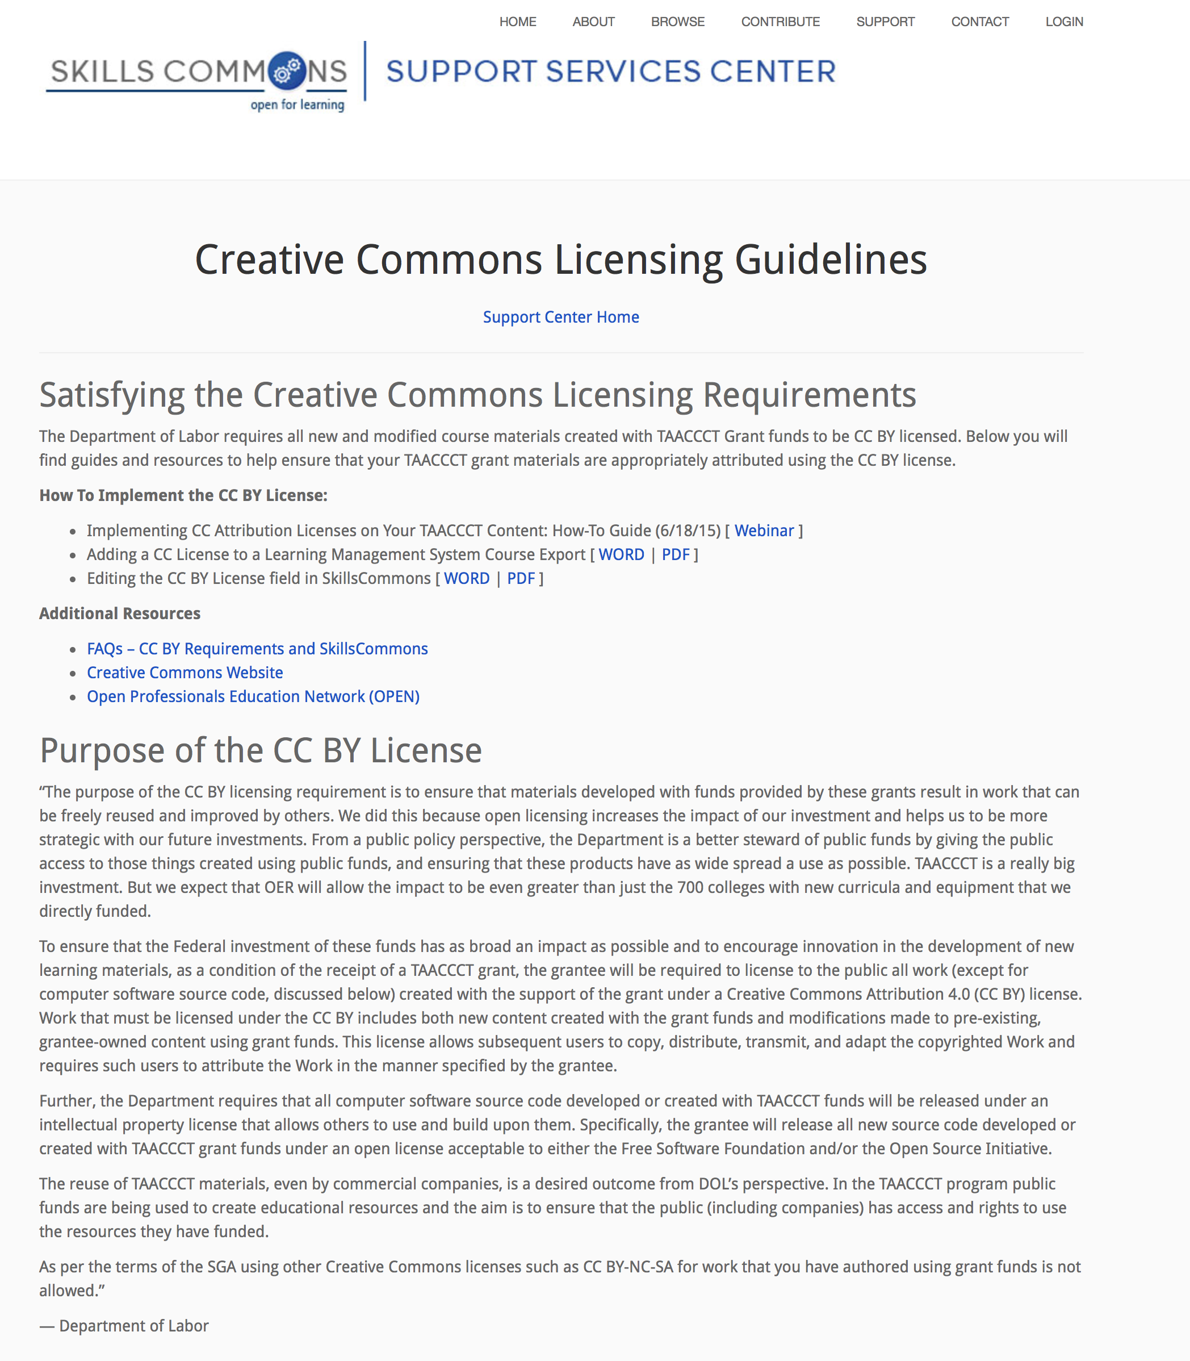
CC-BY Licensing – Guidelines

Slide 27
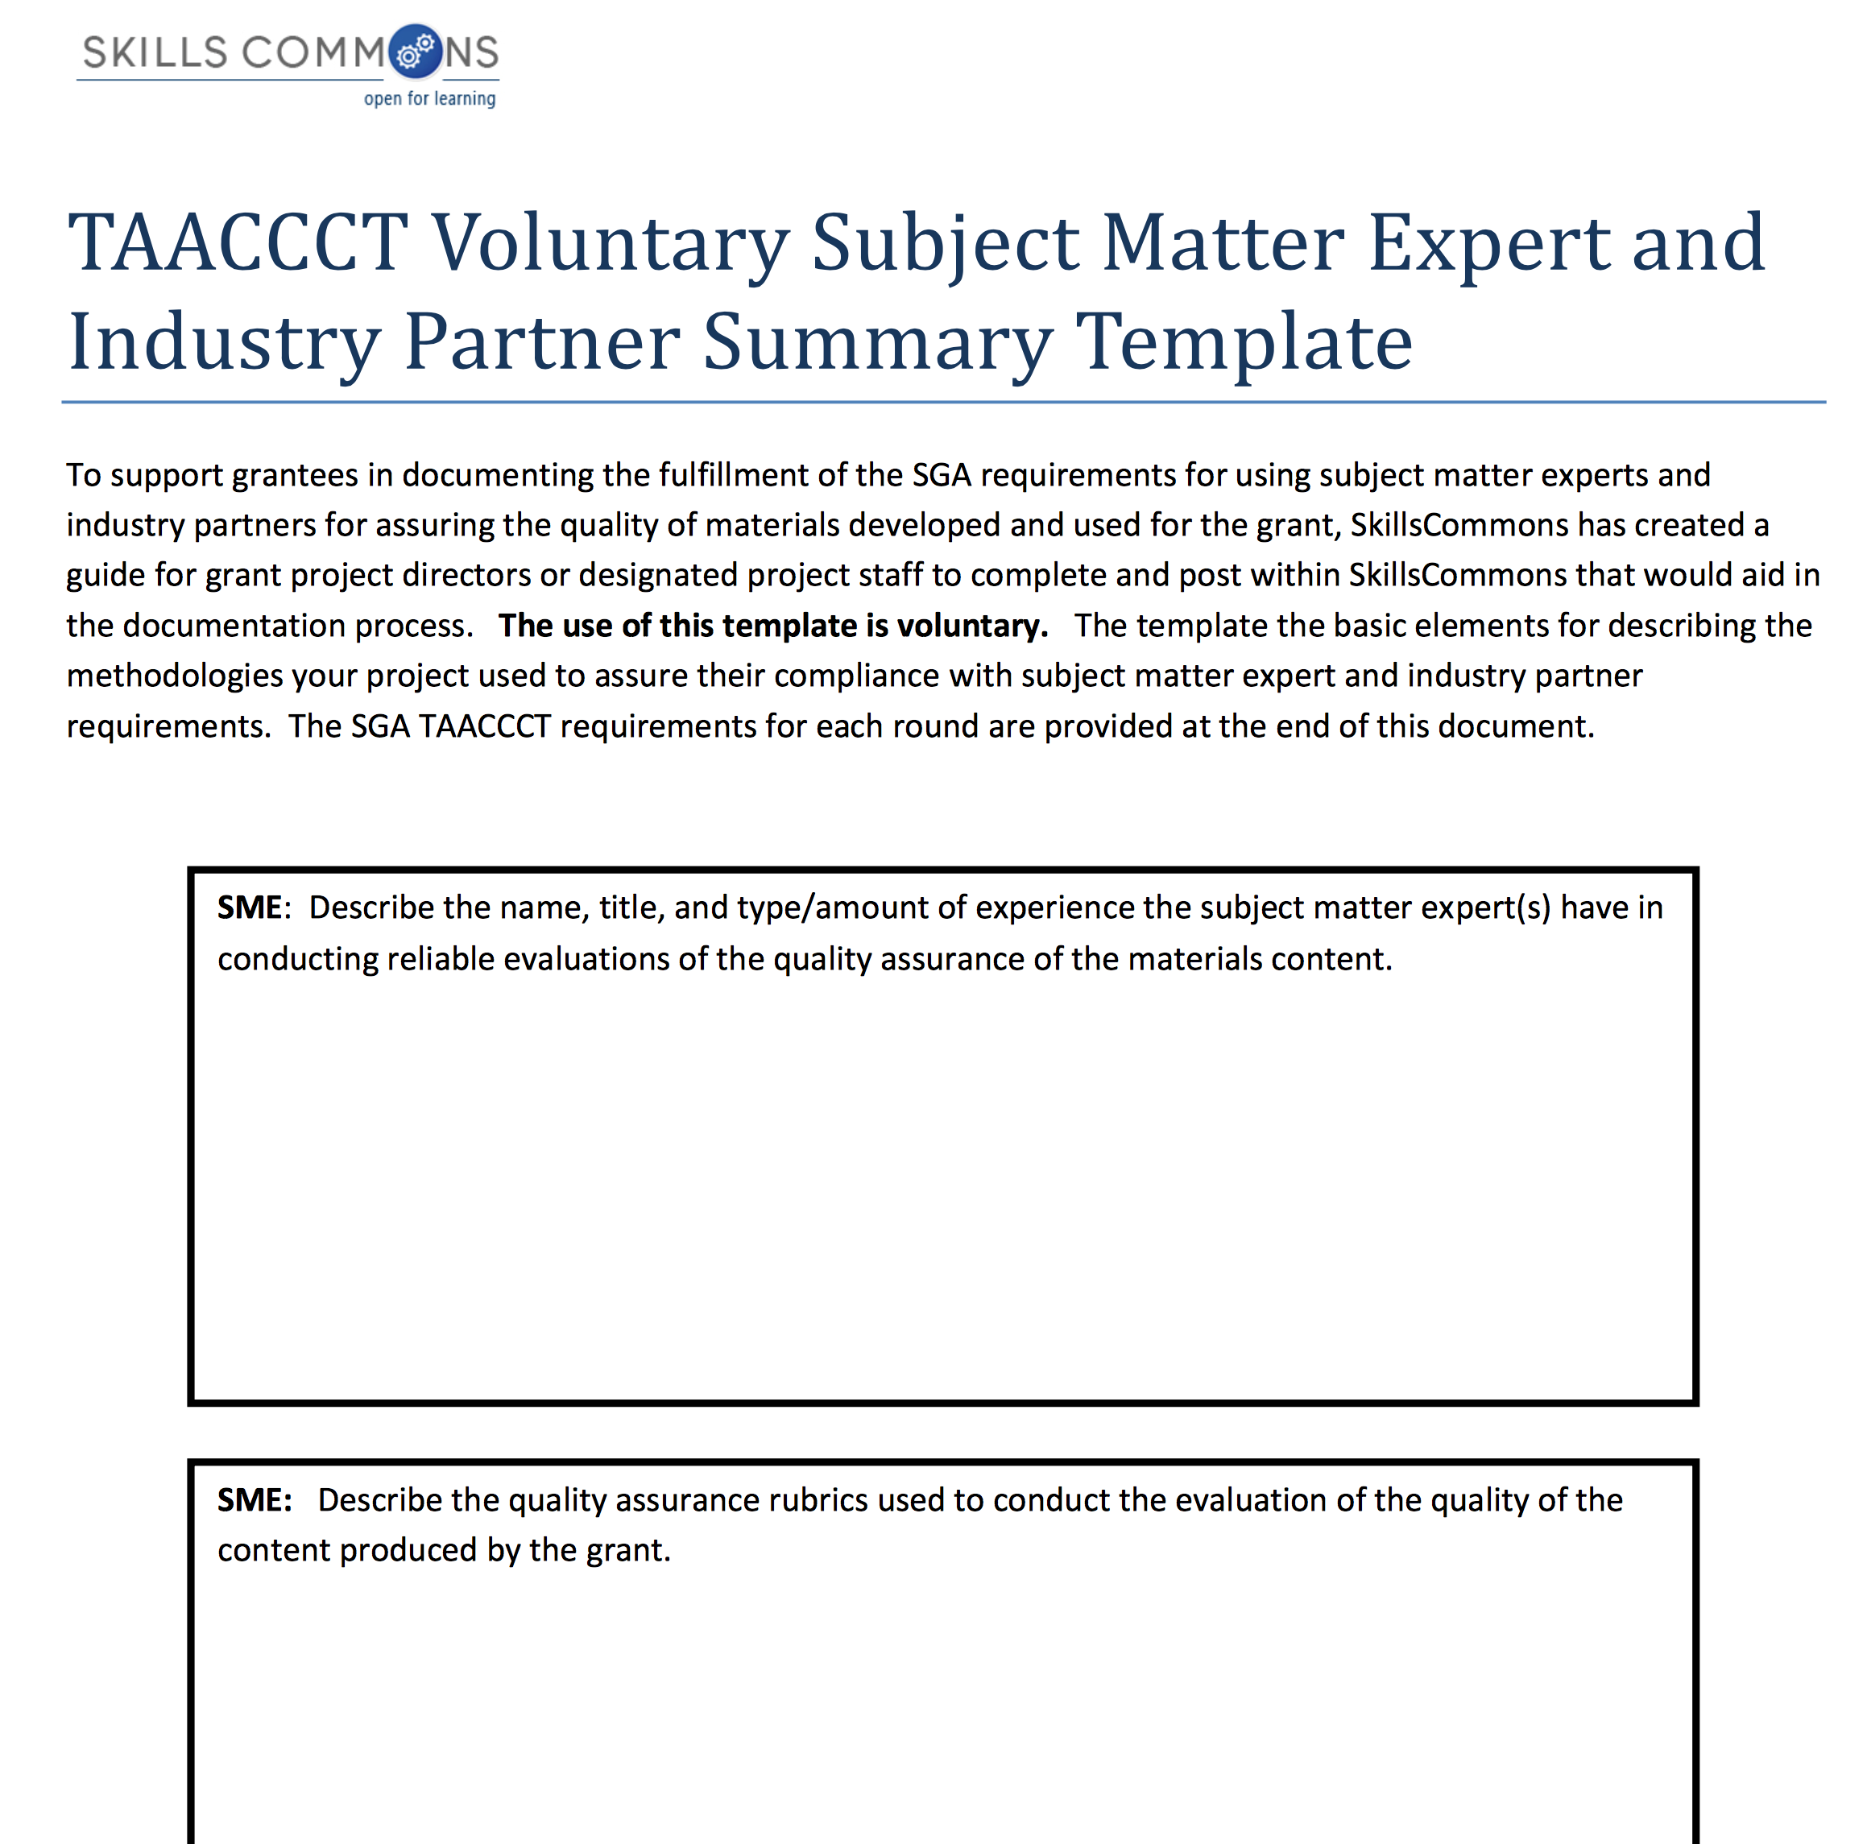
Subject Matter Expert (SME) – Voluntary Template

Slide 28
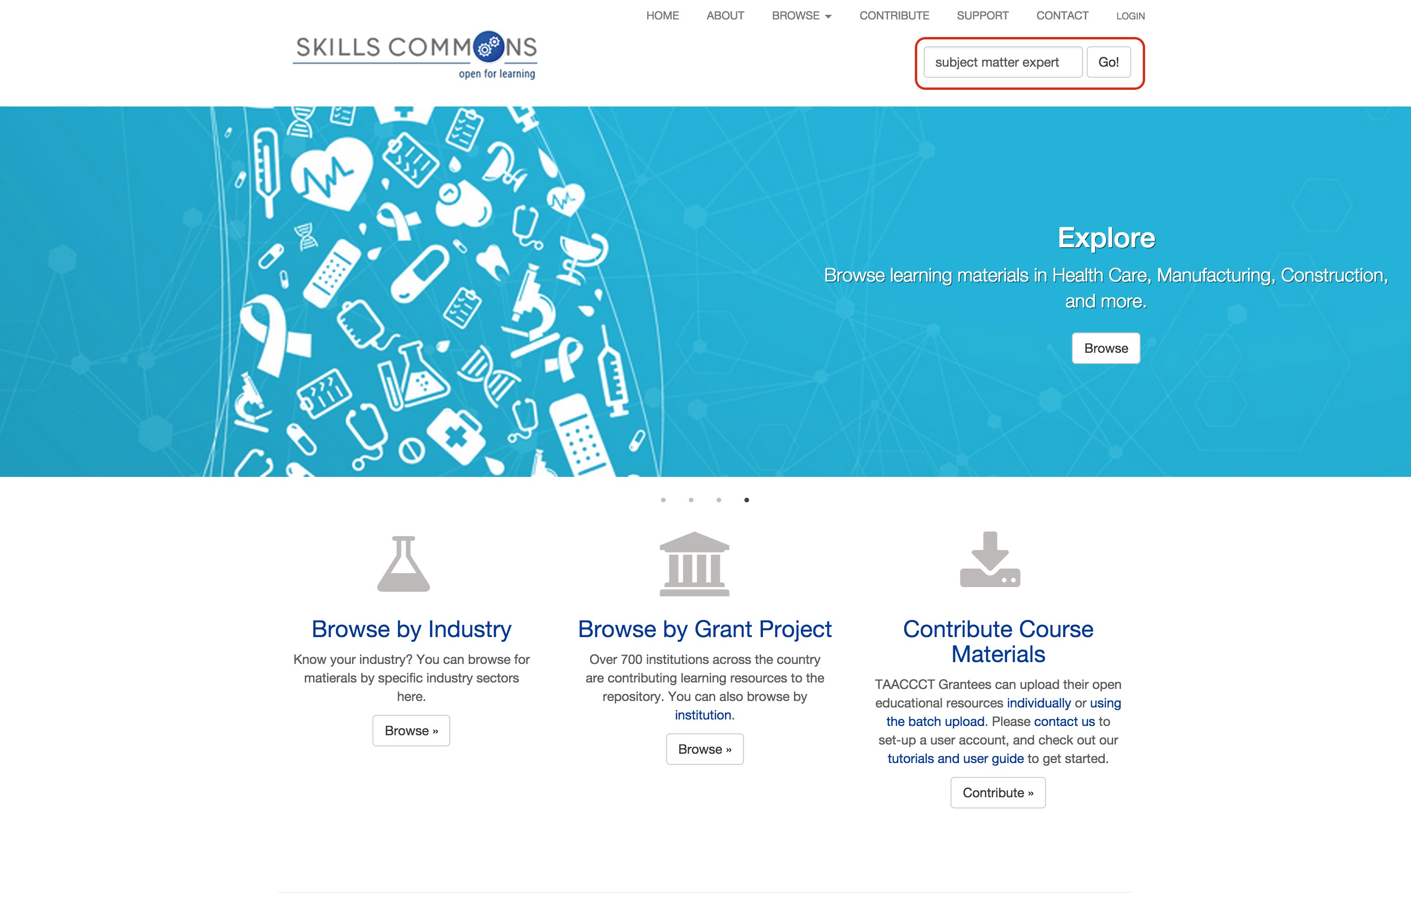
Search for Examples of SME Reports in SkillsCommons

Slide 29
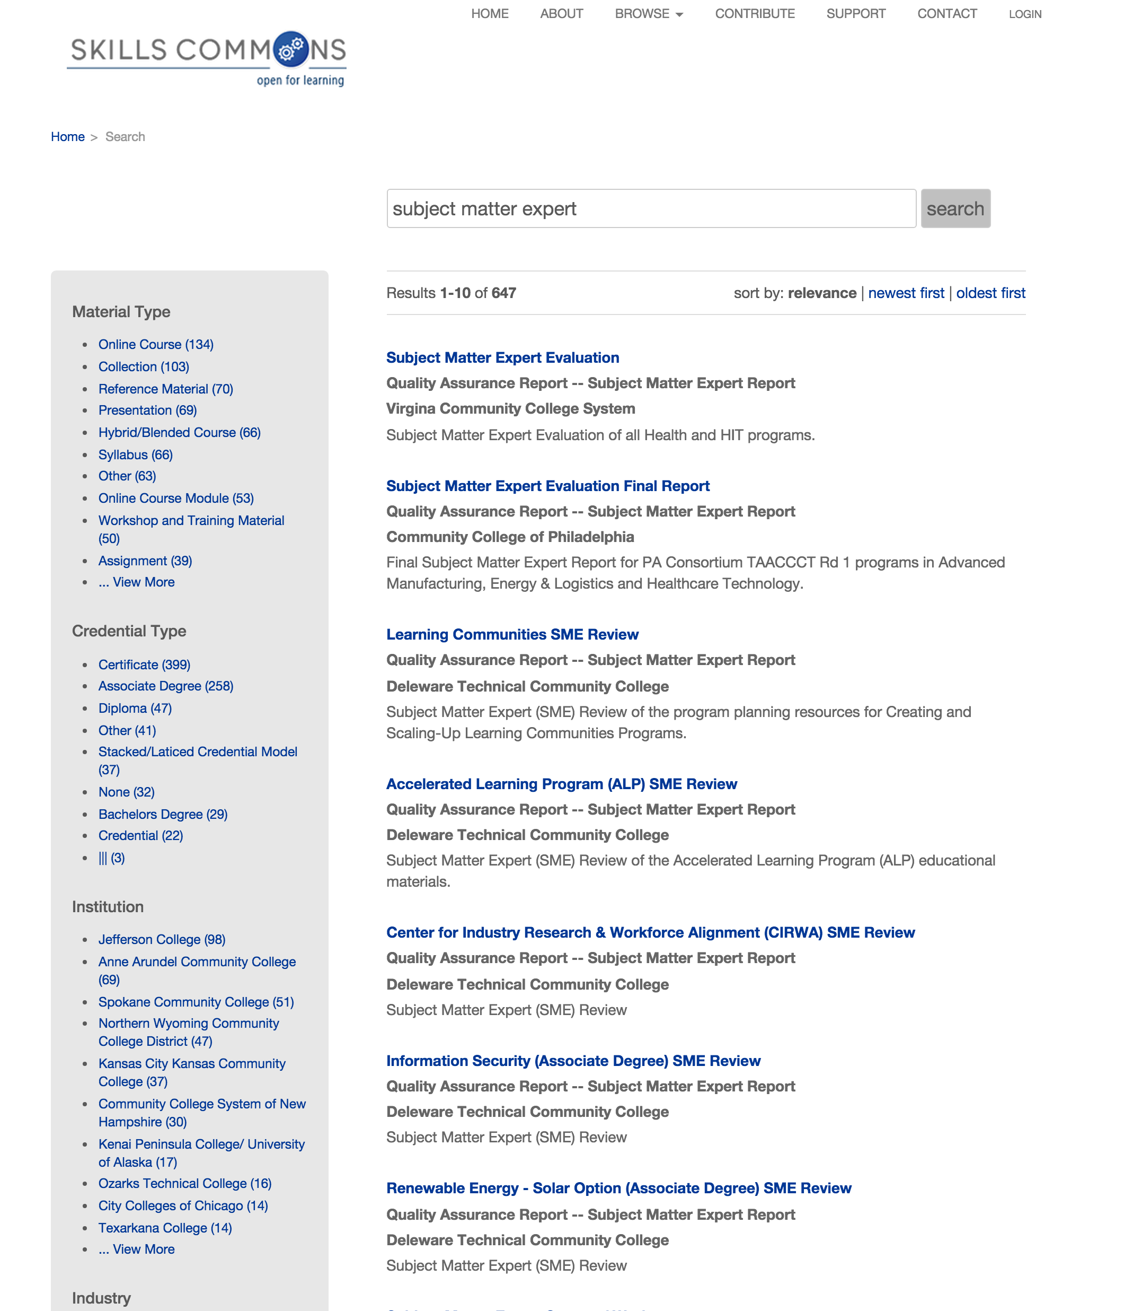
Search for Examples of SME Reports in SkillsCommons

Slide 30
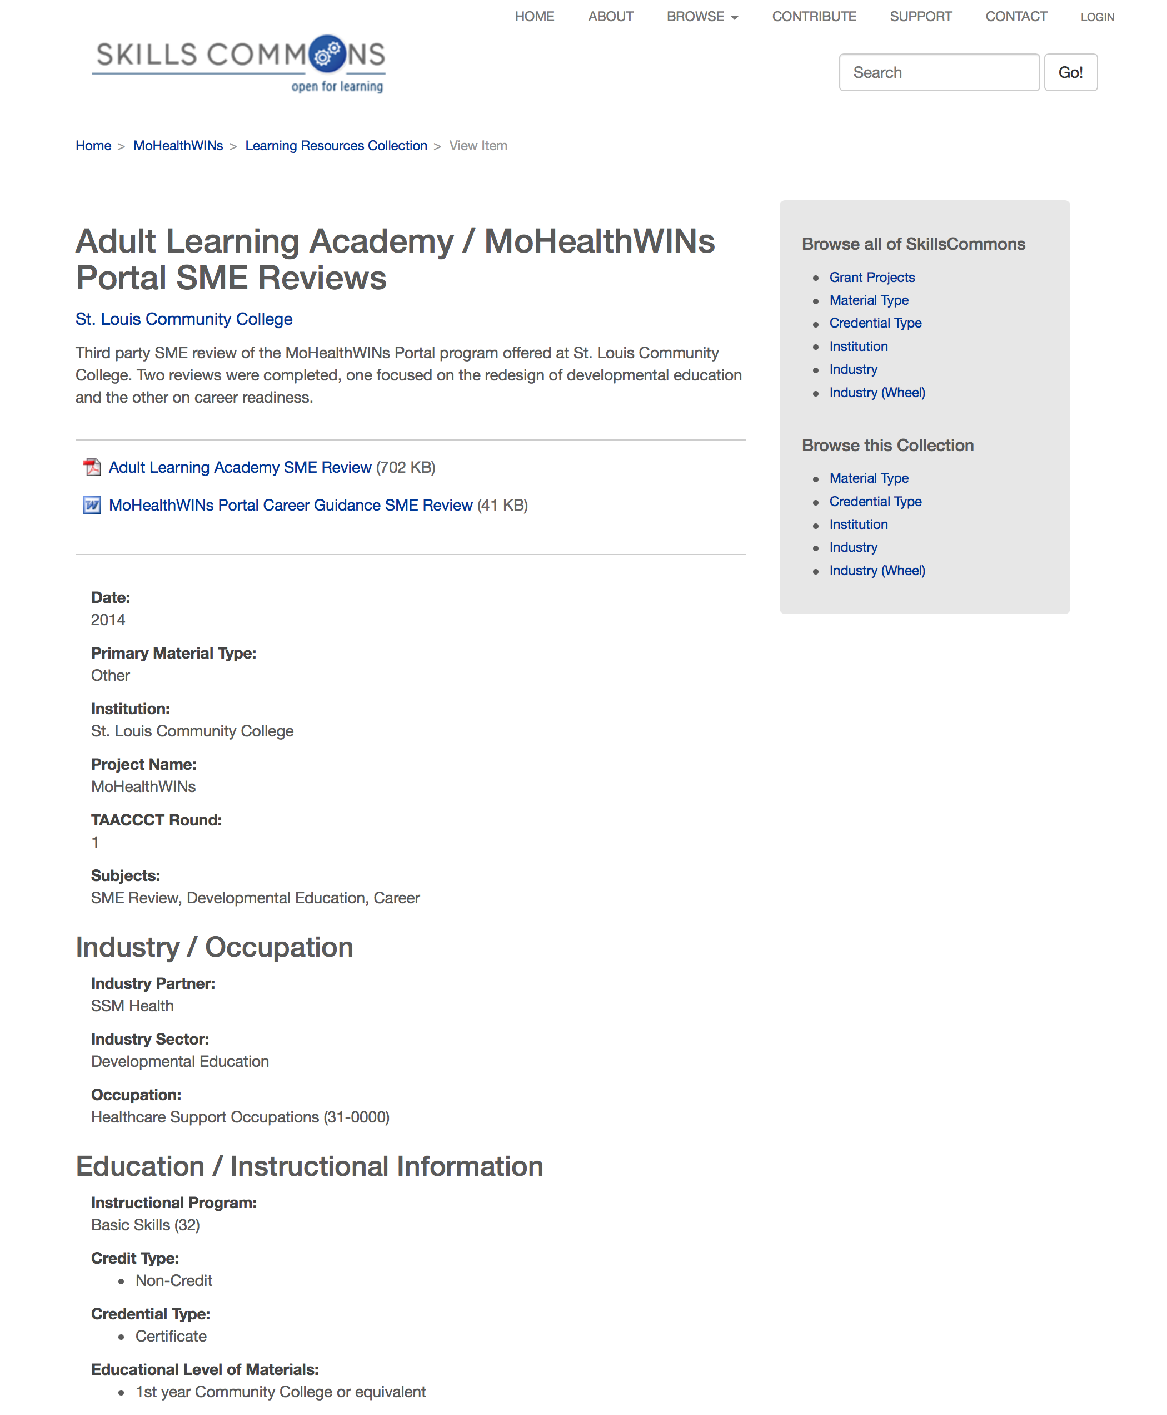
Subject Matter Expert – Example 1
Notes:
https://www.skillscommons.org/handle/taaccct/2571

Slide 31
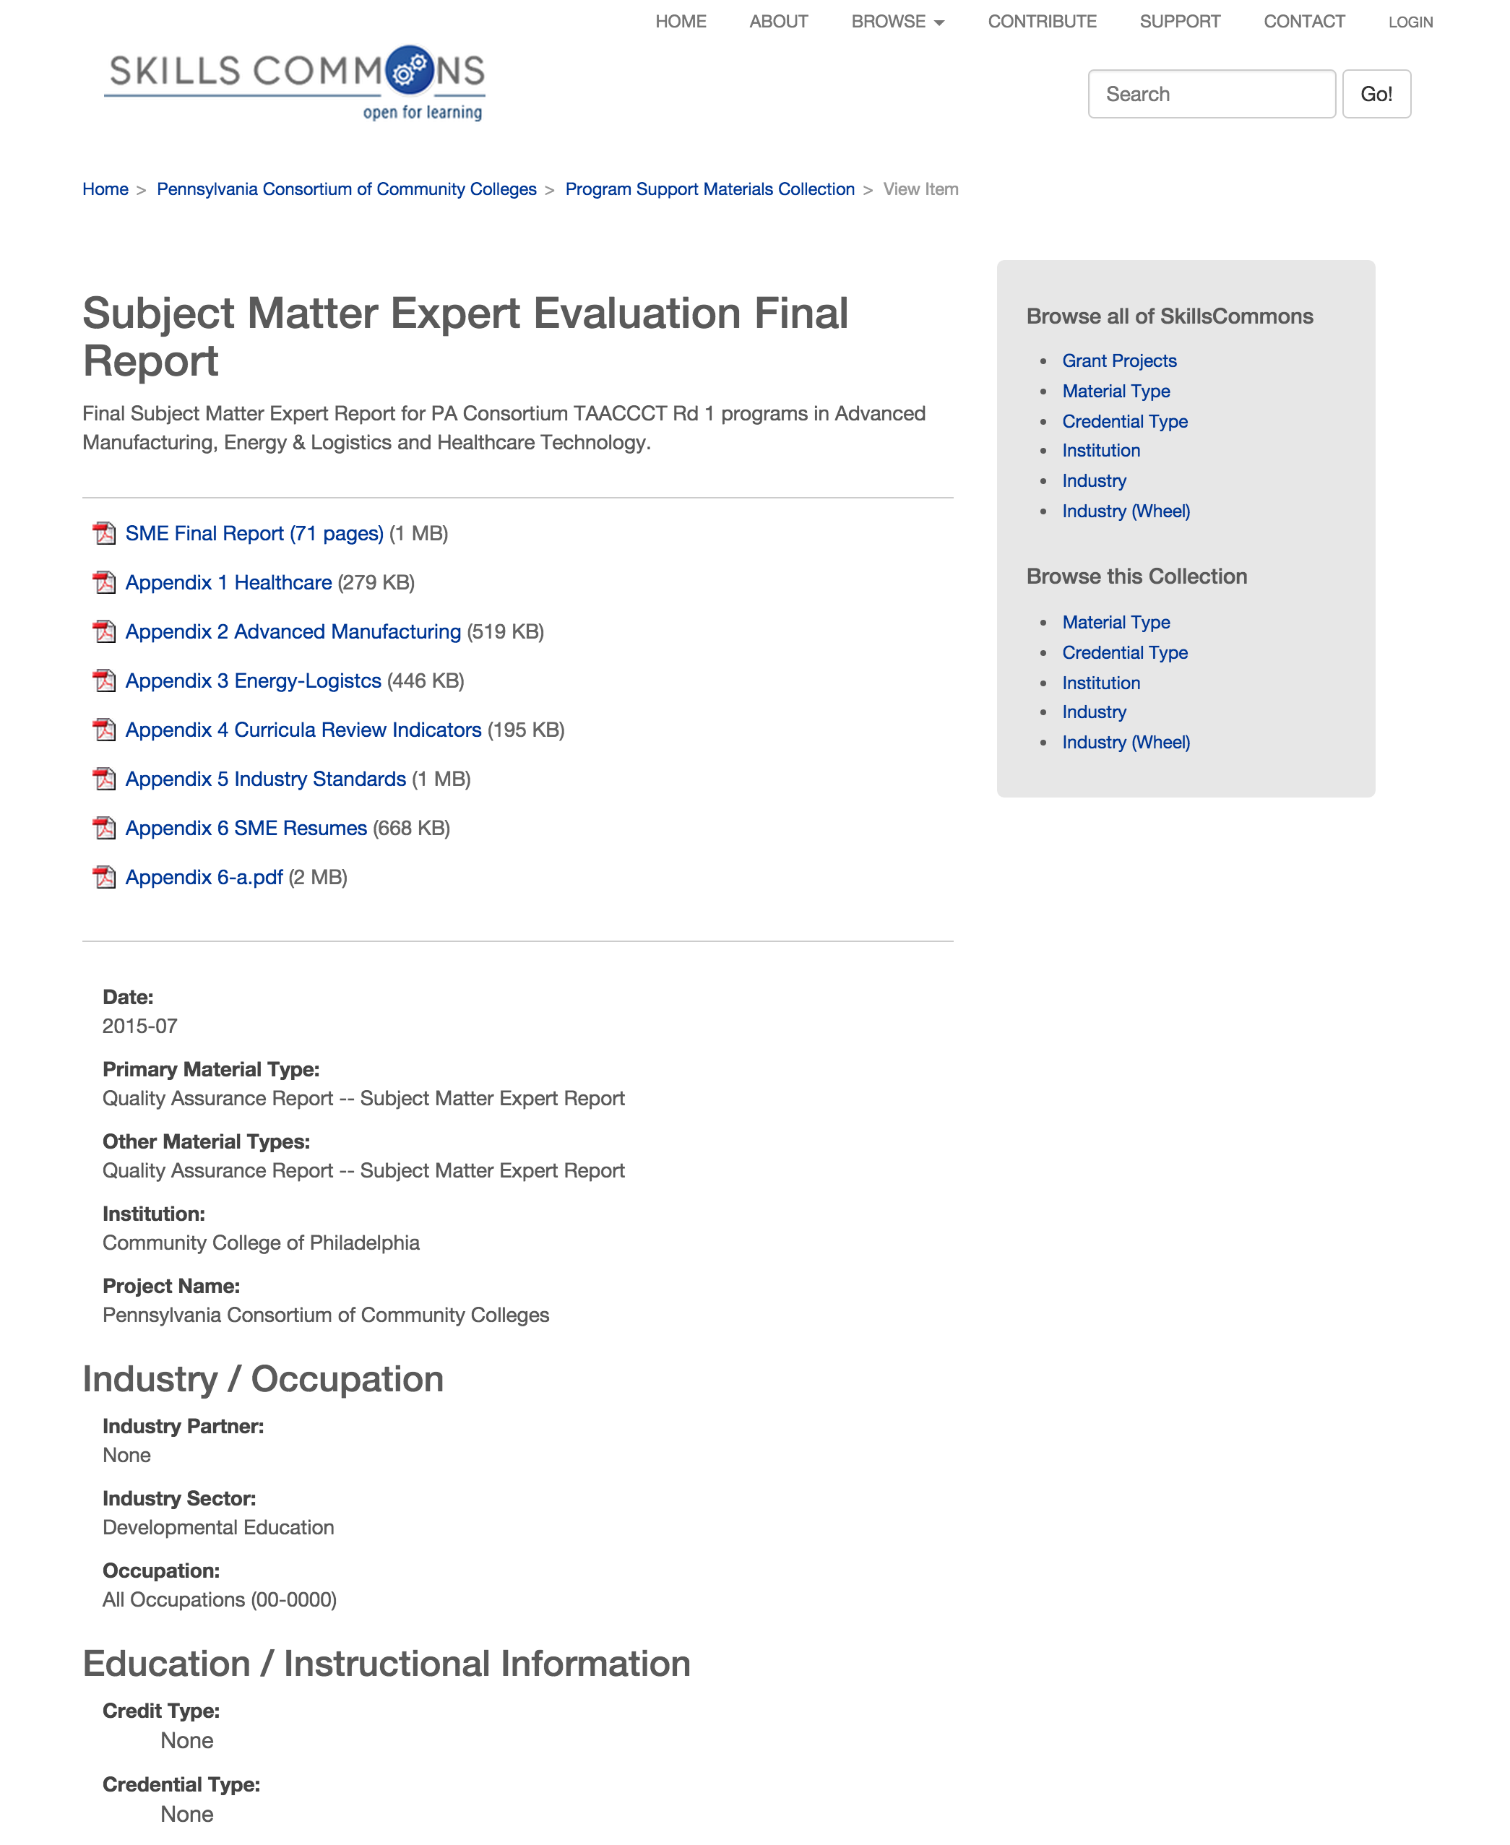
Subject Matter Expert – Example 2
Notes:
https://www.skillscommons.org/handle/taaccct/3300

Slide 32
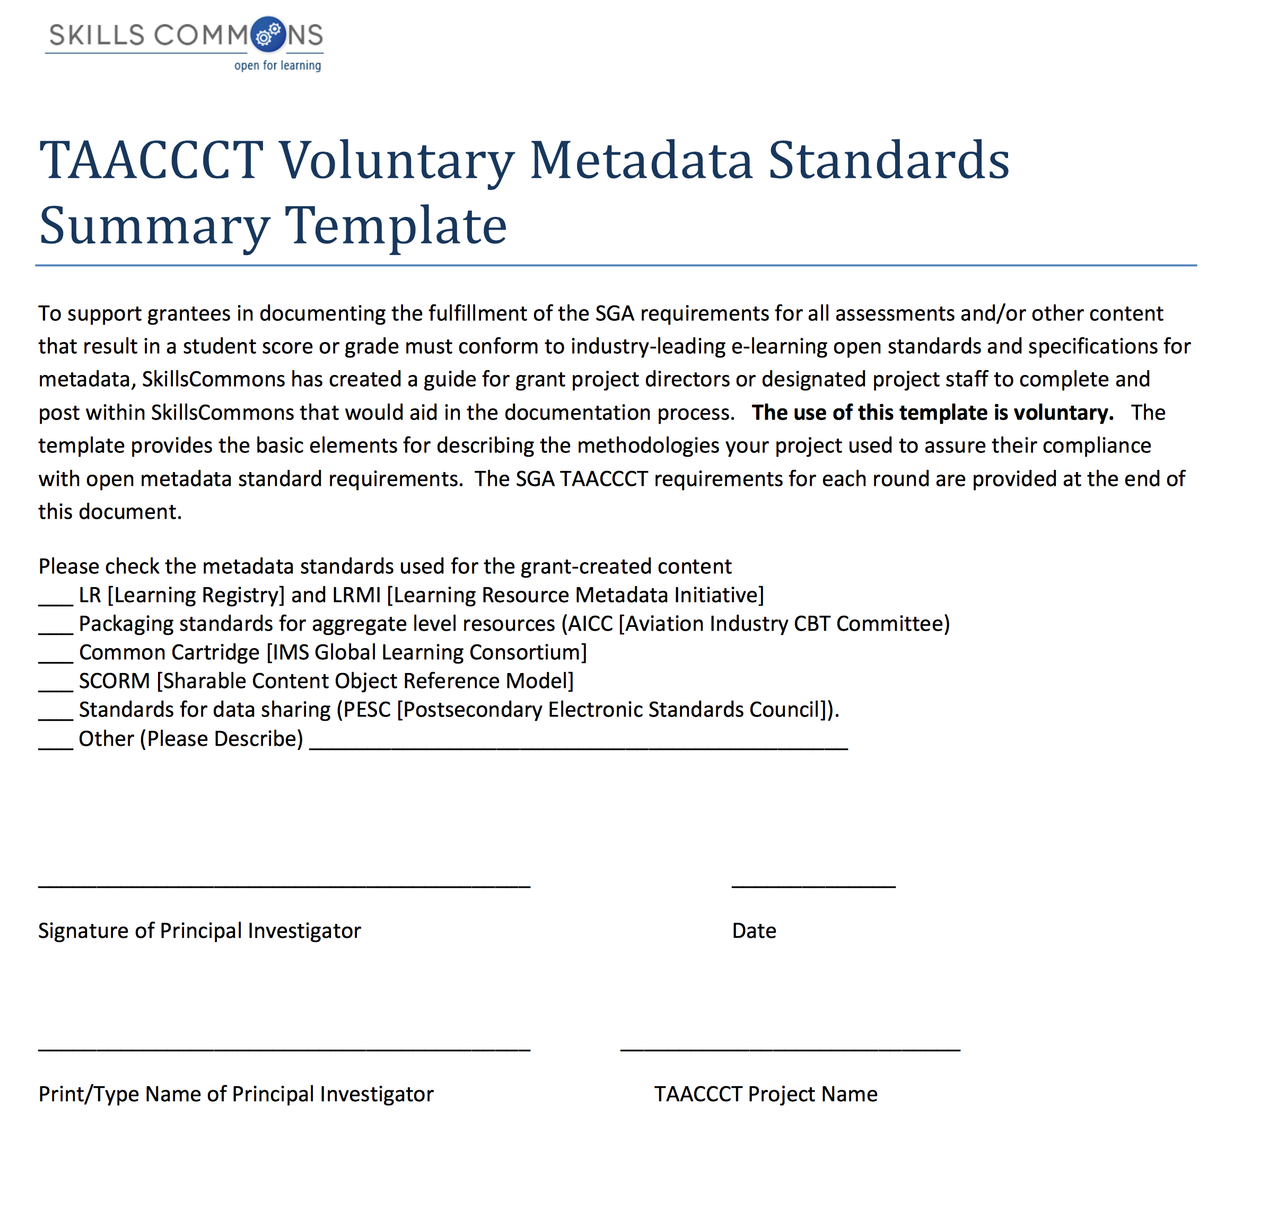
Metadata Standards Summary – Voluntary Template

Slide 33
Q&A

Slide 34
Grant Products and Deliverables
Creative Commons Attribution License
  Grantees will license to the public all work created with the support of the grant under a Creative Commons Attribution 3.0 (CC BY) license;
  Grantee will release all new source code developed or created with grant funds under an open license acceptable to either the Free Software Foundation and/or the Open Source Initiative; and
  Work that must be licensed under the CC BY includes both new content created with the grant funds and modifications made to pre-existing, grantee-owned content using grant funds.

Slide 35
Grant Products and Deliverables
Third Party Review of Deliverables
  Grantees will be required to identify third-party subject matter experts to conduct reviews of the deliverables produced through the grant.
  Grantees must provide the Department with the results of the review and the qualifications of the reviewer(s) at the time the deliverables are provided to the Department.

Slide 36
Grant Products and Deliverables
TAACCCT Repository of OER
  California State University – MERLOT (Multimedia Education Resources for Learning and Online Technology
  http://www.skillscommons.org
BEGIN UPLOADING PRODUCTS
AS SOON AS POSSIBLE!

Slide 37
FAQ
Question: Can I use Creative Commons 4.0 Attribution License?
Answer: Yes
Question: Do I have to use Creative Commons 4.0 Attribution License?
Answer: No

Slide 38
FAQ
Please Clarify the Types of Items that are Considered Grant Deliverables
According to the SGA, the Department considers curricula, course materials, teacher guides, and other products developed with grant funds to be considered grant deliverables. These items were identified in each grantee’s statement of work as deliverables and to be submitted to the Department according to the workplan or prior to the end of the period of performance.

Slide 39
FAQ
How Should We Submit the Subject Matter Expert Review of Deliverables?
According to the SGA in Section III.G.5, grantees are required to submit the deliverables for independent review by subject matter experts. These reviews, along with the credential of reviewers and any related materials should be submitted to http://SkillsCommons.org.

Slide 40
FAQ
Are Outreach Materials and other Program Support Materials Considered Grant Deliverables?
Although program management and implementation tools, outreach materials, and other program support materials are tangible items that could be considered “works” produced through your grant project, these items are not necessarily considered deliverables unless explicitly described as such in a grantee’s SOW. Grantees should use their discretion in consultation with their FPO about which of these to submit to the Department.
See also the Closeout FAQ.

Slide 41
FAQ
Question: Are activities and costs related to reviewing and posting deliverables allowable during the final year (or six months)?
Costs related to reviewing (including third-party review), finalizing, and posting grant deliverables (i.e. curriculum, course materials, etc.) to Skillscommons.org are not considered program development or delivery, and accordingly, grantees may continue to incur costs for these activities throughout the entire grant period.

Slide 42
SkillsCommons Support Services Center
Thank You!
Find Resources in the SkillsCommons Support Services Center at: http://support.taaccct.org
Contact: support@skillscommons.org
Find resources for TAACCCT success at:
https://etagrantees.workforce3one.org
Subscribe to TLN resources, ask questions or connect with peers at TAACCCT@dol.gov

