Slide 1
November 10, 2015
ROUND 2 VIRTUAL CONFERENCE
SUSTAINING YOUR IMPACT (PART 2):
LASTING POLICIES AND PRACTICES

Slide 2

SHOWCASE YOUR INNOVATION:
Share your story!
Send a brief write-up to the TAACCCT mailbox (TAACCCT@dol.gov)
responding to the following questions:
In what TAACCCT strategy area(s) have you experienced the greatest success?
Please describe the new policies, practices or programs that have had the greatest impact on student credential and job attainment.
Of your successful programs, strategies, policies, practices and partnerships, what will be sustained and/or institutionalized and scaled to reach more students?
Are there other impacts you’d like to share? Any “ripple effects”/surprising outcomes as a result of your work?
Your impact and legacy to TAACCCT is important and we encourage you to also email TAACCCT@dol.gov with prepared documents, videos or other materials that illustrate your TAACCCT story!

Slide 3

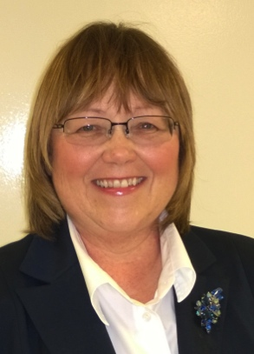
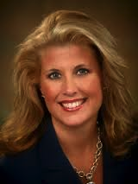
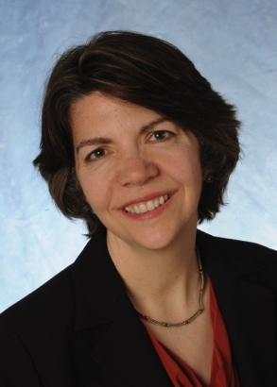
Presenters
Mary Clagett
Program Director
Jobs for the Future
Debra Mikulka
Program Director, TRAC 7
Washburn Tech
Dawn Busick
Program Director, MoWINs
Missouri Community College System
Jennifer Freeman
Program Director TAACCCT Learning Network
Jobs for the Future

Slide 4
AGENDA ITEMS
Welcome & Introductions
Framework for sustaining and scaling TAACCCT
Sustainability on Multiple Levels:
Statewide policy change
  Regional partnerships
  Institutional—structural and delivery changes
Opportunities of WIOA
Q&A

Slide 5
Framework for Sustainability Rooted in Change Management Theory

Slide 6
Where Change is Sustained and Scaled
Statewide Policy
Regional Partnerships
Institutional Structure, Practices and Culture

Slide 7

PARTICIPANT POLL
Has your college/consortium developed a sustainability plan?
Yes
No
At which level(s) are you working to sustain your programs, policies and practices? Check all that apply.
Institutional structures, practices and policy
Regional partnerships and regional practices/policies
State-level policy

Slide 8
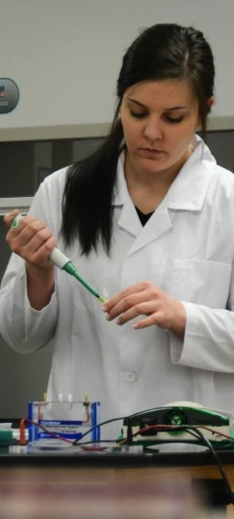

Sustainability Planning:
Lessons from TRAC-7
The Long & Winding Road
  Intentionality
    Planning
    Backloading
    Champions
  Responsibility
  Define: who & why
    Operationalize: what & when
  Accountability
    Continuous Improvement
    Solution-Based

Slide 9

Sustainability Planning:
Lessons from TRAC-7
Foundations of Sustainability
Facilities
Programming
Personnel
Leadership
  Planning & Monitoring
Where are you going?
Are you where you thought you'd be?
Evaluating progress
Adapting to circumstances

Slide 10
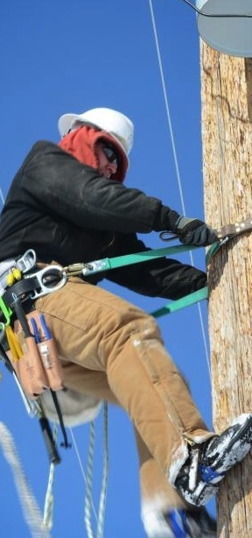
Sustainability Planning:
Lessons from TRAC-7
Final Year Questions
What did we do that made a difference?
How the innovation differed from other initiatives?
What should be sustained?
How will it be sustained financially?
Who is responsible for sustaining it?
Who are the champions?
What went wrong?
Are we where we want to be?

Slide 11

Sustainability:
Institutional Practices
Intended & Unintended Outcomes
Align sustainability planning with project deliverables
Curriculum & instructional support materials developed
  Industry & agency partnerships
  Identify internal systems, practices or policies adopted or strengthened
  I-Best A-OK Advantage center
  Student success center
  Conqs Work
  Serendipitous outcomes
  KanVet integration

Slide 12

Sustaining Regional Partnerships
Effective MOUs include the following:
Partnership collaboration roles with mutual respect for both organizations
Detail grant eligibility and enrollment processes
How both partners will coordinate participant reports and updates to these reports
How the WIB will leverage their portfolio of services (business services, job placement, training financial aid assistance, OJT, etc.)
Who will coordinate participant employment placement and reporting
What is the participant completer/exiter process going to be for each grant program of study
What is the post employment follow-up for performance metric tracking
What is the record keeping role for both partners for participant files
How often will the partners meet to review
and evaluate the grant performance

Slide 13
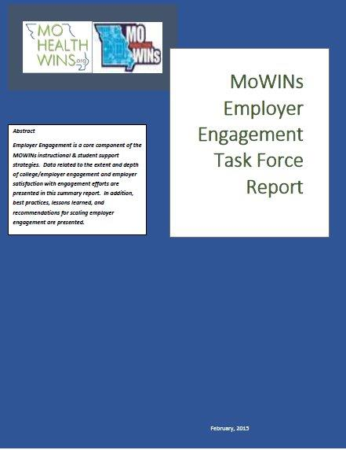
Sustaining Institutional Practices
MoWINs Employer Engagement White Paper Report
Identified/Approved course competencies
Develop/refine/validate curriculum
Assist with mock interviews
Provide internships/clinical work experience
Assist with outreach and recruitment
Serve on employer panels and judge student projects
Provide instructional materials/equipment/instructors
Pay for certification exams
Donate equipment/provide facilities
Provide feedback on program completers
Hire graduates and assist to connect graduates to employers

Slide 14
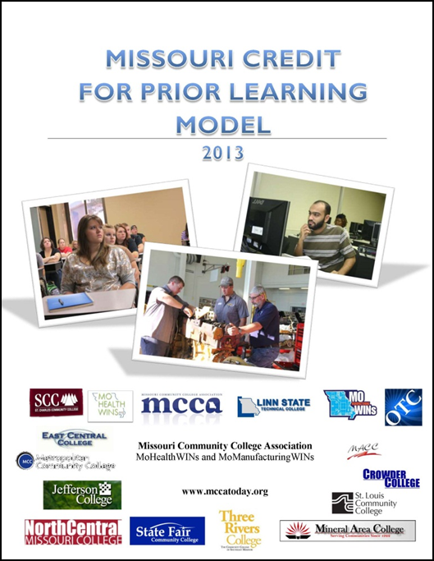
Sustaining through State Policy
Developed a statewide work group;
18 months to research, develop, vet and adopt;
Professional Development supported;
TAACCCT Quarterly Reporting;
What’s next—Phase 2 All Inclusive Course Matrix mapping crosswalk to national standardized PLAs; and
More Professional Development.

Slide 15



Demonstrating ROIs
Total grant participants served was 4,251
28% or 1,200 participants were referred by the LWIBs to our colleges
80% of the program completers secured employment
75% of those completers were unemployed at enrollment
Average wage $23,050 with a 6-month retention rate of more than 90%
10,998 certificates and degrees were awarded
Grant started with 31 employers, closed with some 229 employers engaged

Slide 16
Opportunities Presented by WIOA
The Workforce Innovation and Opportunity Act (WIOA) emphasizes:
  Cross-system alignment, strategic planning, performance measurement, data collection.
  Regional convening, planning, service delivery.
  Training for high-demand industry sectors and occupations and employer engagement.
  Emphasis on LMI to ensure high-demand focus.
  Convening, facilitation, and leveraging roles for state and local boards—working with education, economic dvpt, employers, and other partners.

Slide 17
Opportunities Presented by WIOA
Career Pathways systems that increase articulation; acceleration; contextualization; supports, counseling and navigation services; prior learning assessments and other strategies that increase attainment of industry-recognized, postsecondary credentials.
Major shift in youth services (up to age 24) with 75% of youth funding dedicated to out-of-school youth—stressing connections to postsecondary education and Career Pathways for youth.
Performance measures that include industry-recognized credentials and new educational progress measures—encouraging longer-term service delivery.

Slide 18
SUMMING IT ALL UP
Remember – it’s not too late! You have time to build a plan for sustainability
To sustain your successes through TAACCCT you have to have a plan for WHAT you are sustaining and HOW
Engage your team, leadership and partners in sustainability planning

Slide 19
Q & A

Slide 20
Thank You!
Find resources for TAACCCT success at:
https://etagrantees.workforce3one.org
Subscribe to TLN resources, ask questions or connect with peers at TAACCCT@dol.gov

