Slide 1
Workforce Employment Networks Supporting Career Pathways for People with Disabilities
Webinar Date: November 12, 2015
Presented by:
U.S. Department of Labor
Employment and Training Administration

Slide 2
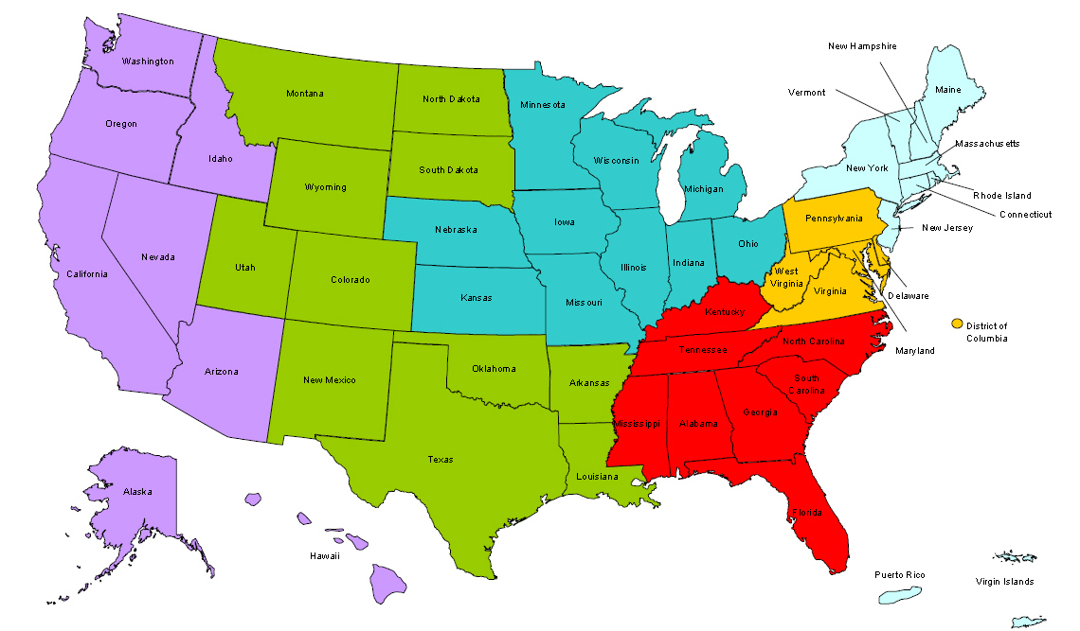
Where are you?
Enter your location in the Chat window – lower left of screen

Slide 3
Moderators
Moderator: Kim Vitelli
Title: Deputy Administrator
Organization: Employment and Training Administration
Moderator: Miranda Kennedy
Title: Director of Training for DEI, NDI Technical Assistance Team
Organization: National Disability Institute
#
3

Slide 4
Here’s what you can expect to get out of this webinar!
How your Workforce Employment Network (EN) activity strengthens access to Career Pathways.
Information on how you can use the flexible resources generated by your EN to address gaps in your service system
The importance of benefits planning and asset development in Career Pathways

Slide 5
Agenda
Workforce Innovations and Opportunity Act (WIOA) Vision and Career Pathways
Lessons Learned in Workforce Employment Network (EN) Operation
Customer Service and Making Connections
How Success as a Workforce EN will Increase Access to Career Pathways for Others

Slide 6
Presenter
Presenter: Doug Keast
Title: Training and TA Manager
Organization: National Disability Institute

Slide 7
Agenda Item #1
Workforce Innovation and Opportunity Act (WIOA) Vision and Career Pathways

Slide 8
WIOA
Emphasis on the inclusion of people with disabilities
Establish subcommittees on disability and employment
Physical and Program Accessibility
Performance for customers that have disabilities
Emphasis on unified planning will increase the capacity of AJC’s to be responsive to targeted populations

Slide 9
Polling Question
How many times is the word disability or disabilities mentioned in WIOA?
28
105
323
412

Slide 10
WIOA: The Proposed Rule
Excerpt from a summary of:
The Workforce Innovation and Opportunity Act; Joint Rule for Unified and Combined State Plans, Performance Accountability, and the One-Stop System Joint Provisions; Notice of Proposed Rulemaking
WIOA strengthened the alignment of the workforce development system’s six core programs by imposing unified strategic planning requirements, common performance accountability measures, and requirements governing the one-stop delivery system. In so doing, WIOA placed heightened emphasis on coordination and collaboration at the Federal, State, and local levels to ensure a streamlined and coordinated service delivery system for job seekers, including those with disabilities, and employers.

Slide 11
WIOA: The Proposed Rule
NPRM citation language on section 678.800:
§ 678.800 How are one-stop centers and one-stop delivery systems certified for effectiveness, physical and programmatic accessibility, and continuous improvement?
(6) They must also include evaluations of how well the one-stop center ensures equal opportunity for individuals with disabilities to participate in or benefit from one-stop center services. These evaluations must include criteria evaluating how well the centers and delivery systems take actions to comply with the disability-related regulations implementing WIOA sec. 188, set forth at 29 CFR part 37.

Slide 12
WIOA: The Proposed Rule
According to NPRM, such actions include, but are not limited to:
(1) Providing reasonable accommodations for individuals with disabilities;
(2) Making reasonable modifications to policies, practices, and procedures where necessary to avoid discrimination against persons with disabilities;
(3) Administering programs in the most integrated setting appropriate;
(4) Communicating with persons with disabilities as effectively as with others; and
(5) Providing appropriate auxiliary aids and services, including assistive technology devices and services, where necessary to afford individuals with disabilities an equal opportunity to participate in, and enjoy the benefits of, the program or activity.

Slide 13
Caveat
This Presentation will not Show you how to become an EN
Workforce EN and Job Center activities lines up perfectly with regard to service flow
As a Job Center you already qualify to
For more information:
www.choosework.net
https://www.workforce3one.org/view/5001330446127387381/info

Slide 14
Workforce EN Operation
SSA will provide payments to Employment Networks that assist beneficiaries in moving off benefits
There are many beneficiaries that already come to Job Centers for assistance to go to work
Job Centers can enter into agreements with SSA to become an EN
Job Centers can re-invest funds received from SSA back into the center to enhance the tools, strategies and expertise that will allow the Center to be more effective in serving people with disabilities

Slide 15
WIOA: Career Pathways
Workforce Development Boards focus on meeting needs of key locally identified business sectors
Pathways established in those sectors and supported in partnership between workforce and education
These pathways outline the range of skills and experiences necessary to support the key business sectors, and the resources for Job Seekers to gain those skills and abilities
On-ramps, Off ramps
Stackable Credentials

Slide 16
Polling Question
In 2014, in the State of Iowa, 89,628 people came into Job Centers for assistance. Of those that disclosed disability, how many were “ticket holders”?
59
235
672
912
1,367

Slide 17
WIOA: Your Job Center
Workforce and Education maintain the Pathway
Every agency connected with employment works with Workforce and Education
There are NOT separate pathways for separate agencies
Will not provide equal access to opportunities
Not an effective way to meet business sector needs
Need for locally developed common “desk aids” for employment specialists of all partner agencies
Integrated Service Flow
More than a referral

Slide 18
WIOA: Your Job Center as an Employment Network
The Job Center is the Employment Network (EN)
The services that the partners provide together result in the outcomes that generate new resources
The investment of these new resources expand the capacity of the job center for greater success in including people with disabilities in jobs…
…..and in Career Pathways

Slide 19
Agenda Item #2
Lessons Learned in Workforce Employment Network (EN) Operation

Slide 20
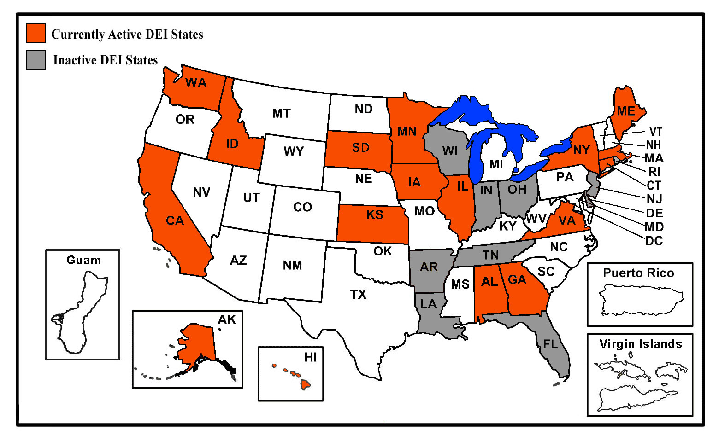
Promising Practices: Disability Employment Initiative
The DEI has Supported Workforce ENs in twenty-seven participating states since 2010

Slide 21
Promising Practices: State Level EN Operation
Collaborative Oversight
Partnership Plus
Support to Local Leadership from State Partnership
State Partners meeting together with Local Staff

Slide 22
Promising Practices: Local Level EN Operation
Single Common Customer Flow
Commitment of Workforce Development Board (WDB) in Oversight
Collaborative Local Leadership Teams
Use Strategies of Community Engagement in Outreach

Slide 23
Promising Practices: Local EN Operation
Use of a Disability Resource Coordinator:
Integrated into Job Center Operation
Activities overseen collaboratively
Facilitates cross agency services and strategies
Orients staff from both AJC and partner agencies to one another's services
Assists in making links to Career Pathways
Expertise in SSA Disability Benefits Planning services

Slide 24
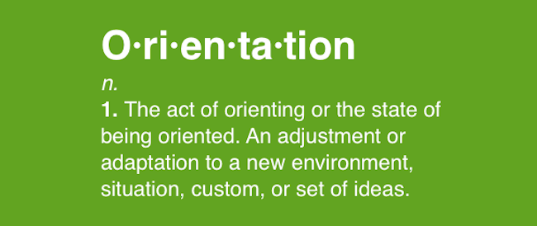
Promising Practices: Local EN Operation
Common Staff Orientation
Use of Assistive Technology
Access to Service – WIOA Section 188
Tips in serving specific populations
Integrated Resource Team (IRT) and other Disability Employment Initiative (DEI) Strategies

Slide 25
Promising Practices: Local EN Operation
Meet Business Needs Together
Use of Asset Coalitions
Weave Financial Literacy into Job Seeker Workshops
Common Tools for Access to Career Pathways

Slide 26
Additional Employment Network Thoughts
For DEI Activity – a good EN takes 5 to 6 years to hit “sustainability”
With focus on sharing resources and outcomes – WIOA Performance will reflect the efforts of all partners in the Job Center
Technical Assistance is available to Workforce Leadership in operation of Employment Networks. Consult with the EN Specialists at the Social Security Administration enservice@ssa.gov

Slide 27
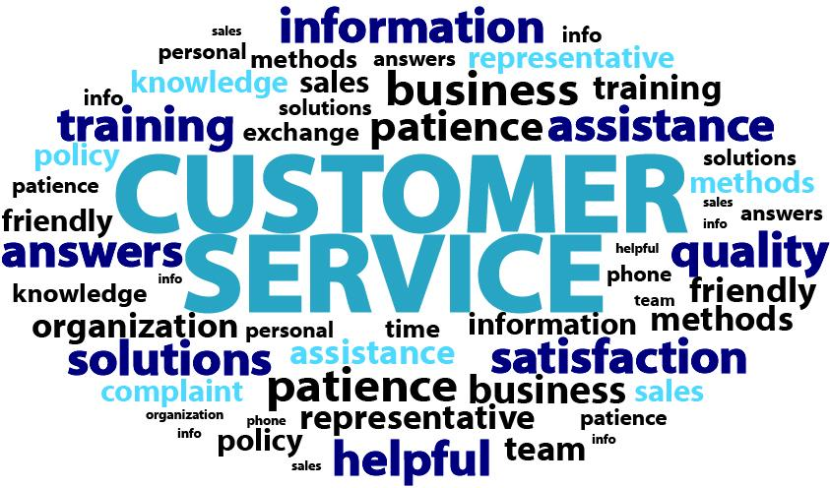
Agenda Item #3
Customer Service and Making Connections

Slide 28
How it Works
It’s all about Customer Service
Using the Tools in the Job Center
Connecting Future Job Candidates with Disabilities to Career Pathways

Slide 29
Martha in New York
Martha is interested in re-entering work – in the Healthcare Career Pathway
She has experience working in Human Services
She developed mental health challenges that disrupted her employment
As a result, she has not worked in 11 years

Slide 30
Martha in New York
Martha came into the Career Center and disclosed that she was on SSI/SSDI
She was referred to meet with Lauraine, who works at the Center and is a certified benefits planner
Received an initial assessment and Benefits Advisement
Developed a Career Objective
Started out in activities that involved working with and around people
Next step – Part-time job with a staffing agency as a health care recruiter

Slide 31
Martha in New York
Second Job as an adjunct instructor at a college
Completed training in medical coding
Had assistance in on-line classes and in completing certification testing
Now working as a Healthcare Instructor earning $75,000 a year

Slide 32
Martha’s Success Strengthens the Job Center
The service identified ways to engage Martha in the Healthcare Career Pathway, using a variety of stepping stones
After several stops, Martha has met her initial Career Objective
Should she wish, she has options to go further down the Pathway
As a result of the ticket assignment, the Job Center will generate up to $25,000 over the next 4 years.
These outcomes, along with those of other ticket holders served in the center, will be reinvested to increase the capacity of the service system to include people with disabilities in Career Pathways.

Slide 33
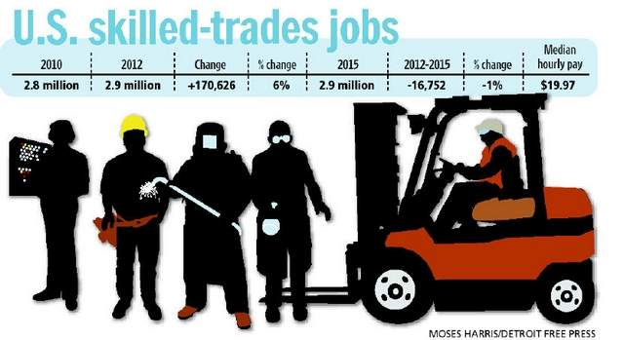
Joe in Iowa
Joe is 25 and interested in the Skilled Trades
He experienced a head injury when he was 19
Has a conviction for Operating a motor vehicle while intoxicated (OWI)
Met with a benefits planner (Brian) at the Career Center, established a service plan and assigned his ticket

Slide 34
Joe in Iowa
Part-Time Position at Lowe’s
Working around building materials
Contact with building contractors
Opportunity to pay off fees and regain driver’s license
Service Team consulted with Apprenticeship Programs – Introduced Joe to the Plumber’s and Steamfitter’s Apprenticeship Program

Slide 35
Joe in Iowa
Joe is in a Plumbing Apprenticeship
After 9 months – Brian continues to provide Benefits Planning and other long term supports
Over the next 4 to 5 years, the Workforce Development Board and Leadership will generate up to $25,000 in payments from SSA as a result of Joe’s success
This region will invest these payments, along with those generated from other like Joe, into the service system so more Iowans with disabilities will be able to access Career Pathways

Slide 36
Agenda Item #4
How Success as a Workforce EN will Increase Access to Career Pathways for Others

Slide 37
Polling Question
How many states have Regions that are at or close to the ability to sustain a full-time DRC, and use the DEI strategies of Integrated Resource Team and Asset Development to support Career Pathway Access using Ticket to Work payments?
0
1
5
8
12

Slide 38
Paying it Ahead to Increase Opportunities
Martha and Joe are examples of how two different workforce regions in two very different states used the services necessary for Employment Network Success to engage people in Career Pathways.
Martha and Joe’s success create resources for the Workforce Development Boards to make it possible for others with disabilities to also access the same Career Pathways.

Slide 39
Some Simple Investments You Can Make Right Away
Provide Physical and Program Access Training to Job Center Staff
Engage a partner staff person to coordinate ticket activity within service flow
Indicate in outreach information that the Job Center is an EN
Establish a Board Committee to address career pathways, employment and disability. This committee can reflect partner agency expertise to strengthen EN operation and investments of ticket income
Include Financial Skills assessment in your center’s staff assisted core services

Slide 40
Some More Advanced Investments
Purchase Assistive Technology for Job Center
Connect with or develop an Asset Coalition
Establish workshops targeted for SSA disability beneficiaries that address employment and benefits
Work with Community Partners to conduct outreach events that promote Job Center services to individuals with disabilities
Develop the Integrated Resource Team strategy among Job Center partner agencies, to be developed individually to support job seekers with disabilities in accessing career pathways and meeting their career objectives

Slide 41
When You’re Really Cooking……
Use the Ticket Payments to support the addition of a Disability Resource Coordinator to the service team
Add Benefits Planning Advisement to your Job Center services
Develop Financial Coaching as a Job Center service

Slide 42
Summary
Workforce Innovations and Opportunity Act (WIOA) Vision and Career Pathways
Lessons Learned in Workforce Employment Network (EN) Operation
Customer Service and Making Connections
How Success as a Workforce EN will Increase Access to Career Pathways for Others

Slide 43
Resources
Choose Work Site
www.choosework.net
Introduction to Employment Network and How to Become one - Webinar
https://www.workforce3one.org/view/5001330446127387381/info
A Guide to Payments under the Ticket to Work Program
https://yourtickettowork.com/documents/855575/855865/Guide_to_Payments.pdf/1ce8a820-fd98-48fe-8f15-25e83e8673d8
Payments at a Glance
https://yourtickettowork.com/documents/855575/855865/EN_Payments_Glance_2015.pdf/c30e3cee-fb85-4b7c-b5f8-6a1274067b3b

Slide 44
Final Word from ETA
Moderator: Kim Vitelli
Title: Deputy Administrator
Organization: Employment and Training Administration
#
44

Slide 45
Please enter your questions in the Chat Room!

Slide 46
Speakers’ Contact Information
Speaker: Doug Keast
Title: DEI Ticket Coordinator
Organization: National Disability Institute
Email: dkeast@ndi-inc.org
Telephone:515.707.8828
Speaker: Miranda Kennedy
Title: DEI Director of Training and Technical Assistance
Organization: National Disability Institute
Email: mkennedy@ndi-inc.org
Telephone:720.890.3990

Slide 47
www.workforce3one.org

