Slide 1
H-1B Performance Reporting Webinar: HUB Updates & Preparing For Final Reporting
Webinar Date: October 8th, 2015; 3:30 p.m. Presented by: Division of Strategic Investments
U.S. Department of Labor
Employment and Training Administration

Slide 2
Polling Questions
Polling Question #1
Select your H-1B grant program.
Our grant program is a:
Technical Skills Training (TST) Round 1
Technical Skills Training (TST) Round 2
Jobs Accelerator (JA) Round 1
Advanced Manufacturing Jobs Accelerator (JA) Round 2
Make It In America (MIIA)
Other
I don’t know
Polling Question #2
Select the role that you play in your H-1B grant program.
For this grant initiative I am the:
Authorized Representative
Program Director/Manager
IT/Data Manager or staff
Training Partner
Employer Partner

Slide 3
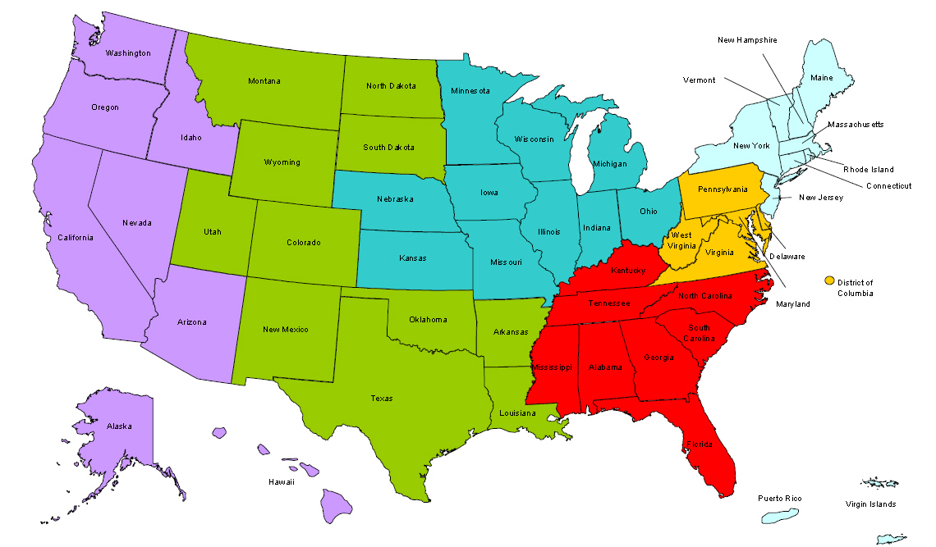
Where are you?
Enter your location in the Chat window – lower left of screen
Notes:
In the Chat Room, please type the name of the your organization, your location, and how many people are attending with you today.

Slide 4
Today’s Hosts
H-1B TST and JA Performance Reporting
Technical Assistance
H-1B Performance Team
Sarah Sunderlin
Kevin Mauro
Ayreen Calimquim
Waqar Ahmad

Slide 5
Agenda
Important updates to HUB Aggregation Rules and how this will impact your QPR form results.
Performance TA and preparing your final data files
Grant cycle completion basics
Ensuring participants are “completed”
Participant tracking and follow-up
Maintaining “Data Momentum” to create sustainability in your grant

Slide 6
H-1B TST and JA HUB Aggregation Rules Update
HUB Updates

Slide 7
HUB Aggregation update
Changes to the aggregation rules in the HUB System will only change how the following elements of your QPR ETA Form 1205-0507 are populated.
Section B1 - Total Exiters
Section E3 – Number Entered Unsubsidized Employment
Section E3a – Number Entered Unsubsidized Training-related Employment

Slide 8
HUB Aggregation update
QPR Section B, Line 1 - Total Exiters
Old Rule
New Rule

Slide 9
HUB Aggregation update
Important Distinction!
To understand these changes, you must remember the difference between the “Date of Exit” and the “Exit Date”
Date of Exit – This is the last date a participant received grant-funded services and “date of exit” is retroactively reported
Example: A participant receives his/her last grant funded service on March 1, 2015
After 90 days, “Date of Exit” = March 1, 2015
If “Date of Exit” is March 1, 2015, then Date of Exit is not reported until the quarter ending September 30, 2015

Slide 10
HUB Aggregation update
Important Distinction!
To understand these changes, you must remember the difference between the “Date of Exit” and the “Exit Date”
Exit Date – This is the date that a participant is reported as an exiter, i.e. the 91st day after their “date of exit”
This new aggregation rule ensures that HUB will accurately report exiters in the correct reporting quarter, by capturing those participants that have a “date of exit” that falls within he previous reporting quarter.

Slide 11
FAQs
Does HUB retroactively exit a participant who has not been active for more than 90 days? When exiting participants, is the date entered supposed to be the date of their last service or the date the grantee exited them from the program?
The HUB system does not automatically exit participants after 90 days without grant-funded services. This is the grantee’s responsibility.
A participant who completed their program of study may continue to receive certain services funded by the grant program as described in the Statement of Work.
DE 302 is used to record the date on which the participant received the last grant-funded service.

Slide 12
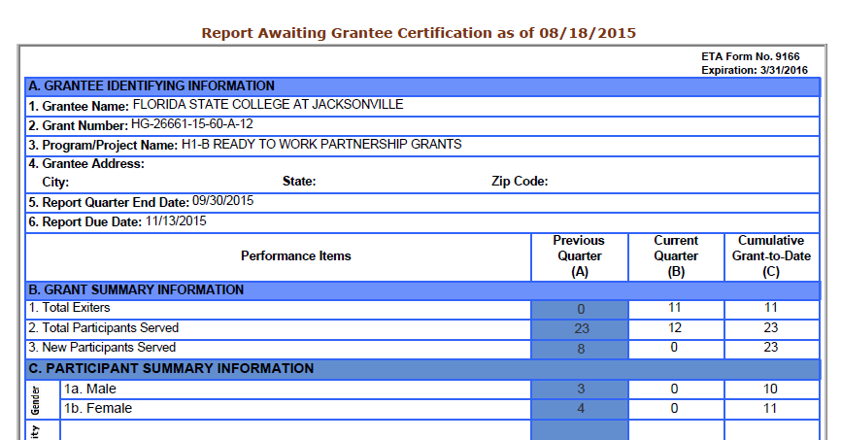
HUB Aggregation update

Slide 13
HUB Aggregation update
QPR Section E, line 3 – Number Entered Unsubsidized Employment, and
QPR Section E, line 3a – Number Entered Unsubsidized Training-related Employment
Old Rule
New Rule

Slide 14
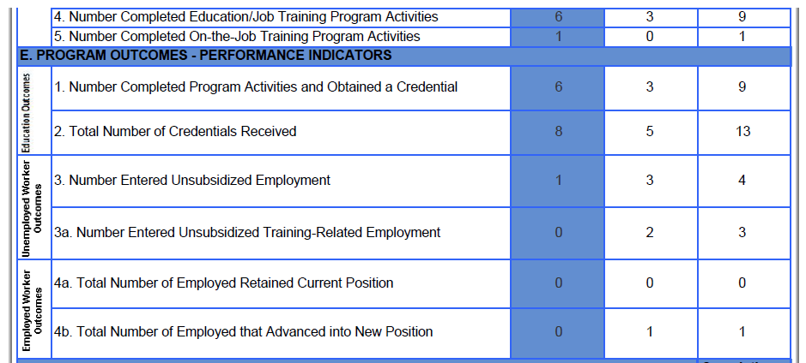
HUB Aggregation update
`

Slide 15
HUB Aggregation update
What does this mean?
HUB will aggregate an additional quarter of your reporting, compared to the previous aggregation rules, for these Data Elements.
HUB is changing the time period in which it aggregates each column.
Your QPR will now accurately reflect your outcome totals.

Slide 16
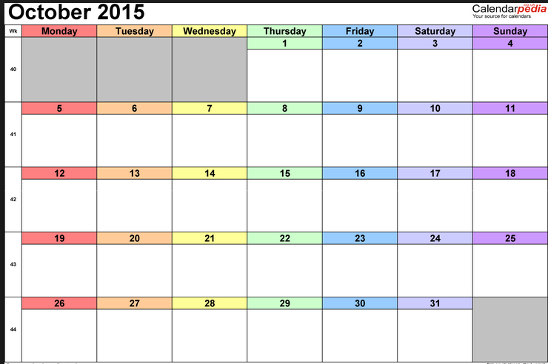
NEXT STEPS
WHEN: We anticipate these HUB updates to be implemented by late October which will ensure that your next QPR will reflect these changes.
ACTION: You do not need to do anything differently when submitting your next QPR. But as always, please review your data and reports for any inaccuracies and let us know if you encounter any technical issues/errors.
X

Slide 17
Please enter your questions in the Chat Room!

Slide 18
Reaching the sunset of your grant
Closing Time

Slide 19
Closing Time
H-1B Performance Reporting Continuity Plan
Do you have one in place?
Systems and Process
Do you know where your database is located?
Do you have access to previous data files that have been updated in HUB?
Do you have your HUB PIN and Password?
Staffing
Do you have the right staff to complete performance reporting even after your grant’s close date?

Slide 20
Closing time
For more information…
Visit ETA’s grant closeout page:
http://www.doleta.gov/grants/grant_closeout.cfm
Your FPO officially closes your grant.
The National Office will be available to support grantees and offer Performance TA as you create your final reports.

Slide 21
Don’t Forget to Include Training and Program Completion Date
Remember!
HUB does not automatically complete your participants
You must go into every participant’s record and “complete” their training by entering the date of the last grant-funded service provided to the participant.
Training completion dates are integral to reporting employment outcomes and credential attainment outcomes.

Slide 22
Definition Refresh
PROGRAM COMPLETION: A program completer is a participant who is enrolled in a grant-funded training program and has completed all training activities necessary towards successful completion and exit. Successful completion is determined by the grantee and could constitute as a certain grade or passing a pass/fail program. Some grantees education/training activities are comprised of a series of courses or activities and the intent of their education/training activities is for individuals to complete the entire series of courses or activities. In this case, “successful completion” should be defined as finishing the entire series of courses or activities and is no longer receiving grant-funded services.
PROGRAM EXIT: Exit from the program occurs when a participant has not received any services funded by the program for 90 consecutive calendar days and has no gap in service and is not scheduled for future services. The date of exit is applied retroactively on the last day in which the individual received a service funded by the program.
Both Definitions taken from H-1B Reporting Handbook v3.3 OMB 1205-0507 https://etagrantees.workforce3one.org/view/2001220744675542997/info

Slide 23
FAQs
When should a program completion date be entered? After the first training activity or after a participant has completed all training available and is still receiving services?
Program completer = meets the goal of their program enrollment
The “date of program completion” is entered when a participant has completed all of their training

Slide 24
Frequently Asked Questions
Will the HUB system begin accepting quarterly reports prior to the end of that quarter?
Grantees may upload data prior to the quarter ending to test data files and resolve data file errors.
However, the HUB system will not allow grantees to submit and certify a QPR until the quarter has ended.
Grantees should follow the usual quarterly reporting schedule for the final performance report. Your last Quarterly Performance and Narrative Reports will also serve as your Final Performance Report, as noted in the H-1B Performance Reporting Handbook.

Slide 25
Tracking and Reporting Employment Outcomes
Are you tracking and verifying employment outcomes for your unemployed workers?
Entered employment
Employment retention

Slide 26
Don’t forget about Incumbent Workers!
You need to ensure that all training and completion dates for incumbent workers are entered into HUB before your last report.
Employment Retention for Incumbent Workers
Advancements to New Positons

Slide 27
Participant Tracking and Follow-Up
Effective participant tracking and follow-up after program completion requires addressing participant needs at every stage of your grant
RESOURCE: Planning for Effective Participant Tracking and Follow-Up https://etagrantees.workforce3one.org/view/2001521639659380076/info
Tracking and Engagement PowerPoint
https://etagrantees.workforce3one.org/view/2001519553700659051/info
Effective Strategies to Engage & Track Participants (Webinar and Recording)
https://etagrantees.workforce3one.org/view/4011527938604951230/info

Slide 28
Using “Data Momentum” to create sustainability
Your Data is your future
The data we need… is everywhere around us

Slide 29
Participant Polling Question
We review our performance data:
Every day
Every month
Quarterly
Annually

Slide 30
The Value of Performance Reporting
Performance data is used to
Create Continuous Improvement
Identify Areas for Opportunity
Illustrate Your Success
Ensure Sustainability and Evaluate Effectiveness

Slide 31
Data-Driven Decision Making
Team Effort
Effective
Attainable
Grantee Assessment
Program Analysis
Performance Achievement

Slide 32
Crunching Your Numbers
We have developed a simple tool to help you see the performance progress that your grant has made

Slide 33
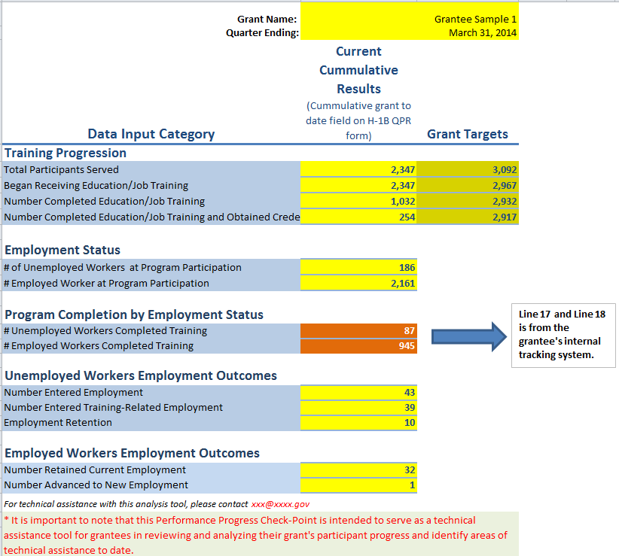
Performance Analysis Tool

Slide 34
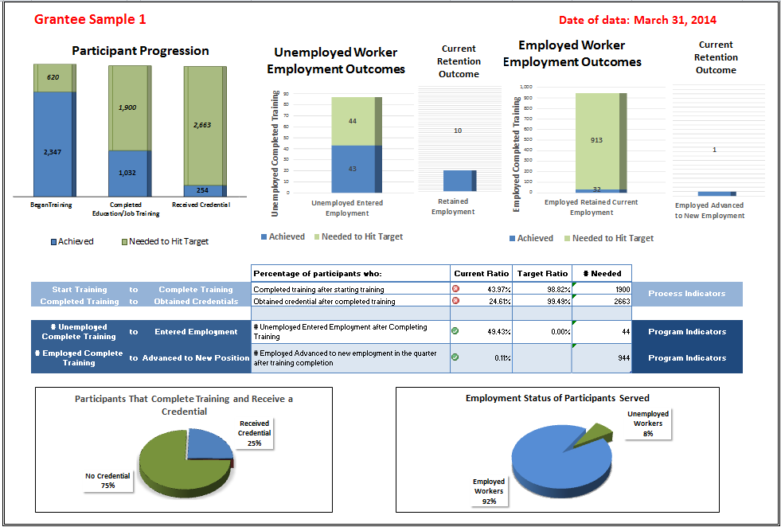
Performance Analysis Tool

Slide 35
Program Sustainability Using Performance Outcomes
Data Factors
Recruitment and Enrollment
Length of Training Design
Program Completion
Credential Attainment
Challenges to Employment
Industry and Occupations
Strategies for Sustainability
Executive and Stakeholders
Press and Media Outreach
Promote Data-Driven Performance Outcomes in Future Grant Solicitations
Performance Reporting Resources Data Driven Decision Making Webinar: https://etagrantees.workforce3one.org/view/4011433738013258225/info
H-1B Performance Grant Data Indicators Tool: https://etagrantees.workforce3one.org/page/resources/1001428044055886927

Slide 36
Questions?

Slide 37
Reminder…
Performance Reporting for quarter ending September 30, 2015 is due by November 13th!

Slide 38
Resources
H-1B Reporting Handbook v3.3 OMB 1205-0507
https://etagrantees.workforce3one.org/view/2001220744675542997/info
HUB System User Manual
https://etagrantees.workforce3one.org/view/2001317656904578012/info
H-1B TST, JA and MIIA Grants Performance Reporting FAQ
https://etagrantees.workforce3one.org/view/2001520858773724097/info
ETA Grant Closeout information
http://www.doleta.gov/grants/grant_closeout.cfm
Performance Analysis Tool
Link forthcoming
MIIA Resource Brief: Planning for Effective Participant Tracking and Follow-Up
https://etagrantees.workforce3one.org/view/2001521639659380076/info
Data Driven Decision Making Webinar:
https://etagrantees.workforce3one.org/view/4011433738013258225/info
H-1B Performance Grant Data Indicators Tool:
https://etagrantees.workforce3one.org/page/resources/1001428044055886927

Slide 39
www.workforce3one.org

