Slide 1
October 8, 2015
TAACCCT Industry Webinar Series:
Energy

Slide 2
TAACCCT LEARNING NETWORK AT A GLANCE
U.S. Department of Labor, Employment & Training Administration
(National)
Jobs for the Future
CalState/Merlot
Maher & Maher
American Association of Community Colleges
U.S. National Science Foundation
ATE Centers
Other Non-Federal Providers of TA and Resources for TAACCCT Grantees:
Creative Commons
CAST
The Transformative Change Initiative

Slide 3
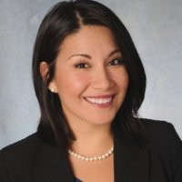
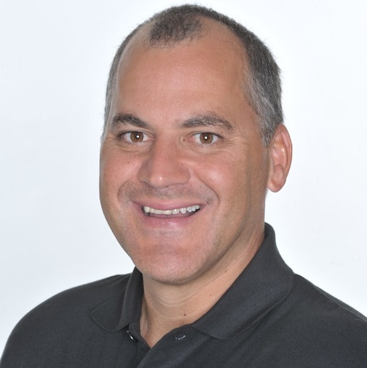
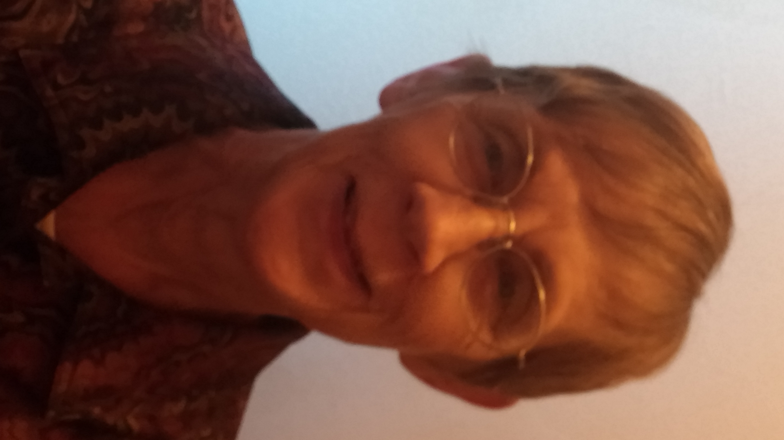
Moderator & Presenters
Erica Acevedo
Senior Program Manager, TLN
Jobs for the Future
Rick Lumadue
Program Manager, Grantee Relations
SkillsCommons.org
Marilyn Smith
Grants Coordinator
Colorado Community College System

Slide 4
Agenda Items
Welcome & Introductions
Highlights from the Colorado Online Energy Consortium
Q&A
Review of Curriculum/Materials on SkillsCommons
Discussion

Slide 5
Participant Poll
Which TAACCCT round do you represent?
Round 1
Round 2
Round 3
Round 4
What is the strategic focus of your grant in the Energy industry?
Capacity Building
Improved Employer Engagement
Curriculum Development
Other (Specify in chat box!)
What job level are your training for?
Entry level
Middle Skills
Advanced level

Slide 6
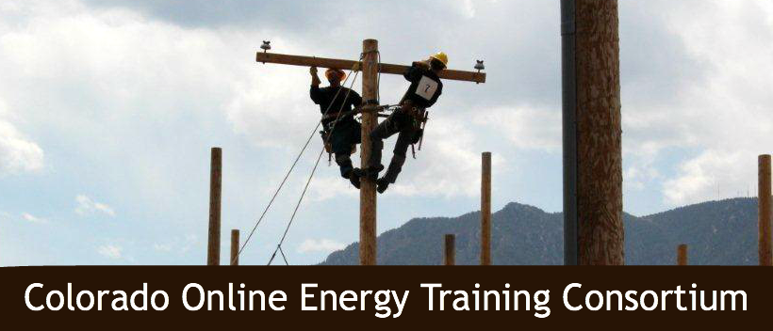
Colorado online Energy Training Consortium

Slide 7
Employer Engagement Results
Mobile Labs
Water Quality program at Red Rocks Community College
Wind Energy Program at Northeastern Junior College
Solar Program at Colorado Mountain College
Building instructional environments that mirror the work environment
Power Plant at Front Range Community College
Nacelle Lab at Northeastern Junior College
Curriculum redesign of all courses in energy programs
All 7 Energy Colleges

Slide 8
Hybrid/Online Curriculum
The TAACCCT1 grant required all COETC consortium members to develop courses in online or hybrid format to provide more opportunities for students to complete certificates and degrees.
That meant that faculty needed to rethink their courses—to determine which skills could be taught in an online environment, which skills needed face to face instruction.
Employers were partners with the faculty and the instructional designer in this process.
Result--- intentional curriculum, competency based, focused on what is needed for the student to become a proficient employee.

Slide 9
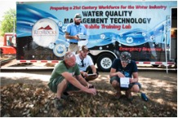
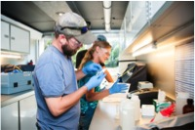
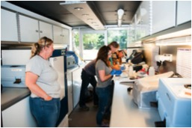
Mobile Lab Red Rocks Community College

Slide 10
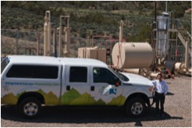
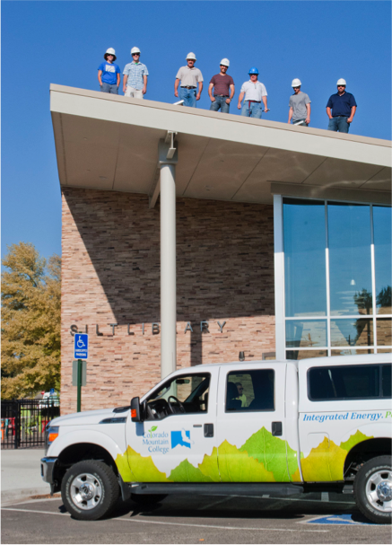
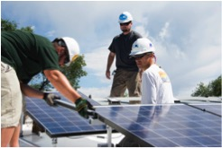
Mobile Lab Colorado Mountain College

Slide 11
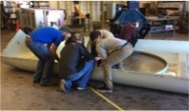
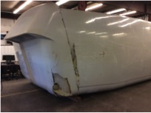
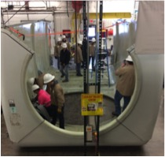
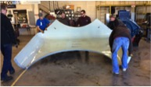
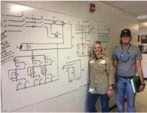
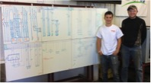
Northeastern Junior College Nacelle Lab

Slide 12
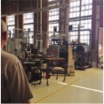
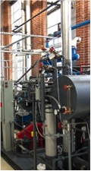
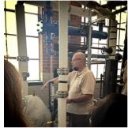
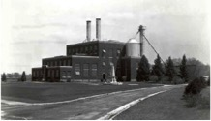
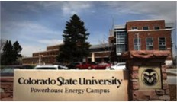
Power Plant
“It creates teaching opportunities for things not in the textbooks.”
Clark Mozer, Integrated Technology Chair

Slide 13
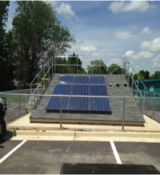
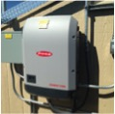
Power Plant
Raising the Roof
The lab consists of a 16’ x 19’ 4:12 pitch roof equipped with aluminum safety side rails, and is positioned south-facing to capitalize on better tracking of the sun’s path. Each semester, the students have the experience of actually assembling, hooking up, and turning on a grid-tie photovoltaic array, just as they would if they were working for a solar company, and the inverter in the array feeds 240V single phase power back into the grid, just as it would for a typical residential installation.

Slide 14
STEAM!
OR
Generator
=
Turbine
Electricity!!
Boiler
CSU System
(Cooling fluid—water—air)
Condenser
Pump
(Cools steam; turns to water)

Slide 15
Access to curriculum
Weebly
http://cccscoetc.weebly.com/
SkillsCommon
https://www.skillscommons.org/handle/taaccct/41

Slide 16
Participant Poll
How you uploaded any products into SkillsCommons yet?
Yes
No

Slide 17
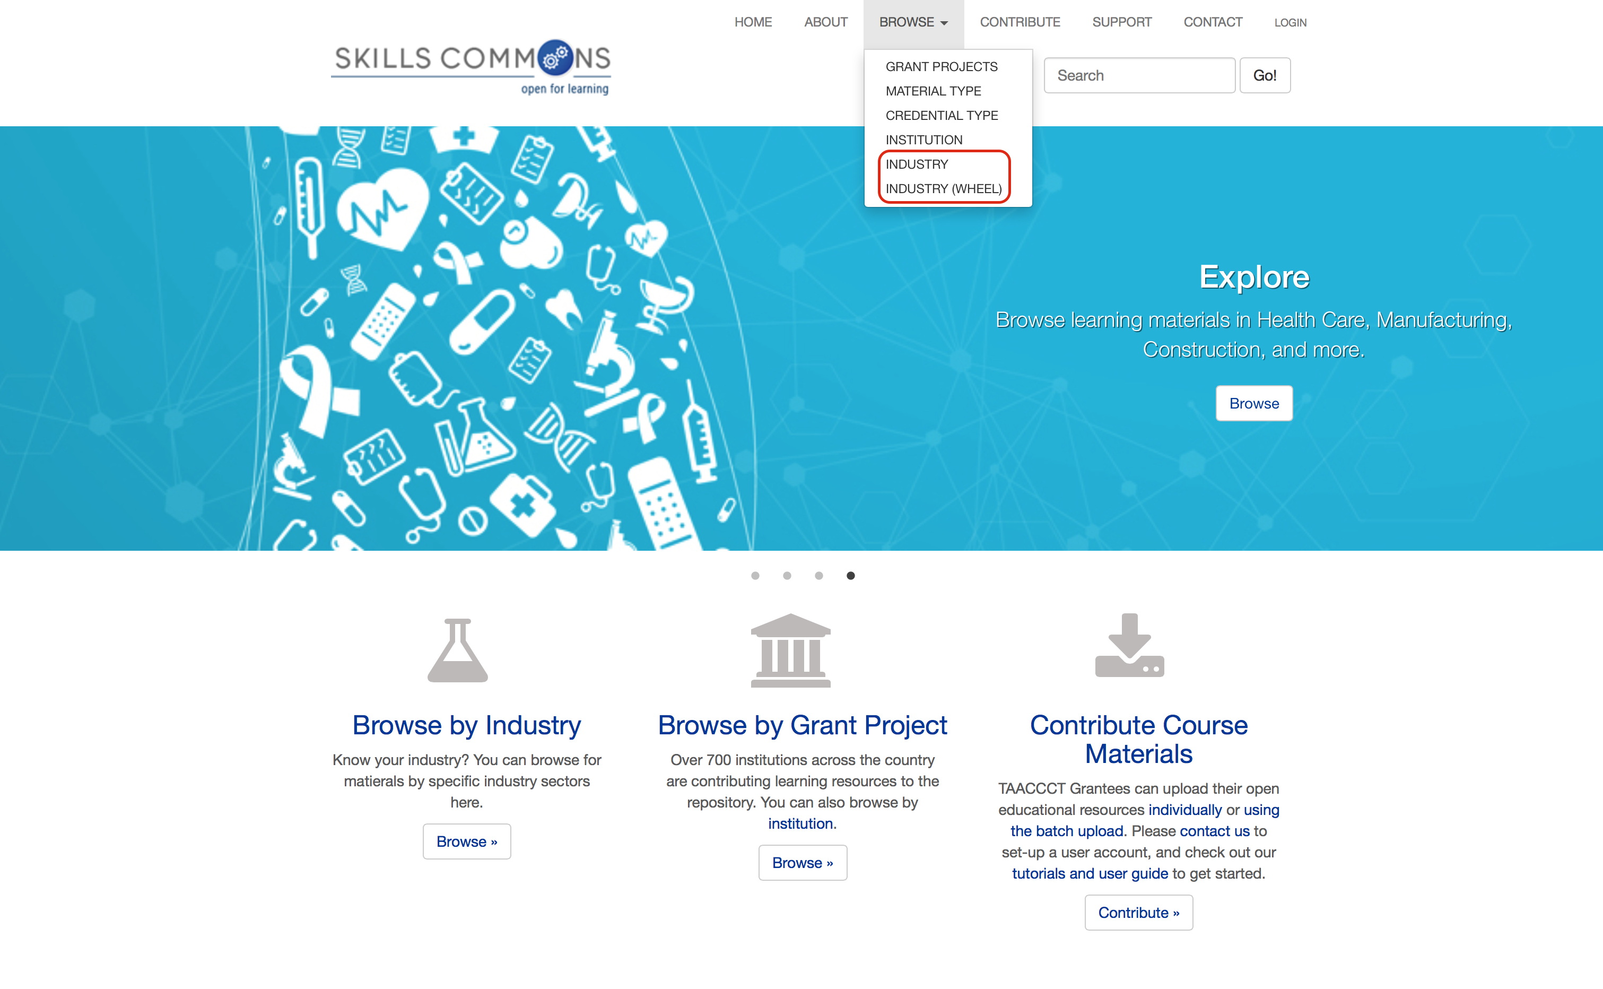
Browse the SkillsCommons Repository by Industry: An Overview
Rick Lumadue, Program Manager of SkillsCommons.org; support@skillscommons.org

Slide 18
Q&A

Slide 19
Thank You!
Find resources for TAACCCT success at:
https://etagrantees.workforce3one.org
Ask questions and to connect with peers and resources at TAACCCT@dol.gov

