Slide 1
Pre-Event YouthBuild Webinar Series: Developing and Managing Quality and Qualifying Work Sites
Webinar Date: October 14, 2015
Presented by:
Division of Youth Services – YouthBuild
U.S. Department of Labor
Employment and Training Administration

Slide 2
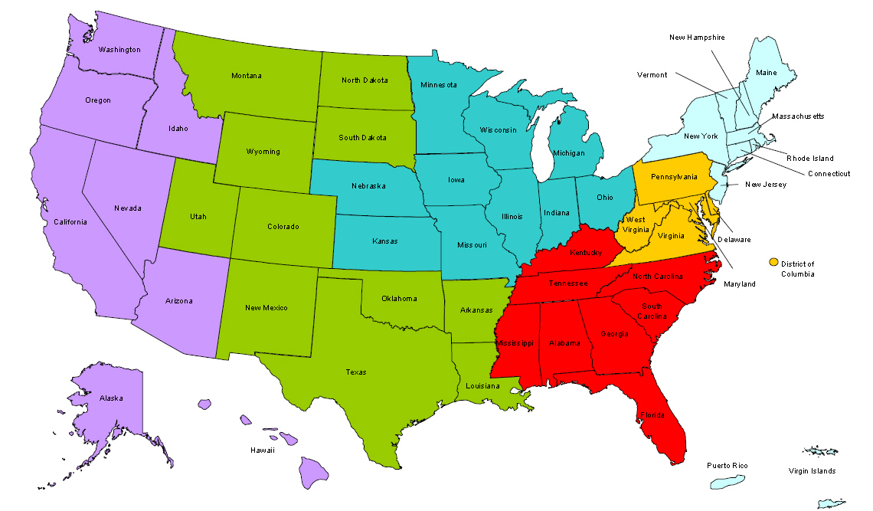
Where are you?
Enter your location in the Chat window – lower left of screen

Slide 3
Moderator
Jenn Smith
National YouthBuild Director
U.S. Department of Labor

Slide 4
Here’s what you can expect to get out of this webinar!
Explore different models of securing, managing, and selling or releasing a construction site – what works for various YouthBuild programs.
Align your construction efforts with other program elements in YouthBuild for an integrated, productive training experience for the young person. Learn how to incorporate OSHA safe work practices for youth and construction work, for compliance and risk management. Review sample safety plans training, youth supervision, contracting, site management, and support services.
Develop contingency plans (plan “B” plus…) for when plan “A” is not going to work. Project constraints do not have = less skills and knowledge training!

Slide 5
Agenda
Requirements for Qualifying Construction
Best Practices
Broader Construction Applications
Planning for the Worst (Plan B)

Slide 6
Presenters
Helen Whitcher
Senior Director, Technical Assistance
YouthBuild USA
Ted Roan
Director, Green Construction
YouthBuild USA

Slide 7
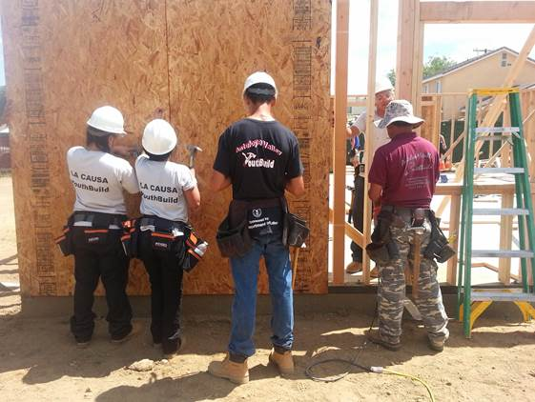
Requirements for Qualifying Construction

Slide 8
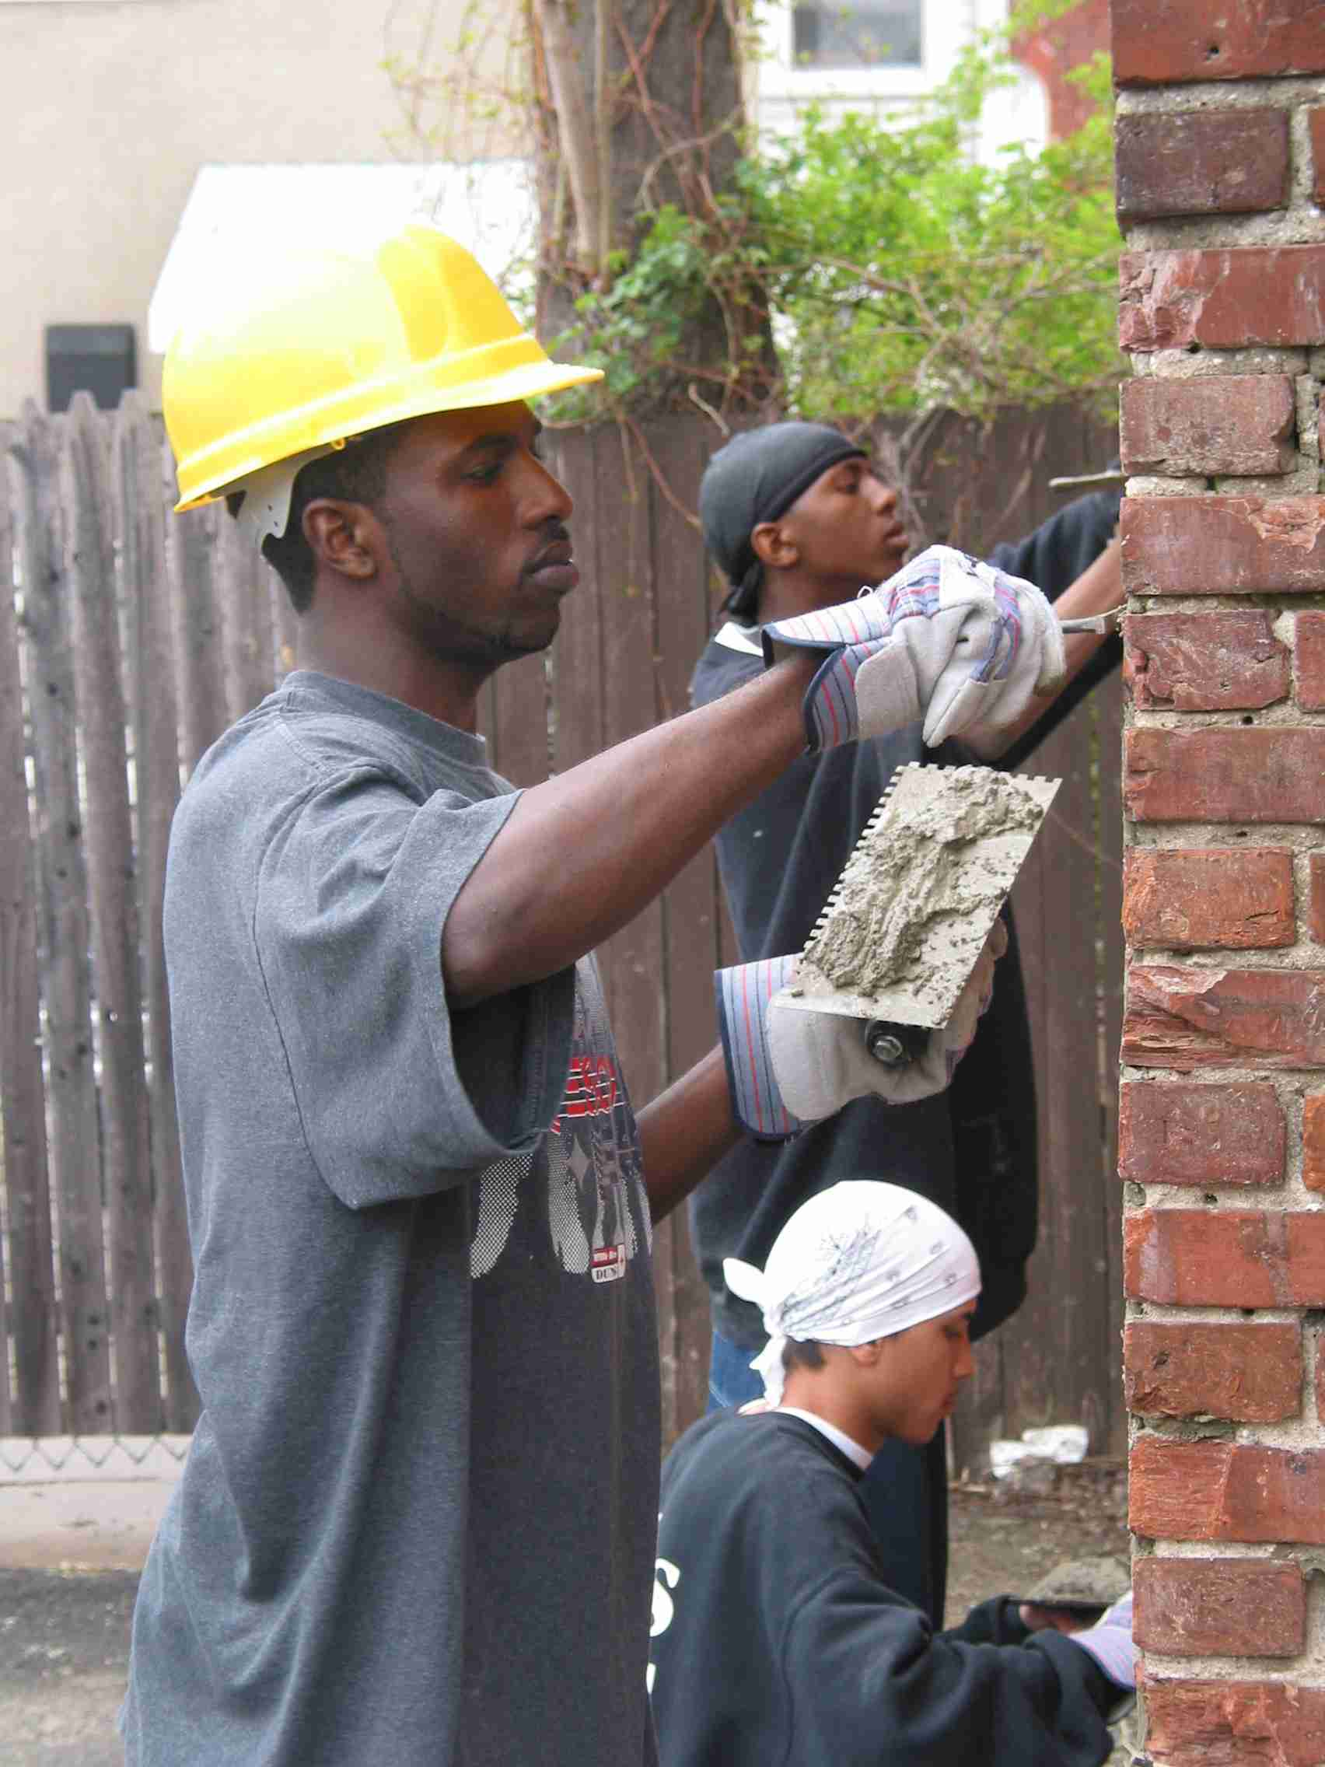
Basic DOL Guidelines According to WIOA
No more than 15% of grant funds may be used for training and supervision on community or other public facilities
40% of time on occupational skills training
Every YB program is required to provide construction training

Slide 9
Question
How can you satisfy the construction project in your Statement of Work?
Build project on our own
Partner with Habitat for Humanity
Partner with CDC
Partner with Housing Authority
Combination of above
Other

Slide 10
Davis-Bacon
DEFINED:
NAHA statutory language: (a) IN GENERAL. Any contract for the construction of affordable housing with 12 or more units assisted with funds made available under this subtitle shall contain a provision requiring that not less than the wages prevailing in the locality, as predetermined by the Secretary of Labor pursuant to the Davis-Bacon Act..., shall be paid to all laborers and mechanics employed in the development of affordable housing involved,.... (b) WAIVER. Subsection (a) shall not apply if the individual receives no compensation or is paid expenses, reasonable benefits, or a nominal fee to perform the services for which the individual volunteered and such persons are not otherwise employed at any time in the construction work.

Slide 11
Davis-Bacon
APPLIED:
SEC. 286. [t42 U.S.C. 12836] LABOR. (a) IN GENERAL.-Any contract for the construction of affordable housing with 12 or more units assisted with funds made available under this subtitle shall contain a provision requiring that not less than the wages prevailing in the locality, as predetermined by the Secretary of Labor pursuant to the Davis-Bacon Act (40 U.S.C. 276a-276a-5), shall be paid to all laborers and mechanics employed in the development of affordable housing involved, and participating jurisdictions shall require certification as to compliance with the provisions of this section prior to making any payment under such contract. (b) WAIVER.-Subsection (a) shall not apply if the individual receives no compensation or is paid expenses, reasonable benefits, or a nominal fee to perform the services for which the individual volunteered and such persons are not otherwise employed at any time in the construction work.

Slide 12
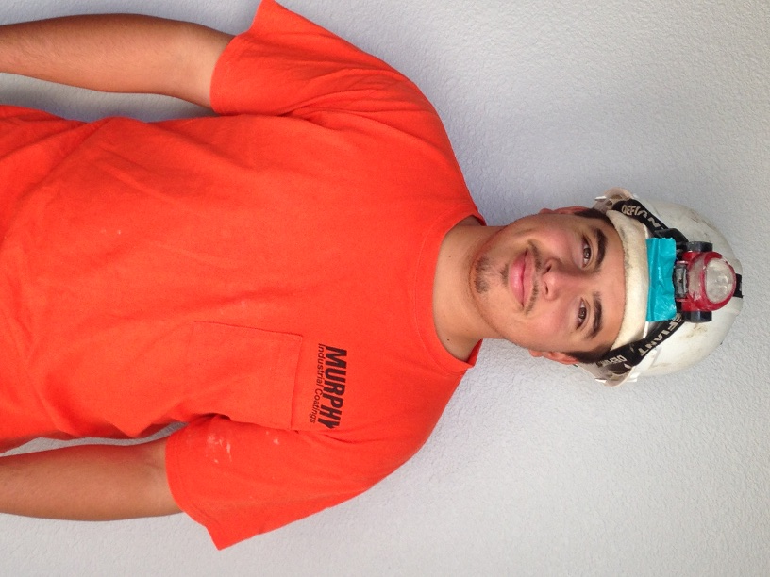
TEGL 05-10
Match and Allowable Construction and Other Capital Asset Costs for the YouthBuild Program
Overarching
Provides important information on what construction-related costs are allowable with grant or match funds for work site training
Provides further explanation of match funds under YouthBuild
Particular focus should be on the attachment, YouthBuild Selected Items of Cost, which provides specific information on various construction activities and costs and whether they are allowed with grant/match funds

Slide 13
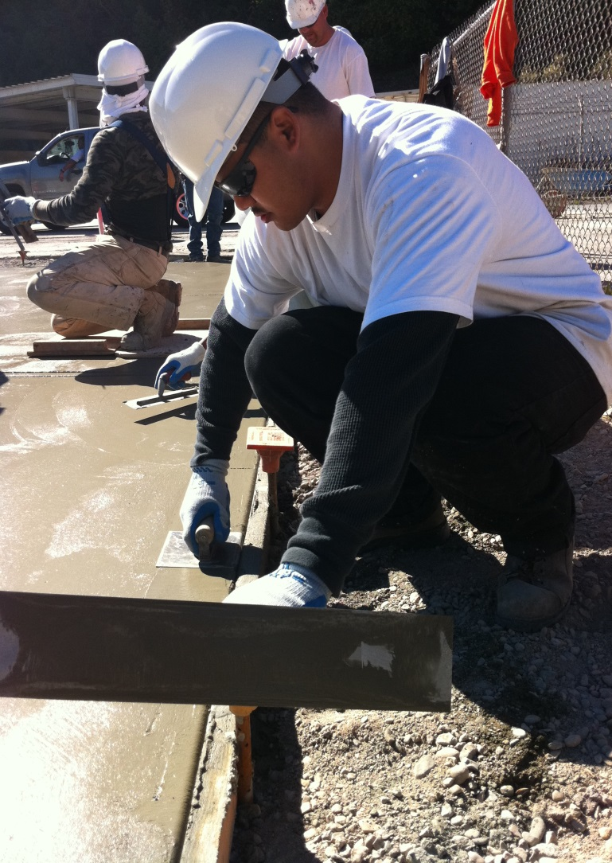
TEGL 35-12
Definition and Guidance on Allowable Construction Credentials for YouthBuild Programs
Outcomes focus
Provides guidance on minimum level of certification allowable for each of three nationally industry-recognized construction certifications – i.e. more than one module may need to be completed and passed for it to count as a “certification outcome”
Encapsulates TEGL 15-10 explanation of how to determine whether additional credentials qualify

Slide 14
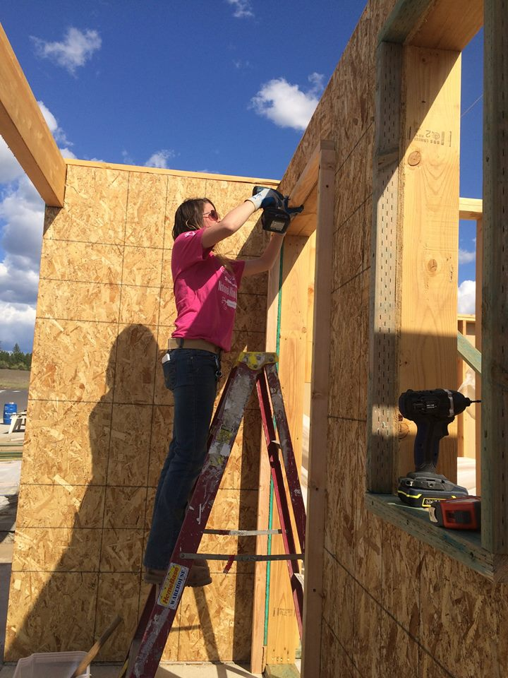
TEN 13-12
Defining a Quality Pre-Apprenticeship Program and Related Tools and Resources
Overarching
Provides information on how a pre-apprenticeship program is defined and how to develop one
Provides helpful strategies for grantees to better understand collaboration with Registered Apprenticeships and paths to facilitated entry/articulation
Also provides information on resources to develop pre-apprenticeship programs and information on existing pre-apprenticeships for potential partnership

Slide 15
TEGL 06-15
Qualifying Work Sites and Construction Projects for YouthBuild Grantees
Their Role in Training
Newest YouthBuild-related TEGL (published October 7, 2015)
Describes the level of construction work that qualifies a work site
Clarifies activities that may be done in conjunction with work site training but that do not qualify as stand-alone work site activities
Provides suggestions for potential work site partners
Reiterates the program structure requirements for the YouthBuild program as they relate to work site training

Slide 16
WORK SITE DESCRIPTION FORM
Work Site Description
(A WorkSite Description is required for each property)
YouthBuild (YB) GRANT
ATTACHMENT 1 |  |  |  |  |  |  | OMB No. | 1205-0464
ETA - 9143 |  |  |  |  |  |  | Expires: | 08/31/2018
APPLICANT IDENTIFYING INFORMATION (Complete All Sections)
Applicant Name:
Program/Project Name & Address:
1. Work Site Identification (Address/Parcel #))
2. Number of Housing Units Planned to be Produced or Renovated:
3. Type of housing to be produced (Check all that apply)
¨ Residential/rental ¨ Homeownership ¨ Transitional housing for the homeless
4. Will all housing produced be provided for homeless, low-income, or very-low income persons?
¨ Yes ¨ No
4. Individual Housing Project Site Estimate and Documentation of Resources: Complete Attachment 1A for each work site to be used in conjunction with the YouthBuild program. Attach documentation of resources behind each Attachment 1A.
5. The on-site training site consists of (Check all that apply) : ¨ New Construction ¨ Rehabilitation
6. Are any of the units currently occupied? ¨ Yes ¨ No (If yes, attach a relocation narrative that identifies the number of persons, the business or others occupying the property on the date of submission of this application, the number of displaced, the number to be temporarily relocated but not displaced, the estimated cost of relocation services payments and services, the source of funds for relocation, and the organization that will provide relocation assistance to occupants and the contact person's name and phone number. Label this Attachment 1B.)
7. Name of the current owner:
8. Documentation of Access: Attach required evidence of work site access (Letter from the owner identified in No. 7). Label this Attachment 1C.
9. Describe the applicant role and responsibilities for the work site housing construction or rehabilitation work. Label this Attachment 1D.
10. Name of entity which will own and manage the property after the construction or rehabilitation work is completed:
OMB No.: 1205-0464 OMB Expiration Date: 08/31/2018 Average Response Time: 30 minutes This reporting requirement is approved under the Paperwork Reduction Act of 1995. Persons are not required to respond to this collection of information unless it displays a currently valid OMB number. Public reporting burden for this collection of information includes time for reviewing instructions, searching existing data sources, gathering and reviewing the collection of information. Respondent’s obligation to reply to this collection of information, which is for general program oversight, evaluation, and performance assessment, is required to maintain benefits [PL 109-281 Sec 173(A)(c)(3)]. Send comments regarding this burden estimate or any other aspect of this collection, including suggestions for reducing this burden, to the U. S. Department of Labor, Employment and Training Administration, Youth Office, Room N4459, 200 Constitution Avenue, NW, Washington, D.C. 20210.
Applicant Signature:
Printed Name: |  |  |  | Signature:
Title: __________________________________________________ Date: _____________
Organization: ______________________________________________________________
Downloadable here: http://doleta.gov/youth_services/pdf/Updated_Work_Site_Form_with_Housing_Census_and_Instructions.xls

Slide 17
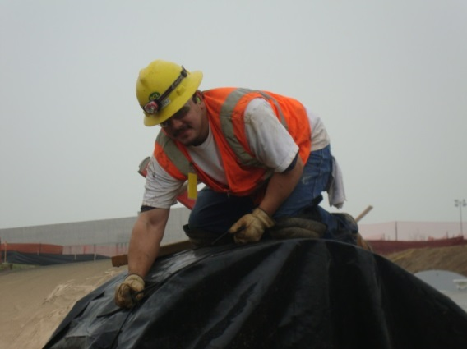
Restrictive Covenants
Restrictive Covenants are a clause in a deed or a lease to property and home that limits what the owner can do with the property.
YouthBuild projects require a ten-year Restrictive Covenant that limits the sale or lease of the project to only low-income individuals or families
The YB restrictive covenant applies on any project where DOL funds have played a role, including youth providing hours on the site
True for site-controlled and partner-controlled projects
Homes and leases must remain available to low-income families for the entire ten-year timeframe
The restrictive covenant must be applied at the time an occupancy permit is issued for the property.
The burden is on the grantee to ensure partners are aware of the restrictive covenant and willing to agree to it before undertaking construction projects.

Slide 18
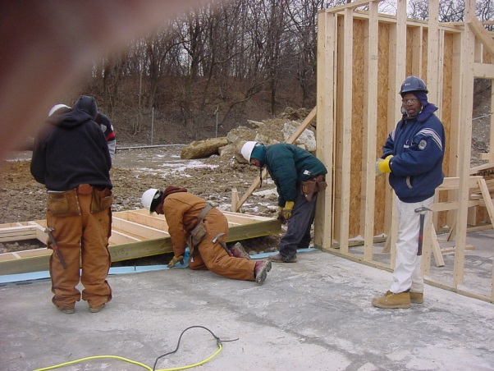
Best Practices

Slide 19
Question
What are best practices?
Projects have an impact on the immediate neighborhood
The partner is committed to YouthBuild’s training mission
Construction staff are not involved in mental toughness
The project will accommodate the program cohort
Participants allowed 1 hour lunches

Slide 20
Construction Projects and Partners: Advantages and Disadvantages
Role | Advantages | Disadvantages
Subcontracting Free Labor Arrangement: Provides supervised, trainee labor at no cost to the developer. | • No financial risk • No liability for missing deadlines • More flexibility in trainee schedule | • No income for work • May have little control over training environment or trainee assignments • May be dependent on others for YouthBuild schedule
Subcontracting Paid Subcontractor Arrangement: Completes a specific “scope of work” on a single or a few trades. Work is done for a fixed price to be completed by a pre-established deadline. | • Program receives some income • Less risk than construction management roles • Does not require complex construction management skills or logistics | • Liability of completing work within a specified deadline • Risk of not estimating materials cost correctly • May not provide for steady work for trainees throughout training year • Depending on subcontract, may not provide broad enough learning experience
Construction Management Works on behalf of the developer to coordinate all subcontractors on the project, in place of a general contractor. Developer assumes all risks and rewards. Coordination work is done for a fee. | • No financial risk or liability • Provides control over the pace of the job • Provides control over scope of work that trainees undertake • Provides leverage with other subcontractors on the job to use trainees effectively | • Requires highly experienced staff with construction management skills • Does not provide same potential for generating program income as general contracting • Hard to find willing development partner
General Contracting Coordinates all aspects of the actual construction work, including all subcontractors for a fixed price/lump sum. General contractor agrees to complete the job within a certain price, regardless of what the job ends up costing, and assumes all risks and rewards. | • Provides control over scope of work that trainees undertake • Provides leverage with other subcontractors on the job to use trainees effectively • Potential to generate more income for program than Construction Management | • Requires highly experienced staff with construction management and estimating skills • Can lose a substantial amount of money, if estimates are incorrect • Requires a sophisticated financial infrastructure • Requires cash reserves (working capital) or a line of credit
Development Obtains a site and oversees all aspects of the development of that site. Assumes the ultimate risk of ensuring that funds available match or exceed project costs. Often receives a developer’s fee for this role. | • Provides maximum control over ensuring that projects are available on time for training • Maximizes control in balancing tension of “training vs. production” • Can maximize income generated for program | • Requires extensive organizational and staff capacity to fulfill all functions • Financial risk and liability are significant • Extra workload could cause housing development to overshadow mission of youth development

Slide 21
Voices from the Field
Brian McMahon
Deputy Director
Operation Fresh Start, Inc.

Slide 22
Safety
Learn how to incorporate OSHA safe work practices (standards, reporting, safety plan) according to the DOL Final Rule and WIOA.
Have your construction trainer OSHA-authorized to deliver the 10 and 30 hour card.
Design a program safety plan that will continue beyond the OSHA training.
Partner with local OSHA providers to deliver the OSHA 10 at a reduced rate or no cost to program.
Select/elect participant safety officers for the construction site.

Slide 23
Construction Curricula
Classroom construction training must result in an industry-recognized certification for the young people.
HBI-PACT: the workforce development arm of National Association of Home Builders (NAHB)
Promotes the home building industry as a career and helps address its workforce needs through programs and resources
Includes trades training and job placement
Instructor candidates must have at least 5 years of experience in their trade to qualify for certification
Certification will expire after 2 years if the Instructor has not submitted for a certificate in that time frame
HBI requires all YouthBuild programs to sign a licensing agreement in order to deliver the PACT curriculum. Current DOL grantees will pay $75 per certificate for the first 30 submissions and $100 for all certifications after that. Non-DOL YB programs must enter a separate technical assistance contract with HBI in order to deliver certificates.

Slide 24
Construction Curricula
Classroom construction training must result in an industry-recognized certification for the young people.
The National Center for Construction Education and Research (NCCER): is a not-for-profit education foundation
Created to develop industry-driven standardized craft training programs with portable credentials to help address the critical workforce shortage facing the construction industry.
Potential Instructors qualifications are to have Journey level experience or to have taught in a vocational training environment for at least 3 years. NCCER offers over 75 craft (trade) areas of certification.

Slide 25
Construction Curricula
Classroom construction training must result in an industry-recognized certification for the young people.
The Building Trades Multi-Craft Core Curriculum, 120-hr curriculum, is created and owned by the Building Trades Department of the AFL-CIO. The training is offered to program coordinators and instructors who are either currently working with or who wish to work with the building trades in their area. This curriculum does not incorporate a hands-on component.
Participants who successfully complete the training will:
Practice teaching construction concepts using participatory methods
Develop strategies for delivery of the curriculum in conjunction with local building trades councils.

Slide 26
Construction Curricula
Classroom construction training must result in an industry-recognized certification for the young people.
BPI A national standards development and credentialing organization for residential energy efficiency retrofit work –
Provides training through a network of training affiliate organizations, individual certifications, company accreditations and quality assurance programs
An independent, not-for-profit organization
Brings together leading building science experts from across North America to develop standards using a consensus-based methodology.
The nation's premier building performance credentialing, quality assurance and standards setting organization.
Develops technical standards using an open, transparent, consensus-based process built on sound building science.
Approved by the American National Standards Institute, Inc. (ANSI) as an accredited developer of American National Standards and as a certifying body for personnel credentials. BPI is also approved by the WAP Weatherization Assistance Program under DOE to provide this needed training and education

Slide 27
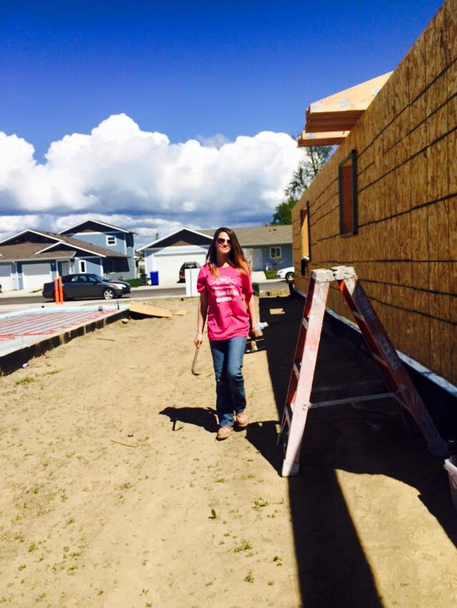
Additional Issues to Consider with Work Sites

Slide 28
Construction Plus
Construction Plus is a non-construction additional career trade track for the youth that results in an industry-recognized certification.
Enough youth are required for the Construction Track to complete the scope of work in the approved projects
Some programs have youth complete Construction and then Construction Plus, if they wish
In some programs, some youth go straight to Construction Plus

Slide 29
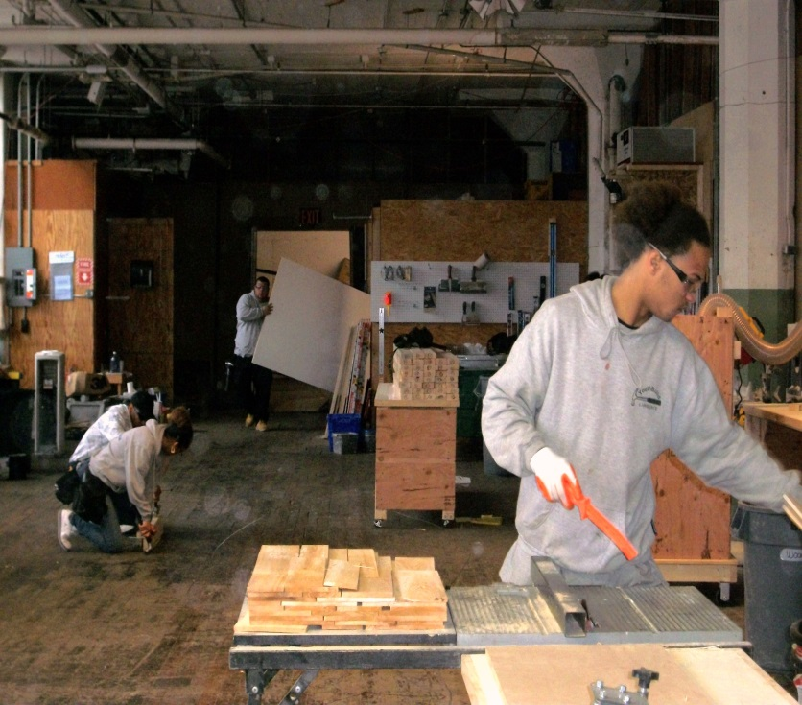
TEGL 07-14
Guidance for Implementing the “Construction Plus” Component of the YouthBuild Program
Provides guidance on Construction Plus implementation and requirements
Provides resources for researching local Labor Market Information to determine in-demand fields in the local area
Includes Considerations attachment that provides additional information for programs to consider in determining what Construction Plus industries to include
NOTE: Insert nice construction picture here – match oval format of other TEGL Slides

Slide 30
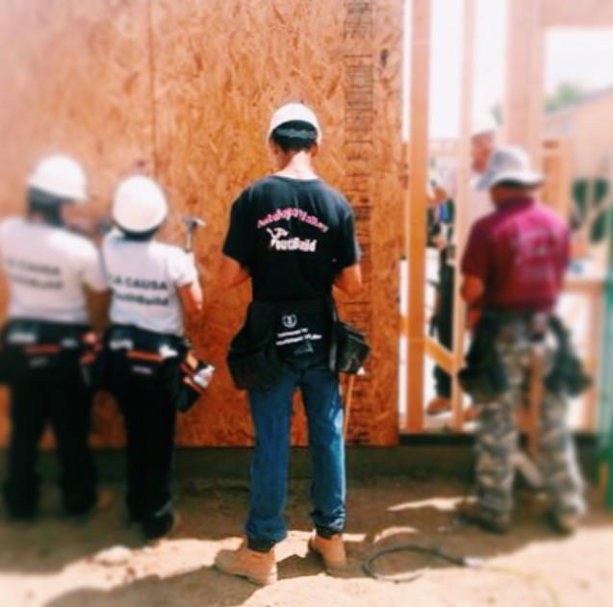
Broader Construction Applications

Slide 31
Question
What other vocational training opportunities would enhance your construction component?
Green building
Radon
Deconstruction
Preservation
Apprenticeship placement
General Industry OSHA certification

Slide 32
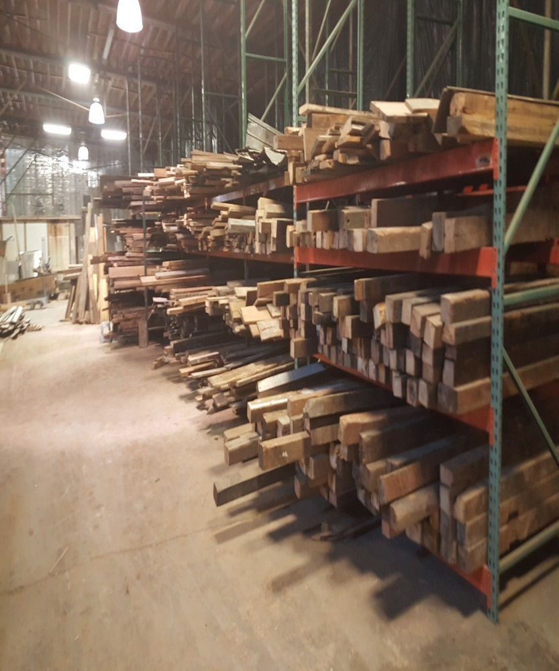
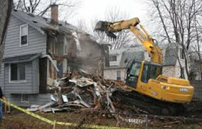
Deconstruction NOT Demolition

Slide 33
What is Deconstruction? (Decon)
Deconstruction is: the selective dismantling of building structures to recover reusable and recyclable materials.
Deconstruction Resources
Building Materials Reuse Association. (2012). Introduction to Deconstruction: A Comprehensive Training Workbook. Building Materials Reuse Association. Clucky Dickens Farm. (2013, June).
Moving a Big Red Barn. Retrieved from A Farmish Kind of Life: http://afarmishkindoflife.com/2013/06/moving-big-red-barn/Elizabeth O'Brien, Bradley Guy, Angela Stephenson Lindner. (Fall 2006, Vol. 1, No. 4).
Life Cycle Analysis of the Deconstruction of Military Barracks: Ft McClellen, Anniston, AL. Journal of Green Building, 166-183.Guy, B. (2005, October 24).
The Optimization of Building Deconstruction. Retrieved from lifecyclebuilding.org: http://www.lifecyclebuilding.org/docs/The%20Optimization%20of%20Building%20Deconstruction.pdf
Habitat for Humanity, Wake. (2015). Kitchen Striip Out/Light Salvage. Retrieved from Habitat ReStore: http://wakerestore.org/deconstruction/kitchen-strip-outs/Housing and Urban Development. (2015).
All That’s Old Is Renewable. Retrieved from www.huduser.org: http://www.huduser.org/portal/pdredge/pdr_edge_featd_article_092313.htmlInstitute for Local Self Reliance. (2002, February 1). Recycling Means Business, from Waste to Wealth. Retrieved from Institute for Local Self Reliance: http://ilsr.org/recycling-means-business/

Slide 34
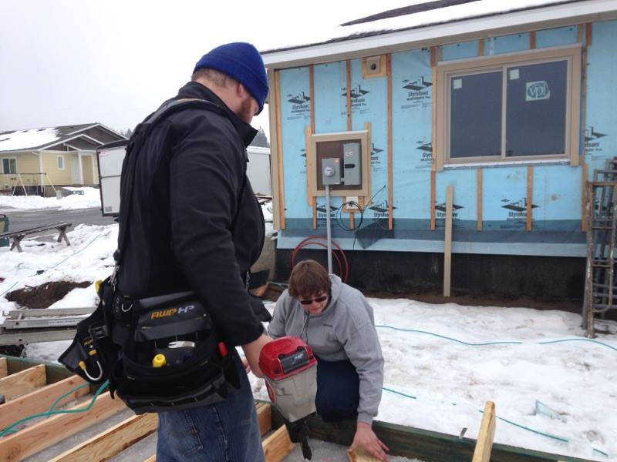
Energy Efficiency and 3rd Party Certification
Benefits:
Greater public visibility
Industry relevant job skills
Increased environmental awareness
Integrated educational opportunity
Reduced living expenses
Increased property value.
Challenges:
Myths
learning curve
Cost
Time
Partner limitations.
Resources:
Shades of Green Getting Started Checklist, McGraw Hill Construction for Industry Data.

Slide 35
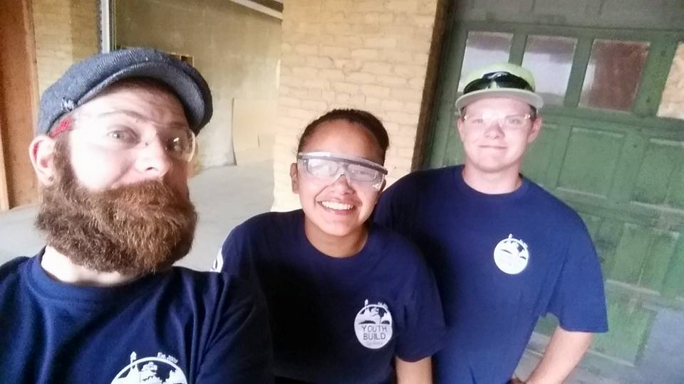
Registered Apprenticeships
Identify the local Union hall that may be associated with your construction project
Registered apprenticeships are not always Union affiliated
Determine which curriculum is what the local Hall is looking for
Invite Hall members as guest speakers for construction
Use Section 3 to leverage apprenticeships
Invite Union leadership to the Program Board

Slide 36
Voices from the Field
Brian McMahon
Deputy Director
Operation Fresh Start, Inc.

Slide 37
Planning for the Worst (Plan B)

Slide 38
Contingency Plans
Use construction lab to work through curriculum
Use construction lab to build a shed or playhouse that incorporates multi phases of construction
Approach local Habitat for Humanity or CDC if they are not already a partner
Reach out to community partners for internship placements

Slide 39
Work Site Pitfalls
Not ensuring that all work sites are approved – must use form ETA-9143 and submit to FPO with ALL required attachments
Not ensuring sufficient training opportunities for youth to make work site qualifying – Attachment 1D of ETA-9143 – work site construction must have “breadth and depth”
Not ensuring Restrictive Covenant will be placed on work site property at time of Occupancy Permit
Not ensuring work sites are within service area as described in SOW
Tying match funds to work sites
* Any of these can result in unallowed costs against your grant that must be paid back or reduced from the total grant award.

Slide 40
Avoiding Work Site Pitfalls
Talk to FPO immediately with any work site concerns
Always submit work site modifications when approved work sites change or fall through or when adding new work sites – the more lead time for review/approval, the better
Ensure you have guarantee of Restrictive Covenant in writing at the start of the project
Have a viable plan for matching funds that does not rely on good weather, speedy building, or other unpredictable and insecure factors to come to fruition

Slide 41
Resources
Safety Resource:
https://www.osha.gov/doc/compliance
Community of Practice (https://etagrantees.workforce3one.org/ws/etagrantees/pages/resources.aspx?pparams=1001435162221393902)
Shades of Green
http://uwworksafe.com/request/#osha
https://www.osha.gov/youngworkers/resources.html

Slide 42
Additional Resources
TEGL 05-10: http://wdr.doleta.gov/directives/corr_doc.cfm?DOCN=2932
TEGL 35-12: http://wdr.doleta.gov/directives/corr_doc.cfm?DOCN=8795
TEN 13-12: http://wdr.doleta.gov/directives/corr_doc.cfm?DOCN=5842
TEGL 06-15: http://wdr.doleta.gov/directives/corr_doc.cfm?DOCN=6610
TEGL 07-14: http://wdr.doleta.gov/directives/corr_doc.cfm?DOCN=5631

Slide 43
RELATED MATERIALS
These documents are available for download during or after this webinar:
Safety plan
Work site description form
Restrictive Covenant
Partnership MOU
Young Workers
Construction Projects and Partners, Advantages and Disadvantages
Industry Recognized Curricula

Slide 44
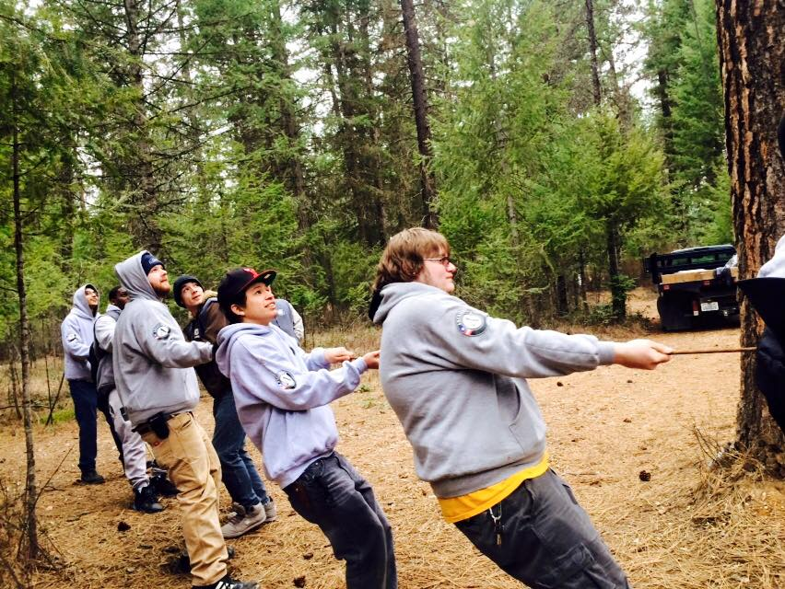
QUESTIONS & ANSWERS

Slide 45
Please enter your questions in the Chat Room!

Slide 46
Speakers’ Contact Information
Moderator: Jenn Smith
Title: National YouthBuild Director
Organization: U.S. Department of Labor
Email: smith.jenn@dol.gov
Telephone: 202-693-3597
Presenter: Ted Roan
Title: Director of Green Construction
Organization: YouthBuild USA
Email: troan@youthbuild.org
Telephone: 617-741-1259
Presenter: Helen Whitcher
Title: Senior Director, Technical Assistance
Organization: YouthBuild USA
Email: hwhitcher@youthbuild.org
Telephone: 843-345-6980

Slide 47
Speakers’ Contact Information
Presenter: Brian McMahon
Title: Deputy Director
Organization: Operation Fresh Start, Inc.
Email: bmcmahon@operationfreshstart.org
Telephone: 608-244-4721

Slide 48
Look for upcoming Webinars in this series!
Community of Practice and Other Resources
October 20, 2015 from 2:00 – 3:30 PM EDT
YouthBuild Grant Post-Award Overview
October 27, 2015 from 2:00 – 3:30 PM EDT
YouthBuild Webinar Series: Registered Apprenticeship
November 10, 2015 from 2:00 – 3:30 PM EST

Slide 49
www.workforce3one.org

