Slide 1

Customer-Centered Design
T H E
Prototype &
Experimentation Phase

Slide 2

agenda
» Welcome & Introduction
» Project Phases
» Panelists
» White House Celebration
» Resources
» What’s Next
» Questions & Answers

Slide 3

Virginia Hamilton
Regional Administrator, Region 6
San Francisco Employment and
Training Administration
U.S. Department of Labor

Slide 4
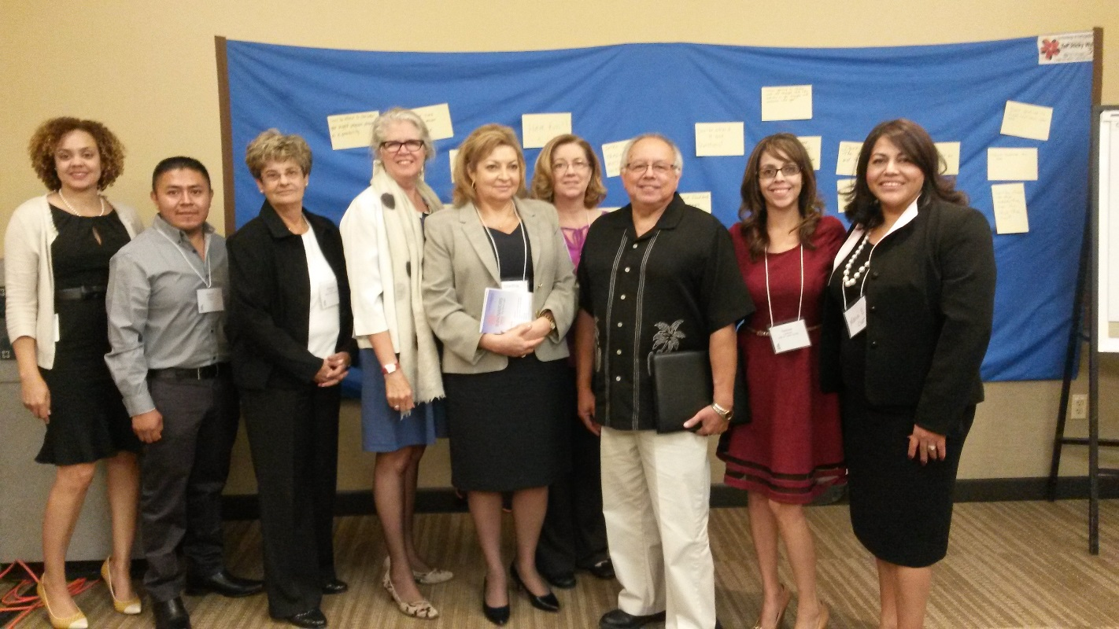
Tulare County California
ASKING
Customer
The

Slide 5

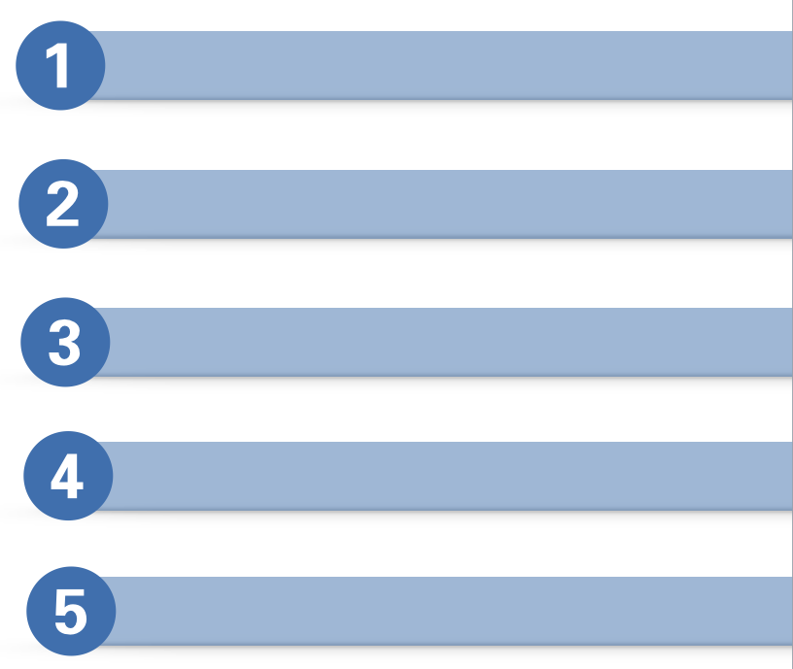
Our Project AND FIVE PHASES
The Launch
The Class
Prototyping and Experimentation
Learning Exchange and Celebration
Peer Mentoring

Slide 6

The HCD Process
A collaborative, discovery-based journey.
Get inspired by
the people
you’re serving.
Start by listening to people to get new ideas about how to design
for them.
Identify patterns and surprising insights to
inspire new opportunities
for design.
Brainstorm new ways to serve
your customers.
Try out your
ideas and get feedback from customers – so you can revise your prototypes and get more feedback.
Try out a pilot program and experiment with ways to implement your new ideas.

Slide 7

Phase 3
The Prototype Phase will:
Let you experiment
Give you hands-on experience speaking to, prototyping for, and
testing with the people for whom you designing solutions.

Slide 8
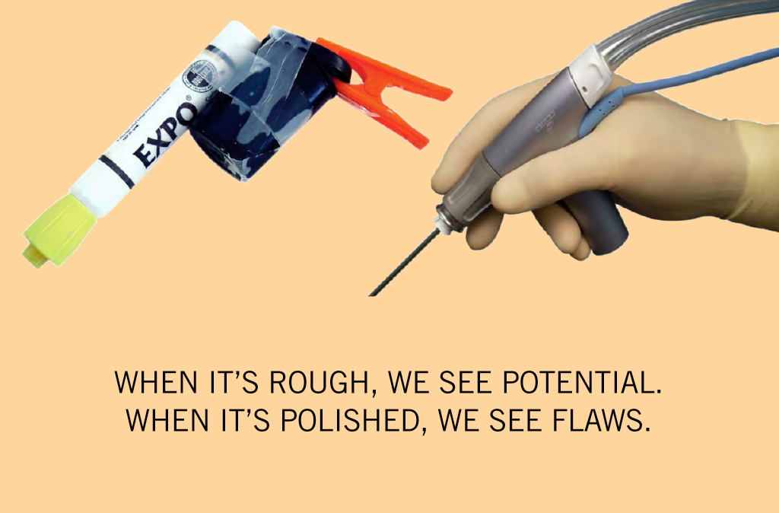

Slide 9
The Panelists
Nancy Saengjaeng
Santa Barbara County Workforce Resource Center
Santa Barbara County Department of Social Services
Santa Maria, CA
Pam Streich
North Central PA, Our Youth, Our Future
North Central Workforce Development Board
Ridgway, PA
Sondra Howell
Delta Force
Memphis Bioworks Foundation
Memphis, TN
Nancy Dischinat
Lehigh Valley Wolf Gang
Lehigh Valley Workforce Investment Board
Allentown, PA

Slide 10

Santa Barbara County
Workforce Resource Centers
(Americas Job Centers of California)
Human Centered Design Project

Slide 11
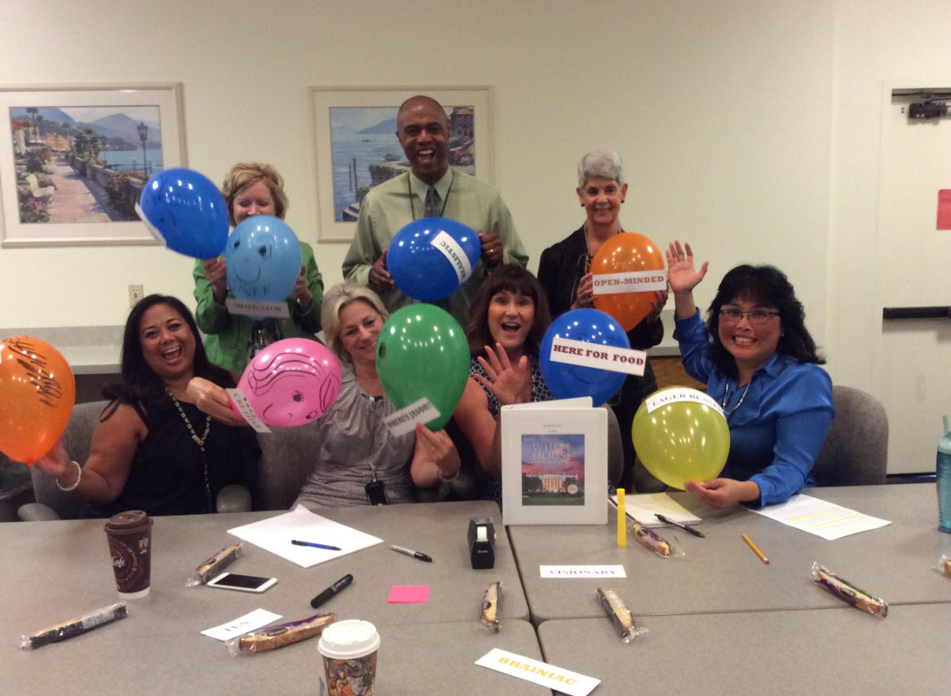
Group Kick-Off
Team Members (from left front)
Andrea Mcgrath, AJCC (WRC)
Mona Baker, AJCC (WRC) Manager (SB Co. Dss)
Alice Razo, WIOA Adult/Dislocated Worker
Nancy Saengjaeng, SB Co. TANF/Calworks WTW
Chris Cronan, Employment Development Dept
Eric Walker, Rescare Workforce Services
Valerie Dhanens, AJCC Training/Capacity Building
Where’s Jason?
Not Pictured
Grace Schoch-manzano, EDD
Jason Ramirez, AJCC (WRC)

Slide 12
Theme: Lack of Integration
Insights:
Currently, each partner manages own recruitment for the most part.
Insight #2
Employers are used to going to individual partner rather than to the Center as a source.
Insight #3
Employer’s comfort level among individual agencies differs within the Centers so partners maintain status quo (not seen as 1 unit/1 team).
Insight #1

Slide 13
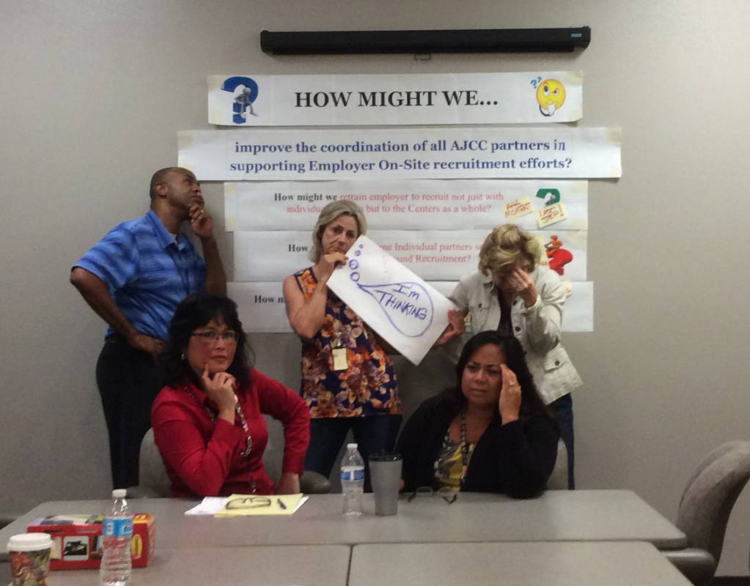
How Might We...

Slide 14
“How might we...” Questions
Insight: Partners need to take advantage of the fact that we can be one source of recruitment thereby taking advantage of the potential synergy.
Insight: Individual partners don’t see overall picture as their responsibility and a few take the opposite stance.
How might we refocus individual partners’ sense of responsibility around recruitment?
Insight: Employer’s comfort level among individual agencies within the Center differs so partners maintain status quo.
How might we foster the employer’s confidence to recruit with any partners within the Center?
How might we tap into the Center’s synergy around recruitment?

Slide 15
“Aha!” Moments
Partners already have strong interpersonal relationships, a good foundation to start on...Need to bring them together and work as ‘One team’.
Partners feel a sense of ownership for Employer Services but have no way to channel collaborative efforts.
We can’t have any impact on the employers until we fulfill #1 and #2 above.

Slide 16
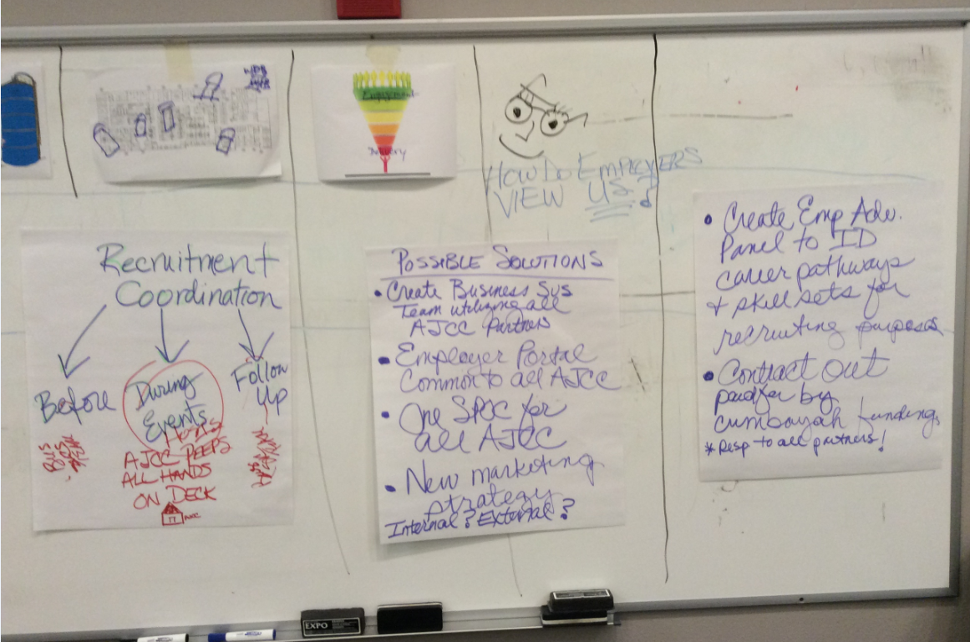
Prototyping Ideas

Slide 17
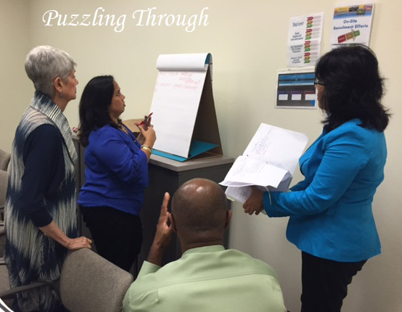
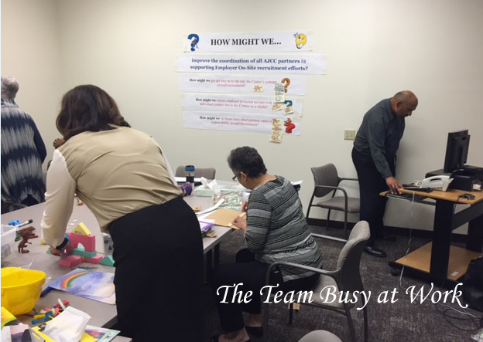
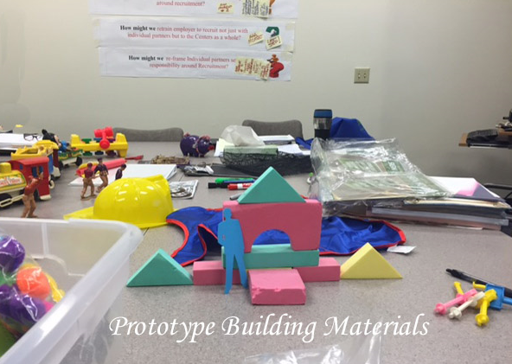
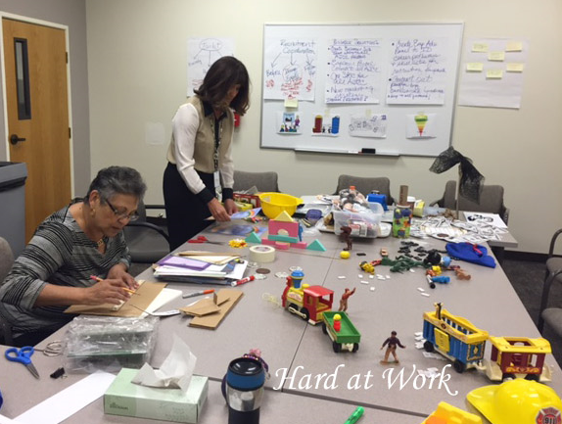
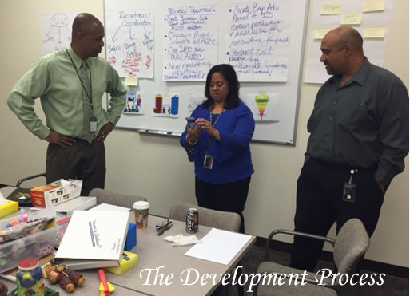
Prototype Session

Slide 18
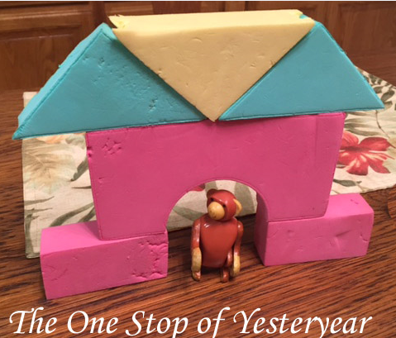
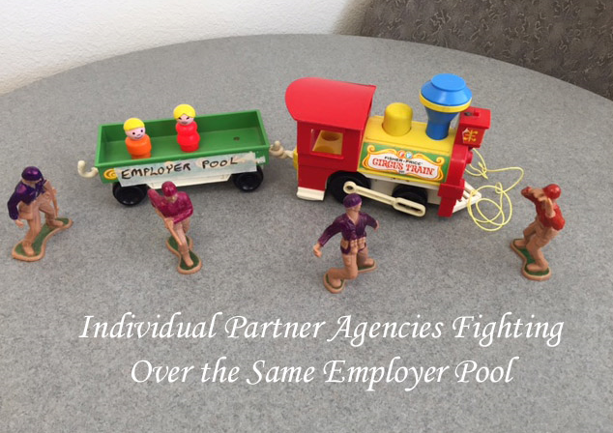
Prototyping Storyboard

Slide 19
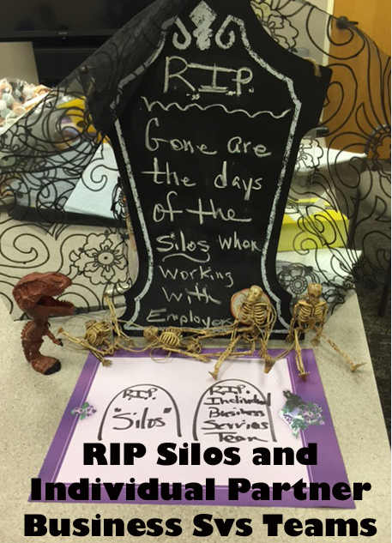
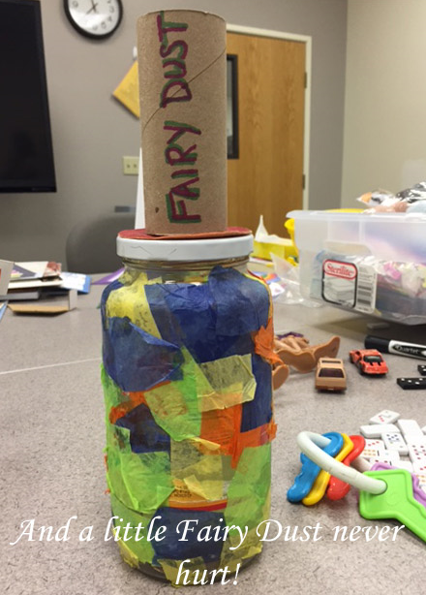
Prototyping Storyboard

Slide 20
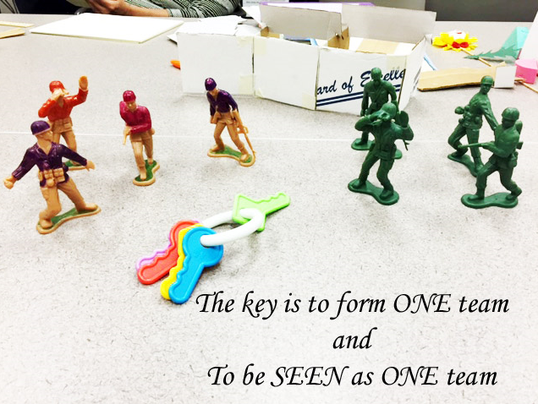
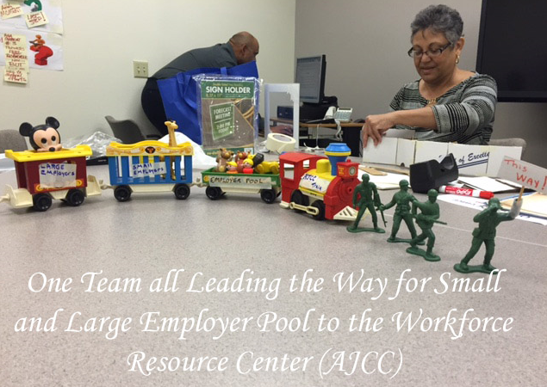
Prototyping Storyboard
Together as One

Slide 21
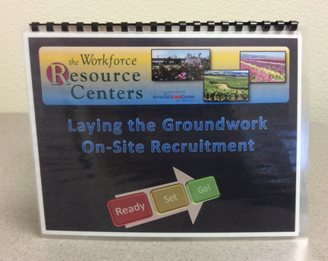
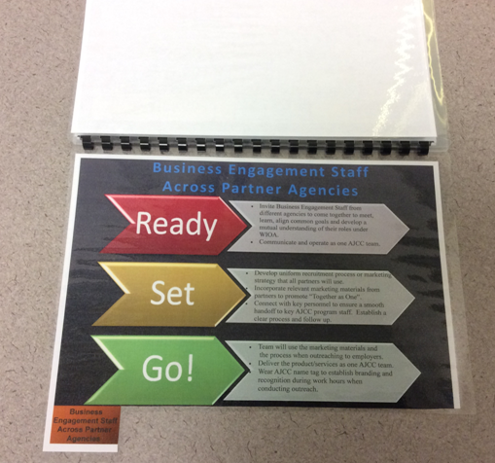
Prototype #1: Ready, Set, Go Flip Book
A Phased Approach
Laying the Groundwork Guide

Slide 22
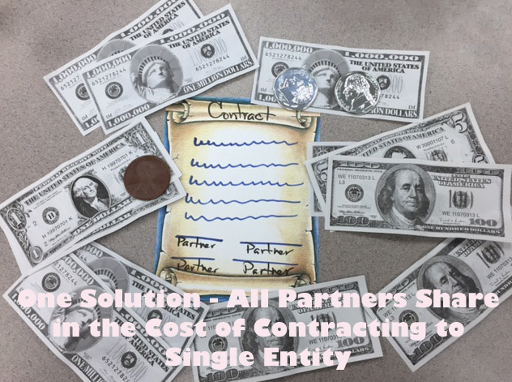
Prototype #2: Contract to Represent All Partners

Slide 23
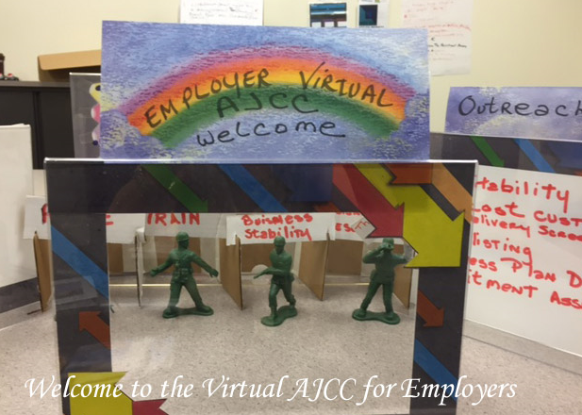
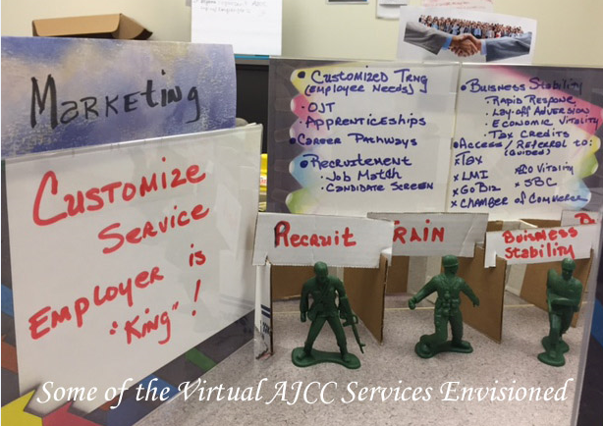
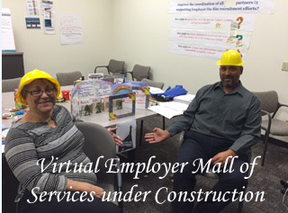
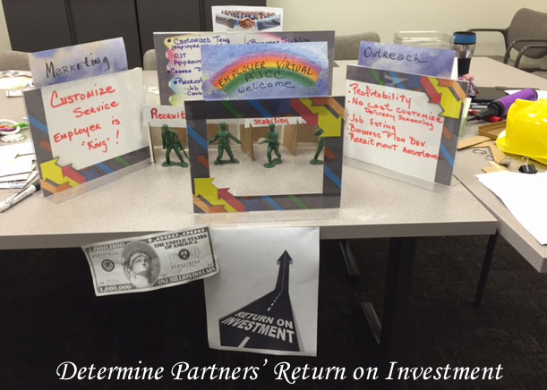
Prototype #3:
Virtual Employer Mall of Services

Slide 24
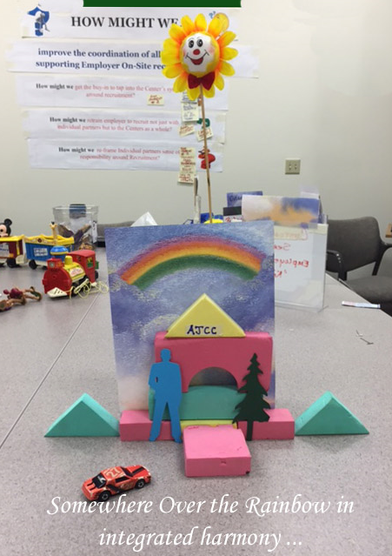
Storyboard

Slide 25
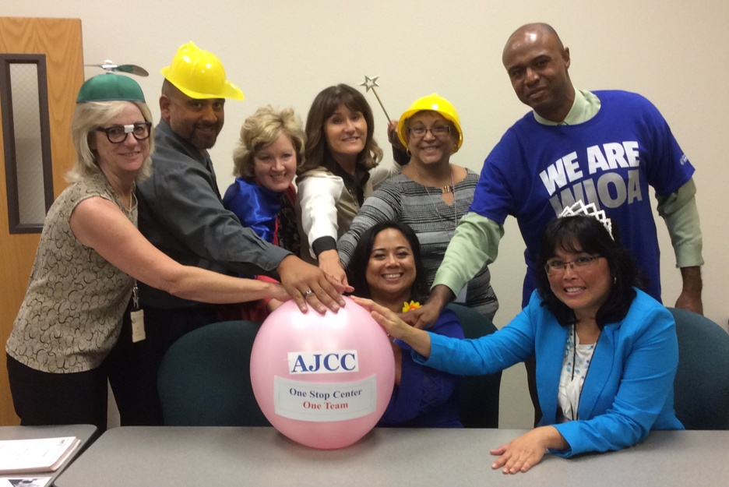
Success:
Together as One

Slide 26
North Central PA, Our youth, our future
North Central Workforce Development Board
Ridgway, PA

Slide 27
The Challenge Question:
How might we improve the customer experience and outcomes for our shared One-Stop customers?
Encompasses our service populations
Allows the opportunity to explore and analyze
Is a priority for each team member

Slide 28
Research Methods
Group Interviews
Individual Interviews
Best Practices Research
Emersions

Slide 30
How Might We?
……train customer service representatives to demonstrate customer respect?
……merge soft skills and technical training to provide a workable candidate for the multitude of jobs open in Memphis?

Slide 31
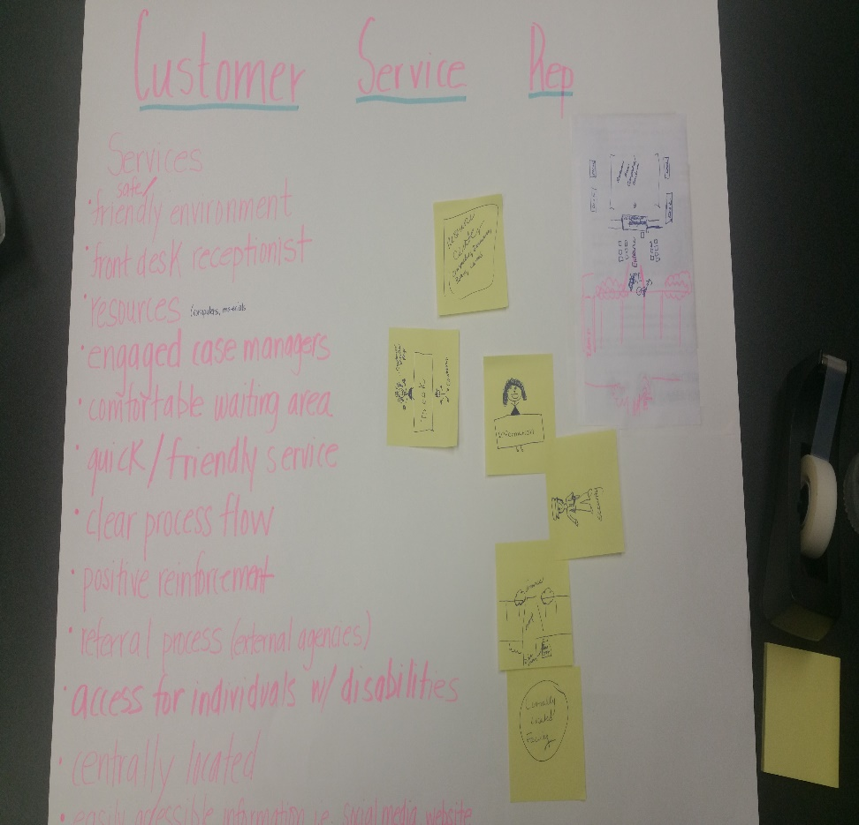
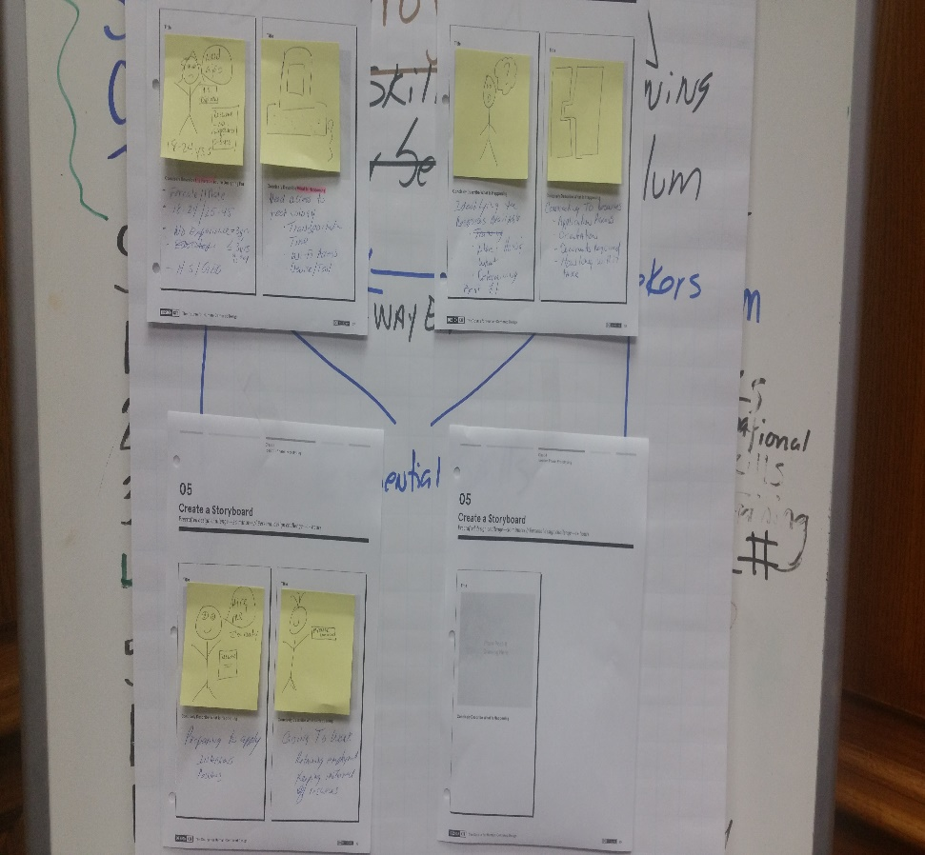
Storyboards
Customer Service
Job Seeker

Slide 32
Prototyping: The Job Seeker
    Have customers gone through the “process” and if so, where and what were the outcomes of the services they accessed or engaged in?
    Test: Create a central data base to connect information from partnering agencies that capture the customer’s experience (resources provided, referrals, documentation, training, etc.)
    Do job seekers have access to computers and the internet and are they computer literate?
    Test: Complete a data analysis to determine what information is being accessed, the number of applications submitted via on-line, etc.

Slide 33
Prototyping: The Customer Service Representative
    Does staff have the right information to serve customers?
    Test: Create a test or exam (Survey Monkey) to gauge the knowledge of staff.
Can customers access information in various places and ways?
Test: An agency self-assessment questionnaire.

Slide 35


Presented by:
Lehigh Valley Wolf Gang
Customer-Centered
Design Challenge
One-stop
clearinghouse
for services
ServiceTown…
Lehigh Valley Wolf Gang: Allentown Housing Authority, Greater Lehigh Valley Chamber of Commerce,
Lehigh Carbon Community College, Lehigh Valley Workforce Development Board, Inc., My Brother’s Keeper, Northampton Community College, Northampton County Area Agency on Aging, Office of Vocational Rehabilitation, PA CareerLink® Lehigh Valley, ProJeCt of Easton, The Literacy Center
October 20, 2015

Slide 36
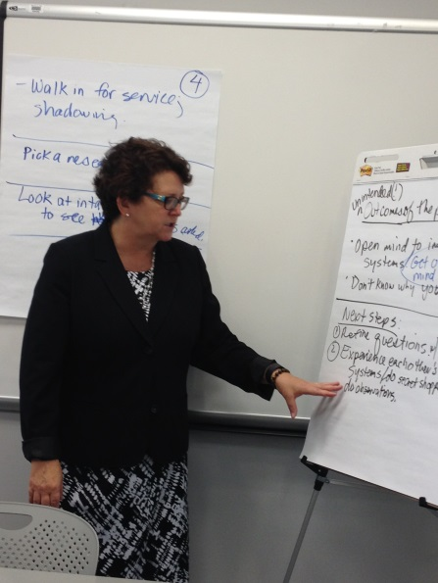
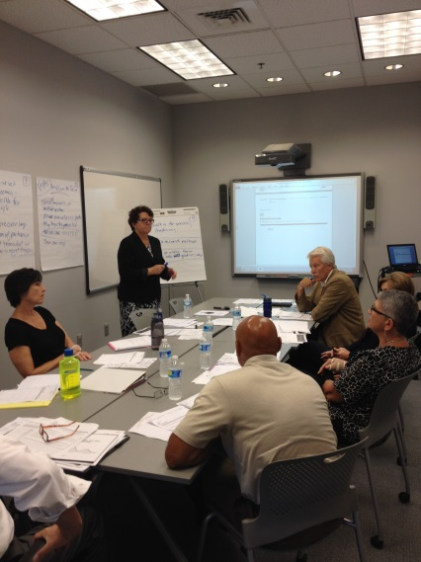
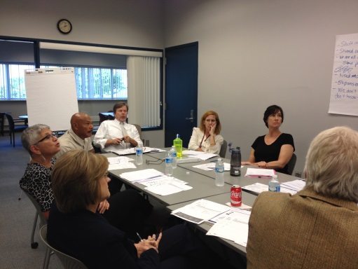
Inspiration
Name
Lehigh Valley Wolf Gang
Problem
Duplicated, disconnected
delivery of services
Challenge
Design a customer-centered one-stop
regional services clearinghouse
Solution
A one-stop clearinghouse for
services called ServiceTown
October 20, 2015 2

Slide 37



Problem: Customer Confusion
Where can I find training?
We need a place to live
How do I find a job?
Who can help?
Vocational
Rehab Services
What are my
training, literacy and education options?
120
organizations!
What do
I need?
Unemployment compensation
Transportation
Options
Where do I go to get help?
Lehigh Valley Wolf Gang
October 20, 2015 3

Slide 38



Ideation
Solution: ServiceTown
Customers start here
AssessLink
AssessLink
One-stop ServiceTown organizations
By computer
In
person
By
phone
October 20, 2015 4

Slide 39



























One-stop ServiceTown Organizations
Click on the
logo for
services descriptions
+many more
October 20, 2015 5

Slide 40










Referral Pages to Service Town
Sample
Training Education
Literacy
Veterans,
Unemployment Compensation
Vocational
Rehab Services
Adult and Youth
Workforce Services
Employer Outreach
Housing and
Transportation
Community Outreach
Area Agency
on Aging
Each organization has the ability to edit its services descriptions
October 20, 2015 6

Slide 41

ServiceTown Cart
Housing
Education
Training
Employment
Literacy
Transportation
Vocational
Rehab Services
Unemployment Compensation
110 additional community based organizations
Select/Unselect Options
October 20, 2015 7

Slide 42
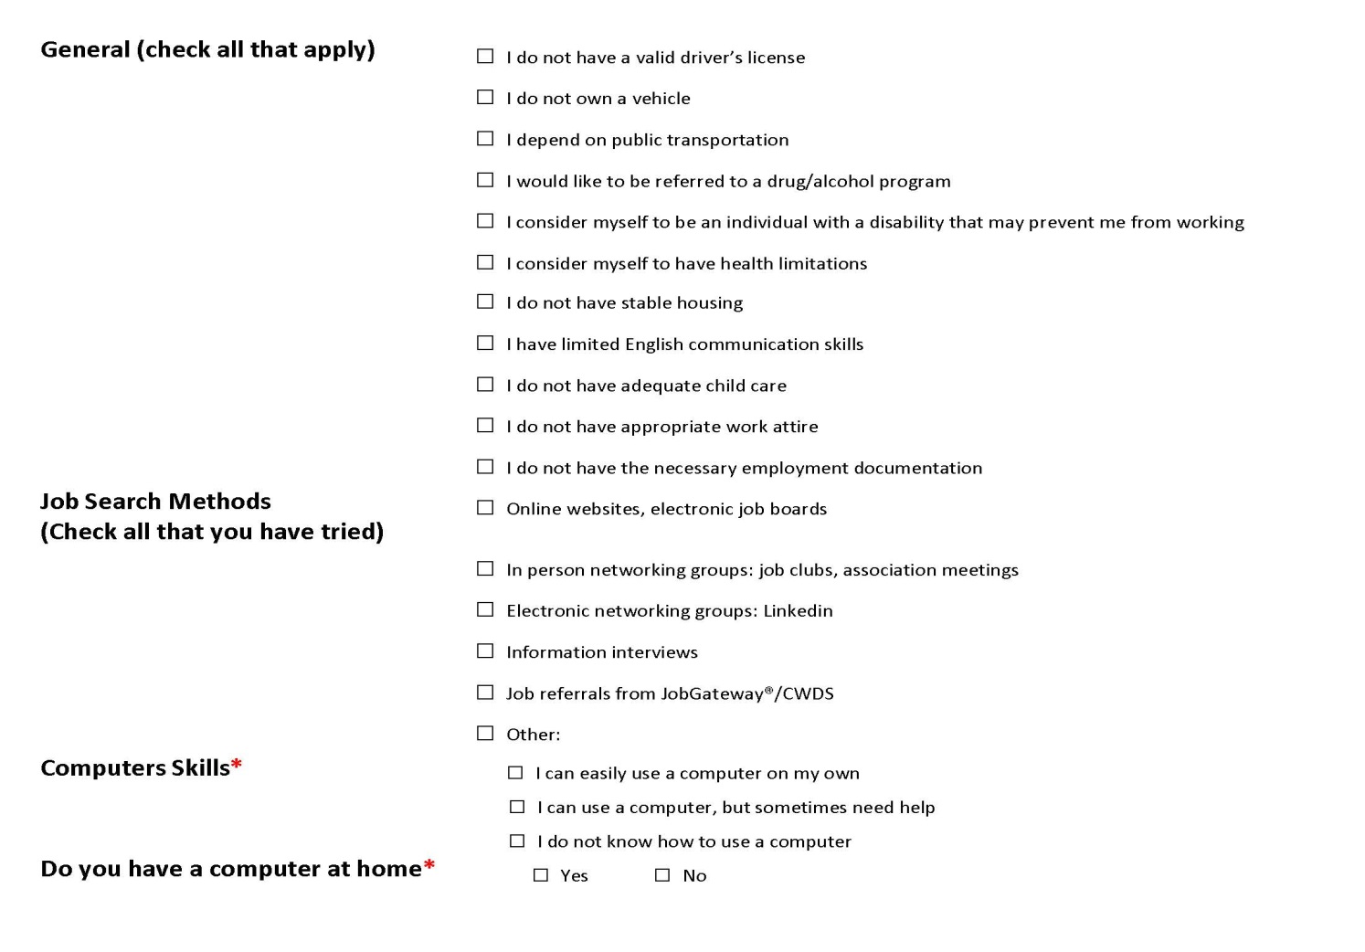

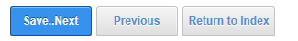
ServiceTown Assessment: On-line, by phone, in person
Diagnostic assessment
tool under construction
Series of pre-eligibility questions to
determine services and referral options
October 20, 2015 8

Slide 43

ServiceTown Check Out Summary
Personalized On-Line Services Summary
Services | Agency | Contact | Quick Link to Agency Referral Page
Click here to print Service Summary
Click here to email a copy of Service Summary
Click here to schedule a ServiceTown Orientation
October 20, 2015 9

Slide 44
ServiceTown: Outcomes
Community commitment to customer-centered system design
One-stop regional clearinghouse called ServiceTown
Holistic approach to customer services and performance outcomes
Improved customer experience
Community commitment to a Learning Exchange Sustainability Model
A one-stop services clearinghouse
October 20, 2015 10

Slide 45


Implementation of ServiceTown Prototype
Roll Out
Pilot
Beta Test
Design and Infrastructure
Community Commitment
Community commitment
to a Learning Exchange Sustainability Model
October 20, 2015 11

Slide 46
Contact
Nancy Dischinat
Executive Director
Lehigh Valley Workforce Development Board, Inc.
610-841-1122
ndischinat@lvwib.org
October 20, 2015 12

Slide 47

White HOUSE
CELEBRATION
      For those who successfully complete the CCD Challenge, there is an opportunity to be selected to attend a White House celebration and learning experience in early 2016.

Slide 48

White HOUSE
CELEBRATION
Selection Criteria
      » Complete all phases of the Challenge
      » Include a complement of relevant workforce team members/ partner
      » Submit a brief proposal to include the following:
Description of the innovation you developed
        Explanation of what you learned about the experiences of your customers
        Description of how you implemented your innovation
        Description of the impact of the innovation
        Explanation of how you shared your experience with others
        Description of the most challenging part of the process and
        how you overcame it
        Explanation of how you will use the skills you learned to
        sustain innovation
        Description of your next steps

Slide 49

White HOUSE
CELEBRATION
Selection
Process
A federal panel will select the teams to attend the white house celebration from among all those who:
          » complete the IDEO/acumen course
    » develop and implemented an innovative
    response to one of the three challenges
    » document their journey
    » submit a proposal
Selected teams will be notified in late December
Note: if your team is selected for the White House celebration, your organization is responsible for all associated travel costs. Additional information will be necessary from all individuals attending due to security protocols. Also, note that there may be a limit on the number of representatives from each team

Slide 50
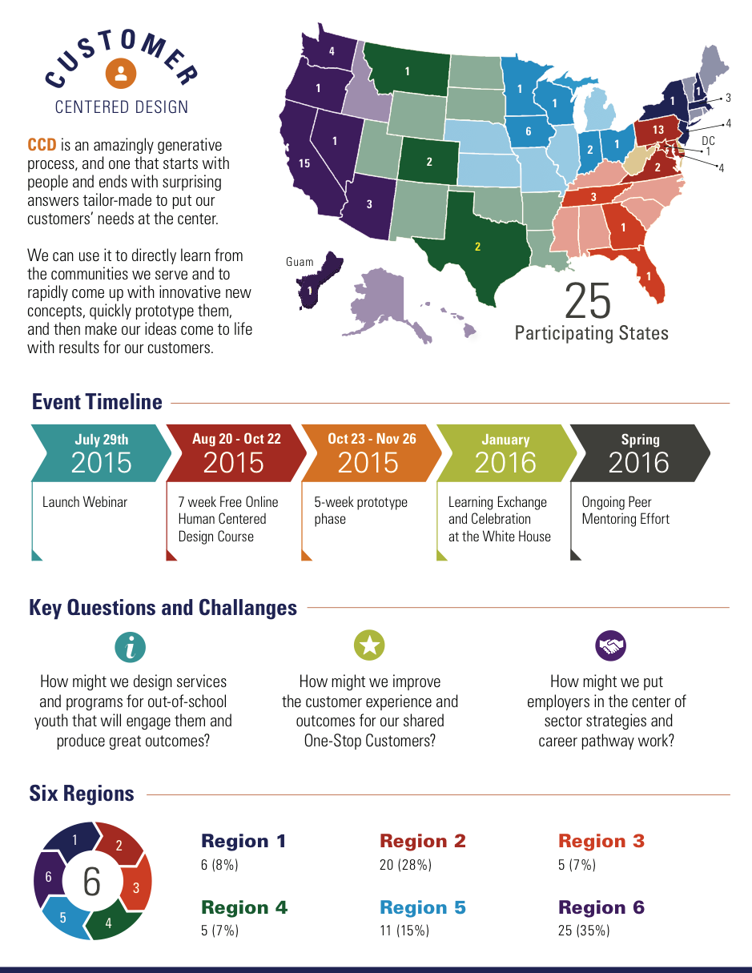

Slide 51
Customer Centered Design

Slide 52
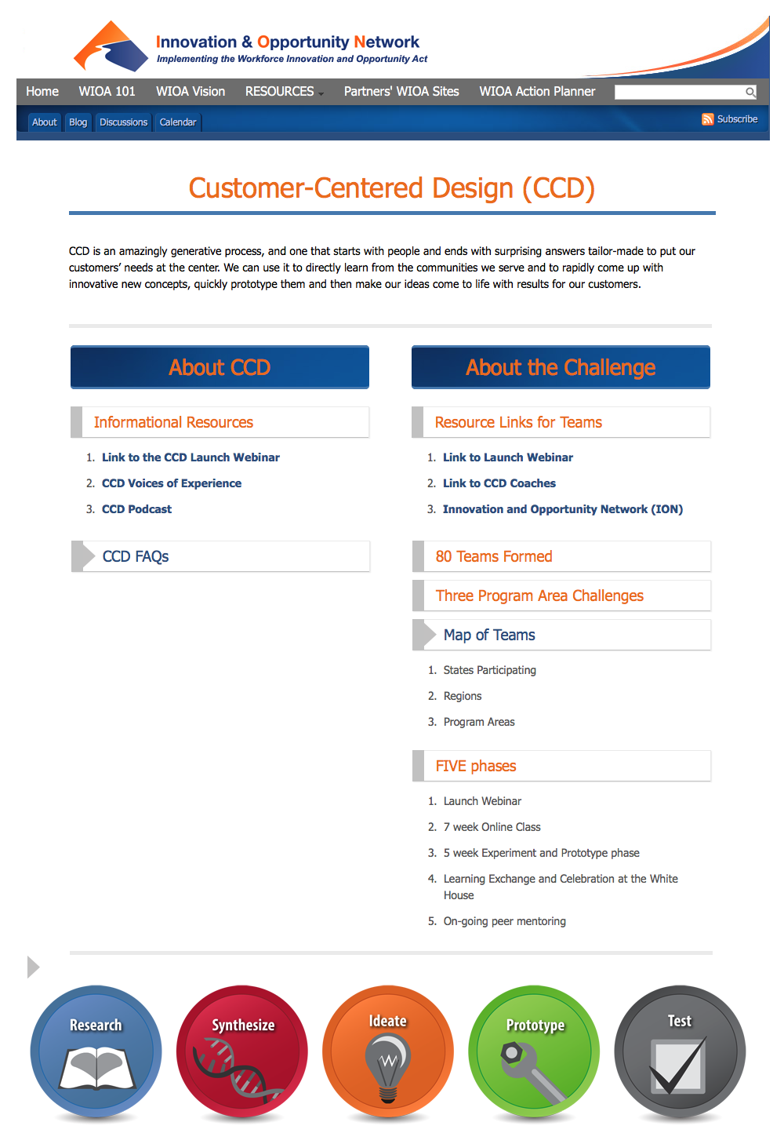
Resources
CCD Home Page:
https://wioa.
workforce3one.org/
page/CUSTOMER_
CENTERED_DESIGN
CCD Home Page:

Slide 53
It’s Time
Final Date
Human Centered Design Coursework

Slide 54

What’s Next
Experimentation Phase
» Beginning October 23
» Support offered by Maher Coaches
» Final wrap-up

Slide 55

&
Questions Answers

Slide 56

Design kit: prototyping
Sign up for the Prototyping Course
Dates: October 27, 2015 - December 2, 2015
Description: The Curriculum Will Strengthen Your Existing Knowledge Of The Human-centered Design Process And Help You To Become A More Innovative Problem Solver By Building Up Your Prototyping Skills. You'll Walk Away Knowing How To Prototype Products, Services, And Environments, And Get Constructive Feedback Along The Way.
https://novoed.com/prototyping-fall-2015

Slide 57

Join Ion
Join the Innovation and Opportunity Network (ION) Community at
and get CCD updates,
as well as:
» Interactive Peer Learning Events
(virtual and in-person)
» The Act-Now Series where you will learn how your peers are moving forward with WIOA implementation
» Voices of Experience: Videos and Podcasts of your peers describing how they are transforming the system
» Best practices and leading-edge resources and guides
» Peer driven blogs and real-time discussions
» Quick Start Action Planners
wioa.workforce3one.org/join

