Slide 1
North Central Our Youth Our Future
Customer Centered Design Challenge – Implementing WIOA with the Customer in the Center

Slide 2
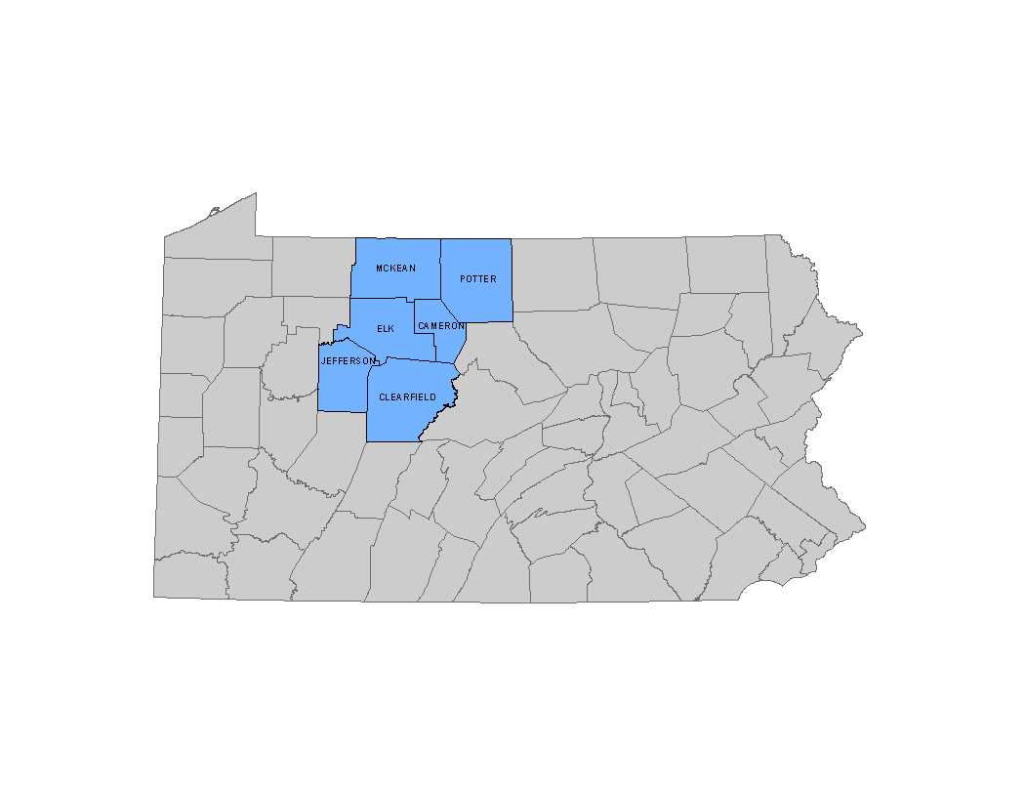
North Central Pennsylvania
Sq . Mi - 5,100
Pop -224,000
43 people per square mile
Roughly the size of the state of Connecticut

Slide 3
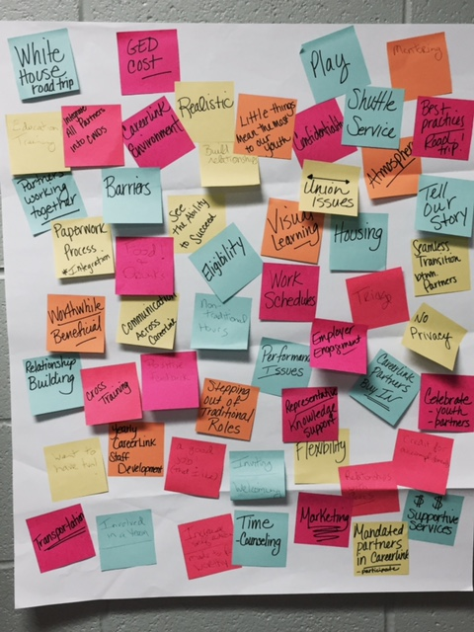
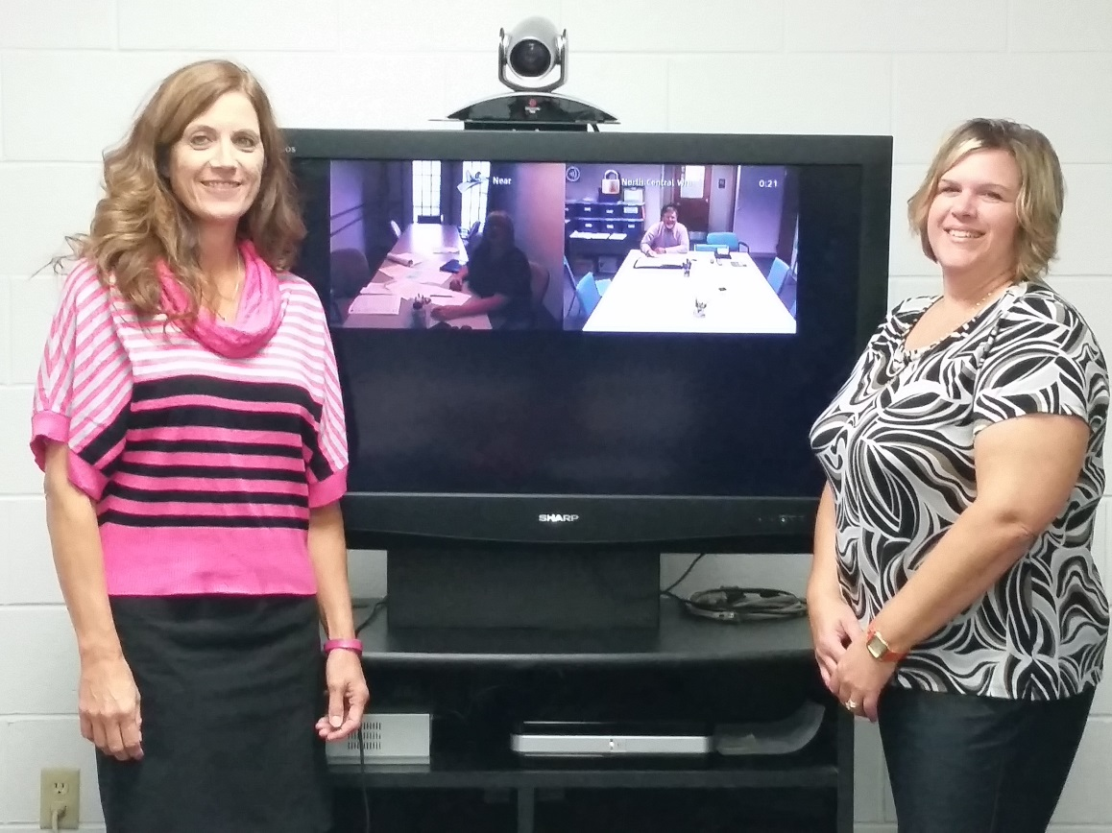
Workshop 1 – The Design Process Begins – Our Design Team!
Pam, Teresa, Troy and Blythe

Slide 4
The Design Process Begins…..
Icebreaker – draw person to your right!
What do we hope to get out of this course!?
See more success with GED program
Develop a consistent process when serving youth.
A Successful, fun youth program.
Doing something different to help youth be successful.

Slide 5
Initial Brainstorming Session
How might design programs and services for out of school youth that ENGAGES them and produces great outcomes?
Paperwork process difficult
Partners working together
Barriers
Integrate all partners to use CWDS.
GED Cost – barrier
Realistic
Little things mean the most to youth
Need yearly CareerLink staff development
Want to have fun (staff and Youth!)
Offer snacks, food and drink
Need Cross Training
Relationship / Connection
Shuttle service
Tell our story
Team involvement
$ for Supportive services
Positive feedback
Non-traditional hours
Communication across CareerLink partners needs improved
Employer engagement is key
Counselor must have knowledge and offer support

Slide 6
Workshop 2: Choosing our Design Challenge
Design services and programs for out of school youth that will ENGAGE them and produce great outcomes!

Slide 7
What We Know…
Transportation options are limited for this population
Services are often provided in a sterile environment
Once immediate needs of young adults are met they don’t come back
No food or money to buy food / lunch
Lack of program structure
Too many hurdles to get to the appropriate staff
Bureaucracy
Youth do not know what they need
Lack of positive support network

Slide 8
What we don’t know…
All of the barriers youth are facing
What makes them tick / excites them / brings them back
Life experiences / exposure to careers
Dynamics of living arrangements – sleep / running water / laundry – no access
Physical health / mental health
How do they manage their money

Slide 9
Define Our Audience…
Out of school youth – aged 16-24 disconnected from education and workforce.
Agencies / representatives who serve youth with barriers
Parents / guardians / grandparents
Significant others
Co-workers
Peers
Neighbors

Slide 10
Experts to speak to….
Probation Officers / jail staff
Office of Vocational Rehabilitation staff
Women Infants and Children (WIC)
Project Rapport (serve pregnant and parenting youth)
GED Teachers
Employers
Independent Living / Homeless Programs
Good will
Secondary Research!!!!!

Slide 11
Immersion Locations….
McDonalds , Sheetz and other eating places
Parks
Shopping Centers / Malls
Community Centers
YMCA and YWCA
Libraries
Downtown – main street

Slide 12
Analogous Inspiration….
Social interaction – park, community centers, street corners
Language
Anger, Attitude, Frustration----Emotions

Slide 13
Interviews and Research - Highlights
Interviews: 4 out of school youth with barriers (criminal justice involvement, pregnant and parenting, high school dropout, basic skills deficient).
Interviews: 10 agencies that serve youth: 3 probation officers (juvenile and adult), 1 MH / MR worker, 1 homeless assistance agency, 2 GED instructors, 2 from Project Rapport (serving pregnant and parenting youth), 2 PA CareerLink staff.
Observations: park, community center, main street, McDonald’s and Sheetz.
Research – best practices from the following sources were researched (the list is not all inclusive)
National Collaborative on Workforce and Disability for Youth, American Youth Policy Forum, Oregon Commission on Children and Families, National Clearinghouse on Family and Youth, Texas Workforce Commission Youth Program Initiative (not all inclusive).

Slide 14
Workshop 3: Sharing Stories and Insights
Sharing Stories / insights
Clustering into Themes
Create insight statements
Create “How Might We Questions”
IDEAS!

Slide 15
Learnings
No real surprises
Youth want instant gratification – GED, Job and then don’t come back.
Entitlement attitude
Never held accountable
Referrals not being made to other programs.
Interagency communication – after care plan
Won’t work for minimum wage
Lack social norms / etiquette
Being available
Contradiction with desire for confidentiality – some want it some don’t care.

Slide 16
Themes
Transportation
Relationships / Connections
Welcoming Environment
Self Esteem

Slide 17
Insights
Youth want to be part of something
Community involvement
Incentives such as gas and gift cards are not that important to them.
Like a fast flow – don’t drag things on!
Job Club – meeting with peers
Don’t come back for services after a short term goal is met
Like group / hands on activities
Desire for personal connections.

Slide 18
How Might We Questions
How might we minimize the impact of limited transportation on youth participation in the youth programs?
How might we create a positive support network to assist youth adults in overcoming the “life happens” events?
How might we create a more welcoming environment and time schedule to serve young adults?

Slide 19
Ideas
Mobile Van – WIOA on Wheels!
Satellite Meeting Locations and Web Based Instruction – go to where the young adults are
Utilize what is available – Transportation Mapping
Support Group
Volunteer Work – Community Service
Marketing – Flyers
Invite a Friend
Review the process young adults need to navigate and simplify
Youth space – smiling faces
Hands on interaction

Slide 20
Workshop 4– Part 1 – Ideation! Via Technology!

Slide 21
Workshop 4 – Part 1
Gut Check Example
Storyboards
We were having so much fun with storyboards (and had so many great ideas) that we decided that we should each do one!
You are going to love our Storyboards!
This team loves our young adults and our excitement shows in each workshop!
During this workshop we were asked to keep the noise down by another office!

Slide 22
Blythe’s Story Board Idea – Invite a Friend

Slide 23
Teresa’s Storyboard Idea – Connection Café

Slide 24
Troy’s Storyboard Idea: Marketing Pamphlet

Slide 25
Pam’s Storyboard Idea: Satellite Meeting Locations

Slide 26
Deciding what to prototype: Time to Vote
We like all of our ideas and want to implement everything!
The vote was in: 2 ideas tied for first so we decided that we could test both:
1. Marketing / Pamphlet for youth
2. Café Connection – (addresses several of our ideas!)

Slide 27
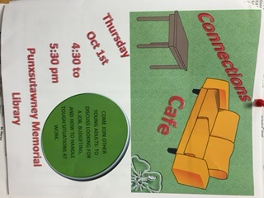
Test and Get Feedback
Brochure / Pamphlet
Connection Café

Slide 28
Testing and feedback continued…
Brochure / Pamphlet
Connection Café
Initial draft of pamphlet
Shared with PA
Shared with team
CareerLink staff and other agencies serving youth
Shared with youth
Feedback received and documented – see next slide
Initial advertisement of first “café”.
Shared with team
Shared with co-workers
First “café’ held
Feedback received from youth and documented – see next slide

Slide 29
Brochure / Pamphlet
Who, What, Where: Deliver to agencies for distribution (or email to them). Deliver to youth in places where they hang out. Do this consistently with each place.
The Good: Just the right amount of information for youth; not too overwhelming; positive quotes / encouragement are a plus. Personal touch can be added depending on staff in each location. Goal is to engage youth to come in for the first meeting!
The Bad: Will take some time to see if the pamphlet increases awareness of the programs; must be revised to reflect each area;
The Unexpected: Despite there being several large resource guides youth were not aware of the other programs available to assist them in meeting their goals until they received the pamphlet.

Slide 30
Connection Café – Testing our Prototype
Who, What, Where: Punxsutawney Memorial Library, Invited 10 out of school youth – 2 attended! YEAH!
The Good – Sharing of information, how to get a photo ID;
they were excited when I asked them “what they wanted”!;
meeting with other young adults/ learning other services
such as banking and healthcare information.
The Bad – not too many attended; having event on a Mon. or Tues may be better; having guest speakers or business owners participate; offer food! And make phone calls the day before as a reminder!
The Unexpected? – both youth were eager to give suggestions! And both are committed to volunteering at upcoming community events.

Slide 31
Connection Café Jefferson County– October 1, 2015

Slide 32
Connection Café McKean County October 2, 2015
4 Young Adults and a baby attended!
Provided hot chocolate, coffee and homemade cake.
Discussed jobs, applications, update on the work experience 2 are currently participating in through WIOA!
Had fun sharing experiencing and catching up.
Relationship building!
Will be held weekly
All in attendance committed to coming back and were encouraged to bring a friend!

Slide 33
Our solution
We will continue to prototype, test and improve the Marketing Pamphlet and the Connection Café
We will continuously improve the ideas with continued, consistent feedback.
The Connection Café as it develops can address many of the other ideas developed during this process:
Addresses transportation issues as we can take the program to the youth and can be moved to different locations.
Provides a peer support network for the youth.
Hands on learning activities can take place during the meetings.
Connections to employers / mentors as guest speakers will be made.
Community involvement activities can be planned.
Provides the foundation for WIOA youth programs

Slide 34
The Result…
Implementing WIOA with the Customer in the Center
Services and programs for out of school youth that ENGAGE them and produce great OUTCOMES!!!

