Slide 1
NGO Webinar Series: Community of Practice and Other Resources
Webinar Date: October 20, 2015
Presented by:
Division of Youth Services – YouthBuild
U.S. Department of Labor
Employment and Training Administration

Slide 2
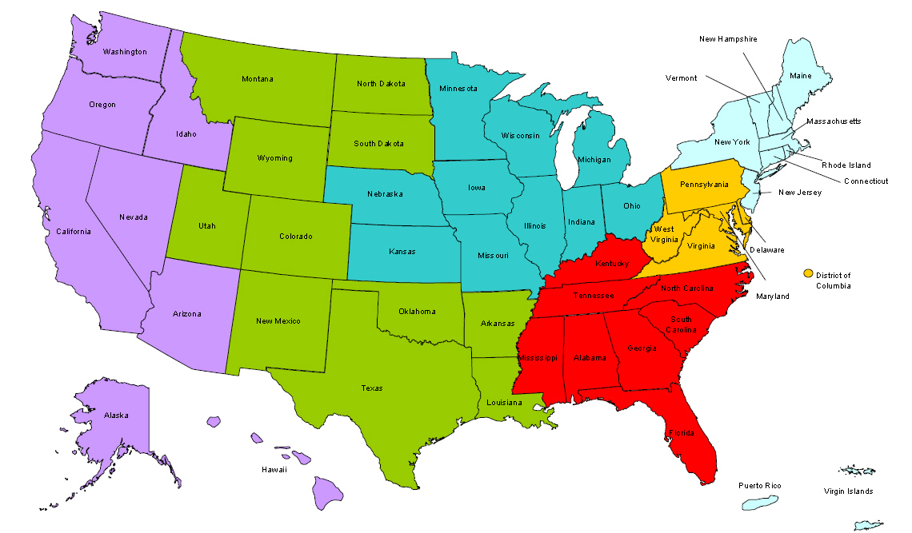
Where are you?
Enter your location in the Chat window – lower left of screen

Slide 3
Moderator
Jeff Hunt
Workforce Analyst
United States Department of Labor

Slide 4
Here’s what you can expect to get out of this webinar!
Where to go for resources and who to ask for help finding them;
How to navigate the new CoP (and the interim CoP)
Educate YouthBuild Programs about Radon
Demonstrate how reducing radon exposure in YouthBuild can lead to employment in the Radon Industry
No Job is Worth a Young Worker’s Life

Slide 5
Agenda
Understanding the DOL YouthBuild Community of Practice.
Radon mitigation and how your program can be a part of the solution.
Online training tools to keeps your worksite safe.

Slide 6
Presenter
Presenter: Lisa Reddy
Title: Associate Director for Knowledge Management
Organization: YouthBuild USA

Slide 7
Polling Question
(What is your level of experience with the DOL YouthBuild Community of Practice)
Choose the answer that best reflects you (or your group): You can choose more than one.
I used the CoP when it was located on the iCohere platform.
I knew about the CoP, but never logged on.
I use the temporary CoP on Workforce3One.
What is the CoP?

Slide 8
DOL YouthBuild Community of Practice
On the DOL YouthBuild Community of Practice you can:
Locate resources to help you improve your program.
Share knowledge and resources with your peers.
Find out about events, webinars and news about other programs.

Slide 9
Sneak Peek: WorkforceGPS
How is the new system different (and better)?
New system shared with other ETA programs.
More user-friendly interface.
Better search capability = easier to locate resources!
Dedicated pages bring you to our videos, manuals and the latest best practices and news from the field.

Slide 10
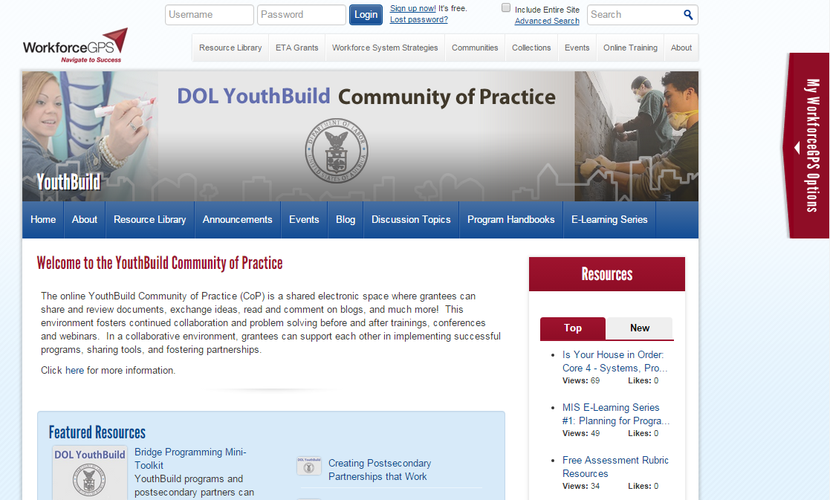
Registering on WorkforceGPS

Slide 11
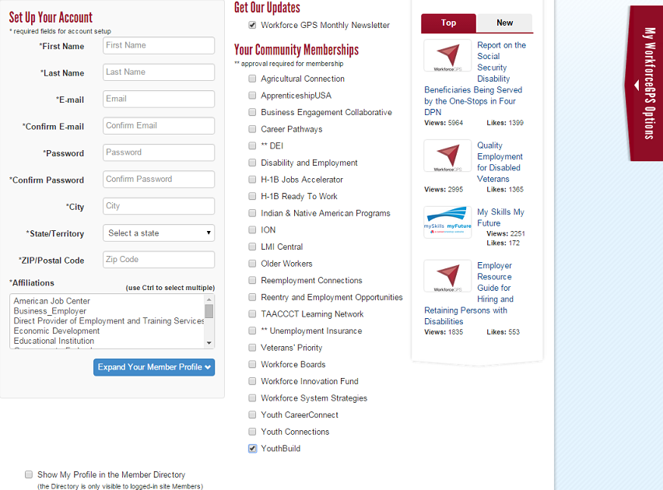
Registering on WorkforceGPS

Slide 12
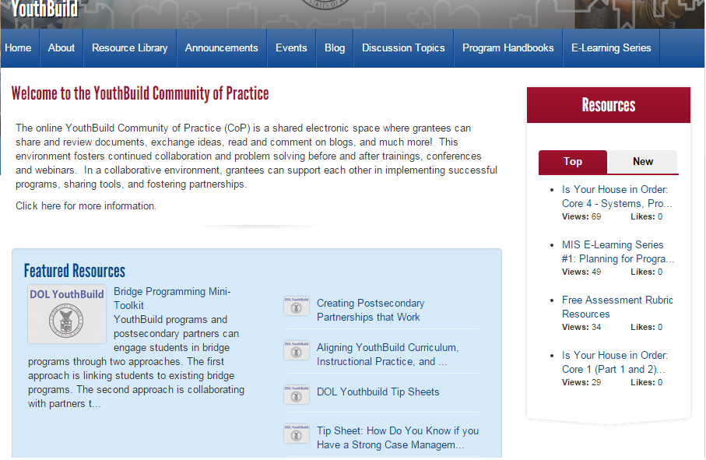
WorkforceGPS Homepage

Slide 13
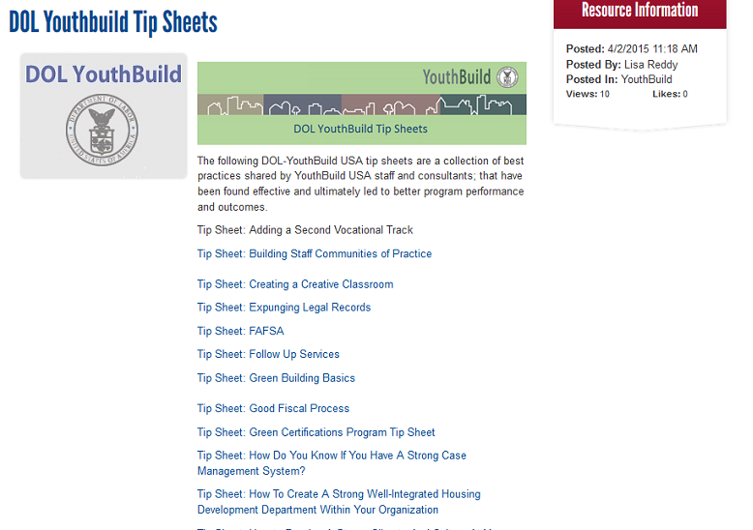
DOL YouthBuild Tip Sheets

Slide 14
E-Learning Video Series

Slide 15
E-Learning Series: DOL Compliance

Slide 16
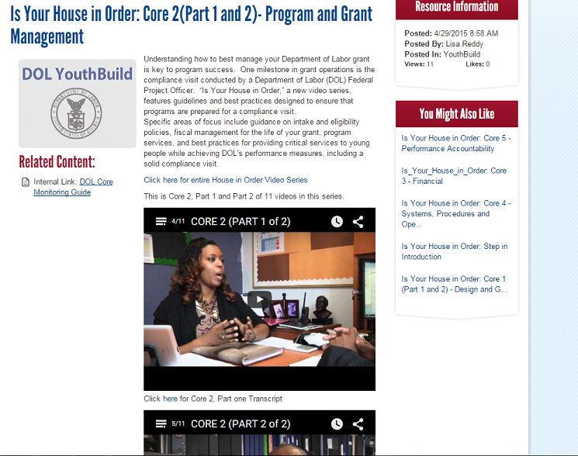
E-Learning Video Series: DOL Compliance

Slide 17
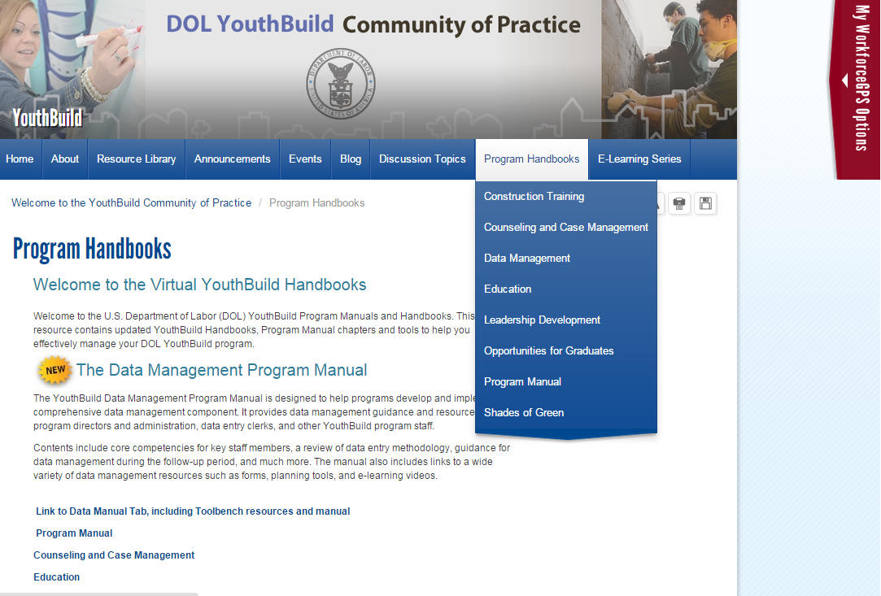
Program Handbooks

Slide 18
Data Management Manual

Slide 19
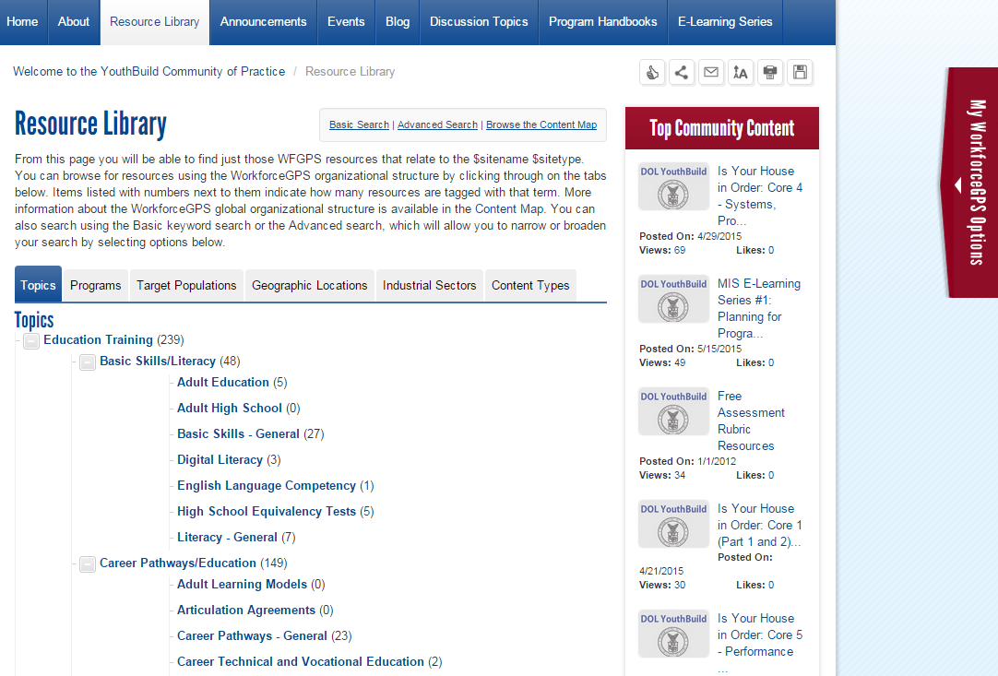
Resource Library

Slide 20
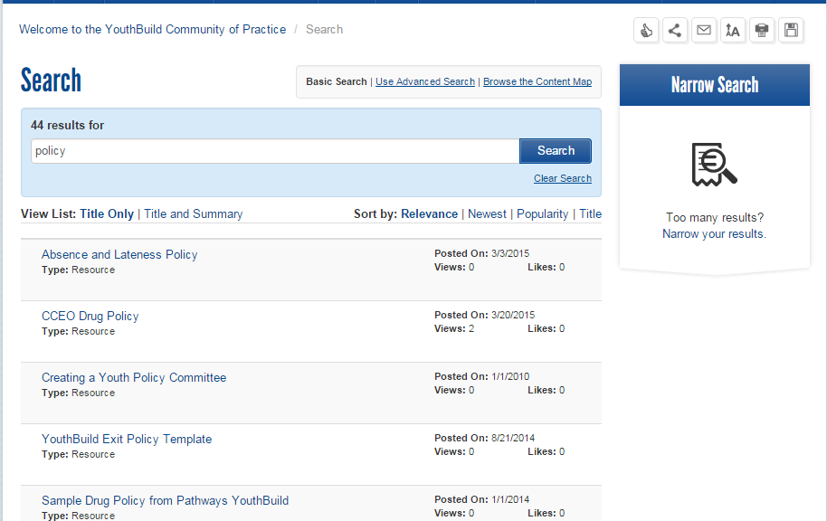
Basic Search

Slide 21
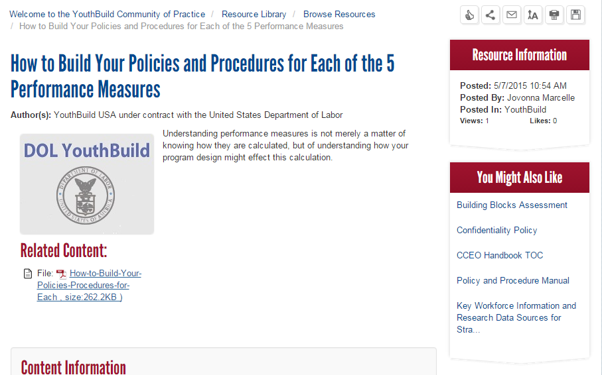
Basic Search – “Policy”

Slide 22
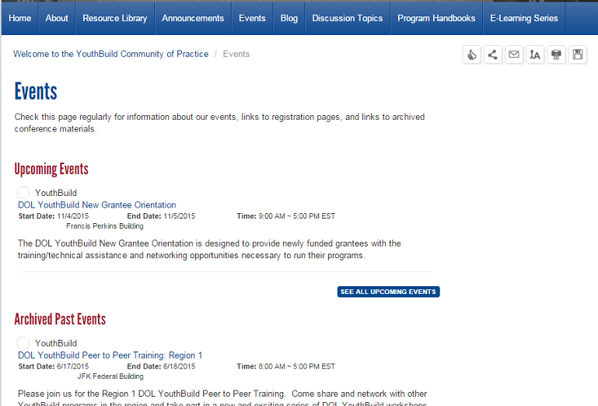
Events

Slide 23
Temporary CoP
The temporary CoP on Workforce3One provides access to some of our best resources
Bookmark this link!
https://etagrantees.workforce3one.org/ws/etagrantees/pages/resources.aspx?pparams=1001435162221393902

Slide 24
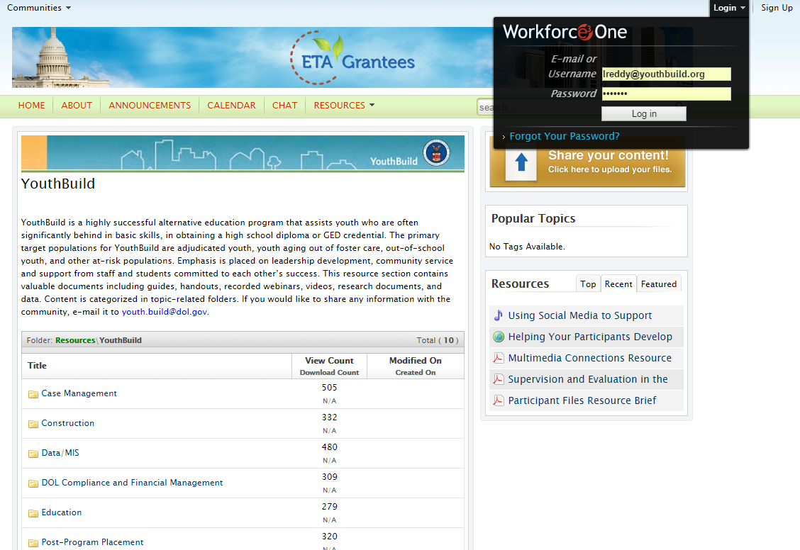
Temporary CoP on Workforce3One

Slide 25
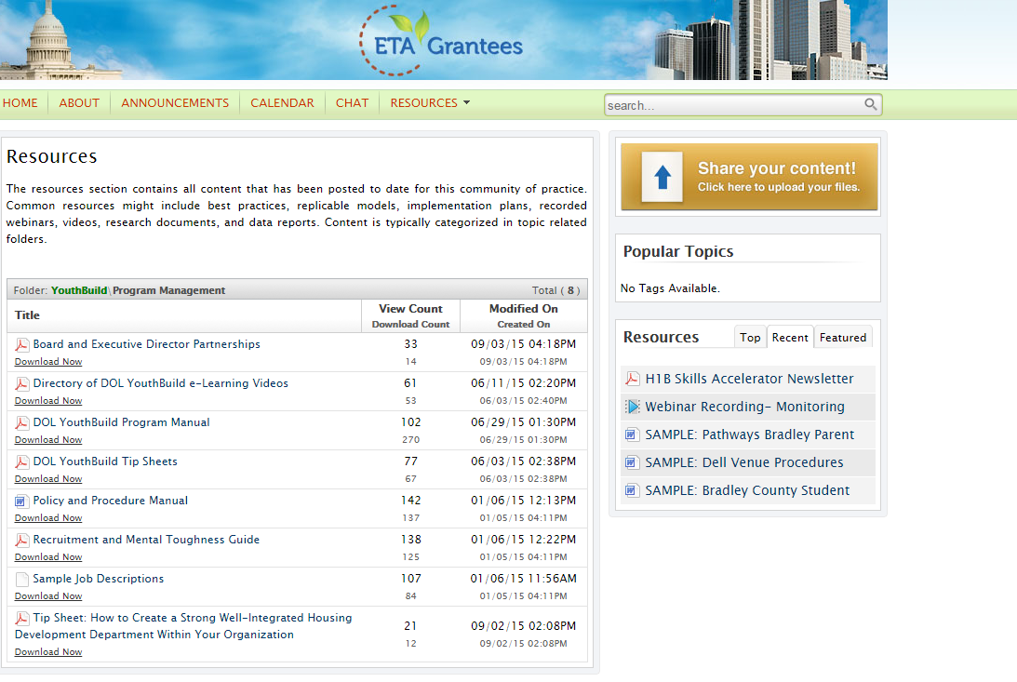
Program Management Folder

Slide 26
Please enter your questions in the Chat Room!

Slide 27
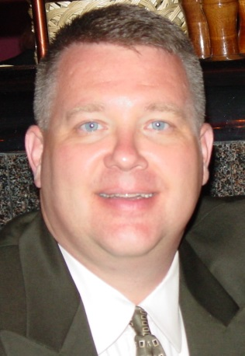
Presenter
Patrick Daniels
IL Radon Program Manager
IEMA

Slide 28
Agenda
About CRCPD
Radon in Homes
Project Partners
Illinois YouthBuild Pilot Project

Slide 29
Polling Question
Have you tested your home for radon?
Yes
No

Slide 30
About CRCPD
The Conference of Radiation Control Program Directors, Inc. (CRCPD) is a 501(c)(3) nonprofit non-governmental professional organization dedicated to radiation protection.
CRCPD's mission is "to promote consistency in addressing and resolving radiation protection issues, to encourage high standards of quality in radiation protection programs, and to provide leadership in radiation safety and education."
CRCPD's primary goal is to assure that radiation exposure to individuals is kept to the lowest practical level, while not restricting its beneficial uses.
CRCPD's primary membership is made up of radiation professionals in State and local government that regulate the use of radiation sources. But anyone with an interest in radiation protection is eligible to join.

Slide 31
What is Radon?
Radon is an indoor air pollutant.
Radon is a colorless, odorless radioactive gas that comes from naturally occurring uranium in the soil.
The only way to tell how much radon a home has is to TEST.

Slide 32
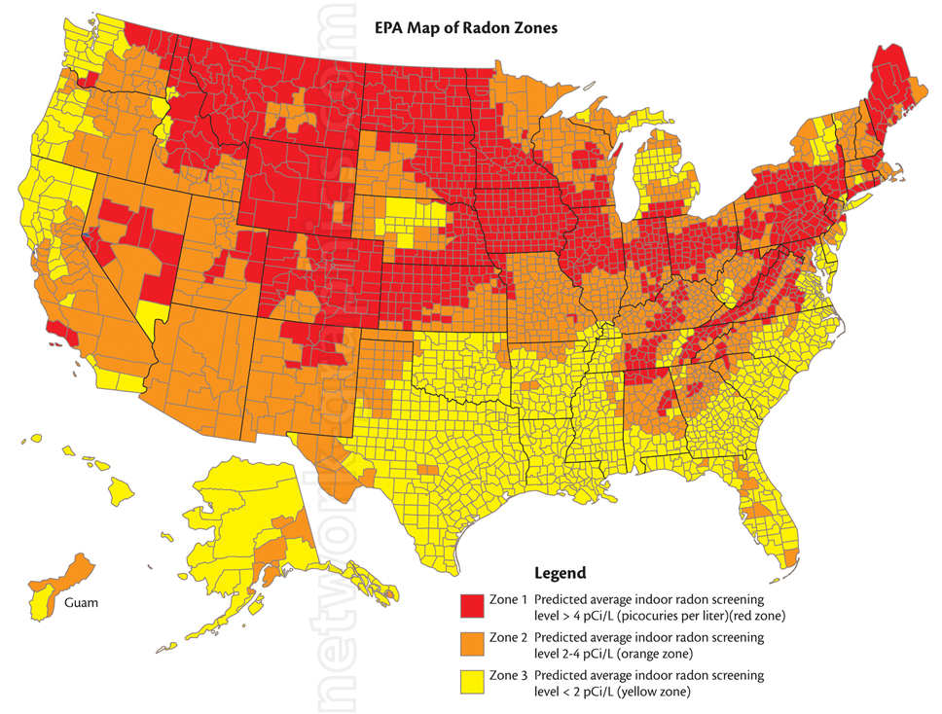
Where is Radon Found?

Slide 33
Surgeon General’s Warning
“Indoor radon is the second-leading cause of lung cancer in the United States and breathing it over prolonged periods can present a significant health risk to families all over the country.”

Slide 34
Radon Risk Estimates
USEPA’s 2003 Assessment of Risks from Radon in Homes estimates radon causes about 21,000 lung cancer deaths per year.

Slide 35
Radon Risk in Perspective
Comparative Risk Assessments by EPA and its Science Advisory Board have consistently ranked Radon among the top four Environmental risks to the Public.
In 1998 Harvard Risk in Perspective, by John Graham, ranked Radon the #1 risk in the Home.

Slide 36
Cancer Mortality - 2015
CANCER TYPE | Estimated U.S. Deaths / Year
1. Lung and Bronchus | 158,040
2. Colon and Rectum | 49,700
3. Pancreas | 40,560
4. Breast Cancer | 40,290
5. Prostate | 27,540
6. Leukemia | 24,450
>>> Radon Induced Lung Cancer | 21,000
7. Non-Hodgkin Lymphoma | 19,790
8. Liver and Bile Duct | 17,030
9. Ovary | 14,180
CA Cancer Journal for Clinicians
Volume 65, Issue 1, Pages 5-29, 2015
Published Online: 5 Jan 2015
Copyright © 2015 American Cancer Society

Slide 37
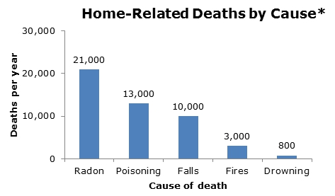
Risks Compared
Top five causes of accidental home injury deaths.
http://www.cdc.gov/cancer/dcpc/prevention/policies_practices/radon/index.htm

Slide 38
Illinois Youthbuild Project Partners

Slide 39
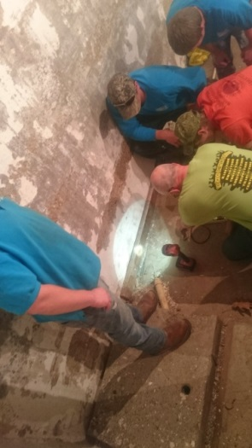
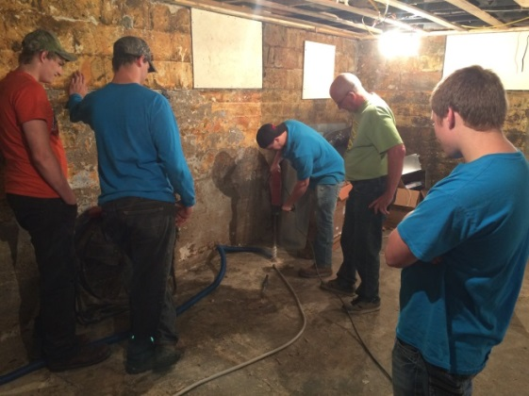
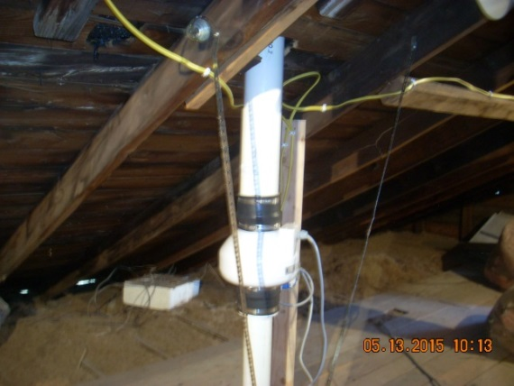
Illinois YouthBuild Pilot Project
Project Objective
A radon training pilot project funded by a Conference of Radiation Control Program Directors (CRCPD) mini-grant was conducted in Illinois in April 2015 to train students engaged in the U.S. Department of Labor YouthBuild program.
Determine if YouthBuild program is a viable method to train youth as potential radon mitigation technicians.
Illinois Emergency Management Agency

Slide 40
Illinois YouthBuild Pilot Project
Project Logistics & Location
April 28 – May 13, 2015
5 students (4 field)
YouthBuild Jefferson Co. – Mt. Vernon, IL
United Methodist Children’s Home
Active Project Contributors
United Methodist Children’s Home – Ryan Alton
US EPA – Susie Shimek
IEMA – Patrick Daniels, Melinda Lewis
Allied Radon Services, Inc – Calvin Murphy
Allied Radon Services, Inc.

Slide 41
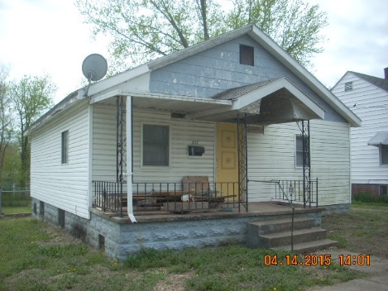
Illinois YouthBuild Pilot Project
Project Logistics & Location (cont.)
The American Lung Association in Illinois mitigation course was the source of classroom material taught to the students.
Alternated between classroom lecture and a house being rehabbed in Mt Vernon for learning environment.

Slide 42
Illinois YouthBuild Pilot Project
Project Logistics & Location (cont.)
After completion of classroom and field training including diagnostics and system installation, students took Illinois state licensing exam.
House has been gutted and day light is visible in parts of the house. Cannot maintain closed house conditions to get an accurate radon measurement. After rehab is completed, will perform measurements with system running and then turn system off, cap the stack and retest.

Slide 43
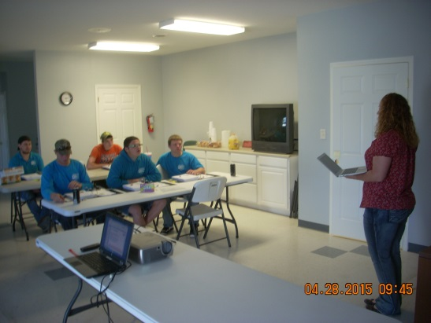
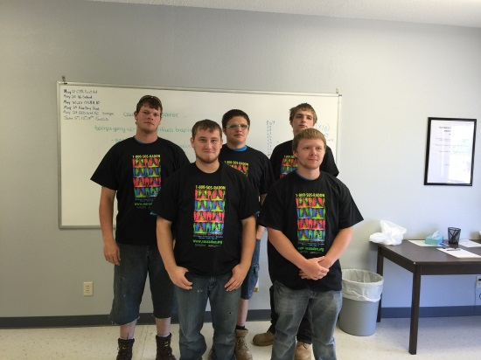
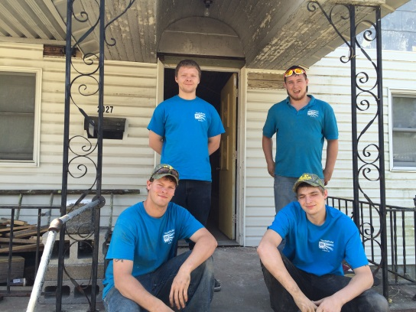
Illinois YouthBuild Pilot Project
Project Outcomes
All 5 students passed the Illinois Radon Mitigation Licensing Exam.
Students successfully completed the install of a radon mitigation system.

Slide 44
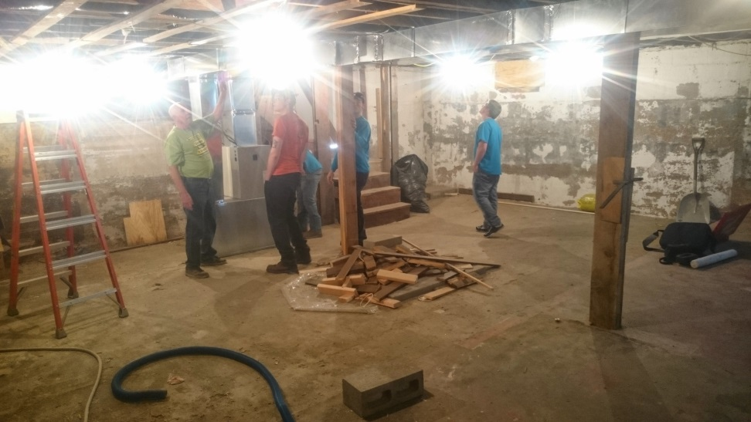
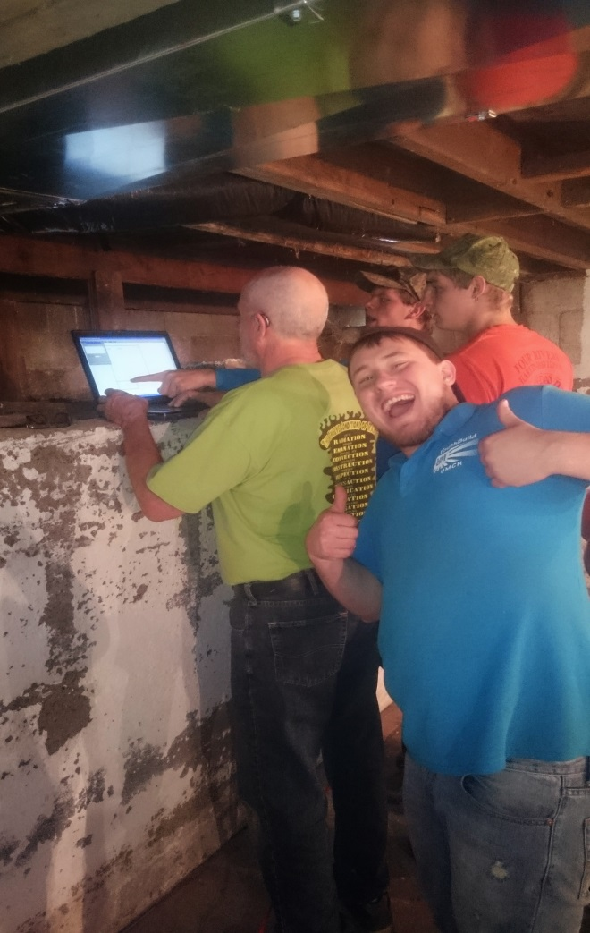
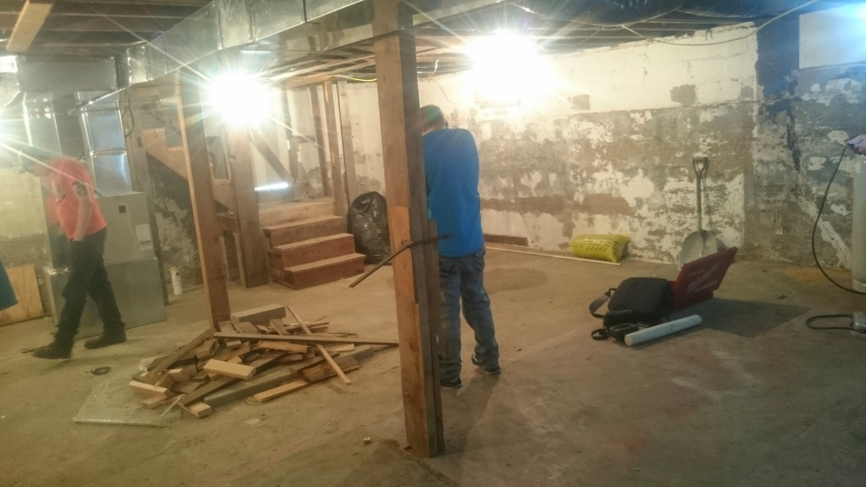
Illinois YouthBuild Pilot Project
Building Inspection

Slide 45
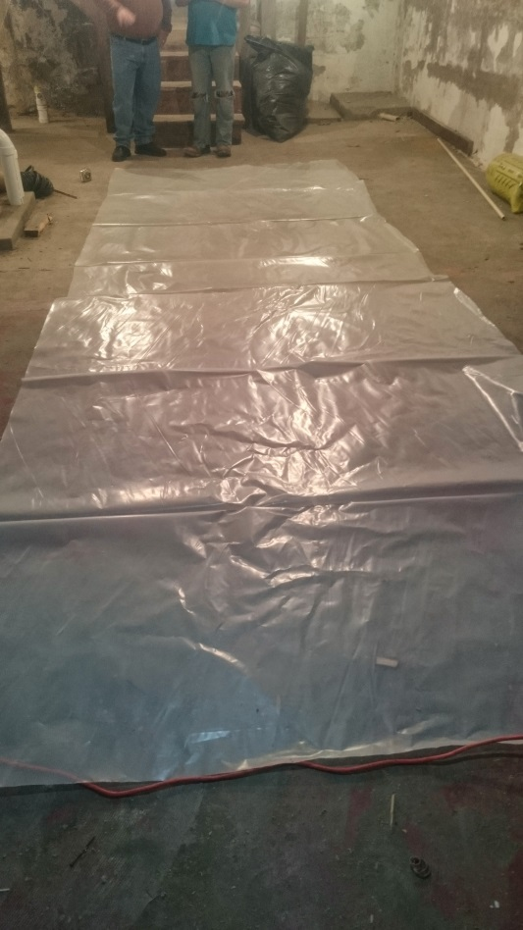
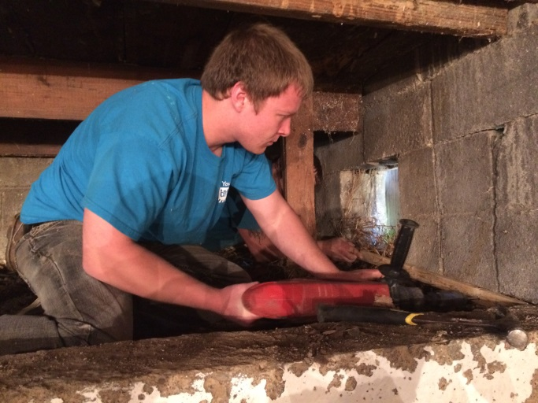
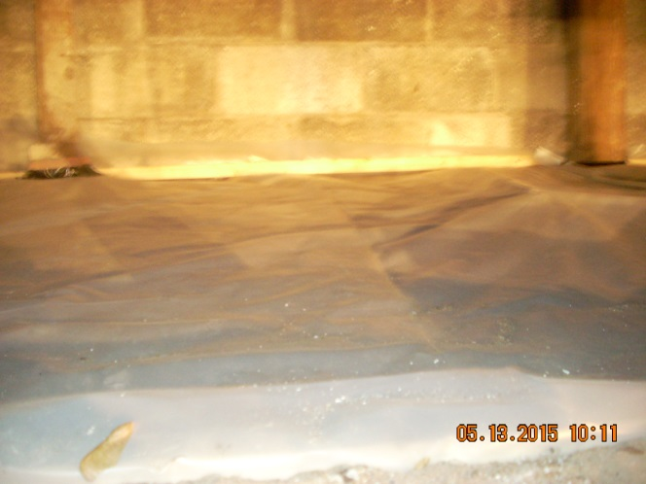
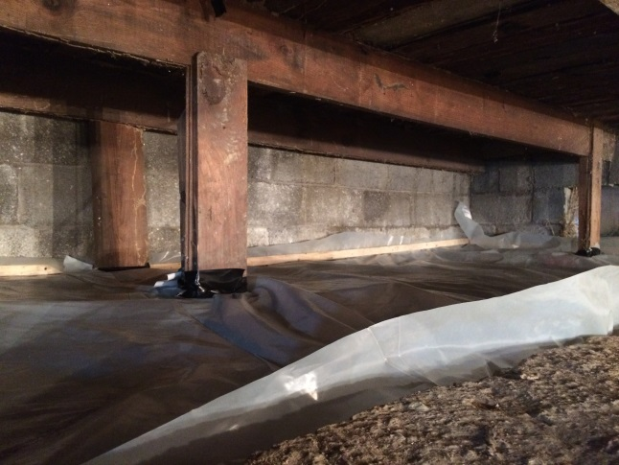
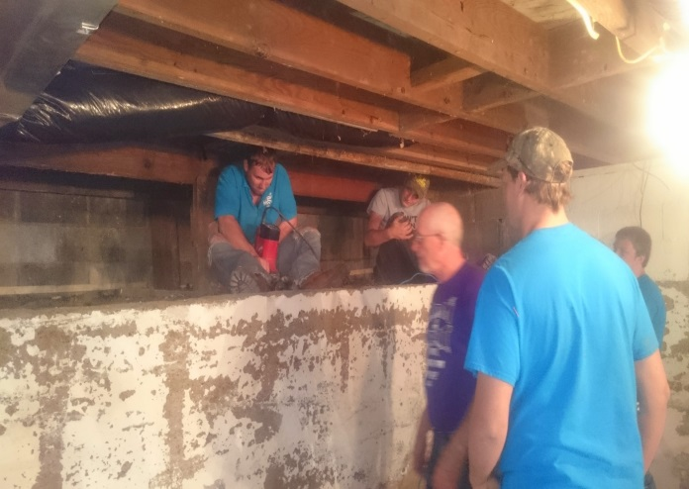
Illinois YouthBuild Pilot Project
Sealing the Crawlspace

Slide 46
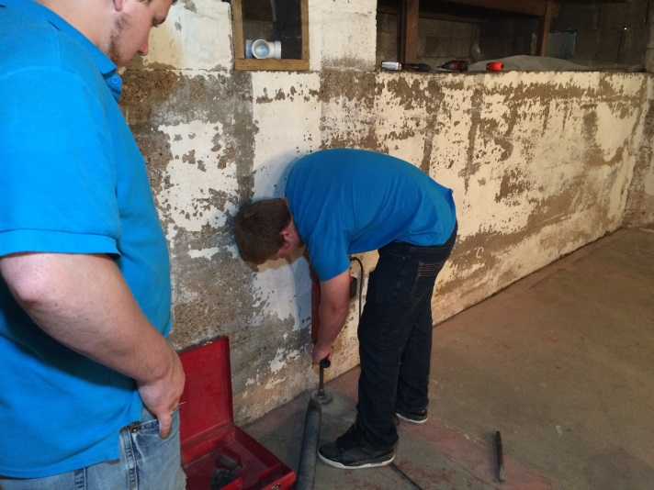
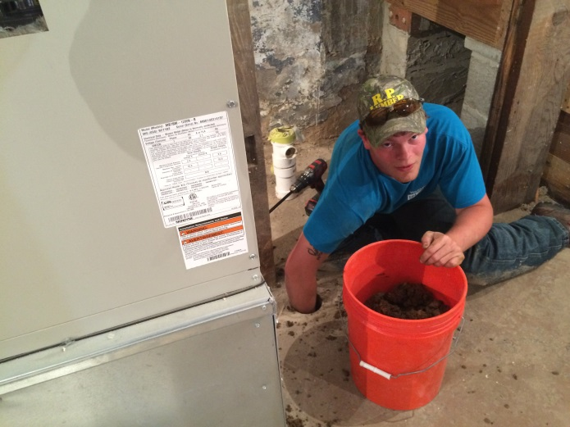
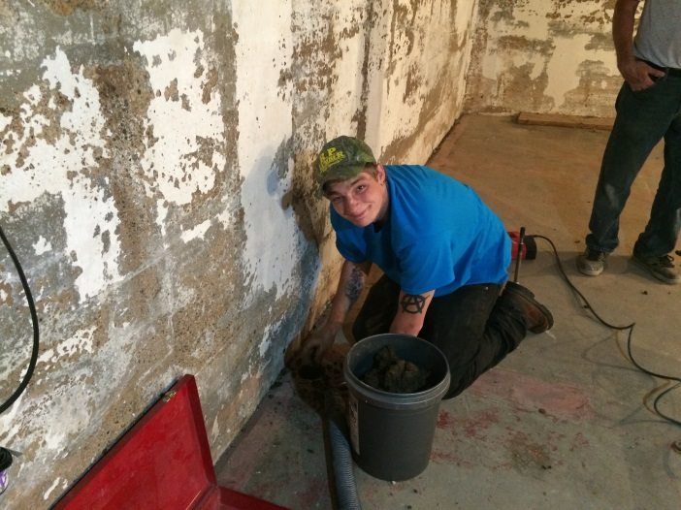
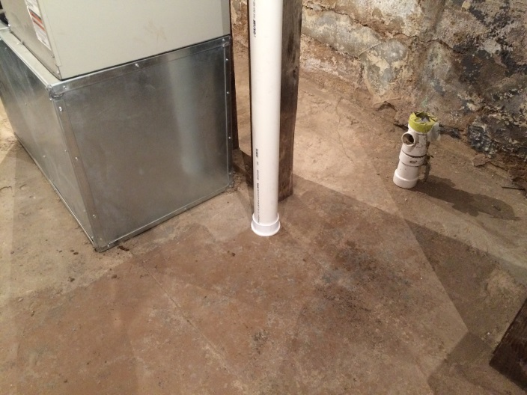
Illinois YouthBuild Pilot Project
Suction Points

Slide 47
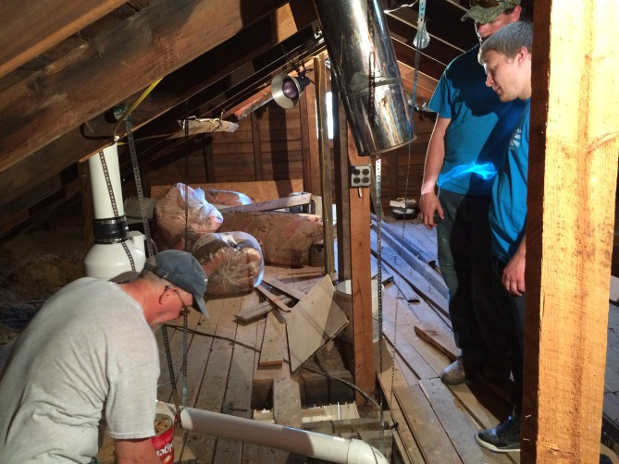
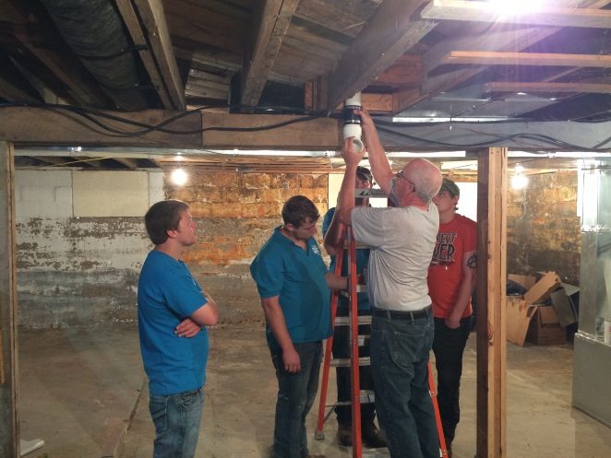
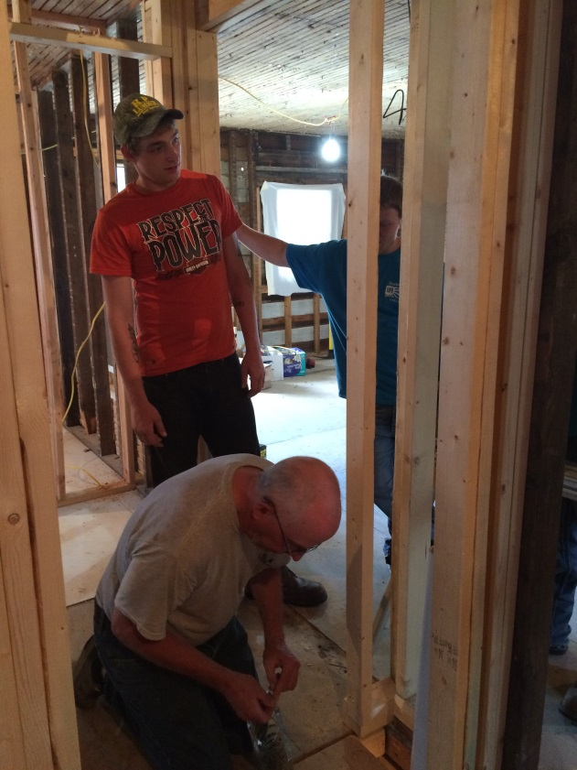
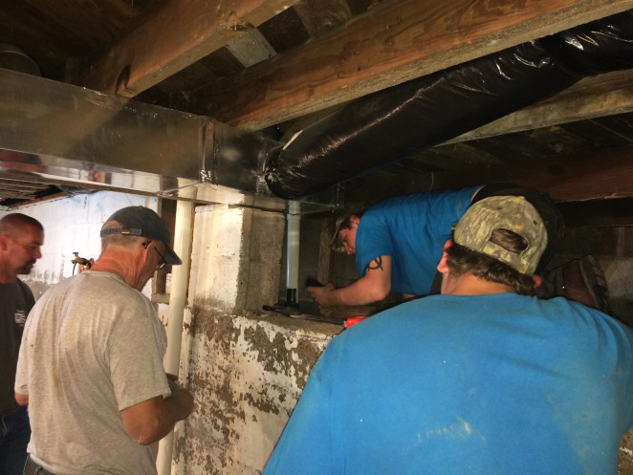
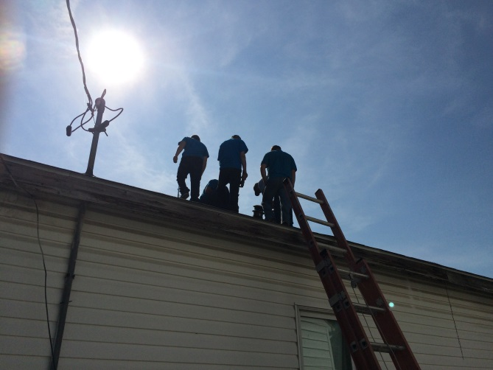
Illinois YouthBuild Pilot Project
Running the Pipe

Slide 48
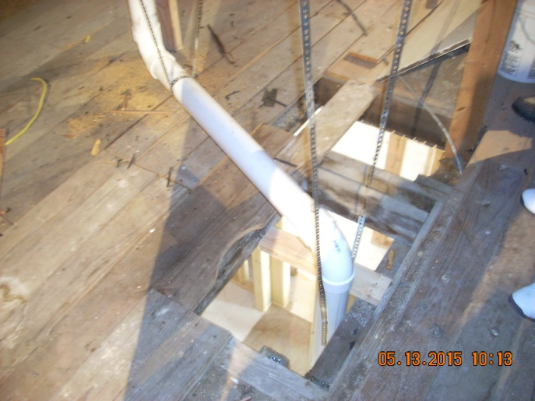
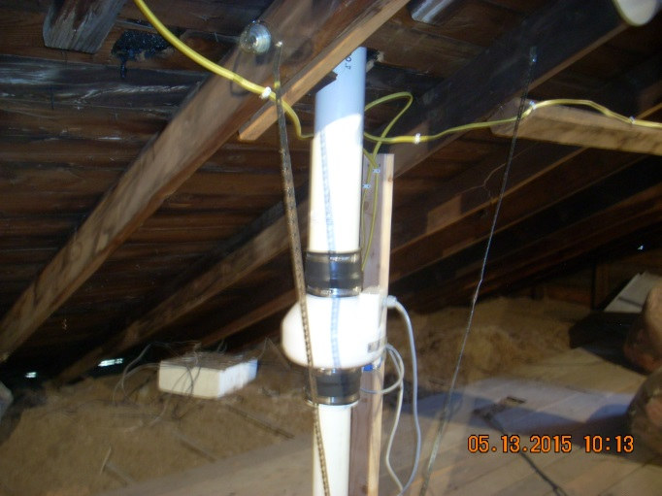
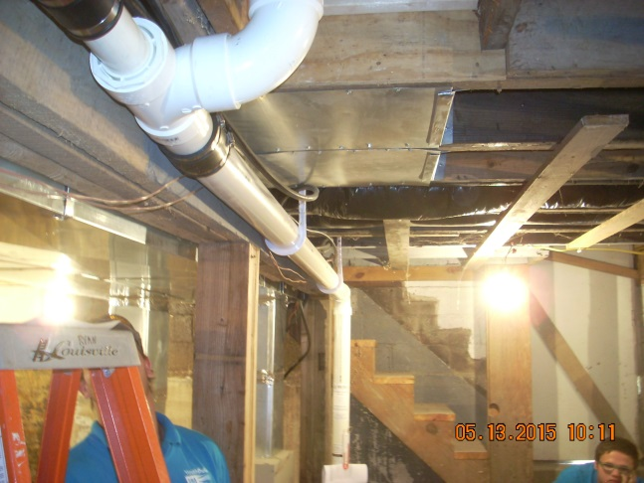
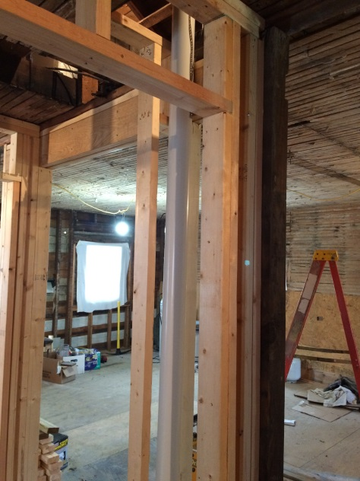
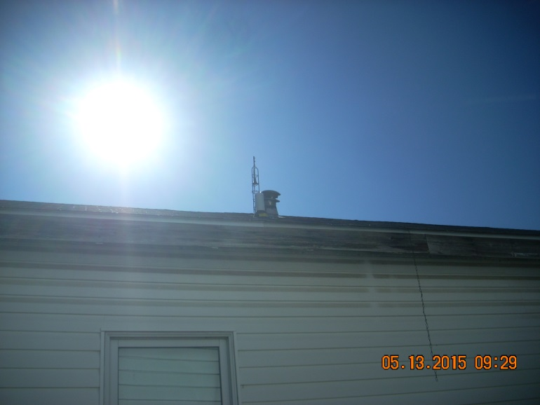
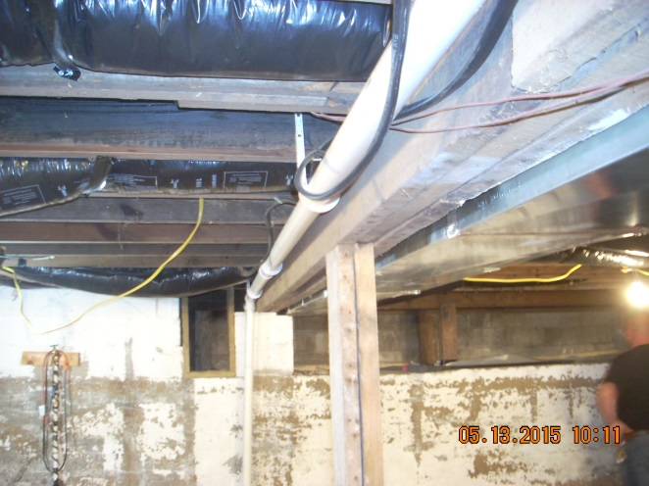
Illinois YouthBuild Pilot Project
Finished Product

Slide 49
Employment Opportunity
Licensed Professional
Licensed Technician
Laborer

Slide 50
Free Radon Test
To receive a free radon test email me at patrick.daniels@illinois.gov with the subject line “Action YouthBuild”

Slide 51
Reminder…
The only way to know if a home has a radon problem is to test. Test Your Home Today.

Slide 52
Please enter your questions in the Chat Room!

Slide 53
Presenter
Andrea Foster-Mack
Vice President, Strategic Alliances
CareerSafe® Online

Slide 54
CareerSafe Online | No Job is Worth a Young Worker’s Life

Slide 55
CareerSafe Online | No Job is Worth a Young Worker’s Life

Slide 56
CareerSafe Online | No Job is Worth a Young Worker’s Life

Slide 57
CareerSafe Online | No Job is Worth a Young Worker’s Life

Slide 58
CareerSafe Online | No Job is Worth a Young Worker’s Life

Slide 59
CareerSafe Online | No Job is Worth a Young Worker’s Life

Slide 60
CareerSafe Online | No Job is Worth a Young Worker’s Life

Slide 61
CareerSafe Online | No Job is Worth a Young Worker’s Life

Slide 62
CareerSafe Online | No Job is Worth a Young Worker’s Life

Slide 63
CareerSafe Online | No Job is Worth a Young Worker’s Life

Slide 64
CareerSafe Online | No Job is Worth a Young Worker’s Life

Slide 65
CareerSafe Online | No Job is Worth a Young Worker’s Life

Slide 66
CareerSafe Online | No Job is Worth a Young Worker’s Life

Slide 67
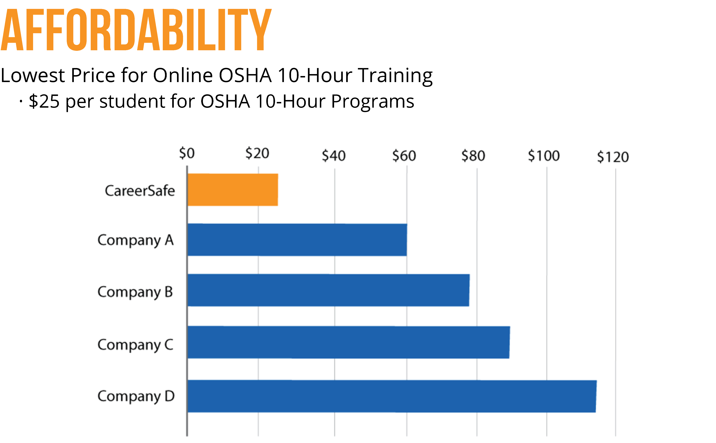
CareerSafe Online | No Job is Worth a Young Worker’s Life

Slide 68
CareerSafe Online | No Job is Worth a Young Worker’s Life

Slide 69
CareerSafe Online | No Job is Worth a Young Worker’s Life

Slide 70
CareerSafe Online | No Job is Worth a Young Worker’s Life

Slide 71
Please enter your questions in the Chat Room!

Slide 72
Speakers’ Contact Information
Speaker: Lisa Reddy
Title: Associate Director for Knowledge Management
Organization: YouthBuild USA
Email: lreddy@youthbuild.org
Telephone: 617-741-1282
Speaker: Patrick I Daniels
Title: Radon Program Manager
Organization: Illinois Emergency Management Agency
Email: patrick.daniels@illinois.gov
Telephone: 217-782-1325
Speaker: Andrea Foster-Mack
Title: Vice President, Strategic Alliances
Organization: CareerSafe® Online
Email: Andrea.Foster-Mack@K2Share.com
Telephone: 979-260-0030

Slide 73
Look for upcoming Webinars in this series!
YouthBuild Grant Post-Award Overview
October 27, 2015 from 2:00 – 3:30 PM EDT
YouthBuild Webinar Series: Registered Apprenticeship
November 10, 2015 from 2:00 – 3:30 PM EST
Register for the 2015 New Grantee Orientation HERE

Slide 74
www.workforce3one.org

