Slide 1
October 21, 2015
TAACCCT Industry Webinar Series:
Healthcare

Slide 2
TAACCCT LEARNING NETWORK AT A GLANCE
U.S. Department of Labor, Employment & Training Administration
(National)
Jobs for the Future
CalState/Merlot
Maher & Maher
American Association of Community Colleges
U.S. National Science Foundation
ATE Centers
Other Non-Federal Providers of TA and Resources for TAACCCT Grantees:
Creative Commons
CAST
The Transformative Change Initiative

Slide 3
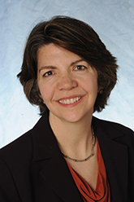
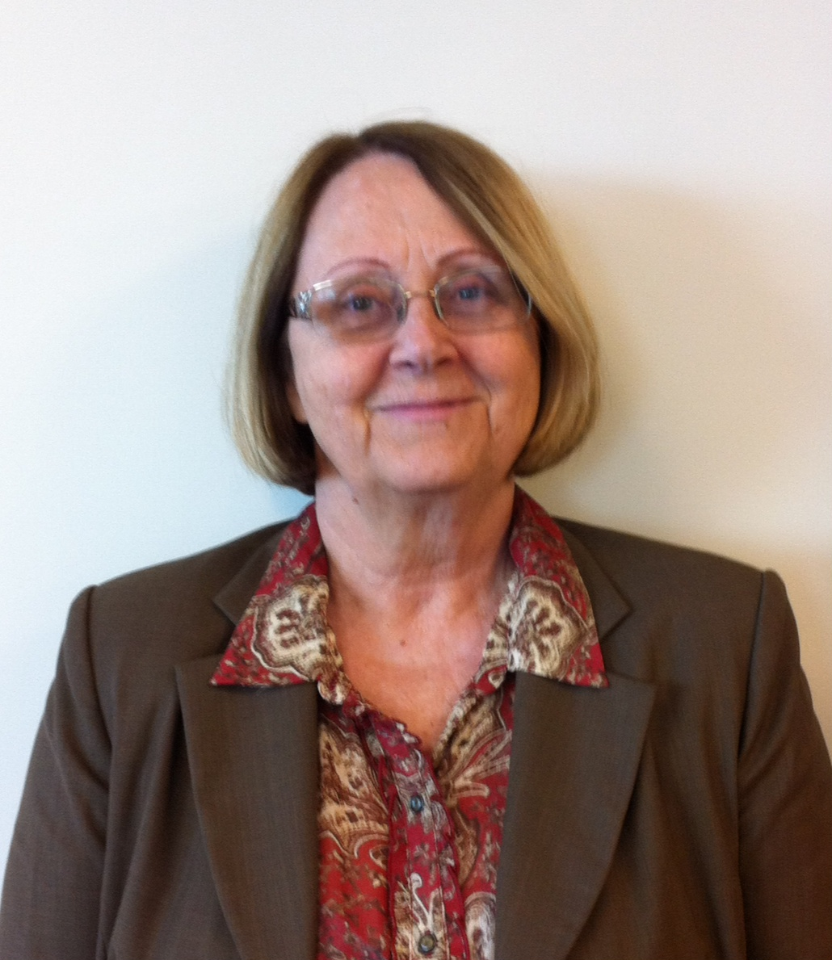
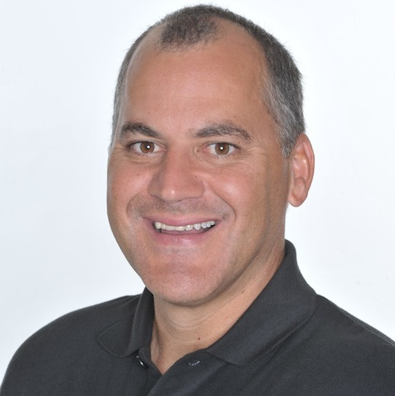
Presenters
Marianne Krismer
National Director, Health Professions Pathway Consortium
Cincinnati State Technical and Community College
Jennifer Freeman
Project Director
TLN
Jobs for the Future
Carolyn O’Daniel
Dean of Health Sciences
Jefferson Community and Technical College
Rick Lumadue
Program Manager, Grantee Relations
SkillsCommons.org

Slide 4
Agenda Items
Welcome & Introductions
Highlights from Grantees
Outcomes and deliverables
Employer engagement approaches
Q&A
Review of Curriculum/Materials on SkillsCommons
Q&A

Slide 5
Participant Poll
Which TAACCCT round do you represent?
Round 1
Round 2
Round 3
Round 4
What are you interested in learning about today? (Check all that apply)
Improved Employer Engagement
Curriculum Products
Other (Specify in chat box!)
What level of ed/training do you offer?
(check all that apply)
Foundational
Short-term healthcare certificate
Long-term healthcare certificate (1 year +)
Associates Degree

Slide 6
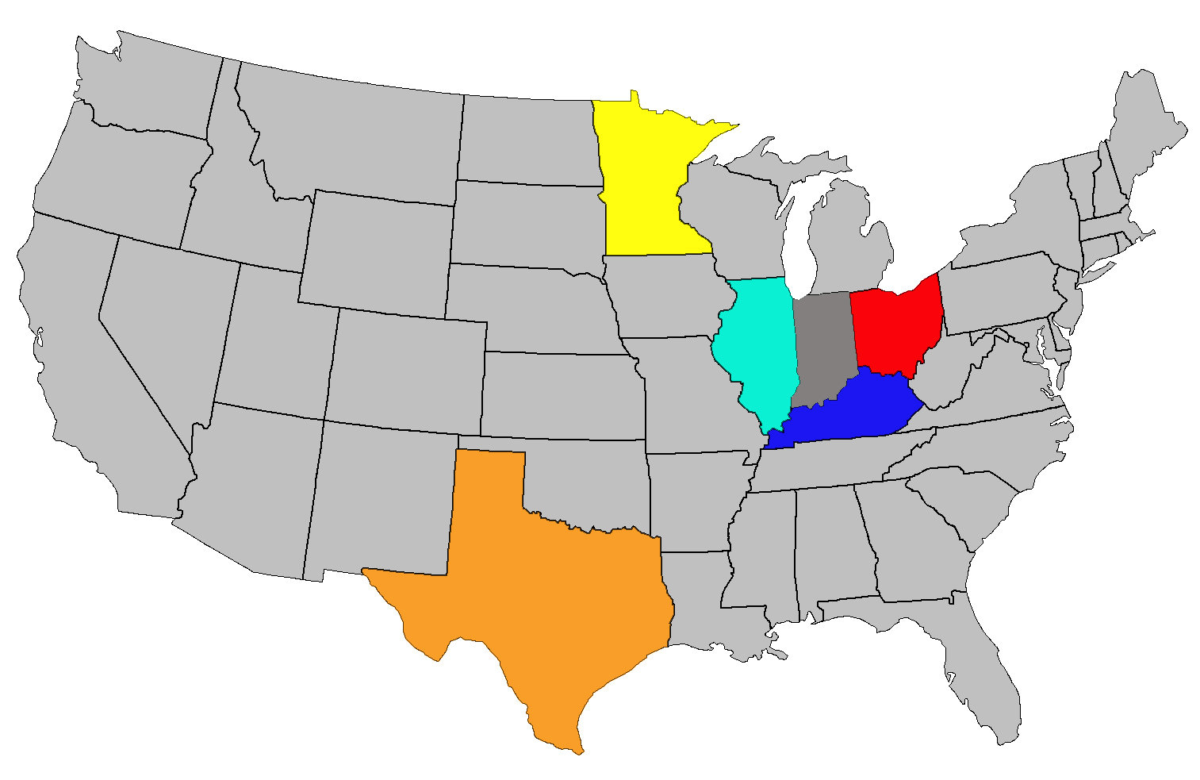
Kentucky
Minnesota
MN
Ohio
OH
IL
Texas
KY
Illinois
TX

Slide 7
H2P Transformative Strategies
Career Exploration and Assessment
Holistic Student Support
Contextualized DE
Stackable Credentials
Health Career Pathway Transformation
Core Curriculum
Incumbent Worker Training
National Scaling
Data and Evaluation

Slide 9
H2P Curriculum Deliverables on Creative Commons
New Stackable Credential Curricula
On-Line Core Curriculum Modules + Faculty Guides
www.H2P.careers
HIPPA
Therapeutic Communication
EKG
Basic First Aid
CQI/TQM
Patient Teaching
Standard Precautions
Physical Assessment
Vital Signs
Wellness Journal
Core Curriculum Courses
For additional Information:
Dr. Carolyn O’Daniel
carolyn.odaniel@kctcs.edu
Dr. Marianne Krismer
mkrismer61@gmail.com
Contextualized DE Courses

Slide 10
Q&A

Slide 11
Participant Poll
Have you uploaded any products into SkillsCommons yet?
Yes
No
What is/are the sub-industry area(s) of focus for your grant? (select all that apply)
Ambulatory healthcare services
Hospitals
Nursing and residential care facilities
Other (please add to chat box)

Slide 12
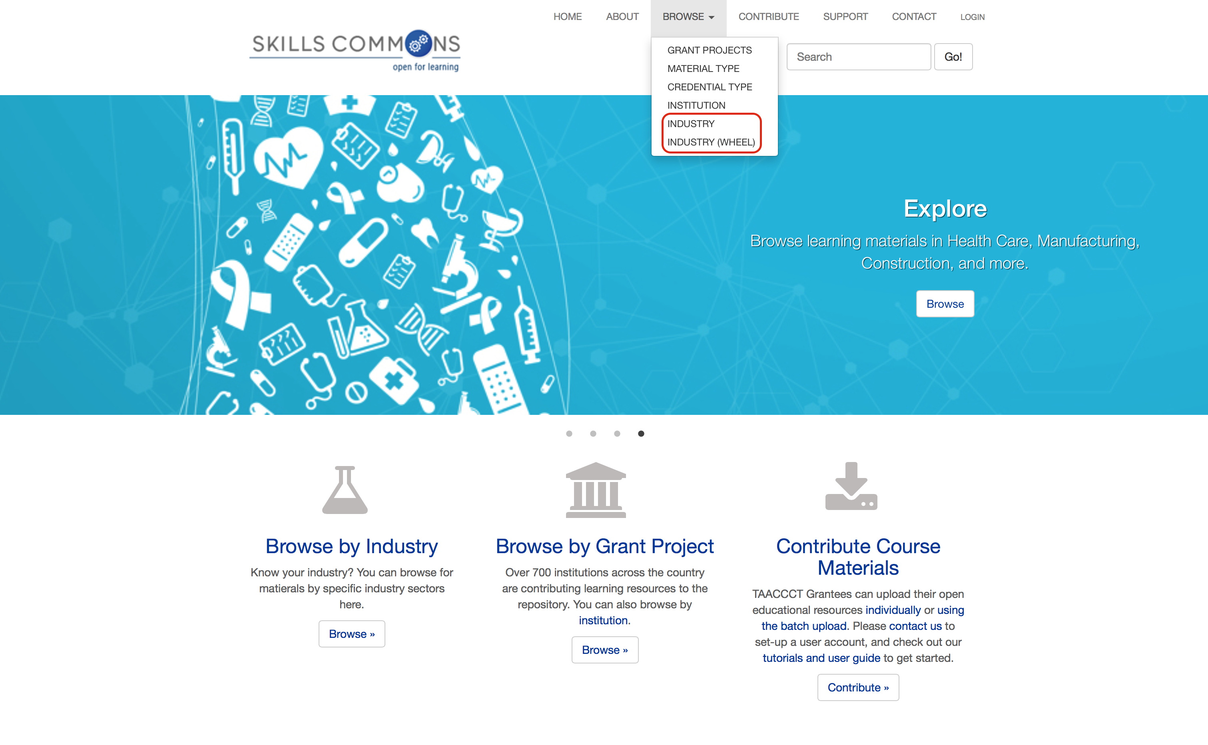
Browse the SkillsCommons Repository by Industry: An Overview
Rick Lumadue, Program Manager of SkillsCommons.org; support@skillscommons.org

Slide 13
Q&A

Slide 14
Thank You!
Find resources for TAACCCT success at:
https://etagrantees.workforce3one.org
Subscribe to TLN resources, ask questions and connect with peers at TAACCCT@dol.gov

