Slide 1
ApprenticeshipUSA Toolkit: A New Tool to Advance Apprenticeship Under WIOA
Webinar Date: October 26, 2015
Presented by:
Office of Apprenticeship
U.S. Department of Labor
Employment and Training Administration

Slide 2
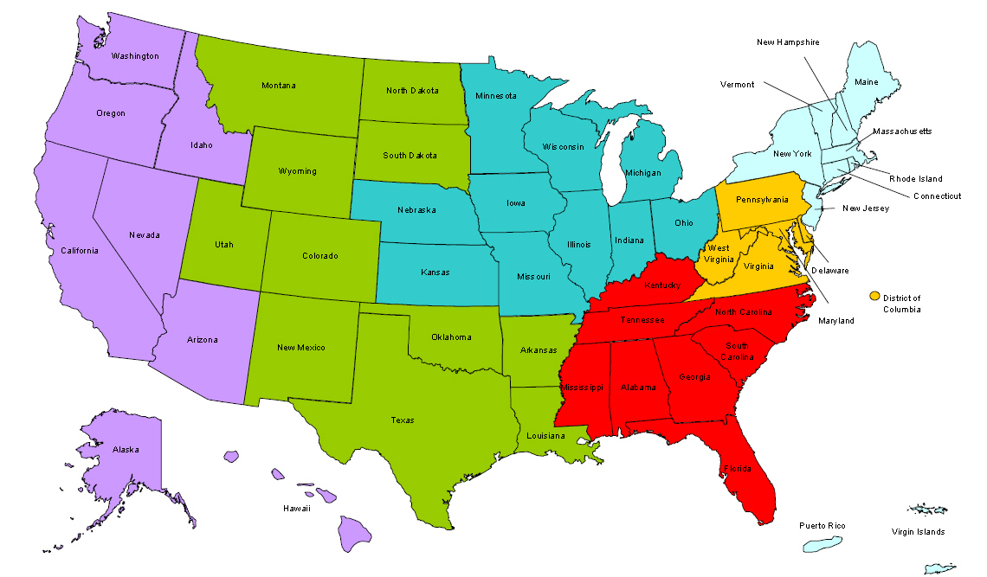
Where are you?
Enter your location in the Chat window – lower left of screen

Slide 3
Polling Question
What organization do you represent?
State Workforce Agency or State Workforce Board
Local Workforce Agency or Local Workforce Board
American Job Center
Federal or State Registered Apprenticeship
Educational Institution
Business/Industry
Other (please enter in the chat)

Slide 4
Objectives
Apprenticeship partnership opportunities under WIOA
Learn about the ApprenticeshipUSA Toolkit
See the toolkit in action
Get answers to your questions

Slide 5
What is Registered Apprenticeship?
A business-driven model that combines on-the-job training with related technical instruction.
1
?
A flexible training strategy that can be customized to meet the needs of every business.
An “earn and learn” model – apprentices receive a paycheck from day one, so they earn wages while they learn on the job.
2
3

Slide 6
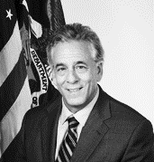
Speakers
Moderator: Chad Aleshire
Program Analyst, Office of Apprenticeship
Employment and Training Administration
Speaker: Eric Seleznow
Deputy Assistant Secretary, Office of Apprenticeship
Employment and Training Administration
Speaker: John Ladd
Administrator, Office of Apprenticeship
Employment and Training Administration

Slide 7
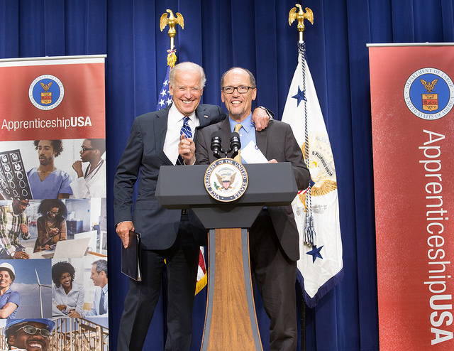
Apprenticeship…building momentum!
President Obama’s Goal:
Double the number of U.S. apprentices by 2020
2015:
White House Summit on ApprenticeshipUSA
$175 Million:
American Apprenticeship grants to 46 sites
Apprenticeship LEADERs:
Over 130 committed to expanding apprenticeships within their sectors

Slide 8
Apprenticeship Opportunities under WIOA
an integral partner on workforce boards and in workforce planning
a key element in business engagement and industry sector strategies
a proven work-based learning model for job seekers
a strategy for increasing outcomes on performance measures
Registered Apprenticeship

Slide 9
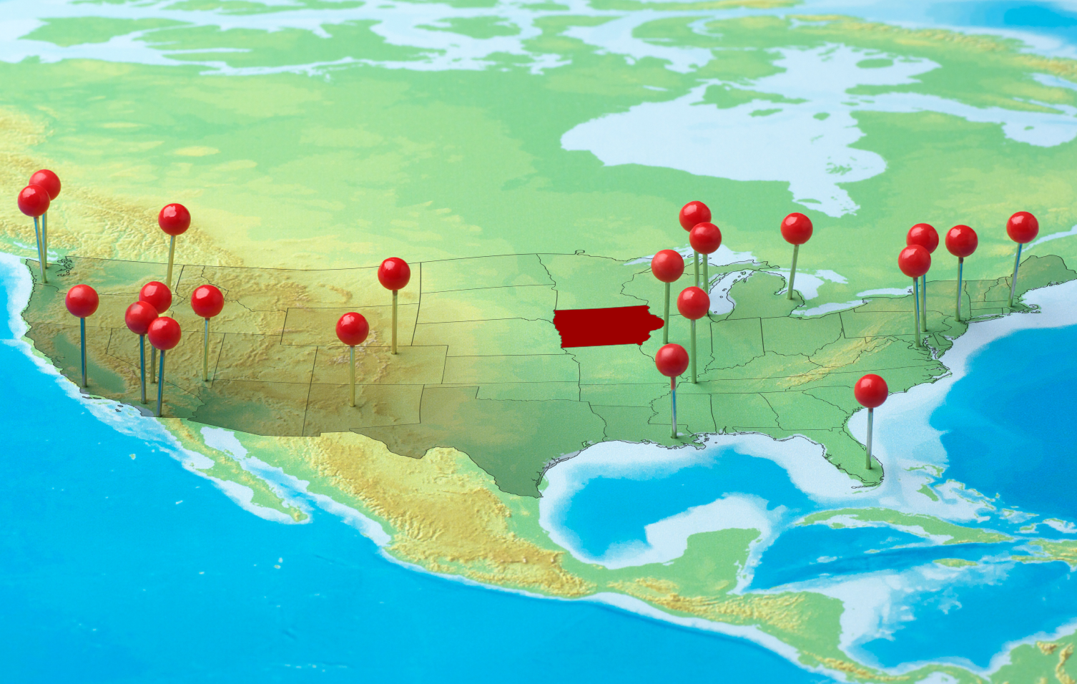
Apprenticeship Models from Coast to Coast

Slide 10
Polling Question
How familiar are you with Apprenticeship?
Choose the answer that best reflects you (or your group):
What’s Apprenticeship?
Isn’t Apprenticeship just about construction?
I know some but I’m still learning.
I’m actively involved with an Apprenticeship program.

Slide 11
Polling Question
What are your challenges with Apprenticeship?
Check all that apply:
Understanding/explaining the Apprenticeship model and benefits
Engaging with employers and industry groups
Understanding how to leverage WIOA and other funds for Apprenticeship
Knowing how to set up an Apprenticeship program
Understanding how to account for Apprenticeship in performance outcomes
Other (please write in chat)

Slide 12
Toolkit Overview
ApprenticeshipUSA Toolkit
www.dol.gov/apprenticeship/toolkit.htm
Build
Implement
Learn
A comprehensive set of tools and resources for the public workforce system and partners to launch or expand apprenticeship strategies

Slide 13
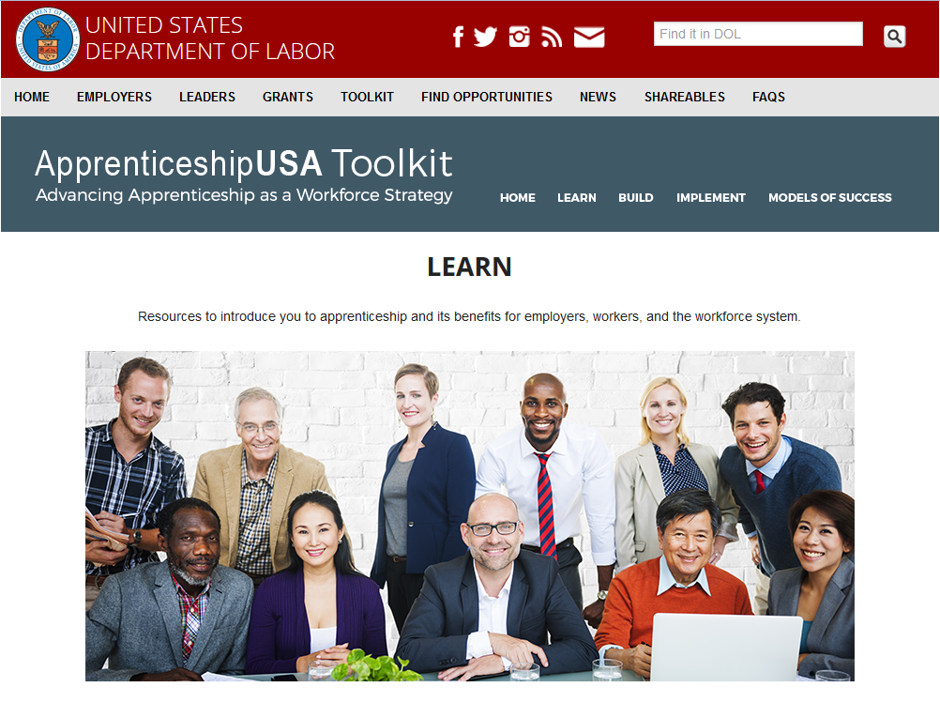
Learn About Apprenticeship…
Online training to learn about the Apprenticeship model
Information on WIOA and Apprenticeship
Answers to frequently asked questions
ApprenticeshipUSA Toolkit
www.dol.gov/apprenticeship/toolkit.htm

Slide 14
Build Apprenticeship Partnerships…
Tool to assess opportunities, identify partners, plan apprenticeship strategies
Links to identify apprenticeship partners
Federal resources “playbook” for apprenticeship
ApprenticeshipUSA Toolkit
www.dol.gov/apprenticeship/toolkit.htm

Slide 15
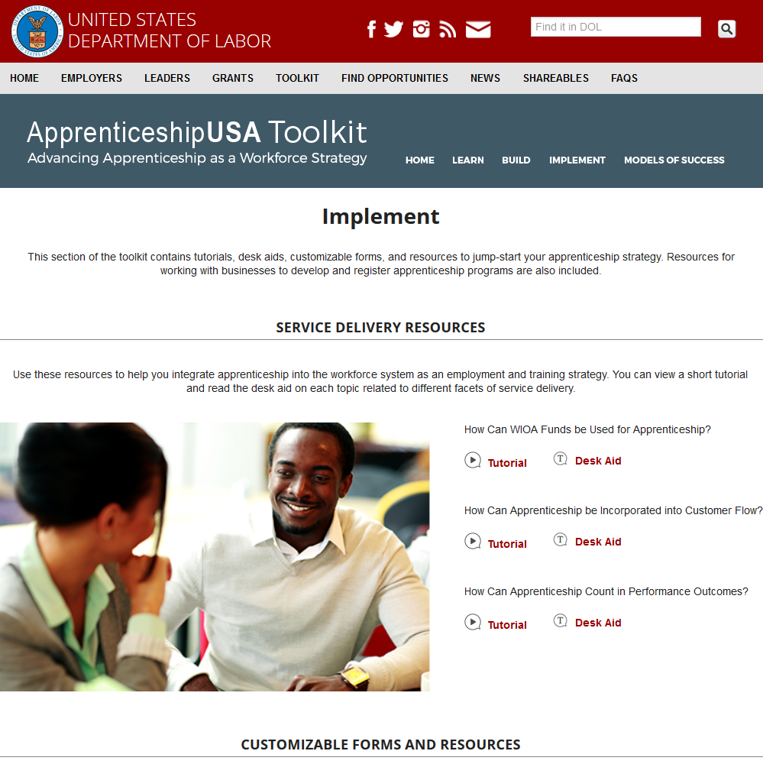
Implement Apprenticeship Strategies…
Business Customers:
Outreach handout to use with employers
Guide for business services staff
Job Seeker Customers:
Using WIOA funds for apprenticeship
Integrating apprenticeship into customer flow in One-Stop Centers
Counting apprenticeship in performance outcomes
ApprenticeshipUSA Toolkit
www.dol.gov/apprenticeship/toolkit.htm

Slide 16
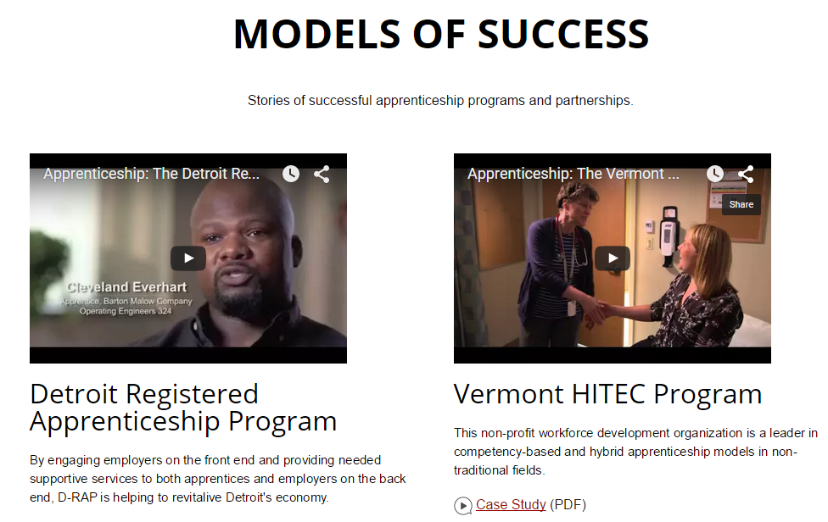
Models of Success
Stories of successful apprenticeship programs and partnerships
Videos
Case Studies
Links to Programs
ApprenticeshipUSA Toolkit
www.dol.gov/apprenticeship/toolkit.htm

Slide 17
ApprenticeshipUSA Toolkit in ACTION
The toolkit has resources for people at all levels for the workforce system…
One-Stop Center Manager
Workforce Board Director
Business Services Representative
Case Manager

Slide 18
ApprenticeshipUSA Toolkit in ACTION
How can a One-Stop Manager use the toolkit?
One-Stop managers can use the toolkit to help workforce staff learn about Apprenticeship and the benefits for job seekers and employers.

Slide 19
Introduction to Apprenticeship Training
5-course web-based training to help workforce professionals learn about apprenticeship:
Introduction to Apprenticeship
Building an Apprenticeship Program
A Closer Look at Apprenticeship Models
Building Partnerships for Apprenticeship Programs
Registering and Funding Apprenticeship Programs

Slide 20
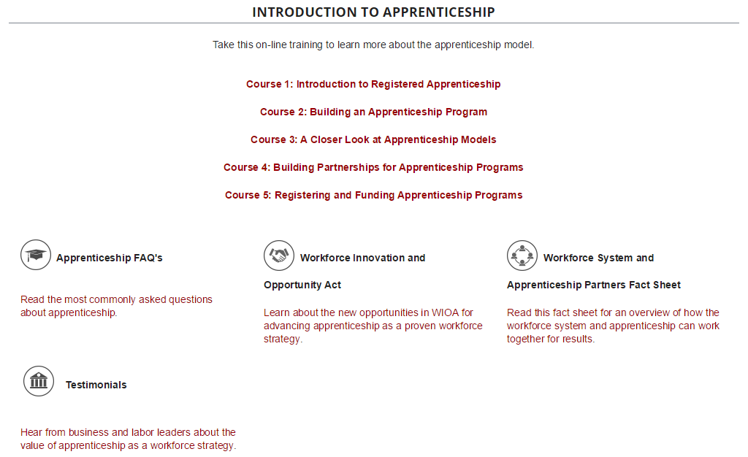
LEARN…

Slide 21
WIOA and Apprenticeship Fact Sheet
How does WIOA promote new opportunities to use apprenticeship?
Apprenticeship representatives on workforce boards
Registered Apprenticeship programs on Eligible Training Provider lists
Promotion of work-based learning strategies
Apprenticeship counted in WIOA performance outcomes

Slide 22
Apprenticeship FAQs
Answers to common questions about apprenticeship:
What are Registered Apprenticeships?
How is Registered Apprenticeship different from other types of work-based training?
Who are typical Registered Apprenticeship Partners?
How do apprenticeship strategies enhance workforce performance outcomes?

Slide 23
ApprenticeshipUSA Toolkit in ACTION
How can a Workforce Board Director use the toolkit?
State and local board directors can use the toolkit to help with assessment and planning of Apprenticeship strategies and show examples of successful models.

Slide 24
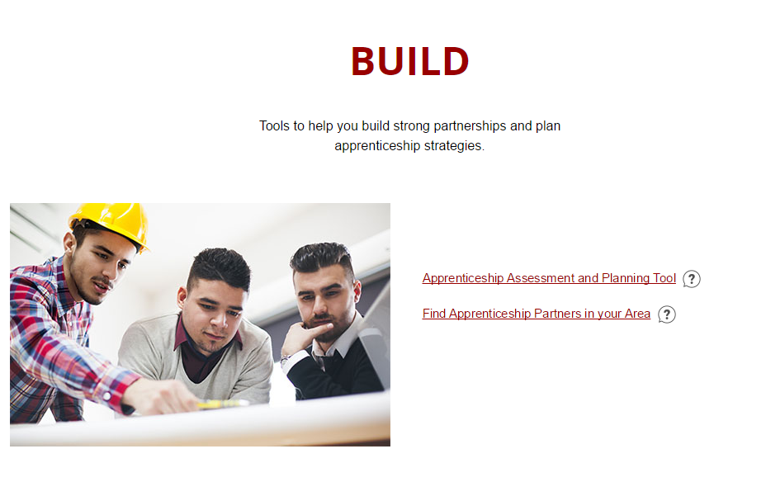
Build…

Slide 25
Apprenticeship Assessment and Planning Tool
Tool to help you build strong partnerships and plan apprenticeship strategies.

Slide 26
Examples of Apprenticeship Models
View several examples of Apprenticeship Models to help you identify the right one for your state or local area.

Slide 27
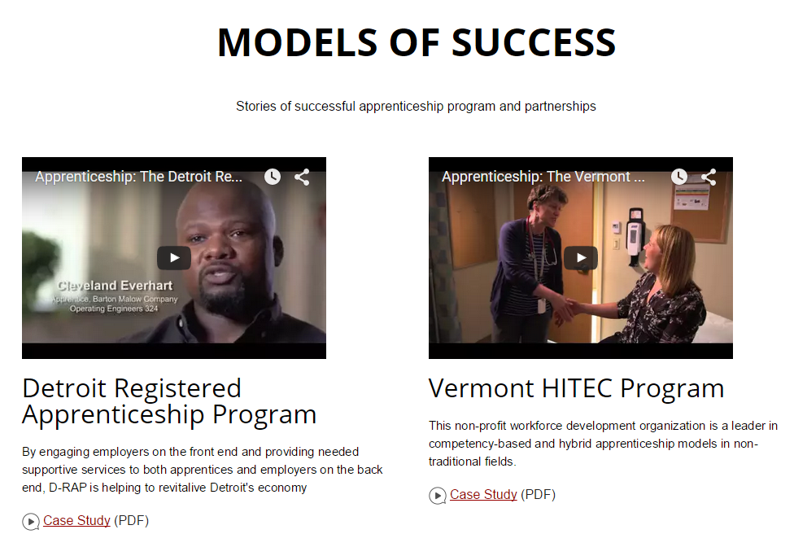
Models of Success
Videos from Detroit, Vermont, and Iowa.
Case Studies from businesses, industries, regional areas, and partnerships.

Slide 28
ApprenticeshipUSA Toolkit in ACTION
How can a Business Services Representative use the toolkit?
Business Services Reps can use the toolkit to learn about how Apprenticeship can meet the demands of employers for a highly-skilled workforce.

Slide 29
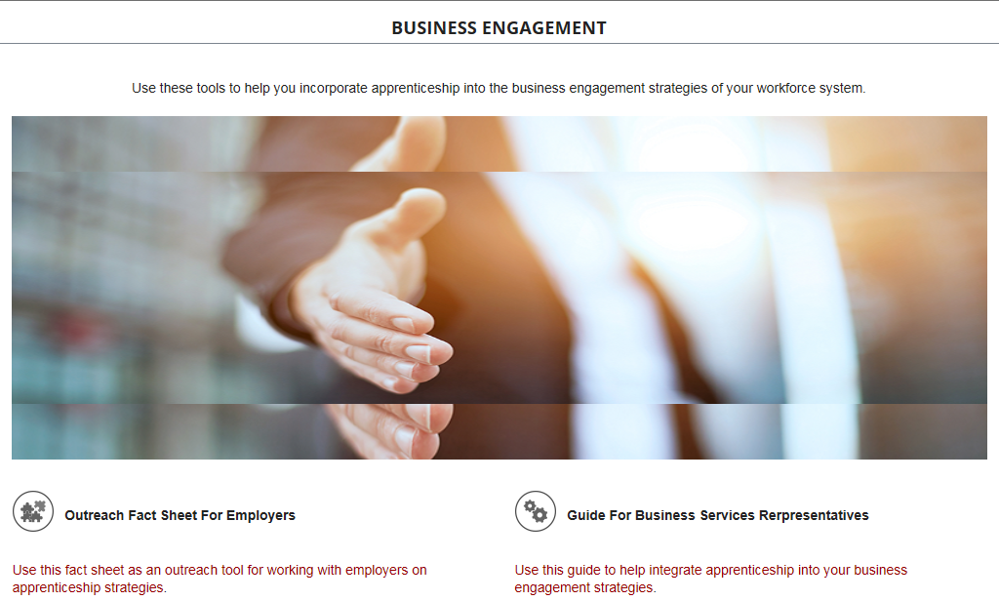
Implement…

Slide 30
Guide for Business Services Representatives
Use this Guide to learn how apprenticeship can be effectively integrated into your workforce system’s business engagement strategies.

Slide 31
Outreach Fact Sheet for Employers
You can use this fact sheet as an outreach tool for working with employers on apprenticeship strategies.

Slide 32
ApprenticeshipUSA Toolkit in ACTION
How can a Case Manager use the toolkit?
Case Managers can use the toolkit to learn about Apprenticeship and how to best use Apprenticeship programs as work-based training for job seekers.

Slide 33
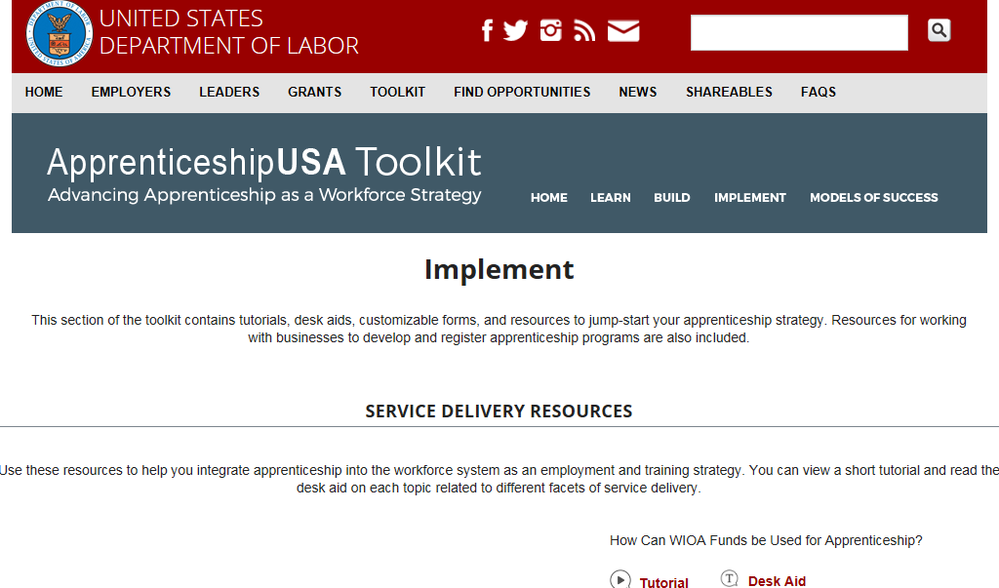
Implement…

Slide 34
Tutorial and Desk-Aid
How can WIOA funds be used to support Apprenticeship?
The on-the-job training component of apprenticeship programs.
Related classroom instruction for apprentices, including tuition, books, supplies, fees, uniforms, tools and other required items.
Basic skills training and pre-apprenticeship programs to prepare participants to enter apprenticeships.
Tutoring, mentoring, and work experience for youth participants can be used in combination with pre-apprenticeship and apprenticeship programs.

Slide 35
Tutorial and Desk-Aid
How can Apprenticeship be integrated into the customer flow of one-stop centers?
This brief reference guide discusses:
Intake and eligibility determination
Assessment and individual employment plan
Preparation for apprenticeship programs
Screening apprenticeship candidates
Post-selection services and support

Slide 36
ApprenticeshipUSA Toolkit
ApprenticeshipUSA Toolkit www.dol.gov/apprenticeship/toolkit.htm

Slide 37
Please enter your questions in the Chat Room!

Slide 38
Contact Information
Office of Apprenticeship, Employment and Training Administration
Email: OA.Administrator@dol.gov
Chad Aleshire
Title: Program Analyst, Office of Apprenticeship
Organization: Employment and Training Administration
Email: Aleshire.Chad@dol.gov

Slide 39
www.workforce3one.org

