Slide 1
Breaking Down the Barriers: Helping the Long-Term Unemployed
Overcome Obstacles and Secure Jobs
Date: September 25, 2015; 2:00 p.m. EST
Presented by: Ofer Sharone, Mitsubishi Career Development Professor and an Assistant Professor of Work and Organization Studies at the MIT Sloan School of Management

Slide 2
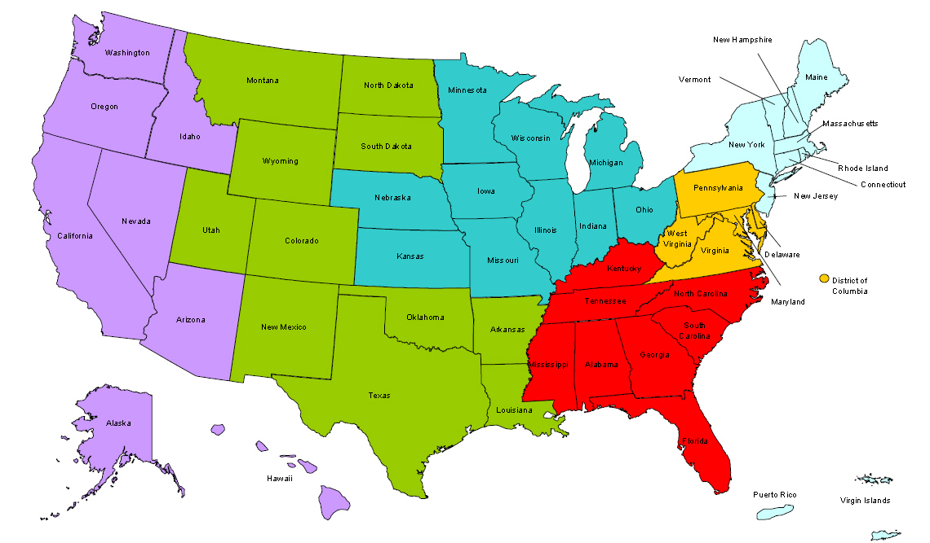
Where are you?
Getting the Ready-to-Work Back to Work
Enter your location in the Chat window – lower left of screen

Slide 3
Welcome & Introductions
Getting the Ready-to-Work Back to Work
Moderator and Facilitator:
Megan Baird, RTW Policy Lead, DOL Division of Strategic Investments
Jen Swidler, RTW Technical Assistance Coach
Guest Speaker:
Ofer Sharone, Mitsubishi Career Development Professor and an Assistant Professor of Work and Organization Studies at the MIT Sloan School of Management

Slide 4
Webinar Objectives
Getting the Ready-to-Work Back to Work
Key takeaways from today’s Webinar:
Recognize and understand the unique challenges the long-term unemployed population faces in networking and navigating the hiring process.
Understand the differences between working with the LTU and other unemployed job seekers.
Learn strategies on how to work with this unique population and help them overcome the challenges they may face, and get them back into the workplace.

Slide 5
Polling Questions
Getting the Ready-to-Work Back to Work
Polling Question # 1
Let’s get to know who is on the call today. Using the poll, select the role that you play in your H-1B RTW grant.
For this grant initiative I am the:
Authorized Representative
Program Director/Manager
IT/Data Manager or staff
Training Partner
Employer Partner
Service Provider

Slide 6
The Lingering Long-Term Unemployment Crisis
Recent Statistics About Long-Term Unemployment
Once unemployed the risk of becoming LTU cuts across all education levels.
Important factors:
Age (45% over 55 are LTU)
LTU becomes its own barrier (“black holes”)
August 2007 | August 2015
18% of unemployed LTU | 28% of unemployed LTU

Slide 7
LTU Experience Beyond the Numbers
Getting the Ready-to-Work Back to Work
Experiential Essence: Series of Rejections
LTU experience significantly different from short-term unemployment
Self-Blame/Internalized Stigma particularly for white-collar workers
Undermines effective job search
Job search discouragement
physical and mental health risks (linked via stress and isolation)

Slide 8
Self-Blame (Internalized Stigma) Produces An Emotional Crisis
Getting the Ready-to-Work Back to Work
LTU job seekers share:
“The hardest thing is feeling that there is something wrong with me”
“The hardest thing is esteem, confidence. It’s killed. I have turned into an introvert. I feel like I’ve gotten older.”
(typically only shared once high trust is achieved)

Slide 9
Explaining Self-Blame
Getting the Ready-to-Work Back to Work
What is Self-Blame?
Inevitable product of American culture of individualism?
NO. Our culture does not doom us to self-blame.
Unemployed Americans use a patterned mixture of individual and structural narratives
Implication: The job search process individualizes the experience and creates a vulnerability for self- blame which can be addressed with support
It’s critical to understand the mechanism to understand the appropriate support.

Slide 10
My Cross-National Research
Getting the Ready-to-Work Back to Work
Cross-National Research to Explore Roots of Self-blame
Comparison with Israel.
Structural similarities (like unemployment benefits regime, labor market conditions)
YET unemployed workers in Israel blame the “system” not themselves.

Slide 11
System-Blame v. Self-Blame
Getting the Ready-to-Work Back to Work
Typical Israeli Interpretation of Obstacles:
I am not getting a job because the “system is a meat-market . . . It does not look at you as an individual. You are just buzzwords.”
Typical American Self-Blame:
I am not getting a job because I am “not good at interviews,” I am “a bad networker.” AND, for LTU, “I feel like I am flawed in some way, like I have a character defect.”

Slide 12
What explains the difference?
Getting the Ready-to-Work Back to Work
Job seekers are playing different “games.”
Israel = Specs Game
Finding a job requires competing on basis of skills or proxies thereof
U.S. = Chemistry Game
Finding a job requires establishing fit with a particular employer
Skills are a threshold requirement but rarely determinative.
Focus on the person behind the skills.

Slide 13
Comparing Job Search Strategies
Getting the Ready-to-Work Back to Work
Different Games Require Different Strategies
 | Israel (Specs Game) | U.S. (Chemistry Game)
Resumes | List of “specs” | Advertisement
Cover Letters | Formality | Self-Revealing
Networking | Back door (corrupt) | Front door
Interviews | Oral Exam | First Date

Slide 14
Structure of the American Game
Getting the Ready-to-Work Back to Work
Chemistry Game experience:
Because self-presentation to create chemistry/fit is perceived as within the control of the job seeker the experience of playing and losing the chemistry game generates self-blame and discouragement
Difficulties in finding work are often linked to assessments of person’s core self

Slide 15
Generating American Self-Blame
Getting the Ready-to-Work Back to Work
The Chemistry Game requires repeatedly putting the self “on the line”in vulnerable ways:
“Resumes are the hardest things to write because it taps into my identity, my pride, my fears . . . Putting yourself out to be judged is pretty heavy.”
“I find [networking] difficult to do. There is a hesitation about calling people and putting myself out there. It’s just difficult.”

Slide 16
What Can Support do Regarding Self-Blame?
Getting the Ready-to-Work Back to Work
Combating Self-Blame
Traditional self-help support vs. sociologically-informed support

Slide 17
Dominant Self-Help Support Practices
Getting the Ready-to-Work Back to Work
How to Play the Chemistry Game
Provides useful strategic advice on how to play the chemistry game (e.g., explaining importance of networking) BUT 2 shortcomings:
Focus on magnifying job seekers’ perceived control –> boomerang to self-blame
Focus on positive self-presentation in support context → intensifies emotional isolation

Slide 18
Sociologically-Informed Support Intervention
Getting the Ready-to-Work Back to Work
Changing the Dialogue
Our research examines effect of support that provides conventional strategic search advice but unlike self-help support:
Replace control discourses with recognition of barriers (e.g., discrimination against the LTU).
Replace positive emotions discourses with encouragement to share full range of emotional experiences.

Slide 19
From Self-Blame to Self-Revaluation
Getting the Ready-to-Work Back to Work
Self-Revaluation through recognition of:
Shared emotional (self-blame) crisis
merit of similar others
one’s own merit (excavation practices)
value to others in group
“numbers game” structure

Slide 20
Breaking the Emotional Isolation: Revaluation of Self
Getting the Ready-to-Work Back to Work
Paradoxical encouragement from shared discouragement:
Dana: “The thing is, you just know you’re not alone and the emotional feelings you have are not just yours alone. These other people have them.”
Bob: “Being with other people who were in a similar situation and just realizing that everyone has these hidden issues.”
Effect: recognition of shared emotional crisis shifts focus away from perceptions of a flawed or weak inner self

Slide 21
Recognizing Merits of Similar Others
Getting the Ready-to-Work Back to Work
Support helps self-revaluation when LTU job seekers recognize each other’s merits:
“When you’re with this group of people and you realize there’s two lawyers, there’s a marketing professional, there’s all these people with all these skills and they’re also having trouble finding stuff for whatever reason. It just helps you feel better about yourself.”
Recognition of external barriers allows LTU job seeker to see themselves in a less self-stigmatized way.

Slide 22
Revaluation by Excavation
Getting the Ready-to-Work Back to Work
Unintended consequence of support practice of excavating past successes:
“We’ve talked a lot about what did I do. How did I work with people. . . . That made me realize that I have a lot of skills that never go away . . . If I keep pursuing it, eventually I will find the right connection, the right match.”

Slide 23
Numbers Game Perspective
Getting the Ready-to-Work Back to Work
Reducing Self-blame
By openly recognizing barriers (like LTU discrimination), support can generate a “numbers game” perspective that diminishes self-blame.
“Before it was more a feeling of futility of things going into black holes in the Internet when applying for jobs. But now it’s just a matter of hanging in there and continuing with the process and continuing with the flow. And at some point, things will connect.”

Slide 24
Value to others in group
Getting the Ready-to-Work Back to Work
Experience of being valuable to other group members helps re-valuation:
“Being part of a group I like feeling like I’m helping other people there with my thoughts or giving them my responses or confirming how they feel, etc.”

Slide 25
One limitation of groups
Getting the Ready-to-Work Back to Work
“The group is not a good place for me because the group that I’m in . . . they’ve all been out of work a very long time.
What got me down was when some of them have been out of work for 8 years. That’s not motivating me in my situation.”

Slide 26
Rapid Re-employment Strategies
Getting the Ready-to-Work Back to Work
When LTU feel under-confident, blame themselves for their situation, and feel stuck in the “black hole,” what can we do to help?

Slide 27
Rapid Re-employment Strategies
Getting the Ready-to-Work Back to Work
In addition to strategic advice focus on re-valuation of the self.
It’s critical because self-blame undermines:
Networking
Interviewing
Continued engagement in job searching

Slide 28
Rapid Re-employment Strategies
Getting the Ready-to-Work Back to Work
How to facilitate revaluation?
Careful messaging regarding the degree of job seeker control to avoid boomerangs
Set expectations for marathon not a sprint
Space/time to share range of emotions to reduce isolation
Group work to facilitate recognition of own merits and to feel valuable to others
Discuss strategies to maintain/repair friendships and marriages

Slide 29
Rapid Re-employment Strategies
Getting the Ready-to-Work Back to Work
How to facilitate networking?
Telling people to get out there and network is usually not enough.
Break the typical resistance by setting clear targets/goals.
Find contexts (e.g., Hackathons) where job seekers can organically meet others as peers

Slide 30
Polling Questions
The information presented in this webinar
Provided strategies that I can implement in my H-1B RTW program.
Provided ideas that I can use to help my LTU clients succeed in my H-1B RTW program.
Provided new information to add to my knowledge on the long-term unemployed.
Are there strategies you are currently using that were not mentioned during today’s Webinar? If so, please add them to the chat window!

Slide 31
Please enter questions in the Chat Room!

Slide 32
Follow-Up Roundtable Discussion
Getting the Ready-to-Work Back to Work
LTU Subject Matter Deep Dive!
Follow-Up Roundtable Discussion with Ofer Sharone
September 30, 2015 at 2:00 p.m. Eastern.
Bring your questions and comments in a lively follow-up discussion on the information presented during today’s webinar.
We will hear from guest grantee speakers:
Rochester Works, Inc. from Rochester, NY
Workforce Alliance, Inc. from New Haven, CT

Slide 33
DOL Contacts
Ofer Sharone
osharone@mit.edu
harone@mit.edu>
Your Federal Project Officer, DOL National Office and Technical Assistance Providers
Ready to Work Grantee Mailbox
RTW@dol.gov

