Slide 1
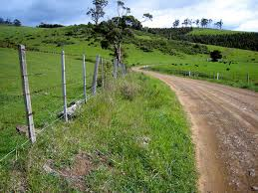
Implementing WIOA in Rural Areas
Enough is Known for Action
Webinar Series
September 30, 2015
11am Pacific/2 pm Eastern

Slide 2

Moderator
Jennifer Troke
Chief, Division of Youth Services
Office of Workforce Investment
Employment and Training Administration
U.S. Department of Labor
Troke.Jennifer@dol.gov

Slide 3
Polling Question: Are you from a rural or urban area? Did you grow up in a rural area?

Slide 4

Today’s Agenda
Welcome and overview
Administration's focus on rural areas
WIOA and rural areas
Local area examples (Pima County, Arizona and North Dakota
Q & A

Slide 5
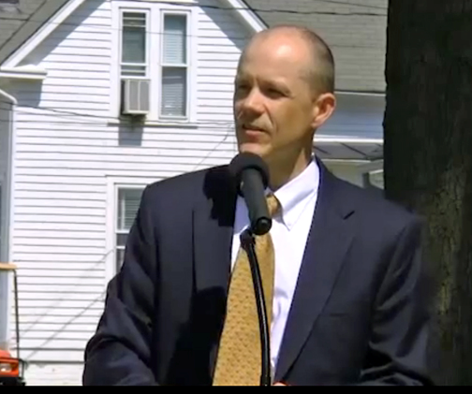
Presenter
Doug O’Brien
Senior Policy Advisor
White House
Domestic Policy Council

Slide 6
White House Rural Council
A sustained campaign to address rural child poverty by supporting improved well-being and upward economic mobility of children in rural and tribal places. Goals include:
(1) Enhancing public awareness of rural child poverty and its impact on the future of rural communities and our nation’s global competitiveness;
(2) Amplifying the Administration’s anti-poverty and economic mobility agenda, including the FY16 Budget, through a rural lens;
(3) Improving implementation and accessibility of programs that better serve rural children and families; and
(4) Developing a model for future federal action addressing child poverty through focused investments in rural places engaging in two-generation, bundled services approaches.

Slide 7
Measured by the Official Poverty Measure, Poverty is Higher in Rural Areas
23.4
19.4
14.2
Measured by the Supplemental Poverty Measure,
Poverty Has Declined Over Time and is Lower in
Poverty rates are higher among children than adults in both rural and urban areas.
In rural areas, poverty rates fell in the 1970s and 1990s, before rising in the 2000s.
The official poverty measure is based on cash, pre-tax income; does not include tax and in-kind benefits, nor does it adjust for geographic variation in the cost of living.
Source: Bureau of Labor Statistics, Current Population Survey, Annual Social and Economic Supplement (2013); CEA calculations.
7

Slide 8
Measured by the Supplemental Poverty Measure,
Poverty Has Declined Over Time and is Lower in Rural Areas
19.2
16.8
From 1967 to 2012, rural poverty rates fell by 17.1 p.p., compared to 4.5 p.p in urban areas.
The trends in child poverty are similar to the trends in overall poverty: rural child poverty was nearly cut in half from 1967 to 2013 while urban child poverty fell by about 22 percent.
The SPM accounts for taxes and in-kind transfers, as well as housing cost differences.
Source: Wimer et al (2015).
8

Slide 9
The Safety Net Lifts Millions Out of Poverty and Sharply Reduces the Severity of Poverty
For both rural and urban children tax credits (EITC and the refundable CTC) have the greatest anti-poverty effect on the child poverty rate (left figure).
Social Security, SNAP, SSI, child support payments, TANF, and WIC all have a greater anti-poverty effect in rural areas than in urban areas (left figure).
Income support programs play a much larger role in alleviating deep poverty among children in rural areas compared to urban areas. For example, Social Security reduces deep child poverty by nearly one-half (almost double its effect in urban areas).
Source: Bureau of Labor Statistics, Current Population Survey, Annual Social and Economic Supplement (2013); CEA calculations.
Note: Poverty is measured by the Supplemental Poverty Measure.
9

Slide 10
Children in Rural Areas Are Less Likely to Have Access to Services
School-aged children in rural areas are less likely to receive an annual preventive medical care visit.
Children in rural areas are less likely to have access to a park, library, sidewalks, or a community center than children in urban areas. For example, about 75 percent of children in rural areas have access to a park, compared to 87 percent of children in urban areas.
10

Slide 11
Demographic Characteristics Differ in Rural and Urban Areas
Adults in rural areas are more likely to have a high school diploma or less; adults in urban areas are more likely to be college graduates. Education has become more important for poverty prevention over time.
Workers in rural areas earn less, on average, than their counterparts in urban areas
Source: Bureau of Labor Statistics, Current Population Survey, Annual Social and Economic Supplement (2013); CEA calculations.
Note: “Rural” is defined as per OMB throughout.
11

Slide 12
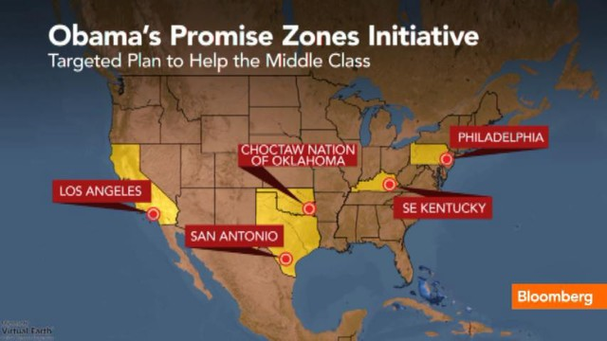
Place-Based Initiatives

Slide 13
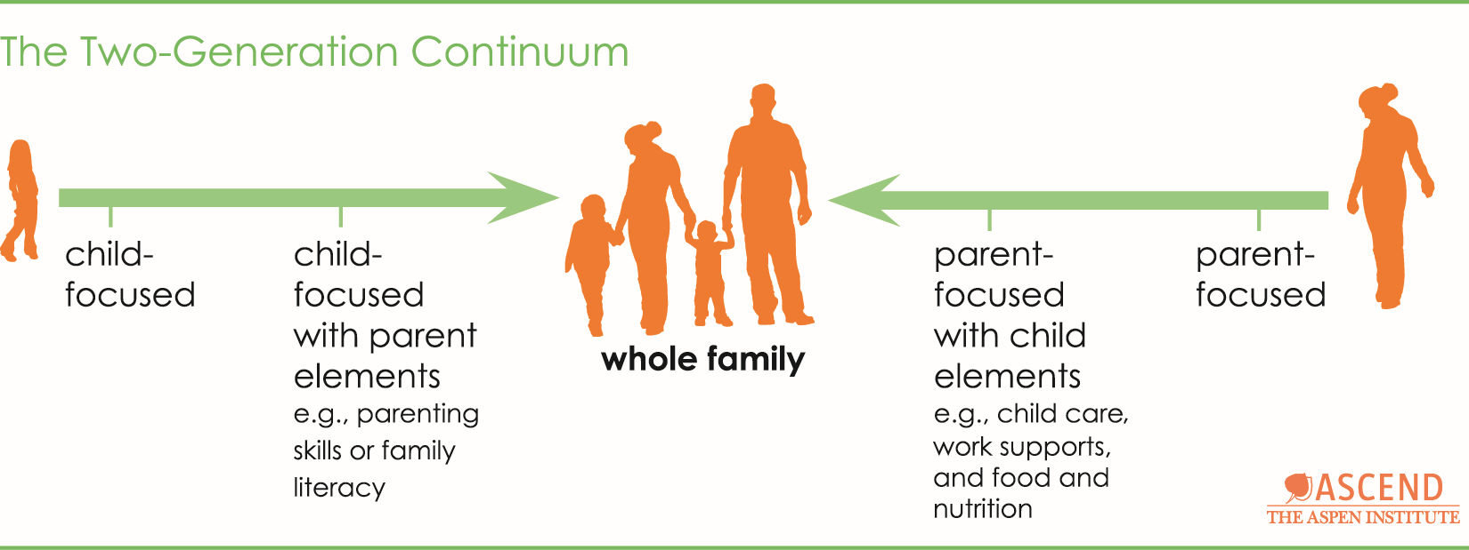
Two-Generation Continuum
Target workforce training technical assistance to address rural challenges.
Notes:
In partnership with Education and HHS, DOL will seek to offer technical assistance supporting state implementation of the Workforce Innovation and Opportunity Act (WIOA) customized for rural areas. Areas of technical assistance may include program integration with TANF and other community services, and expanding the use of technology and distance learning to deliver services and training.

Slide 14
Rural IMPACT communities
Berea (KY), Partners for Education at Berea College (Serving Knox County, KY)
Blanding (UT), The San Juan Foundation (Serving San Juan County, UT)
Blytheville (AR), Mississippi County, Arkansas Economic Opportunity Commission, Inc. (Serving Mississippi County, AR)
Hillsboro (OH), Highland County Community Action Organization, Inc. (Serving Highland County, OH)
Hugo (OK), Little Dixie Community Action Agency, Inc. (Serving Choctaw, McCurtain and Pushmataha Counties)
Jackson (MS), Friends of Children of Mississippi, Inc. (Serving Issaquena, Sharkey and Humphreys Counties, MS)
Machias (ME), Community Caring Collaborative (Serving Washington County, ME)
Marshalltown (IA), Mid‐Iowa Community Action, Inc. (Serving Marshalltown, IA)
Oakland (MD), Garrett County Community Action Committee and the Allegany Human Resources Development Commission (Serving Garrett and Allegany Counties, MD
White Earth (MN), White Earth Reservation Tribal Council (Serving Mahnomen County and portions of Clearwater and Becker Counties)

Slide 15
Workforce Innovation & Opportunity Act (WIOA) Opportunities
Regional strategies to benefit rural areas
Combined state plans and coordinated resources
TA on rural workforce issues via “ION Network”

Slide 16
Polling Question
What are some of the challenges you face in your rural area?

Slide 17
Challenges of Workforce Development in Rural Areas
Making services available to widely dispersed customers
Significant transportation barriers due to distance from workforce delivery systems and to lack of public transportation
Insufficient number of available service providers to offer all youth program elements
Fewer One Stop partners than in urban areas
Lack of telecommunications infrastructure, including Internet services

Slide 18
Other WIOA Provisions Relevant to Rural Areas
Local areas are required to plan regionally which includes coordination in establishing regional service strategies, including cooperative service agreements, and of transportation and other support services – Sec. 106(c)(1)
Local workforce development boards are required to facilitate access to service delivery in remote areas, including through use of technology – Sec. 107(d)(7)
Local board may award grants and contracts on a sole source basis if it determines an insufficient number of eligible providers of youth workforce investment activities in the local area are involved (such as rural areas) – Sec. 123(b)
Youth programs are required to spend not less than 75% of statewide and local areas funds used to provide workforce investment for out-of-school youth; and not less than 20% of local areas funds used to provide out-of-school and in-school youth with work experience - Sec. 129(a)(4) and (c)(4)
Notes:
OSY and work experience expenditure requirements covered in other webinars

Slide 19
Best Practices for Youth in Rural Areas
Transportation vouchers, forming carpools, or transporting customers in vans
Providing services by phone and having staff travel to meet customers
Electronic access to services, such as job referral
Distance learning arrangements with post-secondary providers
Notes:
Best practices you’ve heard, then let’s hear from the local areas

Slide 20

Arnold Palacios
Former Executive Director
Tucson Youth Development Center
Tucson, Arizona
Presenter

Slide 21


Pima County, Arizona
Pima County Workforce Overview
  Arriba y Adelante!
Major Considerations for Pima County Rural Programming
  Distances
  Economic Realities
  Resources

Slide 22
Our Collective Strengths for Rural Systemic Response
Regional Responses
Suburban Rural
Areas
Local One Stop System
Outlying Rural Communities

Slide 23

Opportunities for action in rural communities under WIOA
  Tucson Youth Development
  Portable Practical Education Program (PPEP)
  International Sonoran Desert Alliance
  Regional Responses
    Southern Arizona/New Mexico

Slide 24

Pat Anderson
State Youth Coordinator
North Dakota
Bobbie J. Miller
Job Service North Dakota
Valley City Customer Service Officer
Presenters

Slide 25
WIOA in North Dakota
Challenges Serving Youth:
  Limited funding
  Low unemployment
  Out of School Youth (75%)
  Demand for skilled workers
  Urban vs rural

Slide 26
WIOA in North Dakota
Partnerships/Outreach
Barriers
    Limited Training Options
    Distance
    Cost
    Age Appropriate Training
    High Wage Expectations
Notes:
Partnerships-
Creating partnerships with agencies, Human Service Agencies, - Schools, Transitions teacher, Vocational & High school counselors, Most Effective referral source is the ED/LD emotionally or learning at the schools. Since I have started to go into the classroom and meet the students work on resume, RUReady, Crash Courses or getting them registered on the workforce connection. Students feel more comfortable to come into our office. This has worked great on getting our in school youth involved in the program.
-try and coordinate with VR or agencies that are seeing the students frequently… team approach instead of youth having to be seen by several when the goal is the same. Sometimes the youth has several entities that they are involved in; school counselor, VR to WIOA case manager to work experience supervisor sometimes it is confusing to them, VR counselors that we share the same youth we have begun streamlining our youth together to help them understand whom they should be communicating to and when or meeting as a team. Use youth time together.
21-24 age Library- Our county library has been working very hard on getting people back into the library… they have added more computers….One thing that the library has stated is that young people only have smart phones for the internet etc… They have found that adding the computers they are having more young people into the computer to complete things that have to be done on a computer. Met with library staff educated them on our services, reminded them to make referrals and we are here to help.
Training Facilities:
If the youth isn’t choosing to attend a classroom based training.
Need to look ahead how can we do achieve training 60+ miles away for short term (CDL, weld etc) Commuting isn’t always feasible because of the conditions of the weather- intense training on short term training and limited make up times. Added expense of commuting, metro area higher rent, hotel accommodations, gas transportation or lack of transportation. All things have to be considered when enrolling in short term training – is there a extended stay hotel, the transportation that you do have if commuting is it reliable to be driving 100+ miles everyday.
- Unique scenario that I have come across. Young man 18 graduate of 2015, wants to be a truck driver or welder, it is demand occupation, ND is in of truck drivers. Further investigation with the youth, we are exploring this career – we find out that it will be deem to be very difficult for a 19 year old to get a truck driving position. Employers aren’t able to insure them due to their age. It isn’t affordable due to the high risk factor.
High wages- Some of the individuals that I have worked with are under the impression that all of ND is making the money that our “oil patch” workers are making. They hear that McDonalds, Cafés, Walmart etc are making $12-$15 starting out they think that is what they can make in rural ND on the other side of the state. This isn’t the case and the youth do have to start out in a minimum wage job in the service & retail sector. Working for $8.00/hr doesn’t seem “FAIR” and they wont consider taking a position. Trying to communicate the value of service, retail work isn’t being heard, they can still learn a lot of being a waitress, store clerk, counter attendant, excellent communication skills, working with all sorts of personalities.
Limited amount of employers.
In smaller communities the business can only have so many FTE’s or it is a family based business it is harder for small businesses to grow FTE’s to expand business due to budgets. They would be grateful for the work experience employees, but are limited to the amount of workers that they are able to help train or give an opportunity to have a PT job just because of budget issues.

Slide 27

Questions and Answers
Notes:
These are questions for the presenters

Slide 28
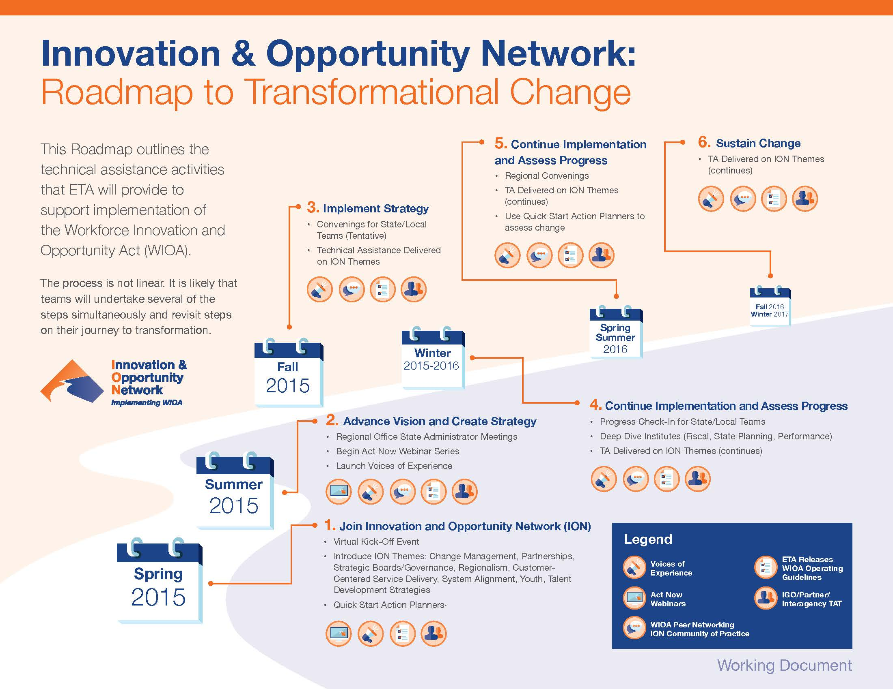
ION Commercial
Notes:
The Innovation and Opportunity Network (ION) is a community of people, practitioners, programs, partnerships and stakeholders that collective thrive for system capacity building and excellence of the public workforce system. A national, regional, state and local alliance that provides and participates in technical assistance and training that moves the collective towards the vision of the Workforce Innovation and Opportunity Act (WIOA) that was signed into law in 2014. The ION is committed to the provision of the awareness, education, and deployment of WIOA and is responsive to the dynamic needs of the environment that impact the public workforce responses to the employment of diverse job seekers and the needs of American business and Industry. The Network is a hub for WIOA information, tools, intelligence, resources and best practices.
The Innovation and Opportunity Network (ION) is the online learning and teaching community, designed to help all levels of workforce development professionals, stakeholders and partners connect with peers throughout the public workforce system who are working to implement the Workforce Innovation and Opportunity Act (WIOA).
ION is a catalytic tool for the dynamic action and innovation called for under WIOA. It provides the platform to access and share new and exciting strategies and find tools to create positive change.
A variety of training and technical assistance and peer to peer exchanges will be available through ION, focused on priority themes: change management, strategic boards, regionalism, system alignment, customer-centered service delivery, and talent development strategies (such as Career Pathways, Registered Apprenticeship, and Sector Strategies). Technical assistance tools include Quick Start Action Planners, Act Now webinar series, Voices of Experience videos and podcasts, a community of practice site, virtual events related to ETA WIOA operating guidance, and others to be added.
Above and beyond the implementation of WIOA, ION will be an ongoing place to connect, motivate, and inspire professionals at all levels who are working to meet the needs of all job-seekers and employers, develop workforce solutions, expand business services and industry engagement, and grow vibrant regional economies.
The ION is intended to be a roadmap that provides a two year view of critical systemic technical assistance and training that will forge comprehensive alignment, strategic investments, capacity building and build new and strengthen existing workforce collaborative partnerships.

Slide 29

Upcoming Webinars
Past webinar recordings on Workforce3one.org
TANF Partnerships
October 28th – 2:00pm EDT
System-Involved Youth
December 16th- 2:00pm EDT
Notes:
Also remind them the other webinar recordings are available on Workforce3one.org – Previous ones were Serving Out of school youth, Work experiences and Credentials.

Slide 30

Input on Future Webinar Topics
Please let us know what topics would be of interest and importance to you and your local areas for future webinars in 2016.
Notes:
We will allow the audience to respond to this question in the chat box.

Slide 31

Implementing WIOA in Rural Areas
Thank You!

