Slide 1
September 30, 2015
TAACCCT Industry Webinar Series:
Manufacturing

Slide 2
TAACCCT Learning Network at a Glance
U.S. Department of Labor, Employment & Training Administration
(National)
Jobs for the Future
CalState/Merlot
Maher & Maher
American Association of Community Colleges
U.S. National Science Foundation
ATE Centers
Other Non-Federal Providers of TA and Resources for TAACCCT Grantees:
Creative Commons
CAST
The Transformative Change Initiative

Slide 3
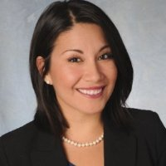
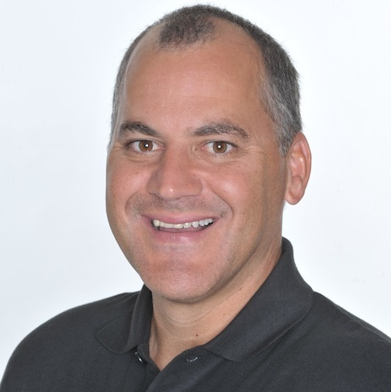

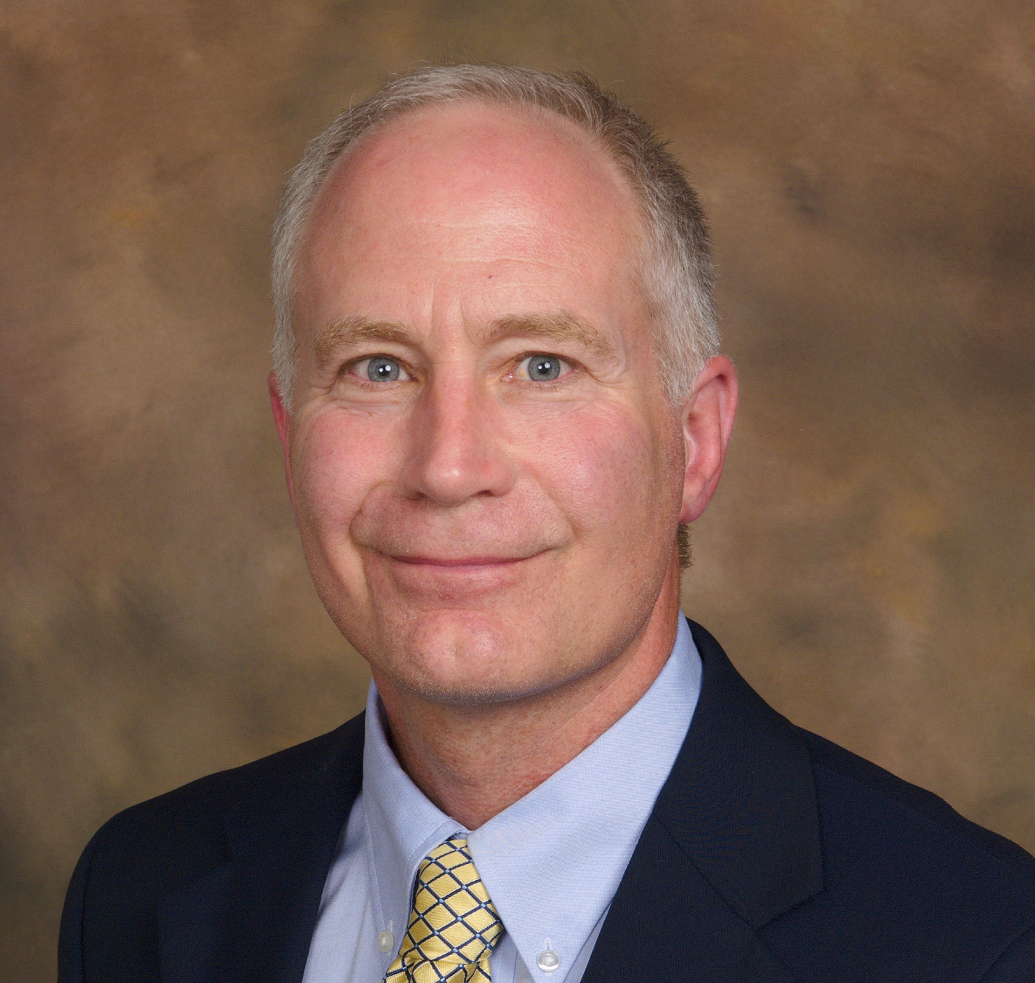
Presenters & Moderator
Erica Acevedo
Senior Program Manager,
Jobs for the Future
Rick Lumadue
Program Manager, Grantee Relations
SkillsCommons.org
Shelly Jewell
Director, Office of Workforce Development
CSCU Board of Regents of Higher Education
Todd Mattison
Consortium Project Manager
Northeast Wisconsin Technical College

Slide 4
Agenda Items
Welcome & Introductions
Highlights from Grantees
Brief Q&A
Review of Curriculum/Materials on SkillsCommons
Brief Q&A
Employer Engagement Discussion
Brief Q&A

Slide 5

Participant Poll
Which TAACCCT round do you represent?
Round 1
Round 2
Round 3
Round 4
What is the strategic focus of your grant in the Manufacturing industry?
Capacity Building
Improved Employer Engagement
Curriculum Development
Other (Specify in chat box!)
What job level are your training for?
Entry level
Middle Skills
Advanced level

Slide 6

Connecticut Manufacturing, Energy and Transportation Initiative (CT-MET)
Shelly Jewell
Director, Office of Workforce Development
Connecticut State Colleges and Universities (CSCU)
Board of Regents of Higher Education

Slide 7
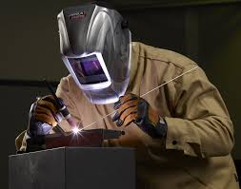
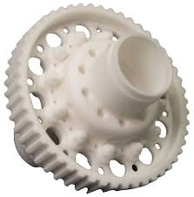

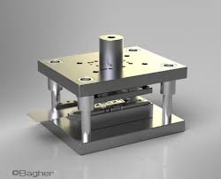

Connecticut Manufacturing Initiatives:
Developing a Talent Pipeline
Connecticut Manufacturing, Energy and Transportation initiative (CT-MET) TAACCCT Round 1, 2011-2015
Connecticut Advanced Manufacturing Centers 2011
Connecticut Advanced Manufacturing Initiative (CAMI), TAACCCT Round 4, 2014-2017

Slide 8
Connecticut Manufacturing, Energy and Transportation Initiative (CT-MET)
$2.7M Round 1 TAACCCT grant
Goals: Increase retention, rate of completion, employment and pipeline of students to higher levels of education
  Emphasized relationships with employers and the workforce system
Utilized evidence-based practices and provides capacity-building at the colleges
  Created and/or modified training programs that met identified workforce needs in Connecticut
Programs were appropriate for Trade Adjustment impacted and other unemployed or underemployed workers

Slide 9
CT-MET MODEL
Accelerated, contextualized remedial coursework
Short-term certificate programs leading to industry credentials and jobs
Stackable credentials
Pathways to higher-level education and skills training for higher wage careers

Slide 10
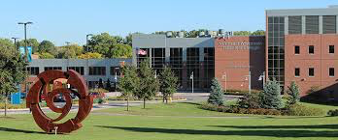

Making the Future: The Wisconsin Strategy
Todd Mattison
Consortium Project Manager
Making the Future: The Wisconsin Strategy

Slide 11
The Big Picture
Round 2 Making the Future: the Wisconsin Strategy
$15M – all 16 colleges, led by Presidents collaboration to increase opportunity for impact
Advanced Manufacturing focus: Machine Tool/CNC, Welding, Industrial Maintenance
Strong demand state-wide for skilled workers, so colleges must implement new strategies

Slide 12
The Wisconsin Strategy - Key Work Plan Goals
Shorten time to completion and employment
Expand capacity in new ways
Develop practices to support dislocated workers
Improve retention and completion rates

Slide 13
The Wisconsin Strategy - Program
Develop short-term certificates
Include certificates in updated Pathways (Roadmaps for outreach)
Add sections: new locations, evenings, more frequent starts
Align stacked credentials with Credit for Prior Learning processes
Add intrusive academic and career advising

Slide 14
The Wisconsin Strategy
Curriculum Changes to Meet Goals
Chunk down credentials, embed into program, or local certificate
Revise Machine Tool curriculum to align with NIMS
Intro to Manufacturing course – program selection next step
Contextualized math created by Math and Mfg instructors

Slide 15

Q&A

Slide 16
Participant Poll
How you uploaded any products into SkillsCommons yet?
Yes
No
What is the area of focus of your grant in the Manufacturing industry? (select all that apply)
Machinery
Mining, Oil & Gas Extraction
Transportation Equipment
Construction
Other

Slide 17
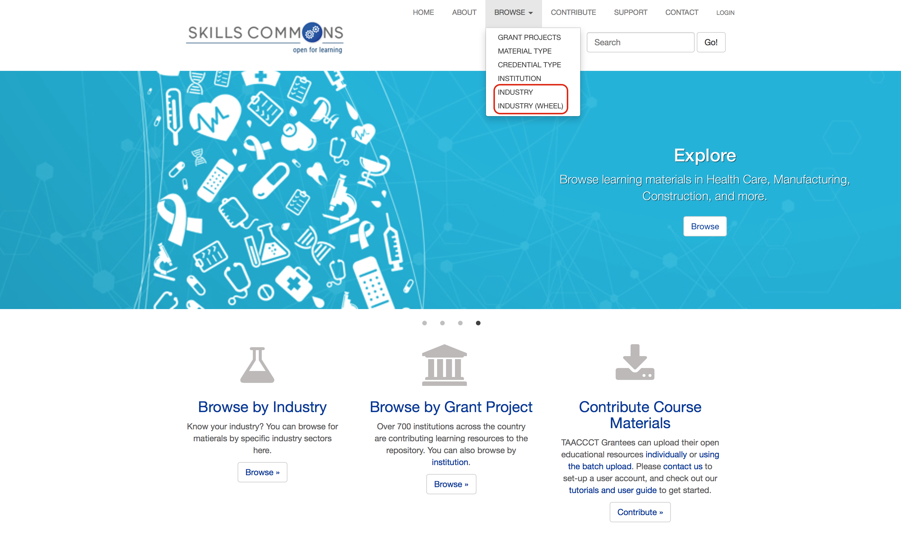
Browse the SkillsCommons Repository by Industry:
An Overview
Rick Lumadue, Program Manager of SkillsCommons.org; support@skillscommons.org

Slide 18
Q&A

Slide 19
EFFECTIVE EMPLOYER ENGAGEMENT

Slide 20
Connecticut Advanced Manufacturing Initiative (CAMI)--$15 M Round $ TAACCCT grant
Compelling Employer Involvement
  Letters of support (52)
  Cash-match for supplies ($6,000)
  Funding for equipment ($25,000)
  Increased internships (35 additional)
  Increased scholarships (11 additional)
  Expanded commitment to hire graduates (51 qualified students)
  Commitment to competitive internship wages ($12 - $15/hr)
  In-kind support ($111,400)

Slide 21
The Wisconsin Strategy
Employer Engagement – Implement Change
Advisor Committees - required by statute
    Colleges must actively seek out new partners
Employers willing to help, do not know how
    Colleges must share their program, then offer ways to engage
Each college industry and needs unique
    Find common need to rally partners
Employers and students gain from interface
    Employers attend graduations, speak in class, provide tours

Slide 22
The Wisconsin Strategy
Employer Engagement – Success Story
Chippewa Valley T.C. – find a solution together
  Ad-Hoc Committee for to re-align curriculum to NIMS credentials.
  Shortage of skilled workers – regional need for long term workforce pool, and address image of mfg.
  New Outreach Committee created, led by employers who asked CVTC for help.
  CVTC, WDB and industry collaborated to solve. Workforce survey and new recruitment strategies implemented.

Slide 23
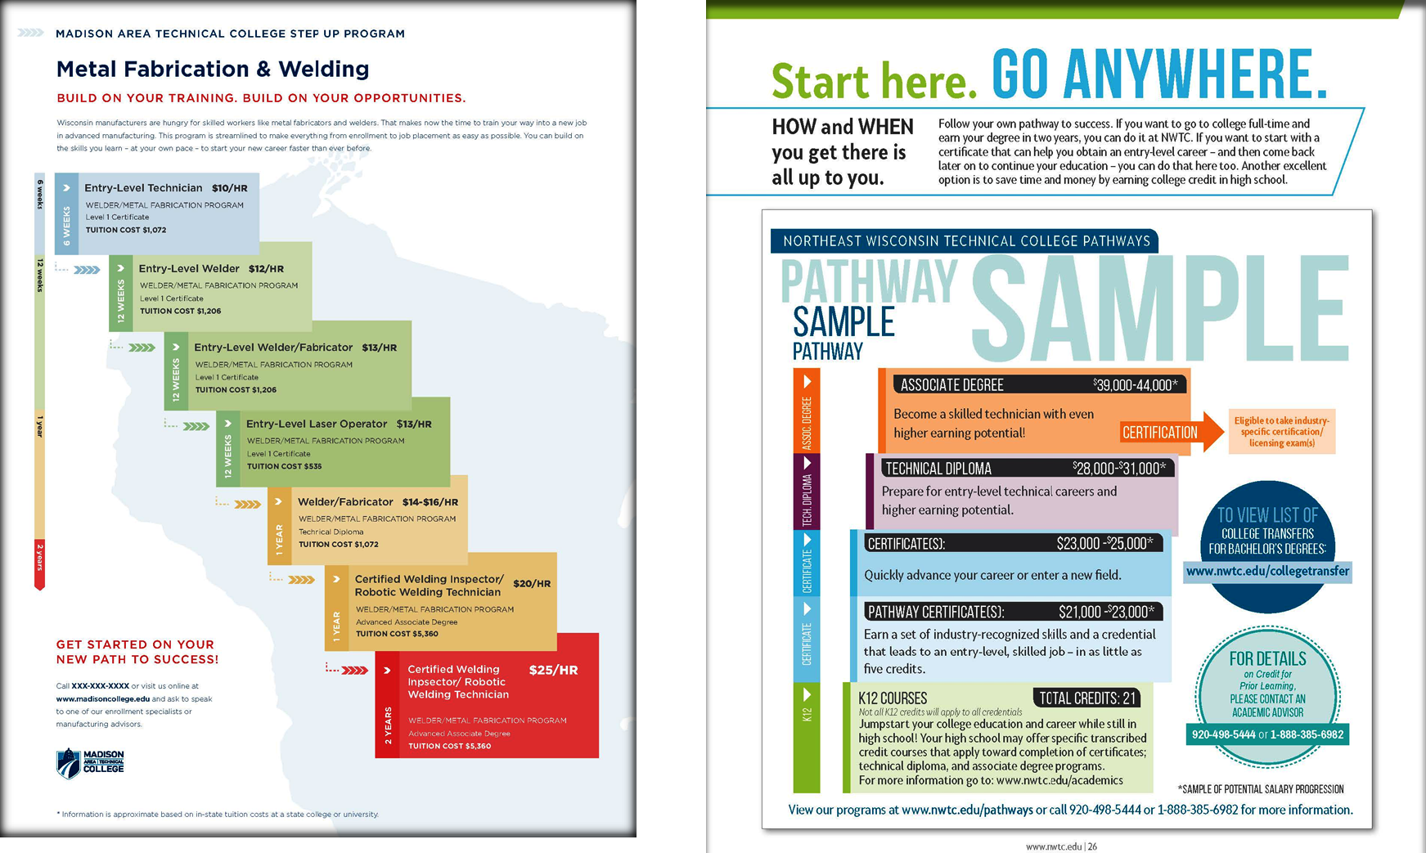
The Wisconsin Strategy - Roadmap Template

Slide 24

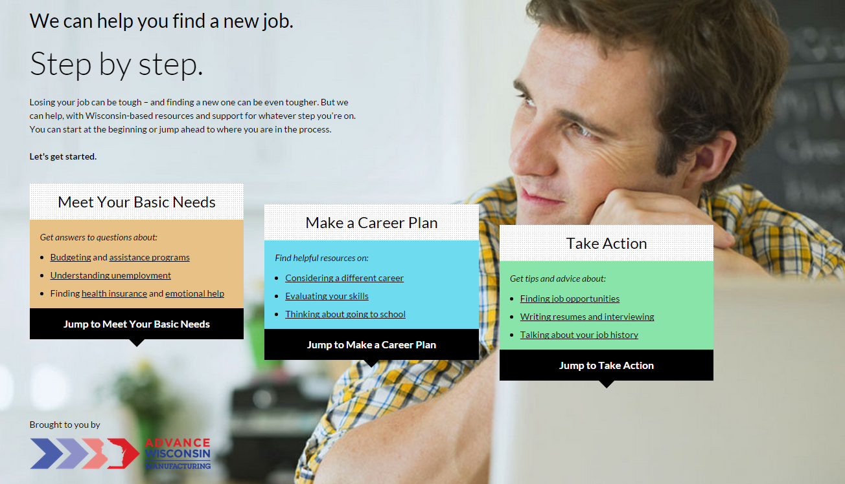
Wisconsin TAACCCT 2 Websites
Advance Wisconsin Website
http://advancewisconsin.org/
Audience is all WDB’s, colleges, job centers, and public
Job Up Website
http://jobupwisconsin.com/
Audience is dislocated workers through job centers, recruiters, college staff, and public

Slide 25
Q&A

Slide 26
Employer Engagement Discussion Questions
Please use the chat box or unmute your phone to participate!
1. In what ways are you currently engaging your industry partners?
2. What challenges are you facing with your industry partners?
3. What are some of your best practices for industry partners?

Slide 27
Participant Poll
Are you interested in convening as a manufacturing industry group beyond this webinar?
Yes
No
How would you like to remain connected?
Series of Conference Calls
Additional Group Webinars
Live “Chat” Sessions with Peers
Basecamp
Other (Please type in chat box!)

Slide 28
To hear more about the TAACCCT Learning Network, other TA offerings, or send any comments/questions, email us at TAACCCT@dol.gov .
Erica Acevedo
Senior Project Manager
eacevedo@jff.org
TEL 617.728.4446 FAX 617.728.4857 info@jff.org
88 Broad Street, 8th Floor, Boston, MA 02110
122 C Street, NW, Suite 650, Washington, DC 20001
WWW.JFF.ORG

