Slide 1
Rapid Response Reporting for
Trade Adjustment Assistance
Webinar Date: 9/30/15
Presented by:
Office of Trade Adjustment Assistance
U.S. Department of Labor
Employment and Training Administration

Slide 2


Presenters
National Staff (OTAA)
  Robert Hoekstra – Program Analyst
  Susan Worden – Supervisory Program Analyst
State Presenters
  Jay Bassett, Arkansas Department of Workforce Services
  Jerry Kluge, Wisconsin Department of Workforce Development
  Tammy Wood, TAA Oklahoma Employment Security Commission
  Patrick Campbell, Illinois Department of Commerce and Economic Opportunity
  Leslie Abramowitz, Massachusetts Department of Career Services

Slide 3

Agenda
Rapid Response (RR) and TAA
RR Reporting Makes a Difference
Reporting Rapid Response for TAA
  History
  Current
State Practices Examples
Resources
  ETA Guidance
  Contacts

Slide 4
Rapid Response and TAA

Slide 5
Rapid Response and TAA
Designed to Quickly Coordinate Services and Provide Immediate Aid to Companies and Their Affected Workers in Response to Layoffs and Plant Closings
Works with Employers and Employee Representative(s) to Quickly Maximize Public and Private resources to Minimize Disruptions Associated with Job Loss

Slide 6

Rapid Response and TAA
Proactive
Business-Focused
Flexible

Slide 7
Rapid Response and TAA
Rapid Response Teams Identify Layoffs through:
  Worker Adjustment and Retraining (WARN) Act Notices (for large layoffs)
  Public Announcements
  Direct Contact from Stakeholders
  TAA Petitions

Slide 8
RR Reporting Makes a Difference

Slide 9
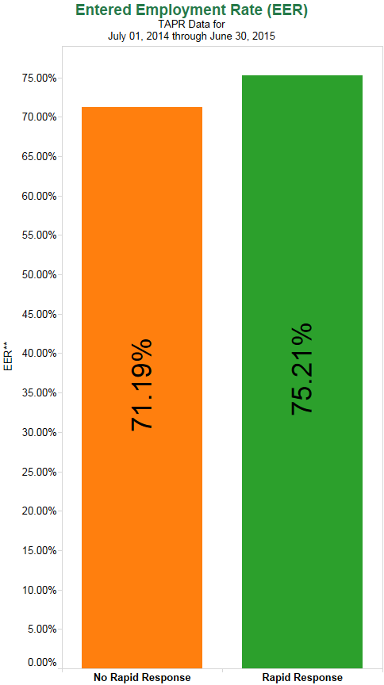
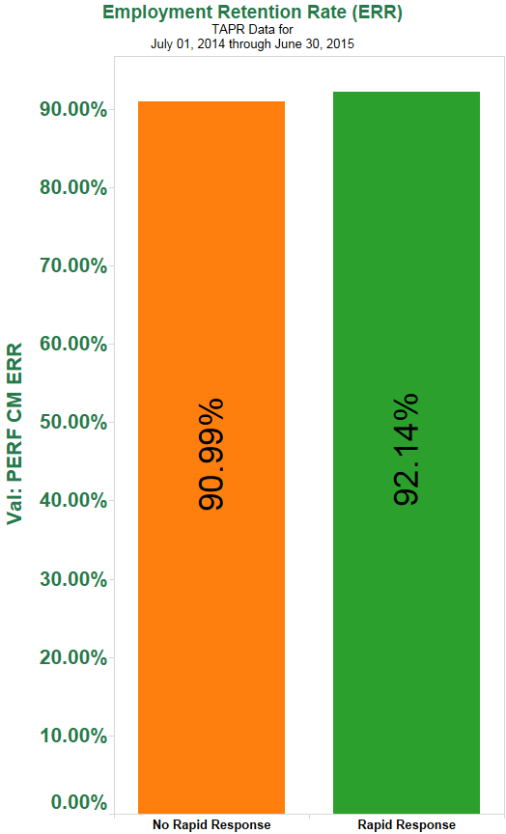
RR Reporting Makes a Difference
Participants Receive Services More Quickly
Rapid Response Participants Have Better Outcomes

Slide 10

RR Reporting Makes a Difference
Reporting Helps Us Determine What Works
  Lend More Granular Analysis
  Avoid State Skew
Reporting Drives Coordination Between Programs
  Better Information
  Better Marketing

Slide 11
Reporting Rapid Response for TAA

Slide 12
Reporting Rapid Response for TAA
Data Element Number | Data Element Name | Data Element Definition | Code Value
921 | Rapid Response | Record 1 if the individual participated in rapid response activities authorized at WIA section 134(a)(2)(A)(i). Record 0 if the individual did not receive services under the condition described above. Leave “blank” if the individual is not a participant or the information is not available. | 1 = Yes 0 = No

Slide 13
Reporting Rapid Response for TAA
Reported in the Trade Activity Participant Report (TAPR)*
First appears in the TAPR in report quarter in which the Date of Eligibility Determination Occurs
Rapid Response vs. TAA Orientations
* Will be replaced in FY 2017 with the ETA Performance Individual Record Layout, which will include almost all the current TAPR elements plus a handful of additional elements to conform to new law.

Slide 14
Reporting RR for TAA:
A History

Slide 15
A History
The Early Days of TAPR saw Rapid Response Rates of Only 20-30%
Scheduled Review of Rapid Response Reporting in TAPR Began in 2012 TAADI Pilot
Formalized in Rapid Response TEGL 04-14
In Fiscal Year (FY) 2015, the Target was Raised from 50% to 55%.

Slide 16
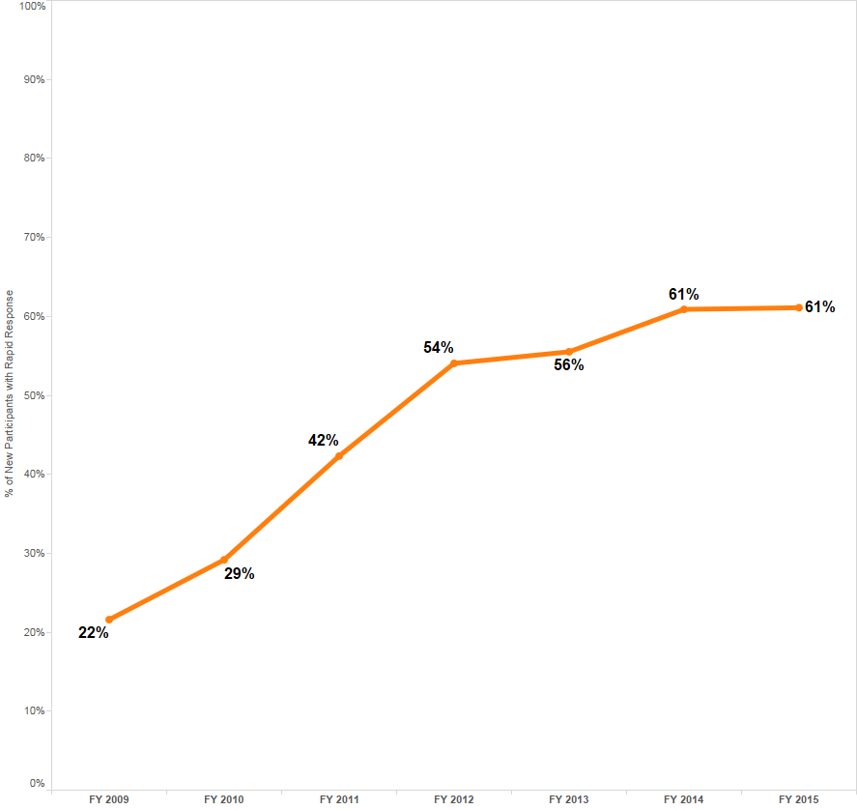
A History
Rapid Response Rates Improved Over Time

Slide 17
Reporting RR for TAA:
Current Status

Slide 18
Current Status
National Rapid Response Rate over 60%
Most States are Passing the TAADI Measure
Wide Variation By States in Percentage
No Single Process is Dominant

Slide 19
Current Status
State Distribution of RR Reporting Rates

Slide 20
State Practice Examples

Slide 21
State Practice Examples
Jay Bassett
Division Chief
Arkansas Department of Workforce Services
Jay.Bassett@arkansas.gov

Slide 22


State Practice Examples
Jerry Kluge
State TAA Program Manager
Wisconsin Department of Workforce Development
Gerald.Kluge@dwd.state.wi.us

Slide 23

State Practice Examples
OKLAHOMA
Tammy Wood
Administrative Programs Officer II
TAA Oklahoma Employment Security Commission
Tamara.Wood@oesc.state.ok.us

Slide 24


State Practice Examples
Patrick Campbell
Northern Regional Manager
Illinois Department of Commerce and Economic Opportunity
Patrick.campbell@illinois.gov

Slide 25
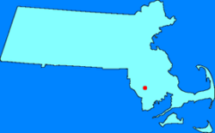

State Practice Examples
MASSACHUSETTS
Leslie Abramowitz
Analyst
Massachusetts Department of Career Services
Labramowitz@detma.org

Slide 26
State Practice Examples
Arkansas: Manual Entry from Rapid Response list. State files nearly every TAA petition to centralize tracking.
Wisconsin: Self-Reporting of Rapid Response on the TAA Application plus some follow-up on lists for major layoffs
Oklahoma: Automatic Matching to Rapid Response Event
Matching changed from Company Name to RR Event ID
Illinois: Automated Dislocated Event Tracking System (DETS) in which Rapid Response staff and Career Planners enter events and match 100% client records to the DETS events for both TAA and WIOA.
Massachusetts: Match on Individual Participant Record
(individual intake during Rapid Response)

Slide 27
Rapid Response Reporting Key Points
Providing and reporting Rapid Response is a requirement and more is needed.
Participants have better outcomes with Rapid Response.
Creating systematic approaches to tracking Rapid Response for TAA workers can enhance coordination, marketing, and reporting.
Coordinating information reduces duplication and increases service delivery.
Reporting has improved at a national level, but improvement is uneven.
Don’t be afraid to reach out to another state for ideas.

Slide 28

Questions?

Slide 29
Resources

Slide 30

Resources
Rapid Response is described in WIOA Sections 3(51) and 134(a)(2)(A)
TEN No. 23-14
Improve the quality of TAA state-filed petitions by ensuring accurate information is disseminated to petitioners through partnerships with Rapid Response teams.
TEGL No. 04-14
Trade Adjustment Assistance Data Integrity as a required component of quarterly reporting submitted by State Workforce Agencies or agencies designated by Governors as "Cooperating State Agencies" (CSAs or "states") and to establish procedures for corrective action by the Department of Labor (Department) in the event of non-compliance.
TEGL No. 05-15
Operating Instructions for Implementing the Amendments to the Trade Act of 1974 Enacted by the Trade Adjustment Assistance Reauthorization Act of 2015 (TAARA 2015)

Slide 31

Speakers’ Contact Information
Speaker: Robert Hoekstra
Title: Program Analyst
Organization: OTAA
Email: hoekstra.robert@dol.gov
Speaker: Susan Worden
Title: Senior Program Analyst
Organization: OTAA
Email: worden.susan@dol.gov
Regional Contacts Can Be Found At:
  http://www.doleta.gov/tradeact/FedContacts_Regional.cfm

Slide 32



www.workforce3one.org

