Slide 1
ETA Real-Time LMI TA Project: Environmental Scan of Vendors and Workforce Development Users
Webinar Date: Tuesday, February 10, 2015
Presented by:
Office of Workforce Investment
U.S. Department of Labor
Employment and Training Administration

Slide 2
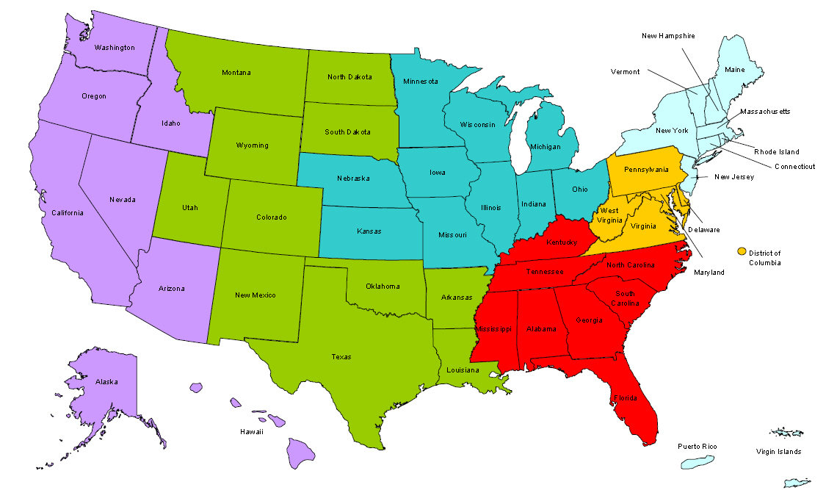
Where are you?
Enter your location in the Chat window – lower left of screen

Slide 3

Moderator Welcome
Pam Frugoli
O*NET/Competency Assessment Team Lead
Office of Workforce Investment
U.S. Department of Labor-Employment and Training Administration

Slide 4

Here’s what you can expect to get out of this webinar!
An overview of ETA’s Real-Time LMI Technical Assistance Project
An understanding of the use of real-time LMI in workforce development
Information about various real-time LMI vendors’ tools and their uses
Promising practices from state and regional practitioners

Slide 5

Agenda
Real-time LMI technical assistance project
Understanding real-time LMI
Real-time LMI vendors and tools
State and regional user profiles
Practitioner perspectives:
  Oregon Employment Department
  Workforce Intelligence Network for Southeast Michigan
Discussion/Q & A

Slide 6



Presenters
Ronnie Kauder
Senior Research Director
New York City Labor Market Information Service, City University of New York (CUNY) Graduate Center
Jeremy Kelley
Senior Project Manager
Jobs for the Future

Slide 7


Presenters
Nick Beleiciks
State Employment Economist
Oregon Employment Department
Lisa Baragar Katz
Executive Director
Workforce Intelligence Network (WIN) for Southeast Michigan

Slide 8

POLL: Please tell us a bit about yourselves!
State or local LMI director/staff
State or local workforce
program administrator/staff
State or local WIB director/staff
ETA administrator/staff
Other (please describe)

Slide 9
POLL: How familiar are you with real-time LMI tools and their application?
Not very – here to learn!
Have begun to explore
Intermediate user looking to expand capacity
“Super-user”: High level of integration and use

Slide 10

The Real-time LMI Technical Assistance Project
Overview:
Gretchen Sullivan,
Senior Consultant & Project Coordinator
Maher & Maher

Slide 11
Project Timeline and Objectives
September 2013-June 2015
  Two phases
Objectives:
  Build participating states’ capacity for utilizing real-time LMI in combination with traditional LMI to enhance employment decision-making, planning and performance, and customer outcomes
  Identify and share promising models to build national workforce system capacity to leverage real-time LMI

Slide 12
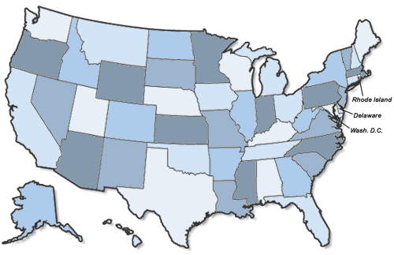
Participating States
Phase 1
Phase 2
ETA Region 5/Chicago
  Indiana
  Minnesota
ETA Region 6/San Francisco
  Arizona
  Oregon
ETA Region 1/Boston
  New Hampshire
  Vermont
ETA Region 4/Dallas
  Louisiana
  Utah

Slide 13

Key Project Activities
Workplan development and ongoing technical assistance and coaching for states
Report on promising state and regional uses
Technical assistance products
Learning events
Short-term licenses for real-time LMI analytic tools

Slide 14

Sample of States’ Areas of Focus
Industry sector partnership and
strategy development
Regional stakeholder engagement
Career coaching for job seekers and business services for employers
Training and curriculum alignment
Skill gap research
Certification and licensure requirements
Staff capacity-building
Data analysis
Reports and other publications

Slide 15

Vendor product review
Environmental Scan Report:
Ronnie Kauder
Senior Research Director
NYC Labor Market Information Service

Slide 16

Environmental Scan
What is Real-Time Labor Market Information (RT LMI)?
Information derived from the analysis of online job postings
Based on data that is “scraped” (or “spidered”) from the Internet daily
Sorted into data categories:
  North American Industry Classification System (NAICS)
  Standard Occupational Classification (SOC) system

Slide 17

Main Features of RT LMI
Data is refreshed at least daily.
It measures volume of online job advertisements daily and over time.
Online listings can be filtered by time period, location, industry, and education, certifications, and skills.
RT LMI allows keyword searches of job ads.
It also displays the names of employers posting the job ads.

Slide 18

RT LMI Strengths
RT LMI is always current
Can drill down to local areas
Provides insight into employer
demand in real time and answer
the following questions:
    Who is hiring and where?
    For which job titles?
    What skills and credentials are required to qualify?
    How do these opportunities change with educational attainment?

Slide 19
RT LMI Limitations
Job ads ≠ Job openings ≠ New Hires
Duplicate ads sometimes remain, despite vendors’ best efforts to de-duplicate
Many postings lack the information necessary to be classified into industry or geography
Skills requirements and salary levels not always in postings
Vendors’ scraping tools (and the algorithms behind them) may misread some elements of a posting

Slide 20
RT LMI Limitations - Representation
www
Not all jobs are listed online!
    Large employers and corporations are more likely to post online
    When they do post online, smaller employers are more likely to post management or executive positions
    Occupations with higher educational requirements, e.g. computer and mathematical occupations, tend to be better represented online. Construction and retail jobs are not well represented online.

Slide 21
Why Use RT LMI?
?
To create a more complete and accurate picture of job demand by comparing, validating, refining and/or supplementing analyses of traditional LMI with RT LMI.

Slide 22

Practical Applications of RT LMI
Can answer questions like:
Is there a relationship between online postings in one quarter and new hires in the next?
How does the advertised salary compare against the median?
How does a one-year history of job ads for an occupation compare against projections or actual employment?
Who are the biggest employers?
  And what are they looking for in terms of education, skills, and credentials?

Slide 23

Environmental Scan
Interviewed three major RT LMI aggregators and four additional LMI vendors that use RT LMI
Focus of interviews was to identify:
  Major RT LMI products offered
  How workforce development system customers typically use RT LMI products
  What RT LMI services or offerings are most valued by workforce system customers
  Vendor licensing structures

Slide 24

RT LMI Vendors
Major Aggregators of RT LMI
Burning Glass Technologies (www.burning-glass.com)
Geographic Solutions (www.geographicsolutions.com)
WANTED Technologies (www.wantedanalytics.com)
Firms that Offer Products and Services Using RT LMI
The Conference Board (Help Wanted OnLine - HWOL)
Economic Modeling Specialists International (EMSI)
Haver Analytics
Monster Government Solutions

Slide 25
Major RT LMI Analytic Products
Vendor | RT LMI Product | Description
Burning Glass Technologies | Labor/Insight | Web-based dashboard. Aggregates, extracts, codes, and normalizes job data from job boards, job banks, and search applications.
Geographic Solutions | America’s Labor Market Analyzer (ALMA) | Includes both traditional and RT LMI
WANTED Technologies | The WANTED Analytics™ online dashboard, incorporating The Conference Board’s Help Wanted OnLine™ data series | Aggregates postings from job boards, corporate career sites and other sites. Provides analytic tools.

Slide 26
Burning Glass Methodology
Sites Spidered | Coded Data Elements | Workforce Customers Value
38,000, including: Newspaper ads Internet job boards Corporate sites | 90 data elements, including: Geographic Employer Industry Occupation Job Title Skills Certifications Education Experience Salary | The granularity of the data, e.g. employer names, actual postings, skills and employer-requested certifications Additional occupational coding beyond SOC/O*NET Text analysis function
www.burning-glass.com

Slide 27
Geographic Solutions Methodology
Sites Spidered | Coded Data Elements | Workforce Customers Value
16,000 sites, including: Newspaper ads Internet job boards Government and military sites Education institutions Hospital sites Volunteer sites Recruiter sites Occupation specific boards Chambers of commerce Corporate sites | 50+ data elements, including: Geography Industry Occupation Education Experience Employer Wage Job Type Certifications Skills | Integration of survey-based national and state LMI and RT LMI into one tool Convenience of comparing information is a specific job posting to broader labor market trends, such as wages and similar job opportunities in the same region Supply side information, drawn from Virtual One-Stop database of actual job candidates
www.geographicsolutions.com

Slide 28
WANTED Technologies Methodology
Sites Spidered | Coded Data Elements | Workforce Customers Value
Approximately 25,000, including: Newspaper ads Internet job boards Corporate career sites Non-profit sites Government job boards Craig’s List | 66 data elements, including: Location Industry Occupation Function Level of experience Skills Certifications Education level Salary Source Job Type Employer Keyword | Strong correlation between WANTED’s national-level data and the JOLTS data published monthly by BLS Comprehensiveness of the data, which allows drill down to the most granular level Easy-to-use web interface, which is flexible and offers customized queries and reports Continuously updated labor market series back to 2005 WANTED’s The Hiring Scale™, which is a supply and demand measure
www.wantedanalytics.com

Slide 29
Licensing Structure
Burning Glass | Geographic Solutions | WANTED Technologies
For Labor/Insight, annual licenses are the norm. Five seats included in the base price. Annual fee is determined on a sliding scale based on several factors. | Access to the America’s Labor Market Analyzer tool is based on an annual per-seat cost for each license within an organization. | Access to the WANTED Analytics portal is by subscription, usually one year. Typical agreement allows a specified number of user logins. Arrangements can be made through the Conference Board’s HWOL, through Monster Government Solutions, or directly.
www.wantedanalytics.com

Slide 30
State and regional user profiles
Environmental Scan Report:
Jeremy Kelley
Senior Project Manager
Jobs for the Future

Slide 31

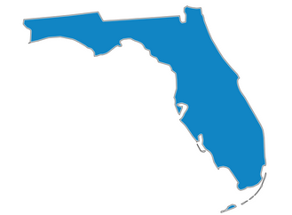

State Level RT LMI Themes
Increased software stability and data spidering
Limited correlation between job ads and actual vacancies
Need for trained LMI specialists using software
Usefulness to stakeholders

Slide 32

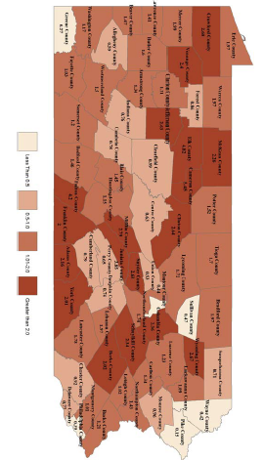
State Profile – Pennsylvania CWIA
Statewide & WIB Area Fast Facts
Industry Sector Analyses
  Sub-industry employment
  Location quotient
  Quarterly workforce indicators
  Monthly job ad comparisons
  Job postings by occupation & industry
Disseminated online & to stakeholders

Slide 33
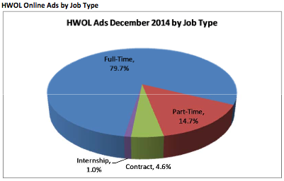
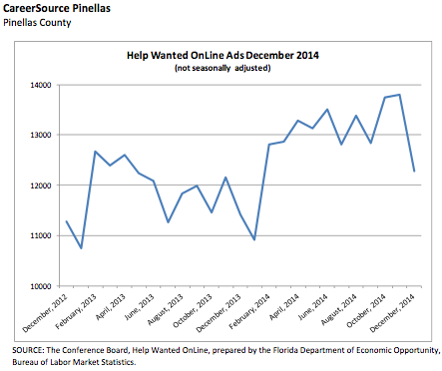
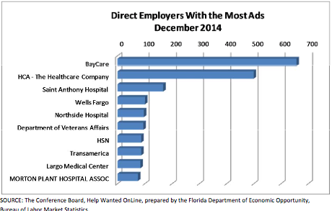
State Profile – Florida LMS
Identifying occupational supply & demand
Monthly summaries on ad volume & trends
Industry demand profiles
LMI training for workforce organizations

Slide 34
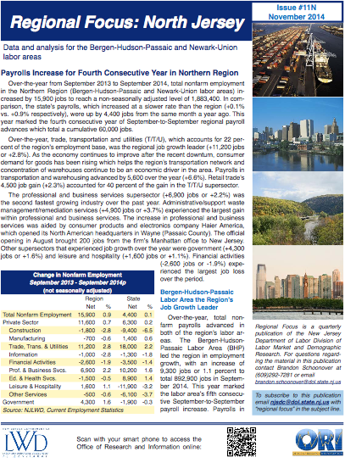
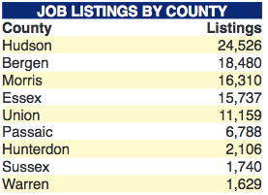
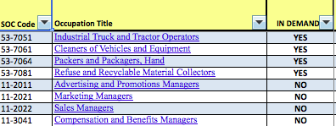
State Profile – New Jersey LWD
Regional Focus Local LMI
Labor/Demand Occupation List
Jobs4Jersey.com
Supporting “Talent Networks” in target Industries

Slide 35
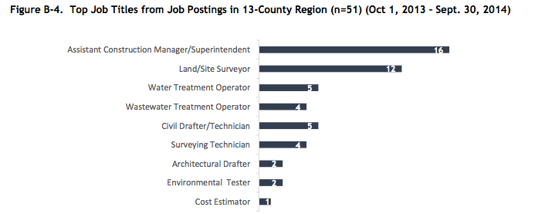

Regional Profiles – Delaware CIRWA
Delaware Technical and Community College
Produces data for colleges in 13 county region across Delaware, Pennsylvania, and Maryland region

Slide 36
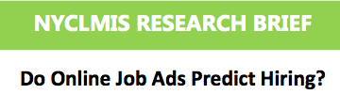

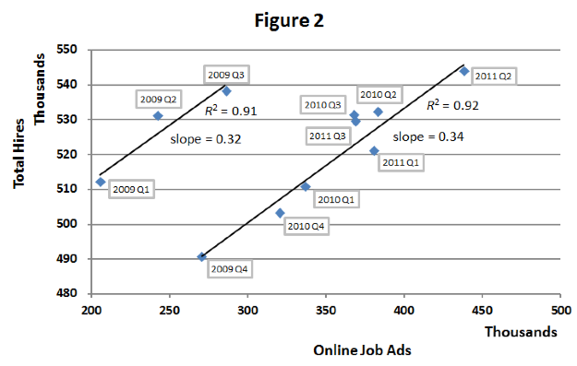
Regional Profiles
Also Profiled:
Michigan Workforce Intelligence Network
Also Profiled:
New York City Labor Market Information Service

Slide 37
NYC LMIS Monthly Real-Time Jobs Report

Slide 38


Discussion/Q&A

Slide 39

Oregon Employment Department
Practitioner Perspectives:
Nick Beleiciks
State Employment Economist
Oregon Employment Department

Slide 40
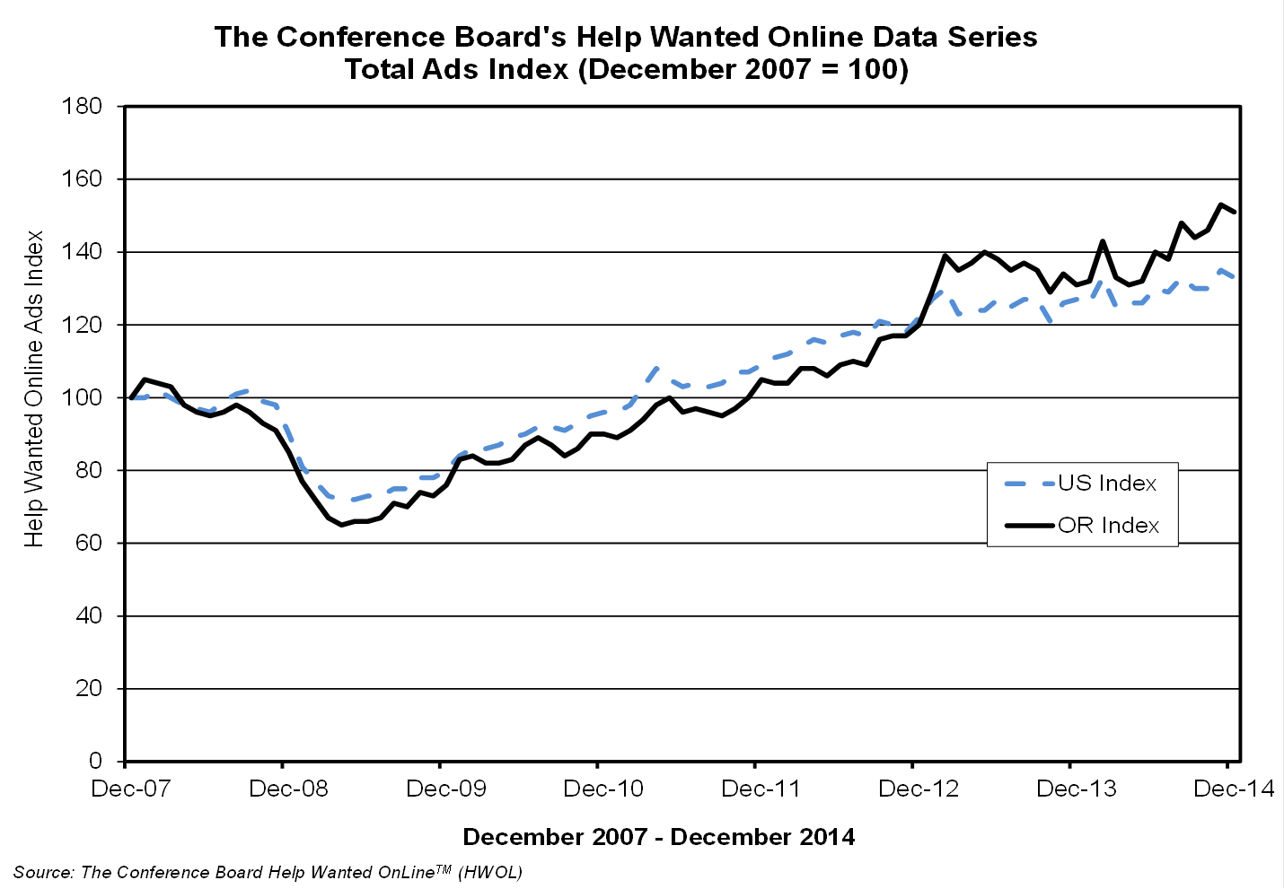
Real-Time LMI as an Economic Indicator
Recent trends in help wanted ads suggest continued job growth.

Slide 41
Real-Time LMI as an Economic Indicator
Local data provides insight into local labor market conditions.

Slide 42
Real-Time LMI as an Economic Indicator
Our customers love having information about their local areas.

Slide 43
Real-Time LMI Reveals “Hidden” Need for Workers
It appears the need for auto technicians is growing faster than projected.

Slide 44
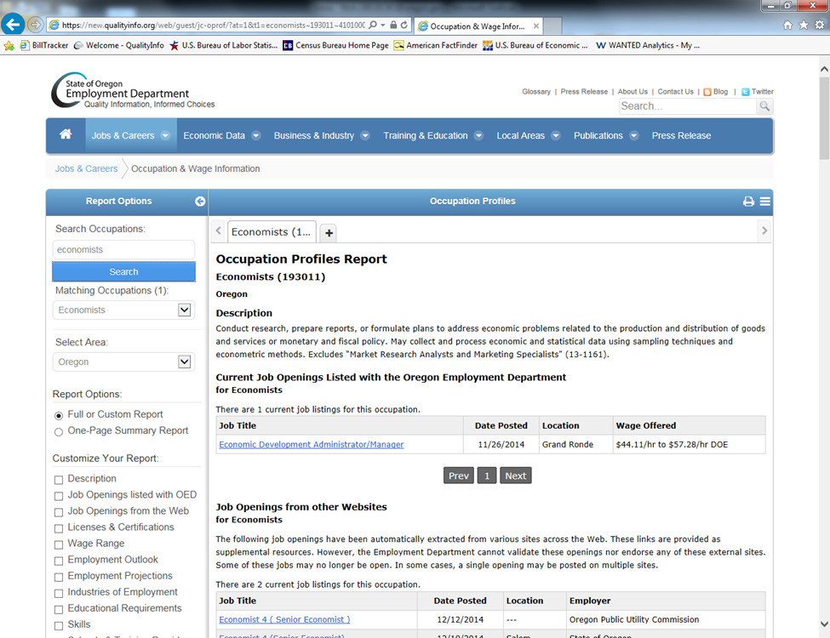
Connecting Real-Time LMI with Job Seekers
Job seekers can find jobs listed with the Department and online job postings.

Slide 45
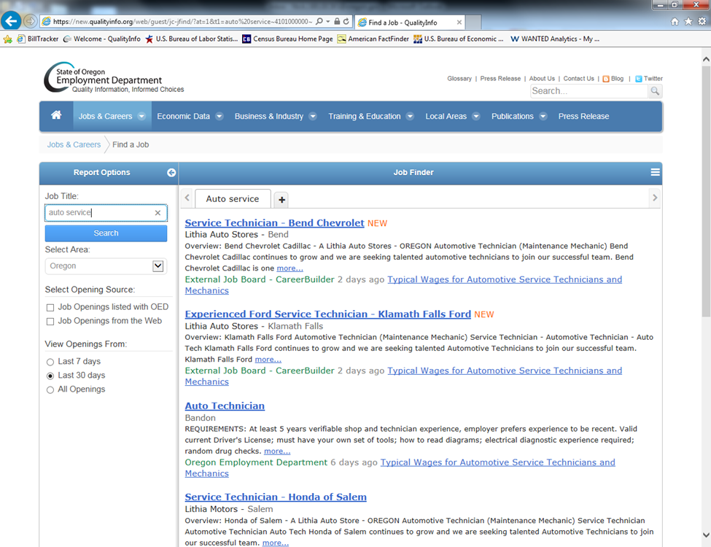
Connecting Real-Time LMI with Job Seekers
Job seekers can find jobs listed with the Department and online job postings.

Slide 46
Real-Time LMI and Job Vacancy Surveys
We don’t spend a lot of time comparing RT LMI with vacancy estimates.

Slide 47
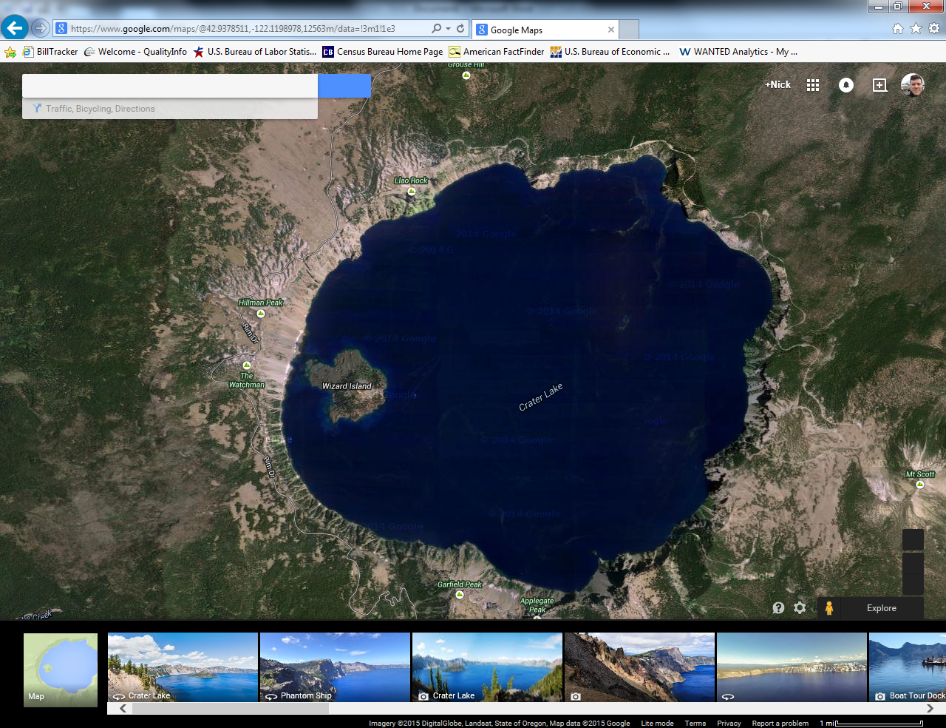
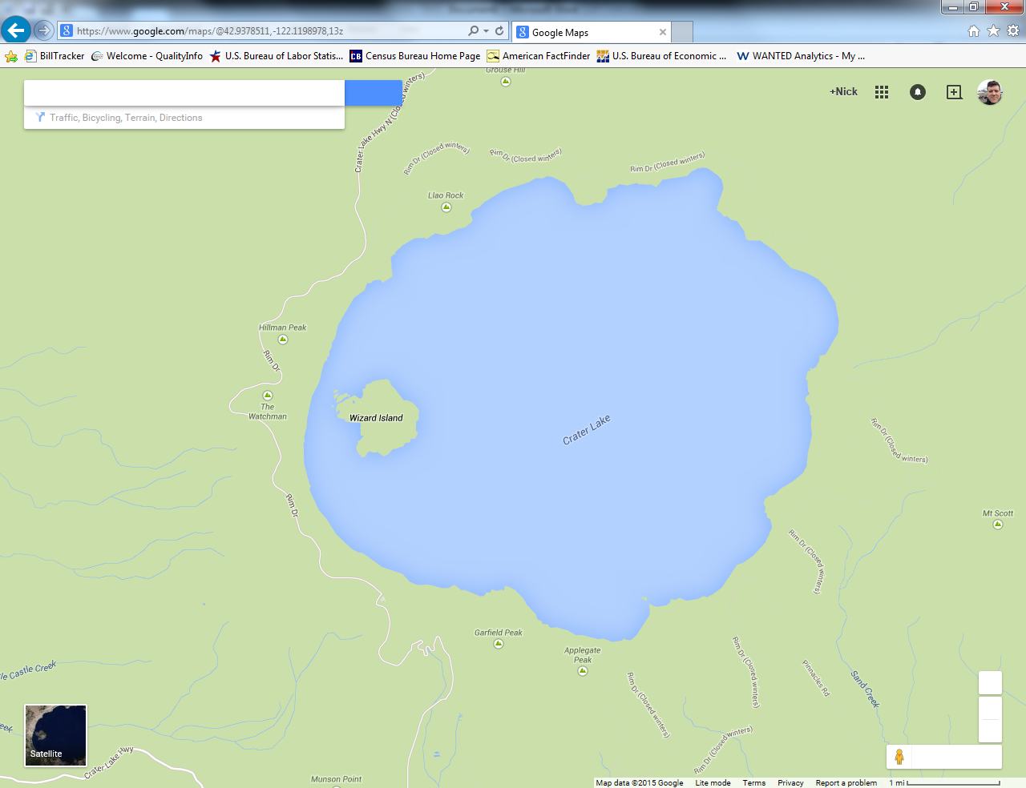
Real-Time LMI and Job Vacancy Surveys
Two views of the labor market are better than one.

Slide 48

Workforce Intelligence Network for Southeast Michigan
Practitioner Perspectives:
Lisa Baragar Katz
Executive Director
Workforce Intelligence Network for Southeast Michigan

Slide 49


Working smarter… together
Using data, engagement, and policy to shift the talent conversation and help employers find the talent they need for success

Slide 50

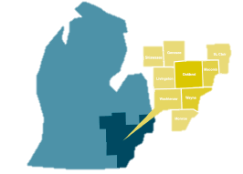
What is WIN?
Data & research guided employer strategies and policy
Community Colleges
Henry Ford College
Oakland Community College
Macomb Community College
Monroe County Community College
Mott Community College
Schoolcraft College
St. Clair County Community College
Washtenaw Community College
Wayne County Community
College District
Michigan Works! Agencies
Livingston County Michigan Works!
Detroit Employment Solutions Corporation
Genesee-Shiawassee Michigan Works!
Macomb – St. Clair Michigan Works!
Oakland County Michigan Works!
Southeast Michigan Community Alliance
Washtenaw County Michigan Works!
Funders
WIN Board Members
New Economy Initiative
W. K. Kellogg Foundation
Kresge Foundation
J. P. Morgan Chase
U.S. Economic Development Administration
U.S. Department of Labor ETA
U.S. Department of Energy
U.S. SBA
NNMI (U.S. Dept of Navy)
Michigan Economic Development
Corporation
Wayne County EDGE
Others

Slide 51

Our Mission
To create a comprehensive and cohesive workforce development system in Southeast Michigan that provides employers with the talent they need for success.
Data
Employer Engagement
Policy

Slide 52





Using Real-time Data
Shift the narrative
Make better investments
Talk to the right people
Change policy
Predict the future

Slide 53



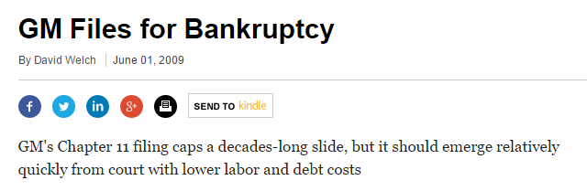


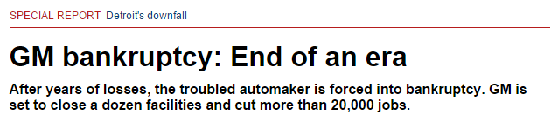

Shift the Narrative

Slide 54
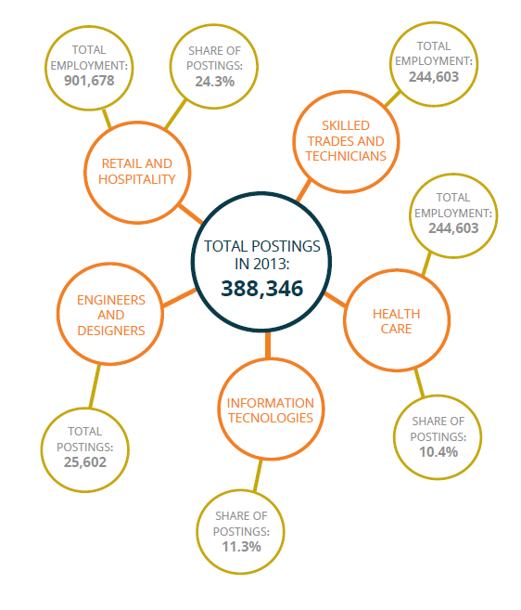

Shift the Narrative

Slide 55

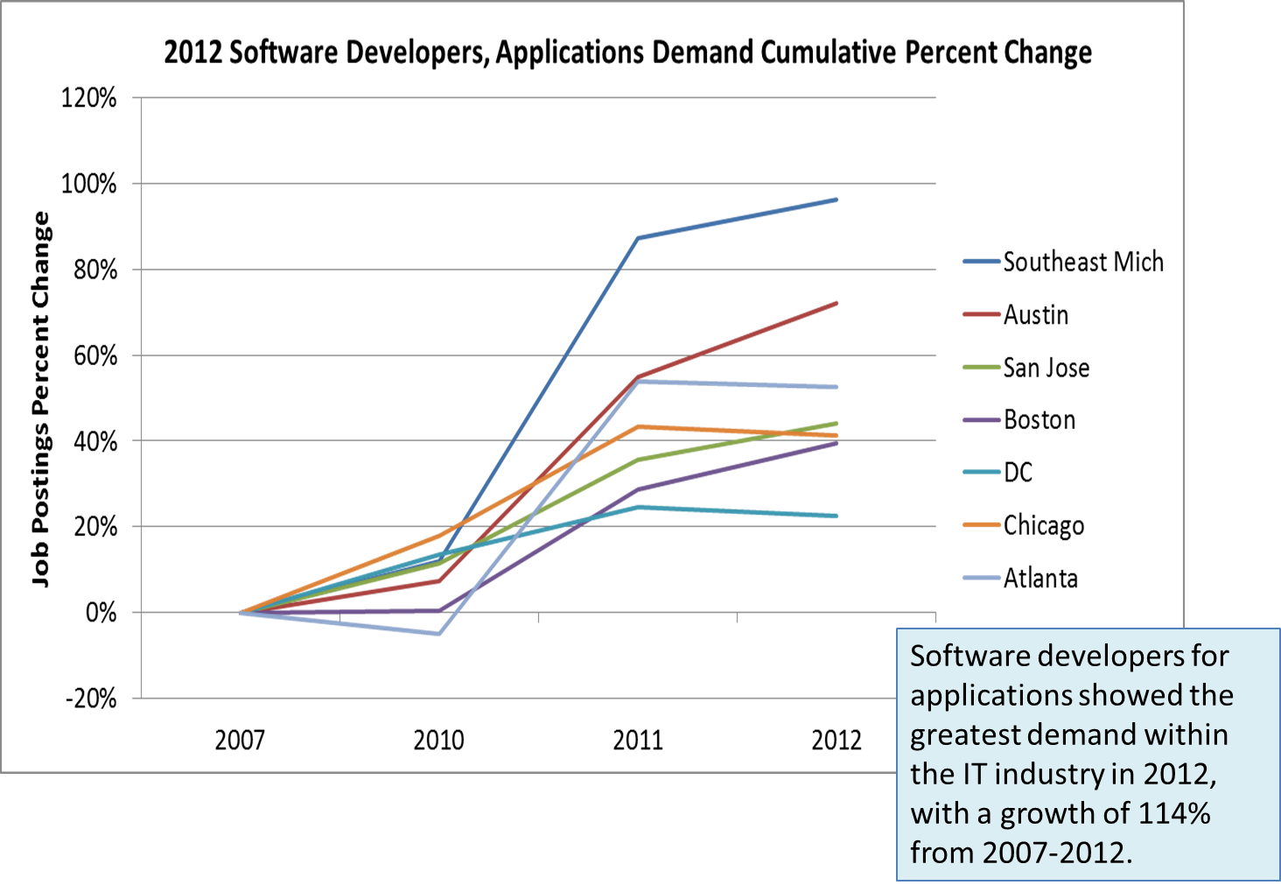
Shift the Narrative

Slide 56
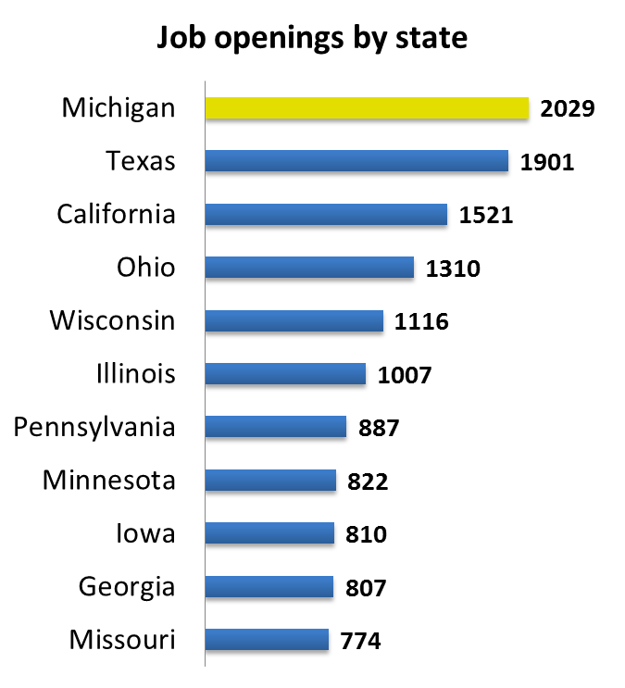
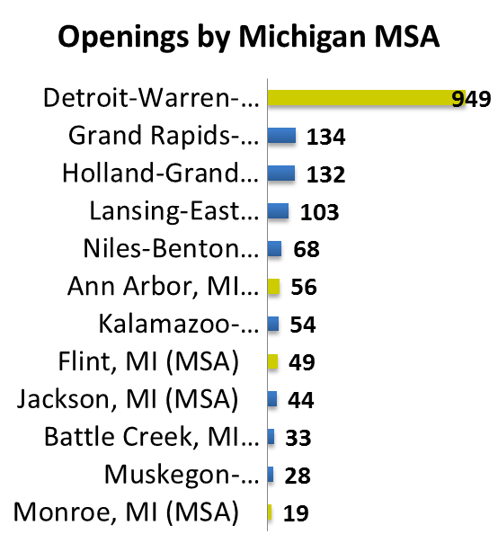
Make Better Investments
Job openings in skilled trades
(Feb 9-May 9, 2012)

Slide 57
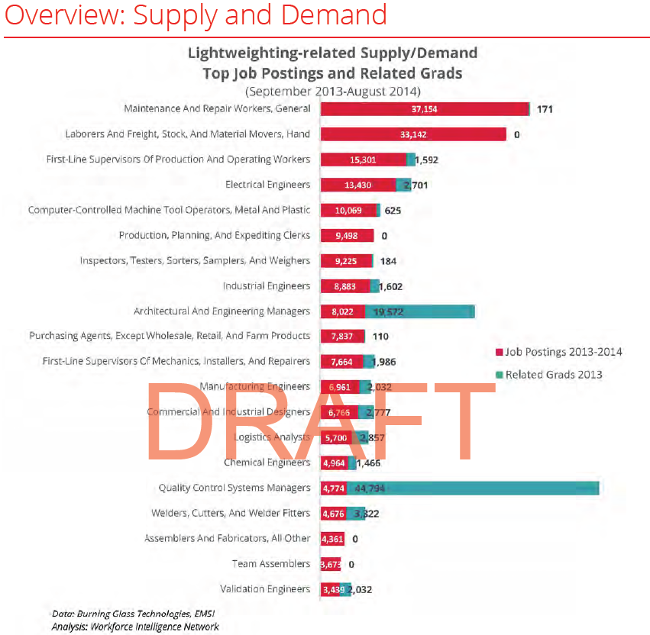
Make Better Investments

Slide 58
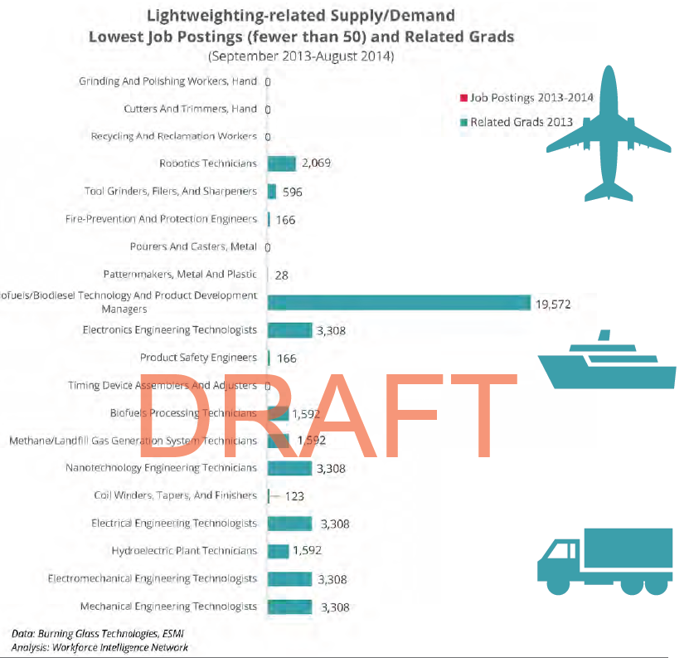
Make Better Investments

Slide 59
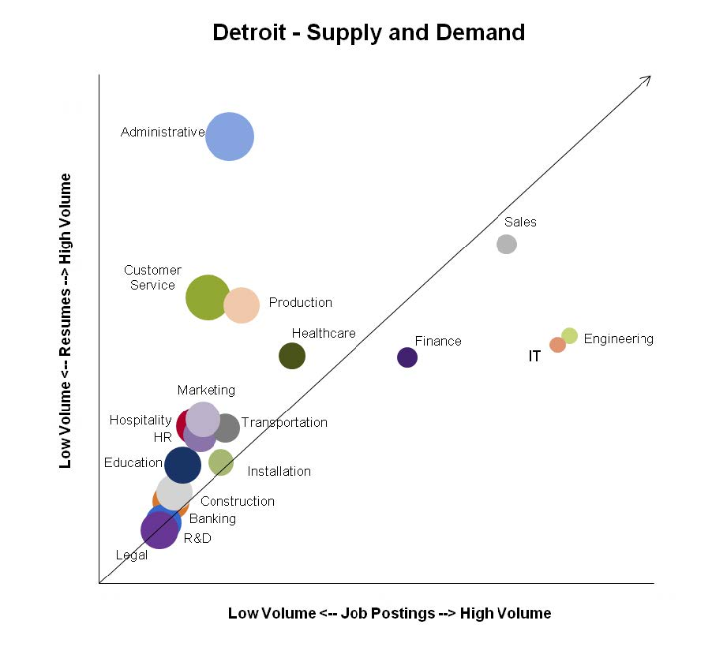

Talk to the Right People

Slide 60
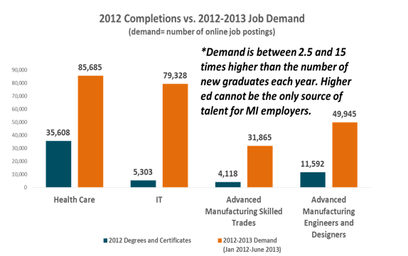
Improve Policy through Evidence

Slide 61
Improve Policy through Evidence
60%
40%

Slide 62
Improve Policy through Evidence
In the United States, every day there are 10,000 new baby boomers who reach retirement age….

Slide 63

Improve Policy through Evidence
This will be the case every day
for the next 16 years.

Slide 64
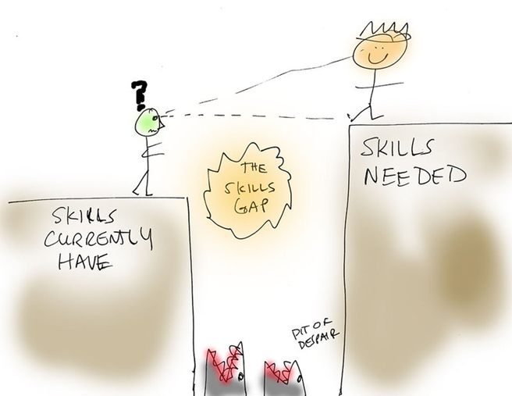
Improve Policy through Evidence

Slide 65
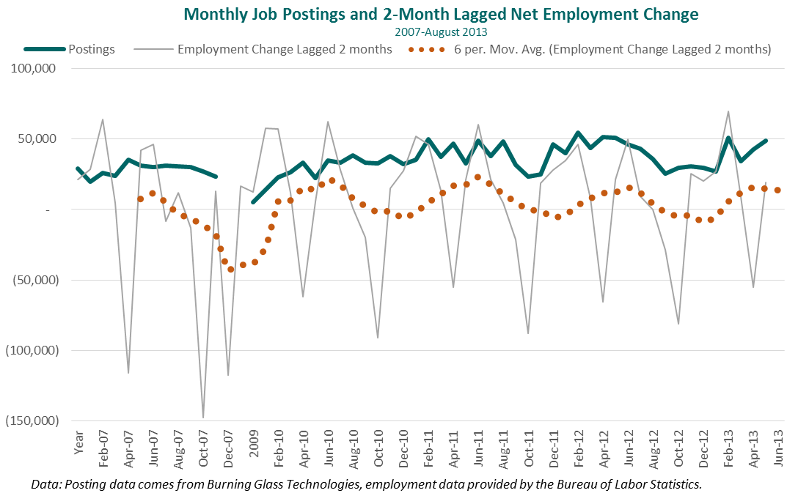
Predict the Future

Slide 66


WEBSITE: win-semich.org
EMAIL: Lisa.Katz@win-semich.org
Thank You!

Slide 67
Discussion/Q&A

Slide 68

Summary
RT LMI supplements more established forms of LMI
RT LMI makes analysis of employment demand easier
RT LMI is influenced by the realities of online job posting practices
Someone with a strong background in LMI and data analysis needs to be on the team using this data for analysis
Understand the strengths and intended uses of each vendor’s products when selecting a vendor of RT LMI
Investigate purchase as a collaborative effort with a consortium or network
Speak to other states, local areas, and other entities to understand how they use RT LMI

Slide 69

DISCUSSION: What would you like to learn more about in a future real-time LMI virtual learning event?

Slide 70

Stay Tuned for Upcoming Events!
Virtual peer learning exchange planned for Spring 2015
NAWB Forum workshop
  March 28-31, 2015; workshop date TBD in late February

Slide 71

Resources
ETA LMI Win-Win Network Community of Practice
  https://winwin.workforce3one.org/
New York City Labor Market Information Service
  http://www.gc.cuny.edu/lmis
Jobs for the Future
  www.jff.org
Oregon Employment Department Workforce and Economic Research Division
  https://www.qualityinfo.org/home
Southeast Michigan Workforce Intelligence Network
  http://www.win-semich.org/

Slide 72

Speakers’ Contact Information
Pam Frugoli
O*NET/Competency Assessment Team Lead
USDOL-ETA
Frugoli.pam@dol.gov
Jeremy Kelley
Senior Project Manager
Jobs for the Future
jkelley@jff.org
Lauren Fairley
ETA Project Manager
USDOL-ETA
Fairley.lauren@dol.gov
Nick Beleiciks
State Employment Economist
Oregon Employment Dept.
Nick.J.Beleiciks@oregon.gov
Ronnie Kauder
Senior Research Director
New York City Labor Market Information Service,
CUNY Graduate Center
rkauder@gc.cuny.edu
Lisa Baragar Katz
Executive Director
Workforce Intelligence Network for Southeast Michigan
lisa.katz@win-semich.org

Slide 73
Thank You!
Please feel free to continue to contribute in the Chat Room. We will leave it open for the next 15 minutes and welcome and value your input!
Find resources for workforce system success at:
www.workforce3one.org

