Slide 1
Federal Student Financial Aid for Apprentices
Webinar Date: March 3, 2015
Presented by:
Office of Apprenticeship
U.S. Department of Labor
Employment and Training Administration

Slide 2
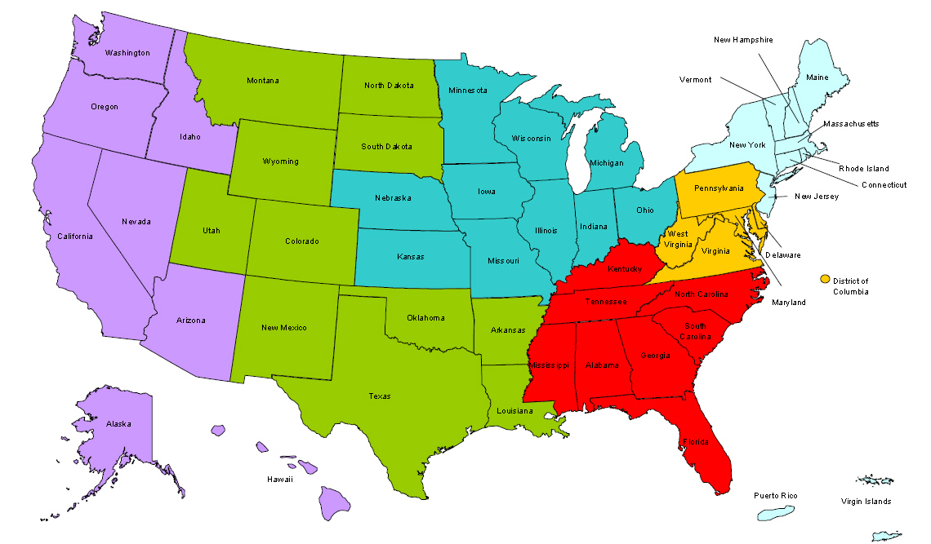
Where are you?
Enter your location in the Chat window – lower left of screen

Slide 3
Here’s what you can expect to get out of today’s webinar!
✓ Learn about new tools that provide step-by-step actions to help apprentices pay for tuition.
✓ Learn how and where you can get assistance to start providing work-study for apprentices.

Slide 4
Polling Question
What organization do you represent?
Business/Industry
State Workforce Agency or State Workforce Board
Local Workforce Agency or Local Workforce Board
American Job Center
Educational Institution
State Registered Apprenticeship
Other (please enter in the chat)

Slide 5
Polling Question
Do you have a relationship with a Registered Apprenticeship program?
Yes (please share more details in the chat)
No

Slide 6
Welcome and Opening Remarks
John Ladd
Administrator, Office of Apprenticeship
Employment and Training Administration, U.S. Department of Labor
Mark Mitsui
Deputy Assistant Secretary for Community Colleges
Office of Career, Technical and Adult Education, U.S. Department of Education
David Musser
Program Specialist, Policy Liaison and Implementation, Federal Student Aid, U.S. Department of Education
Mitchell Harp
Director of Apprenticeships
Trident Technical College, Charleston, SC

Slide 7
Agenda
Department of Education and Labor Collaboration
Overview of Federal Student Aid
Apprenticeships as Part of Eligible Programs
Federal Work Study for Apprenticeship Wages
The Job Location and Development (JLD) Program
How it works in South Carolina: Trident Technical College, Charleston, SC

Slide 8
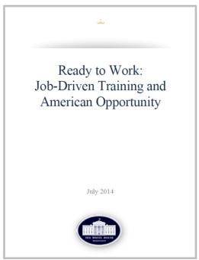
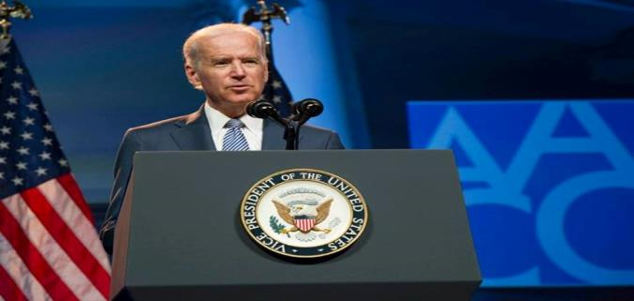
A Transformational Year for Apprenticeship
Tonight, I'm also asking more businesses to follow the lead of companies like CVS and UPS, and offer more educational benefits and paid apprenticeships -- opportunities that give workers the chance to earn higher-paying jobs even if they don't have a higher education.
– President Obama, State of the Union Address, January 20, 2015
Vice President Biden (AACC Conference) on April 7, 2014 , announcing the launch of the RACC.
American Apprenticeship Grants
$100 Million

Slide 9
President’s Challenge: Doubling the Number of Apprentices

Slide 10
Emerging growth in Registered Apprenticeship across new and emerging growth industries.
Energy
Healthcare
TDL
Manufacturing
ICT

Slide 11
Registered Apprenticeship is a proven model that delivers results for workers and the nation.
Impressive Public Benefits
$28 in benefits for every $1 invested by Government*
Strong Outcomes
Completers earn approximately $50,000 per year
87% of completers employed
Opportunities to earn college credit
Over $300,000 more than their peers in life-time earnings
OUTCOMES AND RESULTS
*(Source: An Effectiveness Assessment and Cost-Benefit Analysis of Registered
Apprenticeship in 10 States, Mathematica Policy Research, 2012)

Slide 12
ApprenticeshipUSA
LEADERS
Sectors of Excellence in Apprenticeship
Organizations and leaders in advocating and supporting growth of Registered Apprenticeship across the US.
Supporting Registered Apprenticeship growth in targeted sectors.
Build specific experience and expertise regionally but available nationally.

Slide 13
Leaders of Excellence in Apprenticeship Development, Education and Research - LEADERs
Nationally, DOL will recruit Leading Companies and Intermediaries to serve as LEADERs.
Promote Apprenticeship and Engage Industry Leaders in Adopting Apprenticeship to Train workers particularly in new industries.
Pilot Innovative new models and approaches:
Innovative Apprenticeship program designs;
Leaders in system alignment (workforce, education, and economic development systems)
Strategies to support increasing opportunities for under-represented populations.

Slide 14
Department of Education and Labor Collaboration
American Apprenticeship Grant Competition
Registered Apprenticeship – College Consortium (RACC)
http://doleta.gov/oa/racc.cfm
Federal Resources Playbook for Registered Apprenticeship

Slide 15
Federal Student Aid Overview

Slide 16
Types of Federal Student Aid
“Federal student aid” is financial assistance provided to postsecondary students under Title IV of the Higher Education Act of 1965. Federal student aid includes:
Pell Grants
Supplemental Educational Opportunity Grants
Direct Loans (Subsidized and Unsubsidized)
Perkins Loans
Work Study

Slide 17
Student Eligibility
A student’s eligibility is based on his/her family’s financial resources (called the “estimated family contribution), as determined by the Free Application for Federal Student Aid (FAFSA)
Filling out the FAFSA is the first step to becoming eligible for aid
Once a student completes the FAFSA, his/her postsecondary institution must determine the amount of aid for which the student is eligible

Slide 18
Financial Need
The most important factor in the calculation of a student’s aid is “financial need,” which is determined using the following calculation:
* “Estimated Financial Assistance” refers to Federal student aid, as well as grants, scholarships, loans, and need-based employment
Cost of Attendance
Estimated Family Contribution
Estimated Financial Assistance*
Financial Need

Slide 19
Apprenticeships as Part of Eligible Programs

Slide 20
Apprenticeships as Part of Eligible Programs
If apprenticeship training or employment is part of an eligible postsecondary program, eligible enrolled students may receive Federal student aid for the entire program, including for the apprenticeship portion
For students to receive Federal student aid, the educational program that incorporates the apprenticeship portion must also be eligible

Slide 21
Requirements for Eligible Programs
An eligible program must lead to a degree, diploma, certificate, or other recognized credential awarded by the postsecondary institution
The program must satisfy all State and accrediting agency requirements and must also meet certain program length requirements, including both weeks of instructional time and credit or clock hours

Slide 22
Limitations on Apprenticeship Portion of Program
Except as may be required by the institution's accrediting agency or state, there are no limits on the apprenticeship portion of the program, as long as the training is provided by the institution
If an entity other than the institution provides the apprenticeship portion, that component must be:
25 percent of the program or less; or
With specific permission from the institution's accrediting agency, over 25 percent but less than 50 percent of the program

Slide 23
Federal Work Study for Apprenticeship Wages

Slide 24
Federal Work Study Program
The Federal Work Study (FWS) program provides support for postsecondary students’ employment to help them meet the costs of postsecondary education
In order for a student to receive wages under the FWS program, the student must have financial need

Slide 25
FWS Allocations
Each year, a participating institution applies for funding and receives a FWS allocation from the Federal government
Using a statutory formula, the Department of Education allocates funds based on the institution’s previous funding level and the aggregate need of eligible students in attendance in the prior year
The institution must distribute its FWS allocation fairly among all eligible students

Slide 26
Types of FWS Employers
Under the FWS program, a student may be employed at:
The institution at which the student is enrolled;
A Federal, State, or local public agency or a private nonprofit organization; or
A private for-profit organization
In all cases, the participating institution must sign an agreement with the employer

Slide 27
Requirements for FWS Employers
Institutional employment or employment at a private for-profit organization:
Employment at a government agency or a nonprofit organization:
The student’s work must be in the public interest
To the maximum extent possible, the student’s work must complement and reinforce the educational program or vocational goals of the student

Slide 28
FWS Matching Requirements
Generally, FWS wages require an institutional “match.” The required amount of the match depends on the type of employer:
Employment at the institution, a government agency, or a nonprofit organization: employer must match at least 25% of wages
Employment at a private for-profit organization: employer must match at least 50% of wages
In limited circumstances, there are reduced matching requirements

Slide 29
FWS Matching Requirements
An institution may only use up to 25% of its total FWS Federal allocation to pay FWS wages for students employed by private for-profit organizations
NOTE: The institution or the outside employer may choose to provide more than the minimum required nonfederal share
For example, if a student’s FWS wages were $5,000, the for-profit employer MUST pay $2,500 of those wages, but could choose to pay more (e.g. $3,500 or $4,500)

Slide 30
FWS and Financial Need
In most cases, a student’s annual income influences the calculation of the student’s estimated family contribution in the following year. Greater income could lead to less aid eligibility
However, wages paid under the FWS program are not used in determining the student’s eligibility for Federal student aid in the following year

Slide 31
Job Location and Development Program

Slide 32
Job Location and Development Program
Under the Job Location and Development (JLD) Program, an institution may use a portion of its FWS allocation to establish or expand a program that locates and develops off-campus job opportunities for its enrolled students
This may include identifying or helping employers develop jobs that are part of apprenticeship programs, regardless of whether the students are recipients of Federal student aid

Slide 33
Use of JLD Funds
An institution may use up to 10% of its FWS allocation, but no more than $75,000, to support its JLD program
The institution must use FWS funds to pay up to 80% of the allowable costs for the JLD program. The remaining 20% is provided by the institution either in cash or in services
The institution is expected to generate jobs that result in student earnings that exceed the total amount of spent under JLD

Slide 34
JLD Agreements Among Multiple Institutions
Multiple institutions may enter into written agreements to establish, fund, and operate a JLD program for students enrolled at those institutions
Such agreements would allow those institutions to combine available JLD funds and resources

Slide 36
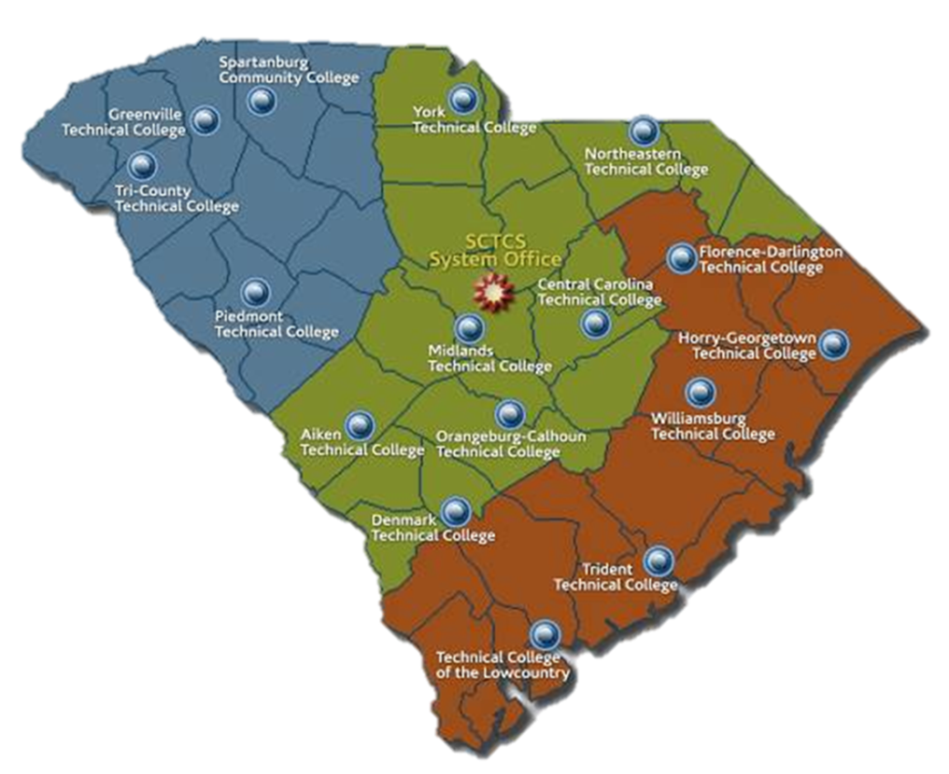
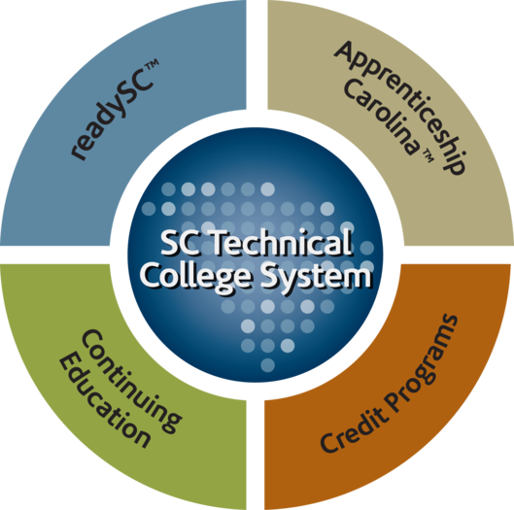
South Carolina Technical College System

Slide 37
Apprenticeship Office
Established in 2007 to assist and educate local companies on how they can partner with Trident Technical College and develop their own United States Department of Labor Registered Apprenticeship program.

Slide 38
How Does TTC Assist?
Educate companies on how to start their own apprenticeship
Introduce them to partners who can assist registering their program with U.S. Department of Labor
Serve as One point-of-contact
Register employees for classes
5. Explain how to reduce tuition costs
Pell Grants
State Lottery
Tax Credits
Communication on employees progress (attendance/grades)
Customize programs to meet company’s needs.

Slide 39
Financial Aid Assistance
Sit down with company apprentices and explain documentation required to fill out FAFSA
Social Security Number
Alien Registration Number (if you are not a U.S. citizen)
Most recent federal income tax returns, W-2s, and other records of money earned.
Bank statements and records of investments (if applicable)
Records of untaxed income (if applicable)
A Federal Student Aid PIN to sign electronically
Connect apprentice with a financial aid representative to assist or inform them they can complete online by themselves

Slide 40
Third Party Billing
All third party billing is completed after the first drop/add period of the semester
Finance generates one consolidated bill after all financial aid has been applied which includes:
Bookstore charges
Tuition
Other fees/charges

Slide 42
Polling Question
Would you be willing to provide a work/study program for apprentices at your college?
Yes
No

Slide 43
Please enter your questions in the Chat Room!

Slide 44
Additional Resources
Dear Colleague Letter GEN 14-22: Apprenticeships and the Federal Student Aid Programs
https://ifap.ed.gov/dpcletters/GEN1422.html
The Federal Resources Playbook for Registered Apprenticeship
http://www.doleta.gov/oa/federalresources/ playbook.pdf
A Quick-Start Toolkit: Building Registered Apprenticeship Programs
http://www.doleta.gov/oa/employers/ apprenticeship_toolkit.pdf

Slide 45
Contact Information
Questions on apprenticeships as part of eligible programs
Office of Career, Technical, and Adult Education: OCTAE@ed.gov
Questions on FWS and JLD
Federal Student Aid, Campus Based Call Center: CBFOB@ed.gov

