Slide 1
WIOA Vision Webinar
March 4, 2015
U.S. Department of Labor
U.S. Department of Education
U.S. Department of Health and Human Services

Slide 2
Presenter
Portia Wu
Assistant Secretary
Employment and Training Administration
U.S. Department of Labor
Have a question or comment about WIOA? E-mail DOL.WIOA@dol.gov
2

Slide 3
WIOA Vision
Needs of business and workers drive workforce solutions.
One-Stop Centers provide excellent customer service and focus on continuous improvement.
The workforce system supports strong regional economies and plays an active role in community and workforce development.

Slide 4
WIOA Changes the System
WIOA is customer-focused, placing job seekers and businesses at the center of the workforce system.
4

Slide 5
TEGL 19-14 WIOA Vision
In February 2015, the TEGL - Vision for the Workforce System and Initial Implementation of the Workforce Innovation and Opportunity Act of 2014 was issued, and provided guidance on:
Actions State and local workforce leaders can take to support successful implementation.
Following the initial guidance on the availability of 2% transition funding (TEGL 12-14).
The vision for a revitalized, transformed workforce system.
The new “WIOA Collection Page” at wioa.workforce3one.org
Follow this link to the Vision TEGL http://wdr.doleta.gov/directives/corr_doc.cfm?DOCN=7353
Adult Education and Vocation Rehabilitation will provide complementary documents soon.

Slide 6
Taking Action
Initial State & Local Implementation Activities
Developing goals and a vision for the workforce system in the State, including the One-Stop center delivery system.
Identifying and allocating funding for the transition.
Assessing the system’s ability to meet new statutory requirements.
Developing and carrying out transition plans that include provisions for fiscal and program changes across legislations.
Ensuring proper partnerships are in place.
Beginning the strategic planning process for State, local, and regional plans.

Slide 7
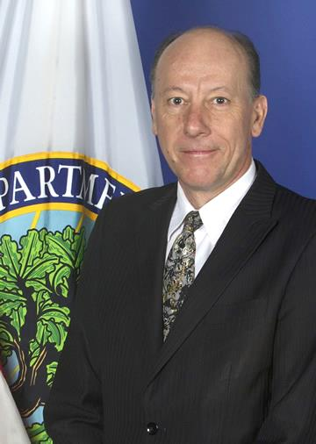
Presenter
Johan Uvin
Acting Assistant Secretary
Office of Career, Technical, and Adult Education, U.S. Department of Education
Have a question or comment about WIOA? E-mail DOL.WIOA@dol.gov
7

Slide 8
Changes to AEFLA
Emphasizes transition to postsecondary education and training, including through use of career pathways
Focuses education on college and career readiness, evidence based instruction and teacher preparation
Strengthens alignment of adult education with one stop delivery system
Provides new opportunities for immigrant integration and reentry for incarcerated

Slide 9
Taking Action
Build and strengthen partnerships
Develop transition plans
Reassess the role of adult education in one-stop delivery system
Explore connections to serve out of school youth

Slide 10
Presenter
Janet Le Breck
Commissioner of Rehabilitation Services Administration, U.S. Department of Education
Have a question or comment about WIOA? E-mail DOL.WIOA@dol.gov
10

Slide 11
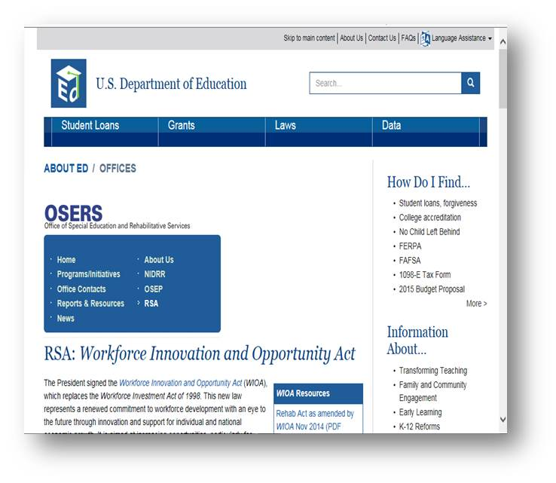
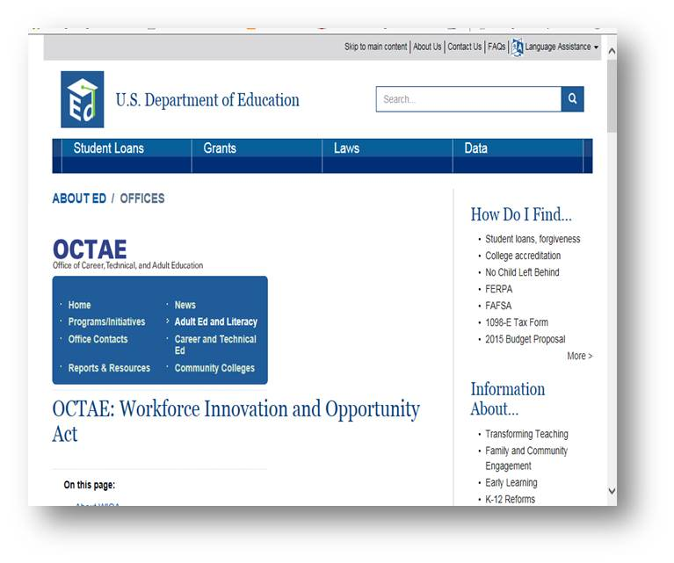
EDUCATION WIOA Websites
OCTAE- http://www2.ed.gov/about/offices/list/ovae/piAdultEd/wioa-reauthorization.html
OSERS- http://www2.ed.gov/about/offices/list/osers/rsa/wioa-reauthorization.html

Slide 12
Presenter
Mark Greenberg
Acting Assistant Secretary
Administration for Children and Families,
U.S. Department of Health and Human Services
Have a question or comment about WIOA? E-mail DOL.WIOA@dol.gov
12

Slide 13
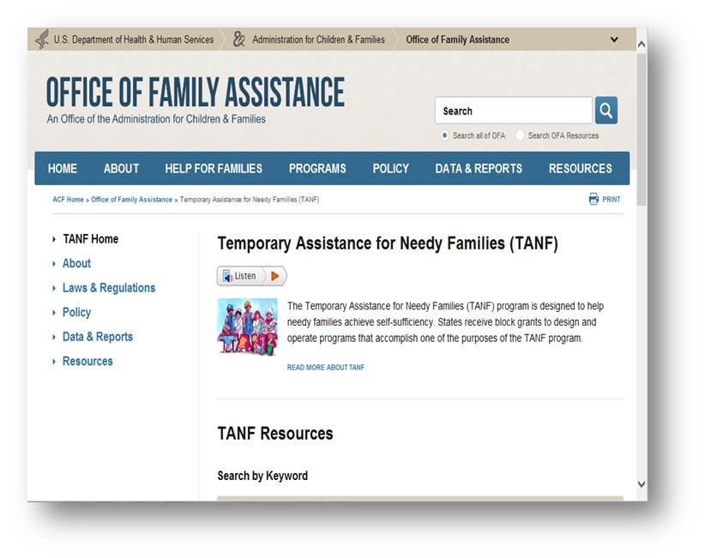
HHS WIOA Website
http://www.acf.hhs.gov/programs/ofa/programs/tanf

Slide 14
Poll Question # 1
Do you feel that the federal partners are delivering a consistent partnership message “to act now” to the states and locals?
Agree
Disagree

Slide 15
Regulations
5 Notices of Proposed Rulemaking (NPRMs) will be issued in early 2015.
Labor and Education will release a joint NPRM that will cover State planning, performance, and the One-Stop system.
Another NPRM will cover the DOL-administered programs and provisions.
The Department of Education will also issue three NPRMs covering its administered programs authorized or amended by WIOA.
The public will have an opportunity to comment on the NPRMs.
Final Regulations will be published in early 2016.
NPRMs

Slide 16
Guidance
In Spring 2015, the ETA will issue operational guidance through a series of Training and Employment Guidance Letters (TEGL):
The operational guidance will be issued steadily over several months
It will convey our current thinking on the implementation of WIOA statutory requirements and the overall intent of changes under WIOA.
Training and Employment Guidance Letters (TEGL)

Slide 17
Poll Question # 2
As a state and/or local area where do you consider yourself to be on WIOA Partnership development/implementation? (Scale of 1 -5 ?)

Slide 18
Technical Assistance
Labor, Education and Health and Human Services are gathering additional stakeholder input for guidance development and to address technical assistance needs for WIOA implementation.
Technical assistance tools and resources are being considered, such as webinars, regional events, and conferences.
Fact Sheets will be developed to address WIOA implementation topics and help board members and stakeholders better understand the law’s opportunities and provisions.

Slide 19
Technical Assistance
Planning robust technical assistance strategies on various topics.
ETA will collaborate with intergovernmental partners to align technical assistance.
More details are coming soon, visit www.doleta.gov/WIOA.
Transition
Change Management
Strategic Boards
One-Stop Service Design
Voices of
Experience

Slide 20
Poll Question # 3
What are your WIOA technical assistance priority needs?

Slide 21
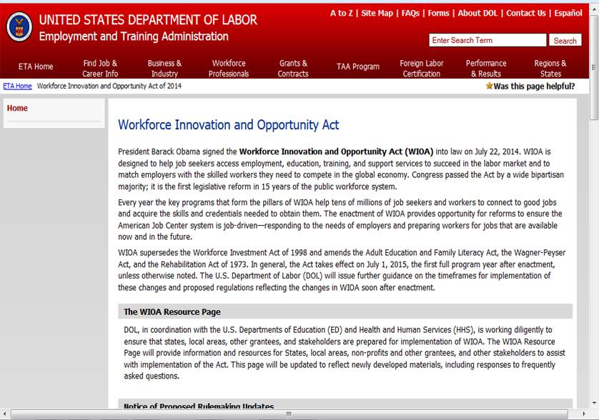
Labor WIOA Website
http://www.doleta.gov/WIOA/

Slide 22
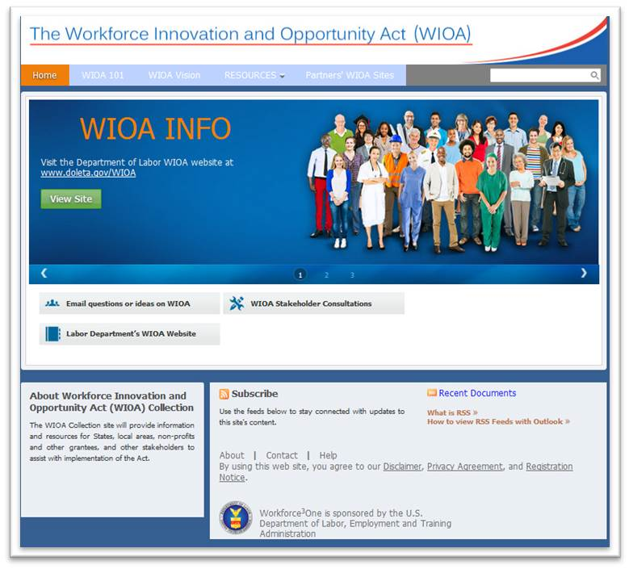
Labor WIOA Collection Site
wioa.workforce3one.org
The WIOA Collection site provides information and resources for States, local areas, grantees, and other stakeholders to assist with WIOA implementation.

Slide 23
Questions/Comments
Have a question about WIOA implementation?

