Slide 1
Overview of SkillsCommons.org v 1.0
Gerry Hanley, Dave Walker,
Rick Lumadue & Marla Gunasegaram
California State University
MERLOT

Slide 2
Led by DOL, the TAACCCT Learning Network includes:
Jobs for the Future (JFF) for comprehensive technical assistance, with Maher & Maher and American Association of Community Colleges
CalState/Merlot for SkillsCommons.org, working in collaboration with Creative Commons (sharing and licensing) and CAST (Universal Design for Learning)
National Science Foundation, Advanced Technological Education Centers for targeted/topical technical assistance
TLN technical assistance takes many forms:
Virtual events (e.g., webinars, conference calls) and in-person events
Peer mentoring
Tools and resources
How to find us:
Find TLN resources on ETA Grantees (click on TAACCCT in right column)
Contact DOL and JFF: TAACCCT@dol.gov
Contact CalState/Merlot: support@skillscommons.org
Note: Evaluation support is provided separately through DOL’s Chief Evaluation Office, supported by Urban Institute and Abt Associates. Contact them at TAACCCTeval@urban.org.

Slide 3
Introduction
Learn about the purposes of SkillsCommons.org
Learn how to use SkillsCommons.org through our demonstration
Learn about the Support Services Center
Become confident that you will be able to easily contribute your TAACCCT materials to SKillsCommons.org

Slide 4
What is SkillsCommons?
The official repository for TAACCCT OER
Dspace Technology: open source repository system
Hosted on Amazon Cloud
The start of a bigger project
Capture and Preserve
Enable easy & reliable discovery
Demonstrate the adoption of TAACCCT OER
Sustain the TAACCCT OER collection and community of developers and users

Slide 5
Who Are We? Your Partner
Cal State University System – 23 campuses, 450,000 students, 44,000 faculty and staff
Collaboration required & “Working for California”
Digital library services manage about 1 billion digital assets; 8 years experience with D-Space
MERLOT – 17 years in the open library business
Over 500 campuses within consortium – many community colleges
46,000+ resources and 125,000+ individual members
Over 40 customized services for different communities

Slide 6
SkillsCommons.org - Demo.
http://skillscommons.org

Slide 7
Support Services Center
Contributing Materials
Register as a contributor
Preparing your materials
Develop quality materials
Contribute to SkillsCommons.org
Searching Materials
Learn how to use the search feature

Slide 8
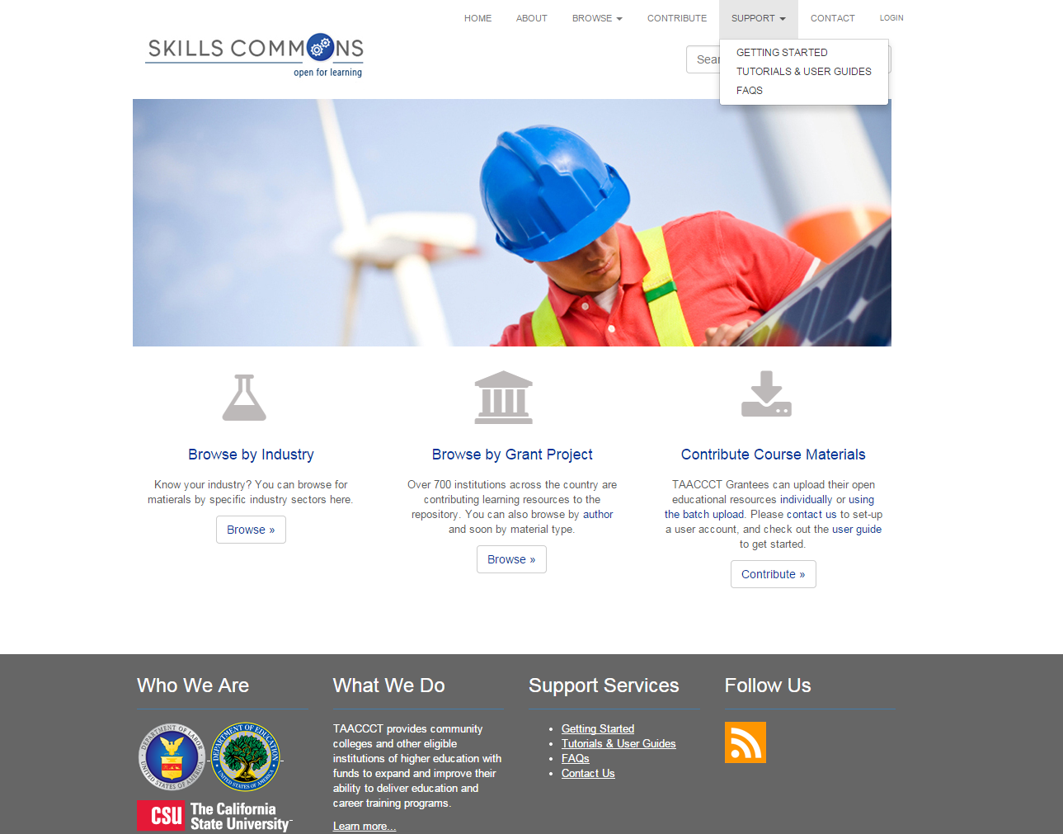
Support Center
Support Services Include:
How To Get Started
Register for an Account
Prepare Your Materials
Tutorials & Guides
How To Prepare
How To Contribute
Learning Resources
Program Support Materials
FAQs
Partner Services

Slide 9
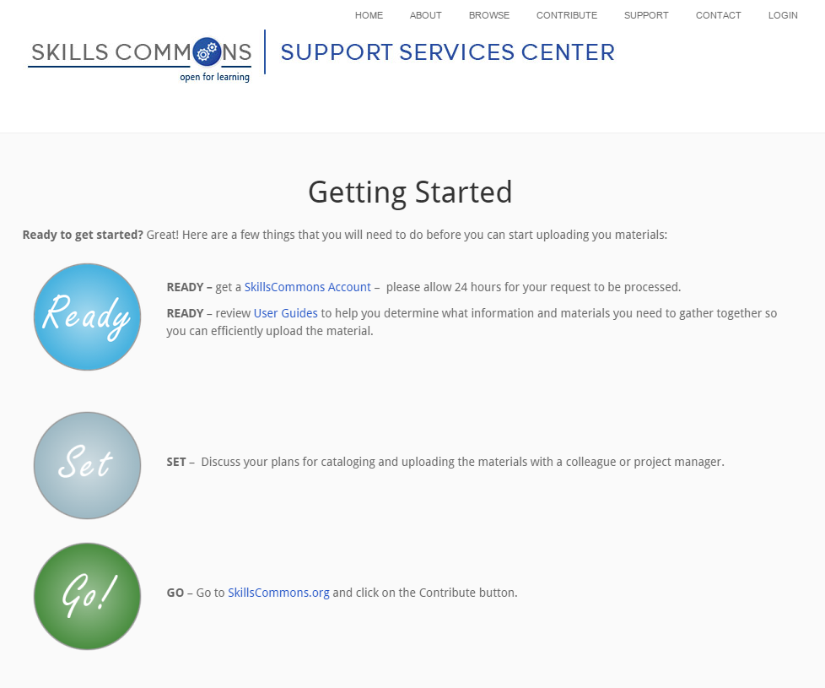
Support Center
Getting Started
Register
Discuss Your Plans
Prepare Your Materials
User Guides & Videos
Start Uploading

Slide 10
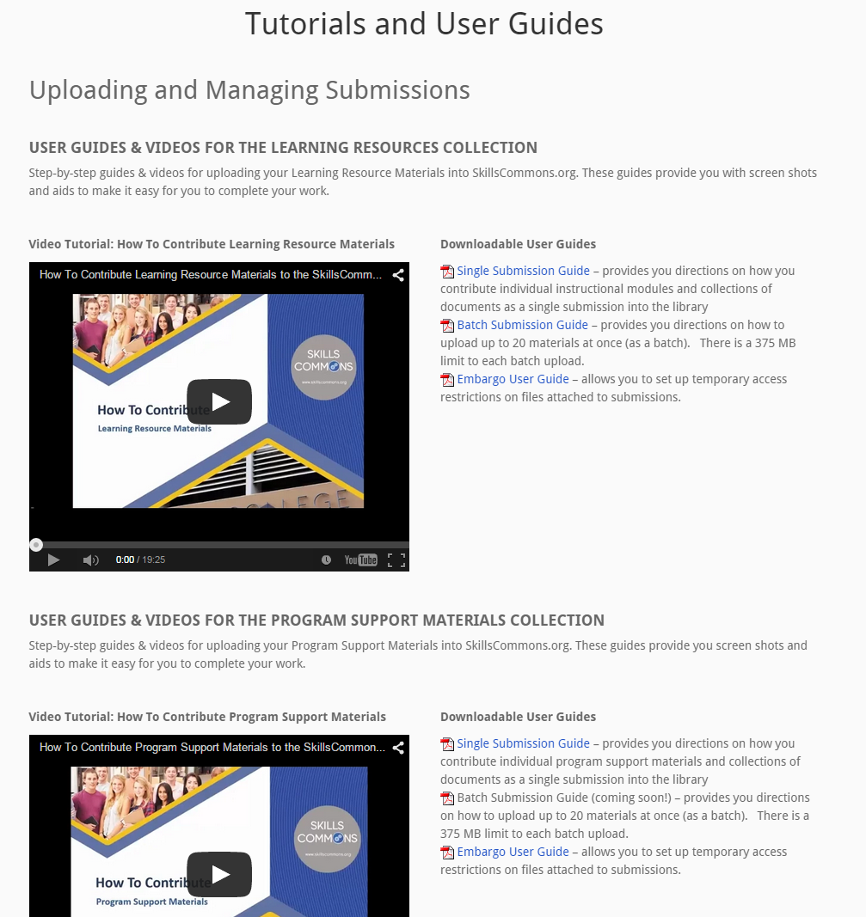
Support Center
Tutorials & User Guides
Learning Resource or Program Support?
Videos & Documentation
Single Submission
Batch Submission
Editing Submissions
Embargo Feature

Slide 11
Support Center
Guidelines & Strategies
Packaging Instructional Content
Enabling Others Reuse
Use Cases
Accessibility Guidelines
Assuring Quality of Resources

Slide 12
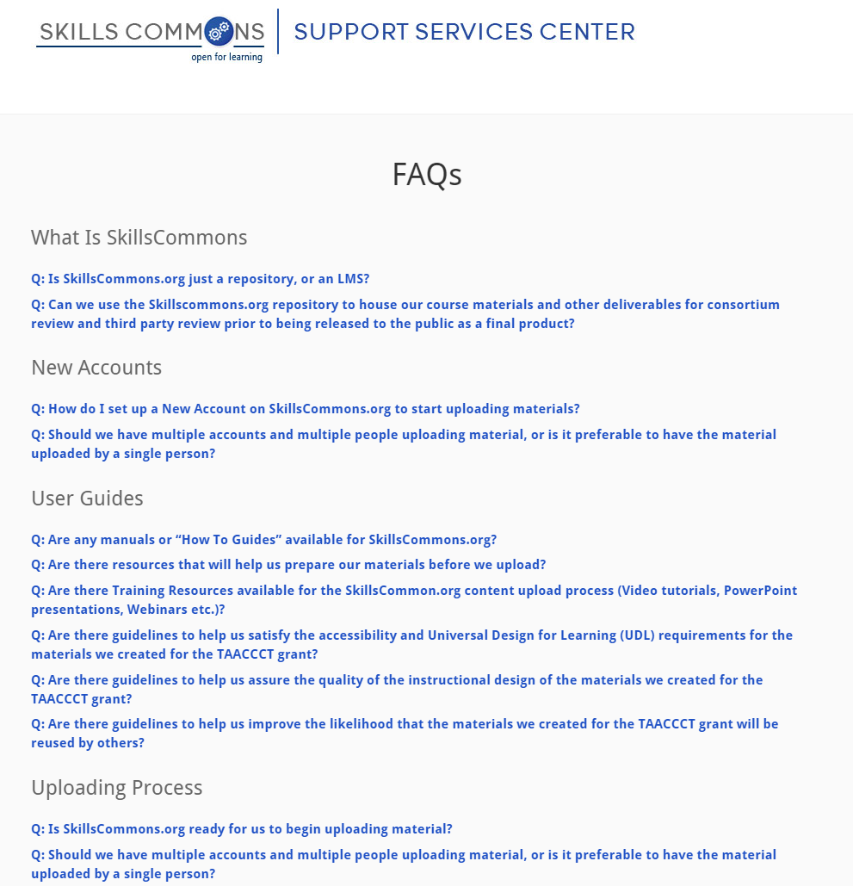
Support Center
FAQs
What Is SkillsCommons
New Accounts
User Guides
Uploading Process
File Types/Sizes
Creative Commons Requirements
FAQs continue to grow as we get helpful feedback and questions from Grantees

Slide 13
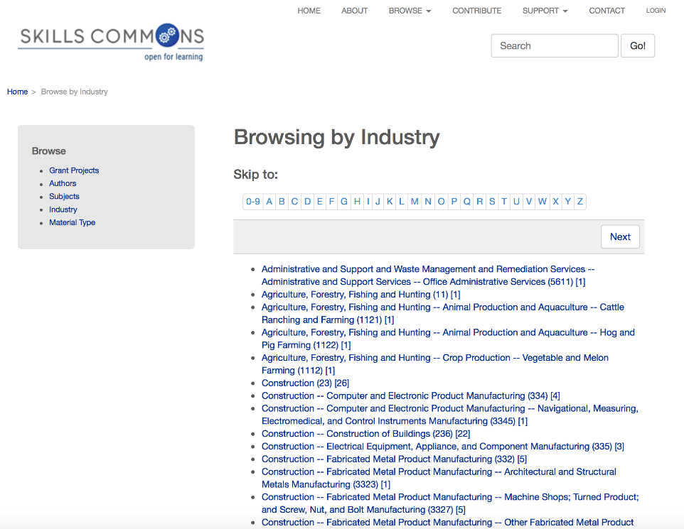
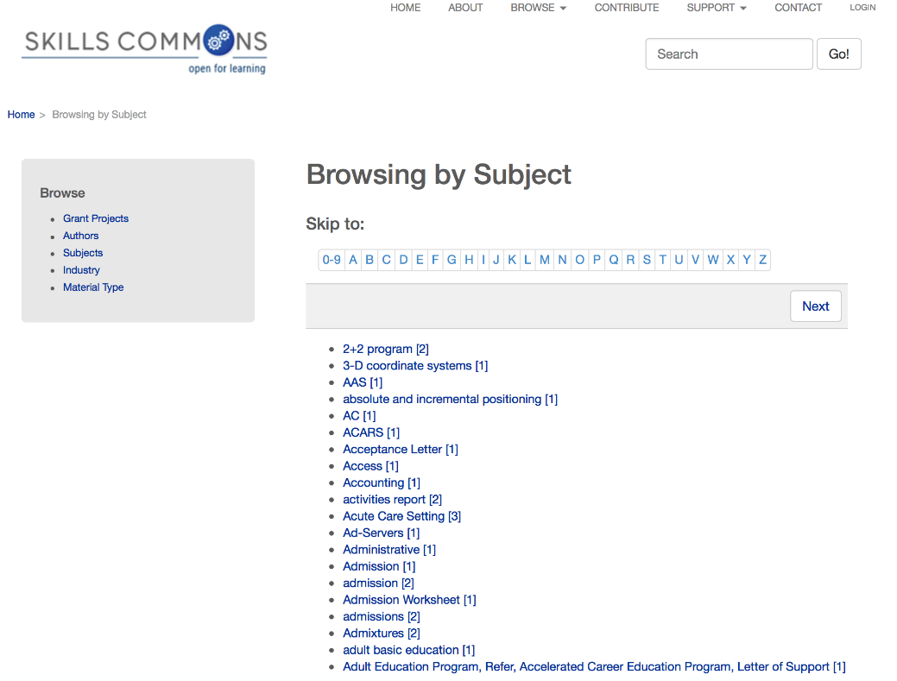
Search for Material
Browse by Industry
Browse by Subject

Slide 14
Contribute materials
Prepare your materials
CC license
Format (esp. audio and video)
Cataloging
Describe the submission
Upload files
Review
Submit

Slide 15
Cataloging considerations
Type of material
Learning resources
Program support materials
Level of contribution
Course
Individual item (e.g., simulation)
Single submission or Batch submission

Slide 16
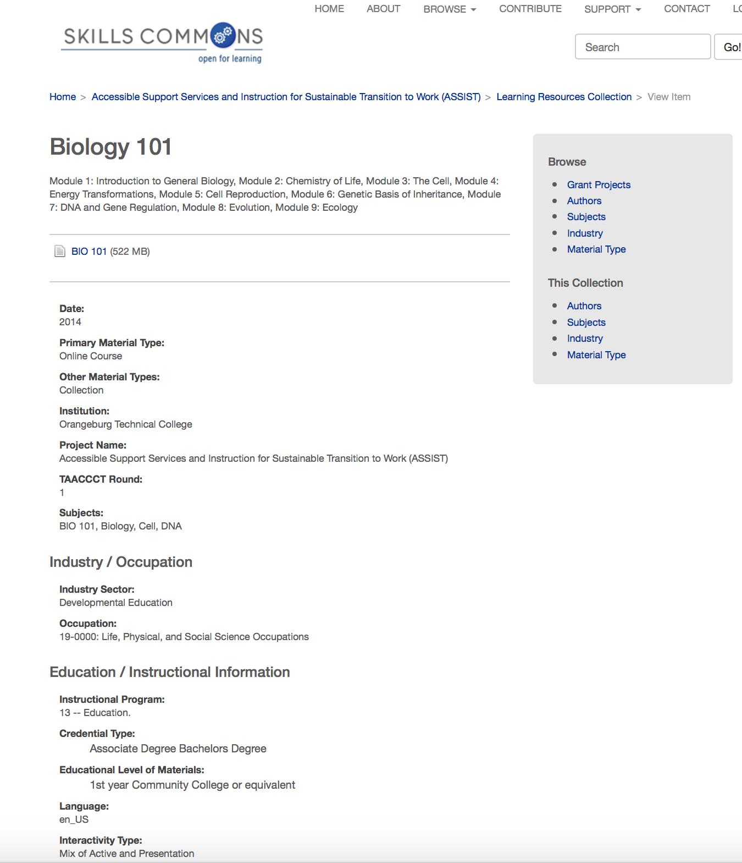

Slide 17
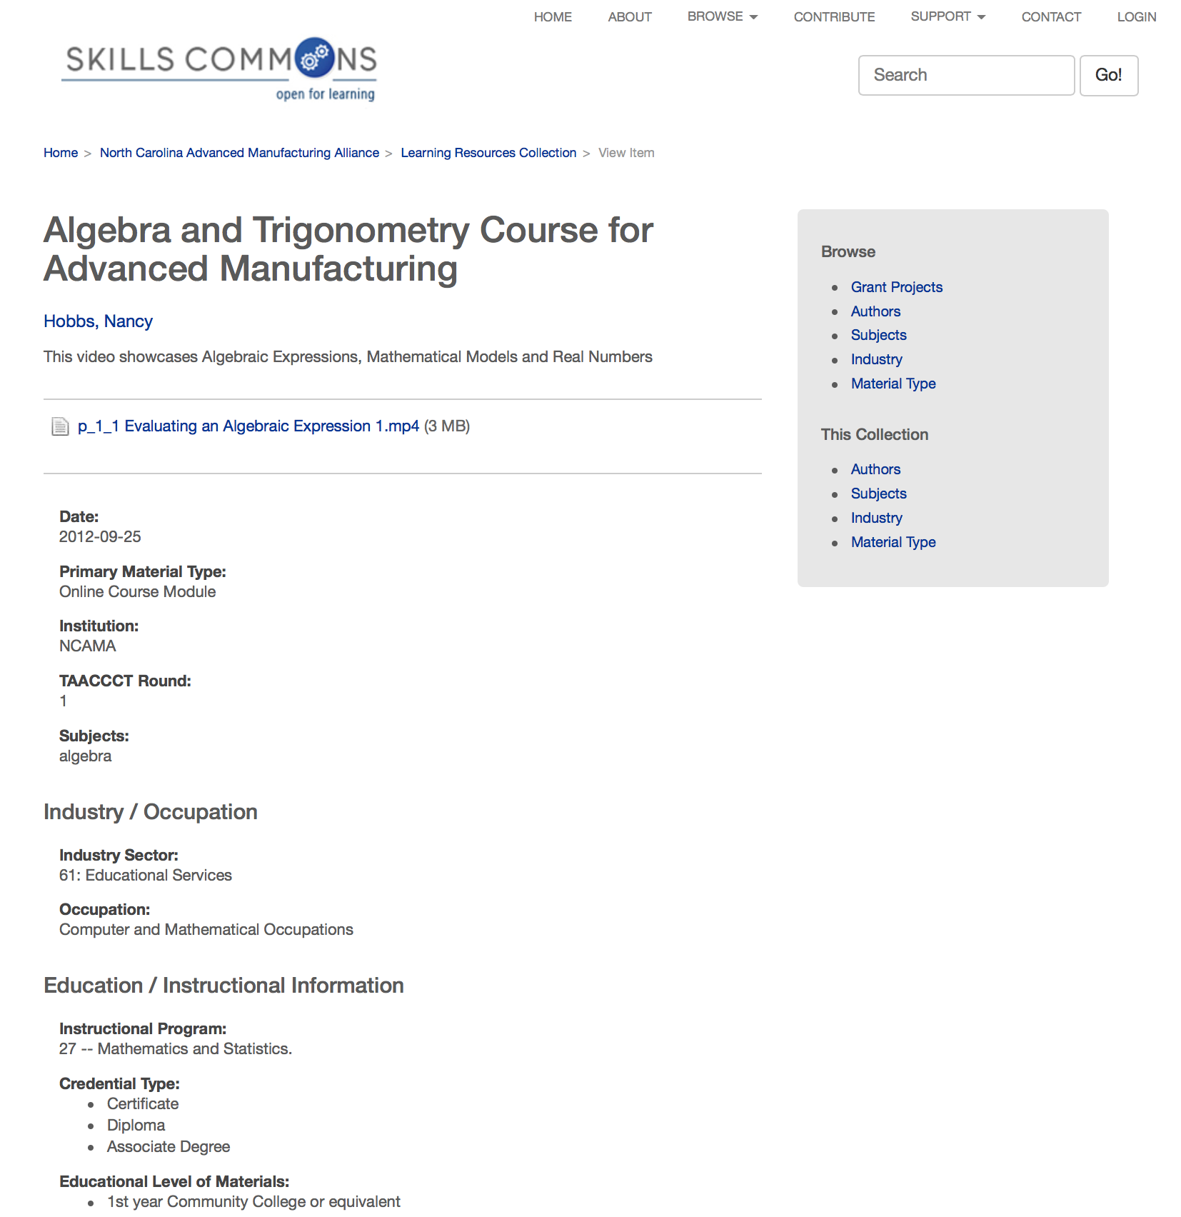

Slide 18
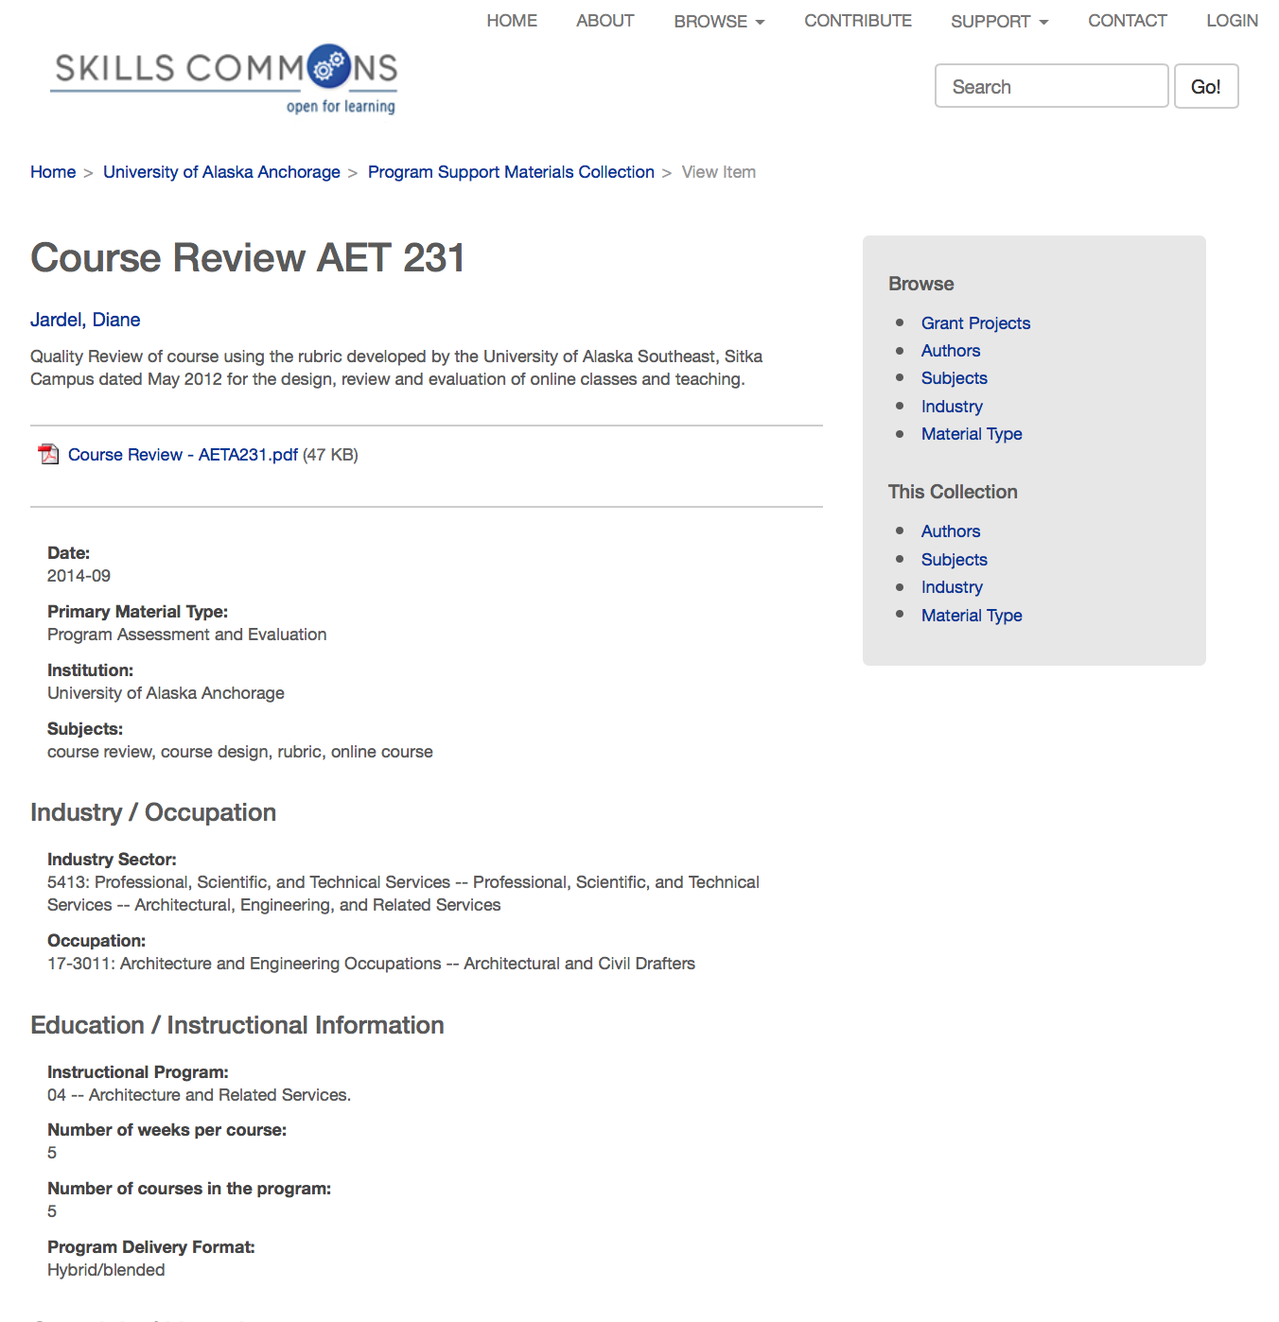

Slide 19
Questions
Gerry Hanley
Assistant Vice Chancellor, Academic Technology Services
Director, SkillsCommons.org
ghanley@calstate.edu
David Walker CSU Director Systemwide Dig. Lib. Services Technology Director, SkillsCommons.org
dwalker@calstate.edu
Rick Lumadue Program Manager and Grantee Relations, SkillsCommons.org rlumadue@calstate.edu
Marla Gunasegaram
Library and user support services and instructional design, SkillsCommons.org
mgunasegaram@calstate.edu

