Slide 1
Enough is Known For Action:
Implementing Work Experience Models for Youth

Slide 2
Today’s Presenters
Tiffani Thomas, Moderator
Office of Discretionary Programs
Employment and Training Administration
U.S. Department of Labor, Region 6
Evan Rosenberg
Office of Workforce Investment
Employment and Training Administration
U.S. Department of Labor
Expert Peer Presenters
Sheilah Goulart – Stockton, California
William Bass – Los Angeles, California
Jamie Bernthal – Madison, Wisconsin

Slide 3
Webinar Context
Enough is Known For Action:
Implementing Work Experience Models for Youth
Second in the webinar series
In response to your requests in our WIOA Consultations!
Title builds on Brandeis Enough Is Known For Action Conference
Materials available at http://cyc.brandeis.edu/Employ-educate-support-youth/EnoughisKnownforAction.html

Slide 4
Learning Objectives for Today
Better understanding of:
The youth unemployment challenge we face
The priority of the new work experience program element under WIOA
Why it is important
How to track work experience expenditures
How to plan for implementing the work experience priority
How the work experience connects to academic and occupational education
How the work experience connects to a career pathway

Slide 5
Implementing Work Experience Models for Youth
Evan Rosenberg
dol.wioa@dol.gov
www.doleta.gov
U.S. Department of Labor
Employment and Training Administration
Division of Youth Services

Slide 6
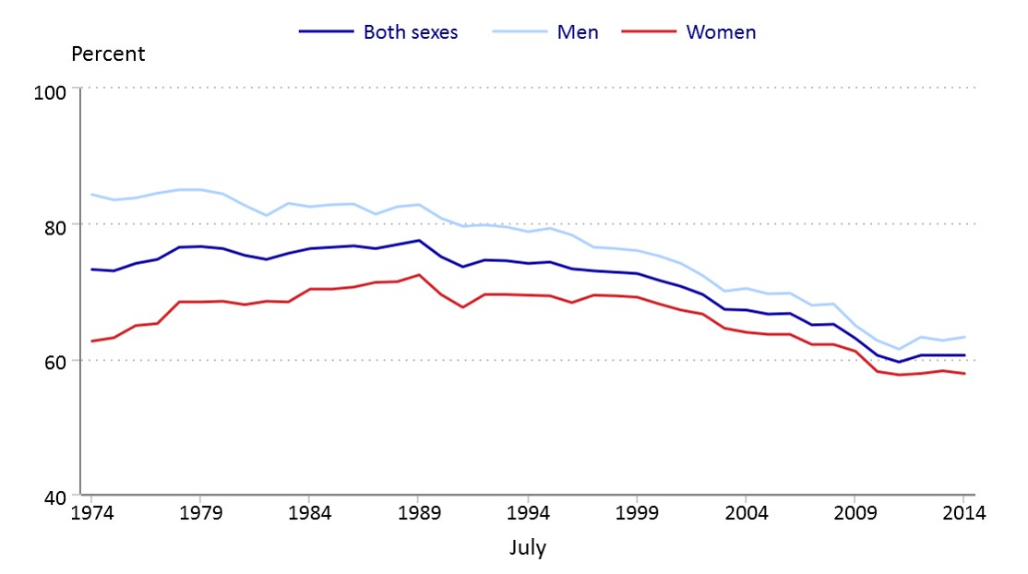
Youth Unemployment Challenge
Youth Summer Labor Force Participation Rates Dropped Sharply Over Last 40 Years
Labor force participation rates of 16- to 24-year-olds in July,
by sex,
not seasonally adjusted,
1974–2014

Slide 7
Youth Unemployment Challenge
Long Term Consequences from lack of work experience
Lower productivity
Lower wages
Lower employment rates later on in a young person’s career
Lower expectations for what one can accomplish among jobless young people
Public Losses
Estimated loss to federal and state governments almost $8.9 billion annually (lost wages and higher public benefits) (Source: Young Invincibles)

Slide 8
Evidence Base for Work Experience – What the Research Shows
Paid work experience may improve educational and employment outcomes for disconnected youth, including increased high school graduation rates
Sector-based employment programs, which provide short-term training and work experience in a targeted, in-demand industry sector, yield promising results for older (18+) out-of-school youth
Greater involvement from the private sector and from employers are aspects of programs that are more successful in connecting youth to work
Employer participation in skill development, career exploration, and the creation of opportunities for work experience is crucial to producing successful results for youth
Increased investments in career-related experiences during high school can improve students’ post-secondary and labor market prospects

Slide 9
Work Experience Program Element under WIOA
Paid and Unpaid Work Experiences is one of the 14 program elements authorized under WIOA
Work experience must have academic and occupational education as a component
Summer Employment Opportunities was its own program element under WIA
Now a sub-element under work experience under WIOA

Slide 10
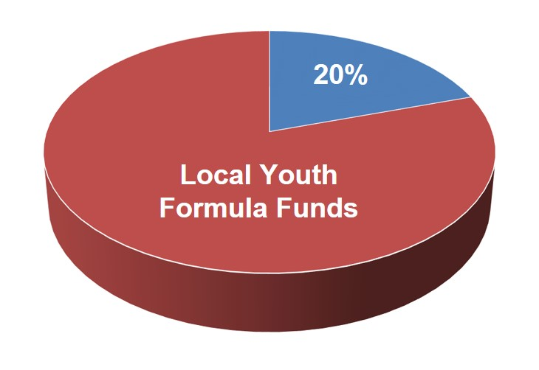
Priority on Work Experience
At least 20% of local Youth formula funds must be used for work experience including:
Summer and year-round employment opportunities
Pre-apprenticeship
Internships & job shadowing
On-the-job training
Funding Work Experiences

Slide 11
Tracking Work Experience
The 20% minimum expenditure requirement applies to overall local area youth funds (minus expenditures on administrative costs)
The minimum expenditure rate is not applied separately for in-school and out-of-school youth
Work experience expenditures will be a new data element in ETA’s revised Local 9130 financial report

Slide 12
Enough is Known for Action
Three areas we can plan for NOW
Identify Essential Partners
Incorporate new work experience requirement in RFPs
Create meaningful work experiences

Slide 13
Planning for Work Experience Priority: Identify Essential Partners
Employer Partners Critical: Partner with employers to provide work experiences in high growth in-demand industries/occupations
Partner with school districts for work experience for in-school youth
Because most funding will be devoted to out-of-school youth, important to partner with school districts through programs such as Career Academies, Youth Career Connect, and others
Youth Committees can help coordinate these services

Slide 14
Planning for Work Experience Priority: Incorporate into RFPs
Incorporate new work experience priority into Request for Proposals for youth service provider contracts

Slide 15
Planning for Work Experience Priority: Create Meaningful Work Experiences
Incorporate academic and occupational education into work experiences
Keep in mind increased age range for out-of-school youth
Types of work experiences for 16-18 year olds may be different than 22-24 year olds
Connect work experiences to broader career pathways
Match participants with work experiences based on participants’ interest, goals, education level, etc.
Ensure youth have basic workplace readiness skills prior to placing them in a work experience
Remember worksite supervision is critical

Slide 16
Checking In: Polling Question
Considering what you know now, how ready are you to Implement the 20% Work Experience Requirement?
Confident and will have no trouble meeting the 20%
Expect to have significant work experience expenditures, but getting to 20% may be difficult in first year
Very concerned about 20%; seeking more guidance & technical assistance

Slide 17
Implementing Work Experience Models for Youth
Peer Presentations!

Slide 18
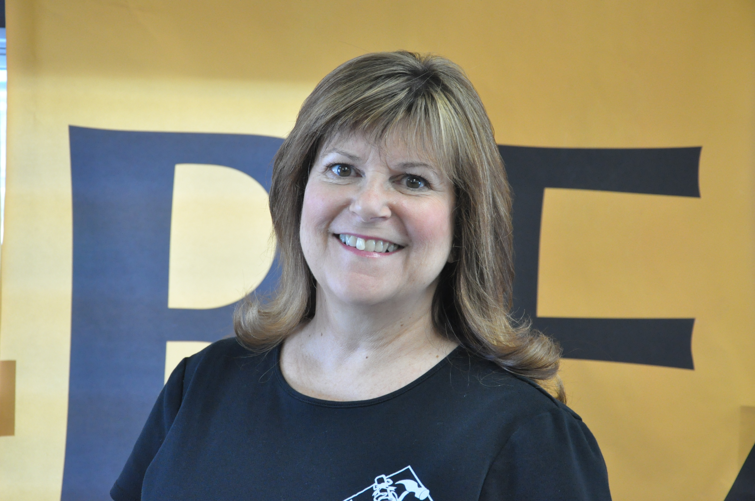
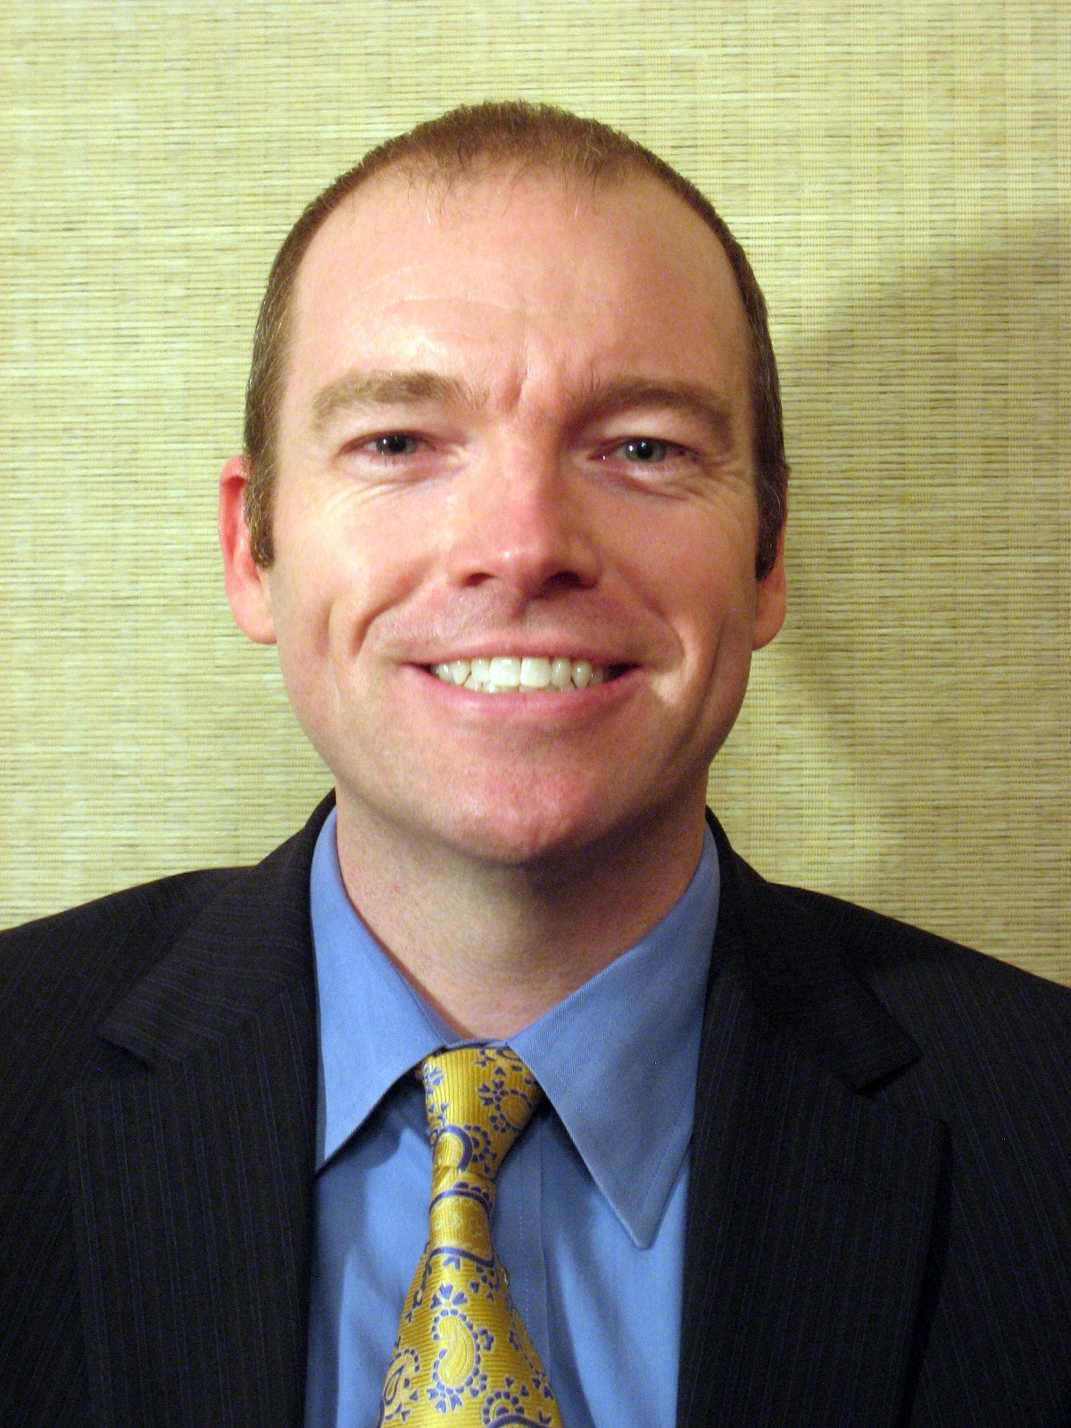
Implementing Work Experience Models for Youth
Los Angeles Unified School District
Wisconsin Department of Workforce Development
Sheilah Goulart
Director
San Joaquin County Office of Education
Stockton, California
William Bass
Program and Policy Development Advisor
Los Angeles Unified School District – Linked Learning
Los Angeles, California
www.lausd.net
Jamie Bernthal
Youth Apprenticeship Coordinator
Wisconsin Department of Workforce Development
Madison, Wisconsin
www.dwd.wisconsin.gov
www.sjcoe.org

Slide 19
Implementing Work Experience Models for Youth
Sheilah Goulart
Director
San Joaquin County Office of Education
2707 Transworld Drive
Stockton, California 95206
Office: (209) 468-9246
sgoulart@sjcoe.net
www.sjcoe.org

Slide 20
Work Experience Opportunities at San Joaquin County Office of Education (SJCOE)
Exceptional work experience provider
Great alignment and leverage opportunity for WIBs, apprenticeship programs, and employers to partner
WIA Youth Provider since 2002 (WorkStartYES)
YouthBuild Provider since 2006 (YouthBuild San Joaquin)
Recycling/Natural Resources Employer since 2009 (San Joaquin Regional Conservation Corps)

Slide 21
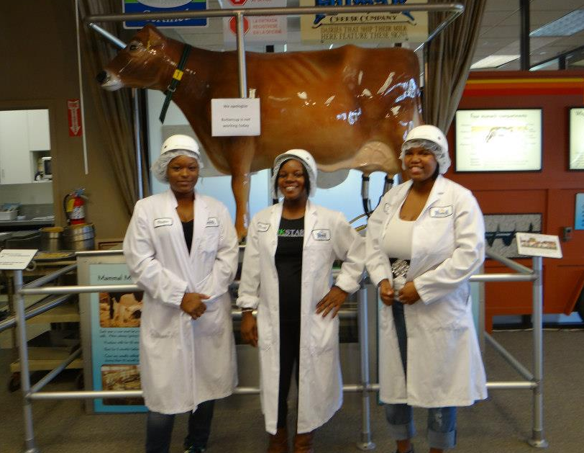
WorkStartYES
Serving ISY/OSY for 12 years in WIA funded Younger Youth Program
Partnership between SJCOE and WorkNet (local WIB)
Multi-year program for ages 16-21 (moving to age 24 in 2015)
SJCOE Career Developers focus on basic skills remediation, high school completion, mentoring, work readiness workshops, leadership development, placement, and follow-up
WorkNet Career Developers focus on subsidized and unsubsidized employment opportunities

Slide 22
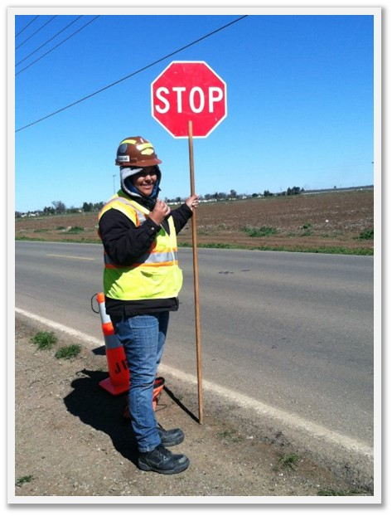
YouthBuild San Joaquin
Serving OSY for 9 years in DOL-funded YouthBuild Program
Partnership between SJCOE, Habitat for Humanity, Carpenters and Laborers Unions, San Joaquin Building Trades Council
Multi-year program for ages 17-24
High school completion and post-secondary readiness
Construction training for industry-recognized credentials
Leadership and Career Development Workshops
AmeriCorps/Community Service
Structured long-term post-placement programming

Slide 23
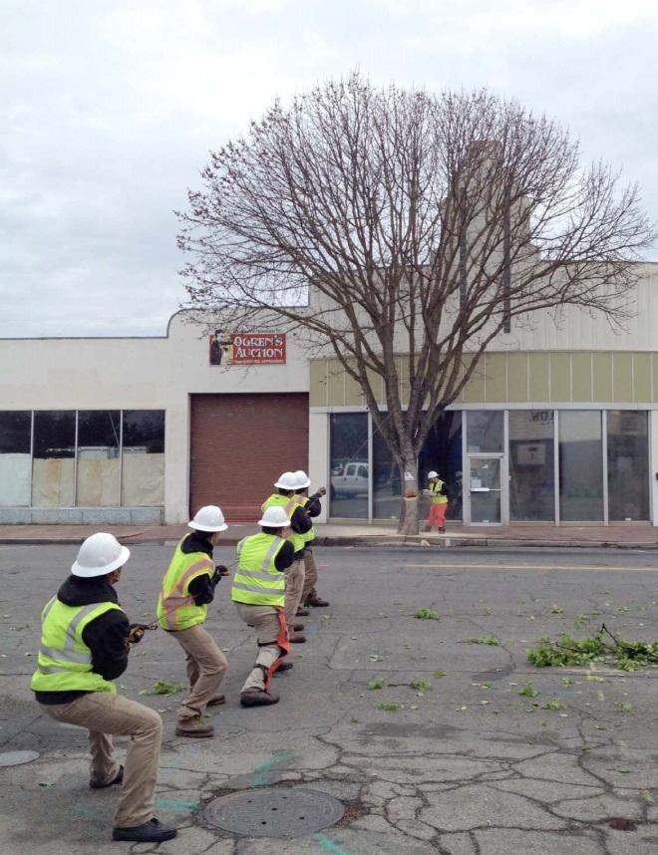
San Joaquin Regional Conservation Corps
Serving OSY and graduates for 5 years in CalRecycle and fee-for-service funded local conservation corps program
Partnership between SJCOE, CalRecycle, River Partners, and variety of municipalities and non-profit agencies
Multi-year program for ages 18-25
High school completion and post-secondary readiness
Landscaping and environmental stewardship training
Leadership Development
AmeriCorps/Community Service

Slide 24
Youth Barriers to Success
Attendance
Incentive Program and Bus Passes
Basic Skills Deficiencies
Tutoring and CAHSEE classes
Drug Use
Referrals to Behavioral Health
Driver’s License
Study Groups
Transportation
Bus Passes

Slide 25
Academic Connections to Success
Academic program taught with a focus on construction
Math teacher a former general contractor
Social Science class focuses on history of American worker
Wednesday workshops focus
Leadership and work ethic
Community Service projects focus
Community Garden and Litter Abatement
Awards program focus
Character traits of a successful person
Invitation
to Chat
How do you tie work experience to academic education?

Slide 26
Training Connections to Success
Workshops and Field Trips (WSYS) = Post-Grad Plan
Work Readiness Workshops
College/Industry Tours
Construction (YBSJ) = Industry Recognized Certificates
Habitat for Humanity
USS Lucid
Laborers Safety Cert. Week/HazWoper
Recycling/Natural Resources (SJRCC) = Resume Builder
Recycling CRV, Used Tires, Electronic Waste, Used Oil
Landscaping and Habitat Restoration
Litter Abatement and Blight Remediation

Slide 27
Employer Partners are Key to Success
Direct entry with Carpenters and Laborers Union (YBJS)
Use Carpenters Boot Camp activities for Mental Toughness
Sample Mental Toughness Curriculum: http://application.jff.org/userImages/files/Orientation_Mental_Toughness1(2).pdf
Contract with Laborers to offer all safety training
Entered into MOU with Building Trades Council (YBSJ)
Will begin using MC3 curriculum in fall
Host annual Career Trades Fair at school site
Entered into MOU with River Partners and Cities (SJRCC)
Work Crews employed by SJRCC but work for non-profit on environmental stewardship projects
Work Crews employed by SJRCC but work for cities on beautification and litter abatement projects

Slide 28
Work Experience Opportunities for Success
Summer work crews are available via WorkNet and at Habitat for Humanity and SJRCC
Students must complete application, resume, and cover letter and secure three letters of recommendation
Students working for WorkNet must complete summer workshops
Students must interview for a position
Students attending summer school to complete diploma can have flexible school schedule to accommodate summer work

Slide 29
Implementing Work Experience Models for Youth
Sheilah

Slide 30
Implementing Work Experience Models for Youth
William Bass
Program and Policy Development Advisor
Los Angeles Unified School District &
Los Angeles Coalition for Linked Learning
333 S. Beaudry Avenue, 11th Floor
Los Angeles, California 90017
Office: (213) 241-2149
william.bass@lausd.net
www.lausd.net

Slide 31
Los Angeles Unified and the Los Angeles Coalition for Linked Learning
LAUSD covers 710 square miles
Most of the city of Los Angeles
Portions of 31 cities and unincorporated areas of LA County
Areas served range from rural at District outskirts, to highly urbanized in central Los Angeles.
Population
4.8 million people live within LAUSD’s boundaries
643,493 students enrolled in K-12
255,697 enrolled in Adult Education programs = 899,190 students.
158 high schools and high school magnets, 55 Options Schools, 1 Regional Occupational Program/Center and 26 Alternative Education Work Centers.
Linked Learning in 36 pathways at 24 high schools

Slide 32
Los Angeles Unified and the Los Angeles Coalition for Linked Learning
Student Demographics – Our students reflect the communities we serve:
Free or Reduced Price Meals | 80%
English Language Learners | 161,484 students
Latino | 73.4%
African American | 10%
White | 8.8%
Asian | 3.9
Filipino | 2.2%
Pacific Islander | .04%
American Indian | .04%
Two or more races, not Latino | 1%

Slide 33
Los Angeles Unified and the Los Angeles Coalition for Linked Learning
4 Core Components of Linked Learning
Rigorous Academic Experience
Challenging Career-Technical Component
Work-Based Learning Experiences
Strong Support Services

Slide 34
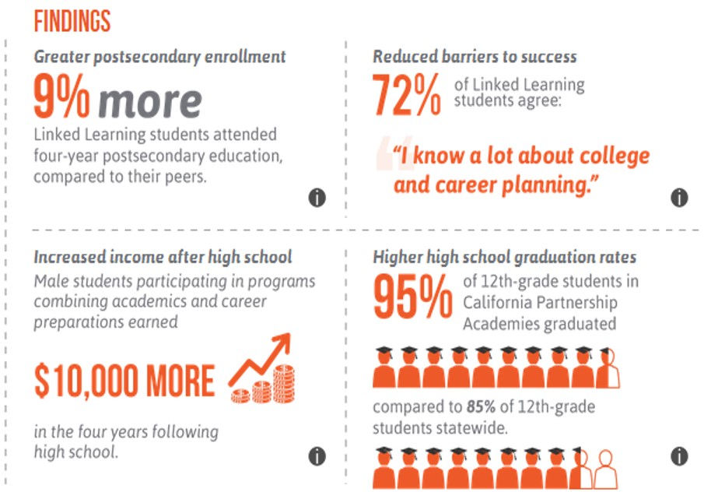
Los Angeles Unified and the Los Angeles Coalition for Linked Learning
Linked Learning improves student outcomes and provides a basis for systemic high school reform
Source: http://irvine.org/linkedlearning2014/evidence/evaluation

Slide 35
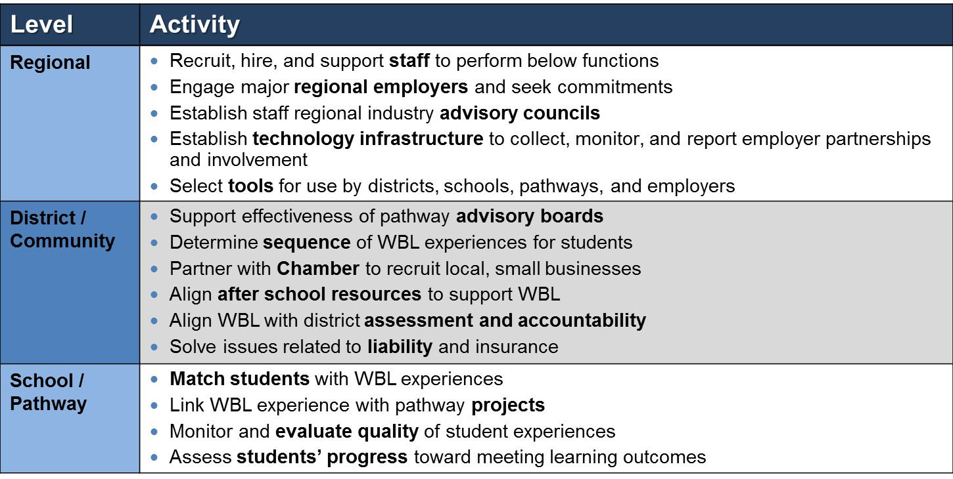
Infrastructure to Support Work Based Learning

Slide 36
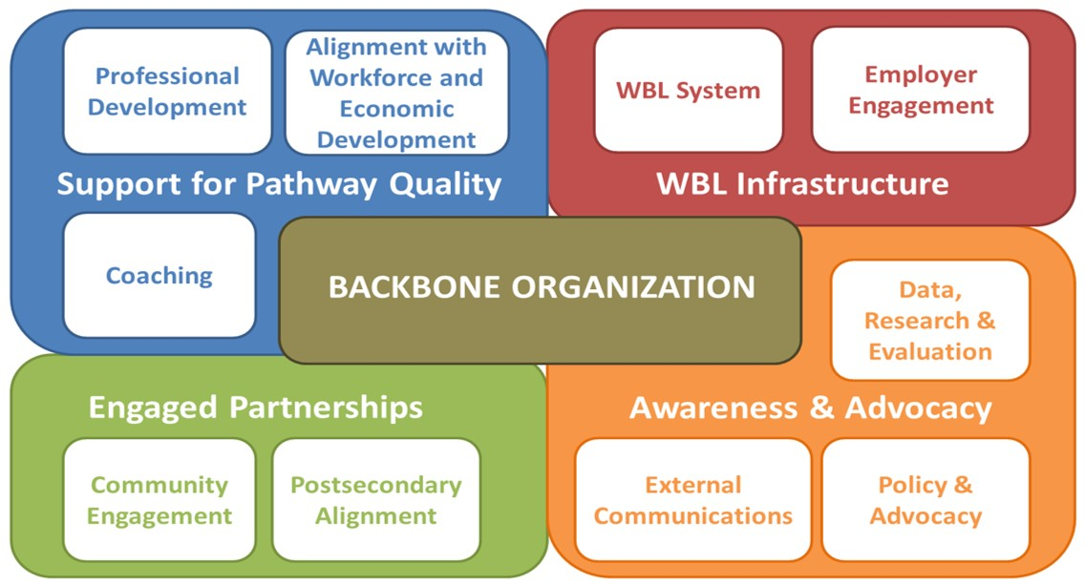
Regional Hub of Excellence Intermediary Functions
Regional Hub of Excellence

Slide 37
How Do We Provide Quality Work Experiences? Rigorous Academic Experience
For Students:
Link academics with the CTE program through rigorous, interdisciplinary, real-world, Common Core aligned projects
Team with industry professionals around curriculum development, project development, and feedback/evaluations on projects
Provide a spectrum of WBL experiences: professional guest speakers, workplace tours, job shadowing, mentorships
Developed Work Readiness training (provided by ConnectEd Studios) and certification which leads to summer paid internships

Slide 38
How Do We Provide Quality Work Experiences? Rigorous Academic Experience
For Faculty:
Provide externships so teachers can develop lessons aligned to their discipline and industry sector
Provide Professional Development for pathways across industry sector to share best practices and to interact with professionals
District provides:
All vendors who respond to RFPs in the district must offer WBL experiences for LAUSD students—receiving a scoring preference for the quality and quantity of experiences offered
Intermediaries and other organizations working with WBL coordinators to provide these experiences such as United Way of Greater LA, LA Area Chamber of Commerce

Slide 39
How Do We Provide Quality Work Experiences? Challenging Career-Technical Component
With the alignment of Career Technical Education under the Linked Learning program, the CTE offerings at LAUSD
Align with the pathway industry sector at the campus
Provide A-G credit, so students can meet University of California entry requirements and graduate on time
Earn dual credit in the Community College system so students get a head start on post-secondary credits
Are making progress toward the goal of professional certifications in their industry sectors that are marketable and lead to living wage jobs

Slide 40
Checking In: Polling Question
How do you tie work experience to a career pathway?
Aligns with an industry sector pathway
Gives advanced standing/dual credit at a community or technical college
Provides advanced standing/dual credit at a 4-year university
Other

Slide 41
How Do We Provide Quality Work Experiences?
Work Based Learning experience(s) that align with the pathway Industry Sector
Supported by prerequisite Work Readiness training and certification by the pathway
During the school year, students experience
Professional guest speakers
Workplace tours
Job shadowing
Other Career Awareness and Exploration activities
These activities + Work Readiness training and certification lead to Summer Internships aligned to the pathway Industry Sector, ideally at the businesses providing Work Based Learning enrichment opportunities

Slide 42
How Do We Provide Quality Work Experiences?
Generating Work Based Learning opportunities requires relationship management, clear expectations of employer and student, and internship ready students
We ensure these elements of success by
Developing and maintaining relationships with local and regional businesses surrounding and supporting our schools and communities
Ensuring that our employer partners feel supported and valued by Work Based Learning Coordinators, with a “high touch” interaction model
Helping our employer partners understand what a quality internship, that provides ample learning and professional exposure for our students, looks like and supporting that model with job aides and frequent contacts
Providing our students with Work Readiness training and certification that can include in a professional e-portfolio, provided by ConnectEd Studios

Slide 43
How Do We Provide Quality Work Experiences? Strong Support Services
Additional Counseling
Individualized attention when case loads reasonable
Tutoring
Available to YCC students to help recover credits, keep students on track academically, and graduate on schedule
Summer Bridge
Eases the transition from middle to high school
Builds peer support networks amongst incoming students
Immerses students in the pathway industry sector
Develops leadership skills in 9th graders and 12th grade Summer Bridge Leaders
Information Technology
Computing equipment allows us to leverage credit recovery software packages and tutoring programs
Helps keep students on-track to graduate on time

Slide 44
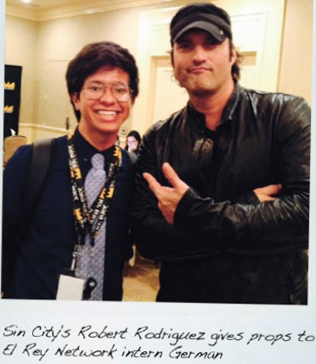
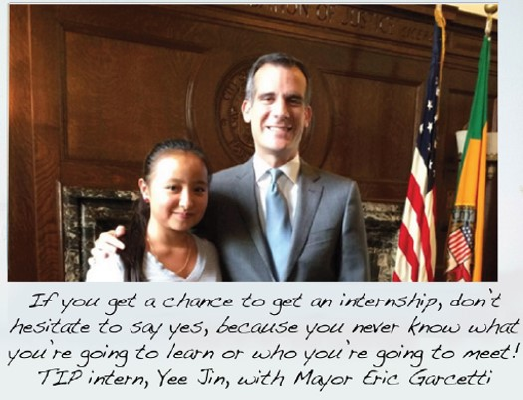
What Our Stakeholders Say

Slide 45
Considerations for Employers and Program Staff
Out-of-school youth are harder to reach, so your partnerships need to include organizations already serving this population
Workforce Investment Boards
YouthSource Centers
WorkSource/OneSource Centers
Community & Faith-based Organizations
Educational Options Programs (Options, Continuation, Pregnant Minor, Opportunity, and other school types)
Restorative Justice programs are being implemented across LAUSD, focusing on keeping students on campus and in school
Suspensions and expulsions have dropped

Slide 46
Implementing Work Experience Models for Youth
William

Slide 47
Implementing Work Experience Models for Youth
Jamie Bernthal
Youth Apprenticeship Coordinator
Wisconsin Department of Workforce
Development
Office: (608) 267-7210
JamieT.Bernthal@dwd.wisconsin.gov
dwd.wisconsin.gov

Slide 48
What is Wisconsin’s Youth Apprenticeship Program?
Statewide paid work experience initiative
Not a Registered Apprenticeship program but could be considered a pre-apprenticeship program under WIOA
One or Two year program
Combines academic & technical instruction with mentored on-the-job training
900 hours work-based learning and 360 hours classroom instruction (450 and 180 for one year option)
Receives Certificate of Occupational Proficiency on completion

Slide 49
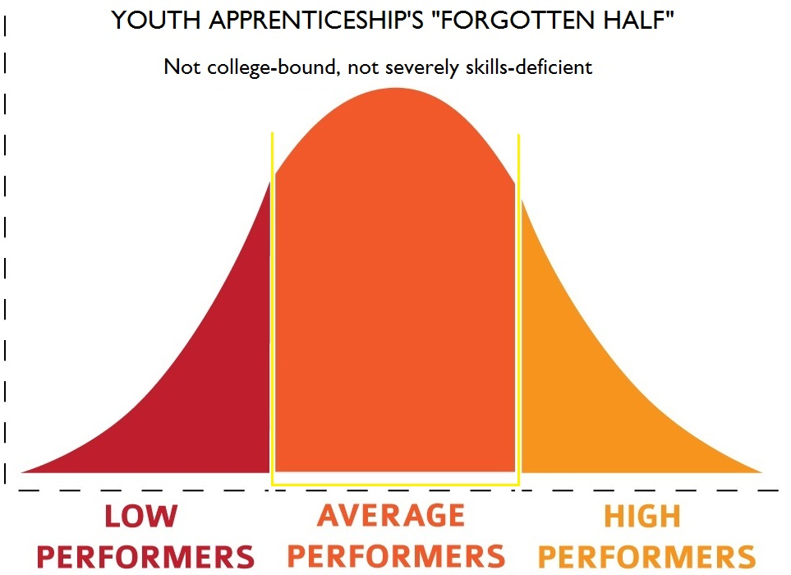
Who do we serve – YA history

Slide 50
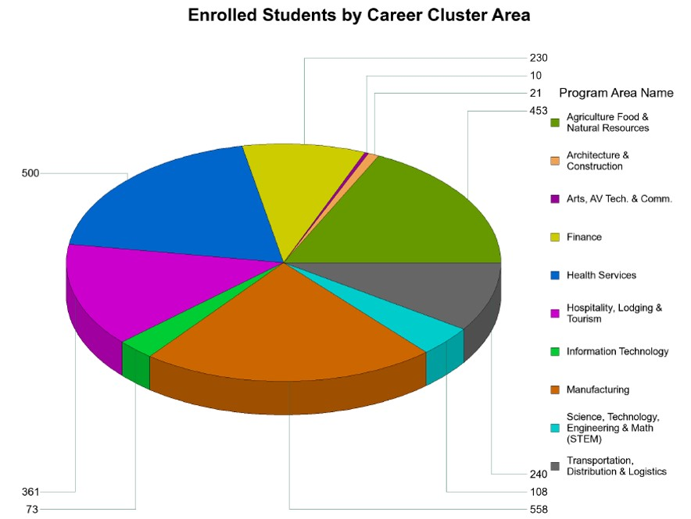
The YA Program Today
Fiscal Year 2013-14
YA Enrollees: 2,555
Active Employers: 1,775
Active Local Consortia: 32
Average Student Wage: $10.04
Completion Rate: 81%
Employment Offer Rate: 76%
Enrollee Demographics: 40% female, 7% minority
15

Slide 51
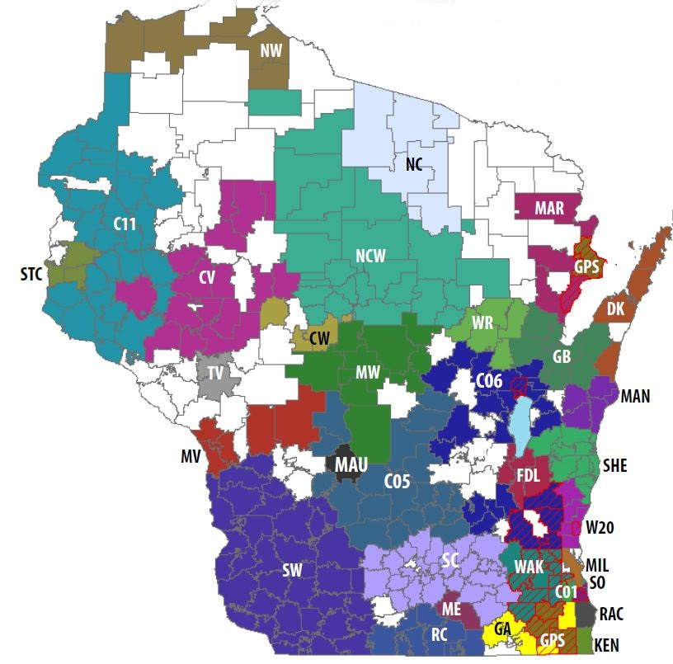
YA Program Implementation
YA Regional Consortiums
WI is divided into 33 YA consortiums
Each consortium has a designated YA Regional Coordinator and a Steering Committee
Participating School Districts
On site teacher/staff coordinator
Nearly 300 school districts and over 200 high schools in WI

Slide 52
YA Program Implementation
Local model:
Responsive to local economy
Selects appropriate education
Reduces administrative costs
Invitation
to Chat
How does the state best support local efforts to serve youth?

Slide 53
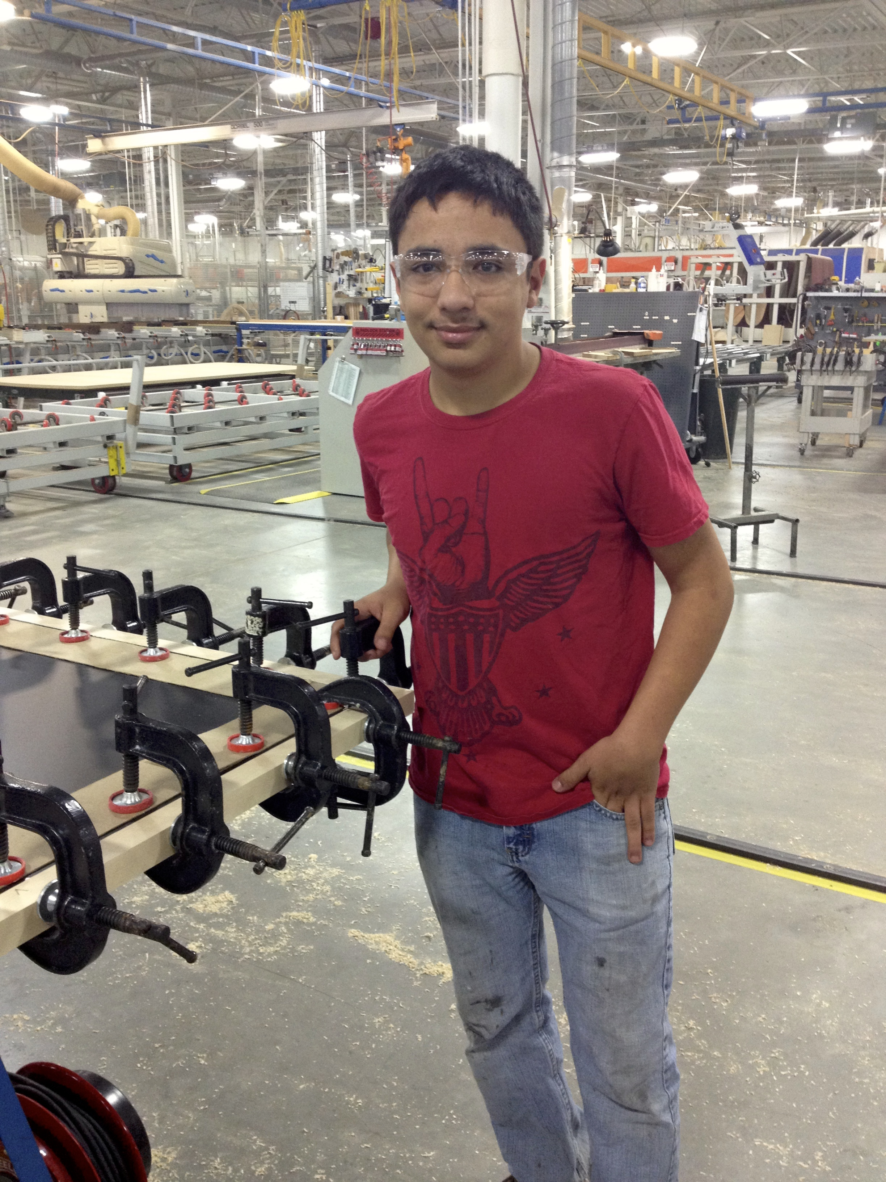
Skill Competencies
Developed by industry
Standardized statewide
Simultaneous work and learning
Learning objectives represent student knowledge
Worksite competencies represent student skills and abilities
Flexible instruction delivery

Slide 54
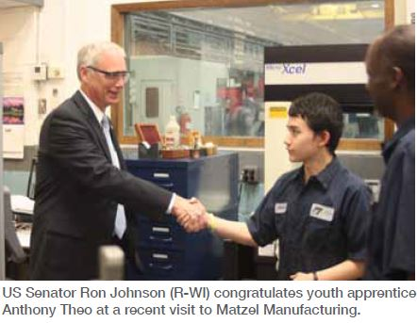
Structured Work Experience
Paid on-the-job work experience
Exposure to multiple aspects of industry
Skilled mentors

Slide 55
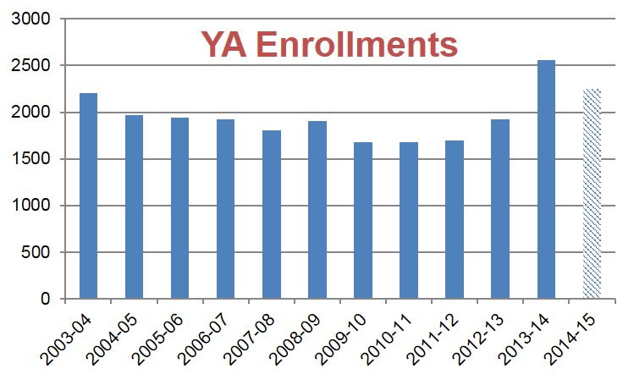
Future Goals
Continue to grow enrollments
Deliver articulated credit and industry credentials to students
Build relationships with Registered Apprenticeship
Dual enrollment of WIOA Youth

Slide 56
Implementing Work Experience Models for Youth
Jamie

Slide 57
Implementing Work Experience Models for Youth

Slide 58
For Additional Information on Today’s Presentations
Information on Linked Learning:
http://linkedlearning.org/
Information on the Linked Learning Program at Los Angeles Unified School District:
http://linkedlearning.lausd.net/
Information on the LAUSD Linked Learning Vendor Program:
http://achieve.lausd.net/Page/576
Information on Wisconsin’s Youth Apprenticeship Program:
https://dwd.wisconsin.gov/youthapprenticeship/

Slide 59
Implementing Work Experience Models for Youth – TA Resources
Grads of Life: Engaging Employers to Ensure Work Experience Opportunities for Youth
https://www.workforce3one.org/view/5001434450436043338/info
Youth at Work: Making the Most of Work-Based Learning
http://www.schoolandmain.org/storage/smi-materials/youth%20at%20work%201203.pdf
Engaging Youth in Work Experiences: An Innovative Strategies Practice Brief
http://www.ncwd-youth.info/innovative-strategies/practice-briefs/engaging-youth-in-work-experiences
A Toolkit for Employers: Connecting Youth & Business
http://www.nyec.org/content/documents/Connecting%20Youth%20and%20Business%20Toolkit.pdf

Slide 60
Implementing Work Experience Models for Youth – TA Resources
WorkReady Program Models: How-to Guides - Occupational Skills
http://www.pynguides.org/os/benefits.php
Quick Start Toolkit: Building Registered Apprenticeship Programs
https://www.workforce3one.org/view/4101434651325684123/info
Registered Apprenticeship Community of Practice
https://21stcenturyapprenticeship.workforce3one.org/page/home
OJT Toolkit
https://ojttoolkit.workforce3one.org/index.aspx

Slide 61
Implementing Work Experience Models for Youth – Federal Guidance
Department of Labor WIOA Resource Page
http://www.doleta.gov/WIOA/
Department of Education WIOA Resource Page
http://www2.ed.gov/about/offices/list/ovae/pi/AdultEd/wioa-reauthorization.html
TEGL 5-14: WIA Youth Program Guidance for PY 2014
http://wdr.doleta.gov/directives/attach/TEGL/TEGL_05-14.pdf
WIOA Youth Programs Fact Sheet
http://www.doleta.gov/wioa/pdf/WIOA_YouthProgram_FactSheet.pdf
Federal Student Financial Aid for Apprentices Webinar
https://www.workforce3one.org/command/view.aspx?look=5001503655421369544&mode=info&pparams=

Slide 62
What Else?! What Else?!
Next Webinar in the Series
Credentialing/Outcomes - April 29
https://www.workforce3one.org/view/5001501353923046151/info

Slide 63
Implementing Work Experience Models for Youth

