Slide 1
Date
Universal Design for Learning
March 30, 2015

Slide 2
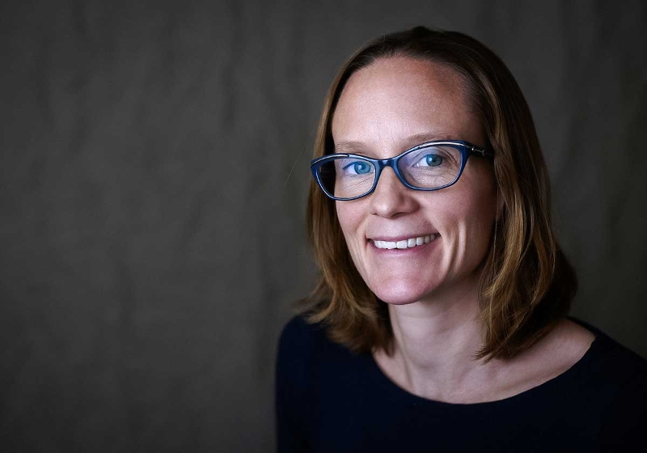
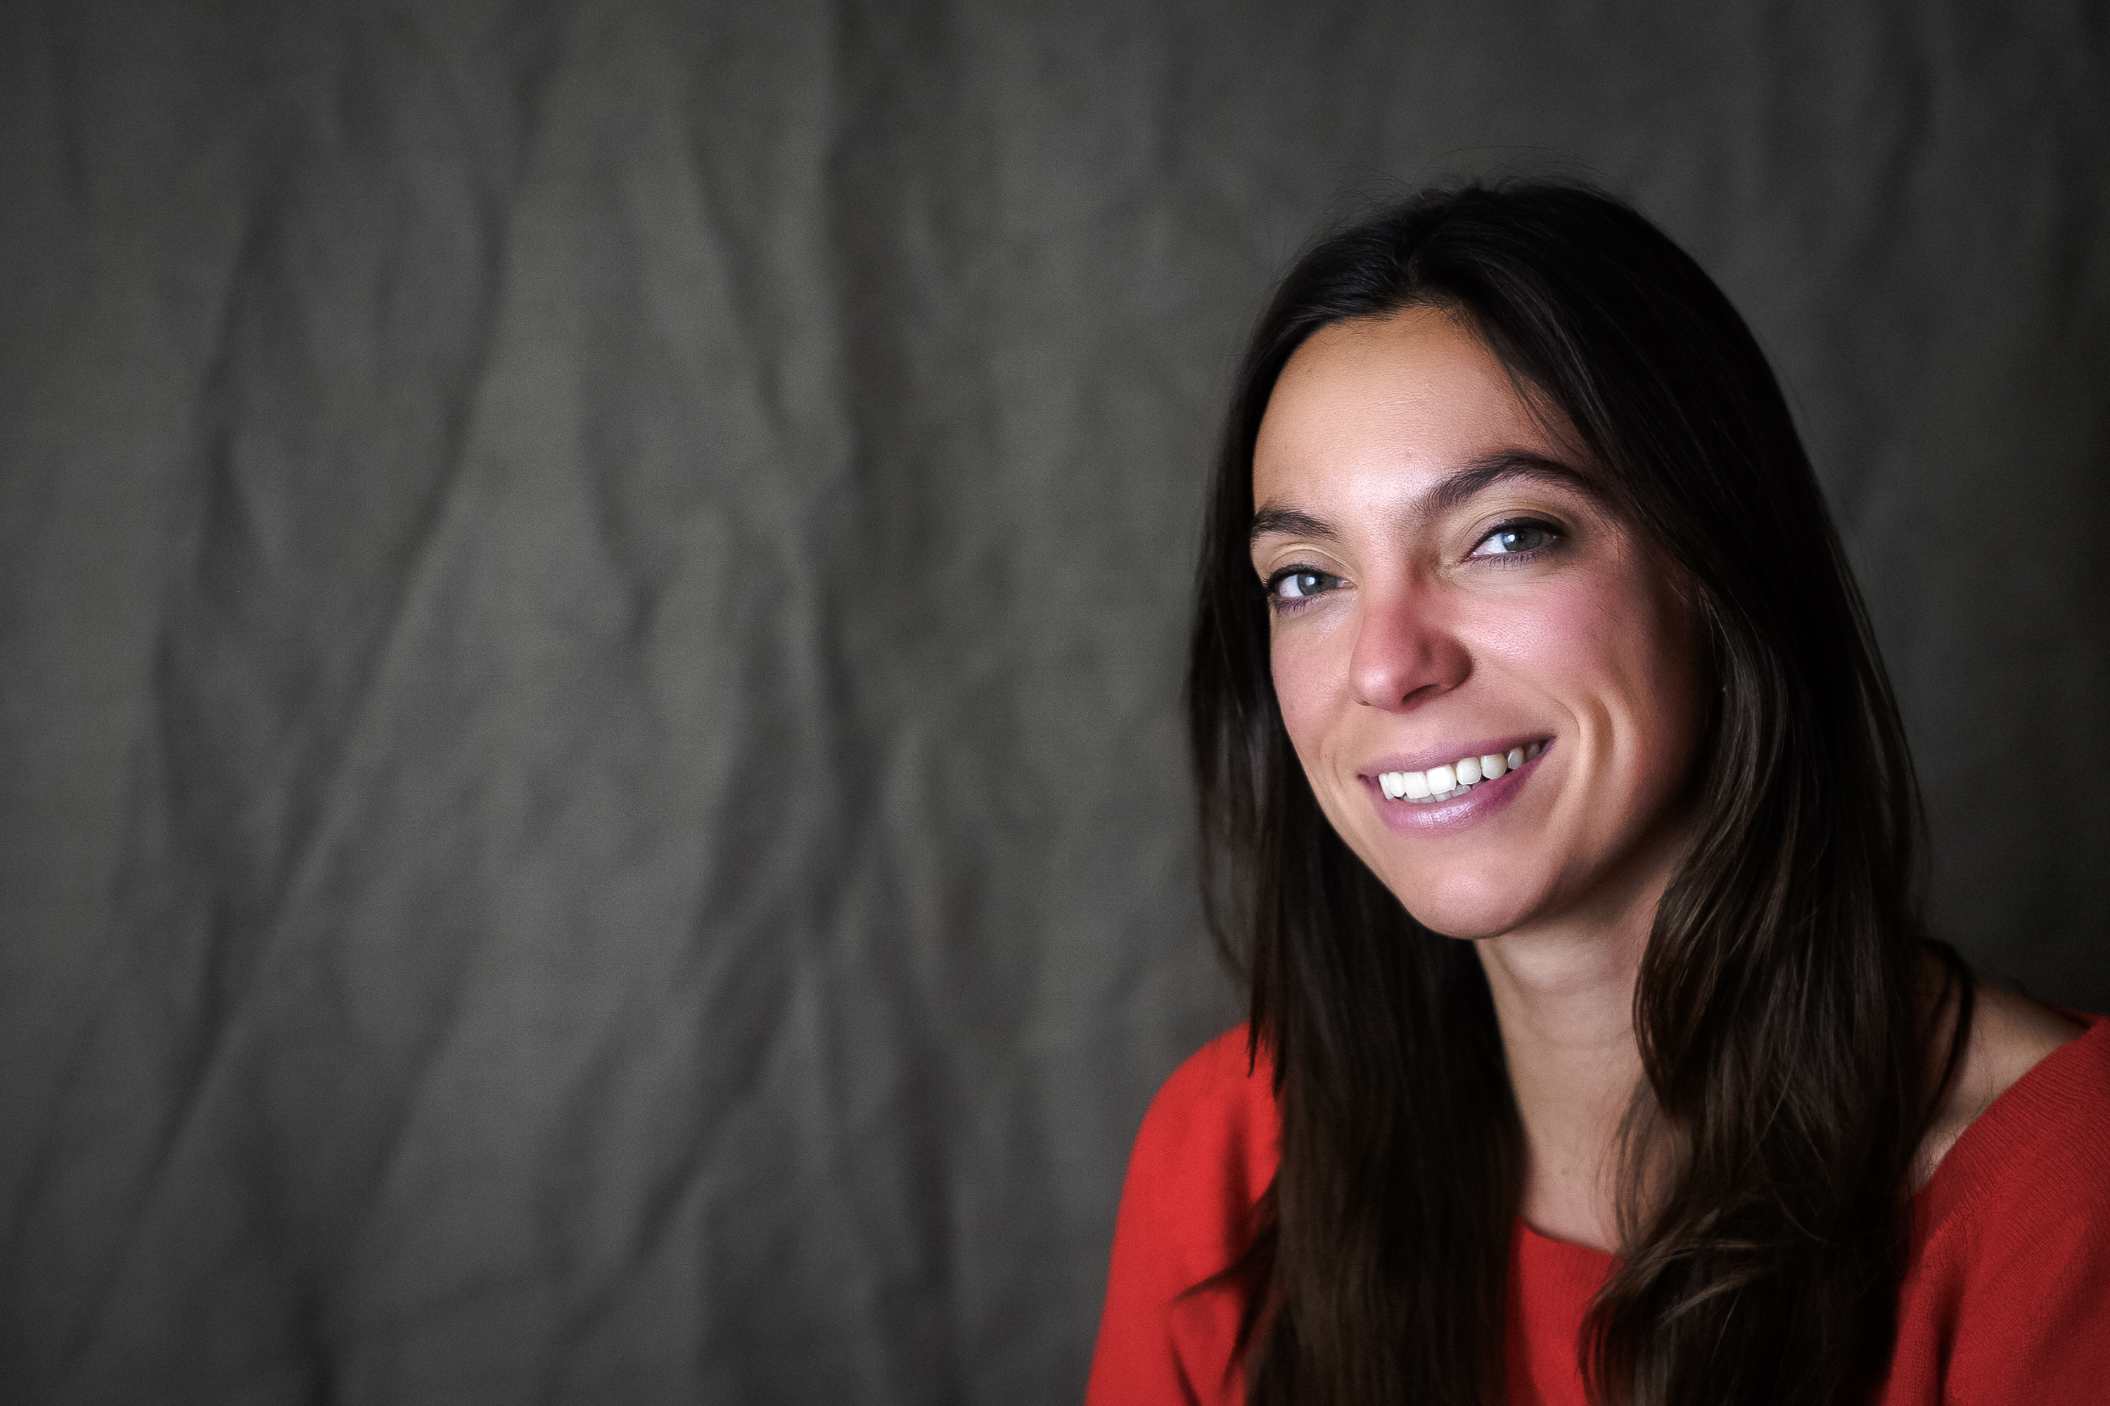
Presenters
Dr. Sam Johnston
Research Scientist
Christina A. Bosch
Instructional Designer/Research Associate

Slide 3
Polling Question
Which of the following best describes your role on the grant?
Project director
Project manager/coordinator
Instructional designer
Technology manager
Curriculum developer
Grants Administrator
Other

Slide 4
Polling Question
How familiar are you with Universal Design for Learning (UDL)?
Very familiar- I use it all the time!
Somewhat familiar- I've heard of it, and use it sometimes.
Not too familiar- I've heard of it, but don't use it.
Not at all familiar- this is my first time hearing about it.

Slide 5
Here’s what you can expect to get out of this webinar:
Outline Universal Design for Learning and provide support to integrate it into postsecondary education and in digital resource development (e.g., OERs).
Introduce UDL On Campus and other CAST resources to help TAACCCT grantees implement UDL.

Slide 6
CAST is an education research and development nonprofit that works to expand learning opportunities for all individuals through
Universal Design for Learning (UDL).
We leverage the learning sciences and technology to create products, promote classroom practices, and inform policy.
We design for students at the margins from the outset. Innovations that are essential to some end up being beneficial to many.

Slide 7
Meeting your SGA Requirements
All online and technology-enabled content and courses developed under this SGA must incorporate the principles of universal design (see http://www.cast.org/udl/) in order to ensure that they are readily accessible to qualified individuals with disabilities. The content and courses must be in full compliance with the Americans with Disabilities Act and Sections 504 and 508 of the Rehabilitation Act of 1973, as amended, and the Web Content Accessibility Guidelines (WCAG) 2.0, Level AA (http://www.w3.org/TR/WCAG/)
Round 3 SGA, Round 4 SGA p. 34

Slide 8

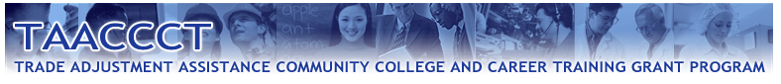





Slide 9
Support from CAST for grantees includes:
An expanding array of online resources and tools on UDL in higher education (www.udloncampus.cast.org)
Targeted webcasts and webinars on UDL and accessibility
Collaboration with CAST (email, phone, webcast) to understand how to implement UDL in your context
Presentations at grantee events by invitation
Working with Merlot & Skills Commons to integrate support for accessibility requirements

Slide 10
OER and UDL
The TAACCCT program will create an unprecedented level of digital open educational resources (OER) that can be leveraged, remixed, or repurposed by community colleges nationwide.
OER adoption will rest on quality, not quantity

Slide 11



When it comes to learning, natural variability is the rule,
not the exception.
Meyer, A., Rose, D.H., & Gordon, D. (2014). Universal Design for Learning: Theory and Practice. Wakefield, MA: CAST.

Slide 12
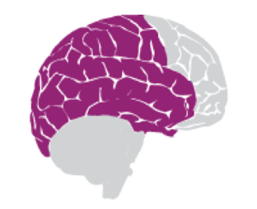




Three Learning Networks
Recognition
what
Strategic
how
Affective
why
Differentiate the ways that students can express what they know
Present information and content in different ways
Stimulate interest and motivation for learning

Slide 13
Options
Addressing a common misconception about providing options:
Options are to be carefully applied to support productive challenge tied to the learning goal and to eliminate unnecessary barriers
(UDL research reader, p. 37)

Slide 14
Accessibility
Making information meaningful
Independent, self-directed learner

Slide 15
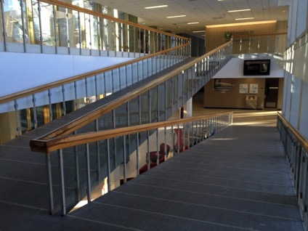
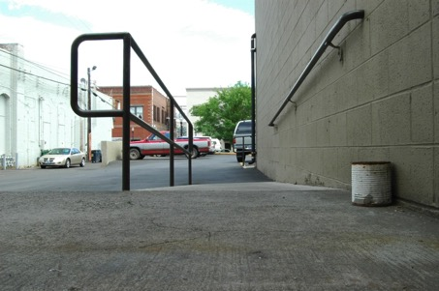

Accessibility should be built in, not added on
Arts Building University of Saskatchewan
Daryl Mitchell, February 14, 2014
https://www.flickr.com/photos/daryl_mitchell/
Ramp and Can
Sam Craig, June 18, 2009
https://www.flickr.com/photos/pirateyjoe/

Slide 16
Example: accessibility in digital environments
Let’s consider the design of the current webcast environment:
Support for variable learner needs
Integrated design
Flexible tools

Slide 17
Polling Question
Which technologies in your environment are most helpful for supporting learner diversity?
Webcast and webconferencing software
Hardware & digital tools (e.g., polling devices, interactive projection boards, etc.)
Learning Management Systems
Specific Apps
Other

Slide 18
Polling Question
How well do these technologies use good accessibility practices and/or UDL?
Not at all well
Somewhat well
Well
Very Well

Slide 19
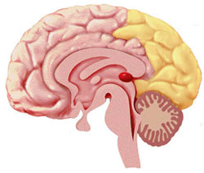
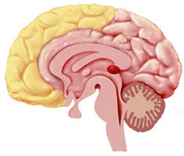
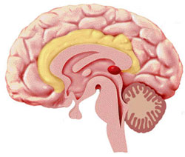
The Neurological Foundation
Recognition
Strategic
Affective

Slide 20
Competency-based education
Competency-based education models in technical education require operating tasks where learners must use tools and demonstrate techniques:
  Options for physical action (keyboarding versus mouse so can have access to common assistive technologies)
  Options for expression and communication
By considering all learners in the design of instruction & assessment, instructors
  minimize barriers for certain groups of individuals (e.g., those with physical mobility limitations, print-disabilities, ELL)
  provide a richer and more accurate method for assessing knowledge for all learners

Slide 21
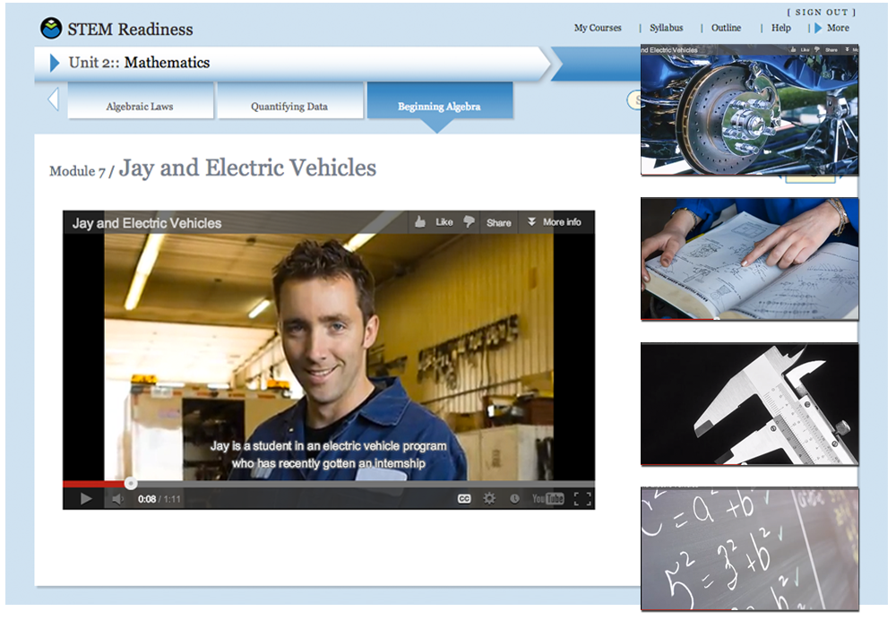
Example: Options for Comprehension
Activate or supply background knowledge
Highlight patterns, critical features, big ideas, and relationships

Slide 22
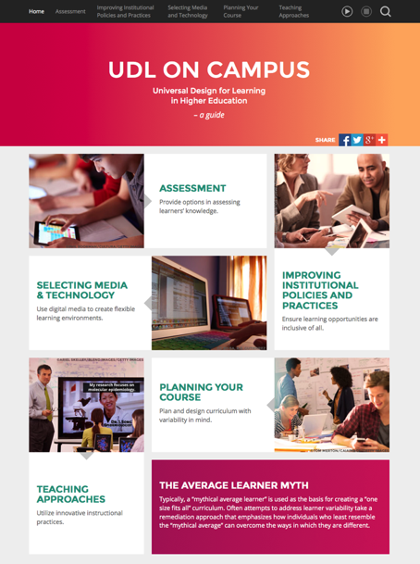
www.udloncampus.cast.org
Designed for multiple stakeholders:
Instructional designers
Faculty
Policy makers
Administrators
Subject Matter Experts
Resources for applying UDL in five areas of focus.

Slide 23
Online Resources: Multiple Means of Representation
Select platforms that offer customization
  Voluntary Product Accessibility Template (VPAT)
    Created as part of Section 508 initiative to assist vendors and consumers
Structure text to guide processing
Illustrate concepts through flexible multimedia

Slide 24
Online Resources: Multiple Means of Action & Expression
Vary the method of response in your assessments
Use web conferencing to broaden options for communication and expression of knowledge
  Interactive, whiteboard tools, upload and annotate media
Support executive functioning skills to help students set goals, manage time, organize, and apply strategies

Slide 25
Online Resources: Multiple Means of Engagement
Optimize relevance through case-based learning
Design educational activities to address the interplay between emotion and learning

Slide 26
Polling Question
Related to UDL, which of these is a priority for you?
Selecting accessible technology
Learning about how to create accessible learning materials
Providing options for assessment
Designing curriculum with UDL
Finding ways to vary engagement for learners
Other?

Slide 27
Polling Question
Do you feel you have the resources you need to address your UDL priorities?
Yes
No
I’m not sure
Other

Slide 28
Additional Resources
UDL On Campus
  www.udloncampus.cast.org
National Center on Accessible Educational Materials
  www.aem.cast.org
National Center on UDL: Guidelines research & examples
  http://www.udlcenter.org/aboutudl/udlguidelines
Educause: 7 Things You Should Know about … Learning Technology
  https://www.educause.edu/research-and-publications/7-things-you-should-know-about
Curricular Opportunities in the Digital Age from JFF
  http://www.studentsatthecenter.org/

Slide 29



Get in touch and give us feedback!
EMAIL: udloncampus@cast.org
@CAST_UDL
@UDL_OnCampus
UDL OnCampus
UDL OnCampus

Slide 30
Sam johnston
sjohnston@cast.org
Christina bosch
cbosch@cast.org
TEL 617.728.4446 FAX 617.728.4857 info@jff.org
88 Broad Street, 8th Floor, Boston, MA 02110
122 C Street, NW, Suite 650, Washington, DC 20001
WWW.JFF.ORG

