Slide 1
Financial Capability and Youth Employment Programs: Pilot with Consumer Financial Protection Bureau (CFPB) and National League of Cities (NLC)
Webinar Date: Thursday, April 2, 2015
Presented by:
Division of Youth Services
U.S. Department of Labor
Employment and Training Administration

Slide 2
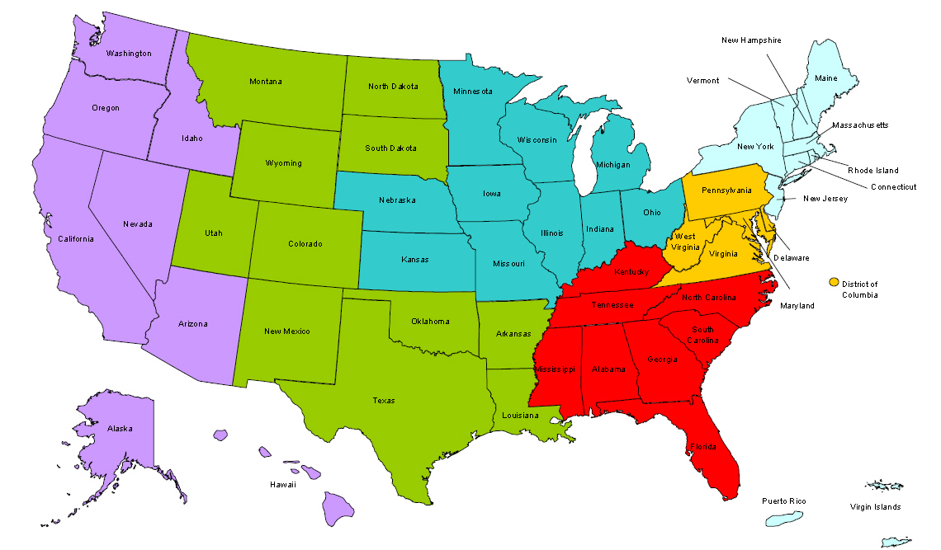
Where are you?
Enter your location in the Chat window – lower left of screen

Slide 3
Here’s what you can expect to get out of this webinar!
Introduce the partnership and the financial literacy pilot
Discuss application procedures and selection criteria for the pilot program

Slide 4
Agenda
Overview of the Partners
Overview of the Workforce Innovation and Opportunity Act (WIOA) Youth Formula Program
Promising Practices for Youth Financial Literacy
Share The Opportunity
Q&As

Slide 5
Moderator
Jennifer Kemp
Youth Policy and Performance Team
Division of Youth Services
Department of Labor

Slide 6
Presenters
Desmond Brown
Program Specialist, Financial Empowerment
Consumer Education & Engagement
Consumer Financial Protection Bureau (CFPB)
Anthony Santiago
Senior Fellow
Institute for Youth, Education, & Families
National League of Cities (NLC)
Olivia Calderon
Program Specialist, Financial Empowerment
Consumer Education & Engagement
Consumer Financial Protection Bureau (CFPB)

Slide 7
About the Consumer Financial Protection Bureau (CFPB)
The mission of the Consumer Financial Protection Bureau is to make markets for consumer financial products and services work for consumers by making rules more effective, by consistently and fairly enforcing those rules, and by empowering consumers to take more control over their economic lives.

Slide 8
About the National League of Cities (NLC)
Dedicated to helping city leaders build better communities, NLC is a resource and advocate for 19,000 cities, towns and villages, representing more than 218 million Americans.
NLC’s Institute for Youth, Education, and Families helps municipal leaders take action on behalf of the children, youth and families in their communities.

Slide 9
About the Department of Labor’s Division of Youth Services
DOL’s Division of Youth Services is responsible for providing:
Leadership,
Policy direction,
Technical Assistance and guidance, and
Program administration for the $800 million youth formula program authorized under the Workforce Investment and Opportunity Act (WIA).

Slide 10
Polling Question One: Who’s on the call?
Workforce Professionals
Financial Institutions
Youth Service Providers
Workforce Board Members
NLC Members
Others

Slide 11
WIOA Youth Formula Program
Requires a 75% out-of-school youth (OSY) expenditure rate
Five new program elements:
Financial Literacy
Entrepreneurial Skills Training
Services that provide labor market and employment information about in-demand industry sectors or occupations available in the local area
Activities that help youth prepare for and transition to post-secondary education and training
Education offered concurrently with and in the same context as workforce preparation activities and training for a specific occupation or occupational cluster
Emphasizes work experience with a 20% work experience minimum expenditure rate, e.g., summer jobs, internships, pre-apprenticeship, and on-the-job training opportunities

Slide 12
Polling Question Two
How comfortable is your staff in delivering financial capability services and training right now?
They’re pros – millions already in the bank!
They can answer basic questions, and have delivered some training.
Financial capability – what’s that?

Slide 13
WIOA and Financial Literacy
Create household budgets, initiate savings plans, and make informed financial decisions that impact their lives
Develop skills to manage spending, credit, and debt
Increase awareness on the significance of credit reports and credit scores
Be able to understand, evaluate, and compare financial products services
Address the financial literacy needs of non-English speakers

Slide 14
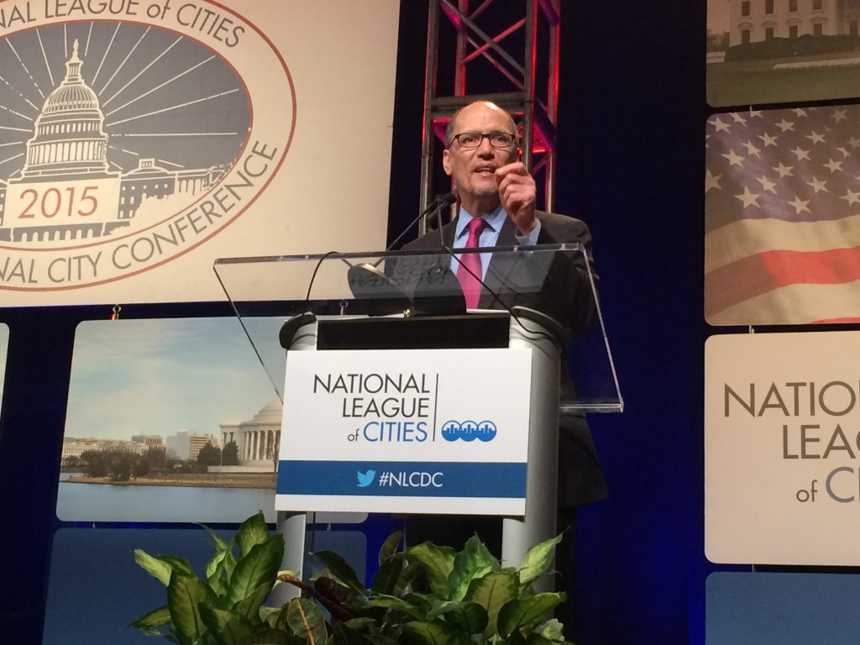
New Collaboration

Slide 15
Overview of Collaboration
DOL, CFPB and NLC are helping municipalities, workforce development boards, and youth serving organizations develop their capacity to increase youth financial capability
Pilot will provide technical assistance in up to 25 municipalities
Work with local leaders to integrate financial knowledge and skills-building services into existing youth employment and training programs
Organizations like the NLC will work with us to engage municipal leaders across the country

Slide 16
Definition of Financial Capability
Financial capability is the capacity, based on knowledge, skills and access, to manage financial resources effectively

Slide 17
What Works in Youth Financial Capability Programs
Tailor financial education to the unique needs of youth
Offer financial products to youth that weigh the costs and risks of various options
Develop explicit strategies for engaging youth in the short and long term
Deliver timely and relevant financial education training for youth
Develop partnerships for successful program implementation

Slide 18
Polling Question Three: Which of these ideas excites you the most?
Tailor financial education to the unique needs of youth
Offer financial products to youth that weigh the costs and risks of various options
Develop explicit strategies for engaging youth in the short and long term
Deliver timely and relevant financial education training for youth
Develop partnerships for successful program implementation

Slide 19
The Opportunity: Technical Assistance
Offer support, tools, and technical assistance to local federally funded workforce systems and municipal officials to integrate age-appropriate financial education
Provide trainings on youth specific financial capability strategies to staff in municipal, youth and workforce systems
Convene program sites to share promising practices and lessons learned
Distribute CFPB financial decision-making tips and tools through local workforce agencies and raise awareness of the ability to submit complaints with the CFPB
Share best practices from pilot sites on ways to promote financial capability in youth employment programs across the broader workforce system

Slide 20
Submission Criteria
Target population being served
Serve low-income youth through year-round youth employment programs
Commitment to youth financial capability
Understand what youth financial capability is and provide an overview for how to integrate services into existing youth-employment programs
Staff capacity
Provide a dedicated staff person to coordinate youth financial capability services and CFPB technical assistance

Slide 21
Submission Criteria
Organizational stability and impact
Demonstrate experience in the community, particularly working with multi-sector partners (government agencies, non-profits, financial institutions) to better serve low-income youth
Client accessibility
Be accessible to the youth they serve and comply with applicable law governing access to youth employment programs
Demonstrated need
Communities with high concentration of low-income youth ages 14-24 in unbanked and underbanked households

Slide 22
Polling Question Four: Will you apply?
What do you think? Will you apply?
1000%, Yes!
We’re seriously considering it – talking through options now…
No way, we are swamped with other work!

Slide 23
Please enter your questions in the Chat Room!

Slide 24
How can a municipality express an interest in participating?
Email Questions and Letters of Interest to: Empowerment@consumerfinance.gov
Must be received by April 20, 2015

Slide 25
What do we mean by TA?
Assistance with developing local youth financial capability plans
Trainings on youth specific financial capability strategies
Convene program sites to share promising practices
Share CFPB financial decision-making tips and tools

Slide 26
When will we notify communities?
We will review letters and follow up with selected communities by May 29, 2015

Slide 27
Is there an evaluation component?
We will work with municipal partners to develop outcomes and report on indicators of success
We identify best practices on youth financial capability and share them with the broader workforce field

Slide 28
How will cities learn from one another?
We will convene monthly calls to bring together municipal partners

Slide 29
Where can I find resources?
Departments of Labor and Education
WIOA Resource Page (www.doleta.gov/WIOA)
WIOA Dedicated Email (DOL.WIOA@dol.gov)
Office of Career, Technical, and Adult Education’s WIOA Resource Page (http://www.ed.gov/AEFLA)
Consumer Financial Protection Bureau
Financial education and consumer protection resources (Consumerfinance.gov)
FDIC
FDIC Unbanked and Under Banked data (https://www.fdic.gov/householdsurvey/2013report.pdf)
NLC- Institute for Youth, Education, and Families
http://www.nlc.org/find-city-solutions/institute-for-youth-education-and-families/family-economic-success

Slide 30
Speakers’ Contact Information
Desmond Brown
Program Specialist, Financial Empowerment
Consumer Education & Engagement
Consumer Financial Protection Bureau (CFPB)
desmond.brown@cfpb.gov
Anthony Santiago
Senior Fellow,
National League of Cities (NLC)
santiago@nlc.org
Olivia Calderon
Program Specialist, Financial Empowerment
Consumer Education & Engagement
Consumer Financial Protection Bureau (CFPB)
Olivia.Calderon@cfpb.gov

Slide 31
Thank You!
Find resources for workforce system success at:
www.workforce3one.org

