Slide 1
Industry Driven Sector Strategies
Webinar Date: April 28, 2015
Presented by:
U.S. Department of Labor
Employment and Training Administration

Slide 2
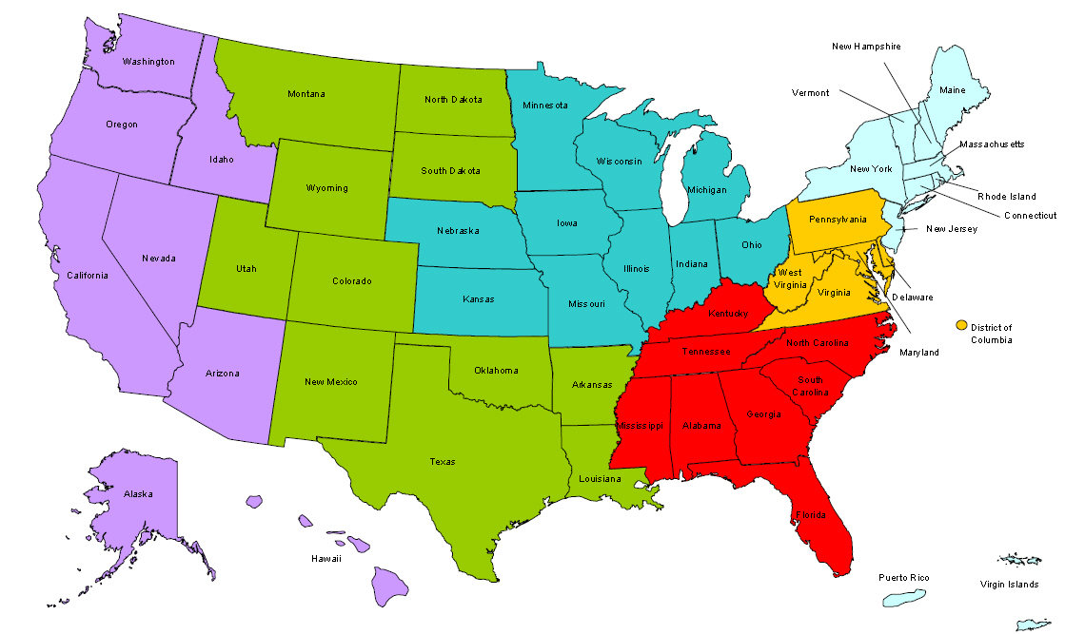
Where are you?
Enter your location in the Chat window – lower left of screen

Slide 3

Moderator
Moderator: Diane Walton
Title: Project Lead
Organization: Office of the Regional Administrator, San Francisco, U.S. Department of Labor, Employment and Training Administration

Slide 4

ETA Sector Strategies TA Initiative
Goal – to increase the number of states and regions actively engaged in sector strategies work

Slide 5





Sector Strategies Initiative Partners

Slide 6

Polling Question
What best describes your agency’s readiness to engage in an industry driven sector strategy?
Currently engaged in an industry driven sector strategy
Beginning to engage businesses and build partnerships
Developing a plan to determine key industries and engage businesses
Have not started to build a sector strategy
Not quite sure what an “industry-driven”
sector strategy is

Slide 7

Here’s What You Can Expect to Get Out of This Webinar!
Learn what it means when sector partnerships are driven by industry, rather than just reflecting it.
Learn about how broad and deep industry engagement works at both a state and local level, with great results for businesses and workers.
Hear best practices and lessons learned from practitioners at the state level about driving sector partnerships in your own area.

Slide 8



Presenters
Presenter: Stephanie Steffens
Title: Director
Organization: Colorado Workforce Development Council
Presenter: Barbara Stanford-Allen
Title: Director, Industry Partnership & Business
Organization: Philadelphia Works
Presenter: Brian K. Oglesby
Title: Industry Partnership & Business Engagement Spec.
Organization: Philadelphia Works

Slide 9


Presenters
Presenter: Frank Cettina
Title: Vice President, Operations
Organization: Computer Components Corporation
Presenter: Navjeet Singh
Title: Deputy Director, National Fund for Workforce Solutions
Organization: Jobs for the Future

Slide 10

Agenda
Introductions (5 min)
Stephanie Steffens: Engaging Industry:
Colorado’s Sector Approach (10 min)
Q&A (3 min)
Barbara Allen & Brian Oglesby: The Southeastern Regional Workforce Development Partnership (SERWDP) (10 min)
Frank Cettina: SERWDP: Measuring Success (10 min)
Q&A (3 min)
Navjeet Singh (10 min): The National Fund for Workforce Solutions
Q&A (3 min)
Wrap-Up (5 min)

Slide 11


Presenters
Presenter: Stephanie Steffens
Title: Director
Organization: Colorado Workforce Development Council

Slide 12
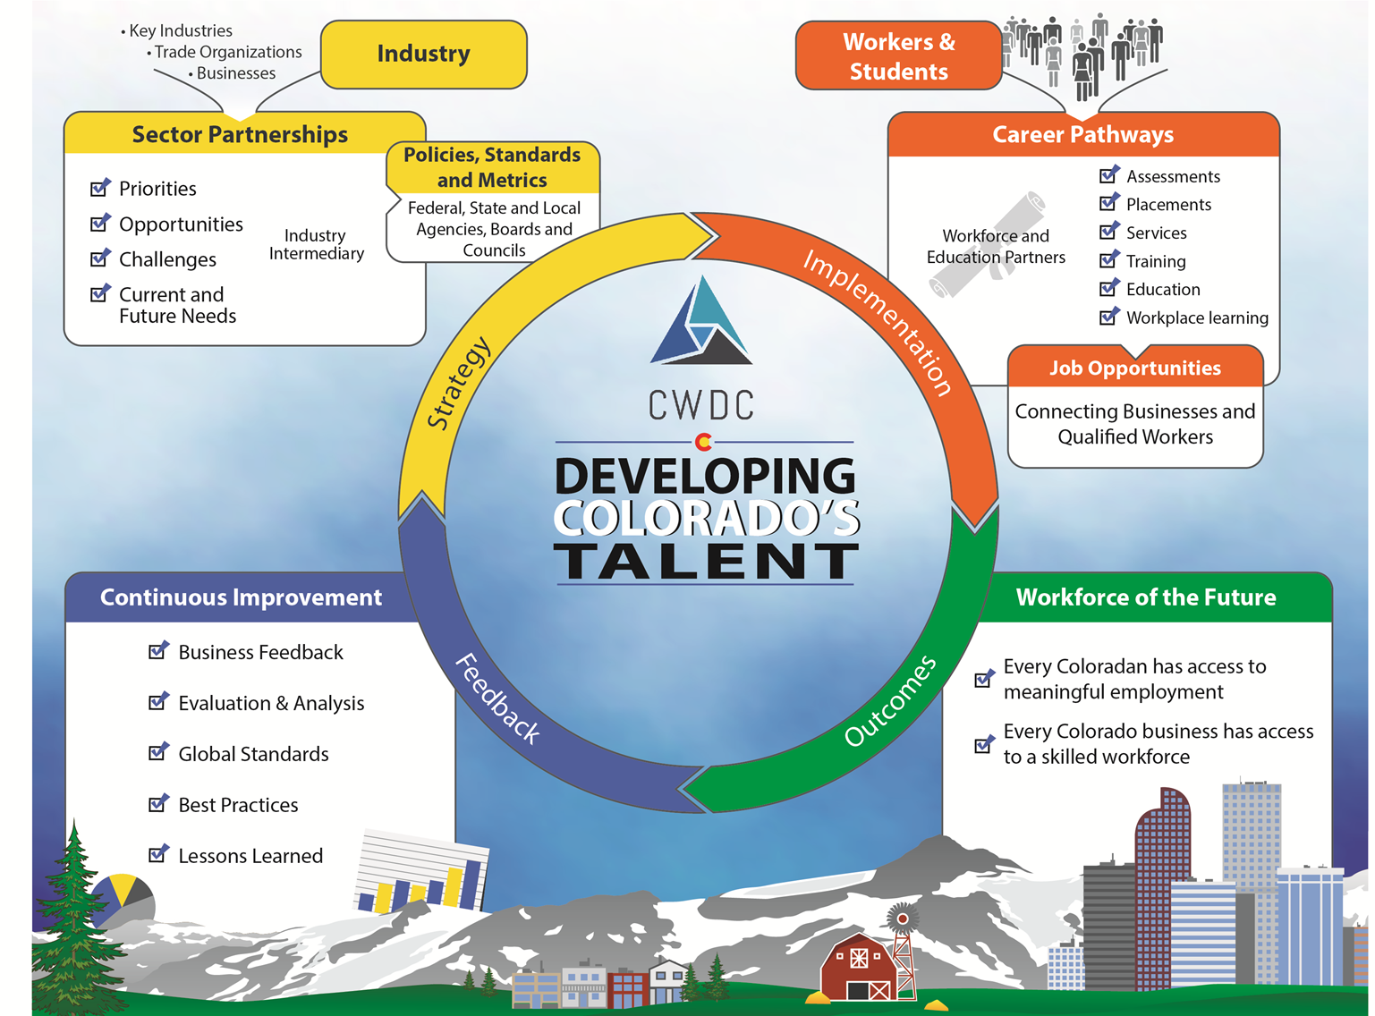
Colorado’s Sector Approach
History
Next Generation Sector Partnerships
Industry Driven Career Pathways

Slide 13
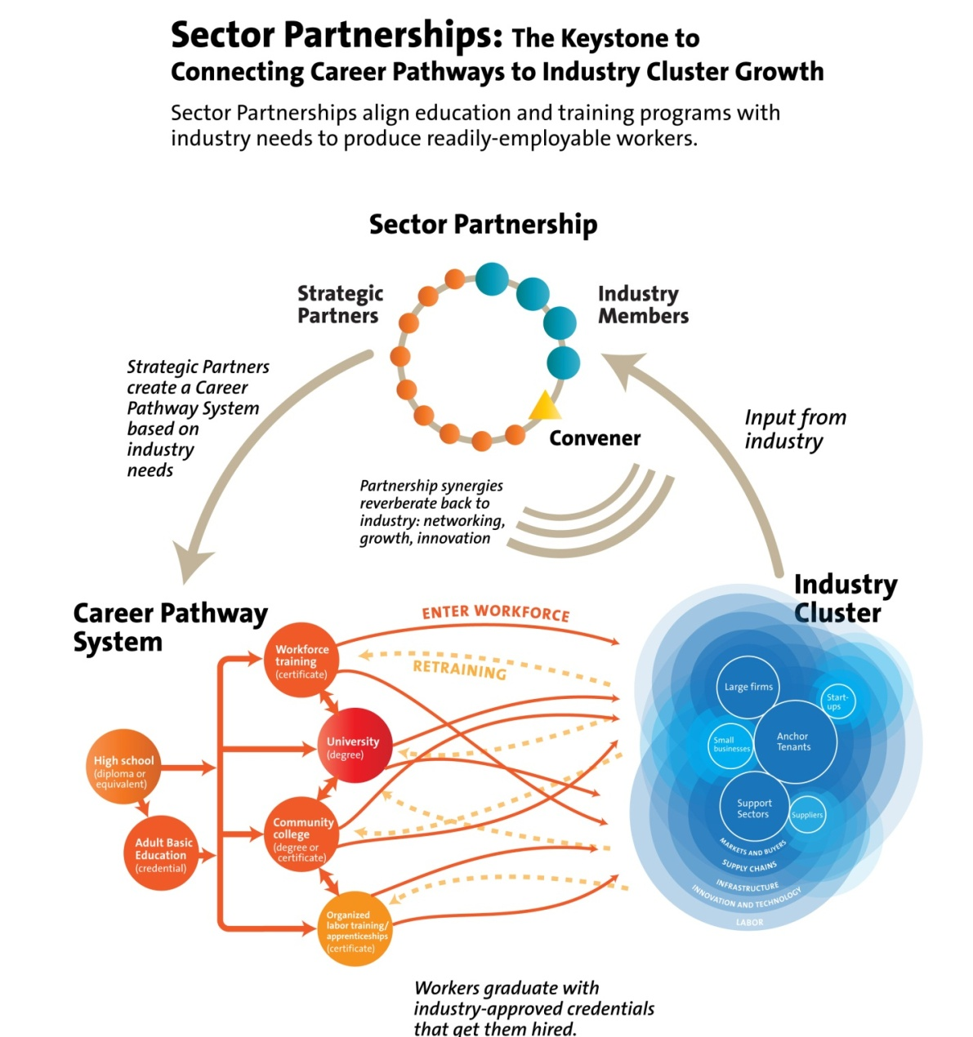
State’s Role in Sector Partnerships
Provide a state-level framework to align programs and resources.
Proactively integrate sector strategies as a core way of doing business.
Utilize a public-private steering committee that fosters business leadership.
Recognize existing work and build upon regional differences and strengths.
Technical Assistance to Regions

Slide 14
Engaging Industry
LESSONS LEARNED
A convener trusted by business and public partners
Evidenced based decisions are key, focus on Return on Investment (ROI): data collection & communication
Create sustainability & flexibility through employer investment, work WITH business not for them
Be flexible to meet needs, do not over-promise!

Slide 15
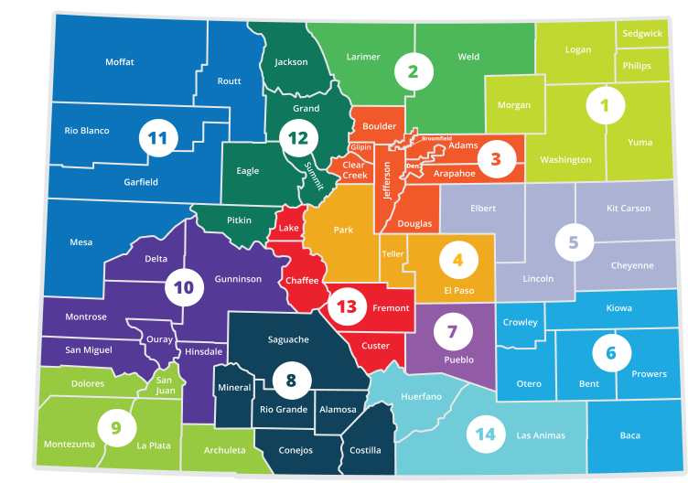
Keeping Industry Engaged
Industry Led
Industry Sets:
  Priorities
  Action Plans
  Timelines
  Commitments
Regional Based
Connected to Statewide Work

Slide 16
Measuring Outcomes and Sector Partnership Sustainability
Defining Levels of Sector Partnerships
  Exploring, Expanding, Active, High Performing
  Creating key performance indicators and a dashboard
Long-term Public-Private Partnerships
  Not Grant Driven
  Technical Assistance
  Project Management

Slide 17
Resources
CWDC is happy to share everything we have.
Our only ask is that you give credit to the authors.
Sectors Partnerships and Career Pathway Resources www.sectorssummit.com
Colorado Workforce Development Council www.coworkforcecouncil.org
Industry led collaborative efforts for Talent Development
Talent Pipeline Report / Scaling up Work Based Learning Paper

Slide 18

Please Enter your Questions in the Chat Room!

Slide 19

Presenters
Presenter: Barbara Allen
Title: Director of Industry Partnership & Engagement
Organization: Philadelphia Works
Presenter: Brian K. Oglesby
Title: Industry Partnership & Bus. Engagement Spec.
Organization: Philadelphia Works

Slide 20

The Southeastern Regional
Workforce Development Partnership (SERWDP)
Who we Are:
  Formed in 2007, the SERWDP is a multi-employer, regional WIB-based collaborative effort that brings together management and labor around the common purpose of improving the manufacturing sector. It has grown from 7 employer members to more than 50 employers, economic development organizations, regional colleges/universities, trade/manufacturing associations, and industrial development corporations.
Goals:
  Address the aging manufacturing workforce through the creation
  of training and career pipelines for younger incumbent workers
  Increase technical skills of incumbent workers
  Connect companies to the resources of the workforce system
  Raise the profile of the advanced manufacturing industry
  Allow businesses to have input on workforce policies and programs
  Develop youth-to-adult career pathways and continuum for growth as manufacturing employers

Slide 21

Industry Engagement - Producing Sector Outcomes
Champions:
  Strong Industry Leadership
  Co-chaired by Industry Leaders
  Committee-Based Structure to Evaluate Strategic Initiatives and Approve Expenditures
  Strategic Planning and Development of Partnership Programming (Consortia Training)
  Avoid Fatigue
Effective Facilitator:
  Simplifying the process and ensuring time together
  is well spent
  Coordination of all meeting logistics
  “Setting the agenda”
  Provider of consultative technical assistance
Valuable Meeting Content:
  Practical problems and solutions that matter to companies
  Training programs that can improve the skills of employees

Slide 22

Industry Role & The Workforce System
The Industry’s Role:
  Advisory
    Industry Needs
    Labor Needs
  Vetting of Workforce Strategies
    Career Pathways and Continuum Development
    Work Readiness
    Data Source and Review of Collection Tools

Slide 23
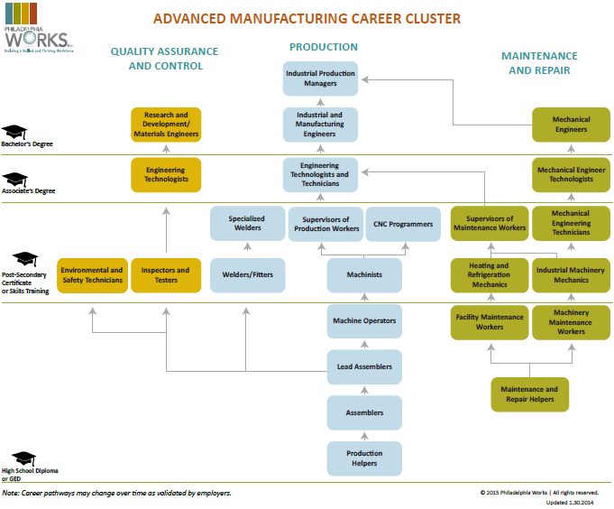
Vetting of Workforce Strategies- Career Pathways

Slide 24

Presenters
Presenter: Frank Cettina
Title: Vice President, Operations
Organization: Computer Components

Slide 25

Dynamics - Industry Engagement and Benefits
Industry Engagement:
  Collegial, Non-Competitive Interaction
  Senior-Level Leadership, Labor Representation
  Monthly Meetings
  Peer Learning, Shared Needs, Mutual Benefits
Benefits- Return on Investment:
  Decreased attrition, hiring costs
  2,000+ Credentials Awarded
  Establish relationships that accelerate industry-wide product and process innovation

Slide 26
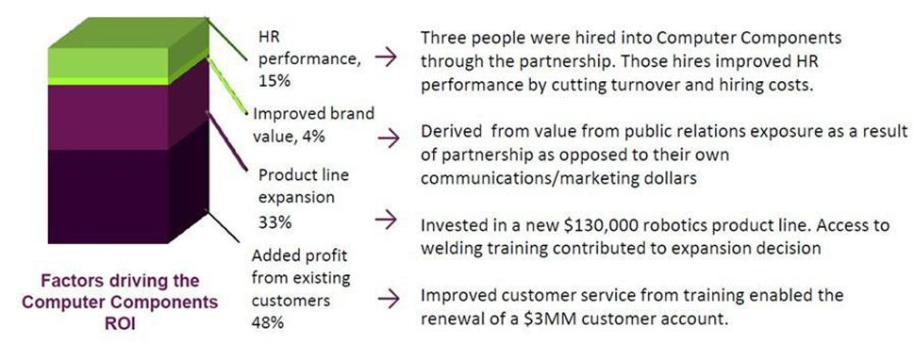
Measuring Success
In an independent study presented by the Job Opportunity Investment Network (JOIN), one of the partnership’s employers, Computer Components, was featured as a case study to demonstrate the return on investment (ROI) of workforce development partnerships.
The study calculated a five-year business return on investment of 407%:

Slide 27

Additional Measures of Success
Increased engagement with the Public Workforce System
Credential Attainment
Wage Increases
Promotions
Sustainability

Slide 28

Lessons Learned
Industry led – “means Industry led”
Empower the members
Actively Listen
Be flexible
If it does not fit – don’t force it

Slide 29
Please Enter your Questions in the Chat Room!

Slide 30
Polling Question
What are some of the benefits of an industry led sector strategy?
Decreased attrition
Partner who provides data and advice in terms of industry and labor needs
Lower hiring costs
All of the above

Slide 31
Presenters
Presenter: Navjeet Singh
Title: Deputy Director, National Fund for Workforce Solutions
Organization: Jobs for the Future

Slide 32
THE NATIONAL FUND FOR WORKFORCE SOLUTIONS
The National Fund for Workforce Solutions
Based in Boston, MA
National partnership of employers, workers, communities and philanthropy
Implements demand-driven strategies that create talent supply chains
Advances workers into family-supporting careers
Improves workforce development systems
Operating in 35 communities across the United States
Promotes the development of employer-led industry partnerships that guide educational and training investments in skills and credentials
To learn more visit http://nfwsolutions.org.

Slide 33
THE NATIONAL FUND for WORKFORCE SOLUTIONS
National Fund for Workforce Solutions/
Jobs for the Future
Individuals Served, Trained, Placed, Retained
Regional Collaboratives
Systems Change:
State policy & $
Individuals Served, Trained, Placed, Retained
Industry Partnerships
Employers
Served, Systems Change
Individuals Served
Trained, Employed, Retained
Systems Change: National, State & Industry
Employers Served
Employers Served

Slide 34
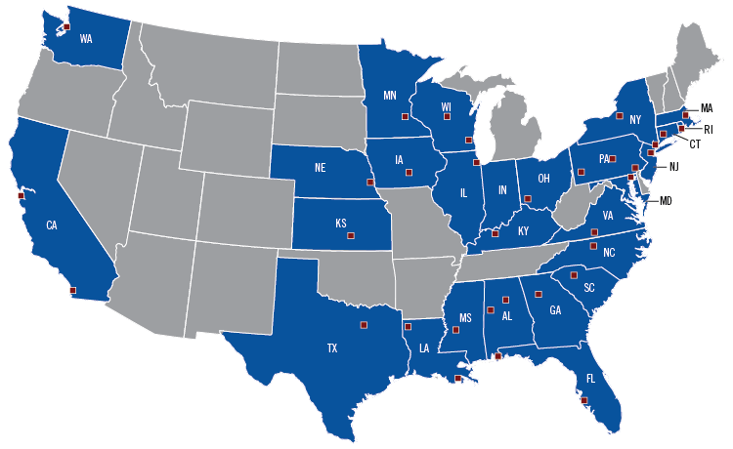
NATIONAL FUND COLLABORATIVES

Slide 35
CHARACTERISTICS OF A HIGH-PERFORMING INDUSTRY PARTNERSHIP
Develops and maintains Employer Leadership
Produces excellent outcomes for individuals and employers
Serves low-skill, low-wage individuals
Promotes career advancement
Promotes industry recognized credentials
Communicates key information to stakeholders
Operates with knowledgeable staffing provided by or through an intermediary

Slide 36
Navjeet SingH
Deputy Director, National Fund for Workforce Solutions
nsingh@jff.org
TEL 617.728.4446 FAX 617.728.4857
88 Broad Street, 8th Floor, Boston, MA 02110
WWW.NFWSOLUTIONS.ORG
TEL 617.728.4446 FAX 617.728.4857 info@jff.org
88 Broad Street, 8th Floor, Boston, MA 02110 (HQ)
122 C Street, NW, Suite 650, Washington, DC 20001
505 14th Street, Suite 900, Oakland, CA 94612
WWW.JFF.ORG

Slide 37
Please Enter your Questions in the Chat Room!

Slide 38

Save the Date… Upcoming Events
Supporting Sector Strategies: Boston Convening - Resources Available
This convening, which was held on April 14-15, 2015, in Boston, MA, was the third in a national series offered through the Department of Labor’s Employment
and Training Administration's Supporting Sector Strategies Initiative.
Resources available at: http://businessengagement.workforce3one.org/
Supporting Sector Strategies: Virtual Meeting
This virtual meeting, will bring together themes, lessons learned, best practices,
and requested Technical Assistance from all three national convenings and all
three national webinars. It will feature opportunities to interact virtually with
panels of experts and your Sector Strategies peers, and several open Q&A sessions.
Registration will be available soon at: http://businessengagement.workforce3one.org/

Slide 39
Save the Date… Upcoming Events
Peer Learning Groups The Sector Strategies Peer-Learning Groups are topic-specific groups (Labor Market Information/Data Solutions, Work-Based Learning, and Industry Engagement) for those interested in pursuing sector strategies work to engage one another and learn from experts in monthly facilitated one-hour phone discussions. We have had tremendous participation and robust discussion in these so far, so please join us for our May calls!
For more information visit: http://businessengagement.workforce3one.org/

Slide 40
Please Enter your Questions in the Chat Room!

Slide 41

Speakers’ Contact Information
Speaker: Diane Walton
Organization: U. S. Department of Labor/ETA (San Francisco
Email: Walton.diane@dol.gov; 415-625-7924
Speaker: Stephanie Steffens
Organization: Colorado Workforce Development Council
Email: stephanie.steffens@state.co.us
Speaker: Barbara Allen & Brian K. Oglesby
Organization: Philadelphia Works
Email: ballen@philaworks.org
Speaker: Frank Cettina
Organization: Computer Components Corp.
Email: fcettina@compcomp.com
Speaker: Navjeet Singh
Organization: Jobs for the Future
Email: nsingh@jff.org; 617.728.4446

Slide 42
Thank You!
Find resources for workforce system success at:
www.workforce3one.org

