Slide 1
Credentials that Count for Youth
Enough is Known for Action
Webinar Series
April 29, 2015
11am Pacific/2pm Eastern

Slide 2
Credentials that Count for Youth: Today’s Moderator
Diane Walton
Training and Technical Assistance
Office of the Regional Administrator
U.S. Department of Labor
Employment and Training Administration
San Francisco Regional Office
walton.diane@dol.gov

Slide 3
Why This Topic?
We heard your requests during our WIOA consultations
Helping youth attain credentials is a critical goal outlined in WIOA

Slide 4
A Critical Goal in WIOA
WIOA

Slide 5
Credentials Matter
By 2018, over two-thirds of American jobs will require some post-secondary education or training, with nearly one-third of all jobs available to those with an associate’s degree.
These “middle-skill” occupations include electricians, construction managers, dental hygienists, paralegals, and police officers.
They pay a significant premium over many jobs open to those with just a high school degree.
27% of people with post-secondary licenses or certificates—credentials short of an associate’s degree—earn more than the average bachelor’s degree recipient.

Slide 6
Today’s Agenda:
Welcome
Background
Toolkit with local examples
San Jose, California
Southern Oregon
Pima County, Arizona
Burlington, Iowa
Q and A
Resources

Slide 7
Credentials that Count for Youth:
Sara Hastings
Workforce Analyst
U.S. Department of Labor
Employment and Training Administration
Division of Youth Services
hastings.sara@dol.gov

Slide 8
What do we mean by Recognized Postsecondary Credential?
WIOA Definition:
Recognized Postsecondary Credential — means a credential consisting of an industry-recognized certificate or certification, a certificate of completion of an apprenticeship, a license recognized by the State involved or Federal Government, or an associate or baccalaureate degree.

Slide 9
Primary Indicator of Performance
Credential measure:
The percentage of program participants who obtain a recognized postsecondary credential, or a secondary school diploma or its recognized equivalent (subject to clause (iii)), during participation in or within 1 year after exit from the program
Indicator Relating to this measure:
Program participants who obtain a secondary school diploma or its recognized equivalent shall be included in the percentage counted as meeting the criterion under such clause only if such participants, in addition to obtaining such diploma or its recognized equivalent, have obtained or retained employment or are in an education or training program leading to a recognized postsecondary credential within 1 year after exit from the program

Slide 10
Guidance on Credentials
The Notice of Proposed Rulemaking (NPRM) was released.
For access to NPRM and all other information related to WIOA, please visit DOL’s WIOA page at: http://doleta.gov/WIOA/
Most recent guidance related to credentials: Training and Employment Guidance Letter (TEGL) 15-10:
Increasing Credential, Degree, and Certificate Attainment by Participants of the Public Workforce System http://wdr.doleta.gov/directives/corr_doc.cfm?DOCN=2967

Slide 11
Poll Questions
Two Questions:
To what degree do you feel your programming focuses on helping youth attain secondary credentials – high school diploma or equivalency?
(answers: It’s our primary focus; it’s one of our key program elements; we offer it to some; we do not offer it)
To what degree do you feel your programming focuses on helping youth attain recognized postsecondary credentials?
(answers: It’s our primary focus; it’s one of our key program elements; we offer it to some; we do not offer it)

Slide 12
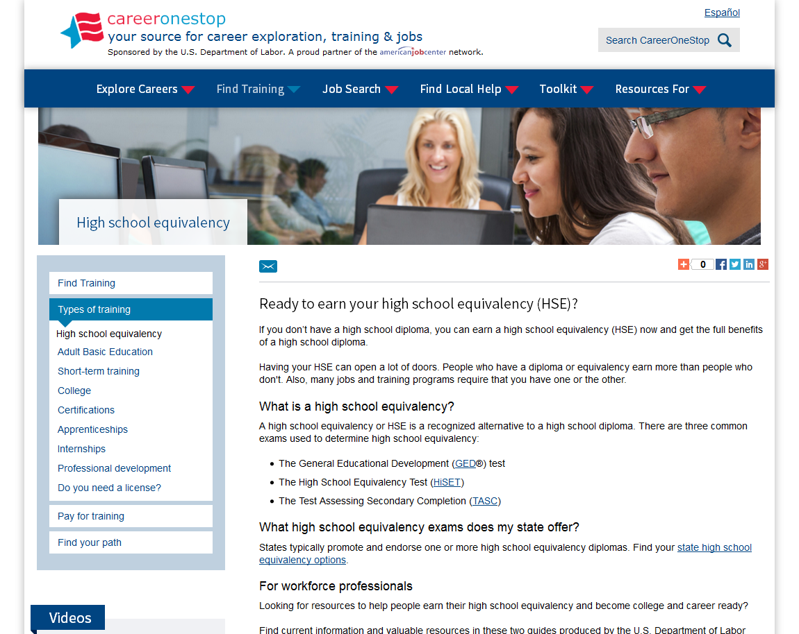
Resource Guides
ETA released two Resource Guides for the Workforce System:
High School Equivalency
College and Career Readiness
http://www.careeronestop.org/findtraining/types/high-school-equivalency.aspx

Slide 13
Chat Question
What strategies have you used
to prepare youth to be successful in taking the new GED®, TASC, or HiSET?

Slide 14
Credentials for Youth Toolkit
Employment and Training Administration (ETA) developed the Credentials for Youth tool.
This tool provides a step-by-step process for helping youth attain credentials in high demand occupations.
In addition, the tool provides local examples of programs that help youth attain credentials.
The Toolkit is available at https://youth.workforce3one.org/page/credentials.

Slide 15
Steps to help youth attain credentials in high-demand occupations
Step 1
Finding High Demand Occupations Using Labor Market Information (LMI)
Step 2
Finding Promising Occupations for Youth Served by the Workforce System
Step 3
Determining Occupations with Pathways to Career Advancement
Step 4
Discovering Credentials Needed for Identified Promising Occupations

Slide 16
Finding High Demand Occupations Using Labor Market Information (LMI)
Step 1
Simplifies career exploration, provides an online interest assessment, and easy-to-read occupation profiles that link to specific local training, credentials, and job openings information

Slide 17
work2future San Jose, CA
Chris Donnelly
David Mirrione
Director
San Jose Silicon Valley Workforce Investment Board – work2future
Christopher.donnelly@sanjoseca.gov
5730 Chamberlin Drive
San Jose, CA 95118
408.794.1100
Executive Director
Work2future Foundation
David.mirrione@work2futurefoundation.org
1601 Foxworthy Avenue
San Jose, CA 95118
408.794.1100

Slide 18
work2future Youth Program
Since 2008, work2future has only served Out-of-School Youth 17-21
Career assessments, trainings, employer outreach and placements based on local and current labor market information on in-demand occupations and sectors
Four of our nine sectors are focused toward youth: Construction, Hospitality, Retail and Manufacturing
Youth Program focuses on Occupational Skills Training (OST)
Delivered by local youth training providers with performance-based contracts
All youth enrolled in work2future youth programs receive two industry recognized certifications - California Food Handler Certification and National Retail Foundation (NRF) Customer Services Certification - prior to additional OST

Slide 19
Finding High Demand Occupations Using LMI-Process - Advice
Step 1
Research in-demand sectors in your area using LMI tools such as EDD, EMSI Analyst, Wanted Analytics and Econovue Services
Start with a top-down, comprehensive approach and list all the occupations (include information on employment, annual openings, actual hiring, employment concentration, hourly earnings, entry level education).
Identify occupations which have grown over the last three years and occupations expected to grow over next three years (actual employment gain).
Screen by education level and hourly earnings to eliminate higher level growth occupations. Show growth potential within each occupation through hourly earnings. (Horizontal Growth)
Cluster occupations to identify different career advancement pathways (Vertical Growth). Help youth clients set a goal for themselves and explore various occupation options in selected priority sectors.
Perform detailed analysis of current job postings and job-openings to introduce youth to job titles and changing employer demands in selected occupations.

Slide 20
Finding High Demand Occupations Using LMI-Process - Advice
Step 1
Identify and partner with training providers to discuss findings and gauge capacity to deliver training for growth occupations. Validate curriculum with employers
Engage employers to hire program graduates and encourage youth to participate in organized job fairs, specialized recruitment events, job shadows, etc.
Establish linkages between youth and adult programs so that youth clients can have access to further training and education while moving along in their customized career pathways.
Based on our LMI analysis, work2future will develop new training models for entry level positions with a credential or certification in the following areas:
All youth that complete trainings will be placed in 6-8 week paid internships.
Certified Production Technician
Introduction to Coding and Technical Support Specialist
Pre-Apprenticeship – Green Cadre / Urban Corps
Institutional Culinary Training
Certified Nursing Assistant (CNA)

Slide 21
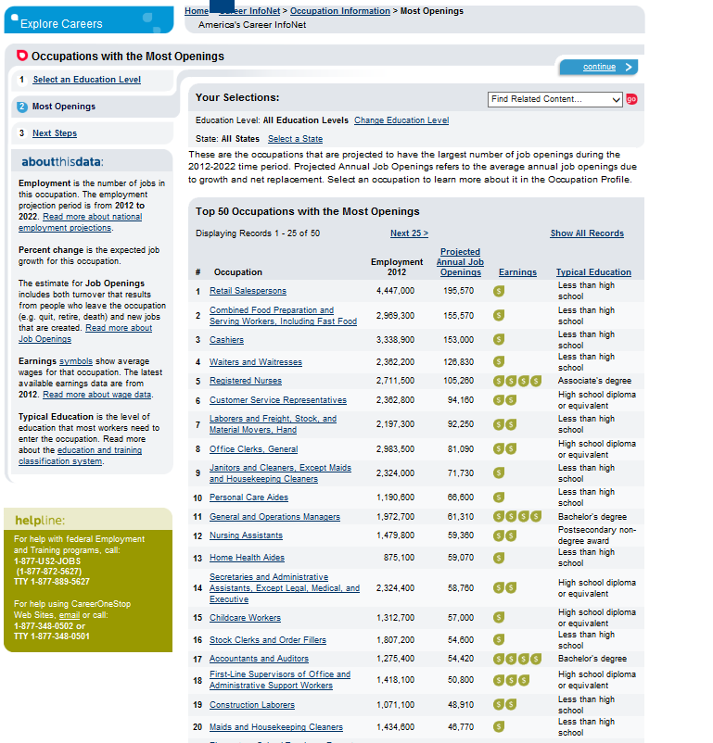
Finding Promising Occupations for Youth Served by the Workforce System
Step 2
Goals should vary based on the age, school enrollment status, and educational attainment of individual youth.
Looking at lists of occupations by educational level is a good way to begin identifying jobs that are promising and appropriate for youth.
America's Career InfoNet is a good source for sortable occupations list.

Slide 22
The Job Council Southern Oregon
Cindy Manning
Jen Perry
In-School Program Manager
Career Build
College Dreams
Jperry@collegedreams.org
(541) 218-4539
Out-of-School Youth Employment Specialist
The Job Council Medford, Oregon
CindyM@JobCouncil.org
(541) 842-2548

Slide 23
The Job Council Southern Oregon
Opportunities for Out-of-School Youth
16-21 NOT attending high school or GED, we can help you:
Opportunities for In-School Youth
Junior or Senior attending Grants Pass, Gladiola, Phoenix or Central Medford High Schools, we can help you:
Gain hands on experience
Develop your professional portfolio
Explore careers/industry tours
Obtain workplace certifications
Learn about education and training opportunities
Receive paid stipends or wages
Receive continued employment assistance after completion
National Career Readiness Certification
Support for graduation attainment
College and industry tours
Career exploration events
Work ethics classes
Summer employment opportunities
College and career mentoring
Regional career fairs (Careers in Gear)
Sector-specific workshops
National Career Readiness Certification
Earn Cash! Get Experience!
Explore Careers & Colleges!

Slide 24
Finding Promising Occupations for Youth - Advice
Step 2
CareerX
Getting a pulse on the labor market and assessing career strengths
Building your personal brand: Marketing yourself online and in person
Creating a winning resume and cover letter
Communication in the workplace
Interviewing
Workplace culture and action planning
Customer service
Training options
Industry tour
NCRC/CASAS and OPAC labs for Certifications

Slide 25
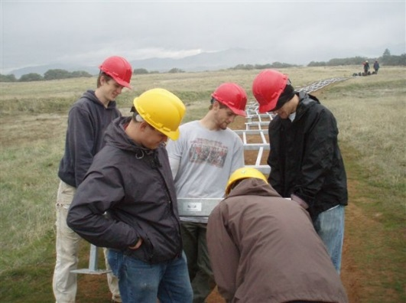
Finding Promising Occupations for Youth - Advice
Step 2
Creating pathways to promising occupations with entry level opportunities
https://qualityinfo.org and Career Information System – Reality Check
Industry tours, job fairs, job shadows and employer forums to identify local opportunities to connect youth to employers – Youth guided whenever possible!
Healthcare / Caregiver
CNA1 - CNA2 - Future
Forestry
building bridges to new opportunities

Slide 26
Determining Occupations with Pathways to Career Advancement
Step 3
Sample Career Ladder/Lattice for Information Technology
Entry-level jobs can help youth get valuable work experience and can be a good first step into the world of work
Help ensure youth are entering occupations in which they are interested and have the ability to be successful, with career ladder potential
Youth should be encouraged to pursue and be provided adequate information on occupations where there is a clear path to specialize or advance

Slide 27
Pima County, Arizona
Gerri Brunson
Workforce Development Specialist
2797 E. Ajo Way
Tucson AZ 85713
gbrunson@pima.gov
phone 520.724-3733
fax 520.724.6799

Slide 28
Pima County, Arizona
Outreach efforts
Data collection
Analysis
Common needs
Credentials
Skill gaps
Focus groups
Identify career paths
Aviation Technology
Biotech
Cyber Security
Machine Tool Technology
Health Information Technology
STEM Metromatematicas
One-Stop Centers
Career Pathways
Workforce agency
Business
Education
Academic pathways
Transferrable articulated curriculum
Technical skills
Dual credits & Career Path alignment
Utilizes a replicable model of collaboration between One-Stop Career Centers, Business Community, School Districts, and Higher Education throughout the Southern AZ region that reaches to economic success involving Communication ⇨ Collaboration ⇨ Education

Slide 29
Determining Occupations with Pathways to Career Advancement
Step 3
https://www.youtube.com/watch?v=sVtGJ4S9SLQ
SAMP
Video

Slide 30
Discovering Credentials Needed for Identified Promising Occupations
Step 4
Use the Career Report to Find Training and Find Certifications
Additional resources related to credentials can also be found on the Workforce Credentials Information Center

Slide 31
YouthWorks Burlington, Iowa
Debbie Dowell, CWDP: MS
Regional Director
IowaWORKS, Southeast Iowa
1000 N. Roosevelt Ave.
Burlington, IA 52601
Debbie.Dowell@IWD.Iowa.gov
319.753.1671 ext. 31406
319.753.5881 fax

Slide 32
YouthWorks Burlington, Iowa
WIA Youth program administered by Southeastern Community College, serving a 4 county area in Southeast Iowa
Local economy consists of 4 major industry sectors:
Manufacturing
Construction Trades
Health Occupations
Business/ Service Industry
Team with industry professionals around curriculum development, project development and continuous improvement
Current youth enrollments comprised of 50-50 ISY/OSY
Strong business relationships allow for opportunities in career exploration, on-the-job learning and placement

Slide 33
Discovering Credentials Needed for Identified Promising Occupations
Step 4
Career portfolios are created for each participant of the YouthWORKS program.
In addition to industry-recognized credentials, stackable occupational certificates add to a youth’s portfolio:
Workplace Readiness “Bring Your A Game to Work”
CPR/ First Aid
OSHA 10
Forklift Operations
Intro to Manufacturing
Intro to Health
Intro to Trades
Customer Service
Retail Sales/ Cash Register Operation

Slide 34
Discovering Credentials Needed for Identified Promising Occupations
Step 4
With the alignment with the pathway industry sector for regional demand, credential offerings include:
Construction/ Trades
NCCER Introductory Craft Skills Certification/OSHA 10
Health Occupations
Certified Nurse Aide
Direct Care Worker Professional
Advanced Manufacturing
MSSC Certified Production Technician
Business/ Finance
Microsoft Office Certification
Service Industry
Para-Educator Certification
ServSafe Food Safety Certification

Slide 35
Discovering Credentials Needed for Identified Promising Occupations
Step 4
Develop and maintain relationships with local and regional businesses supporting our schools and communities.
Provide participants with career-counseling; allowing for exploration into industry sectors, identifying jobs that meet their interests, values and abilities.
Work/partner with training providers to develop training opportunities to meet the needs of employers and participants.
Avoid the “one size fits all” mold with training/work-based learning opportunities.

Slide 36
Toolkit CLOSE

Slide 37
Credentials that Count for Youth

Slide 38
What’s My Next Move?
What’s My Next Move:
Designed to help high-school students manage their career and employment path.
A simple, seven-step guide to print or use online; a great combination of easy access to online resources and straightforward action items for teens to complete on their own or in with an adult.
http://www.careeronestop.org/TridionMultimedia/WMNM%20FINAL%20JAN%2007%202013_tcm24-13704.pdf

Slide 39
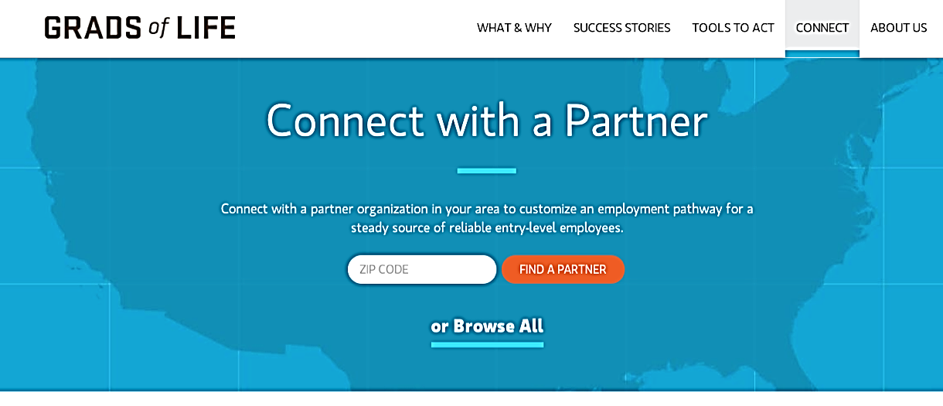
Want to connect with more employers?
Join the Grads of Life partner directory!
GradsofLife.org, an employer-focused website, provides compelling evidence, tools, and partners employers need to develop, mentor, train, and hire opportunity youth.
Apply today to be featured in the partner directory so employers in your area can reach out and work with you to create employment opportunities for young adults.
Apply here:
http://gradsoflife.org/get-involved/partner-application/

Slide 40
Other Key Resources
My Next Move simplifies career exploration through 3 search options, an online interest assessment, and easy-to-read occupation profiles that link to specific local training, credentials, and job openings information.
mySkills myFuture helps workers looking to change careers identify related occupations, current local job openings and outlook for those related occupations, as well as local training opportunities and required credentials.
O*NET Online provides detailed occupational requirements and characteristics that job seekers can use to create skills-based resumes and that businesses can use to enhance hiring and retention efforts.
CareerOneStop provides tools to help job seekers explore careers, research education and training opportunities, plan a job search, browse job sites, and much more.

Slide 41
Upcoming Webinars
Last Wednesday of each month
Youth Committees May 27th - 2:00pmET
Serving In-School Youth June 24th - 2:00pmET
Youth with Disabilities July 29th - 2:00pmET

Slide 42
Credentials that Count for Youth
Thank You!

