Slide 1
June 18, 2015
Implementing Creative Commons Attribution Licenses on Your TAACCCT Content: A How-To Guide

Slide 2
TAACCCT LEARNING NETWORK
AT A GLANCE
U.S. Department of Labor, Employment & Training Administration
(National)
Jobs for the Future
CalState/Merlot
Maher & Maher
American Association of Community Colleges
U.S. National Science Foundation
ATE Centers
Other Non-Federal Providers of TA and Resources for TAACCCT Grantees:
Creative Commons
CAST
The Transformative Change Initiative

Slide 3
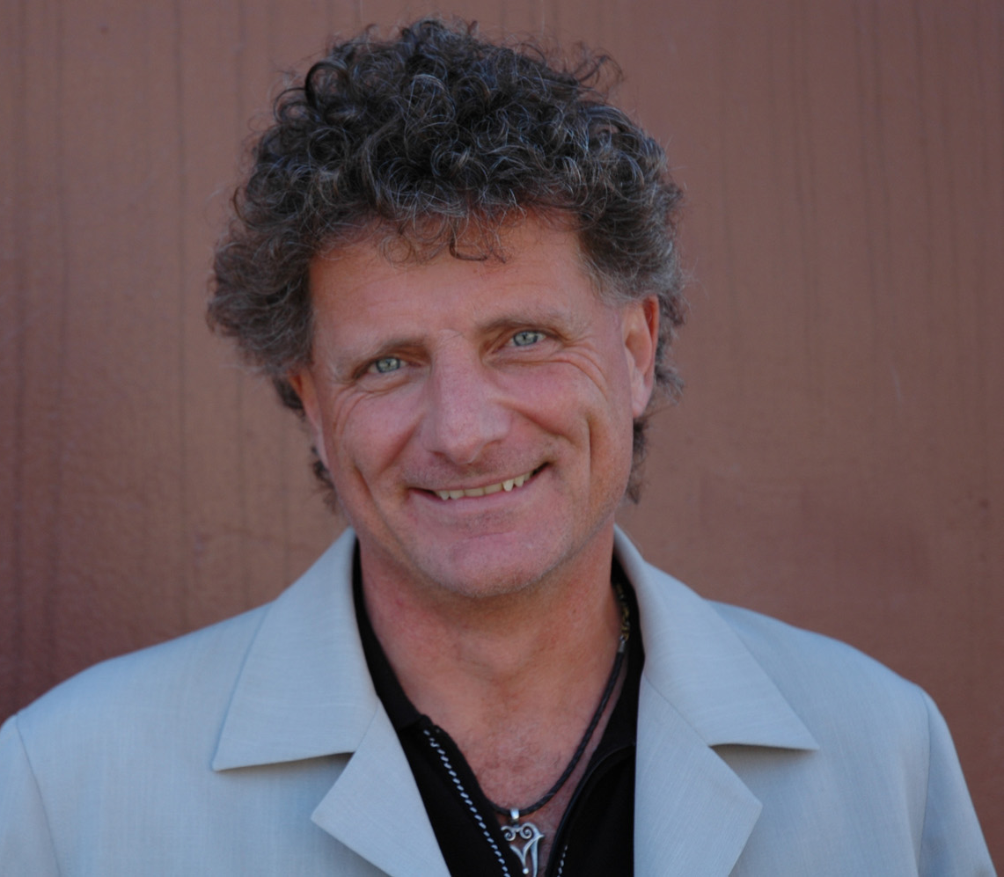
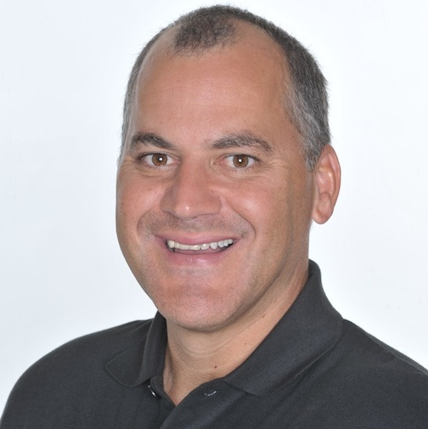
Presenters
Paul Stacey
Associate Director of Global Learning, Creative Commons
Rick Lumadue
Program Manager, Skillscommons.org

Slide 4
Agenda
Applying the Creative Commons (CC BY) license to newly developed works using the Creative Commons license chooser
Applying CC BY to documents, marketing and promotion materials, and program support materials
Creating appropriate attribution statements so you get credit for your work
TAACCCT grantee examples
Learn about a workflow process and set of templates for managing & tracking this through the production process
Finding and using help resources

Slide 5
Applying the Creative Commons (CC BY) license to newly developed works using the Creative Commons license chooser

Slide 6
Licensing your work is easy. No registration is required.
You simply add a notice that your work is under CC BY.
Here’s how you do that →

Slide 7
Go to:
creativecommons.org/choose

Slide 8
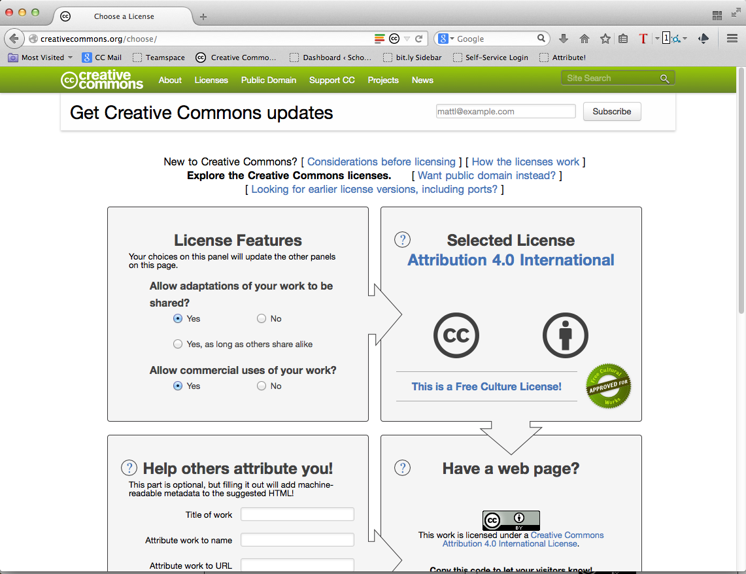
http://creativecommons.org/choose

Slide 9
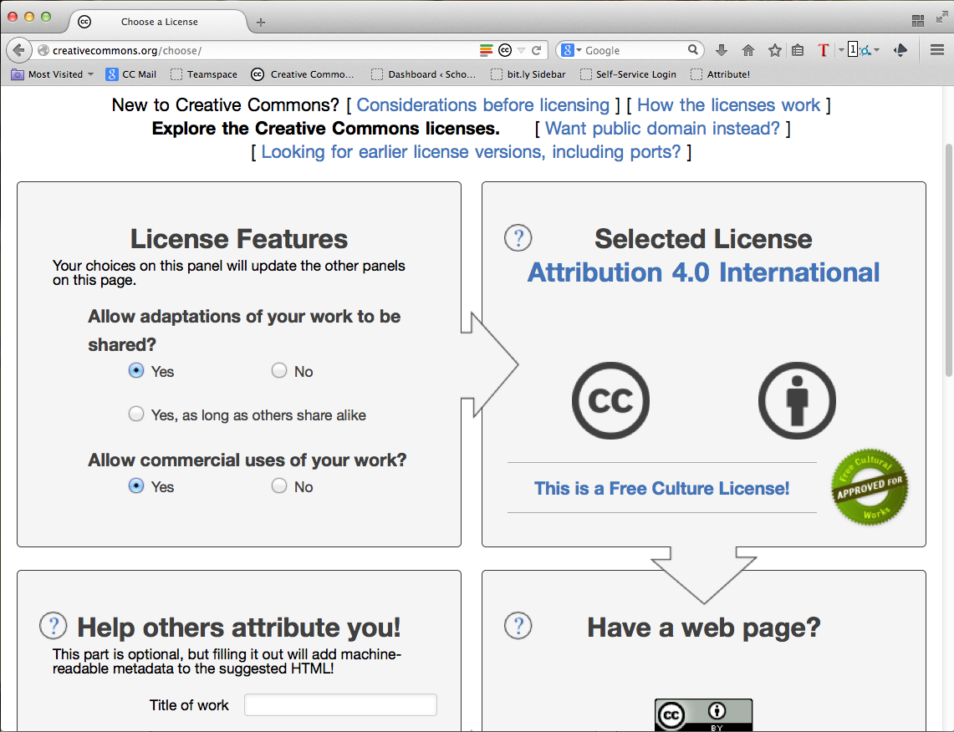

Slide 10
DOL says:
CC BY 3.0 or 4.0 are okay

Slide 12
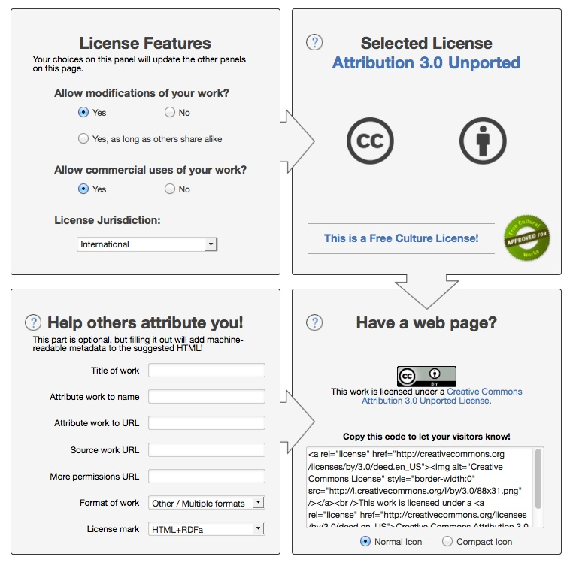

Slide 13
<a rel="license" href="http://creativecommons.org/licenses/by/3.0/"><img alt="Creative Commons License" style="border-width:0" src="http://i.creativecommons.org/l/by/3.0/88x31.png" /></a><br />This work is licensed under a <a rel="license" href="http://creativecommons.org/licenses/by/3.0/">Creative Commons Attribution 3.0 Unported License</a>.v
________________________________________________________
This work is licensed under a Creative Commons Attribution 3.0 Unported License.

Slide 14
You can edit the text for your specific project.
Go back to:
http://creativecommons.org/choose

Slide 15
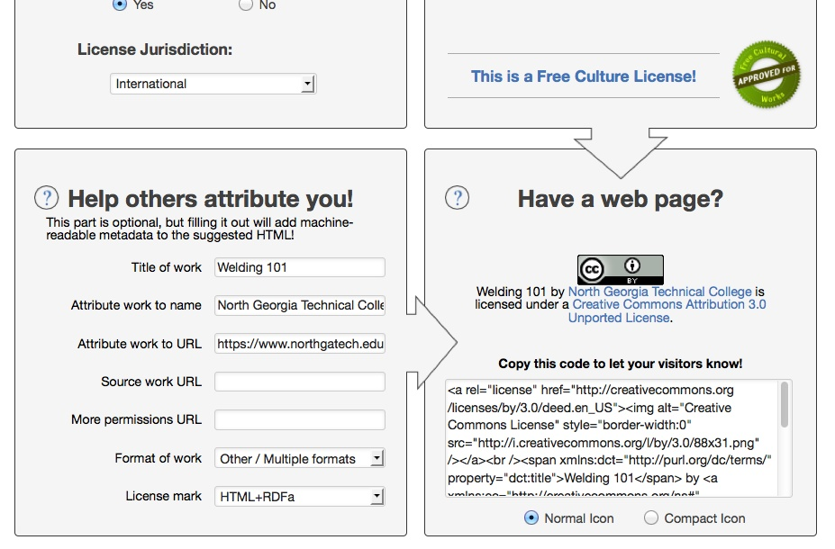
Optional fields

Slide 16
<a rel="license" href="http://creativecommons.org/licenses/by/3.0/deed.en_US"><img alt="Creative Commons License" style="border-width:0" src="http://i.creativecommons.org/l/by/3.0/88x31.png" /></a><br /><span xmlns:dct="http://purl.org/dc/terms/" property="dct:title">Welding 101</span> by <a xmlns:cc="http://creativecommons.org/ns#" href="https://www.northgatech.edu/" property="cc:attributionName" rel="cc:attributionURL">North Georgia Technical College</a> is licensed under a <a rel="license" href="http://creativecommons.org/licenses/by/3.0/deed.en_US">Creative Commons Attribution 3.0 Unported License</a>.
________________________________________________________
Welding 101 by North Georgia Technical College is licensed under a Creative Commons Attribution 3.0 Unported License.

Slide 17
What if I want to add the notice to a document, marketing and promotion materials, or program support materials?
Go back to:
http://creativecommons.org/choose

Slide 18
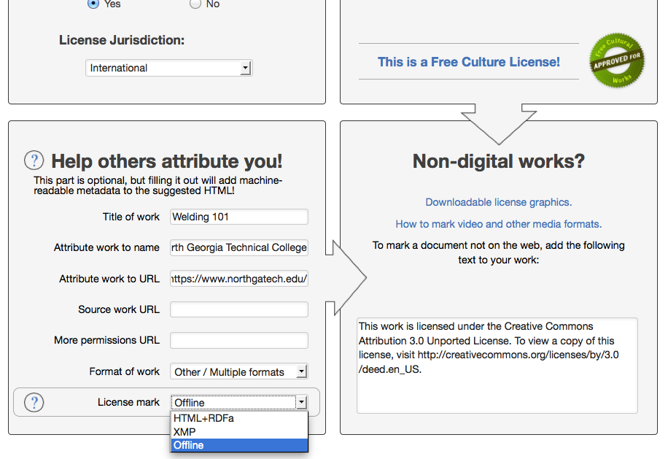

Slide 19
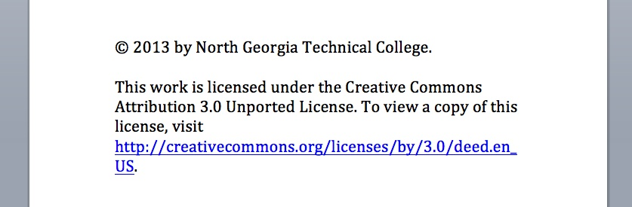
Paste where you usually put © info

Slide 20
Examples →

Slide 21
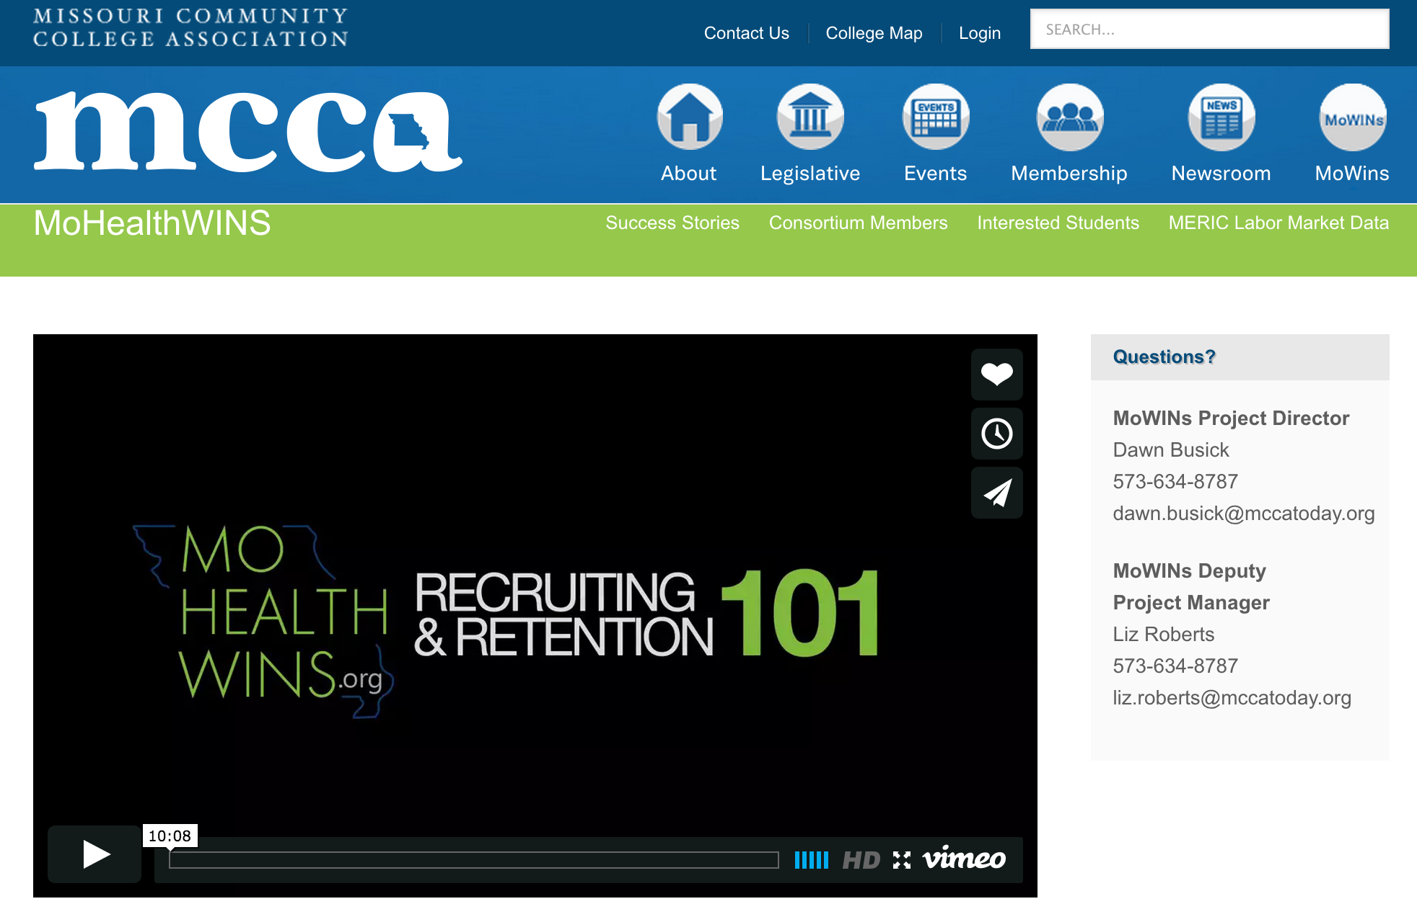
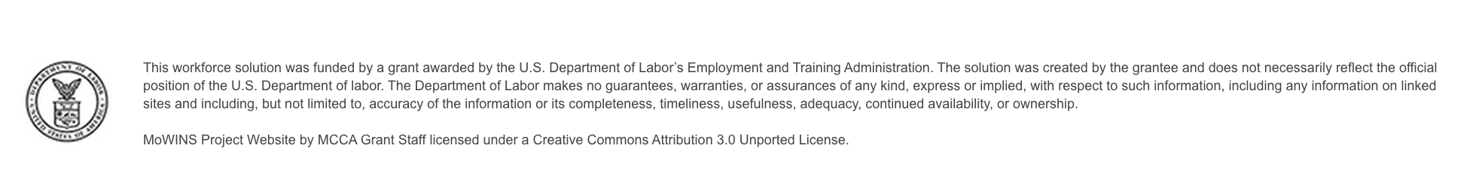
http://mccatoday.org/mohealthwins/

Slide 22


Slide 23
“Missouri Credit for Prior Learning Model is licensed under the Creative Commons Attribution 3.0 Unported License. To view a copy of this license, visit http://creativecommons.org/licenses/by/3.0.”

Slide 24
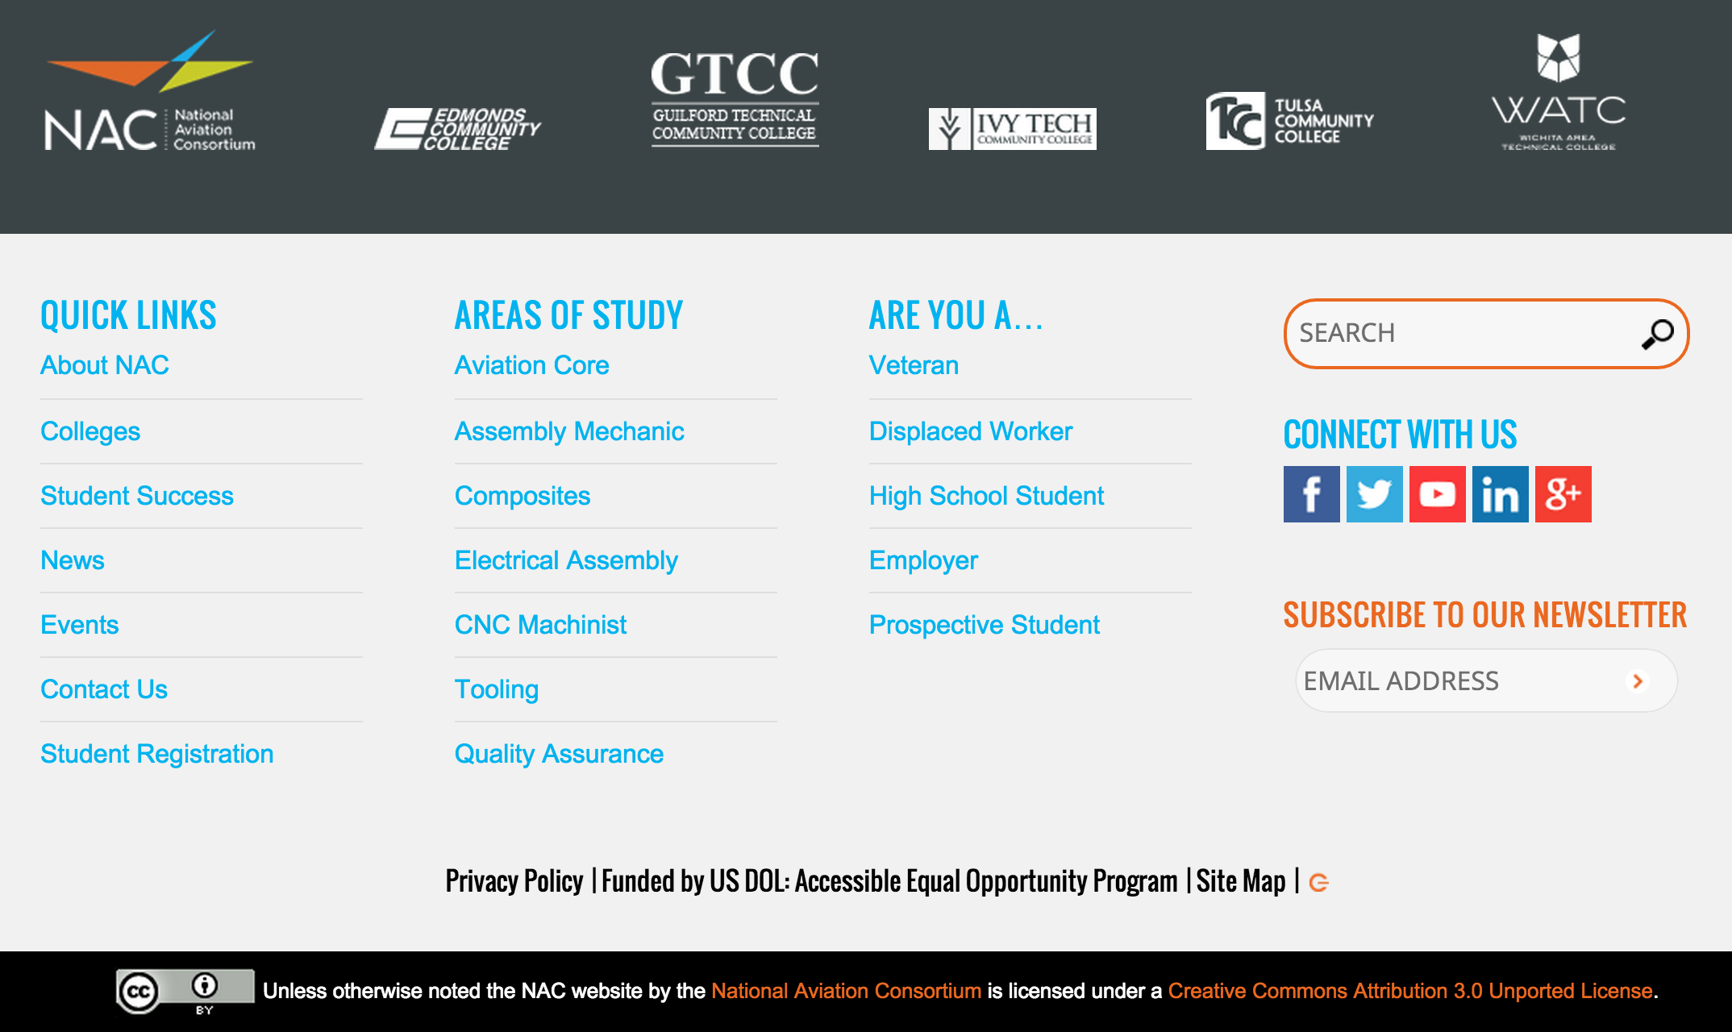
http://naccareers.com/

Slide 25
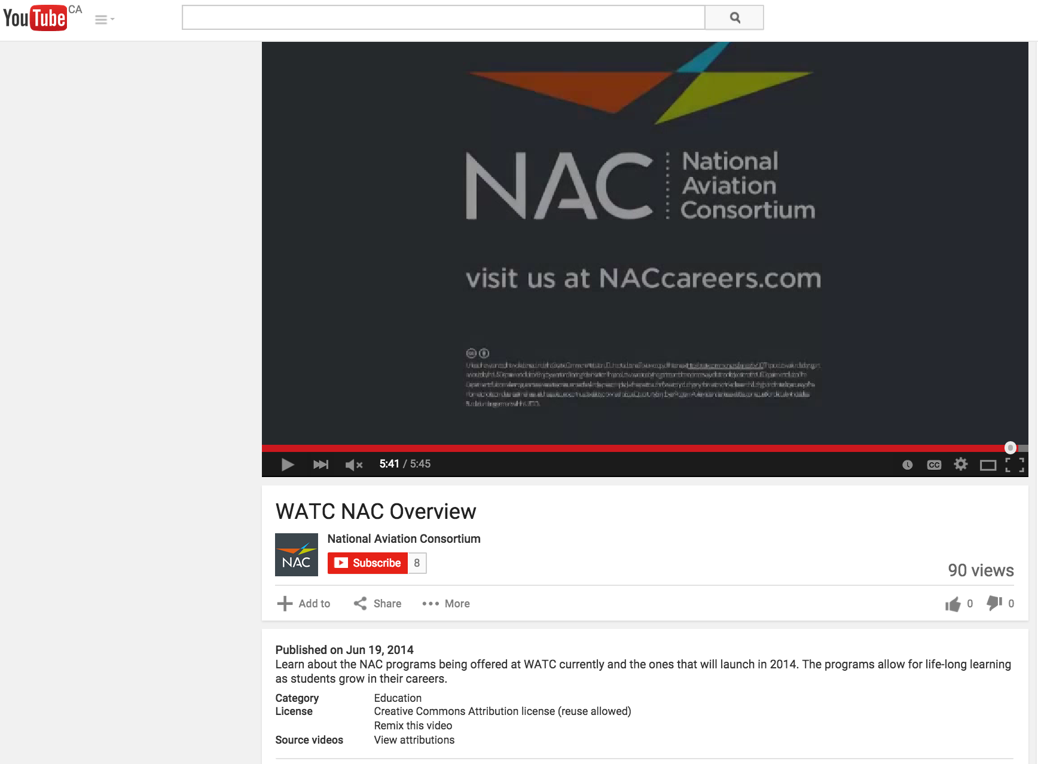
https://youtu.be/S0bumAebi4E

Slide 26
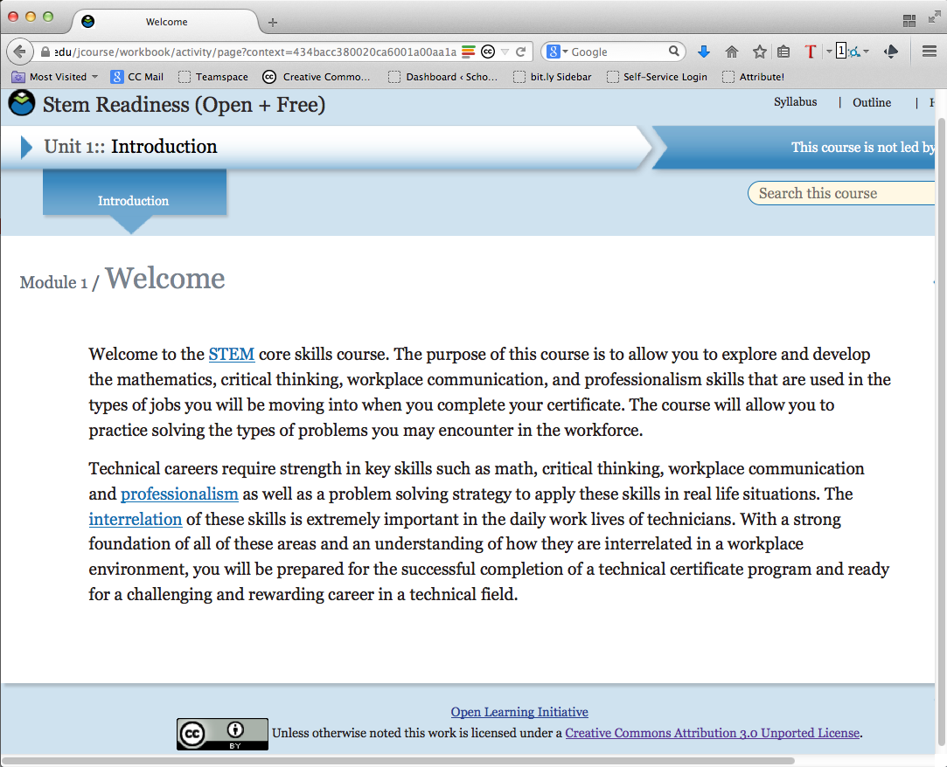

Slide 27
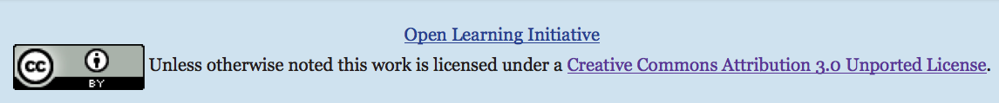
Unless otherwise noted this work is licensed under a Creative Commons Attribution 3.0 Unported License.”

Slide 28
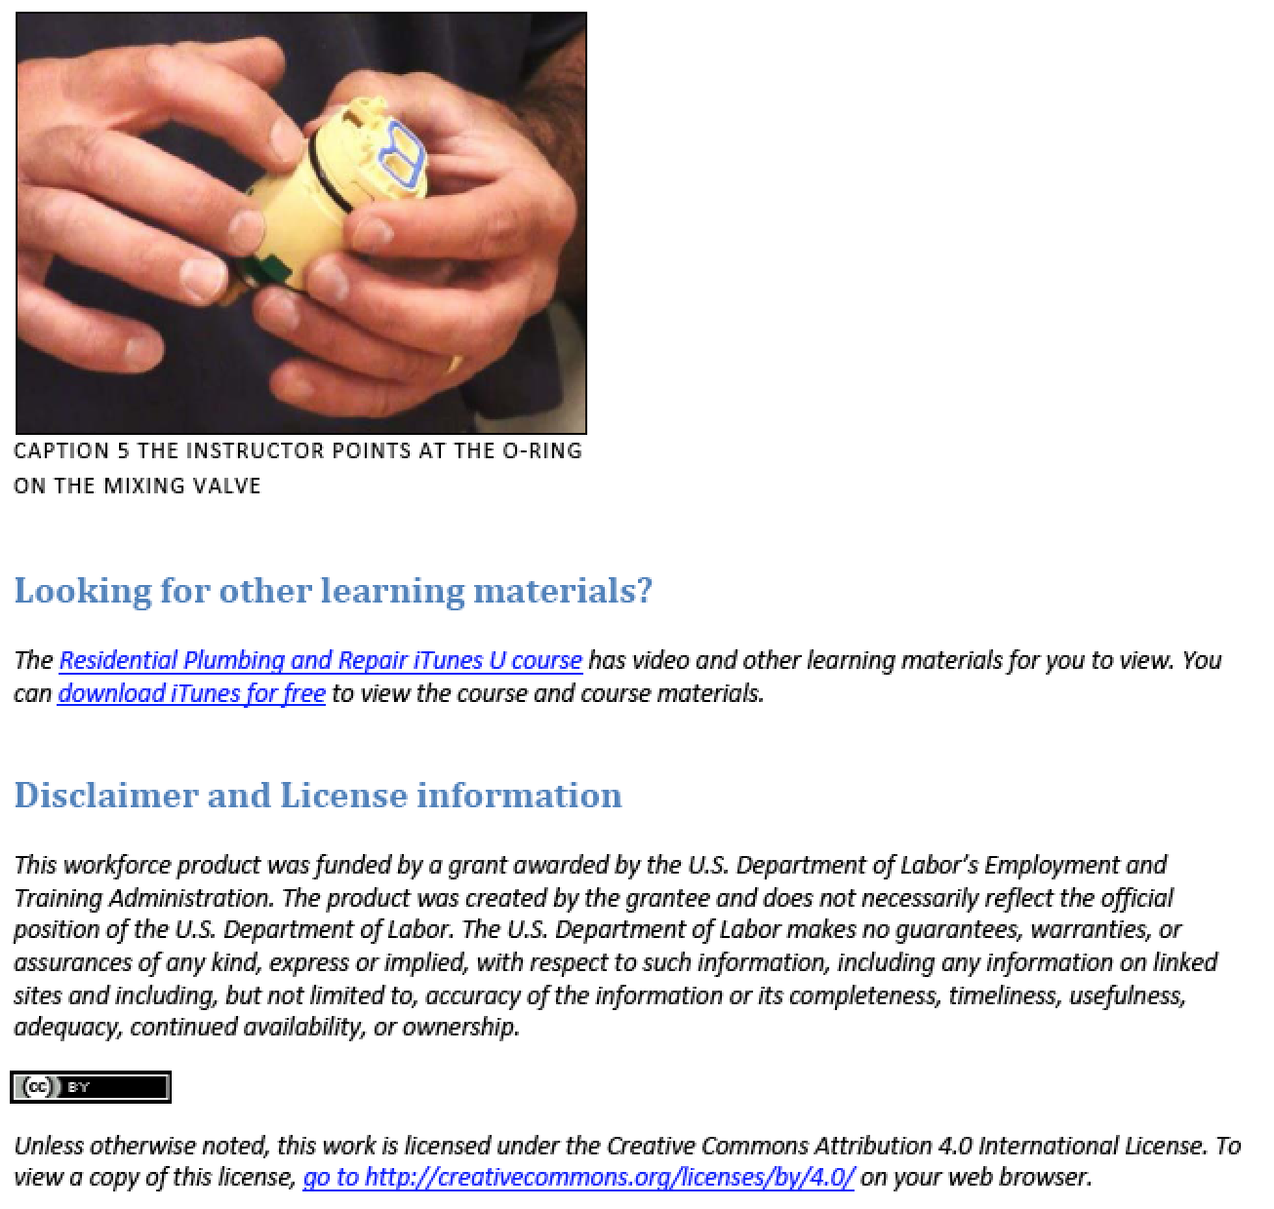
SHOWER FIXTURE A handout containing the highlights of the video titled Residential Plumbing and Repair: Shower Fixture

Slide 29
Screen share – with live Q&A

Slide 30
Creating appropriate attribution statements so you get credit for your work.

Slide 32

Best Practices for Attribution: (TASL)
Title
Author
Source – Link to work
License – Name + Link
Peace Bridge by D'Arcy Norman CC BY

Slide 33
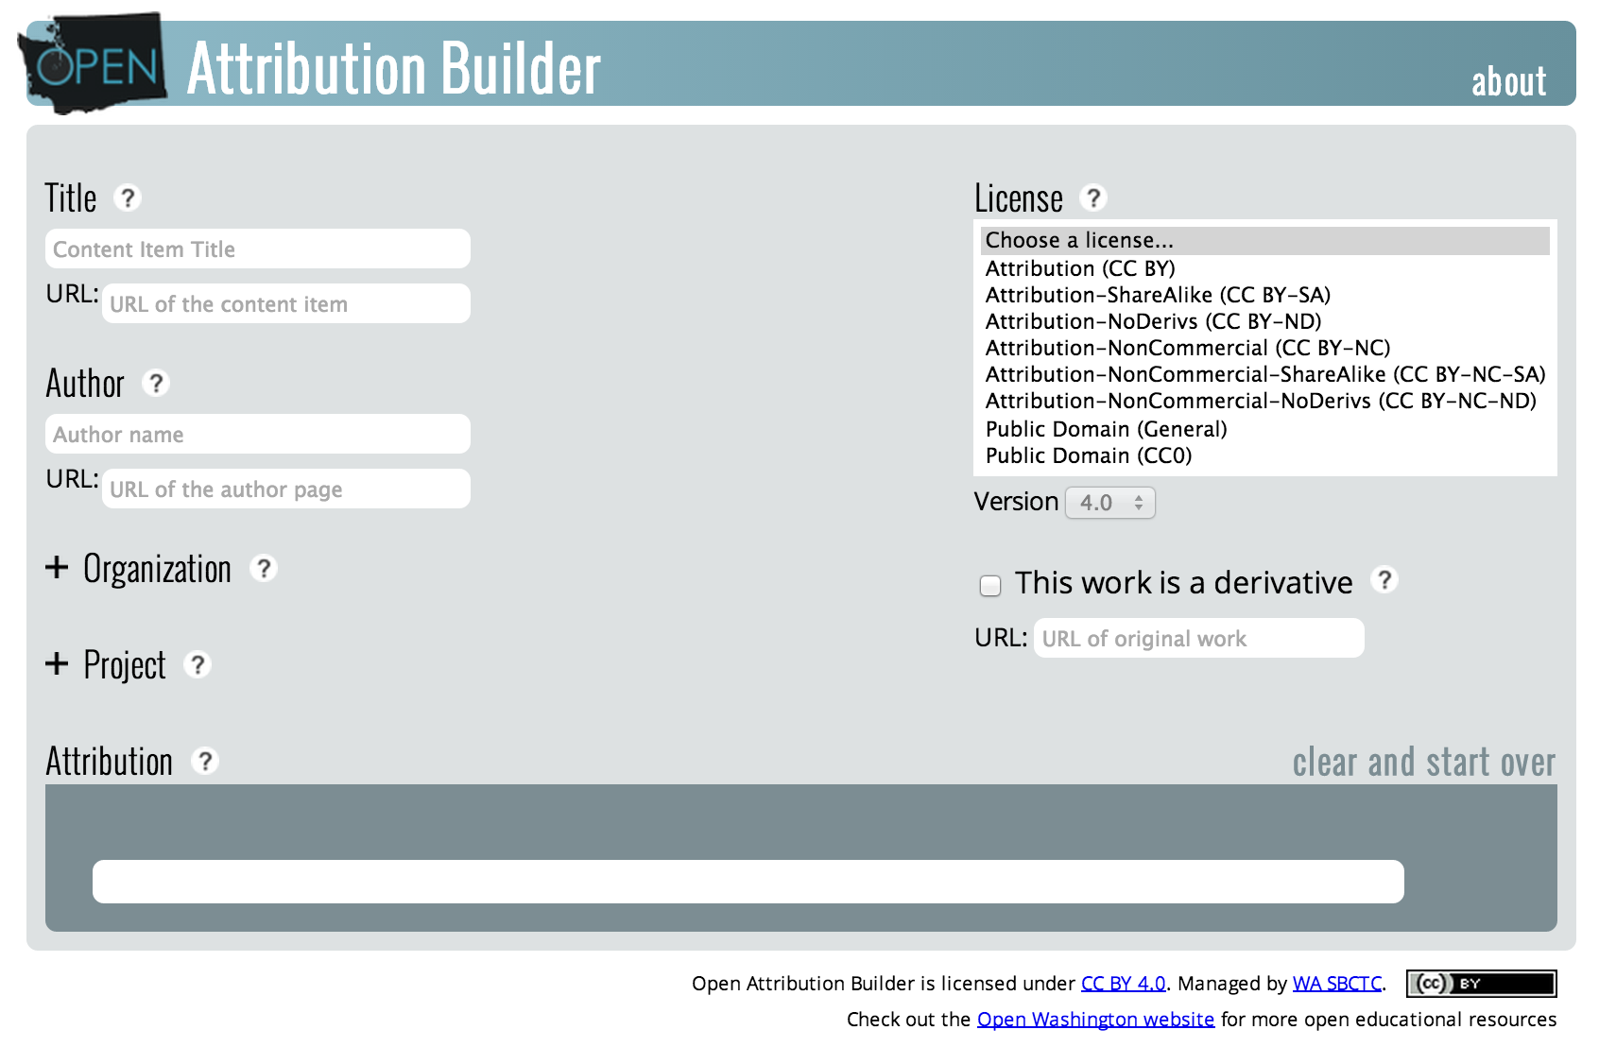
http://www.openwa.org/open-attrib-builder
Screen share – with live Q&A

Slide 34
Workflow process and set of templates for managing and tracking this through the production process.

Slide 35
Work Flow
Best Practice in Creating and Managing Open Educational Resources: Examples and Samples (Word doc http://open4us.org/wp-content/uploads/2013/06/Handout_OpenKickoff_Boyoung.doc)
CC BY
  Not everyone
  One person at each institution, or
  One person for consortium
  http://creativecommons.org/choose/
Skills Commons
  http://support.taaccct.org/home/tutorials-user-guides/

Slide 36
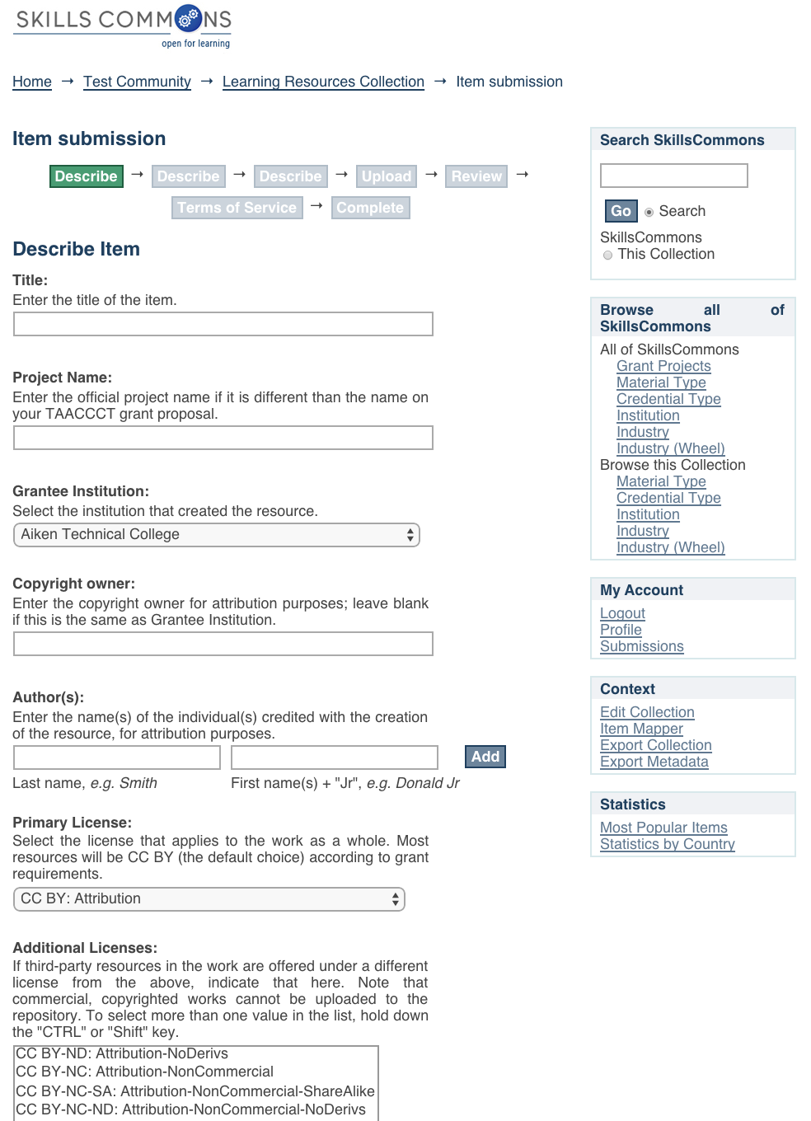
Skills Commons
Contribution process includes meta data about Creative Commons license
This is equivalent of card in library card catalog
CC BY license still needs to be on the resource itself

Slide 37
Questions
Explore the support services available from Creative Commons & Skills Commons and future plans
  Creative Commons: https://open4us.org
  SkillsCommons.org Support Services Center:
  http://support.taaccct.org/home/getting-started/
Ask questions:
Creative Commons taa@creativecommons.org
Skills Commons support@skillscommons.org

