Slide 1
LEADERs Kickoff Webinar
A Campaign to Expand Registered Apprenticeship
Across the USA
Webinar Date:
June 26th, 2015
Presented by:
Office of Apprenticeship
EMPLOYMENT AND TRAINING ADMINISTRATION
UNITED STATES DEPARTMENT OF LABOR

Slide 2
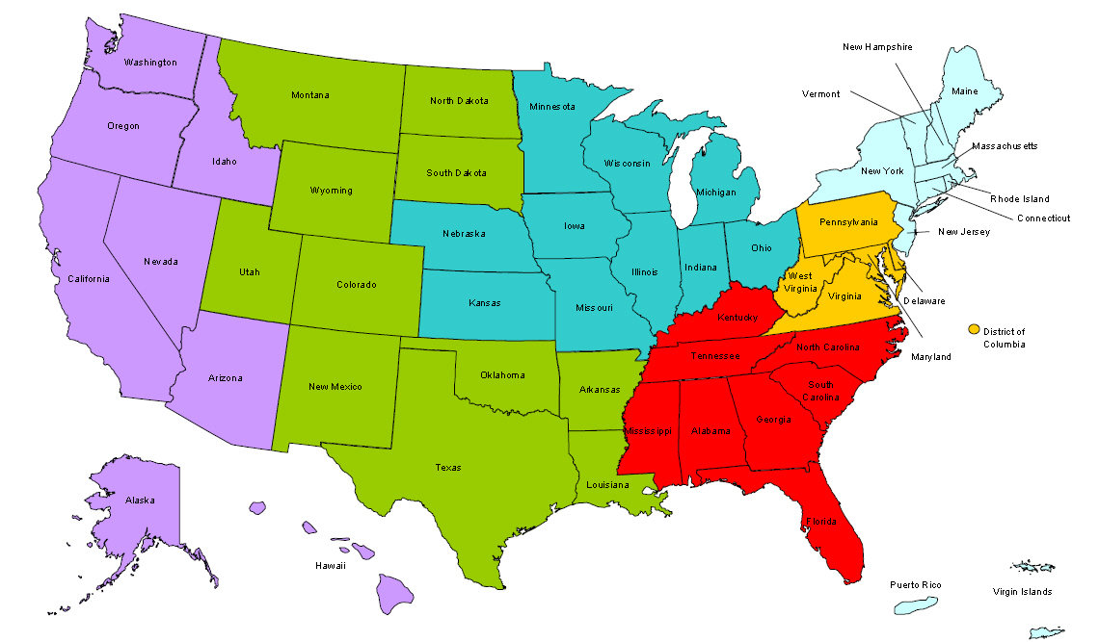
Where are you?
Enter your location in the Chat window – lower left of screen

Slide 3
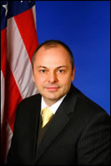
Welcome
John Ladd
Administrator, Office of Apprenticeship
Employment and Training Administration
U.S. Department of Labor

Slide 4
Polling Question
What industry sector do you represent?
Healthcare
Construction
Transportation & Logistics
Energy
Advanced Manufacturing
Information & Communications Technology
Other (please enter in the chat)

Slide 5
Today’s Agenda
Dept. of Labor Leadership
Apprenticeship Goals and Actions
Wrap Up
Sectors of Excellence in Apprenticeship
Apprenticeship USA and LEADERs
Next Steps and Action Items

Slide 6
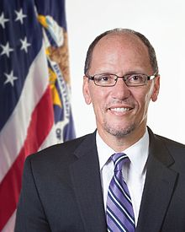
Message from Secretary Perez
“We know the value of apprenticeships for both employers and workers and we want to help jump start apprenticeships in the United States. There’s no better way to get the word out about the program than employers and sponsors advocating for it. That’s what the ApprenticeshipUSA LEADERs program is all about. I’m looking forward to working with our LEADERs to promote the value of apprenticeships to many more employers and in more industries. Thank you for your commitment and help in this effort.”
- U.S. Secretary of Labor Thomas E. Perez

Slide 7
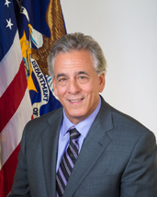
ApprenticeshipUSA LEADERs
Eric Seleznow
Deputy Assistant Secretary
Employment and Training Administration
U.S. Department of Labor

Slide 8
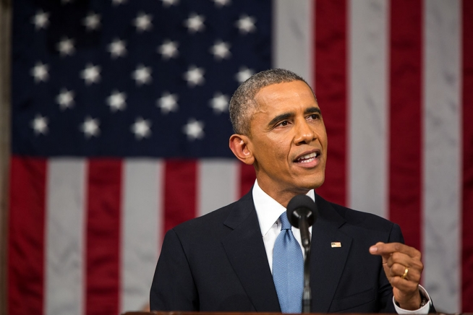
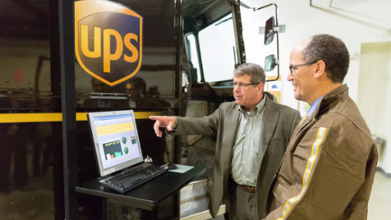
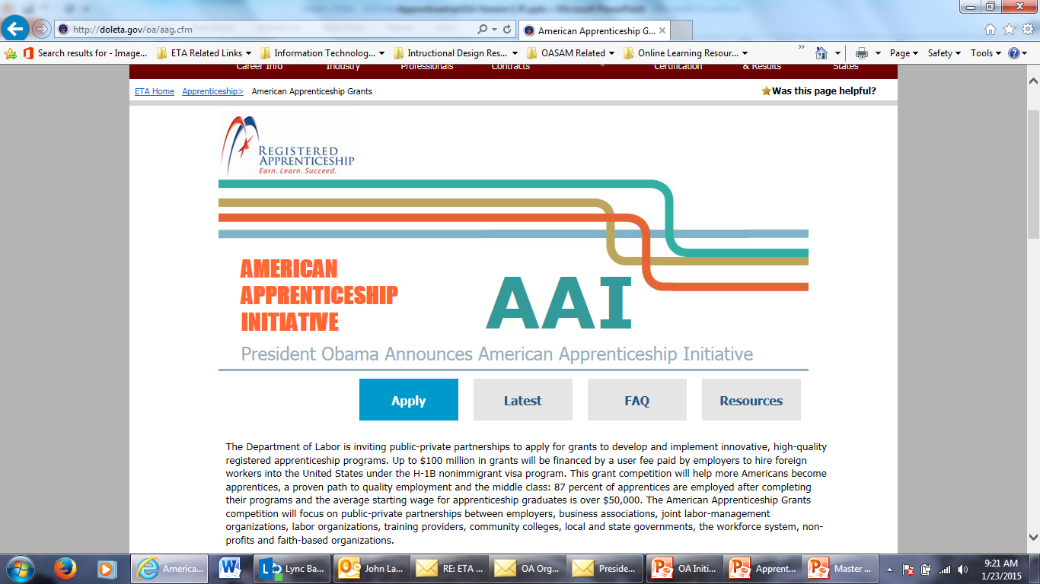
The Time is Now –
Unique Opportunity for Registered Apprenticeship
“
Tonight, I'm also asking more businesses to follow the lead of companies like CVS and UPS, and offer more educational benefits and paid apprenticeships -- opportunities that give workers the chance to earn higher-paying jobs even if they don't have a higher education.
– President Obama
State of the Union Address, January 20, 2015
“
American Apprenticeship Grants
$100 Million

Slide 9
President’s Challenge:
Doubling the Number of Apprentices

Slide 10

ApprenticeshipUSA
What is it?
What is ApprenticeshipUSA?
A new brand and campaign with an integrated set of innovative outreach strategies to engage industries as part of our overall effort to double the number of Registered Apprentices in the United States.

Slide 11
  Lift image of Registered Apprenticeship by Aligning with Leading Companies.
ApprenticeshipUSA
Key Goals
  Recruit LEADERs to promote Registered Apprenticeship in new industries and advance innovative models.
  Create infrastructure to support industry based expansion efforts.
  Create mechanisms to accelerate apprenticeship adoption and innovation.

Slide 12
ApprenticeshipUSA
Sectors of Excellence
in Apprenticeship
LEADERs
Supporting Registered Apprenticeship growth in targeted sectors.
Work with businesses and other partners to expand Registered Apprenticeship in a specific sector.
Organizations and leaders in advocating and supporting growth of Registered Apprenticeship across the US.

Slide 13





What are the Broad Goals for the LEADERs Initiative?
Support and help advance the President’s goal of doubling apprentices in America
Help transform the image of Registered Apprenticeship
Promote Registered Apprenticeship in their industry or supply chain
Participate in the Sectors of Excellence in Apprenticeship (SEAs) as industry leaders
Build public-private partnerships and other mechanisms to accelerate apprenticeship adoption and innovation

Slide 14
ApprenticeshipUSA LEADERs have committed to a variety of activities that will expand and elevate apprenticeships in the US
Expand your RA program(s) within your organization
Elevate your existing work-based learning programs to meet national standards for registration
Promote apprenticeship to other businesses by conducting outreach to employers
Participate in the national kick-off meeting and up to two sector-based convenings over the next year
Allow DOL to recognize and share your best practices
Each ApprenticeshipUSA LEADER determines the appropriate level of commitment

Slide 15
Commitments from Apprenticeship LEADERs
Zurich
North
America
“Zurich North America is establishing a first-of-its kind apprenticeship program for the insurance industry…recruit[ing] college students and foster[ing] the next generation of top underwriters and claims professionals.”
“Oberg intends to increase its apprenticeship programs for CNC Operators, Toolmakers, and CAD Designers by 20%…”
Oberg
UAW
“UAW’s expansion efforts cover regions across the U.S. and include partners such as Caterpillar, General Motors, Chrysler, John Deer, Blue Cross, Blue Shield, and many more.”
“Rutgers commits to start a new apprenticeship program for 500 community health workers and 500 clinical research associates and 500 health care IT professionals in the next four years.”
Rutgers

Slide 16
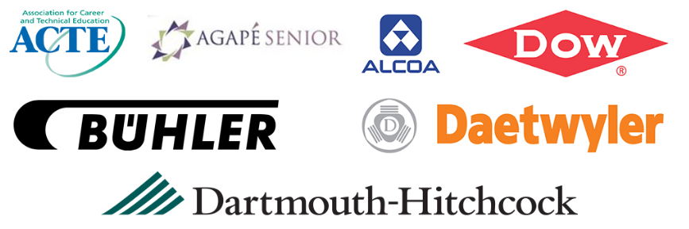
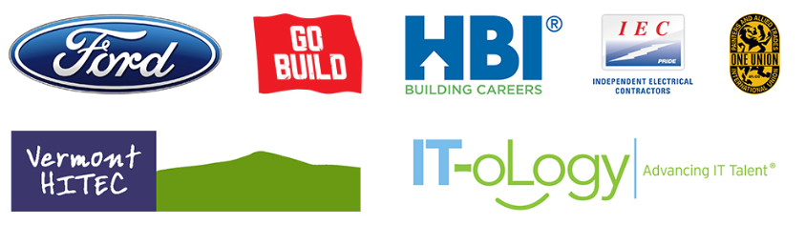
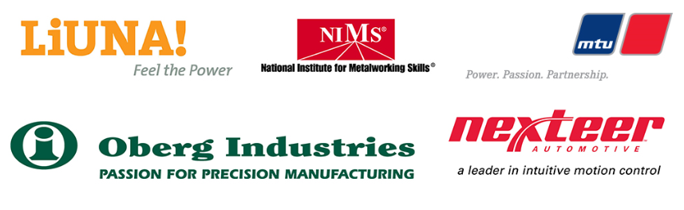
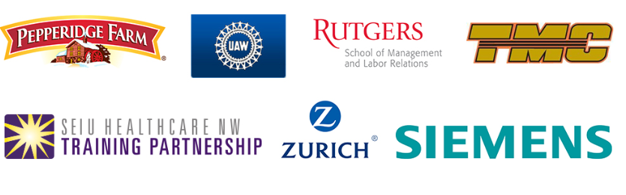
LEADERs Update
100 Members and Growing
And Many Others

Slide 17



Sectors of Excellence in Apprenticeship (SEAs)
What is a SEA?
A Sector-Based Framework
for Apprenticeship Expansion that includes:
  LEADERs
  Industry partners
  Intermediaries
  Experts
  Education
  Government
  etc.
  Expansion through Sector- Based Outreach and Engagement
  To Realize the Value, Potential and Advantages of Training Apprentices through Sector-Focused Technical Assistance
Opportunities to Promote Apprenticeship Expansion
Outreach to Industry Partners
Sector-Based Meetings

Slide 18
Sectors of Excellence in Apprenticeship (SEAs)
ETA to Convene SEAs Around Key Industry Sectors
Healthcare
Boston, MA
Information and Communication Technologies (ICT)
San Francisco, CA
Construction
Philadelphia, PA
Advanced Manufacturing
Chicago, IL
Public Service
Washington, DC
Energy
Dallas, TX
Transportation and Logistics
Atlanta, GA

Slide 19



Preview: SEA Convenings - August 2015
Initial Convening of each SEA:
Form collaborative channels for LEADERs to engage in the Sectors of Excellence in Apprenticeship initiative
Develop a consensus on SEA operational model appropriate to industry needs
Identify and validate 2-4 high-growth, apprenticeable occupations to be scaled up and adopted
Identify other key issues, challenges and opportunities for Apprenticeship expansion

Slide 20
Accelerator Sessions, October – December 2015
Accelerator
Process:
  Facilitate intensive assistance to jump start the development of a customized talent development solution and find resources to support the program
1
2
Overview –
Benefits of RA
Facilitate Consultation & ID Resources
  Build understanding of bottom-line benefits of Apprenticeship
Tailored
Assistance in
Program Development
  Provide a roadmap with on-going personal assistance in building a registered apprenticeship program that seamlessly integrates into HR and talent development structure.
3

Slide 21


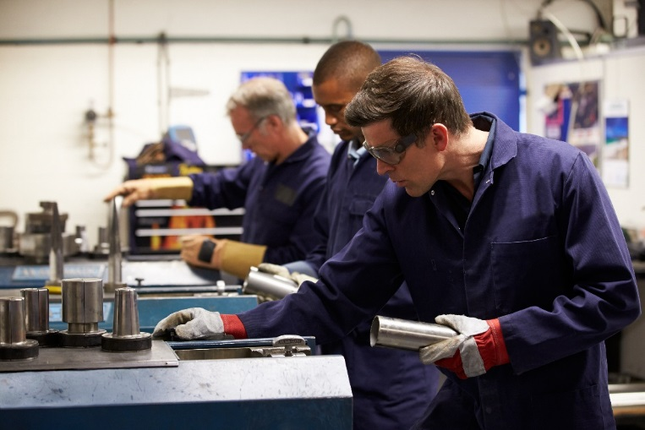

National Apprenticeship Week 2015
Goal is to Elevate Registered Apprenticeship Across the Country through a Series of Events held by LEADERs, such as:
  Open Houses
  Industry Events
  Press Events
  Other Activities as Determined by LEADERs

Slide 22
Building ApprenticeshipUSA Infrastructure and Support
Expand
  Accelerator Sessions
Elevate
  National Apprenticeship Week
Organize
  Summer Convenings
Kick-Off
  Webinar

Slide 23
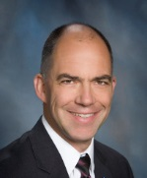
MTU America
Joerg Klisch
Vice President for Operations

Slide 24

Zurich North America
Al Crook
Head of HR Business Partners

Slide 25

International Union of Painter and Allied Trades
Andrew Larson
National Project Coordinator

Slide 26
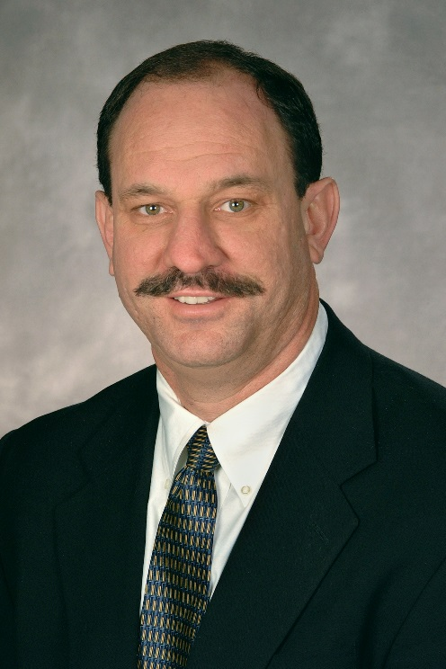
Estrella Mountain College
Clay Goodman
Vice President of Learning

Slide 27
Upcoming LEADER/SEA Events
2015
National LEADERs
Kick Off
Webinar
6 SEA LEADERs Meetings Hosted by Regional Offices
National LEADERs Convening
6 SEA ApprenticeshipUSA Accelerator Sessions Hosted by Regional Offices
June 2015 | August 2015 | September 2015 | October-December 2015

Slide 28

Question and Answer Session

Slide 29






Contact Information on LEADERs
Office of Apprenticeship
U.S. Department of Labor
202-693-2796
Apprenticeship.USA@dol.gov
http://www.dol.gov/apprenticeship/

