Slide 1
November 23, 2015
BREAKOUT ROOM:
New Models for Adult Basic Education

Slide 2
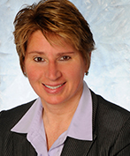


Presenters
Barbara Endel
Senior Program Director
Jobs for the Future
Jon Kerr
Director of Basic Education for Adults
Washington State Board for Community & Technical Colleges
Martha Drysdale
Director, Career, Technical and Adult Education
Mississippi Delta Community College

Slide 3


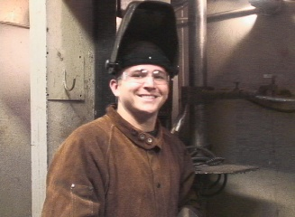
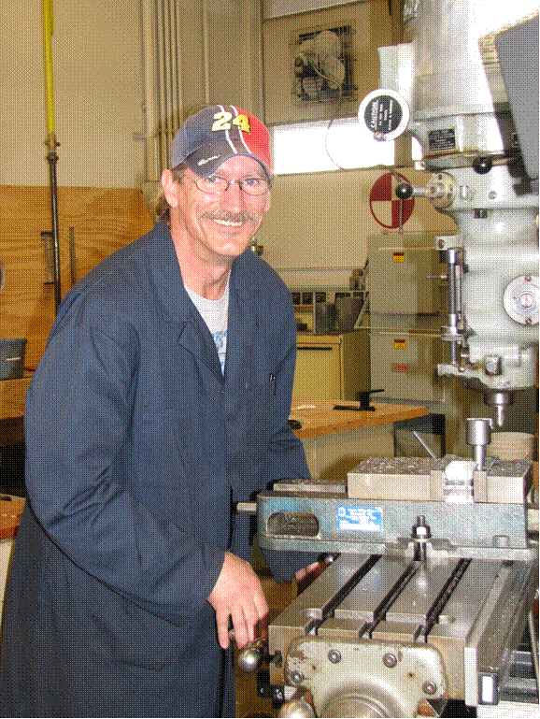
Washington's
I-BEST
Renaissance
Creating Accelerated, Guided Pathways to
Living Wage Jobs
Creating Accelerated, Guided Pathways to
Living Wage Jobs
TAACCCT Virtual Institute: Acceleration Strategies
Jon M. Kerr, Director
Basic Education for Adults
Washington State Board for Community and Technical Colleges

Slide 4

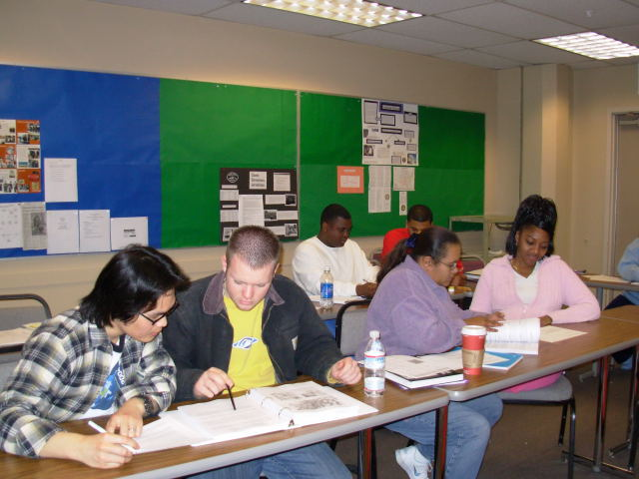

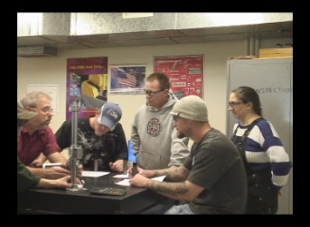
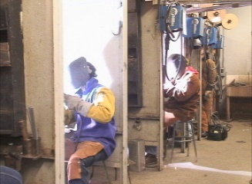
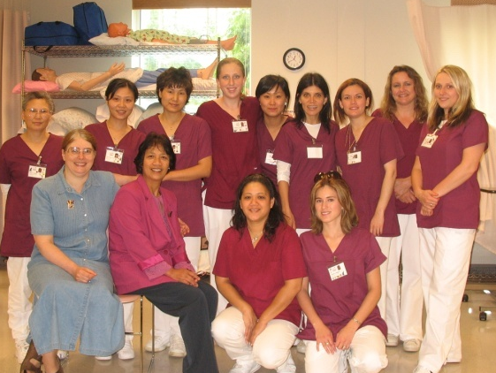

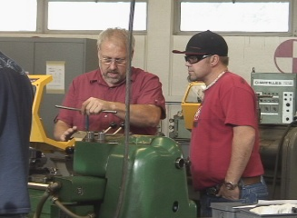

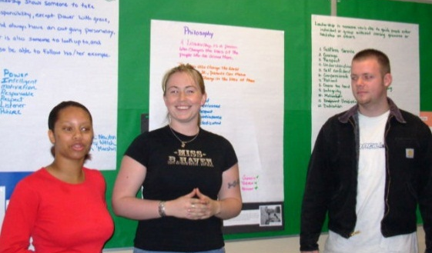




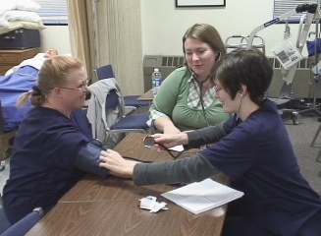
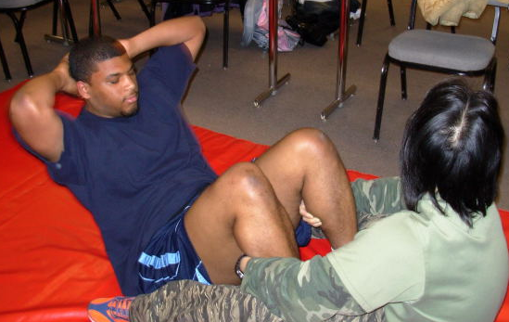


The I-BEST Revolution!

Slide 5
Adult Education (Title II) Defined
The term ‘adult education’ means academic instruction and education services below the postsecondary level that increase an individual’s ability to—
(A) read, write, and speak English and perform mathematics or other activities necessary for the attainment of a secondary school diploma or its recognized equivalent;
(B) transition to postsecondary education and training;
(C) obtain employment.*
*WIOA, SEC. 203 Definitions (1)(A)(B)(C)

Slide 6
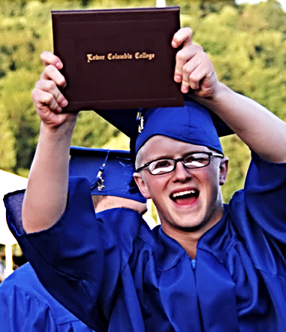
Governor Inslee’s Educational Goals for Basic Education for Adults
By 2023, all adults ages 25-44 in Washington State will have a high school diploma or equivalent
By 2017, increase the percentage of ABE and ELA students who transition to precollege or college level within two years from 12% to 15%
By 2023, increase the percentage of the population enrolled in certificate, credential, apprenticeship and degree programs from 13% in 2012 to 24.8%

Slide 7

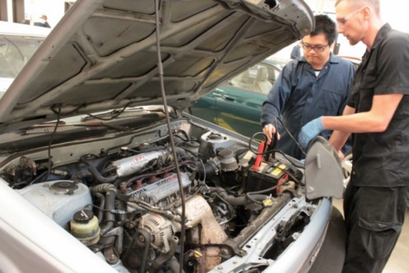
Washington State’s Workforce Needs
Washington’s needs for trained employees with college credentials will increase by almost 60% by 2030
In that same period the population will grow by only 10%
By 2016 nearly ¾ of available jobs will require at least a postsecondary credential
Over the next 20 years there won’t be enough high school graduates to fill the gap
Washington will need to fill the gap with out of school youth and working age adults!

Slide 8
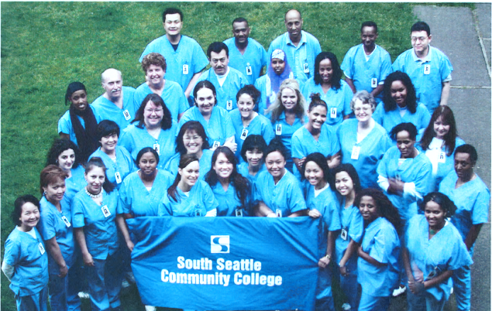
After 10 Years
I-BEST
Continues to be Washington’s most successful instructional model that moves under-skilled adults to living wage jobs!

Slide 9
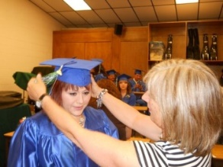
Success Defined
The Tipping Point
1 year of college level credits + a credential
After 6 years, students with 1 year of college credits + a credential had the most significant future earnings bump:
  $7,000 more/year for ESOL students
  $8,500 more/year for ABE students
  $2,700 more/year for workforce students entering with a GED®
  $1,700 more/year for students entering with a HSD

Slide 10

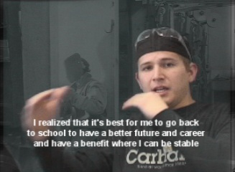
Students Served
English Language Learners
Adult Basic Education, Developmental Education,
& Academic Transfer
High School Completion

Slide 11
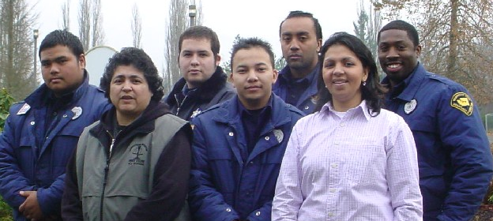

Team Teaching: the Heart of I-BEST
I-BEST pairs a basic skills instructor and a career and technical instructor in the same classroom to jointly plan, teach, and assess students’ learning and skill development.
This allows students to earn college and workforce credentials at the same time as mastering critical basic skills identified by employers.

Slide 12
Comprehensive Wraparound Services
Programs are required to collaborate with partnering agencies to make academic, economic, and social support services easily accessible to students.
  Navigational support
  Academic and financial aid advising
  Childcare
  Housing
  Transportation
  Emergency funds

Slide 13
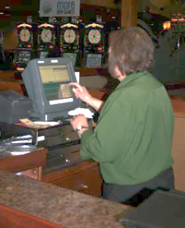


The Biggest Challenge!
Financial Aid to Students
Opportunity Grant Scholarships
State Need Grant
3.5% Funds
WorkFirst/SNAP Funds
Worker Retraining Funds
Traditional Financial Aid
VA Benefits
Tuition Waivers
Tuition Payment Plan
Financial Aid Ability to Benefit!!!

Slide 14
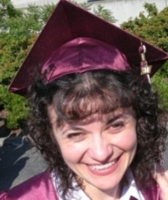
Before I-BEST
Basic Skills Students Didn’t Continue
Only 3 to 6% of students reached the Tipping Point or earned a certificate or degree within five years of completing ABE.

Slide 15

Do Better and Go Further, Faster
I-BEST STUDENTS
Columbia University’s Community College Research Center found that I-BEST students in comparison with other basic skills students in workforce programs were:
  3 times more likely to earn college credit
  9 times more likely to earn an award

Slide 16
and increased student achievement beyond basic skills.
I-BEST Continues to Be the Driving Force to certificate and degree attainment
  I-BEST students earned 92% of certificates and degrees earned by ABE students in 2013-2014
  And 83% of the achievement points for those reaching the Tipping Point

Slide 17
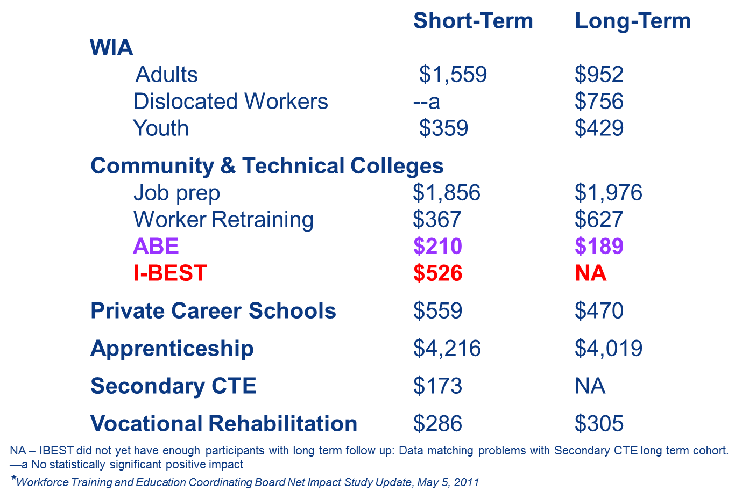
Net Impact of Workforce Development Programs on Quarterly Earnings (In 2005 $)*

Slide 19



Slide 20
HS 21+
Allows students 21 and older to attain a competency-based high school diploma
Awards credit for prior learning, military
training, and work experience
Students can move quickly as outcomes are
met saving both time and money

Slide 21
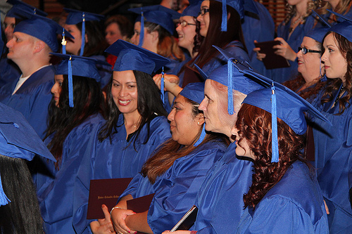
hS 21+ Initial Pilot Results
Collectively Pilot Colleges:
  Enrolled 361 students
  Awarded 52 diplomas
  Transitioned 14 students into I-BEST
  Transitioned 13 students into other college programs
  Had 20 students get jobs
21 Programs Up and Running!

Slide 22
HS21+ Data
As of June 2015*
Data Point | 2013-2014 | *2014-2015 | *Total
Students Enrolled | 521 | *1,935 | 2,456
Diplomas Awarded | 168 | *698 | 866
Significant Gains Earned (CASAS) | 391 | *1,207 | 1,598
Total SAI Points Earned | 1,467 | *4,128 | 5,595
SAI Points Earned Per Student | 2.8 | *2.2 | 2.5
Federal Level Gains | 208 | *531 | 739
*9 new programs will implement in 2015-2016

Slide 23


I-DEA
2013-Implemented in 9 colleges & CBOs
408 students enrolled
  50% made federal level gains (39% traditional ESL students)
  60% made significant gains (51% for traditional ESL students)
  2 Student Achievement Points made on average
2014-Implemented in 19 colleges & CBOs (Data as of Winter Quarter 2015)
694 students enrolled
  *46% made federal level gains (37% for traditional ESL students)
  *57% made significant gains (46% for traditional ESL students)

Slide 24

Professional Technical I-BEST
Professional Technical (Traditional) I-BEST programs result in recognized certificates that lead to employment and progression along a defined educational and career pathway.
  I-BEST programs are also offered in correctional facilities.
Recent analysis found that Professional/Technical I-BEST results were relatively stable and represent a mature program model

Slide 25

I-BEST Expansion to a two-year Degree
Expands professional technical I-BEST programs to the next level of training along that same career pathway.
This allows I-BEST completers to successfully complete pre-college/Dev. Ed. levels and barrier classes that lead to a two year degree.
Twelve pilot projects implemented and tested strategies that move students further and faster accelerating time to the highest credential in the pathway.

Slide 26
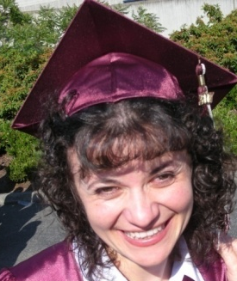
Early Results Prove Promising
Professional Technical Expansion I-BEST Results
Accumulated an average of 42 college credits
Had a retention rate of 75%
80% completed 1 or more levels of Dev. Ed math
84% completed 1 or more levels of Dev. English
Had an average GPA of 2.9
48 students completed at least 1 college of level math course
111 students completed at least 1 college of level English course

Slide 27
Academic I-BEST
Academic I-BEST employs the same strategies as traditional I-BEST and applies them to a transfer pathway that leads to higher wage jobs.
Like traditional I-BEST, Academic I-BEST students in the first cohorts have been highly successful in attaining student achievement points:
  76% of the students made basic skills gains
  79% made college readiness gains
  73% earned their first 15 college credits successfully
  37% earned their first 30 college credits
  And 11% reached the tipping point and earned a college certificate or degree all in 1-3 quarters.

Slide 28


I-BEST
As of Winter 2015*
Data Point | 2012-2013 | 2013-2014 | *2014-2015 | *Total
Students Enrolled | 2,698 | 2,904 | *2,430 | *8,004
FTE | 1,749 | 2,034 | *1,559 | *5,342
Degrees & Certificates | 1,604 | 1,883 | *465 | *3,952
Significant Gains Earned (CASAS) | 1,541 | 1,675 | *1,239 | *4,455
Total SAI Points Earned | 16,210 | 17,068 | *10,835 | *44,113
SAI Points Earned Per Student | 4.6 | 4.6 | *3.8 | *4.3
Federal Level Gains | 903 | 926 | *713 | *2,542

Slide 29

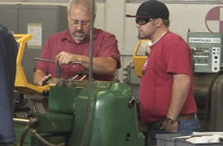

The Guided Pathway Funded
On-Ramps to I-BEST
($25/quarter)
-HS 21+
-I-BEST at Work
-I-DEA
-College Readiness
-Career Specific
I-BEST Quarter 1
(Opportunity Grant & State Need Grant)
-Tuition
-Books
-Fees/Supplies
I-BEST to 2 Year Degree
(Ability to Benefit & State Need Grant)
-High School Diploma
Baccalaureate Degree
(Ability to Benefit & State Need Grant)

Slide 30
I-BEST
A Cost Benefit to Students & Society
Washington's January 2013 Return on Investment Study analysis of I-BEST found that the investment of time and money returns a good fiscal yield.
The study looked at the return on investment (ROI) from a purely cost/benefit analysis and focused on the annual rate of return (ARR). It was a pure look at whether this “investment” of time and money returns a good yield.
The study used net present value for final calculations that allowed analysis in today’s dollars. (In other words, it discounted future earnings by an inflation index.) This is the most conservative approach.

Slide 31
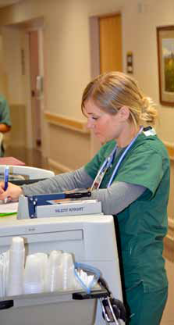
Investments in I-BEST Programs:
A Cost Benefit to Students
I-BEST Tipping Point Completers* gain an annual return on investment of 12.4% per year, more than 3 times greater than a traditional investment, reflecting substantial increases in students’ earnings.
Cost to the Student Completer Tuition (minus weighted average aid package) $1,117 Books $1,000 Fees $300 Foregone Wages $16,197 Total Student Costs $18,614
Benefits to the Student Completer Wage Gains $2,310 Income years at a higher wage 35 Total Lifetime Wage Gains (Net Present Value**) $79,833
Return on Investment (ROI) 329%
Annual Rate of Return (ARR) 12.4%
Pay Back Period (in years) 8.1
*The model assumes a Tipping Point completer within two years of starting, who is receiving state-funded financial aid.

Slide 32
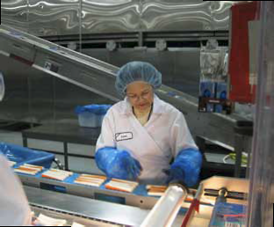
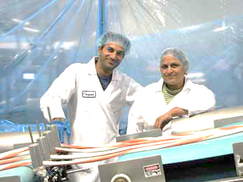
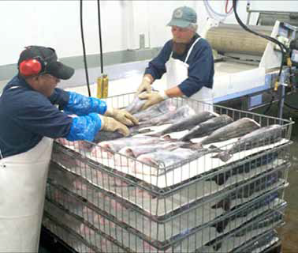
Investments in I-BEST Programs:
A Cost Benefit to Society
Financial benefits to taxpayers are equal to traditional investments and reflect higher tax receipts and lower social costs.
Cost to the State Taxpayer per I-BEST Completer Enrollment Support (direct and indirect state costs of Instruction) $4,396 Financial Aid Support (state sources only) $2,883 Total State Taxpayer Costs $7,279
Benefit to the State Taxpayer Annual Tax Receipts from Higher Net Wage $289 Lower Annual Social Costs (health, criminal justice, etc.) 12% Years at Higher Net Wage and Lower Social costs 35 Total Lifetime Taxpayer Benefits (Net Present Value) $10,374
Return on Investment (ROI) 42.5%
Annual Rate of Return (ARR) 4.1%
Pay Back Period (in years) 24.2

Slide 33

The 2012 CCRC Learning from Washington State’s
I-BEST Program Report
The report is the final phase of a multi-year evaluation of the I-BEST model. The results found:
There are not extraordinary expenses colleges/states would have to undertake to move the I-BEST initiative to scale
Program benefits justify the cost

Slide 34

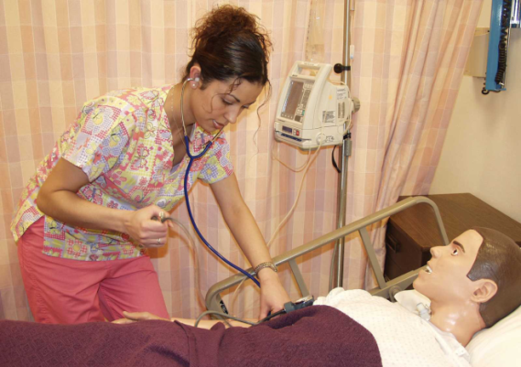
CCRC Findings
Analysis was based on a cost benefit-analysis model
  On average I-BEST students earned 18 credits
  Non-I-BEST Workforce students earned 9 college credits
  Non-I-BEST non-Workforce students earned 11 college credits

Slide 35

Evidence Demonstrates Investment in I-BEST Pays off in Gains to Individuals, Employers & Society
In its final I-BEST cost-benefit evaluation issued in December of 2012, the national Community College Research Center reported:
Substantial improvements occur only with large scale innovations and reforms to programs and policies – like
I-BEST
The benefits of I-BEST approximately equal the additional costs
I-BEST yields resource savings expressed as dollars that justify the investment

Slide 36

I-BEST has a proven track record in innovative education resulting in student success by design
I-BEST: A Pathway Out Of Poverty
Better Jobs. Better Futures. A Stronger Washington."

Slide 37
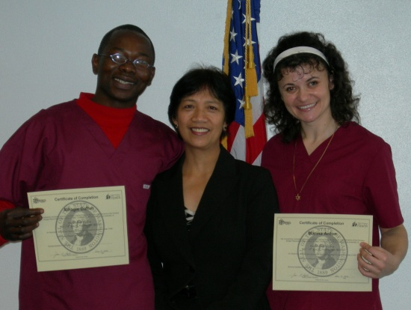
QUESTIONS?

Slide 38


Slide 39



Slide 40
Facts about MDCC and the TAACCCT Grant
MDCC is one of the 5 community colleges chosen in the state of Mississippi to participate in the TAACCCT Grant.
In the Fall of 2013, 70% of MDCC co-enrolled Adult Education/GED and Career-Technical students passed their high school equivalency exam.
MDCC is one of the first community colleges in the state to successfully implement team teaching into career-tech classrooms.

Slide 41
Types of Students who can Benefit from the Grant
Co-Enrolled Students
Students who want to work toward passing their high school equivalency exam(GED) while earning six to twelve career-technical college credits.
Special-Enrolled Students
Students who have a low ACT score or have a low TABE score.
Students who were unsuccessful the previous college semester.
Students who are transitioning from an adult education student to a traditional college level student.

Slide 42
Co-Enrolled Students
Requirements
Students must commit to attending class and tutoring sessions.
Students must have reliable transportation and child care if applicable.
Students must meet a specified TABE test score.
Students must be at least 18 years of age before September 1st to test without exceptions.
Perks
Students will receive an MDCC student ID and officially be a college student.
Students will have the support system of a career counselor and instructors who provide assistance in the classroom and outside tutoring.
Students will receive team- taught instruction in some classroom settings.
Students will benefit from hearing speakers discuss everyday life skills.
Students will have special tutoring sessions to prepare them to receive special certifications.

Slide 43
Special-Enrolled Students
Requirements
Students must commit to attending class and tutoring sessions if needed.
Students must have reliable transportation and child care if applicable.
Perks
Students who would not traditionally be allowed admission can provisionally enroll.
Students will have the support system of a career counselor and instructors who provide assistance in the classroom and outside tutoring.
Students will receive team- taught instruction in some classroom settings.
Students will have special tutoring sessions to prepare them to receive special certifications.
Students will benefit from hearing speakers discuss everyday life skills.

Slide 44
Career-Technical Programs
Automotive Options:
*Automotive Machinist
*Automotive Mechanics Technology
Electronics Options:
*Electronics Technology
*Biomedical Equipment Repair

Slide 45
Career-Technical Programs
Hospitality Options:
*Culinary Arts

Slide 46
Career-Technical Programs
Miscellaneous:
*Brick, Block, and Stone Masonry
*Computer Networking Technology
*Construction Equipment Operation
Industrial:
*Drafting and Design Technology
*Electrical Technology
*Heating, Ventilation, Air-Conditioning, and Refrigeration Technology
*Machine Tool Technology
*Welding

Slide 47
Career-Technical Programs
Agricultural Options:
*Field Crops Technology
*Precision Agriculture Technology
Business and Office Options:
*Accounting Technology
*Office Systems Technology
*Healthcare Data Technology

Slide 48
Student Success Stories
During the first semester of the grant, the team-taught Medical Terminology I class had a 100 % passing rate.
70% of co-enrolled students earned their high school equivalency diploma.
One of the co-enrolled TAACCCT students had the highest average in Medical Terminology I and Medical Terminology II.
All of the co-enrolled students were full time students by the fall of 2014.
Phi Theta Kappa recently extended an invitation to join to one of the grant program participants.

Slide 49
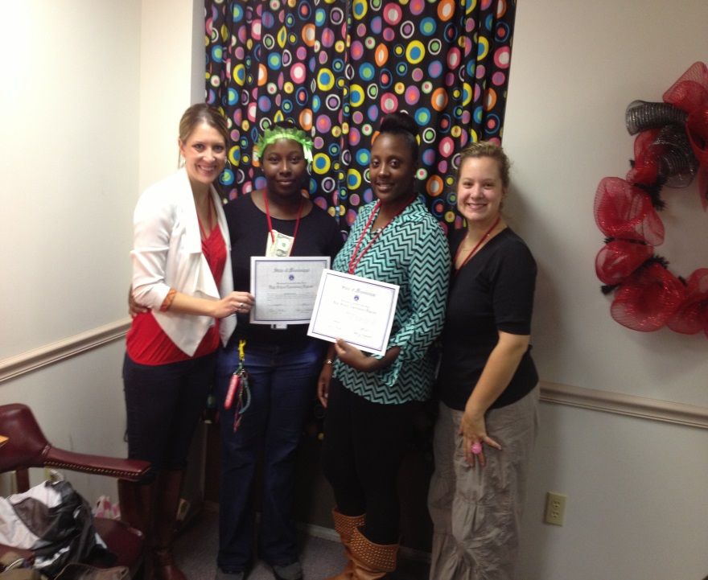
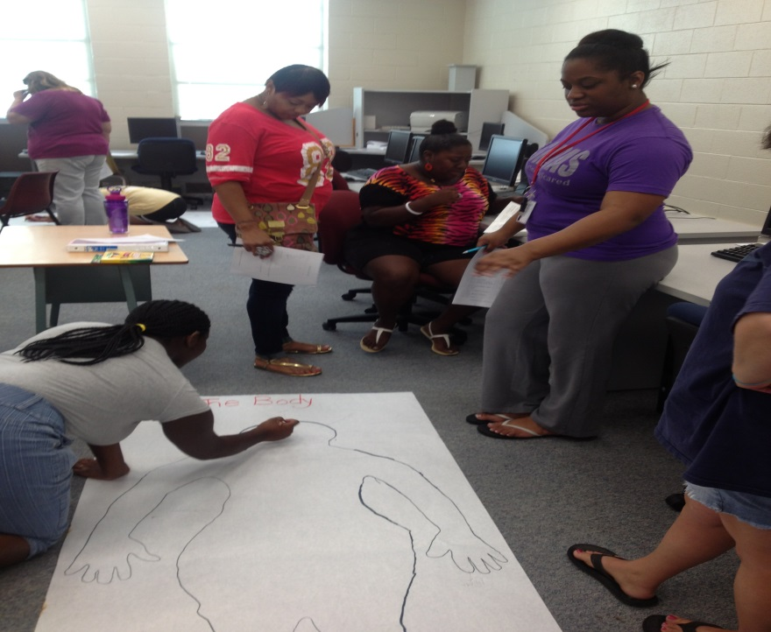
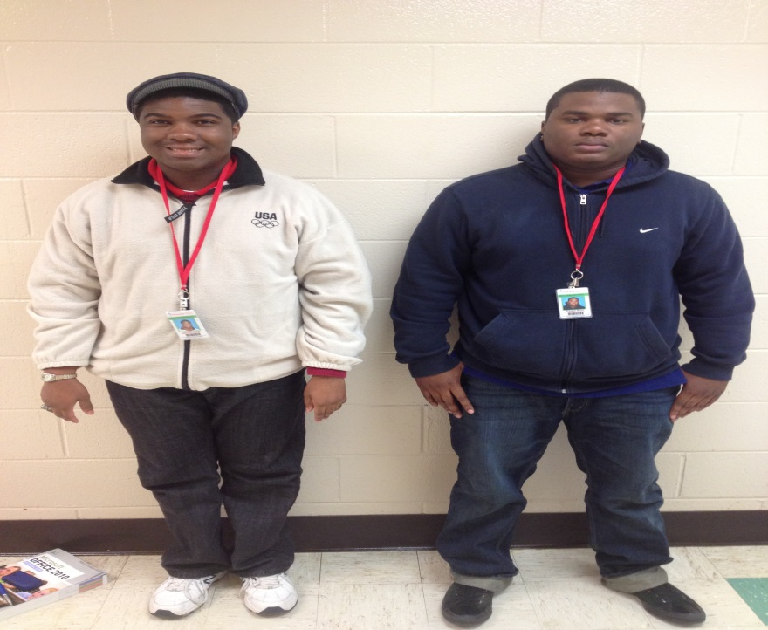
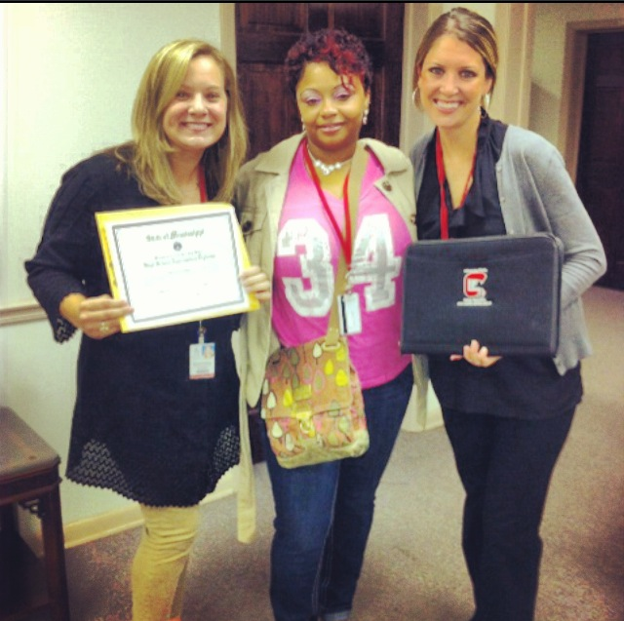

Slide 50
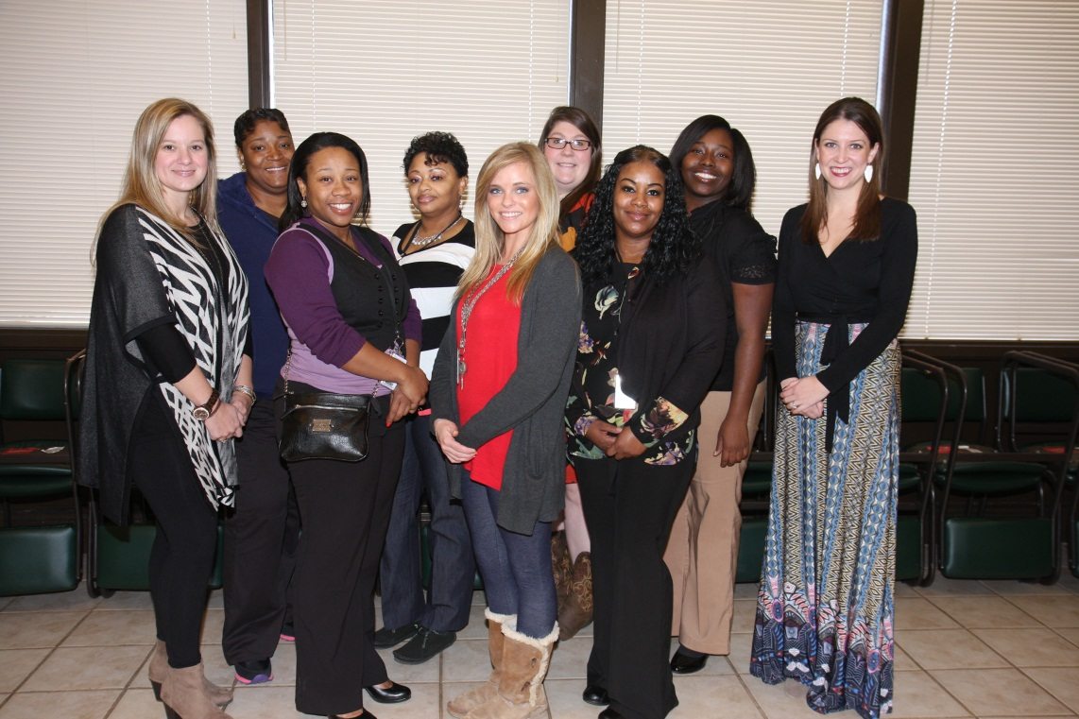

For More Information Contact:
Jamie Hargett- C4 Program Coordinator and Team Teacher/Trainer
Martha Claire Drysdale, Director - Career, Technical & Adult Education
662-246-6572
careertech@msdelta.edu
The Gulf Coast IT Consortium is made possible by a $14.7 million grant from the U.S. Department of Labor ‘s Employment and Training Administration’s Trade Adjustment Assistance Community College and Career Training (TAACCCT) Initiative.
Mississippi Delta Community College does not discriminate on the basis of race, color, national origin, sex, disability, or age in its programs and activities. The following person has been designated to handle inquiries regarding the non-discrimination policies: The Associate VP for Institutional Effectiveness, Stauffer-Wood Administration Building, P.O. Box 668, Moorhead, MS 38761, 662-246-6558.

Slide 51

Q&A

Slide 52
Thank You!
Find resources for TAACCCT success at:
https://etagrantees.workforce3one.org
Subscribe to TLN resources, ask questions or connect with peers at TAACCCT@dol.gov
Notes:
Wrap up and Next Steps

