Slide 1
November 30, 2015
PRIOR LEARNING ASSESSMENT: 101 Breakout Session

Slide 2
Presenters
Sandy Goodman
Director, Career Pathways
National College Transition Network
Rilla Jones
Vice President of Instruction
Northeast Mississippi Community College

Slide 3
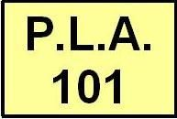
Welcome
Overview of Methods for Assessing Prior Learning
Standards and Principles
Challenge Exams at Northeast MS CC
Discussion
Tools and Resources

Slide 4
Prior Learning Assessment (PLA)
Process that enables learners to demonstrate what they have learned and translate that learning into college credit.
Validates knowledge and skills acquired through a variety of experiences.
Credit is awarded for college-level knowledge and skills gained from experience and not for the experience itself.

Slide 5
Ways to Award PLA
Standardized Exam
Challenge Exam
Certification Crosswalk
Evaluation of Military Training
Individualized Portfolio

Slide 6
Acceleration & Completion Strategy
Study found that students with credit earned through PLA:
Higher completion rates
Lower time to degree
2.5 times more likely to persist to completion
Saves students time and money
Pathway from non credit to credit programs

Slide 7
Key Considerations
Policies and Procedures
Marketing and Outreach
Data Collection

Slide 8
Gulf Coast IT Consortium
U.S. Department of Labor Employment and Training Administration
Trade Adjustment Assistance Community College Career Training (TAACCCT)

Slide 9
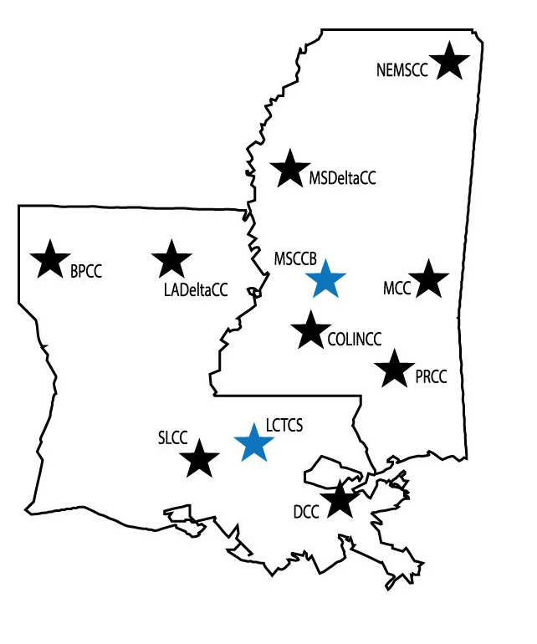
Consortium Members
Bossier Parish Community College
LA Delta Community College
South LA Community College
Delgado Community College
LCTCS Office (state level policy work)
Northeast MS Community College
MS Delta Community College
Meridian Community College
Copiah-Lincoln Community College
Pearl River Community College
MS CC Board (state level policy work)

Slide 10
Northeast Mississippi Community College
PLA overview

Slide 11
Round 1- Career Accelerated Pathways
Priority 3 Build Programs that meet Advanced Manufacturing (AM) needs by designing, implementing, testing, credentialing, and forging Articulation Agreements for the AM Career Accelerated Pathways (CAP) that includes: Stackable Credentials; Workforce certification (WFC), Academic Credit for Prior Learning; Portable Credentialing ; Advanced Industry-Driven Curricula, and Multi-level Goal Attainment

Slide 12
PLA Timeline
April – Faculty in three pathways identify and agree to develop challenge examinations:
9 in Industrial Maintenance
6 in Advanced Machining
3 in Facility Maintenance
Considered courses that all colleges offered, high enrollment courses, college need

Slide 13
PLA Timeline
May-
Faculty identify main competencies within each course
Divide the content into percentages based on those main competencies
Identify the content that will require a skills check-off

Slide 14
Competencies Example:
1. Demonstrate calculations with decimal and Fractional numbers | 40%
Demonstrate basic geometric and trigonometric functions | 40%
Demonstrate the use of measuring tools using English and /or metric measuring system. | 20%

Slide 15
PLA Timeline
May-June 30th
Based on the percentages, determine the number of questions needed for each competency
Write three levels of questions for the competency based on Bloom’s Taxonomy:
Knowledge
Interpretation
Analysis
Write the procedures for the Skills Check Off

Slide 16
PLA Timeline
May-June 30th
Based on the percentages, determine the number of questions needed for each competency
Write three levels of questions for the competency based on Bloom’s Taxonomy:
Knowledge
Interpretation
Analysis
Write the procedures for the Skills Check Off

Slide 17
Competencies Example:
1. Demonstrate calculations with decimal and Fractional numbers | 40% | 40% of 200 = 80 questions needed 60%-Knowledge (48) 30% Interpretation (24) 10% Analysis (8)
Demonstrate basic geometric and trigonometric functions | 40% | 40% of 200 = 80 questions needed 60%-Knowledge (48) 30% Interpretation (24) 10% Analysis (8)
Demonstrate the use of measuring tools using English and /or metric measuring system. | 20% | 20% of 200 = 40 questions needed 60% knowledge (24) 30% Interpretation (12) 10% Analysis (4)

Slide 18
Skills Check Off Example:
Given a steel ruler measure the following objects to the nearest 1/16th of an inch:
Object one
Object two
Object three
Object four
Object five
Given a steel ruler measure the following objects to the nearest 1 millimeter:
Object one
Object two
Object three
Object four
Object five
Skills were written around equipment and materials common to all of the programs laboratories

Slide 19
PLA Timeline
July 1- 30th
Send sample exams to industry partners
Faculty from all of the programs meet to edit and recommend changes to the exams.
Faculty and industry partners meet to finalize and validate all challenge exams.
Exams are loaded into LMS

Slide 20
Challenge Exam Procedures
Challenge exams were loaded into a course within the LMS called NECC_DECS challenge exams
Students seek permission to sit for the challenge exam from the instructor of the course
The instructor asks the eLearning coordinator to open the exam, provides the access code for the student to take the exam.

Slide 21
Challenge Exam Procedures
After the exam is graded, students that pass the written portion can ask to take the skills portion. Arrangements are made with the instructor.
The instructor submits the grade to the Dean of Instruction’s office.
The Dean of Instruction notifies the student of the fee to be paid. Following payment the records office is asked to transcript the grade (Z). 15 SCHs limit on challenge credit.

Slide 22
Policy Changes
A new flat fee of $50 per course was approved in 2013-2014 effective in fall 2015
Studying the Transcripting of the grade achieved on the challenge exam rather than using Z.

Slide 23
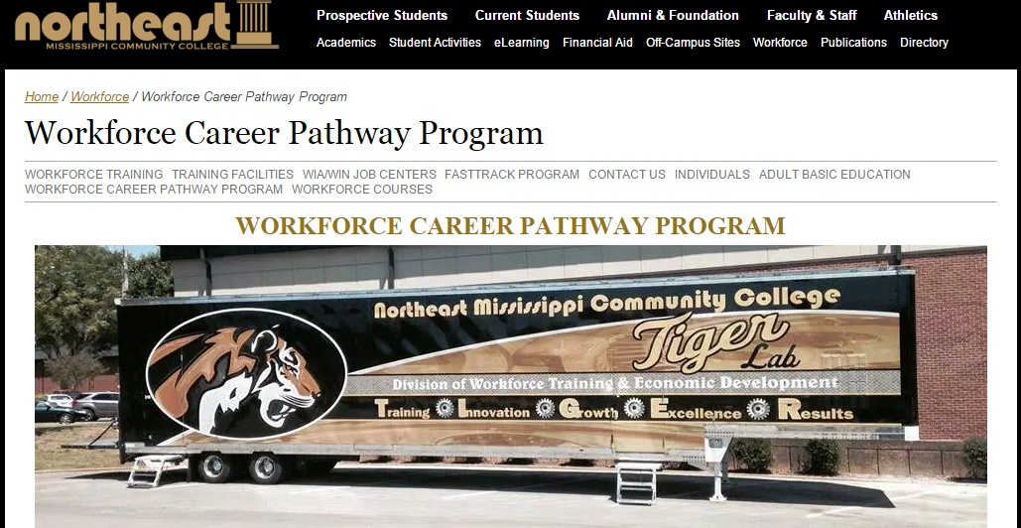
Challenge Exams Offered
http://www.nemcc.edu/workforce/career-pathway-program/

Slide 24
Discussion Questions
What PLA methods is your college using?
What results have you seen?
How do students learn about PLA?
How have you engaged faculty and other key stakeholders on campus?
Challenges and roadblocks?

Slide 25
PLA Resources
http://www.collegetransition.org/PLAdocuments.html

Slide 26
Thank You!
Find resources for TAACCCT success at:
https://etagrantees.workforce3one.org
Subscribe to TLN resources, ask questions or connect with peers at TAACCCT@dol.gov

