Slide 1
November 30, 2015
PRIOR LEARNING ASSESSMENT: A CRITICAL STRATEGY FOR ADULT LEARNERS

Slide 2
TAACCCT LEARNING NETWORK AT A GLANCE
U.S. Department of Labor, Employment & Training Administration
(National)
Jobs for the Future
CalState/Merlot
Maher & Maher
American Association of Community Colleges
U.S. National Science Foundation
ATE Centers
Other Non-Federal Providers of TA and Resources for TAACCCT Grantees:
Creative Commons
CAST
The Transformative Change Initiative

Slide 3
Presenters
Rachel McDonnell
Senior Program Manager
Jobs for the Future
Sandy Goodman
Director, Career Pathways
National College Transition Network
Ellen Hewett
Director
National College Transition Network
Rilla Jones
Vice President of Instruction
Northeast Mississippi Community College
Louise Bradley
Grant/Credit for Prior Learning Coordinator
Southwest Wisconsin Technical College

Slide 4
TODAY’S AGENDA
WELCOME AND INTRODUCTIONS
AN INTRODUCTION TO PRIOR LEARNING ASSESSMENT
BREAK-UP INTO GROUPS: 101 AND DEEP DIVE (50-60 MIN SESSION)
WRAP-UP: TAKE-AWAYS, AND WHERE THE FIELD IS HEADING
RESOURCES FOR YOUR WORK

Slide 5
The problem we are trying to solve
The national imperative to improve postsecondary degree and credential completion and connect students to the labor market is driving strong innovations within colleges to improve student retention and academic success, particularly of non-traditional learners.
Prior Learning Assessment (PLA) is one such strong innovation.

Slide 6
What is Prior Learning Assessment?
PLA is the process by which many colleges evaluate for academic credit the college-level knowledge and skills an individual has gained outside of the classroom, including from:
Employment (e.g., on-the-job training, employer-developed training)
Military training/service
Travel
Hobbies
Civic activities
Volunteer service

Slide 7
What is Prior Learning Assessment?
Many students with work experience have technical and work-related competencies that have been acquired in the workplace.
Colleges that recognize that prior learning and offer ways to evaluate it for college credit can help those students progress more quickly towards a postsecondary degree or credential, saving the student (and in many cases, the employer) both time and tuition dollars).

Slide 8
PLA Approaches
There are many different methods of offering PLA, including:
Standardized exams (e.g., Advanced Placement-AP, College Level Examination Program-CLEP)
Challenge exams
Evaluation of non-collegiate instruction
Portfolio assessments
When carried out according to nationally-established standards, institutions can establish whether the student has college-level skills and competencies that are worthy of college credit.

Slide 9
Why do credit for prior learning?
Recent Lumina Gallup Poll
87% of Americans responded that students should be able to receive college credit for knowledge and skills acquired outside the classroom
75% said they would be more likely to enroll in higher education if they could receive credit for what they already know

Slide 10
Why do credit for prior learning?
62% of adults who returned to school chose their school based on their options for credit for prior learning

Slide 11
Why do credit for prior learning?
In 2010, CAEL did a survey of over 62,000 adult students at 48 institutions who were 25 years or older
Increased graduation rates and persistence
Took more courses
Decreased time to degree completion

Slide 12
Effect on graduation rates
Students who earn credit for prior learning are 2.5 times more likely to complete their degree
That number increases to 8 times when looking at students of color

Slide 13
PLA Research Study (CAEL)
Community colleges are largely familiar with PLA and most of the respondents said that their institution offers it already. In particular:
64% offer portfolio assessments 90% accept CLEP exam credit 93% accept AP exam credit 85% offer challenge exams 82% use the ACE Guides to award credit to students with military transcripts
Although PLA is an official offering in most respondents’ institutions, it is not used by large numbers of students at these institutions.
Source: 2010 CAEL study

Slide 14
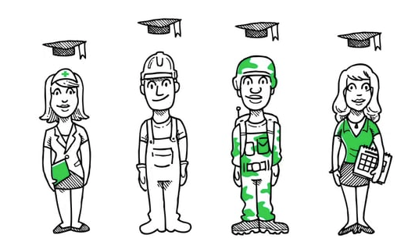
Showcase of PLA - Video

Slide 15
Key Questions for Breakouts
What are some of the most promising PLA approaches?
How can campuses deepen implementation and application of PLA strategies to impact more students?

Slide 16
Breakouts
Break up into 101 and Deep Dive Groups

Slide 17
Thank You!
Find resources for TAACCCT success at:
https://etagrantees.workforce3one.org
Subscribe to TLN resources, ask questions or connect with peers at TAACCCT@dol.gov

