Slide 1
November 30, 2015
PRIOR LEARNING ASSESSMENT: Deep Dive Session

Slide 2
Presenters
Ellen Hewett
Director
National College Transition Network
Louise Bradley
Grant/Credit for Prior Learning Coordinator
Southwest Wisconsin Technical College

Slide 3
Welcome
Making the Case
Accomplishments, Challenges and Lessons
Southwest Tech (WI)
Meridian Community College (MS)
Discussion
Questions
Key Considerations
Tools and Resources

Slide 4
Making the Case
Why award credit for prior learning?

Slide 5
Data
The information that follows is from a March 2010 study from CAEL (Council on Adult Experiential Learning) www.cael.org
Fueling the Race: A 48-Institution Study of Prior Learning Assessment and Adult Student Outcomes

Slide 6
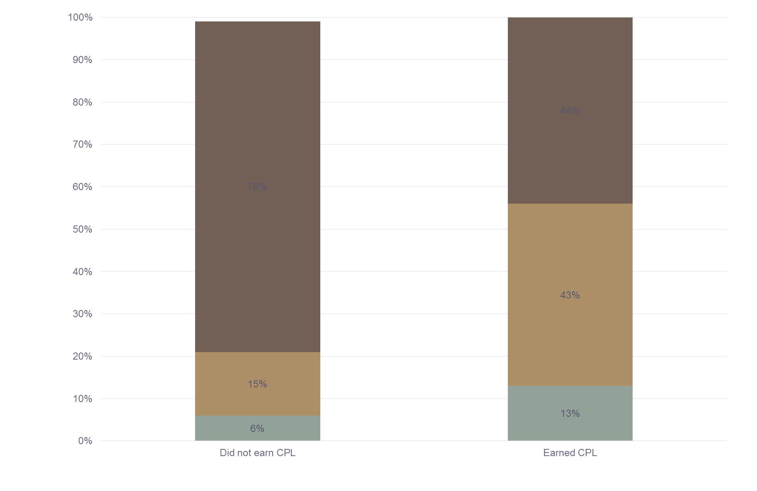
Effect on Graduation Rates

Slide 7
Other Key Findings
Outcomes | Credit for Prior Learning Students | Non-CPL Students
Graduation rate for students with a GPA of 3.0 or higher | 66% | 35%
Graduation rate for students with a GPA of 2.0 – 2.9 | 44% | 28%

Slide 8
Other Key Findings
Outcomes | Credit for Prior Learning Students | Non-CPL Students
Retention of first year students | 63% | 40%
GPA of over 3.0 | 70% | 64%

Slide 9
Average Credits Earned
Credit for Prior Learning Students | Non-CPL Students
53.7 average credits | 43.8 average credits
* Does not include CPL credits (only faculty-taught, tuition-bearing hours)

Slide 10
Southwest Tech
Accomplishments, Lessons and Challenges

Slide 11
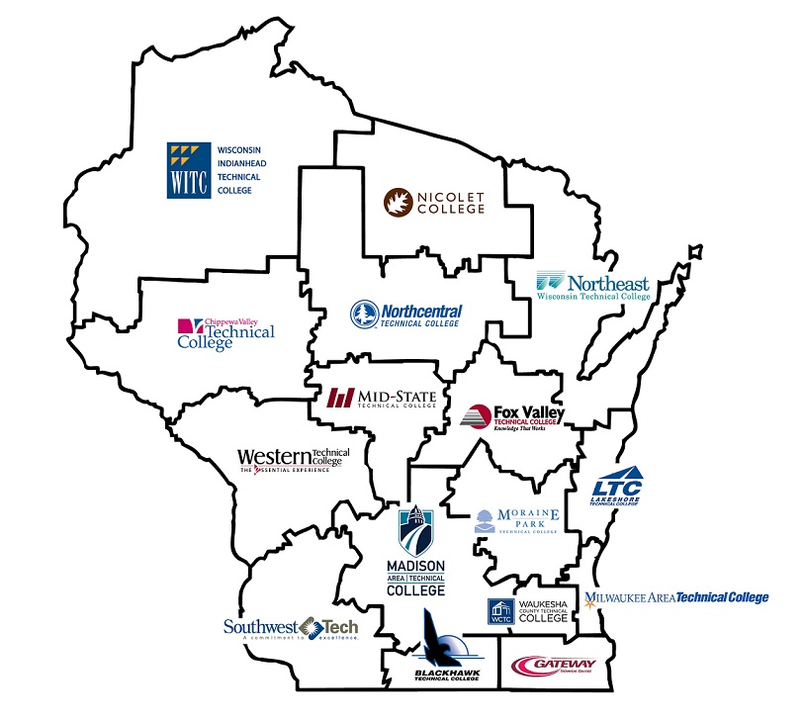
The Wisconsin Story

Slide 12
The Wisconsin Story
Three colleges part of TAA CCCT #1
All 16 technical colleges TAA CCCT #2 – 4 as a consortium
Credit for prior learning was built into all 4 grants

Slide 13
The Wisconsin Story
Credit for Prior Learning - History in Wisconsin
Before TAACCCT Round 2
Existing State policy is general
Implemented at various degrees within individual colleges
Assessment procedures inconsistent or undefined
Labor intensive for students and college leadership
Subjective outcomes

Slide 14
The Wisconsin Story
  Credit for Prior Learning – Consortium Scope
  CAEL - Council on Adult Experiential Learning
    Interview colleges, process map templates, advising
    Provide training to faculty and staff
    Veterans credentials translation
    Advise and support

Slide 15
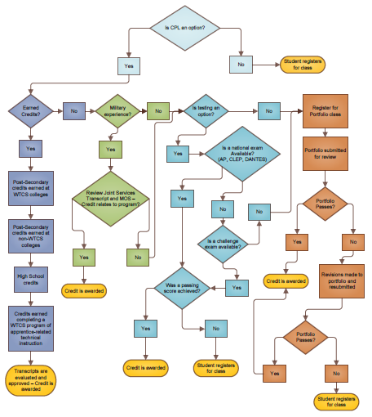
The Southwest Tech Story
Path to Credit
Path to Credit
Transfer Credit
Military
Testing
Portfolio

Slide 16
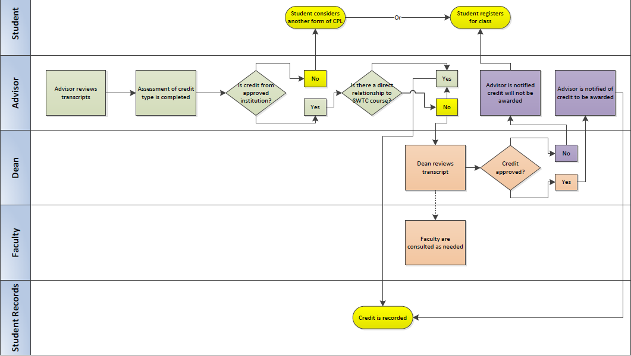
The Southwest Tech Story
Transfer Credit

Slide 17
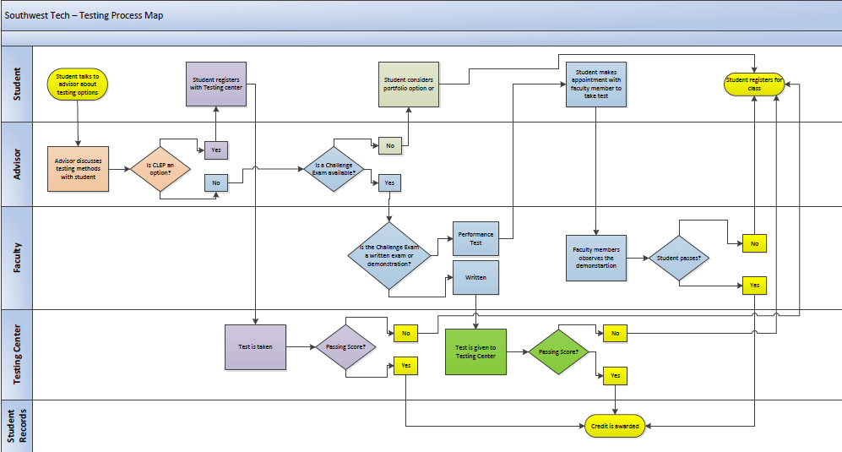
The Southwest Tech Story
Testing

Slide 18
The Southwest Tech Story
Experiential Credit

Slide 19
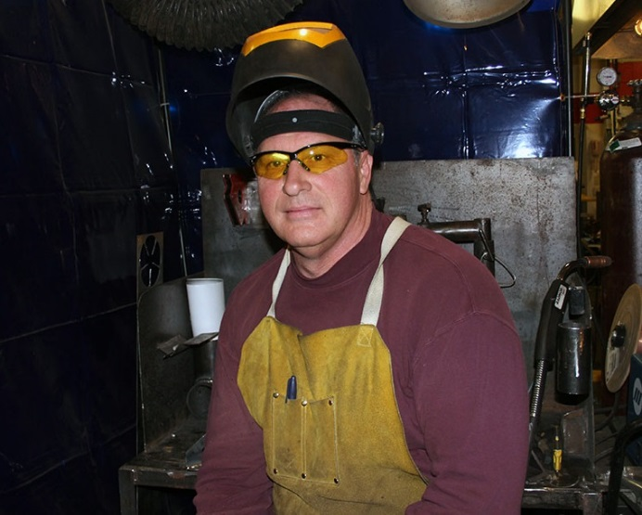
The Southwest Tech Story
Welding Curriculum
Welding taught in four 5-credit classes
New curriculum is 20 competency based 1-credit classes
Courses are more descriptive
Expanding to CNC Setup/Operation

Slide 20
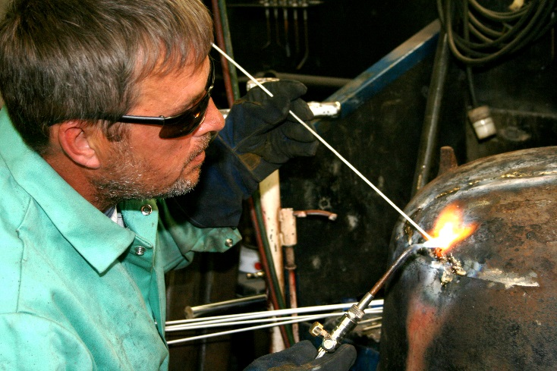
The Southwest Tech Story
Old Curriculum
Course # 31-442-353
Welding 1 & 2
10 credits
New Curriculum
31-442-311 Oxyfuel Gas Cutting & Gouging
31-442-312 Arc Cutting & Gouging
31-442-313 Plasma Cutting & Gouging
31-442-314 Oxyfuel Equipment
31-442-315 Oxyfuel Brazing & Welding –
Carbon Steel
31-442-316 Oxyfuel Brazing & Welding –
Stainless Steel
31-442-317 Forming & Folding
31-442-318 Fabricating
31-442-334 Fabrication Planning and
Drawing
31-442-320 SMAW – Equipment
31-442-321 SMAW – Carbon Steel
31-442-322 SMAW – Stainless Steel
12 Credits

Slide 21
The Southwest Tech Story
Challenges
Scheduling 1-credit courses
Getting buy in from the right people
Lessons
Bring faculty into the discussion early on
Tried to make things too simple
Creating unintentional barriers
Notes:
After this part – Pose for questions.

Slide 22
Meridian community college
Accomplishments, Lessons and Challenges

Slide 23


Gulf Coast IT Consortium
U.S. Department of Labor Employment and Training Administration
Trade Adjustment Assistance Community College Career Training (TAACCCT)
The Gulf Coast IT Consortium is made possible by a $14.7 million grant from the U.S.
Department of Labor’.

Slide 24
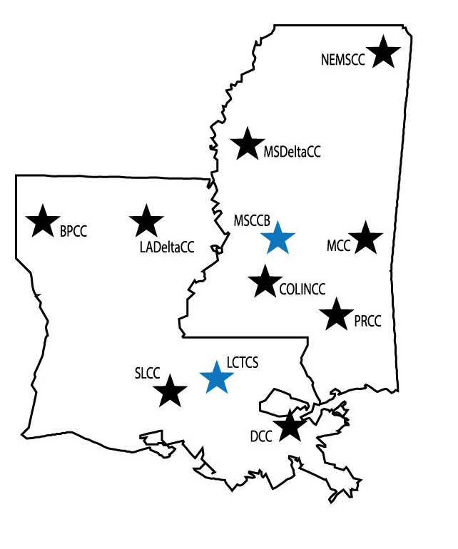
Consortium Members
Bossier Parish Community College
LA Delta Community College
South LA Community College
Delgado Community College
LCTCS Office (state level policy work)
Northeast MS Community College
MS Delta Community College
Meridian Community College
Copiah-Lincoln Community College
Pearl River Community College
MS CC Board (state level policy work)

Slide 25
Non-Credit Training
Short-term, less than 1 year
Customizable, Self-paced, and hybrid/online
Academic credit through PLA
Available pathways
  Adult Basic Education (GED)
  Workforce Development

Slide 26


Barriers to Success – PLA Policy
Does a policy exist?
Is the policy easily accessible?
Is PLA affordable to the student?
How will credit be transcripted?

Slide 27
Credit for Knowledge
Workforce Development non-credit coursework
Challenge exam administered by academic or CTE faculty
Credit transcription

Slide 28


COMMON CORE
HEALTHCARE IT
INFORMATION TECHNOLOGY
IST 1124
IT Foundations
IST 1134
Fundamentals of Data Communication
BOT 1133
BOT 1213
Personal and Professional Development
Microcomputer Applications
OR
CSC 1113
Computer Concepts
AHT 1113
Medical Vocabulary
BOT 2743
Medical Office Concepts
IST 1143
Security Principles and Policies
Earn up to 15 hours of credit through PLA!

Slide 29
Discussion
Questions
Key Considerations

Slide 30
Reflective Questions
What changes in PLA policy and procedures have been adopted by your institution? How have these changes been communicated?
Has awareness of PLA increased? How do you know?

Slide 31
Faculty Engagement
How have faculty been in engaged in the current development of PLA policy and practice, especially in the development of challenge exams?
What needs to happen to strengthen their engagement?
How can the use of challenge exams be expanded?

Slide 32

Promoting PLA to Students
How do potential and current students learn about PLA opportunities?
Messaging
Orientation
Advisement
Recruitment
Admission Interview

Slide 33
Key Considerations
Promotion requires a seamless message from all members of the college community.
Faculty must be engaged in the determination of credit awards or competency levels.
Data collection system must be in place.

Slide 34
Faculty Role
  Develop challenge exams
  Develop cross-walks with industry-recognized credentials and other non-credit trainings
  Determine skills/knowledge assessed
  Provide advisement
  Recommend/support policy changes

Slide 35

College-wide Promotion
  Assess knowledge and engagement of:
  Registrar
  Financial Aid Office
  Admissions Office
  Faculty
  Academic Leaders
  Public Relations
  Veterans Official
  Workforce Staff
  Others?

Slide 36
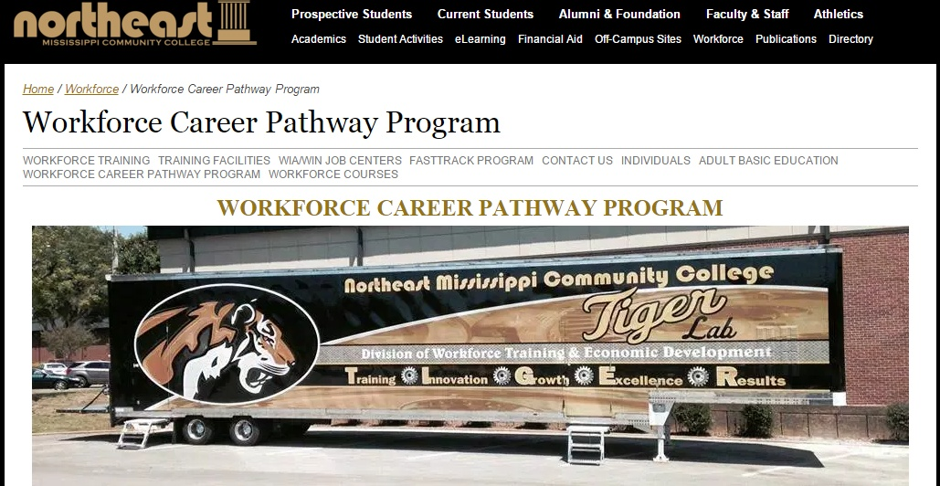
Challenge Exams Offered
http://www.nemcc.edu/workforce/career-pathway-program/

Slide 37
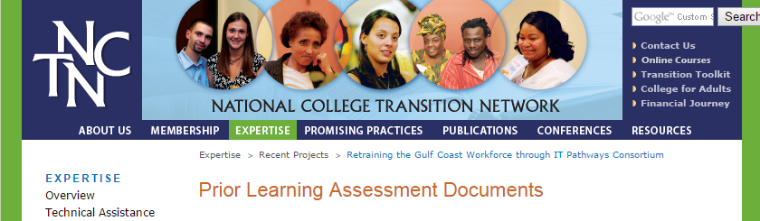
PLA Resources
http://www.collegetransition.org/PLAdocuments.html

Slide 38
Thank You!
Find resources for TAACCCT success at:
https://etagrantees.workforce3one.org
Subscribe to TLN resources, ask questions or connect with peers at TAACCCT@dol.gov

