Slide 1
How Can ETA Assist Grantees In Serving Disconnected Youth Under WIOA?—Discovery Session
Webinar Date: December 1, 2015
Presented by:
Philadelphia Regional Office
U.S. Department of Labor
Employment and Training Administration

Slide 2
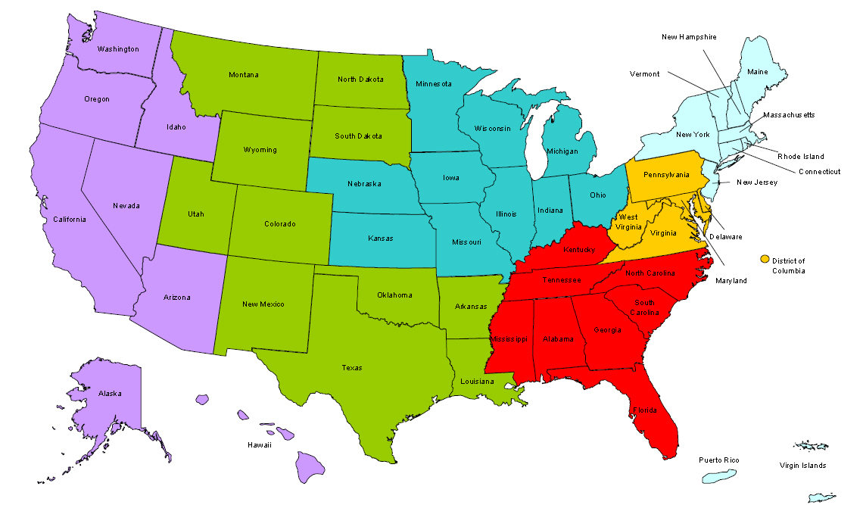
Where are you?
Enter your location in the Chat window – lower left of screen

Slide 3


Welcome
Leo Miller, Regional Administrator, Employment and Training Administration
Mark Edwards, President & CEO, Philadelphia Works Inc.

Slide 4

Here’s what you can expect to get out of this webinar!
Information Gathered:
  Youth Employment Research
  Youth Employment Statistics
  Various Program Participants
Information Shared:
  Facilitated Discovery Sessions
  Identified Areas of Need / Gaps
  Future Technical Assistance

Slide 5

Agenda
10:15 a.m. – 10:45 a.m.
Dr. Sara Heller
Department of Criminology, University of Pennsylvania
10:45 a.m. – 11:15 a.m.
Kara Markley
Supervisory Economist, U.S. Bureau of Labor Statistics
11:15 a.m. – 12:30 p.m.
Voice of Experience: Facilitated Youth Panel

Slide 6

Studying Summer Jobs for Disadvantaged Youth
Sara Heller
University of Pennsylvania
hellersa@sas.upenn.edu
1 December 2015
Research made possible by generous support from the
U.S. Department of Justice (OJJDP) & U.S. Department of Labor

Slide 7
“Nothing Stops a Bullet Like a Job”
Why should a job prevent youth violence?
Provide $
Information on value of schooling
Employer connections
Develop work & soft skills, self-efficacy
Incapacitation (keep kids off the corner)

Slide 8
But theory not clear cut
Violence mostly evenings & weekends, jobs during day
More $ for “criminogenic commodities”
(alcohol, drugs)
More time in transit, with different peers

Slide 9
Surprisingly little rigorous evidence
A lot of correlational research on summer jobs → reasons to think there should be positive effects
But studies often compare youth who show up to those who don’t
  And those who show up might already be doing better
Lottery creates “treatment” and “control” groups that are on average identical
  Fair way to allocate slots for over-subscribed program

Slide 10

One Summer Plus
Run by Chicago’s Dept of Family & Support Services, non-profit community partners
8-week summer 2012 program
  Gov’t & non-profit minimum wage jobs (25 hrs/wk)
  Adult job mentor
    1-day job readiness training, 1 meal/day, bus passes when needed
For subset of youth, add cognitive behavioral therapy-based curriculum
  3 hrs/day at job, 2 hrs/day at CBT (for same wage)

Slide 11
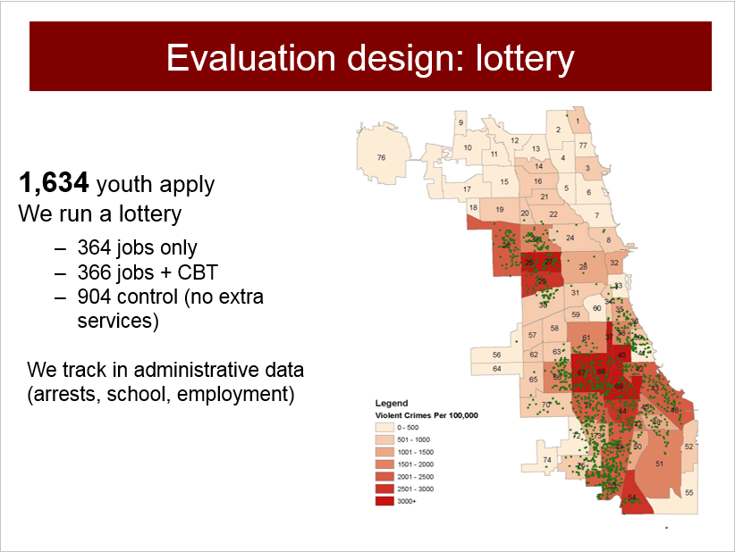
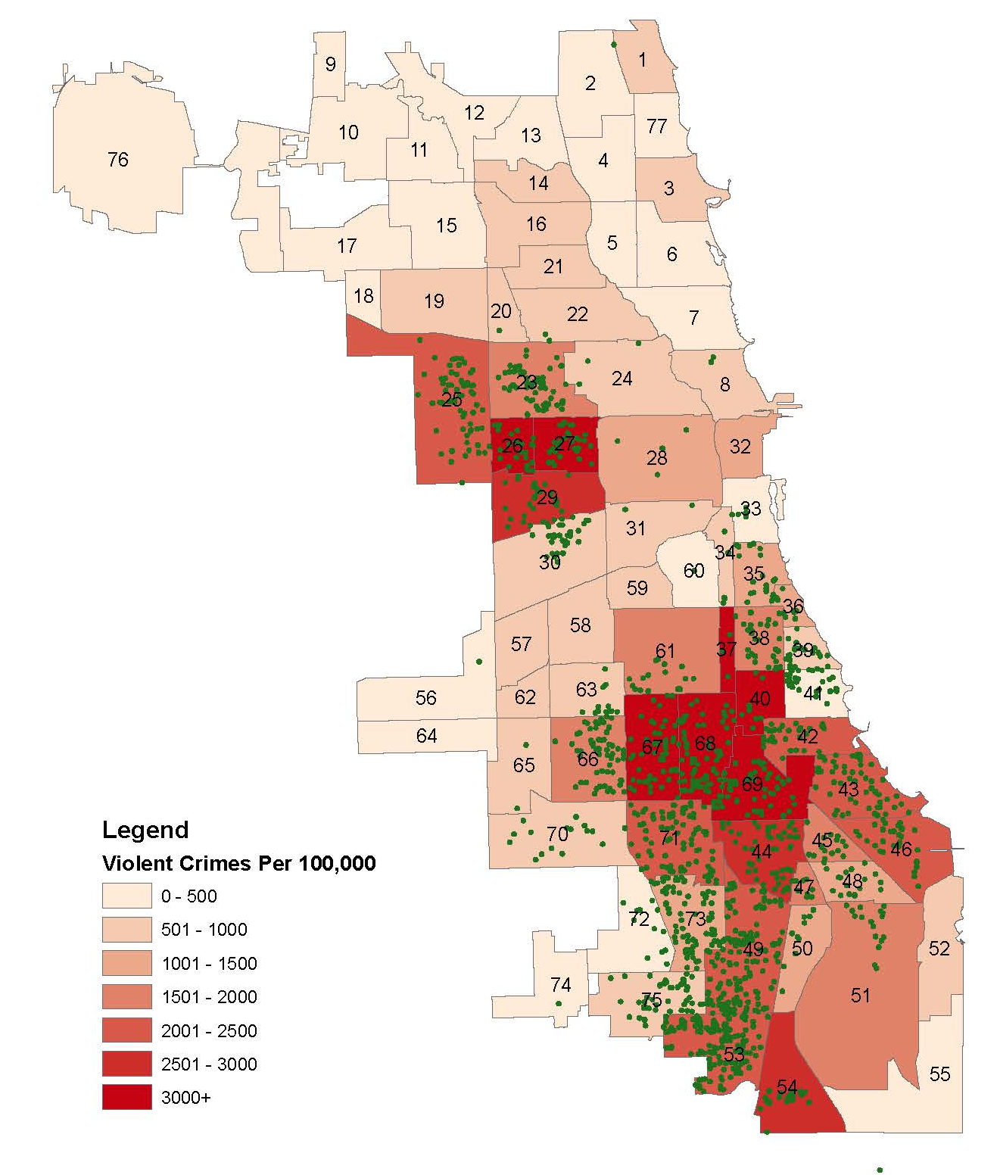
Evaluation design: lottery
1,634 youth apply
We run a lottery
  364 jobs only
  366 jobs + CBT
  904 control (no extra services)
  We track in administrative data (arrests, school, employment)

Slide 12
Study Population

Slide 13
Program reduces violence over next 16 months – by a lot
43%

Slide 14
Extremely promising results
Huge decline in violence, mostly after the program
  From just 8 weeks!
  Benefits may already outweigh costs
  First rigorous evidence of crime effects
Echoed in recent NYC summer jobs study
  Decline in mortality, likely driven by homicide
  But no post-summer employment impacts → again seems to be changing violence-specific outcomes

Slide 15




Study results put Chicago in the news

Slide 16
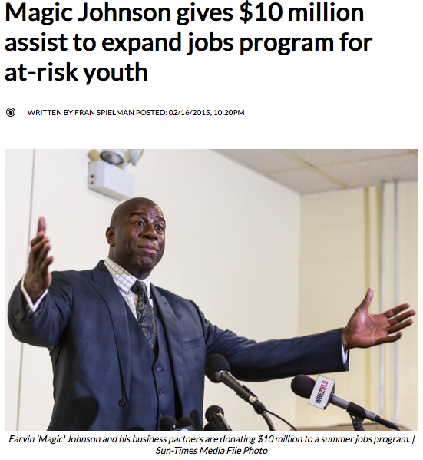
And:

Slide 17
Now developing Philly study
City government & Philadelphia Youth Network asked for rigorous study of WorkReady
Do summer jobs have similar (or other) effects with different program model, population & context?
Pilot in 2015, larger-scale evaluation in 2016
  Challenge of securing funding early

Slide 18
Concluding Thoughts
May be worth thinking broadly about the effects of youth employment programs
Chicago became national leader in part because of willingness to evaluate
  Philly now leading the charge
Much left to learn: mechanisms, generalizability
So I hope you’ll think about incorporating outcome evaluation into your own programs

Slide 19


Slide 20
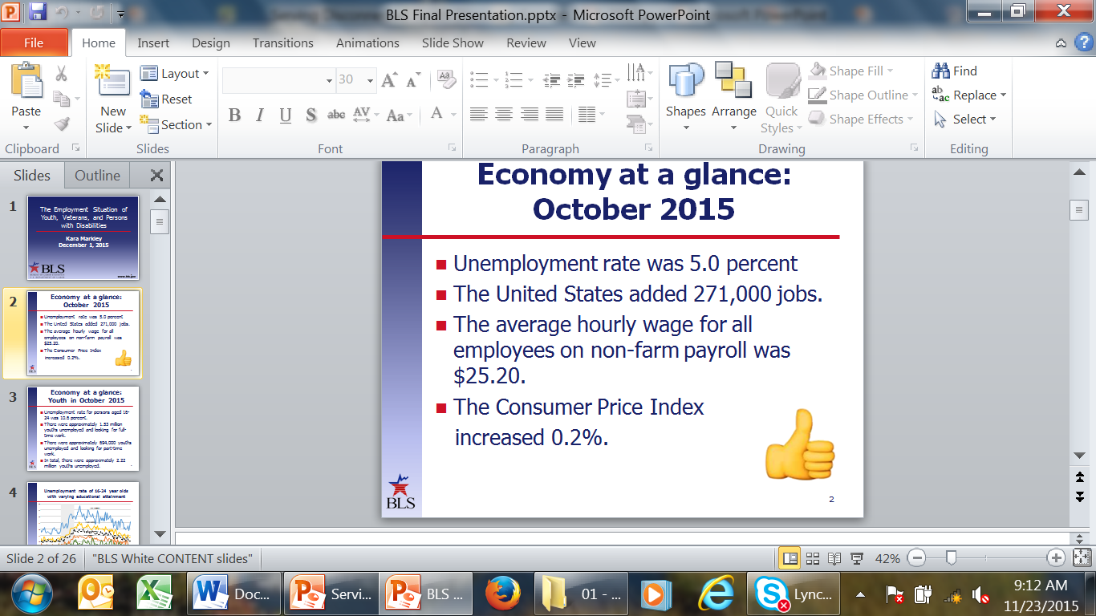

Economy at a glance: October 2015
Unemployment rate was 5.0 percent
The United States added 271,000 jobs.
The average hourly wage for all employees on non-farm payroll was $25.20.
The Consumer Price Index
increased 0.2%.

Slide 21
Economy at a glance: Youth in October 2015
Unemployment rate for persons aged 16-24 was 10.6 percent.
There were approximately 1.53 million youths unemployed and looking for full-time work.
There were approximately 694,000 youths unemployed and looking for part-time work.
In total, there were approximately 2.22 million youths unemployed.

Slide 22
Unemployment rate of 16-24 year olds with varying educational attainment

Slide 23
Unemployment levels of 16-24 year olds, by gender, October 2015
(numbers in thousands)

Slide 24
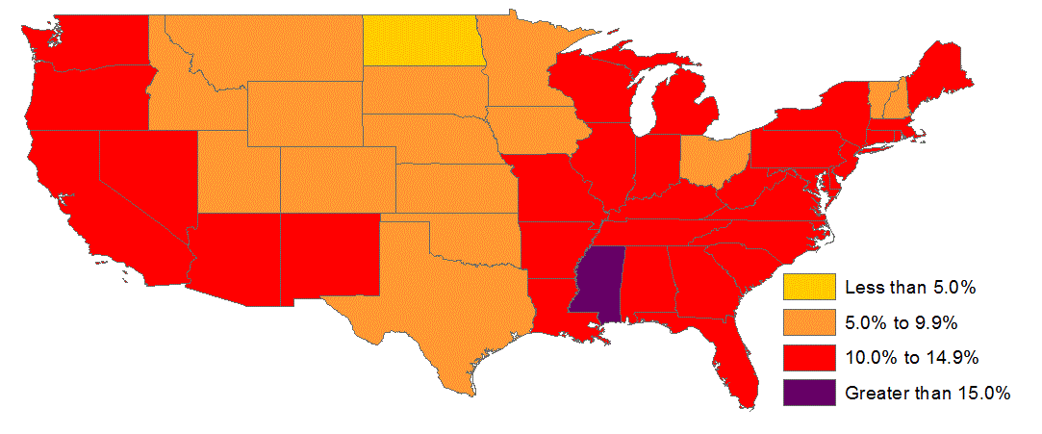
Unemployment rate, 20-24 years old, across the country, 2014 annual averages
State Average: 10.7

Slide 25
Unemployment rate, by state and gender, 20-24 years old, 2014 annual averages

Slide 26
Unemployment levels, by state and gender, 20-24 years old, 2014 annual averages
(numbers in thousands)

Slide 27
Veterans
In 2014, 21.2 million men and women were veterans. Of these,
  10.5 million were not in the labor force
  10.2 million veterans were employed
  573,000 unemployed
Unemployment rate for all veterans was 5.3 percent in 2014.

Slide 28
Unemployment rate of young veterans and nonveterans, 18-24 years old

Slide 29

Persons with Disabilities

Slide 30
May 2012 Supplemental Disability Survey
Data on persons with disabilities was collected through a supplement to the May 2012 Current Population Survey (CPS).
The CPS is a monthly survey of about 60,000 households that provide information on the labor force status, demographics, and other characteristics of the nation's civilian population age 16 and over.

Slide 31
May 2012 Supplemental Disability Survey: Disability status
An individual was classified as having a disability if the household answered “yes” to any of the following questions:
  Is anyone deaf or does anyone have serious difficulty hearing?
  Is anyone blind or does anyone have serious difficulty seeing even when wearing glasses?
  Because of a physical, mental, or emotional condition, does anyone have serious difficulty concentrating, remembering, or making decisions?
  Does anyone have serious difficulty walking or climbing stairs?
  Does anyone have difficulty dressing or bathing?
  Because of a physical, mental, or emotional condition, does anyone have difficulty doing errands alone such as visiting a doctor’s office or shopping?

Slide 32
Disabled persons
In May 2012, over 28.3 million had a disability
  45.4 percent of persons with a disability were over 65 years old
  15.1 percent of persons with a disability age 25 and over had a bachelor’s degree or higher, compared to 33.4 percent for persons with no disability
  The labor force participation rate of all persons with a disability was 20.9 percent, compared to 64.2 percent for persons with no disability

Slide 33
May 2012 Supplemental Disability Survey: Disability status
An individual was classified as having a disability if the household answered “yes” to any of the following questions:
  Is anyone deaf or does anyone have serious difficulty hearing?
  Is anyone blind or does anyone have serious difficulty seeing even when wearing glasses?
  Because of a physical, mental, or emotional condition, does anyone have serious difficulty concentrating, remembering, or making decisions?
  Does anyone have serious difficulty walking or climbing stairs?
  Does anyone have difficulty dressing or bathing?
  Because of a physical, mental, or emotional condition, does anyone have difficulty doing errands alone such as visiting a doctor’s office or shopping?

Slide 34
Disabled persons
In May 2012, over 28.3 million had a disability
  45.4 percent of persons with a disability were over 65 years old
  15.1 percent of persons with a disability age 25 and over had a bachelor’s degree or higher, compared to 33.4 percent for persons with no disability
  The labor force participation rate of all persons with a disability was 20.9 percent, compared to 64.2 percent for persons with no disability

Slide 35
Barriers to employment
The following question was asked of persons with a disability who were not employed. “Do you consider any of the following a barrier to employment for you?”
Lack of education or training
Lack of job counseling
Lack of transportation
Loss of government assistance
Need for special features at the job
Employer or coworker attitudes
Your difficulty
Other
The individual was classified as having a barrier to employment if they answered “yes” to any of the above responses.

Slide 36
Do you have a barrier to employment?
(numbers in millions)

Slide 37
Type of barriers to employment

Slide 38
Reasons why I never worked: Barriers to employment for disabled individuals

Slide 39
Career assistance programs
The following question was asked of persons with a disability. “In the past five years, have you received assistance from any of the following?”
Vocational Rehabilitation Centers
One-Stop Career Centers
Ticket to Work program
Assistive Technology Act program
Center for Independent Living for individuals with disabilities
Client Assistance Program
Any other employment assistance program

Slide 40
Current employment status of disabled individuals that received career assistance in the last 5 years, 16-64 years old

Slide 41
Education pays…
Unemployment rate, 2014
Median weekly earnings, 2014
Average, all occupations = 5.0
NOTE: Data for persons aged 25 and over.
Average, all occupations = $839

Slide 42
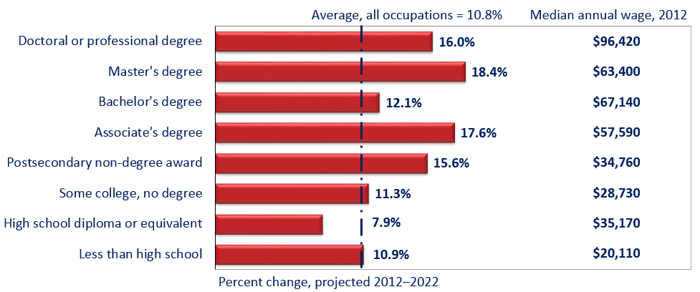
Projected growth in jobs categorized by typical education requirements

Slide 43
Less than high school occupations with the largest job growth
W | T | Median annual wages, May 2012
N | S | $19,910
N | S | $21,110
N | S | $20,820
N | S | $18,260
N | S | $22,320
N | S | $29,990
N | S | $23,890
N | S | $19,570
<5 | M | $22,030
N | S | $23,570
Median annual wage: $34,750

Slide 44
High school diploma occupations with the largest job growth
W | T | Median annual wages, May 2012
N | S | $32,410
N | S | $30,580
N | A | $39,940
N | M | $35,170
N | M | $31,350
N | S | $19,510
N | S | $27,470
<5 | N | $49,330
N | S | $25,990
N | M | $54,230
Median annual wage: $34,750

Slide 45
Associate’s degree or postsecondary non-degree award occupations with the largest job growth
W | T | Median annual wages, May 2012
N | N | $65,470
N | N | $24,420
N | S | $38,200
N | N | $41,540
N | N | $29,370
N | N | $22,700
N | N | $27,130
N | N | $34,500
N | N | $70,210
N | L | $43,640
Median annual wage: $34,750

Slide 46
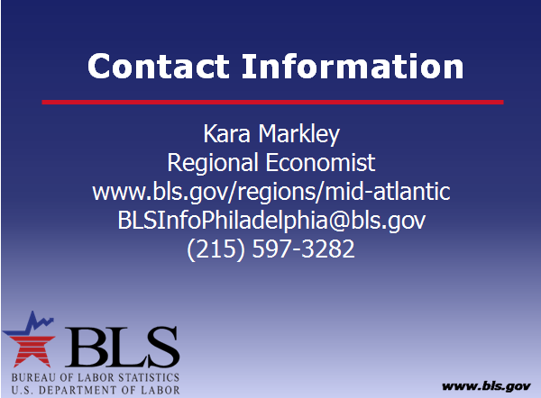

Slide 47


Special Thank You to…
1199c
Connection Training Services Project YES YouthBuild
JEVS E³ Power Center
Pathways PA
Philadelphia Job Corps Center
Philadelphia Works, Inc.
Philadelphia Youth Network
Philadelphia YouthBuild Charter School
PHMC E³ Power Center
Southeast Regional Workforce Development
Partnership (SERWDP)
Youth Service, Inc.

Slide 48


Future Technical Assistance—Spring 2016

Slide 49



www.workforce3one.org

