Slide 1
WIOA Performance Accountability
December 1st and 2nd , 2015
Statistical Adjustment Model Methodology
Presented by:
U.S. Department of Labor
Employment and Training Administration
U.S. Department of Education
Office of Career, Technical and Adult Education
Rehabilitation Services Administration

Slide 2
Today’s Moderator
◆ Karen Staha
Director
Division of Strategic Planning and Performance
Office of Policy Development and Research
Employment and Training Administration
U.S. Department of Labor

Slide 3

Today’s Presenters
◆ Ryan Sutter
Mathematical Statistician
U.S. Department of Labor
Chief Evaluation Office
◆ Larry Condelli
Managing Director
American Institutes for Research
Workforce and Lifelong Learning Program
◆ Yann-Yann Shieh
Statistician
U.S. Department of Education
Rehabilitation Services Administration
◆ Burhan Ogut
Senior Researcher
American Institutes for Research
Workforce and Lifelong Learning Program

Slide 4
PART I
Developing a Methodology for Setting WIOA Performance Targets
Ryan Sutter
Mathematical Statistician
U.S. Department of Labor
Chief Evaluation Office

Slide 5
WIOA Methodology Design Approach
Review prior work
Examine pro’s and con’s – completed
Gather and assess available data
  Individual vs aggregate approaches
Back compute the new WIOA measures (to the extent possible)
Estimate the models
  Variable selection
  Cross validate
Produce results

Slide 6
WIOA Measures
Performance Measures | Definition | Labor
Employment rate 2nd quarter after exit | The percent of exiters who are employed in the 2nd quarter after program exit | Can be done with existing labor data
Employment rate 4th quarter after exit | The percent of exiters who are employed in the 4th quarter after program exit | Can be done with existing WIA data and WP data through the third quarter
Median earnings 2nd quarter after exit | The median earnings of all employed exiters in the 2nd quarter after program exit | Can be done with existing labor data
Postsecondary/diploma credential rate within 1 year of exit | The percentage of program participants who obtain a recognized postsecondary credential or a secondary school diploma or its recognized postsecondary credential or secondary school diploma or its recognized equivalent during participation or one year after program exit | Can be done with existing labor data through the 3rd quarter after exit
Measurable skill gains rate | The percentage of program participants who, during a program year, are in an education or training program that leads to a recognized postsecondary credential or employment and who are achieving measurable skill gains toward such a credential or employment | Not possible with existing data
Employment or education rate 2nd quarter after exit | The percent of exiters who are employed or enrolled in education in the 2nd quarter after program exit | Can be done with existing WIA data for the 1st quarter after exit
Employment or education rate 4th quarter after exit | The percent of exiters who are employed or enrolled in education in the 4th quarter after program exit | Can be done with existing WIA data for the 1st quarter after exit
Employer services indicator | The primary indicators of serving employers | Not possible with existing data

Slide 7
Prior Work on Target Setting Methods
JTPA Performance Adjustment Model
WIA Adjustment PY 2010 and 2011
WIA Adjustment PY 2012 – 2014

Slide 8
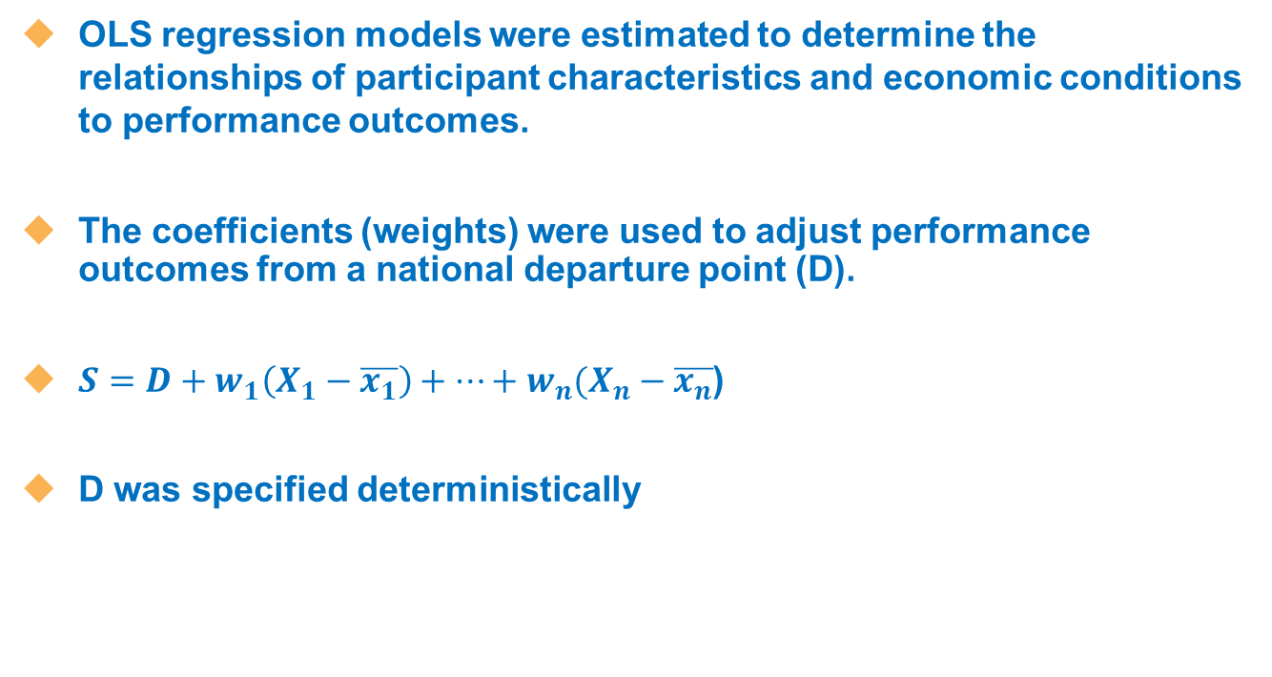
JTPA Performance Adjustment Model
OLS regression models were estimated to determine the relationships of participant characteristics and economic conditions to performance outcomes.
The coefficients (weights) were used to adjust performance outcomes from a national departure point (D).
$S=D+w_{1}\left(X_{1}−\overline{x_{1}}\right)+…+w_{n}(X_{n}−\overline{x_{n}}$)
D was specified deterministically

Slide 9
An Example

Slide 10
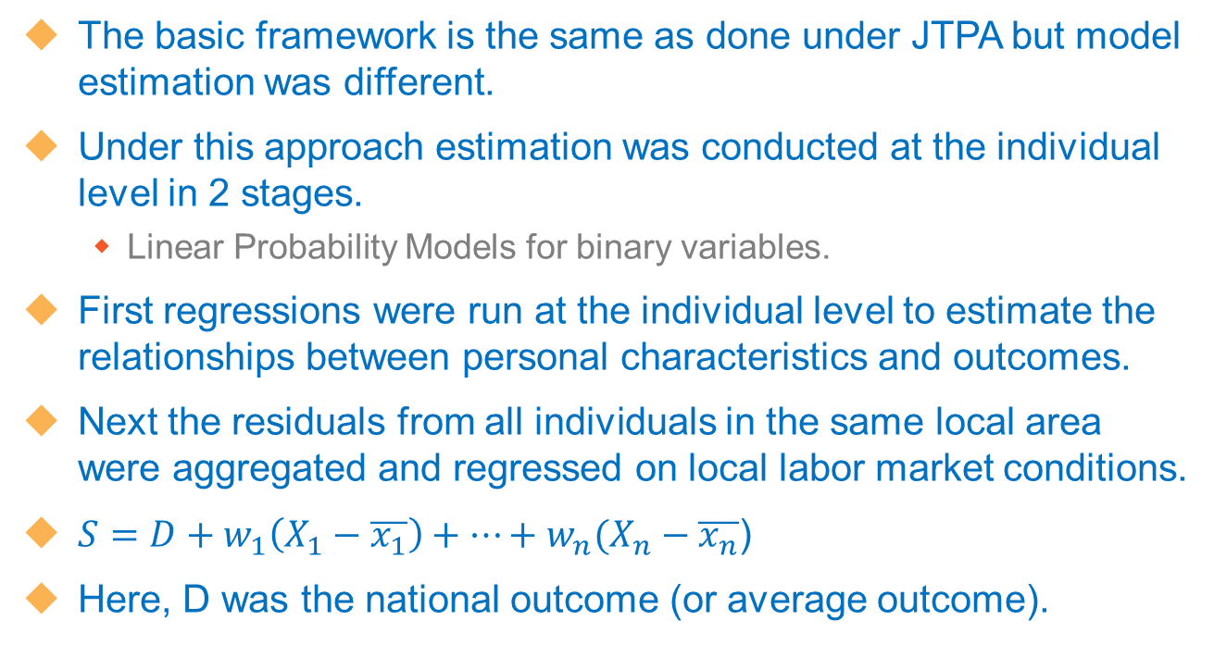
WIA Adjustment PY 2010 - 2011
The basic framework is the same as done under JTPA but model estimation was different.
Under this approach estimation was conducted at the individual level in 2 stages.
  Linear Probability Models for binary variables.
First regressions were run at the individual level to estimate the relationships between personal characteristics and outcomes.
Next the residuals from all individuals in the same local area were aggregated and regressed on local labor market conditions.
$S=D+w_{1}\left(X_{1}−\overline{x_{1}}\right)+…+w_{n}(X_{n}−\overline{x_{n}}$)
Here, D was the national outcome (or average outcome).

Slide 11
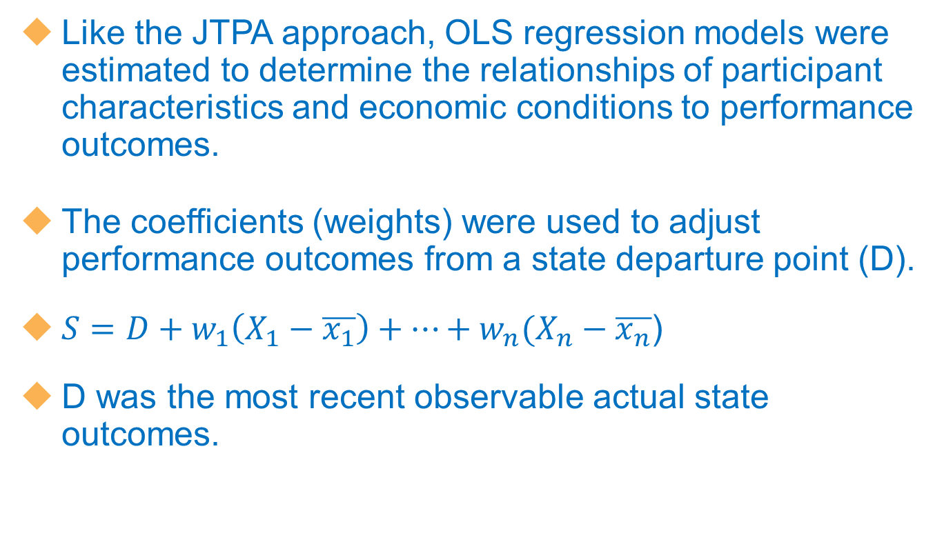
WIA Adjustment PY2012 - 2014
Like the JTPA approach, OLS regression models were estimated to determine the relationships of participant characteristics and economic conditions to performance outcomes.
The coefficients (weights) were used to adjust performance outcomes from a state departure point (D).
$S=D+w_{1}\left(X_{1}−\overline{x_{1}}\right)+…+w_{n}(X_{n}−\overline{x_{n}}$)
D was the most recent observable actual state outcomes.

Slide 12
Extensions
Model Calibration
    How well do they work?
Variable Selection
    Which variables to include?
Empirical Methodology for Selecting Model Specification

Slide 13
Estimation Methods – Considered Aggregate Level
Traditional Ordinary Least Squares (OLS) methods.
Bayesian variants of OLS methods.
Spatial econometric extensions of these models that account for the influence of spatial dependence.
Fixed and Random Effects methods.
  Including spatial econometric extensions of these models.

Slide 14
Average Prediction Errors
Model Specification | Average RMSE
OLS | 0.0520
Bayesian OLS | 0.0512
Quantile | 0.0516
Fixed Effects | 0.0460
Random Effects | 0.0462
Spatial Fixed Effects | 0.0421
Spatial Random Effects | 0.0432

Slide 15
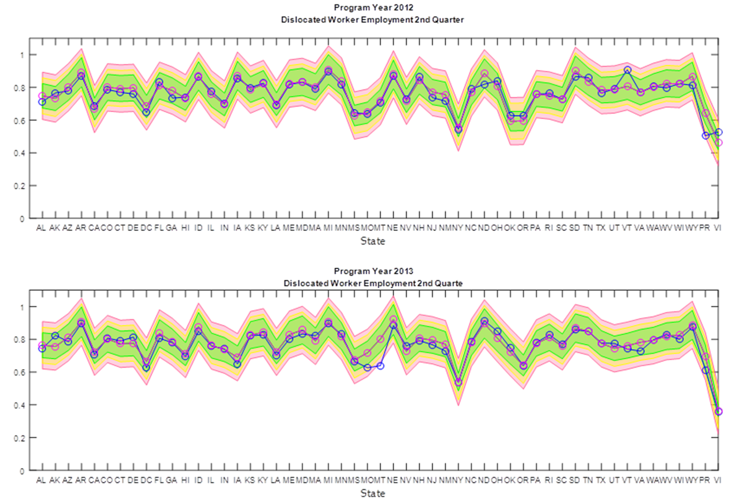
Within Sample Fixed Effects Predictions

Slide 16
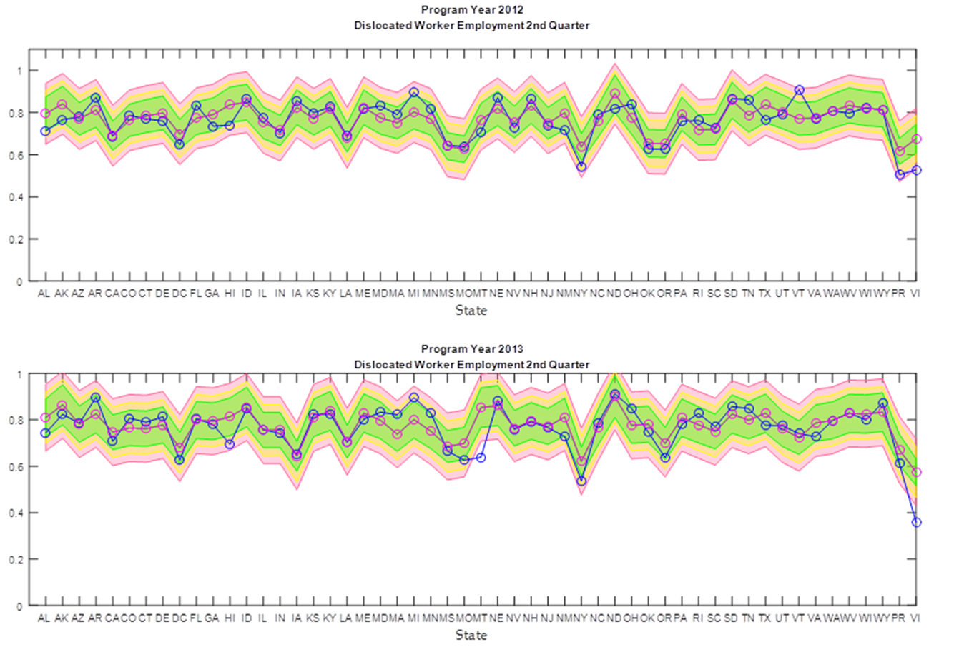
Within Sample Fixed Effects Performance Targets

Slide 17
PART II
Applying the Statistical Adjustment Model for Rehabilitation Services Administration Data
Yann-Yann Shieh
Statistician
U.S. Department of Education
Rehabilitation Services Administration

Slide 18
RSA 911
Vocational Rehabilitation Program Case Services Record (RSA-911) is a data collection form that collects information on individuals with disabilities who apply for VR services in each state agency for the vocational rehabilitation (VR) and supported employment (SE) programs.
RSA-911 data includes information regarding demographics, disability, interventions, reason for case closure, employment status, sources of financial support.
Each state agency is required to submit their data annually by November 30, following the end of a fiscal year.

Slide 19
RSA 911 (cont.)
In the past, annual data submission by agency deadline is no later than Nov. 30.
Beginning July 1, 2016, based on the newly enacted Workforce Innovation and Opportunity Act (WIOA), RSA will be asking state agencies to submit their individual case data information quarterly to enable RSA to better track individuals’ employment status after their cases are closed.
RSA is also making revision to the data collection by adding data elements required by WIOA statistical adjustment model, such as indicators of poor work history, lack of work experience, dislocation from high-wage and high-benefit employment, Ex-offender status.

Slide 20
Current VR Data Availability for Back Computing WIOA Performance Measures
Performance Measures | Definition | Voc. Rehab. Data
Employment rate 2nd quarter after exit | The percent of participants who are employed in the 2nd quarter after program exit | Using RSA-911 data element “Type of Closure” (position 198) – proxy data. Note: This does not correspond to employment status 2nd quarter after exit.
Employment rate 4th quarter after exit | The percent of participants who are employed in the 4th quarter after program exit | No data available with existing data
Median earnings 2nd quarter after exit | The median earnings of all employed participants in the 2nd quarter after program exit | Using RSA-911 data element “weekly earning at closure’ (positions 163-166) as well as data element ‘hours worked in a week’ at closure (position 167-168) – proxy data. Note: This does not correspond to the 2nd quarter after exit.
Postsecondary/diploma credential rate within 1 year of exit | The percentage of program participants who obtain a recognized postsecondary credential or a secondary school diploma or its recognized postsecondary credential or secondary school diploma or its recognized equivalent during participation or one year after program exit | Using RSA 911 data element ‘Level of Education Attained at Closure’ (position 154) and “Level of Education at application” (position 39) – proxy data. Note: This could be calculated at closure but does not extend one year after closure.
Measurable skill gains rate | The percentage of program participants who, during a program year, are in an education or training program that leads to a recognized postsecondary credential or employment and who are achieving measurable skill gains toward such a credential or employment | Using RSA 911 data element ‘Level of Education Attained at Closure’ (position 154) and “Level of Education at application” (position 39) – proxy data. Note: This is not within year progress it is pre and post program.
Employer services indicator | The primary indicators of serving employers | No data available with existing data

Slide 21
Current Data Used for the Statistical Adjustment Model
FY 2004-FY 2013 of RSA 911 data
80 agencies: 24 general, 24 blind, 32 combined agencies.
We combined data of states with two separate agencies into one state data.
Aggregated the individual’s data based on the closure date by quarter
Computed percentage by the characteristics of participants in each quarter
Four agencies without unemployment rate record (AS, CNMI, Guam, VI)-not included in the analysis
Total 2080 records

Slide 22
Explanatory Variables on Participant Characteristics from RSA 911
Identify a set of variables measuring:
  The characteristics of participants and
    Demographic information:
      Age
      Gender
      Ethnicity
    Others:
      Education level at application
      Employment status at application
      Disability types
      Welfare dependency (e.g., receiving any public support at application)
      Receiving any training/services
      Homeless

Slide 23
Explanatory Variables on Economic Conditions
  Conditions of the labor market
    Unemployment rate by quarter from FY 2004 – FY 2013
    Job losses or gains in particular industries (future use)

Slide 24
Methods
RSA has been following DOL’s work on the method (same framework but different explanatory variables).
For the current model run, one core measure “employment rate (in percentage)” is used as an outcome measure.

Slide 25

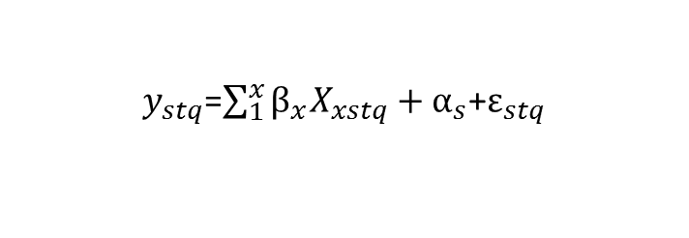
Methods (cont.)
Three models were run:
  Traditional Ordinary Least Squares (OLS) methods.
  Fixed effect model (state fixed effect)
  Random effect model (state random effect)
$y_{stq}$=$\sum_{1}^{x}{β_{x}X_{xstq}+α_{s}}$+$ε_{stq}$
$y_{stq}$ = employment rate in state s year t quarter q
$X_{xstq}$ = a set of individuals with disability characteristics variables spanning 1 to x & unemployment rate in state s year t quarter q
$α_{s}$ = state fixed effect or random effect (not apply to OLS)
$ε_{stq}$ = error term

Slide 26
Results
Results from different methods show similar parameter estimates.
The initial model run result shows that RSA VR data seems to be explaining less variation in outcomes when compared to DOL.
RSA data have larger unit effects (state) and more variation around the targets.

Slide 27
Fixed Effect Result
State | 2013Q1 actual ER | Y-hat | Target | Absolute value difference between actual and predicted | difference between actual and target | Unit effect | 90% failure threshold
Maine | 0.4530 | 0.5028 | 0.6988 | 0.0498 | -0.2458 | -0.1960 | 0.6289
Hawaii | 0.4306 | 0.4450 | 0.6256 | 0.0144 | -0.1950 | -0.1806 | 0.5630
Oklahoma | 0.5597 | 0.4956 | 0.6298 | 0.0641 | -0.0701 | -0.1343 | 0.5668
Indiana | 0.5921 | 0.4819 | 0.6115 | 0.1102 | -0.0194 | -0.1296 | 0.5504
Connecticut | 0.4561 | 0.5043 | 0.6297 | 0.0482 | -0.1736 | -0.1253 | 0.5667
Ohio | 0.3165 | 0.4118 | 0.5358 | 0.0953 | -0.2193 | -0.1240 | 0.4822
Arizona | 0.4291 | 0.4092 | 0.5297 | 0.0199 | -0.1006 | -0.1205 | 0.4767
South Dakota | 0.7900 | 0.6361 | 0.7551 | 0.1539 | 0.0349 | -0.1191 | 0.6796
Wisconsin | 0.5798 | 0.4906 | 0.6042 | 0.0892 | -0.0244 | -0.1136 | 0.5438
Nebraska | 0.6672 | 0.6298 | 0.7335 | 0.0374 | -0.0663 | -0.1036 | 0.6602
Iowa | 0.5789 | 0.5800 | 0.6736 | 0.0011 | -0.0947 | -0.0937 | 0.6062
Vermont | 0.5515 | 0.5801 | 0.6704 | 0.0286 | -0.1189 | -0.0903 | 0.6034
Montana | 0.5252 | 0.5606 | 0.6500 | 0.0354 | -0.1248 | -0.0894 | 0.5850
North Dakota | 0.4169 | 0.6073 | 0.6715 | 0.1904 | -0.2546 | -0.0641 | 0.6044

Slide 28
Fixed Effect Result (cont.)
State | 2013Q1 actual ER | Y-hat | Target | Absolute value difference between actual and predicted | difference between actual and target | Unit effect | 90% failure threshold
Maine | 0.4530 | 0.5028 | 0.6988 | 0.0498 | -0.2458 | -0.1960 | 0.6289
Hawaii | 0.4306 | 0.4450 | 0.6256 | 0.0144 | -0.1950 | -0.1806 | 0.5630
Oklahoma | 0.5597 | 0.4956 | 0.6298 | 0.0641 | -0.0701 | -0.1343 | 0.5668
Indiana | 0.5921 | 0.4819 | 0.6115 | 0.1102 | -0.0194 | -0.1296 | 0.5504
Connecticut | 0.4561 | 0.5043 | 0.6297 | 0.0482 | -0.1736 | -0.1253 | 0.5667
Ohio | 0.3165 | 0.4118 | 0.5358 | 0.0953 | -0.2193 | -0.1240 | 0.4822
Arizona | 0.4291 | 0.4092 | 0.5297 | 0.0199 | -0.1006 | -0.1205 | 0.4767
South Dakota | 0.7900 | 0.6361 | 0.7551 | 0.1539 | 0.0349 | -0.1191 | 0.6796
Wisconsin | 0.5798 | 0.4906 | 0.6042 | 0.0892 | -0.0244 | -0.1136 | 0.5438
Nebraska | 0.6672 | 0.6298 | 0.7335 | 0.0374 | -0.0663 | -0.1036 | 0.6602
Iowa | 0.5789 | 0.5800 | 0.6736 | 0.0011 | -0.0947 | -0.0937 | 0.6062
Vermont | 0.5515 | 0.5801 | 0.6704 | 0.0286 | -0.1189 | -0.0903 | 0.6034
Montana | 0.5252 | 0.5606 | 0.6500 | 0.0354 | -0.1248 | -0.0894 | 0.5850
North Dakota | 0.4169 | 0.6073 | 0.6715 | 0.1904 | -0.2546 | -0.0641 | 0.6044

Slide 29
Fixed Effect Result (cont.)
State | 2013Q1 actual ER | Y-hat | Target | Absolute value difference between actual and predicted | difference between actual and target | Unit effect | 90% failure threshold
Illinois | 0.5700 | 0.5623 | 0.5548 | 0.0077 | 0.0152 | 0.0074 | 0.4993
California | 0.3195 | 0.4546 | 0.4385 | 0.1351 | -0.1190 | 0.0161 | 0.3947
Virginia | 0.4965 | 0.5277 | 0.5102 | 0.0312 | -0.0137 | 0.0175 | 0.4592
Texas | 0.6200 | 0.5900 | 0.5582 | 0.0300 | 0.0618 | 0.0317 | 0.5024
Utah | 0.4788 | 0.6037 | 0.5710 | 0.1249 | -0.0922 | 0.0327 | 0.5139
North Carolina | 0.7364 | 0.5733 | 0.5354 | 0.1631 | 0.2010 | 0.0379 | 0.4819
South Carolina | 0.6620 | 0.5893 | 0.5451 | 0.0727 | 0.1169 | 0.0442 | 0.4906
Rhode Island | 0.6455 | 0.5717 | 0.5271 | 0.0738 | 0.1184 | 0.0446 | 0.4744
Arkansas | 0.7150 | 0.6562 | 0.6100 | 0.0588 | 0.1050 | 0.0462 | 0.5490
Tennessee | 0.6765 | 0.5401 | 0.4932 | 0.1364 | 0.1833 | 0.0469 | 0.4439
Kentucky | 0.5413 | 0.6321 | 0.5824 | 0.0908 | -0.0411 | 0.0496 | 0.5242
Oregon | 0.6039 | 0.5341 | 0.4841 | 0.0698 | 0.1198 | 0.0500 | 0.4357
Washington | 0.5969 | 0.5429 | 0.4924 | 0.0540 | 0.1045 | 0.0505 | 0.4432
Alaska | 0.6111 | 0.5996 | 0.5412 | 0.0115 | 0.0699 | 0.0583 | 0.4871

Slide 30
Fixed Effect Result (cont.)
State | 2013Q1 actual ER | Y-hat | Target | Absolute value difference between actual and predicted | difference between actual and target | Unit effect | 90% failure threshold
Illinois | 0.5700 | 0.5623 | 0.5548 | 0.0077 | 0.0152 | 0.0074 | 0.4993
California | 0.3195 | 0.4546 | 0.4385 | 0.1351 | -0.1190 | 0.0161 | 0.3947
Virginia | 0.4965 | 0.5277 | 0.5102 | 0.0312 | -0.0137 | 0.0175 | 0.4592
Texas | 0.6200 | 0.5900 | 0.5582 | 0.0300 | 0.0618 | 0.0317 | 0.5024
Utah | 0.4788 | 0.6037 | 0.5710 | 0.1249 | -0.0922 | 0.0327 | 0.5139
North Carolina | 0.7364 | 0.5733 | 0.5354 | 0.1631 | 0.2010 | 0.0379 | 0.4819
South Carolina | 0.6620 | 0.5893 | 0.5451 | 0.0727 | 0.1169 | 0.0442 | 0.4906
Rhode Island | 0.6455 | 0.5717 | 0.5271 | 0.0738 | 0.1184 | 0.0446 | 0.4744
Arkansas | 0.7150 | 0.6562 | 0.6100 | 0.0588 | 0.1050 | 0.0462 | 0.5490
Tennessee | 0.6765 | 0.5401 | 0.4932 | 0.1364 | 0.1833 | 0.0469 | 0.4439
Kentucky | 0.5413 | 0.6321 | 0.5824 | 0.0908 | -0.0411 | 0.0496 | 0.5242
Oregon | 0.6039 | 0.5341 | 0.4841 | 0.0698 | 0.1198 | 0.0500 | 0.4357
Washington | 0.5969 | 0.5429 | 0.4924 | 0.0540 | 0.1045 | 0.0505 | 0.4432
Alaska | 0.6111 | 0.5996 | 0.5412 | 0.0115 | 0.0699 | 0.0583 | 0.4871

Slide 31
Next Steps
Add FY 2014 data into analyses
Add state industries data into analyses
Run other core measures
  Median earnings
  Postsecondary attainment rate
  Measureable skill gain
Use model as a tool to assist and inform performance target negotiations for PY 2016

Slide 32
PART III
Constructing Adjusted Performance Indicators for Adult Education
Larry Condelli
Managing Director
American Institutes for Research
Workforce and Lifelong Learning Program
Burhan Ogut
Senior Researcher
American Institutes for Research
Workforce and Lifelong Learning Program

Slide 33
National Reporting System (NRS)
NRS for Adult Education was created to meet the requirements of the Workforce Investment Act (WIA -- P.L. 105-220).
States submit 10 required tables, six optional tables, four financial reports, one narrative report, and one data quality checklist.
NRS data are aggregated in tables.
Workforce variables described in WIOA for SAM are not collected.
Data quality is uncertain on some measures—not all states submit them.

Slide 34
Outcome Measures
Our key outcome variables include all available measures:
  Percentage of students achieved one or more educational levels (Educational Gain) from 2002-03 to 2012-13
  Percentage of students entered postsecondary education from 2002-03 to 2011-12
  Percentage of students obtained GED from 20002-03 to 2011-12
  Percentage of students entered employment from 2002-03 to 2010-11
  Percentage of students retained employment from 2002-03 to 2010-11

Slide 35
Control Variables
Demographics
  Age
  Race/ethnicity
  Gender
  Disability
  Adult education program type (ABE, ASE, ESL)
  English as a Second Language
  Single Parent
  Learning Disabled
  Homeless
Workforce
  Dislocated Worker
  Employed
  Not in Labor Force
  Low Income
  On Public Assistance
  Workplace Literacy Programs
Community
  Urban
  Rural

Slide 36
Analyses
Analyses are conducted at state level due to NRS limitations
  Decreased precision in estimating the relationships between indicators and outcome measures
  Can only be used to evaluate state level performance

Slide 37
Model Specifications
Three regression models
  Pooled ordinary least square (POLS)
  State fixed-effects (FE)
  State random effects (RE)
Four variations
  Long panel
  Short panel (most current 5 year)
  Fixed year effects
  Continuous year effects

Slide 38
Procedure
Estimate models by leaving the most current available data out for validation
Compute predicted performance measures for the states for the most current year
Compare the predicted and actual performance measures
Evaluate models by using the mean squared error of the residual

Slide 39
Results
Fixed effects models with a continuous year trend using the short panel resulted in lower mean squared error
Observed, predicted, and 95% confidence intervals of educational gain for 2013

Slide 40
POLLING QUESTION
Let us know which area you represent today:
  Workforce
  Adult Education
  Vocational Rehabilitation
  Other

Slide 41

Please Enter Your Questions in the Chat Room!

Slide 42

Presenters’ Contact Information
◆ Ryan Sutter
Mathematical Statistician
U.S. Department of Labor
Chief Evaluation Office
Sutter.Ryan@dol.gov
◆ Larry Condelli
Managing Director
American Institutes for Research
Workforce and Lifelong Learning Program
LCondelli@air.org
◆ Yann-Yann Shieh
Statistician
U.S. Department of Education
Rehabilitation Services Administration
Yann-Yann.Shieh@ed.gov
◆ Burhan Ogut
Senior Researcher
American Institutes for Research
Workforce and Lifelong Learning Program
bogut@air.org

Slide 43


