Slide 1
December 7, 2015
COMPETENCY BASED EDUCATION: A NEW APPROACH TO ACCELERATION

Slide 2
TAACCCT LEARNING NETWORK
AT A GLANCE
U.S. Department of Labor, Employment & Training Administration
(National)
Jobs for the Future
CalState/Merlot
Maher & Maher
American Association of Community Colleges
U.S. National Science Foundation
ATE Centers
Other Non-Federal Providers of TA and Resources for TAACCCT Grantees:
Creative Commons
CAST
The Transformative Change Initiative

Slide 3
Presenters
Barbara Endel, PhD
Senior Director
Jobs for the Future
Nancy Thibeault
Dean, Distance Learning
Sinclair Community College

Slide 4

CBE 101
Competency-based education model
December 7, 2015
Dr. Nancy Thibeault, Dean eLearning Division / Director TAACCCT Grant
Flex-Paced Online IT Programs
Program Overview
This product was funded by a grant awarded by the U.S. Department of Labor’s Employment and Training Administration. The product was created by the grantee and does not necessarily reflect the official position of the U.S. Department of Labor. The Department of Labor makes no guarantees, warranties, or assurances of any kind, express or implied, with respect to such information, including any information on linked sites and including, but not l
imited to, accuracy of the information or its completeness, timeliness, usefulness, adequacy, continued availability, or ownership.

Slide 5

Agenda
TAACCCT Grant
Project Model Components
  Overview
  Workforce Relationships
  Curriculum
  Program Delivery
  Student Experience
Challenges

Slide 6
The Grant

Slide 7
Sinclair’s TAACCCT Grant Project
Grant Goal – Adapt and adopt competency-based IT instruction to accelerate learning for TAA-eligible, veterans, unemployed, and other adult learners.

Slide 8





Round 2 TAACCCT Grant
Consortium Partners
  Austin Community College
  Broward College
  Sinclair Community College
  Western Governors University, Consultant
  Mathematica, Grant Evaluator

Slide 9
“Stacked” Programs
Network Engineering
NEEN.S.AAS
Software
Development
SODE.S.AAS
Secure Systems Administration
NEMA.S.AAS
INTERNSHIP
GENERAL EDUCATION REQUIREMENTS
security+
security+
CNSS 4011
Networking
Engineering
Associate
Certificate
Fast-Track Programming
Associate
Certificate
Microsoft
Certified
Solutions
Associate
Certificate
IT FUNDAMENTALS ASSOCIATE CERTIFICATE
Network+
Network+
Network+

Slide 10
CBE Model

Slide 11
Strategy
Build a college within a college
Integrate into existing college departments
Retrofit back end semester-based systems
CBE Model Components
Workforce
Curriculum
Program Delivery
Student Support

Slide 12
Accelerate IT Model
Workforce/Employer Partners
Strategic Partners
Business/Industry
Leadership Team
Program Advisory Committee
Public Workforce Agencies
Job Forecasting
Incumbent
Development Plans
Recommend Technologies
Job Alignment
Programs
Courses
Delivery Logistics
INTERNSHIP
Learner Support
STUDENTS
Faculty Facilitation
JOB
Holistic Case Management
PROMOTION
TRANSFER
Data-Informed

Slide 13
Accelerate IT Model – Workforce Relationships

Slide 14
Accelerate IT Model
1. Workforce
Workforce/Employer Partners
Strategic Partners
Business/Industry
Leadership Team
Program Advisory Committee
Public Workforce Agencies
Job Forecasting
Incumbent
Development Plans
Recommend Technologies
Job Alignment
Programs
Courses
Delivery Logistics
INTERNSHIP
Learner Support
STUDENTS
Faculty Facilitation
JOB
Holistic Case Management
PROMOTION
TRANSFER
Data-Informed

Slide 15

Strategic Imperative
TACTICAL
STRATEGIC
AREA OF FOCUS
Watch List
Executive Management
Middle Management
Line Management
Advisory Boards
Executive Business &
Industry Forums
AREA OF FOCUS
Watch List
Advisory Boards
Response
Based upon need
Focus Groups
Reactive | Proactive | Anticipatory
Operational Strategic Strategic Plan
Plan Operational Plan

Slide 16
Accelerate IT Model - Curriculum

Slide 17
Accelerate IT Model
2. Curriculum
Workforce/Employer Partners
Strategic Partners
Business/Industry
Leadership Team
Program Advisory Committee
Public Workforce Agencies
Job Forecasting
Incumbent
Development Plans
Recommend Technologies
Job Alignment
Programs
Courses
Delivery Logistics
INTERNSHIP
Learner Support
STUDENTS
Faculty Facilitation
JOB
Holistic Case Management
PROMOTION
TRANSFER
Data-Informed

Slide 18
Unbundling the faculty role
Course Development
  Faculty SMEs with ID
Assessment Development
  Faculty SMEs (can be different from 1) with ID
Facilitation
  Faculty (can be different from 1 and 2)
Grading
  Faculty (same as 3)
Student Performance Monitoring
  Academic coach in collaboration with faculty

Slide 19
Discussion Question
Shifting to CBE models requires really re-thinking roles.
How would some shifts in the role of faculty play out on your campus?

Slide 20
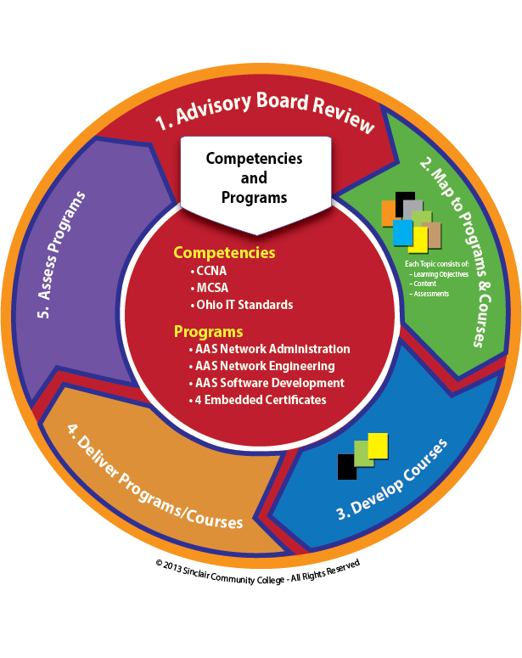
Program Development | Curriculum Updates

Slide 21
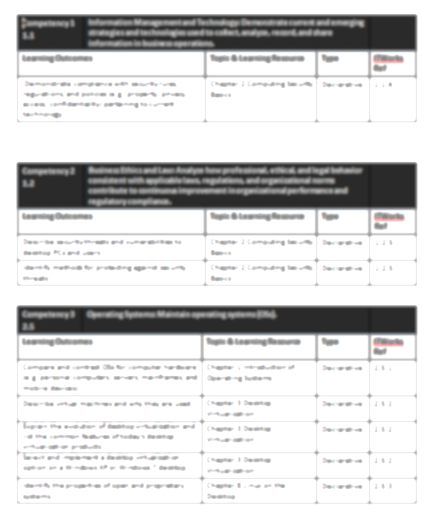
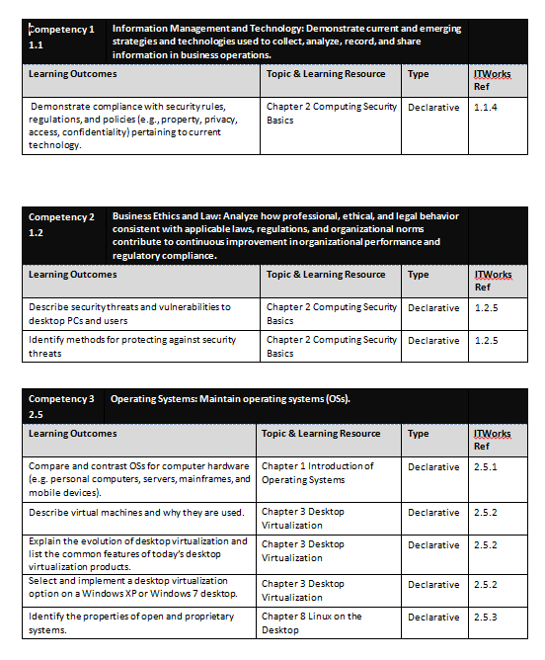
Program Development | Aligning Competencies
Programs
Gen Ed Outcomes
Program Outcomes
Master Syllabus
Course Description
Course Outcomes
Topics

Slide 22
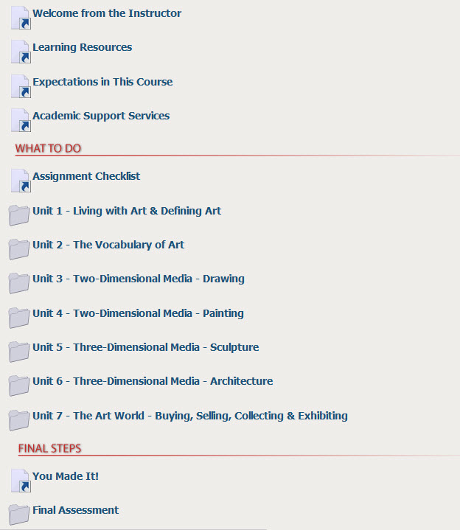
Online CBE Course Organization

Slide 23
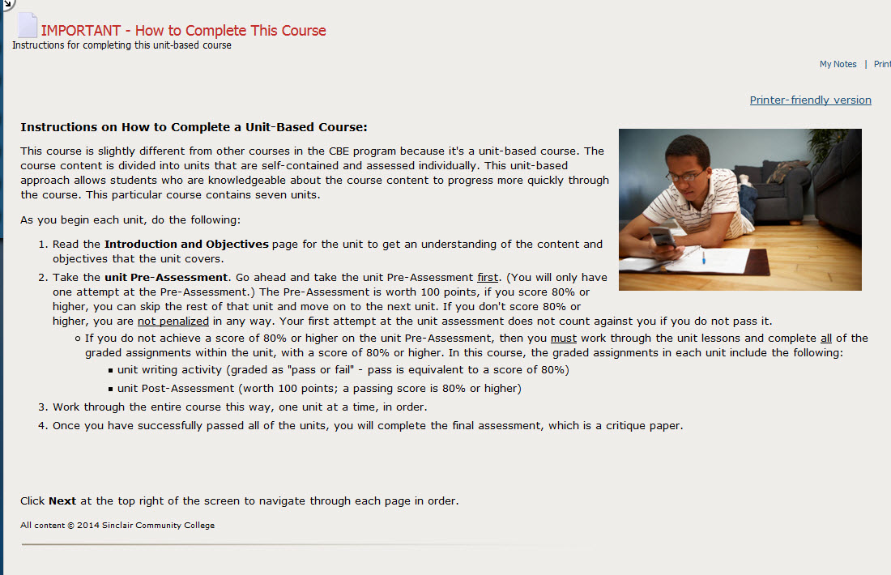
Acceleration through Module Pre-Assessment

Slide 24
Discussion Question
Assessment is a prominent feature of CBE models, how do you think this would work on your campus?

Slide 25
Accelerate IT Model – Delivery

Slide 26
Accelerate IT Model
3. Delivery
Workforce/Employer Partners
Strategic Partners
Business/Industry
Leadership Team
Program Advisory Committee
Public Workforce Agencies
Job Forecasting
Incumbent
Development Plans
Recommend Technologies
Job Alignment
Programs
Courses
Delivery Logistics
INTERNSHIP
Learner Support
STUDENTS
Faculty Facilitation
JOB
Holistic Case Management
PROMOTION
TRANSFER
Data-Informed

Slide 27
Program Delivery
30 self-paced, online courses
Enrollment on Mondays through week 12 of term
Students can “flex pace” or accelerate
800
Content Shell

Slide 28
Accelerate IT Model
4. Student Support
Workforce/Employer Partners
Strategic Partners
Business/Industry
Leadership Team
Program Advisory Committee
Public Workforce Agencies
Job Forecasting
Incumbent
Development Plans
Recommend Technologies
Job Alignment
Programs
Courses
Delivery Logistics
INTERNSHIP
Learner Support
STUDENTS
Faculty Facilitation
JOB
Holistic Case Management
PROMOTION
TRANSFER
Data-Informed

Slide 29

Learner Support | Phases
ADMIT
ENROLL
RETAIN
TRANSITION
COMPLETE
Apply
Admissions Counseling
Career Counseling
Right Fit Assessment
HANDOFF
Coach Intake Session
Vision Statement
Completion Goals
Coach Agreement
Coaching Sessions
LMS Caseload Report
SSP
Faculty & Peer Mentoring
Career Community
Connections with Faculty
Student Groups
Job Placement
Screen
Placement Test
Prior Learning
Transcripts
MAP
Progress Monitoring
Course
Degree
Resume & Career Preparation
Job Center
Workshops
Promotion
Funding
FAFSA
GI Bill
TAA
Register
Rolling Starts & In-Term Registration
Triggered Intervention
Performance
Engagement
Stop Out or Withdrawal
Transfer to
4-year
Internship
Trigger Courses
Motivation &
Persistence Tools
Registration Prompts
Completion Countdown
Career Community
Graduate
Feedback &
Follow-Up
Program Survey
Service Survey
State Wage Agency
Orientation
How to Succeed
Program Policy
Readiness Assessment
Payment
Books
FA Disbursement
Transfer Planning
Articulations
Connection with
Transfer Counselor

Slide 30
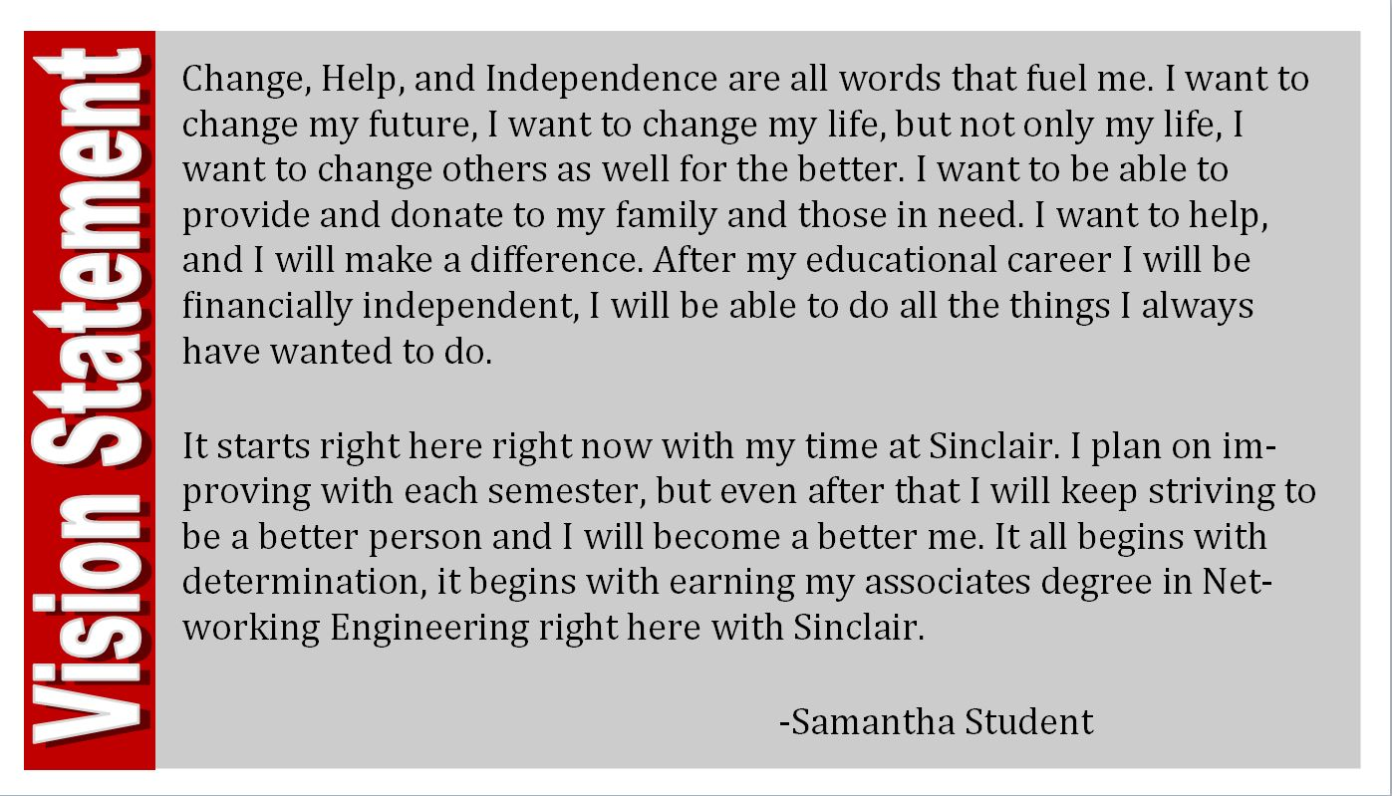
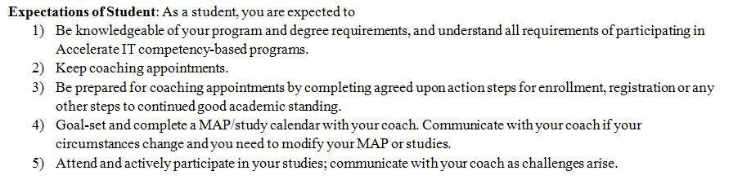
Coach-Student Relationship
Vision Statement
Goals, Progress & Pacing
First Coach Appointment

Slide 31
Coaching: Embedded Career
ADMIT
(Connect)
ENROLL
(Entry)
RETAIN
(Progress)
TRANSITION
(Complete)
COMPLETE
1) Goals and Vision Statement
2) “Right fit:” Identify knowledge of desired occupation and whether Accelerate IT program aligns
3) Overview of regional job market statistics
4) Referral if necessary: Campus career related resources
1) Transition vision statement into concrete goals
2) Set expectations of student involvement to their own career pathway
3) Establish internal mentorship: peer/faculty
4) Make connection to Career Community
1) Re-evaluate vision statement and goals
2) Help student identify class learning competencies with workforce needs
3) Encourage participation in Career Community
4) Introduce industry connections/look for mentoring opportunities
1) Bridge industry and student expectations
2) Student knows how to connect learning competencies to industry needs
3) Transition industry connections into areas of potential placement
4) Refer to career resources as needed
Admitted
First two terms
Mid-program
Final term before graduation

Slide 32
Accelerate Successes
Course success rate: 81%
Median days to course completion: 91
Program averages 10 contacts with students per term
Through 14FA, 85% of Accelerate students who interned went on to be hired or promoted after internship
Accelerate program created first collaborative coaching template between faculty and coaches

Slide 33
Challenges

Slide 34
Challenges
Implementing Self-paced mastery model in traditional Learning Management System
Accreditation – HLC required new process effective October 2015
Financial Aid eligibility
GI Bill living allowance
Faculty Policy
  Faculty Role
  Faculty Payload
Faculty grading load
Course granularity
Student procrastination
Integration into semester system / Delivery efficiency
  Flexible starts
  Out of synch grade reporting
  Restricted Registration (automate)
  Data / Report s (automation)
  Progress monitoring (automate)

Slide 35
Q & A
Your time is greatly appreciated.
Thank you!
Nancy.Thibeault@Sinclair.edu
http://www.sinclair.edu/accelerate/

Slide 36
Thank You!
Find resources for TAACCCT success at:
https://etagrantees.workforce3one.org
Subscribe to TLN resources, ask questions or connect with peers at TAACCCT@dol.gov
Notes:
Wrap up and Next Steps

