Slide 1
December 7, 2015
COMPETENCY BASED EDUCATION: Deep Dive Breakout Session

Slide 2
Presenters
Tara Smith
Senior Program Manager
Jobs for the Future
Ed Sargent
Project Director, PACE-IT
Edmonds Community College
Linda Smarzik
Dean, Computer Studies and Advanced Technology
Austin Community College

Slide 3
Competency Based Education at
Austin Community College District
December 7, 2015
A TAACCCT Department of Labor grant with Sinclair CC, Broward CC, and WGU
Overview
Linda Smarzik—Grant Lead, Dean Computer Studies and Advanced Technology

Slide 4
Ultimate challenge for Texas: The Non-Completion Story
The Problem
3.65 million Texans have some college credit and no degree.
1.89 million are not enrolled.
The State’s Cost
Texas is losing $13,303,820,000 in lifetime income for students who do not complete a bachelor’s degree.
The Student’s Cost
56% of all university non-completion rates leave with an average student debit of $11,800.

Slide 5
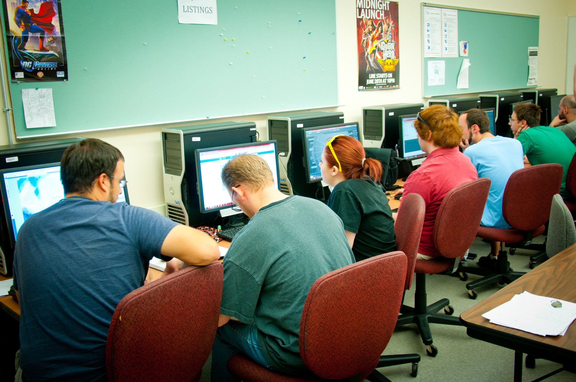
First problem to solve: The trend of IT employment in the Central Texas area
Unemployment rate under 4% 4,800 companies employ over 100,000 people in the technology sector.
Austin ranks second in the nation for high tech employment.
“Austin meets about 60% of job openings in the IT area.”
“ACC needs to provide overwhelming support in Central Texas for entry-level
IT completers.”
* Austin Chamber of Commerce

Slide 6
Second Problem to Solve: Declared majors and completers for CS/CIT (2013)
Department | Declared Majors/ 2-year and Certificate | Degree Seeker/Intent | Certificate Seeker/ Intent | Certificate Completers/2013 | Degree Completers 2013 | Total Completers
Computer Science | 939 | 368 | N/A | N/A | 30 | 30
Comp. Info Systems/ Info Tech | 943 | 498 | 109 | 23 | 53 | 76
Total | 1,882 | 861 | 109 | 23 | 83 | 106
970

Slide 7
Third problem to solve: DL enrollment increase – National trend
Over 7.1 million students were taking at least one online course during the fall 2012 term, an increase of 411,000 students over the previous year.

Slide 8
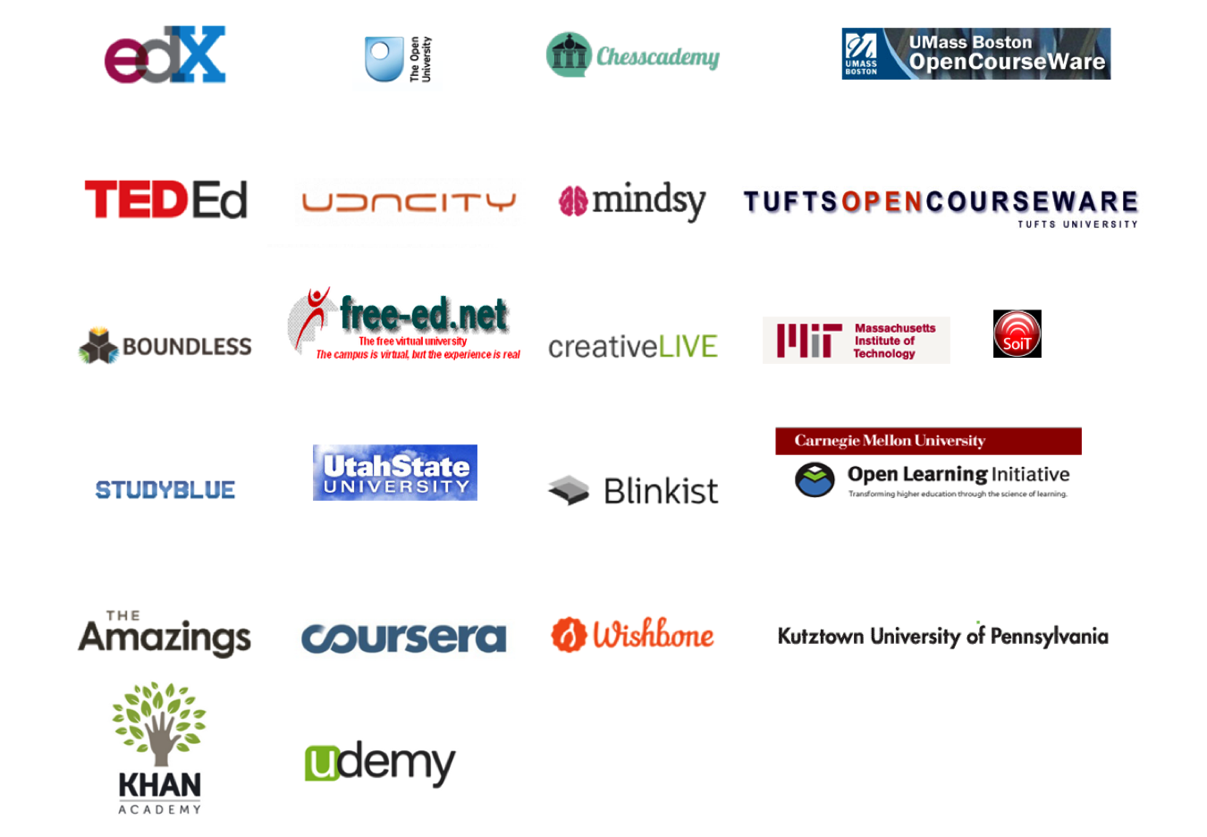
Fourth problem to solve:
Open Education Resource options

Slide 9
National Trends: Clay Christenson
“Higher education is poised for massive disruption as a result of new offerings in online learning.”
Harvard business professor, Clay Christenson speaking as the 2014 keynote for Educause

Slide 10
TAACCCT DOL Grant
Solution:
Meet industry and student needs by
developing accelerated,
flexible-entry,
competency-based education
using substantial interaction
via distance learning

Slide 11
DOL TAACCCT Grant: Description
2.1 million dollar grant to develop 24 CIT/CS distance learning competency based courses
In consortium with Sinclair CC
and Broward CC and consultation
by Western Governor’s University
Provide accelerated education leading to employment in the CIT/CS workforce
Recruit TAA eligible, veterans,
and the underemployed
Recognize
Reward
Retain
Recruit
Notes:
Heyman, E. (2010). Overcoming student retention issues in higher education online programs. Online Journal of Distance Learning Administration, 8(4). Retrieved from http://www.westga.edu/~distance/ojdla/winter134/heyman134.html.

Slide 12
Accelerated Programmer
Training Staff
Grant Hire | Name | Start Date
Project Director (Level 20) (100%) | Samuel Greer | 2/4/13
Administrative Assistant III (Level 8) (100%) | Crystal Cruz | 6/17/13
Coordinator, Research & Analysis (Level 18) (50%) | Willie Martinez | 6/1/13
Outreach Coordinator (Level 13) (100%) | Michael Martino | 3/1/13
Contract Recruiter (Service agreement) | Gene Brown | 6/1/13
Instructional Design Specialist (Level 17) (100%) | Ninghua Han | 5/1/13
Multimedia Developer (Level 17) (100%) | Chris Burns | 1/3/13
15 Faculty Subject Matter Experts (Contract)
ACC Staff
Grant Lead | Linda Smarzik
Subject Matter Expert | Mary Kohls
Student Support Specialists: Judy Arriaga & | Millie Marquez
Notes:
Heyman, E. (2010). Overcoming student retention issues in higher education online programs. Online Journal of Distance Learning Administration, 8(4). Retrieved from http://www.westga.edu/~distance/ojdla/winter134/heyman134.html.

Slide 13
Benefits of Implementing CBE at Austin Community College

Slide 14
Fall 2014: Credit hours by Dean
Dean | 2014 | 2013 | % Change
Business | 15,343 | 15,438 | -0.6
Health Sciences | 16,137 | 16,149 | -0.1
Applied Tech Multi & Public | 23,127 | 23,367 | -1.0
Math & Science | 75,423 | 77,051 | -2.1
Comp Studies & Adv. Tech | 19,249 | 18,383 | 4.7
Social & Behavioral Sciences | 78,524 | 78,903 | -0.5
Arts & Humanities | 31,732 | 32,514 | -2.4
Communications | 55,091 | 55,849 | -1.4
As of 10/21/14

Slide 15
Fall 2014: Contact hours by Dean
Dean | 2014 | 2013 | % Change
Business | 291,776 | 292,368 | -0.2
Health Sciences | 503,835 | 528,192 | 1.9
Applied Tech Multi & Public | 522,632 | 528,192 | -1.1
Math & Science | 1,499,168 | 1,550,048 | -3.3
Comp Studies & Adv. Tech | 446,672 | 429,280 | 4.1
Social & Behavioral Sciences | 1,273,728 | 1,273,232 | 0.0
Arts & Humanities | 552,512 | 570,112 | -3.1
Communications | 897,456 | 908,272 | -1.2
As of 10/21/14

Slide 16
Fall 2014: Duplicated Headcount by Dean
Dean | 2014 | 2013 | % Change
Business | 3,444 | 3,460 | -0.5
Health Sciences | 3,778 | 3,885 | -2.8
Applied Tech Multi & Public | 4,289 | 4,333 | -1.0
Math & Science | 18,044 | 18,937 | -4.7
Comp Studies & Adv. Tech | 3,747 | 3,582 | 4.6
Social & Behavioral Sciences | 19,521 | 17,683 | -0.8
Arts & Humanities | 7,932 | 8,117 | -2.3
Communications | 16,169 | 16,364 | -1.2
As of 10/21/14

Slide 17
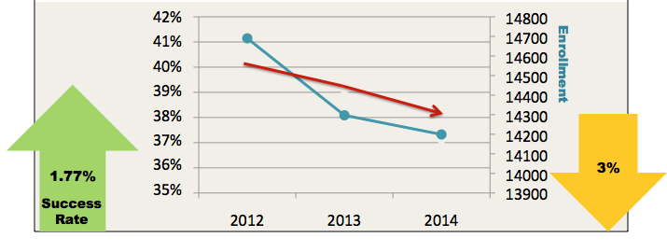
Austin Community College District
Distance Learning Spring 2012 - 2014
 | Spring 2012 | Spring 2013 | Spring 2014
ABC | 8,806 | 8,694 | 8,763
DF/IP/Withdrawal | 5,884 | 5,603 | 5,436
Total Enrollments | 14,690 | 14,297 | 14,199
Unsuccessful | 40.05% | 39.19% | 38.28%

Slide 18
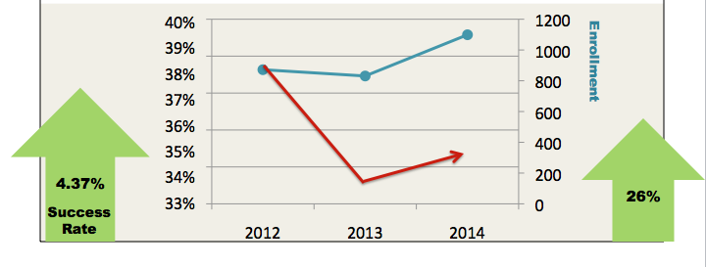
Computer Studies and Advanced Technology
Distance Learning Spring 2012 - 2014
 | Spring 2012 | Spring 2013 | Spring 2014
ABC | 534 | 552 | 721
DF/IP/Withdrawal | 338 | 278 | 378
Total Enrollments | 872 | 831 | 1,099
Unsuccessful | 38.76% | 33.45% | 34.39%

Slide 19
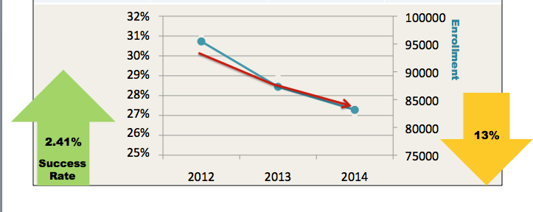
Austin Community College District
Traditional Classroom Spring 2012 - 2014
 | Spring 2012 | Spring 2013 | Spring 2014
ABC | 66,783 | 62,327 | 60,172
DF/IP/Withdrawal | 28,677 | 24,970 | 22,974
Total Enrollments | 95,460 | 87,297 | 83,146
Unsuccessful | 30.04% | 28.60% | 27.63%

Slide 20
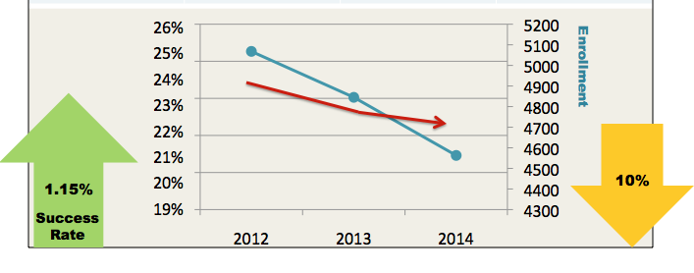
Computer Studies and Advanced Technology
Traditional Classroom Spring 2012 - 2014
 | Spring 2012 | Spring 2013 | Spring 2014
ABC | 3,888 | 3,750 | 3,553
DF/IP/Withdrawal | 1,180 | 1,095 | 1,010
Total Enrollments | 5,068 | 4,845 | 4,563
Unsuccessful | 23.28% | 22.60% | 22.13%

Slide 21
Pathways:
Stacked certificates and degrees
User Experience
(latticed with Viscom)
User and Computer Support Specialization
Web Programming Specialist AAS
Software Testing Specialization
Computer Programming AAS
Web Developer Specialist
Java Certificate
Software Testing
C++
Certificate
Database Certificate
Industry Certifications
User Computer Support
Marketable Skills Award
Marketable Skills Award Foundation
Intro to Computing — COSC 1301
Fundamentals of Networking — ITNW 1325
Programming Fundamentals I — COSC 1336
Web Design Tools — ITSE 1401

Slide 22
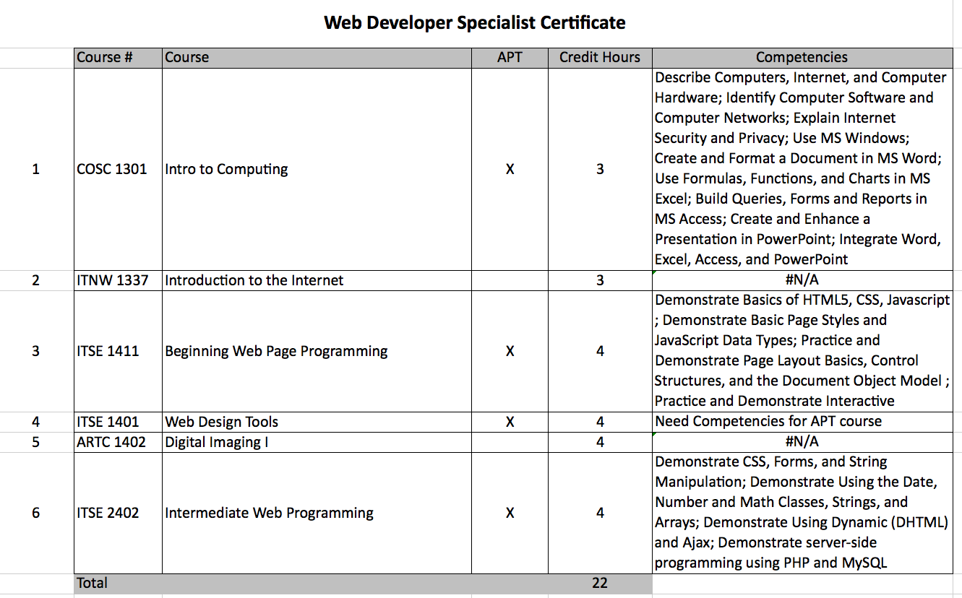
Mapping the Competencies:
Working with industry

Slide 24
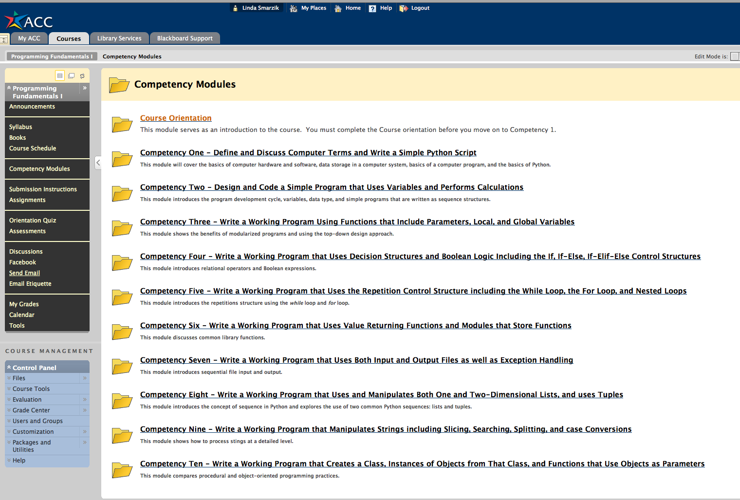
Course Template

Slide 25
Course Template

Slide 26
Challenges of Implementing CBE at Austin Community College

Slide 27
Challenge for ACC: The easy part
Chamber of Commerce
Info sessions
Marketing
Student Support Specialists
Accelerated Curriculum
MSA Award
Certificates
Degrees
Career services
Job Placement
Recruit
Retain
Reward
Recognize
Initial Focus
Notes:
International Journal for the Scholarship of Teaching and Learninghttp://academics.georgiasouthern.edu/ijsotl/v6n2.htmlVol. 6, No. 2 (July 2012) ISSN 1931-4744 @ Georgia Southern University

Slide 28
Building the program:
Competency Based Education
Chamber of Commerce
Info sessions
Marketing
Student Support Specialists
Accelerated Learning
MSA Award
Certificates
Degrees
Career services
Job Placement
Recruit
Retain
Reward
Recognize
Initial Focus
Current Focus
Integration
Faculty
Registration
Technology
Enroll in full certificate rather than a single course
Sustainability
Convert core courses
Faculty loading
Redefine the faculty role
LMS
Real-time data
for intervention
Notes:
International Journal for the Scholarship of Teaching and Learninghttp://academics.georgiasouthern.edu/ijsotl/v6n2.htmlVol. 6, No. 2 (July 2012) ISSN 1931-4744 @ Georgia Southern University

Slide 29
Systems Changes
Transition intake process
Transition course scheduling process
Transition student tracking process
Transition into a subscription-based option model
Transition into streamlined career services
Transition into proctored online testing
Transition into credit for prior learning

Slide 30
Industry and Community Partnerships

Slide 31
Recruit: Marketing methods
Recruiting methods
APT and Computer Science Website
Posters and handbills
Recruiting Events with the Chamber
Recruiting Previous Students
Radio, print, TV interviews
ACC’s front page website banner
Event tables
Advising by Department Chair
Social Media
Community partners
Veterans recruiter
Notes:
Heyman, E. (2010). Overcoming student retention issues in higher education online programs. Online Journal of Distance Learning Administration, 8(4). Retrieved from http://www.westga.edu/~distance/ojdla/winter134/heyman134.html.

Slide 32
Reward: Industry & community partners

Slide 33
Expansion into other demographics
The Accelerated
Career Program
Computer Information Technology
Visual Communication
Career Expressway
IT
Academy
Women in
IT

Slide 34
Women in Information Technology:
WiT

Slide 35
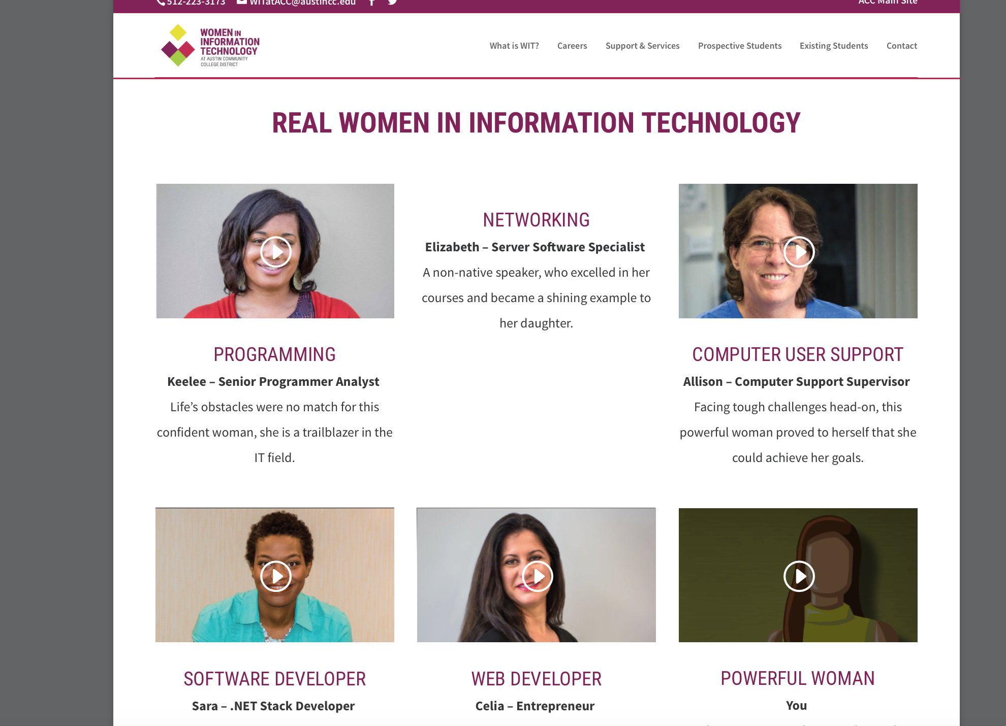
Women in Information Technology: WiT

Slide 36
For information contact:
Linda Smarzik – Dean/Computer Studies and Advanced Technology
lsmarzik@austincc.edu

Slide 37
PACE – IT
Ed Sargent – Project Director, PACE-IT Edmonds Community College
ed.sargent@email.edcc.edu

Slide 38
What is PACE-IT?
Five competency-based, self-paced, fully online IT certificates
Web Developer
Technology and Integration Support
Intro to Network Security
Data Management
Ethical Hacker

Slide 39
What is PACE-IT?
Funded through a four-year, three million dollar Department of Labor grant.

Slide 40
What makes our program special?
Continuous support
Industry standards
Our learning resources
Collaboration
Data Driven

Slide 41
Our Curriculum Development Model
DACUM (Developing A Curriculum) The DACUM process is used to determine the competencies that should be addressed in a training curriculum for a specific occupation

Slide 42
Curriculum Development

Slide 43
Industry Subject Matter Experts
Guidance on curriculum outcomes
Reviews capstone projects
Helps determine curriculum content

Slide 44
Student Mentors
Makes weekly phone calls that help keep the student on track with their PACE-IT plan
The Student Mentors listen
The Student Mentors remove barriers (excuses) to success
Problem solvers
Successful Online learning needs student mentors

Slide 45
Navigator
Remove barriers (excuses)
Our Navigator has on-going discussions with employers with the goal of providing job and internship opportunities for our students
Our monthly Navigator hour (career development webinars) offers guidance and expertise to our students.

Slide 46
Retention Rate
60%

Slide 47
Industry Certification Exams
92%

Slide 48
Where are our students?
14%

Slide 49
Where are our students?
67%

Slide 50
Wage Increases for Incumbent Workers
63.5%

Slide 51
Important Notice
This workforce solution was 100 percent funded by a $3 million grant awarded by the U.S. Department of Labor's Employment and Training Administration. The solution was created by the grantee and does not necessarily reflect the official position of the U.S. Department of Labor. The Department of Labor makes no guarantees, warranties, or assurances of any kind, express or implied, with respect to such information, including any information on linked sites and including, but not limited to, accuracy of the information or its completeness, timeliness, usefulness, adequacy, continued availability or ownership. Funded by the Department of Labor, Employment and Training Administration, Grant #TC-23745-12-60-A-53.
PACE-IT is an equal opportunity employer/program and auxiliary aids and services are available upon request to individuals with disabilities. For those that are hearing impaired, a video phone is available at the Services for Students with Disabilities (SSD) office in Mountlake Terrace Hall 159. Check www.edcc.edu/ssd for office hours. Call 425.354.3113 on a video phone for more information about the PACE-IT program. For any additional special accommodations needed, call the SSD office at 425.640.1814.
Edmonds Community College does not discriminate on the basis of race; color; religion; national origin; sex; disability; sexual orientation; age; citizenship, marital, or veteran status; or genetic information in its programs and activities.

Slide 52
Thank You!
Find resources for TAACCCT success at:
https://etagrantees.workforce3one.org
Subscribe to TLN resources, ask questions or connect with peers at TAACCCT@dol.gov

