Slide 1
Employment Placement & Support for Nontraditional Occupations in the Construction Industry
Webinar Date: December 8th 2015
Presented by:
U.S. Department of Labor
Employment and Training Administration

Slide 2
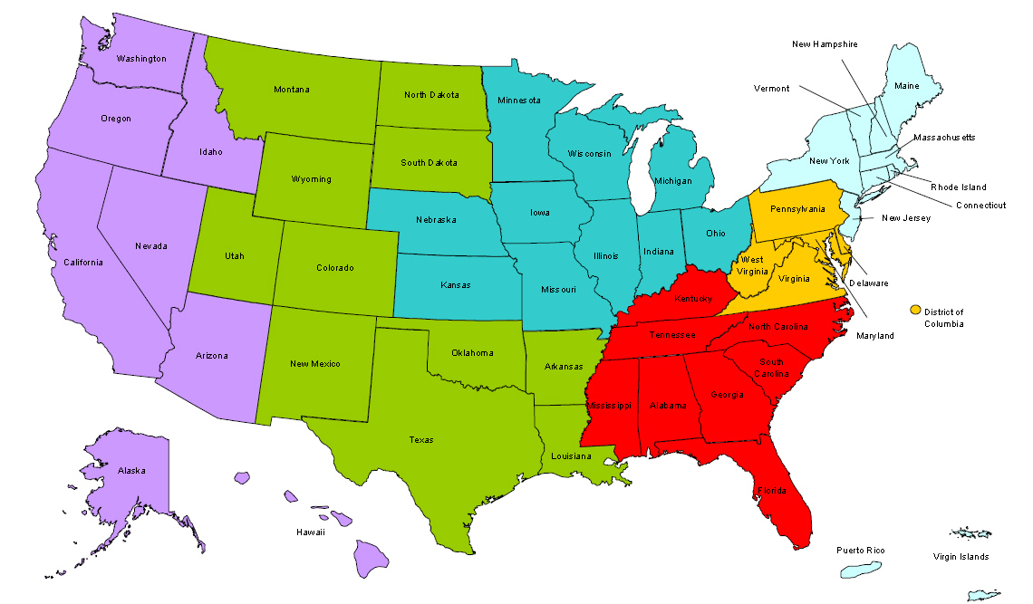
Where are you?
Enter your location in the Chat window – lower left of screen

Slide 3
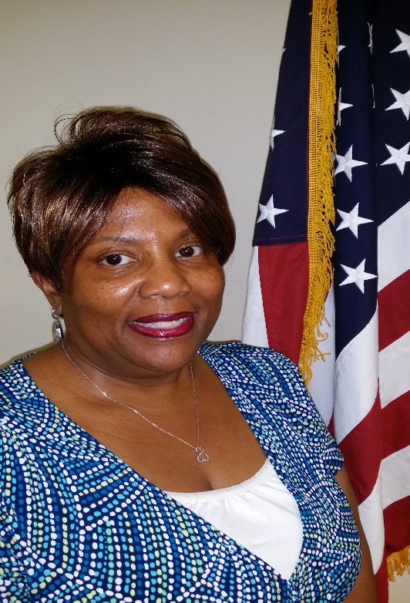
Moderator
Felecia Hart
WANTO Federal Project Officer
U.S. Department of Labor
Employment and Training Administration
Office of Apprenticeship

Slide 4
WANTO OVERVIEW
The Women in Apprenticeship and Nontraditional Occupations (WANTO) Act of 1992 authorizes the U.S. Department of Labor to award grants to assist employers and registered apprenticeship programs in promoting the recruitment, training, employment and retention of women in apprenticeship and nontraditional occupations.

Slide 5
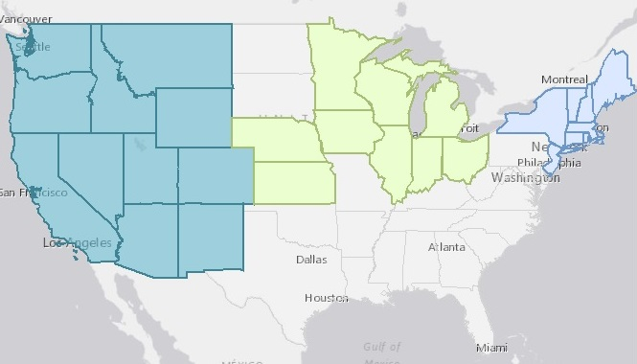
WANTO Grantee Service Areas
Nontraditional Employment for Women (NEW NYC)
Chicago Women in Trades
Western WANTO Consortium
Oregon Tradeswomen, Inc.
Tradeswomen, Inc. (CA)
Apprenticeship and Nontraditional Employment for Women (ANEW – WA)

Slide 6
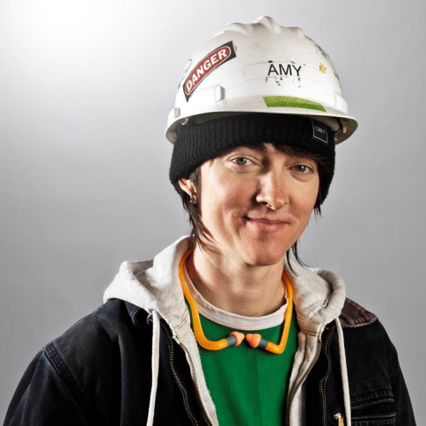
Presenters
Presenter: Amy James-Neel
Title: Construction Job Placement Manager
Organization: Oregon Tradeswomen Inc.

Slide 7
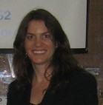
Presenters
Presenter: Kathleen Culhane
Title: President
Organization: Nontraditional Employment for Women (NEW)
Presenter: Chelsea McGrath
Title: Training Manager
Organization: Nontraditional Employment for Women (NEW)

Slide 8
Polling Question
What type of industry stakeholder are you?
1. Registered Apprenticeship Program
2. Employer
3. WIOA / American Jobs Center
4. Community College
5. Community-based service program
6. Government
7. Other

Slide 9
Nontraditional Employment for Women - NYC
--------------------------------------------------------
Northeast Regional Technical Assistance Center
--------------------------------------------------------
Hard Hats. Strong Women. Building the Future.
---------------------------------------------------------
Hard Hats. Strong Women. Building the Future.

Slide 10
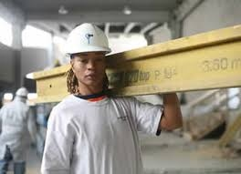
Employment Supports and Placement
Successful Strategies:
The number of women construction workers in New York City has grown substantially as a result of a coordinated effort between NEW, labor unions, contractors, and government
NYC Mayor’s Commission on Construction Opportunity
NEW Signature Projects Program

Slide 11
Direct Entry/Opportunity
History:
Direct entry granted to NEW, Construction Skills, and Helmets to Hardhats programs in New York through the 2006 Mayor’s Commission on Construction Opportunity
In 2006: “Construction trade unions have agreed to commit specific percentages of construction apprentice slots targeting demographic groups. 15% of apprentice slots will be set aside for graduates of Department of Education high schools, 10% for returning veterans, 10% for women.”
Today:
Mayor’s Commission on Construction Opportunity recently renewed
MOU with the Building and Construction Trades Council of Greater New York
Project Labor Agreements (PLAs) – example New York City Housing Authority

Slide 12
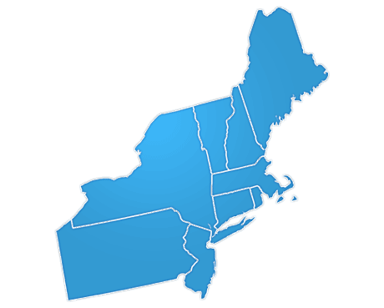
NEW Employers
Carpenters NYC District Council
Carpenters Dock Builders Local 1556
Carpenters Floor Coverers Local 2287
Carpenters Millwrights Local 740
Cement and Concrete Workers District Council
Electricians IBEW Local 3
Heat and Frost Insulators, Local 12
Ironworkers Local 40 & 361, Structural Ironworkers
Ironworkers Local 46, Metallic Lathers and Reinforcing Ironworkers
Ornamental Ironworkers Local 580
Laborers Local No. 78 Hazardous Materials
Laborers Local No. 79 Construction and General Building
Operating Engineers, Local 15
Painters and Allied Trades DC9 – Painters
Painters and Allied Trades DC9 – Bridge Painters Local 806
Painters and Allied Trades DC9 – Drywall Tapers Local 1974
Plasterers, Local 262
Plumbers Local Union No. 1
Sheet Metal Workers Local 28
Steamfitters Local 638
Tile, Marble and Terrazzo Local 7

Slide 13
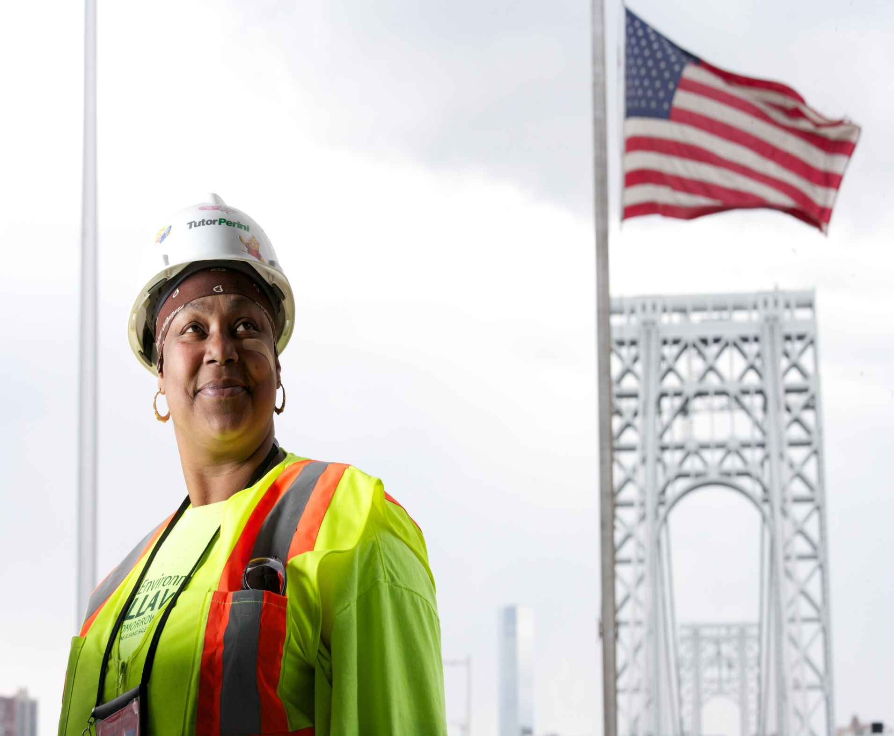
Building the Future
NEW Signature Projects Program
Example Projects
Trini Dent-Fernandez
2006 NEW graduate
Laborer, Local 79
World Trade Center Towers 1, 2, 3 & 4
Barclays Center
Goethals Bridge Replacement
Columbia University Projects
40 NEW Signature Projects Citywide

Slide 14
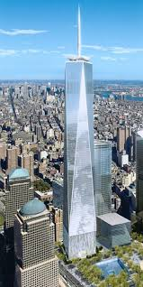
NEW’s Signature Projects Program
Launched in 2010 by NEW’s Board of Directors
Increase the number of tradeswomen on jobsites
Target local residents as tradeswomen on construction projects
Ensure that there is an adequate
supply of skilled tradeswomen
prepared for the demands of the
industry
Help industry leaders adopt best practices

Slide 15
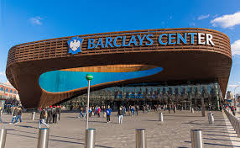
NEW Signature Projects Program
"Tradeswomen make up 15 percent of our workforce. Without NEW, I don't think our company would hire nearly as many women. We hire women from NEW because they know what they are getting into by the time they come to our jobs. They have been educated about the industry and what is really involved. That gives NEW referrals a two-to-one success rate over a standard candidate."
- Lee Zaretzky,
President of Ronsco, Inc.

Slide 16
CONTACT INFORMATION
Kathleen Culhane, President
kculhane@new-nyc.org
Chelsea McGrath, Training Manager
cmcgrath@new-nyc.org
Nontraditional Employment for Women (NEW)
243 West 20th Street, New York, NY 10011 (212) 627-6252
www.new-nyc.org

Slide 17
Oregon Tradeswomen, Inc.
--------------------------------------------------------
Connecting Tradeswomen to Industry
---------------------------------------------------------
Amy James Neel
Construction Manager / Job Developer

Slide 18
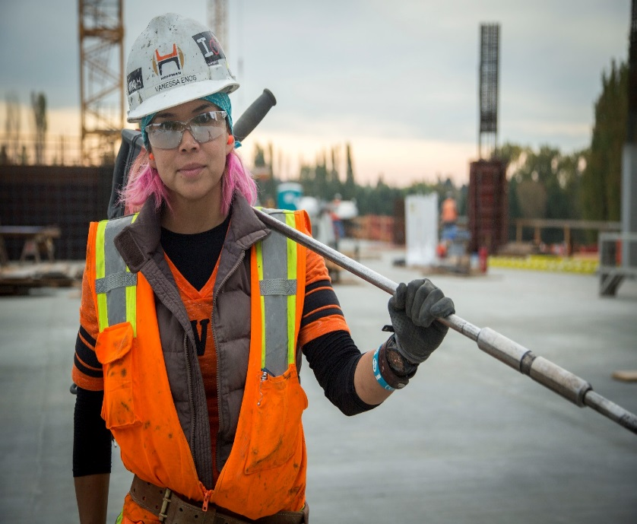
Oregon Tradeswomen, Inc. Impact
We graduate approximately 96 women per year
Graduates who want work in the trades, get work in the trades. 88 got their first trades job in 2014.
31% were women of color
Average starting wage $15.18 per hour

Slide 19
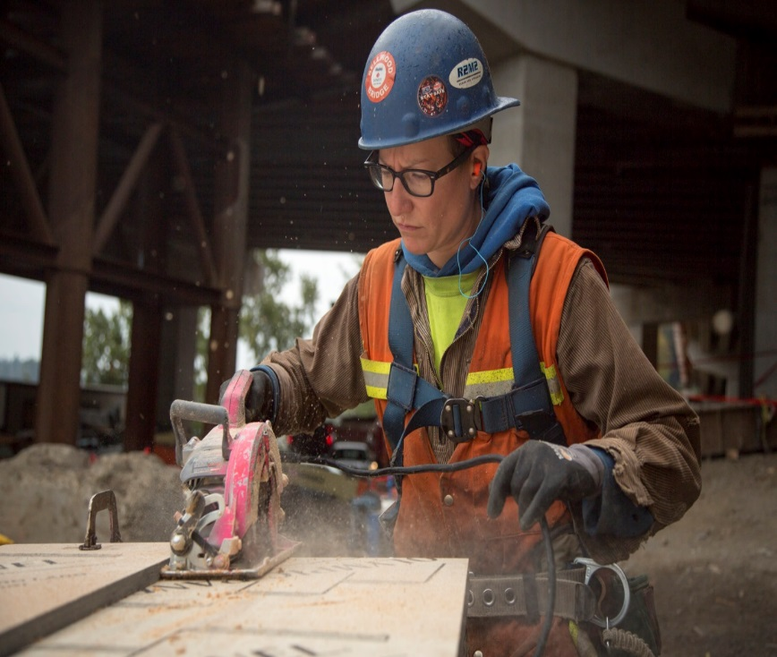
Developing a Ready & Prepared Workforce
Hands-on construction experience with Journey-level, female instructors as role models
Run like a professional site, not a class
Weekly, written evaluations from instructors teach resilience, perseverance and self improvement
Preserve our reputation by only graduating students we feel are ready
Teach what it means to be a “trades professional”

Slide 20
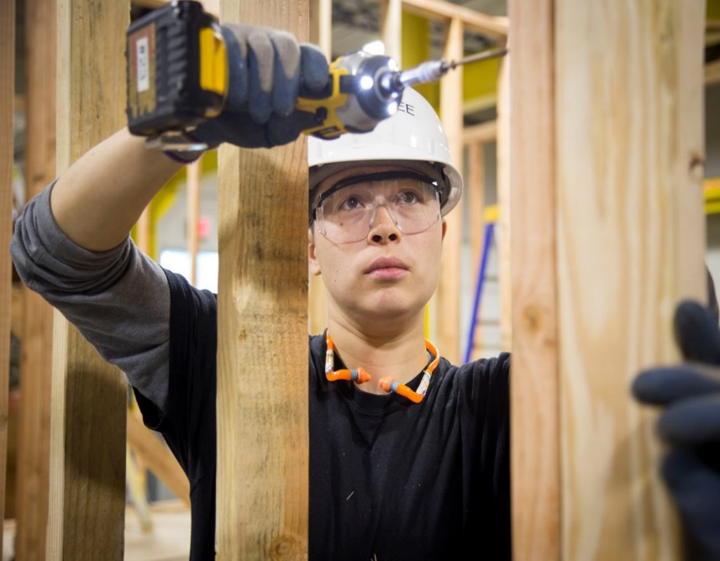
Job Placement Strategies
Field trips ensure students find a trade that suits them and that they are serious about.
Work closely with all 4 pathways into construction work
Field trainer helps with job placement. We are familiar with our students and honest with contractors about their skill-set.
“Boot Camps”; Facilitated Entry
Work with employers to create entry-level versions of their trades jobs

Slide 21
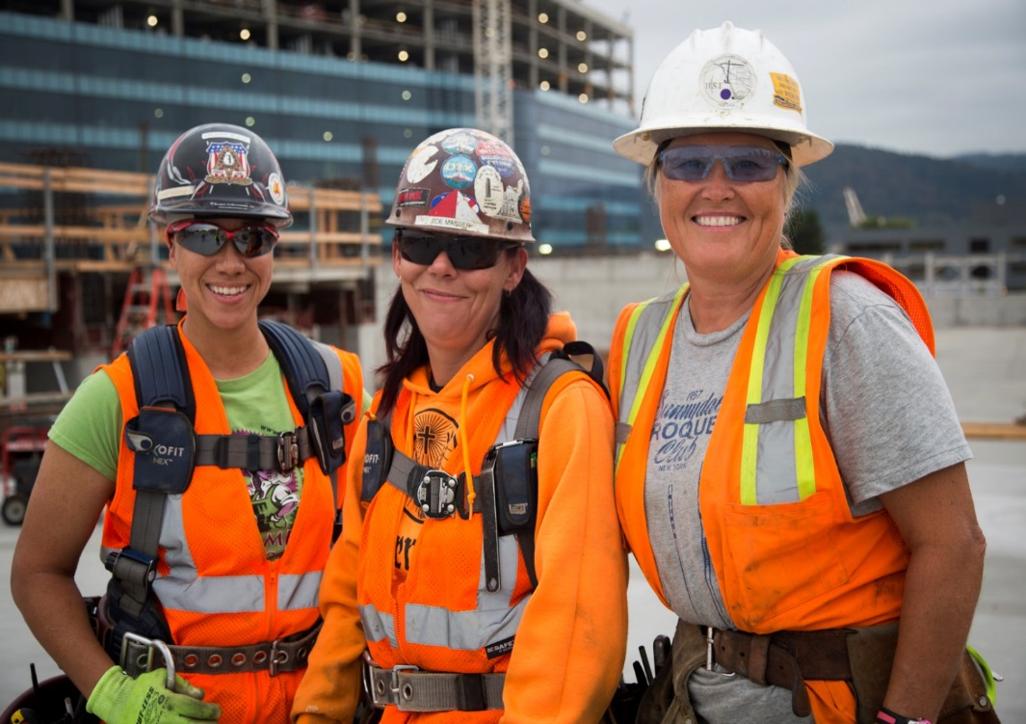
Selling Benefits of a Diverse Crew
Deconstruct the “we cant find women” argument. Assess outreach strategies of contractors
Diverse crews have broader skill-set and better pool of resources for solving challenges. Valuable perspectives mean efficiency.
Access to contracts with diversity goals
Women and diverse men are exceptional leaders

Slide 22
CONTACT INFORMATION
Amy James Neel Construction Manager / Job Developer
amy@tradeswomen.net Oregon Tradeswomen, Inc. 3934 NE Martin Luther King Jr. Blvd. #101 Portland OR 97212 503.335.8200 x 34
www.tradeswomen.net

Slide 23
Please enter your questions in the Chat Room!

Slide 24
Upcoming Webinars
Creating Equitable Jobsites & Classrooms:
Sexual Harassment Prevention
March 2016
Best Practices in Mentoring for Nontraditional Occupations
June 2016
www.workforce3one.org

Slide 25
Resources
Office of Apprenticeship Pre-Apprenticeship Toolkit
http://www.doleta.gov/oa/preapp
Women’s Bureau Nontraditional Occupations Portal
http://www.dol.gov/wb/NTO

Slide 26
For More Information
For more information on the WANTO grant, please contact the U.S. Department of Labor:
Felecia Hart, WANTO Federal Project Officer
U.S. Department of Labor
Employment & Training Administration
202-693-3792
Hart.Felecia@dol.gov

Slide 27
www.workforce3one.org

