Slide 1
H1-B Ready to Work Long-Term Unemployed Subject Matter Expert Webinar Series How to Motivate the LTU: Behaviors, Attitudes and Active Engagement Strategies to Improve Participant Job Placements
Webinar Date: Tuesday, December 15th at 11:30 a.m. Eastern
Presented by: Division of Strategic Investments
U.S. Department of Labor
Employment and Training Administration

Slide 2
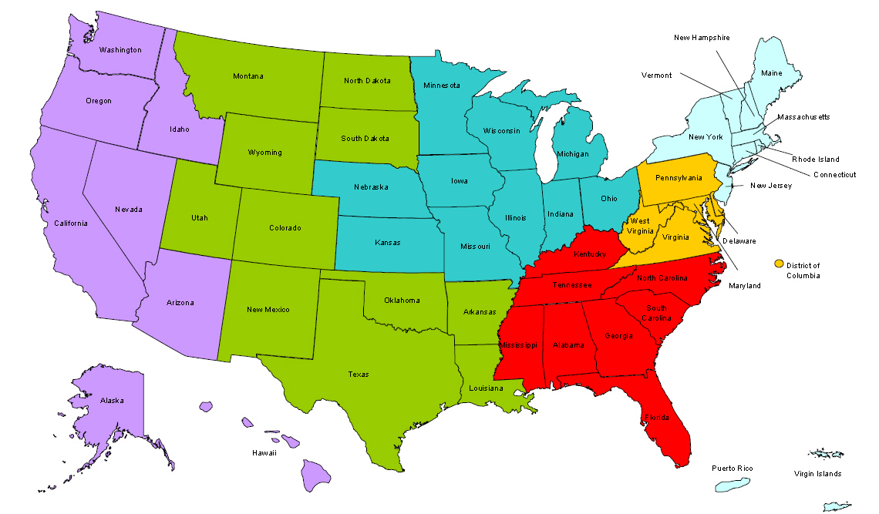
Where are you?
Enter your location in the Chat window – lower left of screen
Notes:
In the Chat Room, please type the name of the your organization, your location, and how many people are attending with you today.

Slide 3
Polling Questions
Getting the Ready-to-Work Back to Work
Polling Question # 1
Let’s get to know who is on the call today. Using the poll, select the role that you play in your H-1B RTW grant.
For this grant initiative I am the:
Authorized Representative
Program Director/Manager
IT/Data Manager or staff
Training Partner
Employer Partner
Service Provider

Slide 4
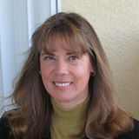
Welcome & Introductions
Getting the Ready-to-Work Back to Work
Moderator:
Megan Baird, H1-B Program Manager
DOL-Division of Strategic Investments
Facilitator:
Tressa Dorsey, RTW Technical Assistance Coach
Guest Speaker:
Jodie Sue Kelly, Cygnet Associates
Notes:
Hi everyone, welcome to today’s H-1B Ready to Work Grant Subject Matter Expert Series on How to Motivate the LTU: Behaviors, Attitudes and Active Engagement Strategies to Improve Participant Job Placements
I’m Tressa Dorsey, with High-Impact Partners, our TA providers for the RTW grants. Joining me today is my colleague Ayreen Cadwaller
It is my pleasure to introduce to you our Presenter: Jodie Sue Kelly, with Cygnet Associates.

Slide 5
Here’s what you can expect to get out of this webinar!
How to Identify Motivation Killers
Motivational Strategies and Tools
Re-Engaging Slipping Motivation
Notes:
Video clip of what to expect in the webinar room. (instead of the 5 tech slides)

Slide 6
Agenda
Common Motivation Potholes
Rethinking the Upfront Process
Using Motivational Phrasing
Designing an Engaging Motivational Orientation
Goal Setting
Re-Engagement Techniques
Notes:
Agenda/Objective
Agenda/Objective 1
Agenda/Objective 2

Slide 7
How to Motivate the LTU: Behaviors, Attitudes and Active Engagement Strategies to Improve Participant Retention and Job Placements

Slide 8
Where has motivation been left dangling?
Assess the Danger Points

Slide 9
Find motivational pot holes we have created that need to be patched.

Slide 10
TIP: In order to fine tune the position of the letters when copying and pasting, select the letter and hit the control (Crtl) button and then at the same time use the arrow keys to move it in small increments.
TIP: Sometimes you have to double click on the letters to be able to select them. Make sure there is a small box around the letter before copying or editing.

Slide 11
Energy-Draining Motivation-Killing Orientation
Fill Out Paperwork as Applicants Enter
Staff Introductions
Mission of the Organization
History of the Organization
Eligibility Requirements:
Income
Barriers
Residency Requirements
Review of Calendar of Training
Rules (dress, smoking, etc.)
A review of the various staff and their roles
Steps in the Process
Big Ending: Let’s take the CASAS/TABE.
Questions?

Slide 12
A Tone That Saps Any “Love” for the Organization
If you are missing any eligibility documentation, you will have 14 calendar days to provide it to the Intake Specialist. If required eligibility documentation is not provided within the 14 day period, you will be deemed ineligible and will have to begin the enrollment process again, at a later date.
It is important to note that your enrollment is contingent upon your follow through with the steps outlined above. Failure to complete the Initial Assessment within the initial 30-day period will result in non-enrollment into the program.

Slide 13
Robbing People of Their Motivation and Self-Esteem by Labeling Them and Using Words That Harm

Slide 14
Suitability
We enroll everyone. We have no real criteria.

Slide 15
Nothing To Keep Them Engaged In Between Enrollment and Training Start Date
Motivation

Slide 16
Still not skilled enough at job search to get a job so client thinks “What’s the Use?”

Slide 17
Build Motivation, Engagement, Participation
Tool Kit

Slide 18
Warm, Friendly, Helpful Tone
Welcome!
We are excited that you have taken the first step to a bright future.
We will help you free of charge. But first we need you to get a few simple but important papers.
Please bring everything checked below. If you cannot get all of these papers, give us a call. We will help you.
Remember….before we can give you our free services, you must bring in everything checked.
4.8 reading level

Slide 19
Developing Powerful Conversational Hooks
Need: lack of something, unsolved problem
Features Tell: is a fact, detail, or description of your services. It is a description of process.
Benefits Sell: is the positive result your client gets as a result of working with you.
Motivation is Tied to Outcomes/Benefits.

Slide 20
Are We Using Motivational Phrasing that Builds Excitement Or Bureaucratic Terminology that Customers Don’t Understand.
We have vocational training in a skill, trade or occupation.
You can get a GED and tutors to help you move through quickly.
We can offer you free tuition at some of the area’s best schools.
You can earn some money while you complete your education.
We have placed more than 100 customers in jobs this year.
We have workshops on job search and career planning that you are required to attend.
With the right training, you can to work and get a higher salary than you might be able to earn otherwise.

Slide 21
Financial Stability

Slide 22
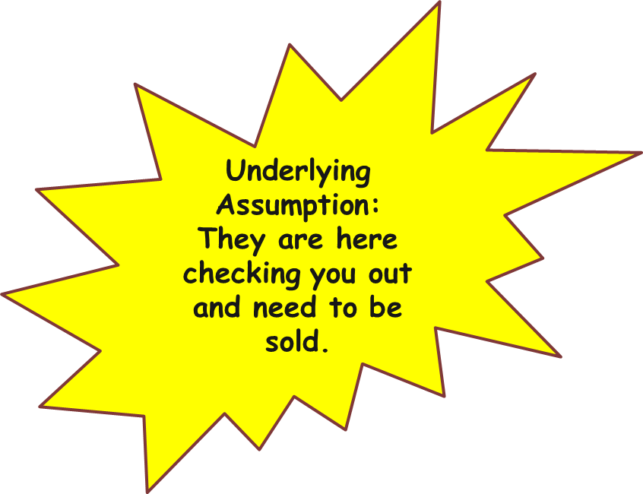
Sample Fun, Informative Motivational, Engaging Orientation
Welcome and Introductions
Get Acquainted
Agenda for Orientation
Expectations/Want to Know
Overall Goal of Organization (Increase Income)
How it Works (Training/Scholarships/Jobs/Advancement)
It Takes A Team
What Others Have Said
Goal Setting Activity
Easy Steps to Join the Team (Eligibility/Testing)
Invitation to Join (and Suitability)
What Happens Next?
Questions and Answers
Market Research

Slide 24
Staying on Track
Notes:
Sometimes it is difficult to stay on track when you set goals. Reaching those goals isn’t always easy. It is useful to remind yourself constantly what it is that you are trying to achieve.
So when you get down and don’t want to look for a job, go to school, go to work experience, it’s good to go back and look at those goals as way of remembering why you are doing this.

Slide 25
Program Goals: Not Real Powerful

Slide 26
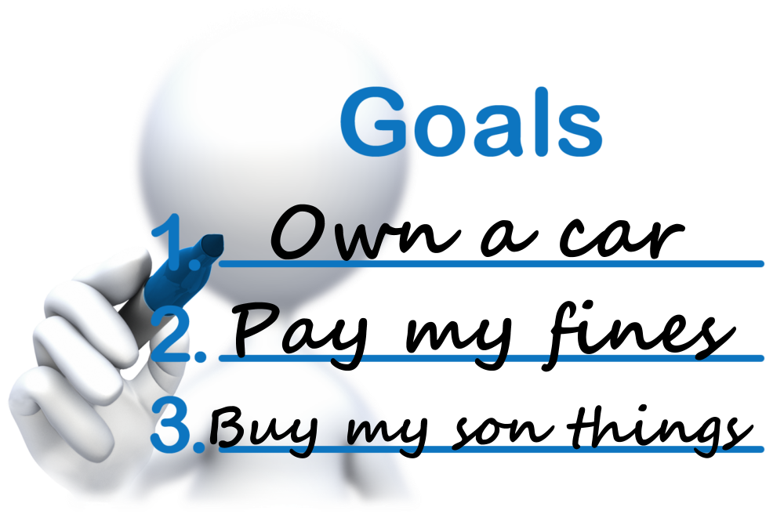
Life Goals: Much More Powerful

Slide 27
A goal is a dream unless you take action.
Example:
Dream:
I want to be able to make a better life for my family.
Goal:
I will get training and certification in a health care occupation.
Working in health care will enable me to get a steady job and that will help me to make a good life for my family.

Slide 28
Set Life Goals: All Motivation Begins with a Goal
It is useful to identify your goals and how you want your life to be once you are working. It will help you to stay motivated. Think and list five ways your life would be better if you were in a job in a high paying career.
________________________________________________
________________________________________________
________________________________________________
________________________________________________
________________________________________________
Notes:
I am going to pass out a little life goals sheet. I want you to think about how your life will be better or what you could do if you had that much more money. Write down five ways your life would be better.
(Ask for a few volunteers if time to read one of the ways his/her life would improve.)
That is what we want to help you to achieve.

Slide 29
Inclusion of the dream is critical during on-going case management to continue motivation and change.
“You are taking some important steps toward making a better life for your children.”
You are in school, you are making good progress and only have 4 weeks left.
Have you thought about a way to celebrate with your children once you have finished the classroom training?

Slide 30
Be alert for warning signs that the client is beginning to cut the tie!

Slide 31
To revive, slipping motivation
Life goals
What I hate about my life right now

Slide 32
Quicker You Catch: The Greater the Success
Decreasing Success as Time Goes On

Slide 33
Poor Strategy to Re-Engage their interest!
Attended A Step and Stopped Coming
No reminder of goal.
Hello. This is Karen from the XYZ Program. I was calling to reschedule your appointment. You were scheduled for (x) and you missed that appointment. I would like to get you rescheduled.
u
c
k
Y

Slide 34
Much better script for re-engagement!
Attended a Step and Stopped Coming.
Reminder of real goal.
Hi Michelle. This is Ann from xxx Inc. A while back, when we met, you said you hoped to get training so you could get a better job to provide more for your daughter. I am wanting to work out a plan for you so you can get back on track. I know how important increased money was to you and your child.
D
E
A
I

Slide 35
Focus on Outcomes
Re-Engagement
Accepts
part of responsibility.
Hi Marco. This is Robert at XYZ and I am trying to reach you. My goal was to help you to __________. We were working on a plan and then we lost our momentum. I wanted to call to find out what I can do to get us back on track. I really want to help you to_________. Give me a call back at xxx-xxxx. I would be excited to hear from you.
D
E
A
I

Slide 37
Recognition: Emphasizing Income Improvement
Congratulations on being admitted into the Vocational Training program. Going to school, learning new skills, getting a diploma or license is an important step toward earning more money in the future. I am delighted you have applied and been accepted.

Slide 38
More Recognition…
Congratulations on getting an increase in hours. Working more hours means a bigger paycheck, and that is great. Even more impressive is that being given more hours shows you have proven yourself to be a valued employee. I could not be happier for you.

Slide 39
You will remember that when you joined the program, you learned that one of our goals was to help you to improve your financial future. And you are doing just that. I know you aren’t financially where you want to be. Few people are. But you are closing the gap by having retained this job for the past six months and by getting that raise. I am excited for you.

Slide 40
Please enter your questions in the Chat Room!
Notes:
Please enter your questions into the Chat Room!

Slide 41
Follow-Up Roundtable Discussion
Getting the Ready-to-Work Back to Work
LTU Subject Matter Deep Dive!
Follow-Up Roundtable Discussion with Jodie Sue Kelly
Friday, December 18th at 1:00 p.m. Eastern
Bring your questions and comments in a lively follow-up discussion on the information presented during today’s webinar.
Featuring RTW Grantee It’s My Community Initiative
Notes:
Jen

Slide 42
Look for upcoming Webinars in this series!
Part II:
H-1B RTW LTU Subject Matter Expert Webinar Series
Job Retention and Career Advancement
Coming in February 2016!

Slide 43
Presentation Contacts
Jodie Sue Kelly
Cygnet Associates
www.cygnetassociates.com
410-263-8515
H-1B GRANTS PROGRAM OFFICE
Federal Project Officer, DOL National Office and Technical Assistance Providers
Ready to Work Grantee Mailbox
RTW@dol.gov
Notes:
Megan Baird:
Closing Remarks
- Thank Jodie Sue for an interesting/relevant/useful presentation
- Thank grantees for attending, encourage them to attend Roundtable Discussion (Jen will have already mentioned the details)

Slide 44
www.workforce3one.org

