Slide 2
Building Registered Apprenticeship Opportunities for Out of School Youth
Enough is known for action webinar series
USDOL Office of Apprenticeship and Division of Youth Services

Slide 4
Toni Wilson
Workforce Analyst
Division of Youth Services
U.S. Department of Labor
Washington, DC

Slide 5
Amy Firestone, Ph.D..
Program Analyst
Office of Apprenticeship
U.S. Department of Labor
Washington, DC
Eric Karmecy
Project Manager
OH-Penn
West Central Job Partnership
Sharon, PA
Philip Starr, Psy.D
Executive Director
OPENTECH LA
Managed Career Solutions
Hollywood WorkSource Center
Hollywood, CA

Slide 6
WIOA and Out-of-School Youth
WIOA Provisions Relevant to Registered Apprenticeship for Disconnected Youth
Overview on Registered Apprenticeship
Developing apprenticeship pathways through partnerships
OH-Penn
OPENTECH LA
Resources

Slide 7
2:00 | Welcome & Introductions
2:05 | WIOA
2:10 | Registered Apprenticeship
2:25 | OH-Penn
2:45 | OPENTECH LA
3:05 | Resources
3:15 | Q & A

Slide 8
WIOA
WIOA Provisions relevant to Registered apprenticeship for disconnected youth

Slide 9
WIOA
WIOA prepares vulnerable youth for successful employment through increasing use of proven service models services.
Local areas must increase percentage of youth formula funds used to serve out-of-school youth to 75% from 30% under WIA.
Local areas must spend at least 20% of youth formula funds on work experience activities such as summer jobs, pre-apprenticeship, on-the-job training, and internships so that youth are prepared for employment.
Eligibility criteria are changed for the youth formula program: In school youth are ages 14-21 and out of school year are ages 16-24.
5 new program elements to the youth formula program.
Additional allowable activities include financial literacy education and entrepreneurial skills training.

Slide 10
Registered Apprenticeship as an OSY Placement Strategy
Proven model to help OSY immediately start working and increase skills and earning.
Effective strategy to connect with employers in diverse fields and to use as part of industry sector strategies.

Slide 11
Registered Apprenticeship
Overview of registered apprenticeship

Slide 12
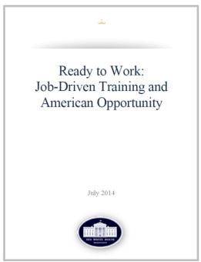
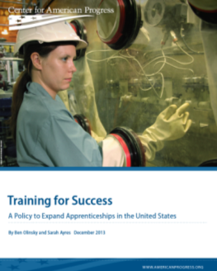
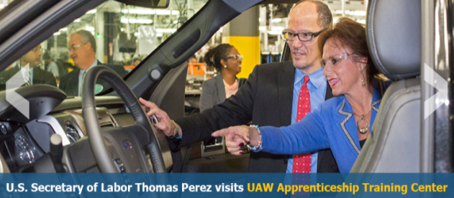
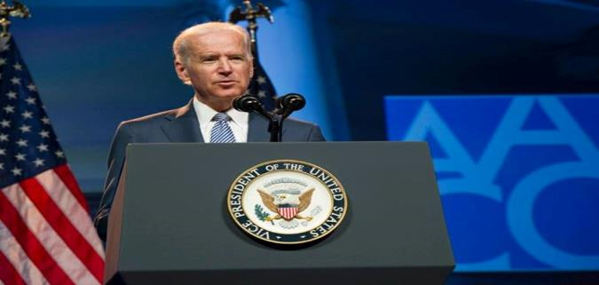
A Transformational Year for Apprenticeship
Tonight, I'm also asking more businesses to follow the lead of companies like CVS and UPS, and offer more educational benefits and paid apprenticeships -- opportunities that give workers the chance to earn higher-paying jobs even if they don't have a higher education.
– President Obama, State of the Union Address, January 20, 2015
Vice President Biden (AACC Conference) on April 7, 2014 , announcing the launch of the RACC.
American Apprenticeship Grants
$175 Million

Slide 13
The American Apprenticeship Grant Funding Opportunity Announcement
Learn more at http://doleta.gov/oa/aag.cfm
American Apprenticeship SGA
$175 Million.
Launch apprenticeship in new, high growth fields.
Scale models that work.
Align apprenticeships to pathways for further learning & career advancement.

Slide 14
Expansion for Fiscal Year 2016: $90 Million for American Apprenticeship Grant program
This historic new program has the potential to increase alignment by providing classroom instruction for apprenticeships and ensuring States support college credit for apprenticeship:
States: Build state capacity to administer RA programs;
Industry: Build on American Apprenticeship grant and expand apprenticeship beyond H1B targeted occupations and industries;
Under-Represented Populations: Support community-based organizations and workforce intermediaries on innovative strategies for career pathways; and
National Activities: Increase national outreach, technical assistance, and capacity building needs.

Slide 15
ApprenticeshipUSA continues to grow
750,000
500,000
FY 16 Annual Goal
455,257
Quarter 2- FY 16
Number of Active Apprentices
375,000

Slide 16
WIOA was signed into law July 2014 with an increased emphasis on work-based learning and Registered Apprenticeship.
Registered Apprenticeship Provisions in WIOA
RA on Eligible Training Provider List | Section 122(a)(2)(B) and (3)
RA as recognized post-secondary credential | Section 101(52)
RA on State Workforce Board | Section 101(b)(1)(C)(ii)(II)
RA on Local Workforce Board | Section 107(b)(2)(B)(ii)
Pre-apprenticeship as Youth program service | Section 129(c)(2)(C)(ii)
RA as career pathway for Job Corps | Section 141(1)(A)(ii) and Section 148(a)(2)(B)
Pre-apprenticeship/RA for YouthBuild | Section 171(c)(2)(A)(i)

Slide 17
Registered Apprenticeship has
union and non-union programs

Slide 18
Components of Registered Apprenticeship
Employment with
on-the-Job Learning
Related Education
Reward Skills
Fully Credentialed

Slide 19
American Apprenticeships are…
Industry-driven
Nationally- recognized, high-quality programs
Modern, flexible, adaptable
Proven talent solutions

Slide 20
Innovations: High Schools and Youth Focus
Opportunity:
Employers interested in working with high school students
Increase linkages between high school career and technical education courses with apprenticeships
High schoolers are in dual enrollment programs and receive college credit

Slide 21
Youth Apprenticeship Ad-Hoc Working Group
Purpose:
Meet monthly and focus on how to expand youth apprenticeships and strengthen alignment between the Career and Technical Education (CTE) and Registered Apprenticeship systems on the secondary level.
Members:
Part of the DOL Advisory Committee on Apprenticeship (ACA); includes representatives from the ACA, the Department of Education and select Subject-Matter Experts (SMEs) including CTE state directors, employers and other experts.

Slide 22
Youth Apprenticeship Ad-Hoc Working Group
Topics:
How to expand Registered Apprenticeship on the secondary level.
How to strengthen alignment between CTE and RA across the country.
Identify the challenges and gaps in recruiting and maintaining more high school-age apprentices such as liability concerns and child labor laws.
Role of community colleges and linkages between Registered Apprenticeship-College Consortium (RACC) members and high school CTE programs.
Outreach needed regarding RA opportunities; How to educate target groups (disadvantaged and underrepresented youth and families) regarding opportunities and future federal funding opportunities.

Slide 23
Registered Apprenticeship College-Consortium
The Registered Apprenticeship College-Consortium (RACC) was launched at the 2014 AACC conference in Washington, DC.
244 colleges joined the RACC
956 Apprenticeship Training Centers
Electrical Training ALLIANCE
Finishing Trades Institute
Heat & Frost Insulators & Allied Workers
Sheet Metal and Air Conditioning Industry
National Elevator Industry Educational Program
United Association of Plumbing & Pipefitting

Slide 24
Registered Apprenticeship College-Consortium
14 National, Regional, State Organizations
American Association of Community Colleges
AFL-CIO Building and Construction Trades
Council on Adult and Experiential Learning (CAEL)
Colorado Community College System
North Carolina Community College System
Ohio Association of Community Colleges
Ohio Board of Regents
Oregon Department of Community Colleges
and Workforce Development
Collegiate Consortium for Workforce and Economic Development
South Carolina Technical College System
Southeast Maritime & Transportation Center (SMART)
Technical College System of Georgia (TCSG)
University of Alaska System
VA Tidewater Consortium for Higher Education
Wisconsin Technical College System
Notes:
Grantee membership: Essentially, grantees are expected to join the RACC as a condition of their grant award according to the FOA:
P. 4: Promoting Career Pathways and Aligning Apprenticeships with Institutions of Higher Education (IHEs) and Workforce Investment Systems: Engaging states, regions, and local areas to align, at a minimum, education and training systems (e.g., Workforce Investment Boards/State Workforce Agencies; and career technical education, community college, and university systems) behind apprenticeship as an area for cooperation and co-investment and linking apprenticeship to credit and industry-recognized credentials that allow for further advancement (e.g., college credit, portable industry-recognized credentials; also see the Registered Apprenticeship College Consortium at http://www.doleta.gov/oa/racc.cfm);
P. 57 (Innovations to Create a Supportive Ecosystem): Create incentives for community colleges to support the development and provision of apprenticeship training by a) articulating apprenticeships to community college credit (visit the RACC website: http://www.doleta.gov/oa/racc.cfm), b) creating financial incentives through FTEs or other mechanisms for community colleges to support apprenticeship, or c) create capacity within the community college system to support employers in setting up or expanding apprenticeship programs
The link to the FOA is here if you’d like to get additional context. Let me know if you need anything else.

Slide 25
Win-Win-Win-Win
Stakeholders | Benefits
Apprentices | Earn credits towards associate’s and/or bachelor’s degree Earn-as-you-learn model ensures earnings while training to build up technical skills
Educational Institutions | Closer relationships with industry partners Articulation between apprenticeship and college programs ensures relevance and rigor Increased enrollment in credit classes by apprentices and journey people (apprenticeship graduates)
Businesses and Unions | Increased credibility helps recruitment efforts Expansion of viable education and training options for employees/members Increased employee retention Trained and educated workforce - addresses pipeline concerns
State and Federal Government | Rigorous programs that give individuals upward mobility and fuel economic development Strong connections between industry and higher education

Slide 26
OH-PENN
Program Partnership example

Slide 27
Pre-Employment Preparation

Slide 28
Pre-Apprenticeship Track
America Job Centers Outreach
Pre-Apprenticeship Preparation
Healthcare
Manufacturing
Building Trades
Education
Certification
Education
Certification
Education
Certification

Slide 29
Advancement Pathways
Pre-Apprenticeship Preparation
Career Research
Literacy
Work-Readiness
Aptitude Evaluation
Team Building
Job Shadowing
Financial Literacy
Navigation Reset
On-the-Job Training
Additional Credentials
Entry-level Employment
Continuing Education
Apprenticeship
Employment

Slide 30
Return on Investment
51 Completers in 7 Cohorts
269 industry-recognized credentials earned
WorkKeys®
OSHA 10
MSSC Safety, Quality,
Manufacturing Processes and
Maintenance Awareness
MSSC Certified Production
Technician
Manufacturing Readiness Graduate Benny Hunt, now employed as Team Lead at Pennex Aluminum

Slide 31
OPENTECH LA
Regional apprenticeship collaborative
Program Partnership example

Slide 32
WHY NON-TRADITIONAL APPRENTICESHIP
New tech occupations are more aligned with work-based learning than traditional classroom-based training.
They open doors for at-risk youth and minority youth to enter these occupations.

Slide 33
OUR COMMITMENT
For apprenticeships to thrive, they must be incorporated into the workforce development system. This entails multiple funding sources that capitalize on individual program strengths, and provide wraparound services designed to assist at-risk youth.

Slide 34
CUSTOMER NEEDS
Basic and Remedial Training (i.e., Bridge Training)
Soft Skills (Workplace Competencies)
Life Skills
Technical Competencies

Slide 35
CUSTOMER NEEDS
‘Bridge Training’
Pre-Apprenticeship
Registered Apprenticeship + Related Learning

Slide 36
OUR METHOD
Engage the Workforce Development System at the Federal, State, and Local Levels to ensure the participant’s success

Slide 37
JUAN

Slide 38
JUAN
Graduate of Foshay Tech Academy
Age 24 (Out-of-School Youth)
Discovered OpenTech LA through Foshay Tech Academy’s Alumni Network and Lead Teacher Leslie Aaronson

Slide 39
JUAN
Enrolled in OpenTech LA
Through interview with Success Counselor, developed Individual Employment Plan
Outlined each step toward a Registered Apprenticeship in Software Development

Slide 40
FIRST STEPS
Registered in LA Mayor Eric Garrett’s ‘HIRE LA YOUTH’ Summer Program
Modality: 120 Hours of Soft Skills, Life Skills, and Internship
Funding: Stipend of $9.00/hour
Trainer: OpenTech and Host Employer

Slide 41
FIRST STEPS
Host Employer saw great potential in Juan during Summer Internship Program, and contacted OpenTech LA to develop a training plan enabling Juan to become an apprentice.

Slide 42
NEXT STEP: CLASSROOM-BASED TRAINING
Enrolled at American Job Center in West Covina, CA.
Qualified for WIOA funding as Out-of-School Youth and Adult.
Modality: Classroom-Based Training
Funding: WIOA Individual Training Account (Youth)
Trainer: New Horizons

Slide 43
NEXT STEP: PRE-APPRENTICESHIP
OpenTech LA Curriculum Committee designed Pre-Apprenticeship Curriculum incorporating both industry standards and employer needs

Slide 44
NEXT STEP: PRE-APPRENTICESHIP
Enrolled at American Job Center in Hollywood, CA.
Qualified for WIOA funding as Adult.
Began Pre-Apprenticeship in Software Development (CRM Specialty-Salesforce) with Host Employer
Modality: On-the-Job Learning
Funding: WIOA OJT Funds (Adult)
Trainer: Mentor at Host Employer

Slide 45
FINAL STEP: APPRENTICESHIP
OpenTech LA Curriculum Committee designed Registered Apprenticeship Curriculum incorporating both industry standards and employer needs
Apprenticeship application currently in process with DOL and State Division of Apprenticeship Standards

Slide 46
FINAL STEP: APPRENTICESHIP
Begins Apprenticeship in Software Development (CRM Specialty-Salesforce) this Summer 2016
Modality: On-the-Job Learning
Funding: WIOA OJT Funds (Adult) + DOL Funds
Trainer: Mentor at Host Employer

Slide 47
FINAL STEP: APPRENTICESHIP
We combined multiple funding streams to minimize fiscal impact on the Host Employer, creating incentives to take a chance on OpenTech candidates they might not have considered otherwise.

Slide 48
FINAL STEP: APPRENTICESHIP
Each funding stream capitalized on program strengths in order to maximize service delivery to the participant.

Slide 49
FINAL STEP: APPRENTICESHIP
Hire LA Youth Summer Funding = Soft and Life Skills
WIOA Youth ITA Funding = Technical Competencies
WIOA Adult OJT Funding = Real-World Experience
DOL Apprenticeship Funding = Commitment to Hire and Train as Apprentice

Slide 50
FINAL STEP: APPRENTICESHIP
All training programs must include financial assistance and/or earn-and-learn components to ensure open access to diverse and disadvantaged youth.

Slide 51
FUNDERS
US Department of Labor, American Apprenticeship Initiative
Workforce Development Board of the County of Los Angeles, WIOA Training Funds (Youth and Adult)
Workforce Development Board of the City of Los Angeles, WIOA Training Funds (Adult)
Private Foundations
Corporate Sponsors

Slide 52
FOUNDING PARTNERS
LA MAYOR’S OFFICE OF ECONOMIC DEVELOPMENT
::
CITY OF LA, ECONOMIC AND WORKFORCE DEVELOPMENT DEPARTMENT //
LA BUSINESS SOURCE
COUNTY OF LOS ANGELES, WORKFORCE DEVELOPMENT BOARD
::
MCS ECONOMIC DEVELOPMENT CORPORATION
::
YWCA OF GREATER LOS ANGELES
::
STEM ADVANTAGE
::
FOSHAY TECH ACADEMY
::
EAST LOS ANGELES COLLEGE
::
CALIFORNIA STATE, LOS ANGELES
::
CALIFORNIA STATE, DOMINGUEZ HILLS

Slide 53
Registered Apprenticeship as an OSY Placement Strategy
Partner
Develop sector and/or career pathway strategies utilizing apprenticeship
Connect with a Sponsor
Recruit and screen candidates to be apprentices
Provide pre-apprenticeship and basic skills preparation
Provide supportive services

Slide 55
American Apprenticeship Grants
http://www.dol.gov/apprenticeship/grants.htm
Pre-Apprenticeship
http://www.doleta.gov/oa/preapp/
Apprenticeship Fact Sheet
Frequently Asked Questions
http://www.doleta.gov/oa/aag.cfm
Apprenticeship website
www.dol.gov/apprenticeship
Women in Construction
Pre-Apprenticeship: Pathways for Women into High-Wage Careers
http://www.doleta.gov/oa/preapp/
Apprenticeship Staff
Contact map
http://www.doleta.gov/oa/contactlist.cfm

Slide 56
Amy Firestone, Ph.D.
Program Analyst
ETA
U.S. Department of Labor
Firestone.amy@dol.gov
(202) 693-3998
https://www.dol.gov/featured/apprenticeship
Toni Wilson
Workforce Analyst
ETA
U.S. Department of Labor
Wilson.toni@dol.gov
(202) 693-2922

Slide 57
Eric Karmecy
Project Manager
OH-Penn
West Central Job Partnership
ekarmecy@wcjp.org
(724) 347-7855
www.industryneedsyou.com
Philp Starr, Psy.D
Executive Director
OPENTECH LA
Hollywood WorkSource Center
pstarr@mcscareergroup.co
(724) 730-5276

