Slide 2
Moving forward together:
NFJP Grantee Orientation
Employment and Training Administration

Slide 4
Laura Ibañez
Unit Chief
Specialty National Programs Unit
Employment and Training Administration
U.S. Department of Labor

Slide 5
Introductions
Program Overview
Reporting Requirements
Grant Package
Communications Plan
Next Steps

Slide 6
Introductions
National Office &
Regional Office

Slide 7
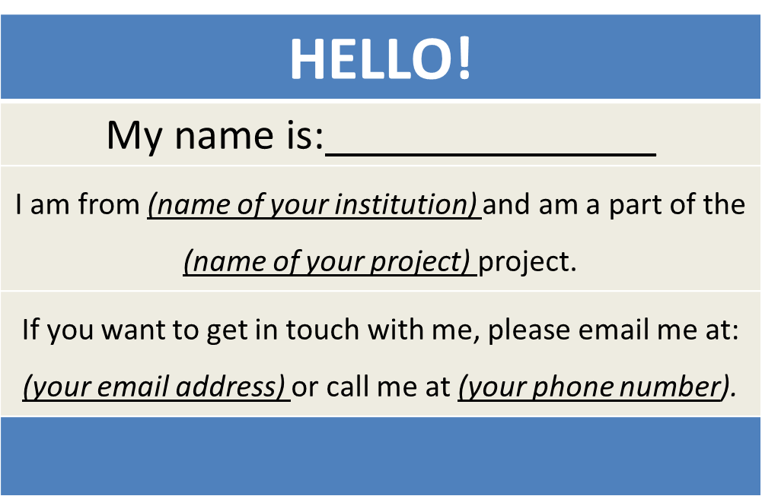
NFJP Grantees
Create a virtual name tag…

Slide 8
Steve Rietzke
Division Chief
Division of National Programs, Tools, and Technical Assistance
Employment and Training Administration
U.S. Department of Labor

Slide 9
Introductions – National Office
Program Office – Division of National Programs, Tools, and Technical Assistance, Specialty National Programs Unit
The Program Office has several functions:
Supports Federal Project Officers (FPOs)
Provides Technical Assistance (TA)
Together with the Association of Farmworker Opportunity Programs (AFOP), Social Policy Research Associates, and Sister Sky
Creates peer learning opportunities
Collects performance data
Reviews grant modifications
Coordinates product submissions and dissemination

Slide 10
How many of you have read the newest edition of “Grantee Handbook: Effectively Managing Your ETA Competitive Grant?
Of course!
Half way done!
It’s on my “must read” list
Huh…

Slide 11
Gregory Scheib
Workforce Analyst
Specialty National Programs Unit
Employment and Training Administration
U.S. Department of Labor

Slide 12
NFJP Program Overview
Nearly $81 million in grant funds
To support the development of employment and training and housing assistance grants for migrant and seasonal farmworkers(MSFW), including MSFW youth, and their dependents to receive career services, training services, housing assistance services, youth services, and other related assistance services that help retain and stabilize their current agriculture jobs as well as acquire new skills they need to start careers that provide higher wages and stable, year-round employment.

Slide 13
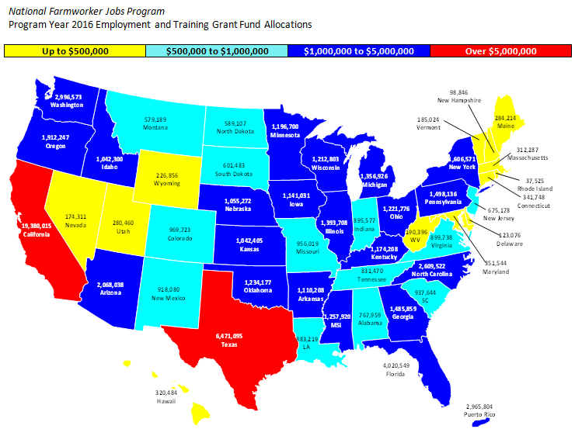
Employment and Training Grantees

Slide 14
Housing Assistance Grantees
National Farmworker Jobs Program (NFJP) Housing Assistance Grants
No. | Organization Name | State | Service Area(s) | Award Amount
1 | Community Resources and Housing Development Corporation | CO | AZ, CO, ID, NM, TX | $709,576
2 | Florida Non-Profit Housing, Inc. | FL | DE, FL, MD, MS, VA | $710,914
3 | La Cooperativa Campesina de California | CA | CA | $800,000
4 | Motivation, Education,and Training, Inc. | TX | TX, LA | $590,266
5 | Office of Rural and Farmworker Housing | WA | WA, OR | $274,770
6 | Pathstone Corporation | NY | NY, VT, NJ, ME, PA, OH, IN, PR | $952,202
7 | PPEP Microbusiness & Housing Development Corporation | AZ | AZ | $445,321
8 | Rural Community Assistance Corporation | CA | HI, CA | $198,380
9 | Tennessee Opportunity Programs, Inc. | TN | TN | $105,000
10 | United Migrant Opportunity Services/UMOS, Inc. | WI | IL, IA, KS, MN, MO, NE, OK, SD, WI | $473,228
 | Total |  |  | $5,259,657

Slide 15
Reporting Requirements
Reporting successes to Congress, Administration, OMB, GAO, etc.
Demonstrating grant outcomes to partners to help maintain and build additional strategic partnerships and leverage resources
Continuously improving program to meet the needs of participants

Slide 16
Reporting Requirements
For grants awarded July 1, NFJP grantees are required to submit the following reports to ETA:
Quarterly Submissions (Due no later than 45 calendar days after the end of each reporting quarter – the first quarter reports are due on November 14)
Joint Quarterly Narrative Performance Report
9130 – See Training and Employment Guidance Letter (TEGL) No. 02-16, Revised ETA-9130 Financial Report, Instructions, and Additional Guidance
Workforce Integrative Performance System (WIPS) – ETA Form 9172 (the DOL-only Participant Individual Record Layout (PIRL). See https://doleta.gov/performance/reporting/eta_default.cfm
Annual Submissions
Revised SF 424 / 424A
Revised program plans
Data validation information

Slide 17
Jimmie Curtis
Grant Officer
National Programs Unit
Employment and Training Administration
U.S. Department of Labor

Slide 18
Introductions - OGM
Program Office – Office of Grants Management (OGM)
The Grant Officer performs official grant duties:
Maintains official grant documents such as modifications, no-cost extensions, and other relevant documents
Approves equipment purchases over $5,000
ETA Grant Officer: Jimmie Curtis
NFJP Specialist: Amanda Denogean

Slide 19
Grant Award Package
Grant Award Letter
Grant Agreement
Signature Page / Notice of Obligation (NOO)
Condition of Award Page
Terms and Conditions
Application for Federal Assistance
Budget
Statement of Work (SOW)
Indirect Cost Rate Agreement (if applicable)

Slide 20
Grant Award Package
Acknowledgements of Award
Payment Management System
Information and forms on www.doleta.gov under Payment Information
ETA’s on-line Grantee Fiscal Reporting System
ETA 9130
Information to access system on www.doleta.gov/grants under Financial Reporting
Passwords/PINs are sent separately after supplying the necessary information
Once you receive this please do not lose it

Slide 21
Grant Award Package
Project Title – NFJP
Grant Awardees’ Identifying Information
Agreement number
Period of Performance
Award Amount
Regulations and Cost Principles
Signatures

Slide 22
Grant Award Package
Equipment purchases with a per unit acquisition cost of $5,000 or more, and a useful life of more than one year need prior approval from Grant Officer.
Submit a detailed equipment purchase list with descriptions of each item to your Federal Project Officer (FPO) for review. We encourage you to submit this request as early as possible in the period of performance, with as many planned pieces of equipment as possible.
Your FPO will review the items and submit the list for OGM review. If the equipment purchases are approved, a modification to your grant will be processed.

Slide 23
Grant Award Package
Review of Grant Terms and Conditions
30 days to respond
Assistance from FPO, DNPTTA, and OGM
Grant Transparency Process
- Please continue to work on the redaction request materials and send your redacted project narratives to NFJP@DOL.gov due 14 days after receipt of your grant award.

Slide 24
Laura Ibañez
Unit Chief
Specialty National Programs Unit
Employment and Training Administration
U.S. Department of Labor

Slide 25
Communication Plan
From: ETA, To: You
We will usually go through your FPO for specific requests and information
From You, To: ETA (National Office)
Contact your FPO first
Copy the NFJP Mailbox: NFJP@dol.gov, if appropriate
Remember
- Include your grant number and lead grantee organization name.
- Describe your questions/issue and background as specifically as possible.
- Please be patient yet proactive!

Slide 26
Communication Plan
Grantees’ Main Point of Contact (POC)
Receives communication from ETA
Responsible for sharing information with project team and consortium members
Any time the main point of contact for your grant changes, please remember to alert your Federal Project Officer (FPO) and National Office staff
Note: Changing signature authority requires a formal grant modification

Slide 27
Introductions - Regional Office
Michael Hotard, Region 1 Federal Project Officer (FPO)
Trevor Capon, Region 1 FPO
https://www.doleta.gov/regions/

Slide 28
Introductions – Regional Office
Laura Tramontana Region 2 FPO
Connie Taylor
Region 3 FPO

Slide 29
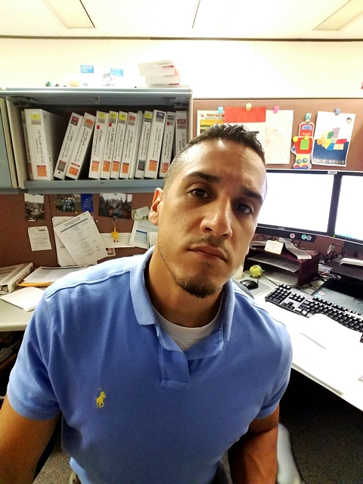
Introductions - Regional Office
Noel Castro Region 4 FPO
Raymundo Garcia
Region 5 FPO
https://www.doleta.gov/regions/

Slide 30
Introductions - Regional Office
Krister Engdahl Region 6 FPO
Marjorie Fong
Region 6 FPO
https://www.doleta.gov/regions/

Slide 31
Introductions - National Monitor Advocate System
Juan Regalado, National Monitor Advocate
Specialty National Programs Unit
Employment and Training Administration
U.S. Department of Labor
Lianna Shannon, Workforce Specialist Specialty National Programs Unit
Employment and Training Administration
U.S. Department of Labor
https://www.doleta.gov/regions/

Slide 32
How do you feel after today’s webinar?
Let’s do this!!!
A little overwhelmed but excited!
Huh…

Slide 33
Next Steps
Join us for the Overview of the Revised WIOA ETA-9130 Financial Reports and Instructions Webinar on August 10 at 2:00 PM EST. https://www.workforcegps.org/events/2016/07/01/14/37/Overview_of_the_Revised_WIOA_ETA-9130_Financial_Reports_and_Instructions.
Join us for the NFJP Eligibility and Enrollment, Program Services, and Performance Webinar on August 11th at 2:00 PM EST.
ETA will work with grantees to set performance goals by August 29, 2016.
Upcoming tentative dates for monthly webinar discussions:
Reporting Webinar Discussion on September 8, 2016.
Collaboration and Partnerships Webinar Discussion on October 6, 2016.

Slide 34
NFJP Webpage
https://www.doleta.gov/Farmworker/html/NFJP.cfm
WorkforceGPS
https://farmworker.workforcegps.org/
Migrant and seasonal Farmworkers Monitor Advocate System
https://www.doleta.gov/programs/msfw.cfm
Association of Farmworker Opportunity Programs
http://afop.org/

