Slide 2
ETA-9130 Financial Report
Overview of Revised WIOA Financial Reports and Instructions
Office of Grants Management
08/10/2016

Slide 4
Debbie Galloway
Fiscal Policy Manager
Office of Grants Management
Chanel Castaneda
Grants Management Specialist
Office of Grants Management

Slide 5
What is your role in the ETA-9130 reporting process?
I am a Federal reviewer.
I complete ETA-9130 reports.
I certify ETA-9130 reports.
I am a program person and I provide information to complete the ETA-9130 report.
I am not sure. Is it something I file with my taxes?

Slide 6
Why do you think ETA needed to revise the ETA-9130 report?
Due to the passing of WIOA.
Due to the passing of the Uniform Guidance.
To reduce the administrative reporting burden.
It was simply long overdue.
Answers 1, 2, and 3.

Slide 7
Discussion of updates to the
Workforce Innovation and Opportunity Act (WIOA)
ETA-9130 Financial Reports and Instructions
(hereafter referred to as ETA-9130 or 9130).
Approval Date: April 13, 2016
Expiration Date: April 30, 2019
OMB Control #: 1205-0461
All documents are available at:
https://www.doleta.gov/grants/financial_reporting.cfm

Slide 8
Background
ETA awards approximately $8 billion in formula and discretionary grants each year to an average of 1,000 recipients.
Financial reports for each of these grants must be submitted quarterly on the financial report form ETA-9130.
There is a Basic ETA-9130 report for discretionary grants and thirteen (13) program-specific variations.

Slide 9
Reasons for Change
Financial reporting requirements for Federal programs prescribed by the Office of Management and Budget (OMB) have changed with the implementation of the Uniform Guidance at 2 CFR Part 200 which went into effect on December 26, 2014, consolidating eight previously applicable Circulars.
DOL’s exceptions to the Uniform Guidance are at 2 CFR Part 2900.

Slide 10
Reasons for Change
With the passage of the Workforce Innovation and Opportunity Act (WIOA), there are numerous new statutory requirements, including new and/or revised limitations and baselines that require the addition of new and modification of existing reporting line items on ETA-9130 Financial Reports.
WIOA

Slide 11
Reasons for Change
Other reporting line items have been added and removed in an effort to streamline Federal financial reporting and make the ETA-9130 more closely resemble the SF-425 (OMB 0348-0061), which is the standard financial reporting form for Federal grant recipients.

Slide 12
Today’s discussion will only address changes to the WIOA-specific ETA-9130s.
It will not cover every section of each 9130 report and its instructions.
The new forms discussed today will become available in the e-Grants reporting system for the quarter ending September 30, 2016.
For copies of the 14 new forms and the instructions, please go to: https://www.doleta.gov/grants/financial_reporting.cfm
For additional information, you may also refer to TEGL 02-16, Revised ETA-9130 Financial Report, Instructions, and Additional Guidance.

Slide 13
ETA-9130 Report Names

Slide 14
HELLO my name is
ETA-9130 – Basic
ETA-9130 (A) – Statewide Youth
ETA-9130 (B) – Local Youth
ETA-9130 (C) – Statewide Adult
ETA-9130 (D) – Local Adult
ETA-9130 (E) – Statewide Dislocated Workers
ETA-9130 (F) – Local Dislocated Workers
ETA-9130 (G) – National Dislocated Worker Grants – NEW
ETA-9130 (H) – Statewide Rapid Response
ETA-9130 (I) – Employment Services & Unemployment Insurance
ETA-9130 (J) – National Farmworker Jobs Program
ETA-9130 (K) – Senior Community Service Employment Program
ETA-9130 (L) – Indian and Native American Program
ETA-9130 (M) – Trade Adjustment Assistance Program

Slide 15
Across The Board Changes
Affects ALL ETA-9130s, including the Basic Form

Slide 16
Unique Entity Identifier
Line item number 4a was renamed Unique Entity Identifier, as prescribed by 2 CFR 200.210.
This field is currently known as the Data Universal Numbering System (DUNS) number or Central Contract Registry extended DUNS number.
The number is pre-filled automatically by the reporting system and will remain the same until such time a Unique Entity Identifier is determined.

Slide 17
Basis of Reporting
Line item number 7 was renamed Basis of Reporting.
DOL’s exception to the Uniform Guidance at 2 CFR 2900.14 allows ETA to require that its grant recipients report expenditures on an accrual basis.
If operating on a cash basis, the recipient will not be required to convert its accounting system, but must develop and report such accrual information through best estimates based on an analysis of the documentation on hand.

Slide 18
Expenditures
Instructions have been updated to reflect the Uniform Guidance definition of Expenditures at 2 CFR 200.34 (c).
For reports prepared on an accrual basis, expenditures are the sum of:
(1) Cash disbursements for direct charges for goods and services;
(2) The amount of indirect expense incurred;
(3) The value of third-party in-kind contributions applied (reported in recipient share section); and
(4) The net increase or decrease in the amounts owed by the non-Federal entity for:
(i) Goods and other property received;
(ii) Services performed by employees, contractors, subrecipients, and other payees; and
(iii) Programs for which no current services or performance are required such as annuities, insurance claims, or other benefit payments.

Slide 19
Recipient Share
Non-federal resources such as match and certain leveraged resources.
Instructions have been updated to reflect DOL’s exception to the Uniform Guidance definition of Cost Sharing or Matching at 2 CFR 2900.8.
In addition to the guidance set forth in 2 CFR 200.306(b), for Federal awards from the Department of Labor, the non-Federal entity accounts for funds used for cost sharing or match within their accounting systems as the funds are expended.

Slide 20
Program Income
Instructions have been updated to reflect additional guidance provided in the Uniform Guidance at 2 CFR 200.305 (b)(5).
Use of resources before requesting cash advance payments. To the extent available, the non-Federal entity must disburse funds available from program income (including repayments to a revolving fund), rebates, refunds, contract settlements, audit recoveries, and interest earned on such funds before requesting additional cash payments.
20 CFR 683.200 (c)(6)-(8)

Slide 21
Removed Line Items
ETA attempts to streamline Federal financial reporting by bringing ETA-9130 requirements as close as possible to the already existing SF- 425 report.
The following lines have been removed:
10l – Recipient Share of Unliquidated Obligations
10m – Total Recipient Obligations

Slide 22
Indirect Expenditures
The following new Indirect Expenditure reporting line items have been added:
Type of Rate
Rate
Rate Approval Date
Period From – To
Base
Amount Charged
Federal Share
Totals

Slide 23
Indirect Expenditures …continued
There is NO section on Indirect Cost on the local 9130s.
X - WIOA Local Youth
X - WIOA Local Adult
X - WIOA Local Dislocated Workers
Indirect costs are only to be reported by the non-federal entity receiving direct awards from DOL and using an indirect cost rate.
Recipients using a Statewide Cost Allocation Plan (SWCAP) and/or subrecipients will not report indirect expenditures.

Slide 24
Indirect Expenditures …continued
Indirect costs are only reported on the Final 9130 report.
Multiple values may be entered in each Indirect Expenditure reporting line item (13a-h) for instances in which more than one rate applies to the applicable grant period of performance.
While some administrative costs may be indirect costs, the two must not be generally equated.

Slide 25
Indirect Expenditures …continued
Type of Rate
Provisional, Predetermined, Final, Fixed, Fixed with Carry-Forward, De Minimis, or other
Rate
Percentage applied to Base
Rate Approval Date
Date on which the indirect cost rate was approved
Period From – To
Two separate fields:
Date on which the indirect cost rate became effective
Last date (ending date) on which the indirect cost rate was (or is going to be) effective

Slide 26
Indirect Expenditures …continued
Base
Amount of the distribution base against which the rate(s) was applied
E.g., Modified Total Direct Costs (MTDC)
Amount Charged
This is a manual calculation; the system will not calculate this for recipients
Multiply the Rate (%) times the Base ($)
Federal Share
Federal Share of the amount charged
Totals
This is a manual calculation; the system will not calculate this for recipients
Add up the individual values for Base, Amount Charged, and Federal Share respectively

Slide 27
Indirect Expenditures …continued
X
=
Sum
Sum
Sum

Slide 28
Certification Statement
2 CFR 200.415 revises the certification statement.
The authorized official certifies accuracy of reported data by entering their individually assigned PIN.

Slide 30
Changes to WIOA Reports

Slide 31
Local Reports
ETA-9130 (B) – Local Youth
ETA-9130 (D) – Local Adult
ETA-9130 (F) – Local Dislocated Workers

Slide 32
Work Experience
WIOA Sec. 129 (c)(4)
A new reporting line item for Work Experience Expenditures was added to the Local Youth 9130.

Slide 33
Pay-for-Performance
A new Pay-for-Performance Contract Expenditures reporting line item was added to the Local Youth, Local Adult, and Local Dislocated Worker 9130s.
WIOA Sec. 129 (c)(1)(D)
WIOA Sec. 134 (d)(1)(A)(iii)

Slide 34
Pay-for-Performance
WIOA Sec. 189 (g)(2)(D) stipulates that funds for pay-for-performance contract strategies remain available until expended.
A new Federal Share of Unliquidated Obligations for Pay-for-Performance Contracts reporting line item was added to the Local Youth, Local Adult, and Local Dislocated Worker 9130s.

Slide 35
Transitional Jobs
A new Transitional Jobs Expenditures reporting line item was added to the Local Adult, Local Dislocated Worker, and National Dislocated Worker Grants 9130s.
WIOA Sec. 134 (d)(5)

Slide 36
Incumbent Worker Training
A new Incumbent Worker Training Expenditures reporting line item was added to the Local Adult and Local Dislocated Workers ETA 9130s.
WIOA Sec. 134 (d)(4)(A)(i)

Slide 37
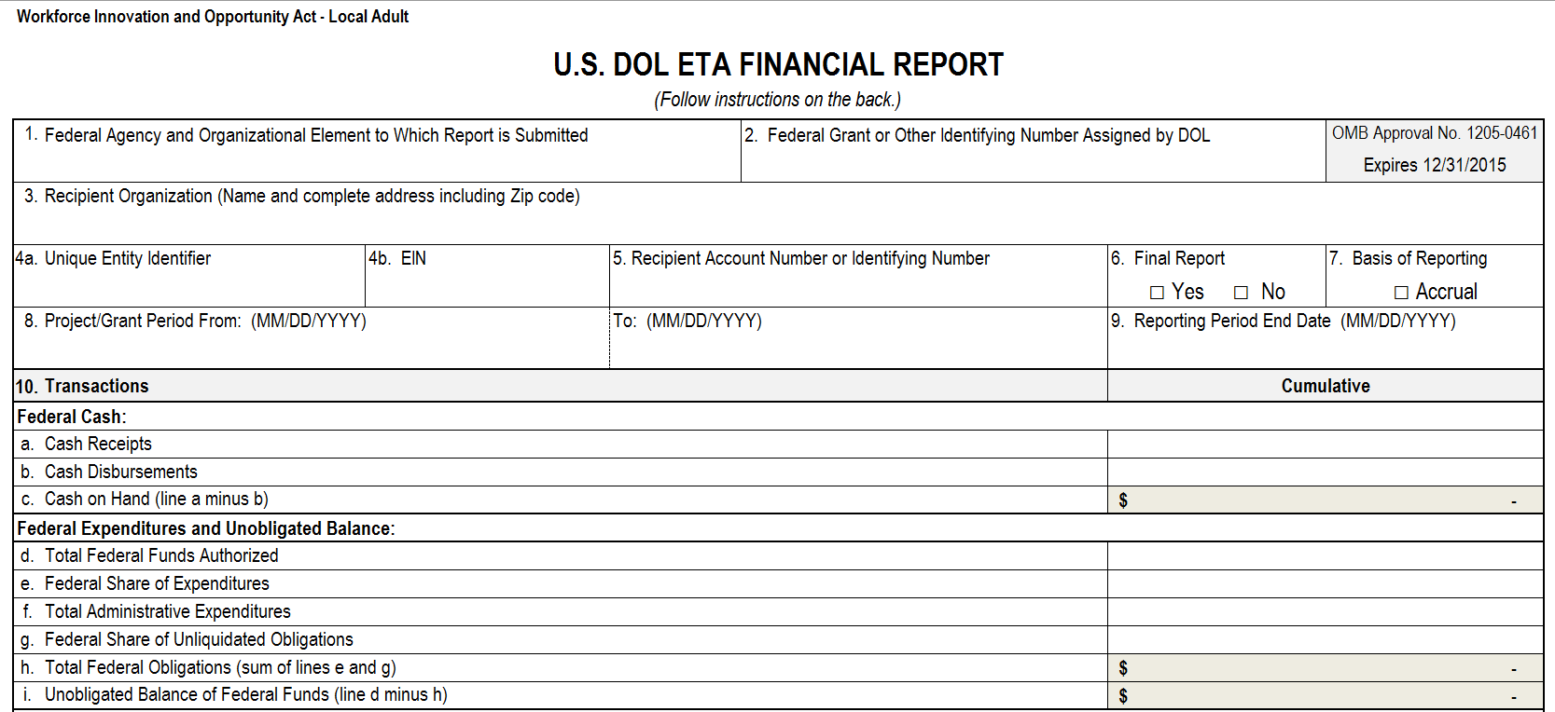
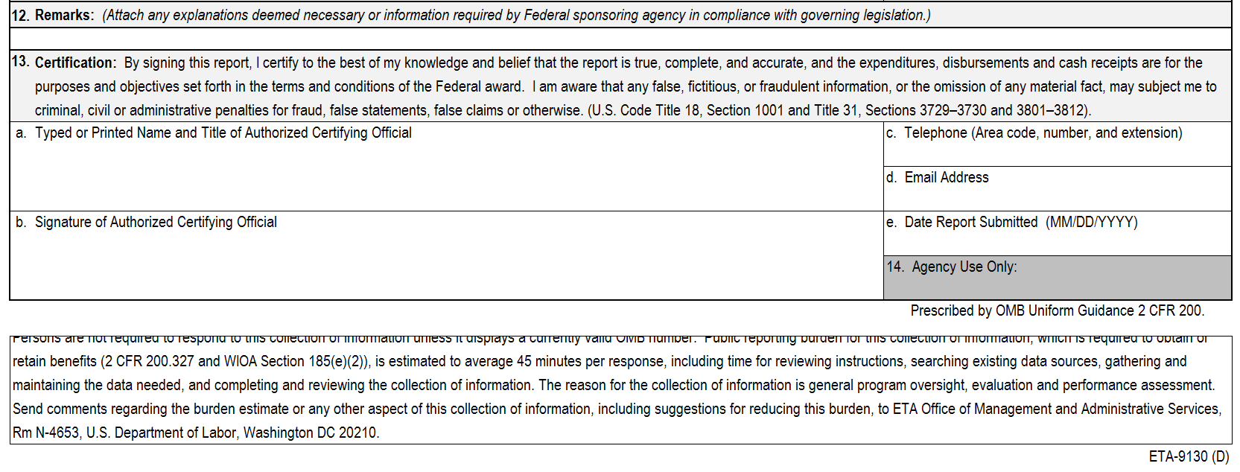

Slide 38
Statewide Reports
ETA-9130 (A) – Statewide Youth
ETA-9130 (C) – Statewide Adult
ETA-9130 (E) – Statewide Dislocated Workers
ETA-9130 (G) – National Dislocated Worker Grants
ETA-9130 (H) – Statewide Rapid Response

Slide 39
In-School Youth
A new In-School Youth Funds Expended on Direct Services reporting line item was added to the Statewide Youth 9130.
In-school youth expenditures must be collected in order to determine the total percentage of out-of-school youth funds expended.

Slide 40
Out-of-School Youth
A new reporting line item for Out-of-School Youth Funds Expended on Direct Services was added to the Statewide Youth 9130.
WIOA Sec. 129 (a)(4)(A)

Slide 41
Out-of-School Youth …continued
Out-of-School Youth Funds Expended on Direct Services
Expenditure Rate Calculation: OSY ÷ (ISY + OSY)
Out-of-School Youth expenditures divided by In-School Youth expenditures plus Out-of-School Youth expenditures
This expenditure rate calculation is only applicable to the Statewide Youth fund stream.
The local OSY Expenditures calculation is outlined in the Local Youth ETA-9130 instructions.

Slide 42
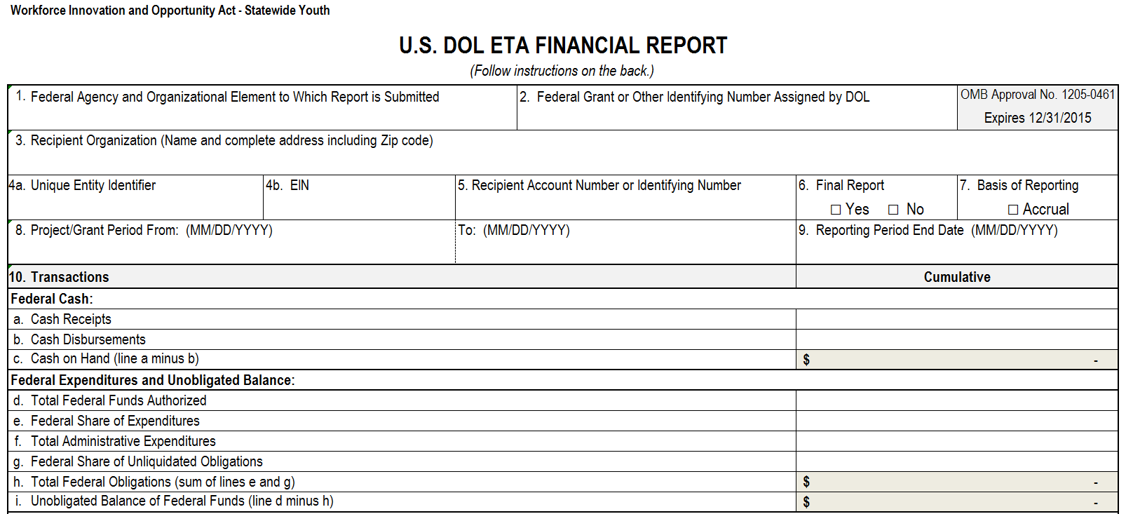
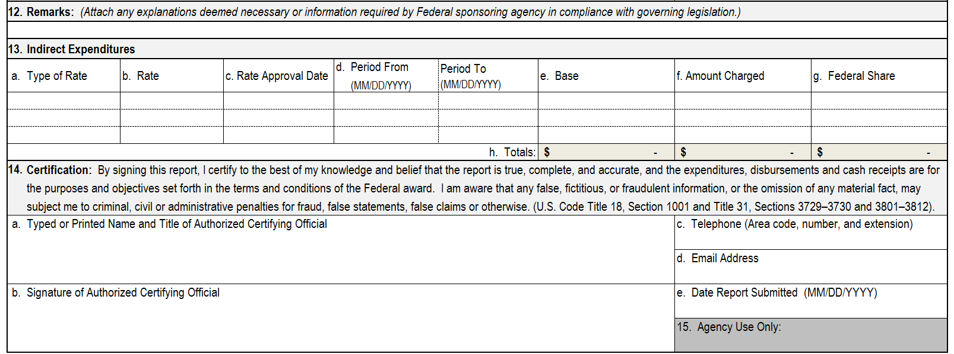

Slide 43
Statewide Adult and Dislocated Workers
No new line items!

Slide 44
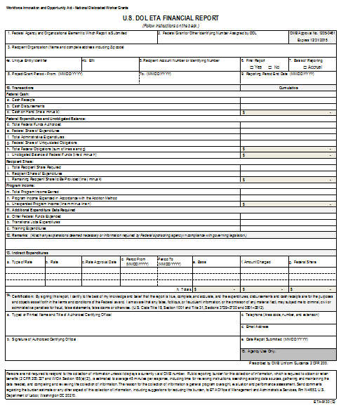
National Dislocated Worker Grants
Due to the programmatic requirements in WIOA, a separate report has been created for National Dislocated Worker Grants (NDWG).

Slide 45
National Dislocated Worker Grants …continued
The new National Dislocated Worker Grants 9130 includes a Training Expenditures reporting line item.
This line item should consider all costs for training, including but not limited to tuition, books, tools, etc., as applicable.
All forms of training must be accounted for, including but not limited to occupational skills training, GED/HiSET/TASC training, and on-the-job training.
WIOA Sec. 116 (d)(2)(D)

Slide 46
Rapid Response
A new Rapid Response Funds Expended on Other Statewide Activities reporting line item was added to the Statewide Rapid Response 9130.
WIOA Sec. 134 (a)(2)(A)(ii)

Slide 47
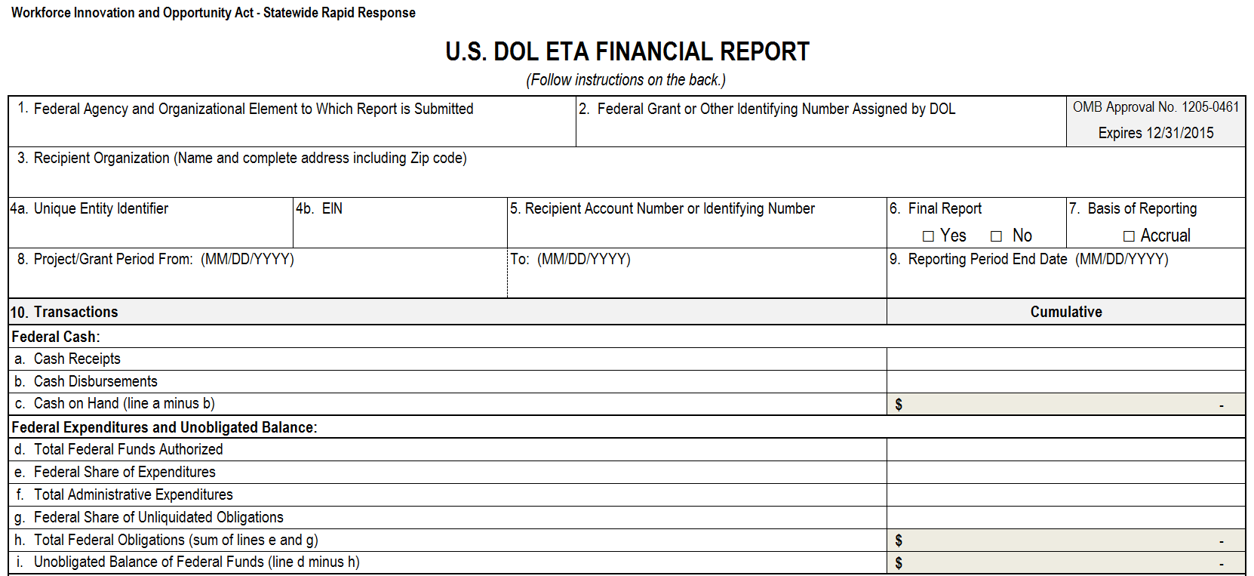
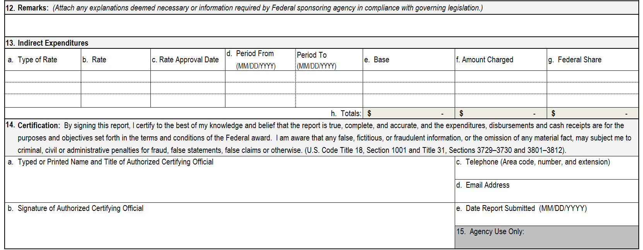

Slide 48
New Line Items In Summary
9130 Report | Indirect Cost Expenditures | Out-of-School Youth Funds Expended on Direct Services | In-School Youth Funds Expended on Direct Services | Work Experience Expenditures | Federal Share of Unliquidated Obligations for Pay-for-Performance Contracts | Pay-for-Performance Contract Expenditures | Incumbent Worker Training Expenditures | Transitional Jobs Expenditures | Rapid Response Funds Expended on Other Statewide Programs | Supportive Services Expenditures | Training Expenditures
Basic | X
Local Youth |  |  |  | X | X | X
Local Adult |  |  |  |  | X | X | X | X
Local Dislocated Worker |  |  |  |  | X | X | X | X
Statewide Youth | X | X | X
Statewide Adult | X
Statewide Dislocated Worker | X
National Dislocated Worker Grants | X |  |  |  |  |  |  |  |  |  | X
Statewide Rapid Response | X |  |  |  |  |  |  |  | X
Employment Services & Unemployment Insurance | X
National Farmworker Jobs Program | X |  |  |  |  |  |  |  |  | X
Senior Community Service Employment Program | X
Indian and Native American Program | X
Trade Adjustment Assistance Program | X |  |  |  |  |  |  |  |  |  | X

Slide 50
Reporting
All pre-existing and new reporting line items must be reported cumulatively.

Slide 51
Transition Activities
Expenditures for activities to facilitate the transition from WIA to WIOA must be reported in section 12 (Remarks) of the ETA-9130.
TEGL 12-14 – Allowable Uses and Funding Limits of Workforce Investment Act (WIA) Program Year 2014 funds for WIOA Transitional Activities

Slide 52
Implementation
Continue to use old ETA-9130 when reporting on quarters ending on 6/30/16 or prior.
Mar. 31, 2016
Jun. 30, 2016
Sep. 30, 2016
Dec. 31, 2017
OMB approves new ETA-9130 on 4/13/16.
First quarter to collect financial information based on new rules.
Beginning on October 1, 2016,
when reporting on quarters ending on 9/30/16 or after,
use new ETA-9130.

Slide 53
