Slide 1
H-1B Strengthening Working Families initiative (SWFI)
New Grantee Orientation
Office of Workforce Investment, Division of Strategic Investments

Slide 3
Presenters
Presenters:
Robin Fernkas, Office Division Chief, Division of Strategic Investment
Megan Baird, Program Manager H-1B Grants, ETA, Division of Strategic Investment
Danielle Kittrell, Workforce Analyst, H-1B Grants, ETA, Division of Strategic Investment
Jake Blanch, Federal Project Officer, Region 2, ETA
Brinda Ruggles, Grant Officer, Office of Management and Administrative Services (OMAS), ETA
Elizabeth DeHart, Grants Management Specialist, ETA
Moderator:
Monica A. Evans, Workforce Analyst, H-1B Grants, ETA, Division of Strategic Investment

Slide 4
Today’s Agenda
Welcome to ETA!
Introductions
Program Overview
Communication Plan
Reporting Requirements
Grant Package
Next Steps

Slide 5
Introductions
Employment and Training Administration (ETA)
National Office
Program Office – Division of Strategic Investments (DSI)
Grant Office – Office of Grants Management (OGM)
Chief Evaluation Office (CEO)
Regional Office
Federal Project Officer (FPO)

Slide 6
National Office – Division of Strategic Investments (DSI)
The Program Office has several functions:
Supports Federal Project Officers (FPOs)
Provides policy clarification and guidance
Provides Technical Assistance (“TA”)
Together with an external TA provider
Creates peer learning opportunities
Collects performance data
Reviews some grant modifications
Periodically requests additional information about your grant

Slide 7
National Office – Technical Assistance Initiative
Technical Assistance Initiative
DOL is in process of procuring a TA provider (in addition to TA provided by the National and Regional Offices).
Functions include:
Intensive and ongoing technical assistance to support grantees in effectively addressing education and job training barriers for low- to middle-skilled parents by prioritizing the needs of this targeted population;
Addressing child care needs for parents seeking education and training;
Increasing access to child care resources;
Utilizing systems integration best practices to bridge the gap between the workforce development and child care systems

Slide 8
National Office – Office of Grants Management (OGM)
The Grant Officer performs official grant duties:
Maintains official grant documents such as modifications, no-cost extensions, and other relevant documents
Approves all purchases over $5,000
ETA Grant Officer: Brinda Ruggles
SWFI Grant Specialist: Elizabeth DeHart
The Office of Grants Management (OGM) also provides guidance on policy issues and training on fiscal and administrative requirements.

Slide 9
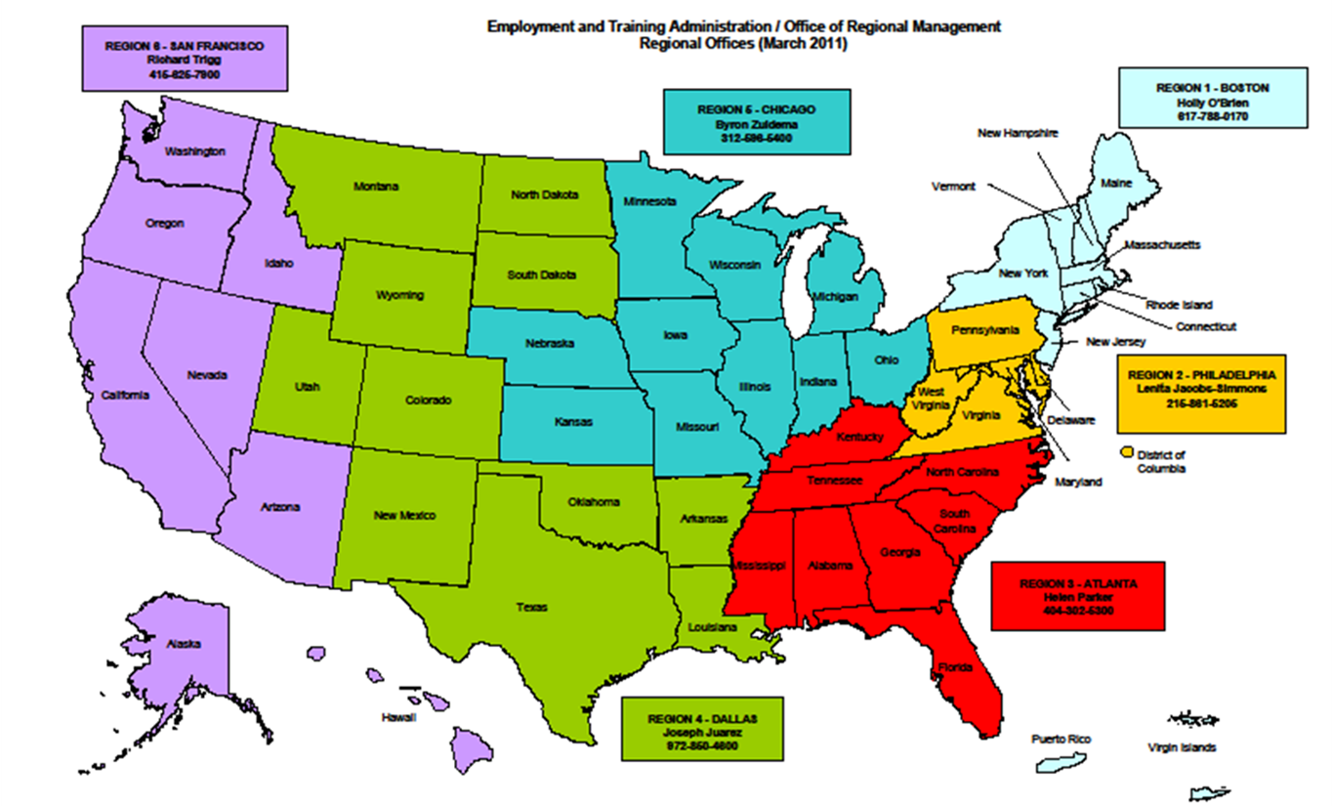
Regional Office Role

Slide 10
DOL’s Chief Evaluation Office (CEO)
Evaluating Successful SWFI Strategies
Conduct the SWFI national evaluation
Oversight of Evaluation Contractors
Committed to building evidence and highlighting innovation among the systems changes, partnerships, and strategies.
Next Steps:
We will be reaching out to grantees in the near future to tell you more about the evaluation and to learn more about your programs.

Slide 11
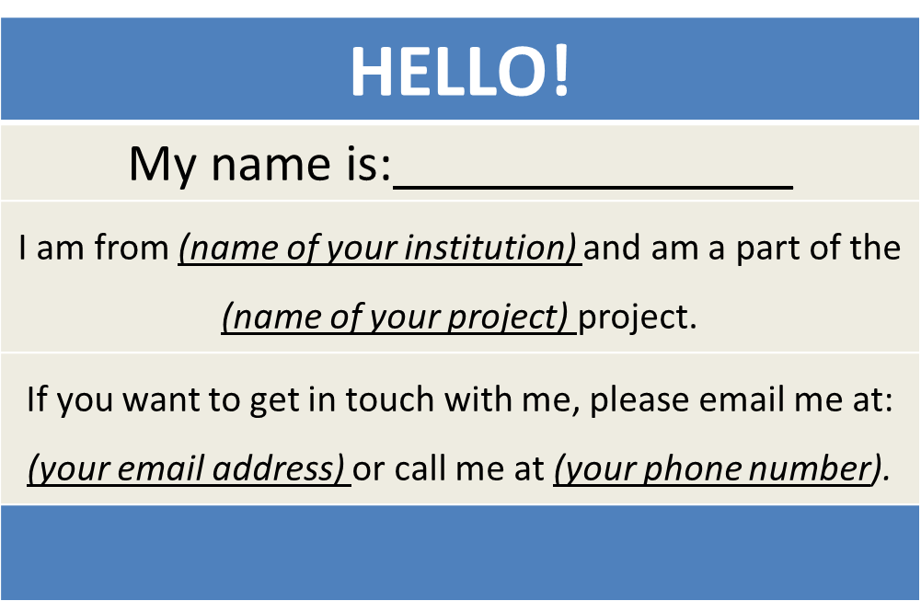
SWFI Grantees
Create a virtual name tag…

Slide 12
Grantee Polling Question
Is this your first ETA grant?
Choose the answer that best reflects you (or your group):
Yes
No

Slide 13
Grant Program Overview

Slide 14
Program Overview
Nearly $54 million in grant funds
To provide support to parents who face barriers to training and are in need of increasing skills and competencies that will either prepare them for entry into middle-or high-skilled jobs;
To give more working parents a career pathway and into middle-or high skilled jobs; and
These grants will give more working parents a career pathway to secure higher wage jobs by addressing the significant barriers to participating in and completing training, and in trying to find and acquire affordable, quality child care.

Slide 15
Overview of Grantees
Awards to 14 public and private partnerships
Projects provide services in 13 states
Period of performance is 48 months
Grant start date: July 1, 2016
Grant end date: June 30, 2020

Slide 16
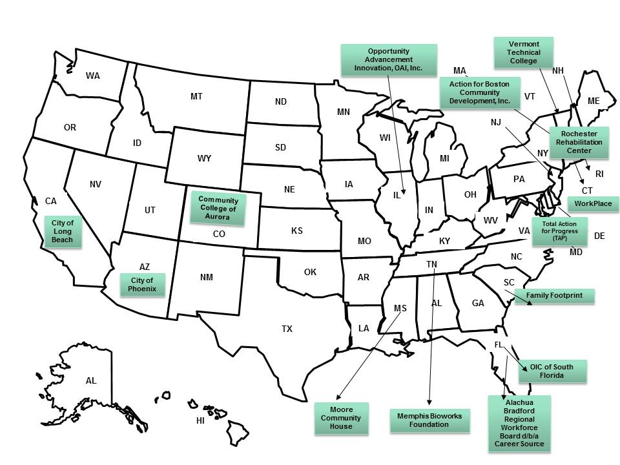
Overview of Grantees
H-1B SWFI Grantees (14 Total)

Slide 17
Overview of Grantees

Slide 18
Target Population
Approximately 7,900 parents will be served by the SWFI grant program.
Types of Populations Being Served
Unemployed or Underemployed Low-Income Parents | Dislocated Workers
Low Skilled, Low Income Custodial Parents | Low-to-Medium Income and/or Low-to-Medium Skilled Women
Legal Guardians | Parents with Childcare Responsibilities
Foster Parents | Head Start/Early Head Start Parents
Incumbent Workers | Veteran Parents
Low Income Parents | Military Spouses with Dependents in Need of Training and Employment

Slide 19
Program Level and System Level Activities
Program-level activities: These activities will address individual training needs, provide customized participant support services, and lead to job placement in middle- to high-skilled jobs.
System-level activities: These activities will simplify and increase access to services and resources that enable low- to middle-skilled individuals with child care needs to participate in and complete training.

Slide 20
Program Overview
Example Training Strategies
OJT
Paid Work Experience
Paid Internships
Registered Apprenticeships
Classroom Training
Technology-based Learning
Other Training Strategies
Activities and Service Strategies
Services and activities that support skill development, training retention, and employment
Child and/or dependent care; Financial counseling; behavioral health counseling; etc.

Slide 21
Division of Strategic Investments ETA Office of Workforce Investments
Communication Plan

Slide 22
Communication Plan
From: ETA, To: You
Usually through your FPO for specific requests and information
SWFI mailbox for general requests and information
WorkforceGPS grantee Community of Practice: https://h1bskillstraining.workforcegps.org/
From: You, To: ETA (National Office)
Contact your FPO first
Copy the SWFI Mailbox: SWFI@dol.gov , if appropriate
Remember
Include your grant number and lead grantee organization name
Describe your question/issue as specifically as possible
Please be patient!

Slide 23
Grantee Team Communications & Support
Main Point of Contact (POC)
Receives communication from ETA
Responsible for sharing information with project team and consortium members
Any time the main point of contact for your grant changes, please remember to alert your Federal Project Officer (FPO) and National Office staff
Note: Changing signature authority requires a formal grant modification

Slide 24
SWFI Project Abstracts
Link: http://webapps.dol.gov/DOLGrantData/KeywordSearch.aspx?parameter=FOA-ETA-16-05B

Slide 25
SWFI Community of Practice
Workforce GPS (WGPS):
A WGPS web portal for H-1B SWFI grantees is currently in development.
For now, H-1B SWFI grantees will access resources from the H-1B Skills Training WGPS Web Portal: https://h1bskillstraining.workforcegps.org/ where all SWFI technical assistance materials will be posted.
When you register for an account, please select H-1B Skills Training in order to receive links to SWFI resources and materials.

Slide 26
Communication Plan
Always contact your FPO first if you have questions!
If you… | Contact:
Are the grant lead | FPO
Are a member of a grant project | The lead for your grant
Have questions or difficulty accessing the performance reporting system | SWFI@dol.gov with a copy to your FPO
Have questions or difficulty accessing the financial reporting system | EBSS.help@dol.gov, with a copy to your FPO and SWFI@dol.gov
Have questions about evaluations | SWFI@dol.gov with a copy to your FPO

Slide 27
Megan Baird Division of Strategic Investments ETA Office of Workforce Investments
Reporting Requirements

Slide 28
The Value of Reporting
Reporting successes of high profile programs to Congress, Administration, OMB, GAO, etc.
Demonstrating Grant Outcomes to investors and partners
Illustrating Return on Investment (ROI) to employer partners
Building additional strategic partnerships and leveraging resources
Sustainability of the project and partnership
Continuously improving program to meet the needs of participants

Slide 29
Reporting Requirements
SWFI grantees are required to submit reports Quarterly to ETA, including a final report
These reports are:
Quarterly Progress Reports (QPR)
Includes performance report
Includes narrative report
Quarterly Financial Report (ETA-9130)
Final Report

Slide 30
Quarterly Progress Report
Each grantee must submit a Quarterly Progress Report (QPR)
Due no later than 45 days after the end of a quarter
More information and training will be provided
Quarter End Dates | QPR Due Date | Report Activities Occurring Between
September 30, 2016 | November 14, 2016 | July 1-September 30, 2016
December 31, 2016 | February 15, 2017 | October 1-December 31, 2016
March 31, 2017 | May 15, 2017 | January 1-March 31, 2017

Slide 31
Quarterly Progress Reports
Submitting QPRs to ETA
Will be submitted through a web-based reporting system available.
In preparation, grantees should prepare to collect and track participant-level data on demographic information, services and training received, credential outcomes, and employment and employment retention information.
This includes providing participant SSNs, which will be used by ETA to track and report long-term employment outcome measures (Common Performance Indicators)
Please ensure you follow PII protocol.

Slide 32
Interim Reporting Process: Submitting 9.30.2016 QPRs to ETA
Until the ETA reporting system is completed, grantees will follow an interim reporting process.
This process applies to your first QPR, for the quarter ending September 30, 2016
We anticipate the ETA reporting system will be available for grantees to submit participant-level data to ETA beginning with the QPR due for the quarter ending 12.31.2016.
Grantees will NOT submit participant data to ETA
However, grantees must still collect participant-level data as it aligns with the required reporting elements for all participants served as of the start of the grant. Grantee will report cumulative data for all participants served once the reporting system is available.
Grantees will submit a quarterly Narrative Report (QNR) to ETA, via email
QNRs should be email to your FPO with a cc to SWFI@dol.gov, no later that the reporting deadline of November 14, 2016

Slide 33
Important Links to DOL Performance Reporting
DOL ETA Performance Reporting Website
https://doleta.gov/performance/reporting/eta_default.cfm
DOL-only Performance Accountability, Information, and Reporting System - OMB Control No. 1205-0521
(PIRL): H-1B Data Elements for participant level data collection and tracking is provided here: https://doleta.gov/performance/pfdocs/ETA-9172_DOL%20PIRL_FINAL_V25_062816.pdf
More to Come!
Detailed Interim Reporting Guidance
H-1B Performance Reporting Technical Assistance

Slide 34
Quarterly Financial Report
Each grantee must submit a Quarterly Financial Report (ETA 9130)
Financial reporting system different than performance reporting system
Due no later than 45 days after the end of a quarter
https://www.doleta.gov/grants/financial_reporting.cfm

Slide 35
Key Dates
Grant Start Date | July 1, 2016
1st QPR Due Date Narrative Report (QNR) | November 14, 2016
1st ETA QFR Due Date Financial report (9130) | November 14, 2016
Grant End Date | June 30, 2020

Slide 36
ETA Office of Grants Management
Grant Award Package and grant modifications

Slide 37
The Grant Award
Grant Award Letter
Grant Agreement -
Signature Page / Notice of Award (NOA)
Condition of Award Page
Terms and Conditions
Application for Federal Assistance
Budget
Statement of Work (SOW)
Indirect Cost Rate Agreement (if applicable)

Slide 38
Grant Award Letter
Acknowledgements of Award
Payment Management System
Information and forms on www.doleta.gov/grants under Payment Information
ETA’s on-line Grantee Financial Reporting System
ETA 9130
Information to access system on www.doleta.gov/grants under Financial Reporting
Passwords/PINs are sent separately after supplying the necessary information
Once you receive this please DO NOT LOSE IT!

Slide 39
Grant Agreement Notice of Award
Project Title –
Grant Awardees' Identifying Information
Federal Award Identification Number (FAIN)
Grant Number # HG-266XX-15-60-A-XX
Period of Performance
Award Amount
Uniform Administrative Requirements
Signatures

Slide 40
Notice of Award Regulations
2 CFR Part 200
DOL Exceptions 2 CFR Part 2900
Terms and Conditions of Award

Slide 41
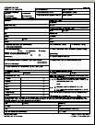
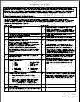
Grant Agreement Conditions of Award & Terms
Conditions of Award
All have first 2 conditions with additional conditions as needed
Terms and Conditions
Order of Precedence
Funding Opportunity Announcement (FOA) and Amendment (incorporated by reference)

Slide 42
Grant Agreement Terms
Indirect Cost Rates
FPO Contact Information
Equipment Requirements
Pre-Award Costs
Reporting Requirements
Consultant Fees
Publicity
Procurement
Audit Requirements
Intellectual Property

Slide 43
Grant Agreement Attachments
Attachment A: SF-424
Attachment B: SF-424A
Attachment C: Budget Narrative
Attachment D: Statement of Work
Attachment E: Indirect Cost Rate Agreement (if applicable)

Slide 44
Terms– Equipment Purchases
Equipment purchases with a per unit acquisition cost of $5,000 or more, and a useful life of more than one year need prior approval from Grant Officer.
Submit a detailed equipment purchase list with descriptions of each item to your Federal Project Officer (FPO) for review.
Your FPO will review the items and submit the list for approval. A modification to your grant will be processed approving the equipment purchases.

Slide 45
Budget and Statement of Work
Budget Information
SF-424A
Budget Narrative
Grantee’s original proposal
Project Narrative
Abstract
Documentation of Employer Commitment
Documentation of Commitment to Participate in an Evaluation
Organization Chart
Performance Outcomes Table

Slide 46
Indirect Cost Rate Agreement
Only applicable to those claiming indirect costs
If grantee is claiming indirect costs but did not provide agreement, placed on 90-day temporary rate
Indirect cost spending limited to lesser of either 10% of total Personnel budget or total claimed indirect costs

Slide 47
SOW Review
SWFI Grantees
Conditions detailing potential issues in your SOW are included in your grant package
Review of SOW, budgets, other attachments
45 days to respond
Assistance from FPO, DSI, and OGM
Review of Program Outcomes
Mathematical accuracy and benchmarks for years 1-4
45 days to respond
Assistance from FPO and DSI

Slide 48
Grant Modifications
What is a modification?
Why do a modification?
What are modification indicators?
FPO Modification Analysis
Reasonable
Performance
Best interest of the government

Slide 49
What is Grant Modification?
Mechanism to Change the Terms of the Grant Agreement

Slide 50
Why Do A Modification?
Change of Scope
{Very rare & only minor changes will be considered}
Program Design
Target population
Service Area
Change in Partners
Key Personnel Changes
Performance Outcomes
Outcome Measures

Slide 51
Why Do A Modification?
Budget Re-alignment
Transfer of fund among direct cost categories if cumulative amount of such transfer exceeds or expected to exceed 10%
Change in Period of Performance
Change Indirect Cost Rate
Change Authorized Representative
Equipment Purchases

Slide 52
FPO Modification Analysis
Grant Quality
Services
Staffing
Grant Efficiency
Timely
Cost Effective
Grant Performance
Enrollments
Expenditures

Slide 53
Required Documentation for Modification Requests
Must be submitted on Organization’s Letterhead
Must be signed by the Signatory Authority
Provide the purpose
Why it’s necessary
How the change will benefit the program
Appropriate documentation to support Modification

Slide 54
HOW TO SUBMIT A MODIFICATION?
ALL requests for modifications should be submitted to your FPO
The FPO will review and recommend approval to the Grant Officer

Slide 55
Questions?

Slide 56
Monica A. Evans Division of Strategic Investments ETA Office of Workforce Investments
Next Steps

Slide 57
Immediate Next Steps
Program Staff Contact Information
Send updated point of contact information to SWFI@dol.gov
Respond to Special Conditions in your Grant Award Package, as appropriate
Get started on DOL Fiscal Training Tutorials!
Get up to speed on DOL Performance Reporting

Slide 58
Next Steps – Upcoming TA (cont.)
Fiscal/Admin - SAVE THE DATE! September 15, 2016
Webinar: Overview of the Revised ETA-9130 Financial Reports and Instructions for Discretionary Grantees
Covers the Basic ETA 9130 Form, which will be the form used by SWFI grantees.
An email from WorkforceGPS should be coming out in the near future to register to attend this live Webinar event!
Performance Reporting – Coming soon!
Live Performance Reporting Overview and Quarterly Progress Report Training , including QPR Reporting System Orientation and Q&A
Evaluation Orientation– Coming soon!
Programmatic Technical Assistance & Grantee Convening – Coming soon!

Slide 59
Next Steps – Upcoming TA (cont.)
HOMEWORK! Get Started On Your Fiscal/Admin Online Training Series – Due Sept. 15!
Title | Description | Link
Cost Allocation and Cost Allocation Plans (CAPs) | This module covers the terms and requirements of the Uniform Guidance in relation to the allocation of costs to federal grants, and developing and using a Cost Allocation Plan (CAP). It distinguishes between the different types of costs and how each is allocated. | https://www.workforcegps.org/resources/2016/03/23/12/52/Cost_Allocation_and_Cost_Allocation_Plans_-CAPs
Indirect Costs and Indirect Cost Plans | This module covers the requirements of the Uniform Guidance and begins by distinguishing indirect from direct costs. The module distinguishes between the different types of federally approved rates, and explains when and how to apply for a federal rate. | https://www.workforcegps.org/resources/2016/03/23/14/07/Indirect_Costs_and_Indirect_Cost_Plans
Policies and Procedures for Federal Award Recipients | This module identifies the requirements of the Uniform Guidance in establishing written policies and procedures that promote sound management practices and effective management controls. | https://www.workforcegps.org/resources/2016/03/23/14/58/Policies_and_Procedures_for_Federal_Award_Recipients
Procurement and Performance-Based Contracts | This module focuses on the updated procurement standards in the Uniform Guidance. The presentation will begin with a focus on the changes to definitions in the new Uniform Guidance. | https://www.workforcegps.org/resources/2016/03/24/09/34/Procurement_and_Proformance-Based_Contacts
Personnel Compensation, Labor Distribution, and Payroll Reports | This module reviews the Uniform Guidance standards for allowable personal services and fringe benefit costs, and the methods for distributing payroll and fringe benefit expenses. | https://www.workforcegps.org/resources/2016/03/23/14/50/Personnel_Compensation_Labor_Distribution_and_Payroll_Reports

Slide 60
Grantee Polling Question
How do you feel after today’s webinar?
Choose the answer that best reflects you (or your group):
Geronimo!!!
Uh…SWFI or swiftly?
A little overwhelmed, but excited!

Slide 61
Resources
SWFI Abstracts: http://webapps.dol.gov/DOLGrantData/KeywordSearch.aspx?ContentPlaceHolder1_txtSearch=foa-eta-16-05ETA
SWFI CoP: https://h1bskillstraining.workforcegps.org
SWFI Grantee Orientation Webinar Series: https://h1bskillstraining.workforcegps.org/resources/2016/08/09/16/09/H-1B-SWFI-GRANTEE-ORIENTATION-WEBINAR-SERIES
Grantee Orientation Handbook: https://ina.workforcegps.org/blog/general/2016/07/26/15/30/DOL-Grantee-Orientation-Handbook
Your FPO!

Slide 62
Please enter your questions in the Chat Room!

Slide 63
Thank You!
Find resources for workforce system success at:
https://www.workforcegps.org/

