Slide 3
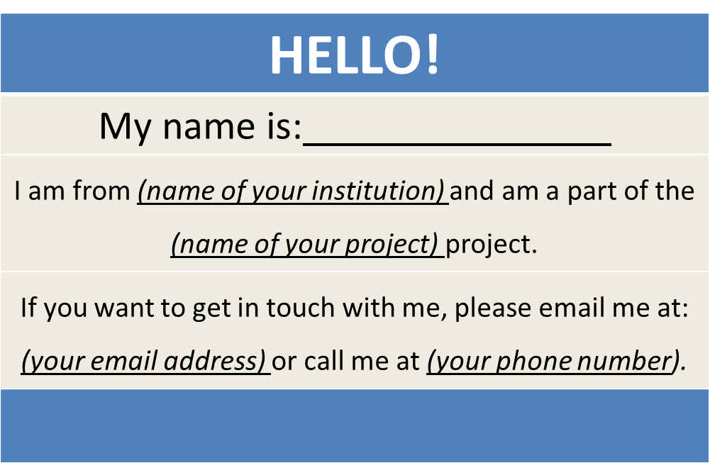
TechHire Grantees
Create a virtual name tag…

Slide 4
H1-B TechHire Partnership Grants
Jumpstarting your H-1B TechHire Grant Program: Grantee Orientation Webinar
DOL ETA
Division of Strategic Investments

Slide 5
Department of Labor
Employment and Training Administration
Division of Strategic Investments
Robin Fernkas, Division Chief, U.S. Department of Labor, Employment and Training Administration
Megan Baird, Program Manager H-1B grants, U.S. Department of Labor, Employment and Training Administration
Caroline Hertel, Workforce Analyst, U.S. Department of Labor, Employment and Training Administration
Moderator(s): Ayreen Cadwallader, Workforce Analyst, U.S. Department of Labor, Employment and Training Administration

Slide 6
Melissa Abdullah
Grant Officer, U.S. Dept. of Labor
Aiyana Pucci, Grants Specialist, U.S. Department of Labor, Employment and Training Administration
Adrian Barrett
Federal Project Officer
ETA Region 3 - Atlanta

Slide 7

Today’s Agenda
Welcome to ETA!
Introductions
Program Overview
Grant Package
Communication Plan
Reporting Requirements
Next Steps

Slide 8
Introductions
Department of Labor, Employment and Training Administration (ETA)
National Office
  Program Office – Division of Strategic Investments (DSI)
  Grant Office – Office of Grants Management (OGM)
  Chief Evaluation Office (CEO)
Regional Office
  Federal Project Officer (FPO)

Slide 9
DOL National Office:
Division of Strategic Investments (DSI)
The Program Office has several functions:
  Supports Federal Project Officers (FPOs)
  Provides Policy Clarification and Guidance
  Provides Technical Assistance (“TA”)
      Together with an external TA provider
  Creates peer learning opportunities
  Collects performance data
  Reviews some grant modifications
  Periodically requests additional information about your grant

Slide 10
DOL National Office
Technical Assistance
Technical Assistance (TA) Provision
DOL will be procuring a TA provider (in addition to TA provided by the National and Regional Offices).
Functions include:
  General technical assistance to all grantees on topics such as outreach and recruitment, employer engagement, and job placement.
  Customized TA, including large and small group, to grantees identified in need of one-on-one support
Coming Soon!

Slide 11
DOL National Office
Office of Grants Management (OGM)
The Grant Officer performs official grant duties:
Maintains official grant documents such as modifications, no-cost extensions, and other relevant documents
Approves all purchases over $5,000
ETA Grant Officer: Melissa Abdullah
TechHire Specialist: Aiyana Pucci
The Office of Grants Management (OGM) also provides guidance on policy issues and training on fiscal and administrative requirements.

Slide 12
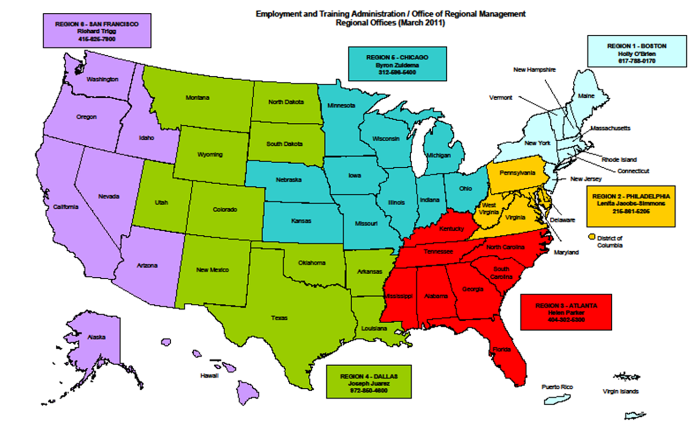
Regional Office Role

Slide 13
DOL Chief Evaluation Office
  Evaluating Successful TechHire Strategies
  Conduct the TechHire national evaluation
  Oversight of Evaluation Contractors: Committed to producing strong evidence
Next Steps:
We will be reaching out to grantees in the near future to tell you more about the evaluation and to learn more about your programs.

Slide 14

Grantee Polling Question
Is this your first ETA grant?
Choose the answer that best reflects you (or your project):
Yes
No

Slide 15
Grantee Polling Question
If this isn’t your first ETA grant, what grant do you currently or previously manage?
Choose the answer that best reflects you (or your project):
H-1B Grants: TST, Jobs Accelerator, Make it in America, or Ready to Work, Youth CareerConnect
Trade Adjustment Assistance Community College and Career Training (TAACCCT) Grant Program
American Apprenticeship Grants
YouthBuild or Other Youth Programs
Recovery and Reinvestment Act Grants: State Energy Sector Partnerships, High Wage High Growth, Community Based Job Training Grants

Slide 16
Megan Baird
Program Manager
H-1B Grants
Program Overview

Slide 17
TechHire Program Overview
President’s TechHire Initiative
DOL TechHire Grant Objectives:
  Expand access to accelerated learning strategies that provide the fastest paths to good jobs;
  Improve the likelihood that the TechHire Target populations complete training and enter employment;
  Connect those who received training or have the skills to employment, paid internships, or Registered Apprenticeship opportunities.

Slide 18

Overview of Grantees
DOL awarded nearly $150 million
39 public and private partnerships
  Located across 25 states, 4 of these projects are multi-state projects
  Awards range from $2.1 million to $5 million
Period of performance is 48 months
  Grant start date: July 1, 2016
  Grant end date: June 30, 2020

Slide 19

H-1B TechHire Grantees

Slide 20
H-1B TechHire Grantees and Communities

Slide 21
Overview of Grantees

Slide 22
Target Populations
TechHire Grants will serve
Youth and young adults, ages 17 – 29, with barriers to training and employment
Special populations with barriers to training and employment
  Individuals with disabilities,
  Individuals with limited English proficiency, or
  Individuals with a criminal record.
Also includes individuals who are underemployed, LTU, incumbent workers, with special focus on veterans, women, black and Latino populations

Slide 23
Target Populations Requirements
Target Population | Percent of Project Participants from the Target Population | Percent of Project Participants from Other Populations
1. Youth and Young Adults with Barriers to Training and Employment (ages 17-29) | 75% Required | 25% may be: other unemployed and underemployed workers who can benefit from the services offered, and/or incumbent workers, particularly front-line, lower-skilled, and lower-wage workers who need training to upgrade their skills
2. Special Populations with Barriers to Training and Employment | 50% Required | 50% may be: unemployed and underemployed workers in need of employment and training assistance, or incumbent workers, particularly front-line, lower-skilled, and lower-wage workers who need training to upgrade their skills No more than 25% of the participants served may be incumbent front-line workers

Slide 24
Grantee Polling Question
Who is the Target Population that you are Serving?
Choose the answer that best reflects you (or your project):
Youth and Young Adults (ages 17-29) with Barriers to Training and Employment
Special Population: Individuals with Limited English Proficiency
Special Population: Individuals with Disabilities
Special Population: Individuals with Prior Criminal Records

Slide 25
Program Overview
TechHire Training Strategies
On-the-Job Training (OJT) (19)
Paid Work Experience and Internships (22)
Bootcamps (19)
Registered Apprenticeships (5)
Incumbent Worker Training

Slide 26
Grantee Polling Question
Who is your training provider?
Choose the answer that best reflects you (or your project):
Community College or Technical College Partner
Tech Industry-based Training Provider
Manufacturing Industry-based Training Provider

Slide 27
Program Overview
TechHire Activities and Service Strategies
Supportive Services
  Activities that will allow individuals to participate in the training provided through the grant.
Specialized Services
  Activities that will facilitate successful completion of education/training activities and job placement to become employed.
Question! Can participants receive a combination of services while enrolled in the grant-funded training?
Notes:
check in with your FPO if you have any further questions!

Slide 28
Grantee Polling Question
What is the most important service that you are providing to ensure participants complete the training they need in order to achieve successful employment placement outcomes?
Choose the answer that best reflects you (or your project):
Networking and Industry Events
Mentoring, Job Coaching and Job Search Assistance
Financial Counseling
Mental Health Counseling
Housing Assistance or Relocation Assistance
Child Care or Dependent Care
Transportation

Slide 30
Melissa Abdullah, Grant Officer and Aiyana Pucci, Grant Specialist
ETA Office of Grants Management
Grant Award Package

Slide 31

The Grant Award
Grant Award Letter
Grant Agreement -
Signature Page / Notice of Obligation (NOO)
Condition of Award Page
Terms and Conditions
Application for Federal Assistance
Budget
Statement of Work (SOW)
Indirect Cost Rate Agreement (if applicable)

Slide 32

Grant Award Letter
Acknowledgements of Award
Payment Management System
  Information and forms on www.doleta.gov/grants under Payment Information
ETA’s on-line Grantee Fiscal Reporting System
  ETA 9130
  Information to access system on www.doleta.gov/grants under Financial Reporting
Passwords/PINs are sent separately after supplying the necessary information
Once you receive this please DO NOT LOSE IT!

Slide 33
Grant Agreement Notice of Award (NOA)
Grant Program – H-1B TechHire Partnership Grants
Grant Awardees' Identifying Information
DOL Identifying Information
  Agreement # HG-293XX-16-60-A-XX
Period of Performance
Award Amount
Regulations and Cost Principles
Signatures

Slide 34
Notice of Award
Cost Principles and Administrative Requirements
2 CFR Part 200
  Cost Principles
  Uniform Administrative Requirements
2 CFR Part 2900
  DOL Exceptions
Other Requirements in the NOA
  Condition of Award
  Federal Award Terms

Slide 35
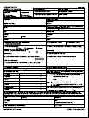
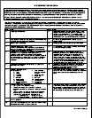
Grant Agreement
Condition of Award & Terms and Conditions
Condition of Award
All have the first conditions with additional conditions as needed
Terms and Conditions
Order of Precedence
Funding Opportunity Announcement (FOA) and Amendments (incorporated by reference)

Slide 36
Grant Agreement Terms and Conditions
Indirect Cost Rates
FPO Contact Information
Equipment Requirements
Pre-Award Costs
Reporting Requirements
Consultant Fees
Publicity
Procurement
Audit Requirements
Intellectual Property

Slide 37
Terms and Conditions – Equipment Purchases
  Equipment purchases with a per unit acquisition cost of $5,000 or more, and a useful life of more than one year need prior approval from Grant Officer.
  Submit a detailed equipment purchase list with descriptions of each item to your Federal Project Officer (FPO) for review. We encourage you to submit this request as early as possible in the period of performance, with as many planned pieces of equipment as possible.
  Your FPO will review the items and submit the list for approval. A modification to your grant will be processed approving the equipment purchases.

Slide 38
Grant Agreement Attachments
Attachment A: SF-424
Attachment B: SF-424A
Attachment C: Budget Narrative
Attachment D: Statement of Work
Attachment E: Indirect Cost Rate Agreement (if applicable)

Slide 39
Budget and Statement of Work
Budget Information
  SF-424A
  Budget Narrative
Grantee’s original proposal
  Technical Proposal
  Abstract
  Documentation of Employer Commitment
  Performance Outcomes Table
  Documentation of Commitment to Participate in an Evaluation
  Organization Chart
  Evidence of Program Design (above $ million)
  Career Pathways Overview

Slide 40
Indirect Cost Rate Agreement
Only applicable to those claiming indirect costs
If grantee is claiming indirect costs but did not provide agreement, placed on 90-day temporary rate
Indirect cost spending limited to lesser of either 10% of total Personnel budget or total claimed indirect costs
Organizations that have never received a NICRA can use the de minimis rate
  10% of Modified Total Direct Costs (MTDC) defined at 2 CFR 200.68

Slide 41
SOW Review
  TechHire grantees
  Conditions detailing potential issues in your SOW are included in your grant package
Review of SOW, budgets, other attachments
  45 days to respond
  Assistance from FPO, DSI, and OGM
Review of Program Outcomes
  Mathematical accuracy and benchmarks for years 1-4
  45 days to respond
  Assistance from FPO and DSI

Slide 42
Grant Modifications
What is a modification
Why requires a modification
Modification Analysis
  Reasonable
  Performance
  Best Interest of the Government

Slide 43
What is a modification?
A change to your grant agreement requires a modification
What requires a modification:
  Change to SOW
  Budget Realignment
  Change in Authorized Signatory or Address
  Changes to ICRA/incorporation of ICRA
  Period of Performance Extension
  Purchase of Equipment

Slide 44
Modification Process
Formal letter of request addressed to your Grant Officer
  Should include modification type, grant name and number, and justification for requested modification
  Send a draft to your FPO
  FPO will review and provide feedback
Submit final letter, signed by your signatory to FPO
  FPO will forward to Grant Officer

Slide 45
Modification Analysis
FPOs review modifications
  Regional management team approves and sends to Grant Officer for final review
Certain SOW modifications require review by Program Office
Grant Officer gives final approval
  Grantee receives copy of modification signed by Grant Officer

Slide 47
Ayreen Cadwallader
Division of Strategic Investments
ETA Office of Workforce Investments
Reporting Requirements

Slide 48
The Value of Performance Reporting
Performance data is used to
Illustrate Success
Ensure Sustainability and Evaluate Effectiveness
Continuous improvement
Identify Areas for Opportunity
Identify Areas for Technical Assistance
Great Programs + Great Data + Great Outcomes =
Greater Success for American Workers!

Slide 49

H-1B Reporting Requirements
TechHire grantees are required to submit quarterly reports ETA:
Quarterly Financial Reports
Quarterly Progress Reports
  Quarterly Performance Report (QPR)
  Quarterly Narrative Report (QNR)
Final Report due at the end of the grant

Slide 50
Quarterly Progress Report
Each grantee must submit a Quarterly Progress Report
  Due no later than 45 days after the end of a quarter
  More information and training will be provided
Quarter End Date | Progress Report Due Date | Report Activities Occurring Between
September 30, 2016 | November 14, 2016 | July 1 – September 30, 2016
December 31, 2016 | February 14, 2017 | October 1 – December 31, 2016
March 31, 2017 | May 15, 2017 | January 1 – March 31, 2017
June 30, 2017 | August 14, 2017 | April 1 – June 30, 2017
Your 1st QPR is due no later than November 14, 2016
Covers activities beginning July 1, 2016 through September 30,2016

Slide 51
Quarterly Progress Reports
Submitting Progress Reports to ETA
Submitted through a web-based reporting system
In preparation, grantees should prepare to collect and track participant-level data on demographic information, services and training received, credential outcomes, and employment and employment retention information.
  This includes providing participant SSNs, which will be used by ETA to track and report long-term employment outcome measures (ETA Common Measures)
  Please ensure you follow PII protocol.

Slide 52
Interim Reporting Process: Submitting 9.30.2016 QPRs to ETA
Until the ETA reporting system is completed, grantees will follow an interim reporting process.
  This process applies to your first QPR, for the quarter ending September 30, 2016
  We anticipate the ETA reporting system will be available for grantees to submit participant-level data to ETA beginning with the QPR due for the quarter ending 12.31.2016.
Grantees will NOT submit participant data to ETA
  However, grantees must still collect participant-level data as it aligns with the required reporting elements for all participants served as of the start of the grant. Grantee will report cumulative data for all participants served once the reporting system is available.
Grantees will submit a quarterly Narrative Report (QNR) to ETA, via email
  QNRs should be email to your FPO with a cc to TechHire@dol.gov, no later that the reporting deadline of November 14, 2016

Slide 53
Important Links to DOL Performance Reporting
DOL ETA Performance Reporting Website
https://doleta.gov/performance/reporting/eta_default.cfm
DOL-only Performance Accountability, Information, and Reporting System - OMB Control No. 1205-0521
  (PIRL): H-1B Data Elements for participant level data collection and tracking is provided here: https://doleta.gov/performance/pfdocs/ETA-9172_DOL%20PIRL_FINAL_V25_062816.pdf
More to Come!
Detailed Interim Reporting Guidance
H-1B Performance Reporting Technical Assistance

Slide 54
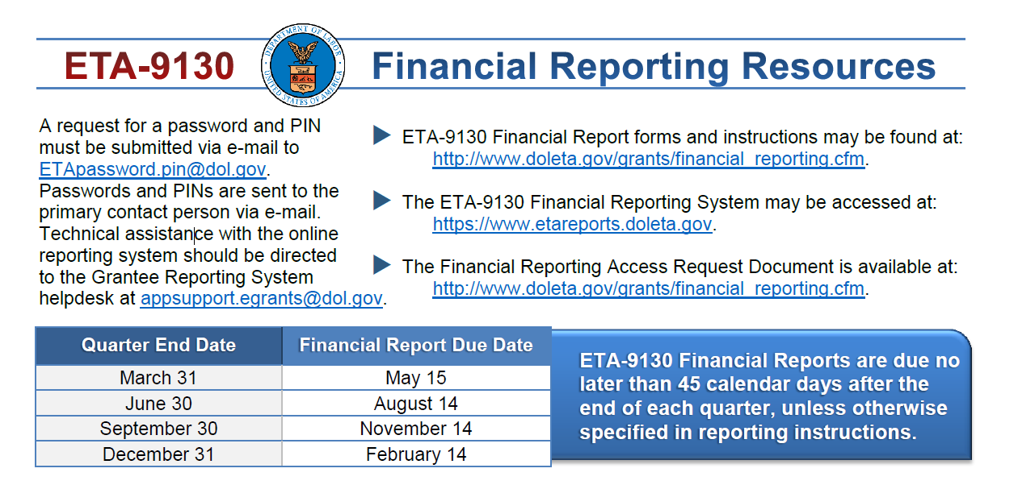
DOL Quarterly Financial Report
Each grantee must submit a Quarterly Financial Report (ETA 9130)
Financial reporting system different than performance reporting system
Due no later than 45 days after the end of a quarter
https://www.doleta.gov/grants/financial_reporting.cfm
Your 1st 9130 is due no later than Nov. 14, 2016 and covers activities beginning July 1 through September 30, 2016.

Slide 55
Important Links to DOL Financial Reporting Resources
DOL ETA Financial Reporting Website
https://www.doleta.gov/grants/financial_reporting.cfm
Uniform Administrative Requirements
https://www.doleta.gov/grants/UniformGuidance.cfm
TRAINING AND EMPLOYMENT GUIDANCE LETTER No. 15-14: ETA Implementation of New Uniform Guidance
http://wdr.doleta.gov/directives/corr_doc.cfm?DOCN=5740
DOL ETA Grant Resources
https://www.doleta.gov/grants/resources.cfm

Slide 56
Key Dates
Grant Start Date | July 1, 2016
1st Progress Report Due Date Performance report and narrative | November 14, 2016
1st ETA Financial Report Due Date Financial report (9130) | November 14, 2016
Grant End Date | June 30, 2020

Slide 58
Caroline Hertel Division of Strategic Investments
ETA Office of Workforce Investments
Communication Plan

Slide 59
Communication Plan
From: ETA, To: You
Usually through your FPO for specific requests and information
TechHire mailbox for general requests and information
WGPS Community of Practice: https://h1bskillstraining.workforcegps.org/
ETA Website: www.doleta.gov/techhire
From: You, To: ETA (National Office)
Contact your FPO first
Copy the TechHire Mailbox: TechHire@dol.gov, if appropriate
Remember
Include your grant number and lead grantee organization name
Describe your question/issue as specifically as possible
Please be patient!

Slide 60

Grantee Team Communications & Support
Main Point of Contact (POC)
Receives communication from ETA
Responsible for sharing information with project team and consortium members
Any time the main point of contact for your grant changes, please remember to alert your Federal Project Officer (FPO) and National Office staff
Note: Changing signature authority requires a formal grant modification

Slide 61
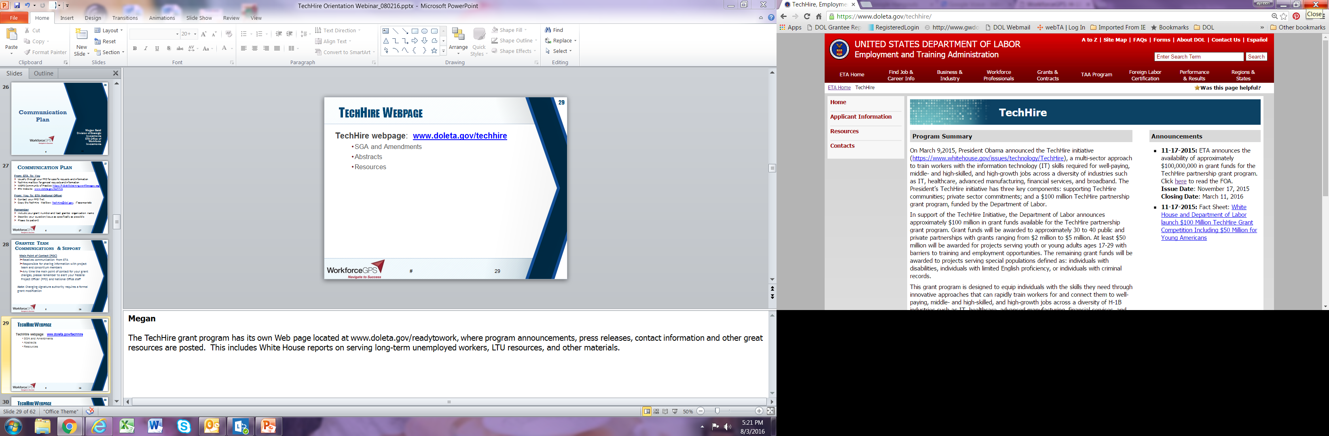
TechHire Webpage
TechHire webpage: www.doleta.gov/techhire
SGA and Amendments
Abstracts
Resources

Slide 62
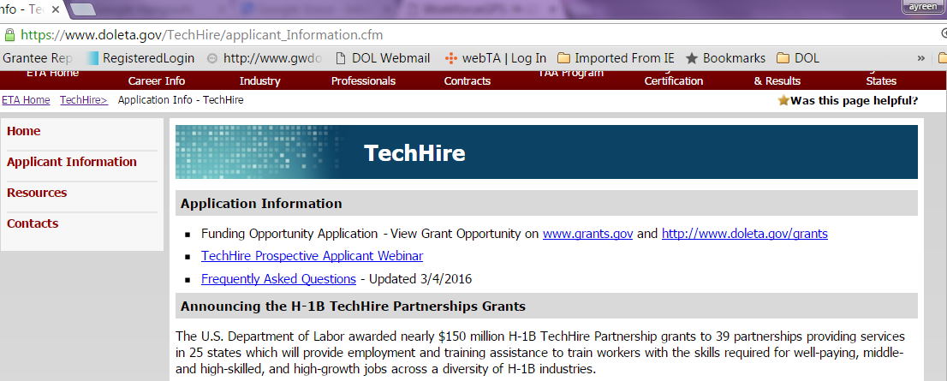
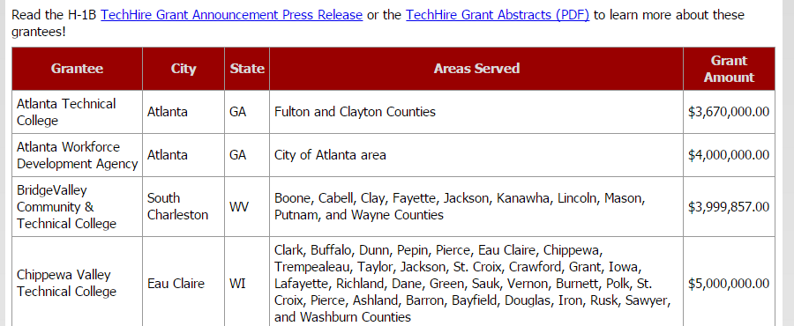
TechHire Webpage
Check out your fellow TechHire grantees !

Slide 63
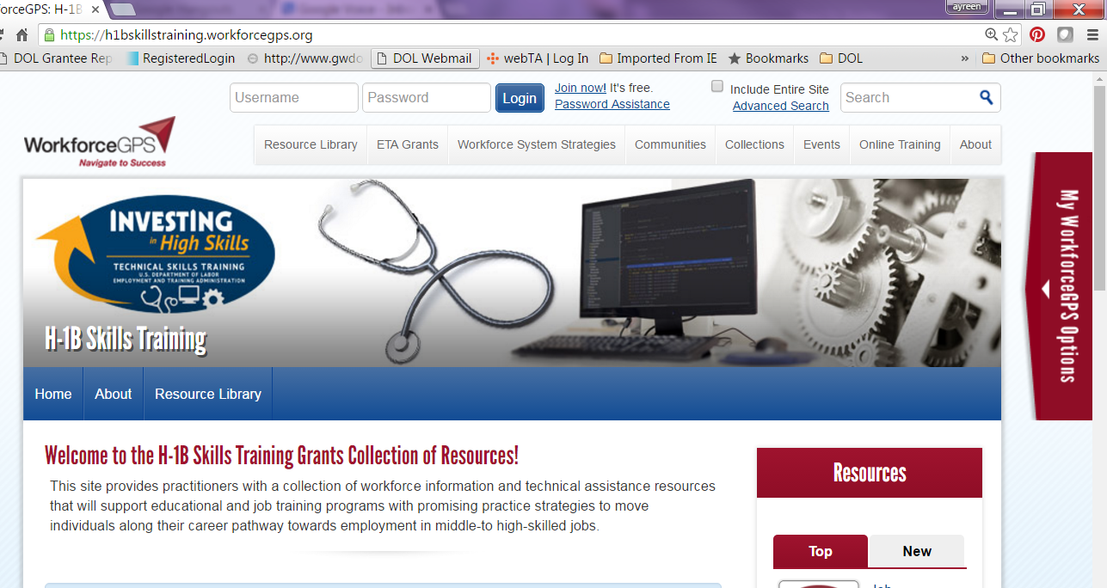
WorkforceGPS Collection Site
H-1B Skills Training Collection Site
https://h1bskillstraining.workforcegps.org

Slide 64
Communication Plan
Always contact your FPO first if you have questions!
If you… | Contact:
Are the grant lead | FPO
Are a member of a grant project | The lead for your grant
Have questions or difficulty accessing the performance reporting system | TechHire@dol.gov with a copy to your FPO
Have questions or difficulty accessing the financial reporting system | EBSS.help@dov.gov, with a copy to your FPO and TechHire@dol.gov
Have questions about evaluations | TechHire@dol.gov with a copy to your FPO

Slide 65
Megan Baird
Division of Strategic Investments
ETA Office of Workforce Investments
Next Steps

Slide 66

Immediate Next Steps
Redacted Technical Proposals
Respond to Special Conditions in your Grant Award Package, as appropriate
  Please send updated Contact Staff, your Redacted Technical Proposals (if applicable), and your Special Conditions Response to TechHire@dol.gov
Program Staff Contact Information
Get started on DOL Fiscal Training Tutorials!
Get up to speed on DOL Performance Reporting

Slide 67
Next Steps – Upcoming Technical Assistance
      Fiscal/Admin - SAVE THE DATE! September 15, 2016
      Webinar: Overview of the Revised ETA-9130 Financial Reports and Instructions for Discretionary Grantees
        Covers the Basic ETA 9130 Form, which will be the form used by TechHire grantees.
        An email from WorkforceGPS should be coming out in the near future to register to attend this live Webinar event!
      Performance Reporting – coming soon!
      Live Performance Reporting Overview and Quarterly Progress Report Training , including QPR Reporting System Orientation and Q&A
      Evaluation Orientatio – coming soon!
      Programmatic Technical Assistance & Grantee Convening – coming soon!

Slide 68
Next Steps – Upcoming Technical Assistance
HOMEWORK! Get Started On Your Fiscal/Admin Online Training Series – Due Sept. 15!
ID | Topic | Title | Event type | Link | Review By Date
1 | Program Orientation | TechHire New Grantee Orientation “Jumpstarting your H-1B TechHire Grant Program: New Grantee Orientation” | Live Webinar | Webinar Platform: https://www.workforcegps.org/events/2016/06/29/14/37/Jumpstarting_your_H-1B_TechHire_Grant_Program-_New_Grantee_Orientation | August 30, 2016
4 | Fiscal/Admin | Cost Allocation and Cost Allocation Plans (CAPs) | Pre-Recorded Tutorial | https://www.workforcegps.org/resources/2016/03/23/12/52/Cost_Allocation_and_Cost_Allocation_Plans_-CAPs | September 15, 2016
5 | Fiscal/Admin | Indirect Costs and Indirect Cost Plans | Pre-Recorded Tutorial | https://www.workforcegps.org/resources/2016/03/23/14/07/Indirect_Costs_and_Indirect_Cost_Plans | September 15, 2016
6 | Fiscal/Admin | Policies and Procedures for Federal Award Recipients | Pre-Recorded Tutorial | https://www.workforcegps.org/resources/2016/03/23/14/58/Policies_and_Procedures_for_Federal_Award_Recipients | September 15, 2016
7 | Fiscal/Admin | Procurement and Performance-Based Contracts | Pre-Recorded Tutorial | https://www.workforcegps.org/resources/2016/03/24/09/34/Procurement_and_Proformance-Based_Contacts | September 15, 2016
8 | Fiscal/Admin | Personnel Compensation, Labor Distribution, and Payroll Reports | Pre-Recorded Tutorial | https://www.workforcegps.org/resources/2016/03/23/14/50/Personnel_Compensation_Labor_Distribution_and_Payroll_Reports | September 15, 2016

Slide 69
Grantee Polling Question
How do you feel after today’s webinar?
Choose the answer that best reflects you (or your group):
Geronimo! We are ready to jumpstart our program!
TechHire What?!…We still have a few more questions!
A little overwhelmed, but excited!

Slide 70
Resources
TechHire webpage: www.doleta.gov/techhire
Workforce GPS: H-1B Skills Training Collection Site: https://h1bskillstraining.workforcegps.org/resources
DOL ETA Performance Reporting Website: https://doleta.gov/performance/reporting/eta_default.cfm
DOL-only Performance Accountability, Information, and Reporting System - OMB Control No. 1205-0521 (PIRL): H-1B Data Elements for participant level data collection and tracking: https://doleta.gov/performance/pfdocs/ETA-9172_DOL%20PIRL_FINAL_V25_062816.pdf
Grantee Orientation Handbook https://ina.workforcegps.org/blog/general/2016/07/26/15/30/DOL-Grantee-Orientation-Handbook
DOL ETA Financial Reporting Website: https://www.doleta.gov/grants/financial_reporting.cfm
Uniform Administrative Requirements: https://www.doleta.gov/grants/UniformGuidance.cfm
TRAINING AND EMPLOYMENT GUIDANCE LETTER No. 15-14: ETA Implementation of New Uniform Guidance: http://wdr.doleta.gov/directives/corr_doc.cfm?DOCN=5740
DOL ETA Grant Resources: https://www.doleta.gov/grants/resources.cfm
ETA’s on-line Grantee Fiscal Reporting System (ETA 9130 Information): www.doleta.gov/grants

Slide 71
TechHire Grantee Mailbox
TechHire@dol.gov
To Reach your Federal Project Officer, DOL National Office and Technical Assistance Providers

Slide 73
“These partnerships are clearing important pathways for communities to develop talent and facilitate growth. And it is especially heartening to see these resources being leveraged to create opportunities for at-risk and disadvantaged youth and other special populations.”
- President Barack Obama

