Slide 2
Registered Apprenticeship
Supporting WIOA Implementation with High Impact
August 31, 2016
USDOL/ETA Office of Apprenticeship
USDOL/ETA Office of Workforce Investment

Slide 4

Maria R. Brady
  Multi-State Navigator
  ETA Office of Apprenticeship
  Region 4 – Dallas, TX

Slide 5
Identify five key “touchpoints” that exist in WIOA in terms of registered apprenticeship
Understand different ways to fund/support Registered Apprenticeship (RA) programs
Identify model elements of an ETPL policy (Eligible Training Provider List)
Highlight opportunities to improve WIOA performance
Understand enrollment and exit options
Stimulate action planning for improvement opportunities
Know where to go for additional information and support

Slide 6
What’s Registered Apprenticeship and What’s ApprenticeshipUSA?
  Quick Overview of Recorded Session
WIOA and Registered Apprenticeship
Five “Touchpoints” in WIOA
Tools and Resources

Slide 7
What’s Registered Apprenticeship and What’s ApprenticeshipUSA?
Quick Overview of Recorded Session

Slide 8
Is There A Definition?
Official Definition | Another Take On It
A structured occupational training program that combines on-the-job training and related instruction in which workers learn the practical and conceptual skills required for a skilled occupation, craft or trade | The best kept secret in talent development The “other” credential A strategic approach for human resource professionals to create a pipeline of skilled workers Likely the most underutilized strategy in our suite of workforce services

Slide 9

Many Myths Surround Registered Apprenticeship – Focus on Facts
  Registered Apprenticeship is more than the construction trades
  It’s not just a second chance system
  It’s not inconsistent with a college degree
  There IS a future and pathway to the middle class
  It’s not outdated, outmoded or outlasted its usefulness—it works!
  There are numerous opportunities across the USA
  Programs are not just time-based, but competency-based and hybrid as well

Slide 10
5 Components of Any
Registered Program
Employer Involvement
  Programs start with employer needs; employers are the foundation for the program
Structured and Supervised OJT
  Provided by employer; competencies are attained through On-the-Job Training; minimum of 2000 hours
Related Training and Instruction
  Called the “RTI” – the classroom training portion or associated curriculum (144 hours per year recommended)
Rewards for Skill Gains
  Progressive wage increases commensurate with increase in proficiency
National Occupational Credential
  RA Completion Certificate is a recognized post-secondary credential under WIOA (Section 3(52)); stackable and portable

Slide 11
The Players – Flexibility is Key
1
2
3
4
Program Sponsor | Employer(s) | Provider of RTI | Workforce System
Responsible for administering the program (they do the paperwork and data entry) Can be the employer or another entity or intermediary such as a community college | Provider of OJT Often the program sponsor Can be group of employers Foundation and driver of the program | Can be employer, community college, joint apprenticeship training committee, or other entity | Multiple opportunities for the workforce system to partner with programs – both before and after an individual becomes an apprentice

Slide 12

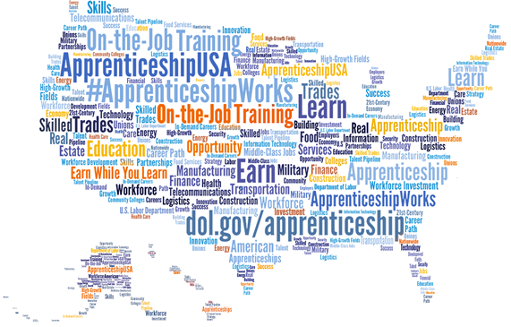
National Branding

Slide 13
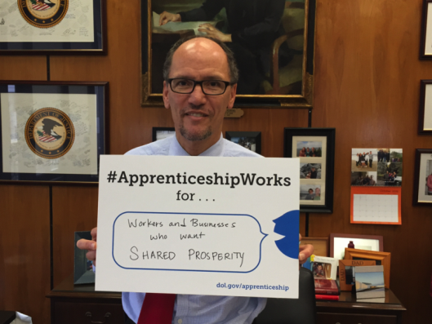



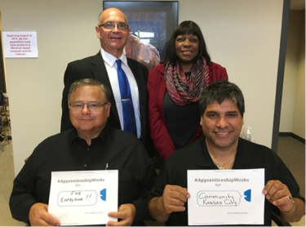
First-Ever National
Apprenticeship Week
NAW 2015
  November 2-8, 2015
  Presidential Proclamation
  Multiple Gubernatorial Proclamations
  More than 300 events!

Slide 14
WIOA and Registered Apprenticeship

Slide 15
RA Provisions in WIOA
OPPORTUNITY | SECTION OF WIOA
RA as recognized post-secondary credential | Section 3(52)
RA on State Workforce Board | Section 101(b)(1)(C)(ii)(II)
RA on Local Workforce Board | Section 107(b)(2)(B)(ii)
RA on Eligible Training Provider List | Section 122(a)(2)(B) and (3)
Pre-apprenticeship as Youth program service | Section 129(c)(2)(C)(ii)
RA as career pathway for Job Corps | Section 141(1)(A)(ii) and Section 148(a)(2)(B)
Pre-apprenticeship/RA for YouthBuild | Section 171(c)(2)(A)(i)

Slide 16

Translating Provisions into Action
Integrate Registered Apprenticeship (RA) into workforce planning and policy
Promote work-based learning and use WIOA resources to support RA
Create new RA opportunities by focusing on services to employers
Support career pathways for youth
Generate real results and positively impact state and local performance

Slide 17
Taking a Step Back:
Workforce System Engagement
From a 2008 study by Planmatics:
  “Interviews with representatives of [One-Stop Centers in several states], as well as comments of sponsors and apprentices, indicated there was very limited coordination and virtually no integration between the Registered Apprenticeship and the One-Stop System.”
What do current data indicate?
  National WIASRD* data (rolling four quarters)
    Qtr ending 6/30/15 – 12 states reporting activity
    Qtr ending 9/30/15 – 14 states reporting activity
    Qtr ending 12/31/15 – 18 states reporting activity
* WIASRD=Workforce Investment Act Standardized Record Data

Slide 18


WIOA “Touchpoints”
Five Key Points of Intersection between WIOA and Registered Apprenticeship
  Funding Support for RA
  ETPs and ETP Lists
  Performance Outcomes
  Board Membership
  State and Local Plans

Slide 19
Polling Question #1
Which of the following statements is TRUE?
Registered Apprenticeship (RA) programs had automatic placement on eligible training provider lists under WIA
Having a RA representative on State and local boards was recommended under the Workforce Investment Act (WIA) but required under WIOA
Pre-apprenticeship was a youth program element under WIA and is part of a youth program element under WIOA
B and C

Slide 20

Five “Touchpoints” in WIOA
Funding Support for RA
ETPs and ETP Lists
Performance Outcomes
Board Membership
State and Local Planning

Slide 21
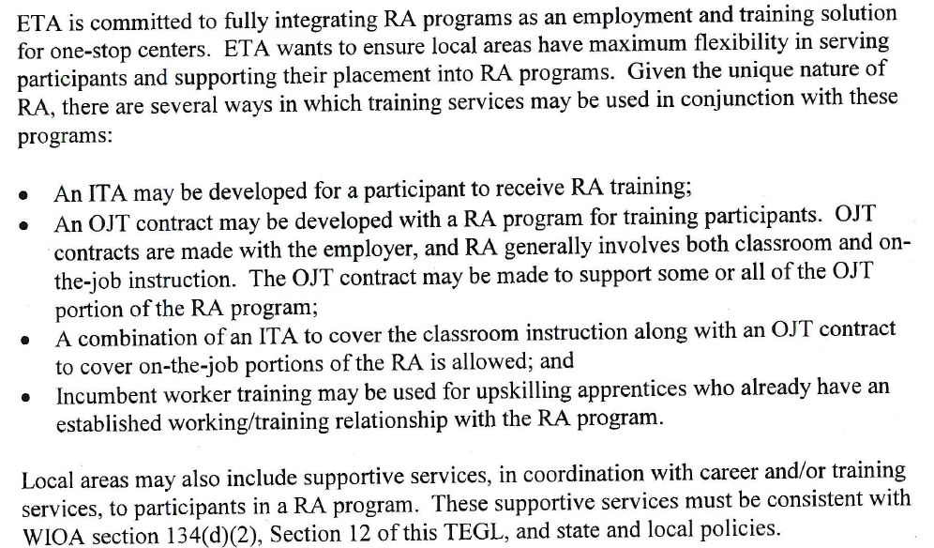
TEGL 3-15 (page 11) –
Clarifies what the workforce system can pay for

Slide 22
Think of it this way…
Supp. Svcs.
Can be paid for with formula funds for WIOA Adults, Dislocated Workers, Older Youth. Can also be funded by ITA if ITA used to support RTI.
OJT
Funded By Contract for WIOA Adults, Dislocated Workers, Older Youth
RTI
Supported with Individual Training Account or ITA; in order to use ITA, program must be on Eligible Training Provider List

Slide 23

Example of Workforce System
Engagement – Tulsa, OK
Training Director of Electrical JATC w/ RA Program
New apprentice cohort starting up August 2015
Many on selection list unable to afford $900 for initial tools and equipment
Interest in connecting with workforce for possible support but unsure how to proceed
Office of Apprenticeship Multi-State Navigator
Contacted by Tulsa JATC Training Director
Connected with Executive Director of Tulsa LWDB
Facilitated several 3-way dialogues to discuss ways to partner
Executive Director of Tulsa, OK LWDB
Interested but reluctant; desire to “start small”
15 WIOA-eligible Adults received $900 in supportive services
They were enrolled in WIOA in early August 2015 before becoming an apprentice
This was the first time workforce dollars supported a Registered Apprenticeship program in Oklahoma. The Executive Director of Tulsa is now a big supporter of RA.

Slide 24
Example of Workforce System
Engagement – Five LWDBs in CO
Employer With Pipeline/Training Needs
Large and well-known employer developing occupation unique to aerospace
External training not meeting all needs
Concern about talent pipeline
Economic/Workforce Development
Jefferson County LWDA approached in Fall 2015 by company
Business Services/ Economic Development Unit brought in 4 other LWDAs to develop regional plan
Office of Apprenticeship
State Director approached by regional partnership
Worked in collaboration with company to develop new Standards of Apprenticeship for first cohort in January 2016!
Standards approved 1/22/2016. Program was immediately placed on CO ETPL. First cohort consisted of 10 WIOA eligibles who received $5000 ITA.

Slide 25



About Pre-Apprenticeship
For Youth
  Part of Work Experience, which has 20% expenditure requirement (OJT also part of work experience)
  Can support 75% out-of-school youth requirement
For Adults
  Can be considered short-term pre-vocational training per TEGL 3-15
  Can also be considered individualized career services

Slide 26
Polling Question #2
You receive a voice mail message from a RA program sponsor expressing concern that they’re not on the statewide ETPL (Eligible Training Provider List) and, as a result, the workforce system will not be able to help apprentices in an upcoming class.
Why is the program sponsor making an incorrect assumption?
Because an Individual Training Account (ITA) could still be used to provide supportive services
Because an ITA could still be used to provide supportive services and/or support the OJT component
Because the ETPL pertains only to the RTI (Related Training and Instruction) component of a RA program
Because there are other components of the program that can still be supported
B and C
C and D

Slide 27

Five “Touchpoints” in WIOA
Funding Support for RA
ETPs and ETP Lists
Performance Outcomes
Board Membership
State and Local Planning

Slide 28
The Highlights
Registered Apprenticeship programs are automatically eligible to be included on statewide lists of eligible training providers
RA programs must indicate their agreement to be placed on the ETP list (they cannot ‘opt out’)
The intent is that registered apprenticeship programs would be included on every ETP list in the state
Why this is so important? Programs must be on the ETPL in order to take advantage of ITAs to support the RTI component

Slide 29
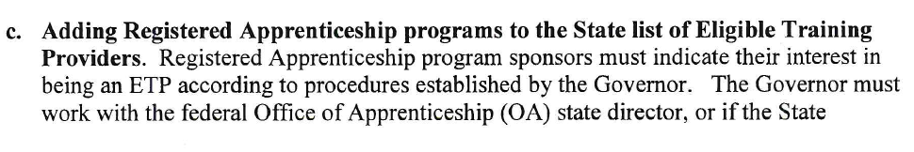
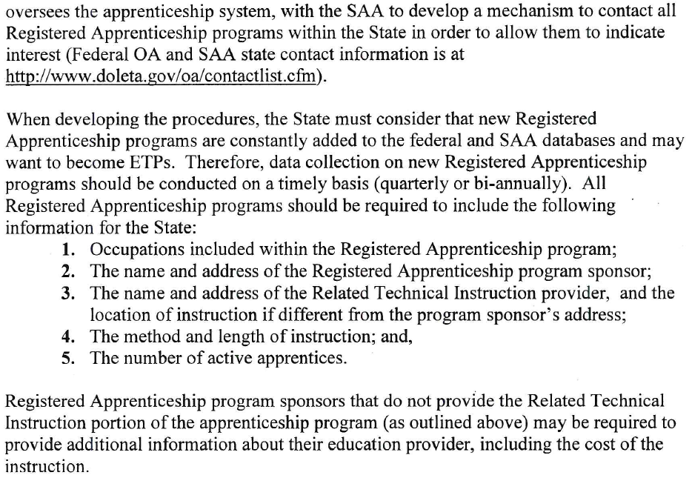
What WIOA Operating Guidance
Says (TEGL 41-14)
This verbiage is on bottom of page 8 and top of page 9 in TEGL 41-14

Slide 30

What’s Happening in Some Places
In some cases, states are not just requesting the information in TEGL 41-14 from sponsors
Hoops, Hoops, and more Hoops
  Not the intent
  In some states, however, the application process is cumbersome and local procedures add another layer of complication

Slide 31
ETPL Policies
Ideally, state policies would clearly specify the following for registered apprenticeship programs:
  No performance requirements
  No reporting requirements
  No cost requirements (unless the provider of RTI is different from sponsor)
  Rationale for exceptions
  Programs taking applications are in-demand occupations by default
  Programs will be on every ETP list across the state

Slide 32
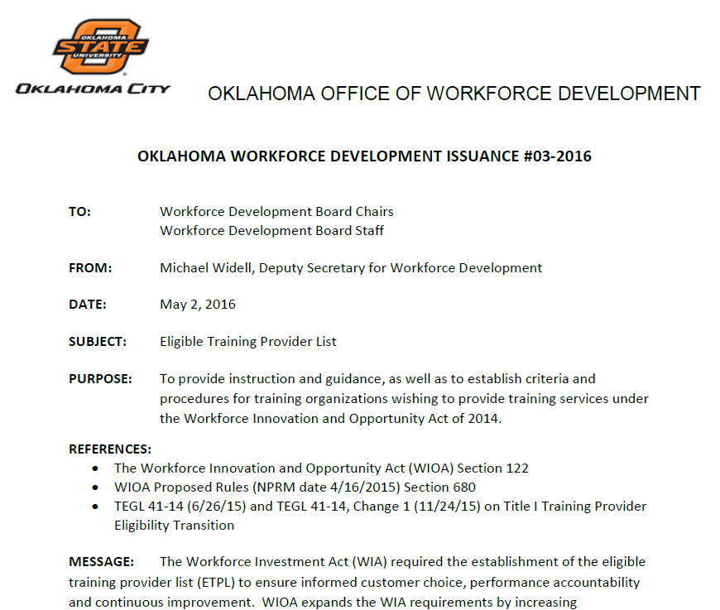

Oklahoma ETPL Policy
OWDI #03-2016 (5/2/16)
Available on-line at www.oklahomaworks.gov/policy-center
What makes this a model policy?

Slide 33
OK ETPL Policy Provisions
  “Registered Apprenticeship (RA) programs are exempt from performance and reporting-related requirements in order to enable these evidence-based programs to be placed on the statewide ETPL with minimal burden.”
“All Registered Apprenticeship openings listed on the ETPL will automatically be considered as a statewide demand occupation for as long as the opening(s) remain unfilled.”
“Note that Registered Apprenticeship programs, if openings for new apprentices exist in the local area, should automatically be considered in-demand training.”

Slide 34
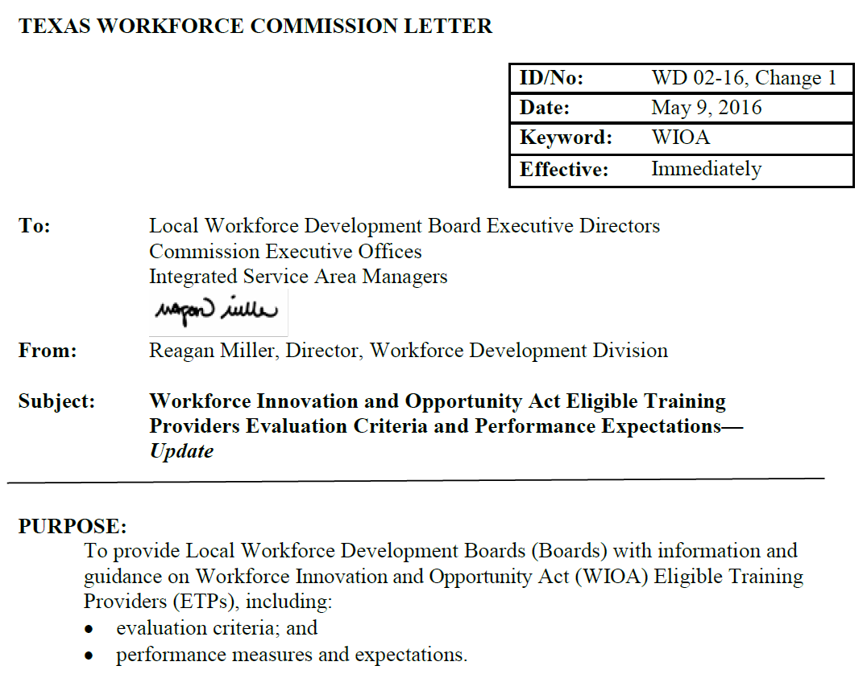

Texas ETPL Policy
WD 02-16, Ch. 1 (5/9/16)
Available on-line at
http://www.twc.state.tx.us/files/partners/02-16-ch1-twc.pdf and http://www.twc.state.tx.us/files/partners/02-16-ch1-att1-twc.pdf
What makes this a model policy?

Slide 35

TX ETPL Policy Provisions
  Says clearly that there are “no performance expectations for [RA] sponsors and training providers specifically to encourage their participation in order to facilitate engagement with the TX workforce system.”
  “Boards may establish additional criteria and require higher levels of performance of all training providers other than Registered Apprenticeship programs.”
  “The only ETP criterion that applies to apprenticeships is that they be registered as apprenticeship programs with DOL.”

Slide 36

A Note About Pre-Apprenticeship Programs and the ETPL
Pre-Apprenticeship Program – A program or set of services designed to prepare individuals (youth or adults) to enter and succeed in a Registered Apprenticeship (RA) program
Programs are not “registered” with USDOL
If a pre-apprenticeship is a training program that wants to be placed on the ETPL, they must follow regular application procedures

Slide 37
Polling Question #3
Which of the following statements from actual State policies are potentially problematic in terms of supporting Registered Apprenticeship consistent with statutory intent?
“There are minimal performance expectations for RA sponsors.”
“RA programs are subject to additional local requirements.”
“RA programs may qualify for ITAs if the occupation is a specified demand occupation in the local area.”
“All programs must fill out the following forms and submit to the State Workforce Agency.”
“Programs must have at least five apprentices in order to receive an ITA.”
Possible Answers:
2 and 4
2, 4 and 5
3 and 4
All are potentially problematic

Slide 38
Five “Touchpoints” in WIOA
Funding Support for RA
ETPs and ETP Lists
Performance Outcomes
Board Membership
State and Local Planning

Slide 39
About those WIOA Outcomes
Notwithstanding the publication of performance and reporting-related policy, Registered Apprenticeship is a win-win for all of the WIOA required metrics
  Employment in Q2 post-exit*
  Employment in Q4 post-exit
  Median Earnings in Q2 post-exit
  Measurable Skill Gains
  Credential Attainment
  Effectiveness in Serving Employers
* 2nd quarter after exit

Slide 40
More on WIOA Outcomes
Registered Apprenticeship is a job from day one
  WIOA Implication – Enroll eligible individuals before they become an apprentice to meet the low income priority; positive outcomes post-exit including higher earnings
RA Completion Certificate
  WIOA Implication – Recognized post-secondary credential; portable and stackable; not inconsistent with college degree; supports credential attainment rate if individual completes while enrolled or a year post-exit
Longer term RA programs
  WIOA Implication – Measurable skill gains; more strategic choices for workforce system engagement

Slide 41
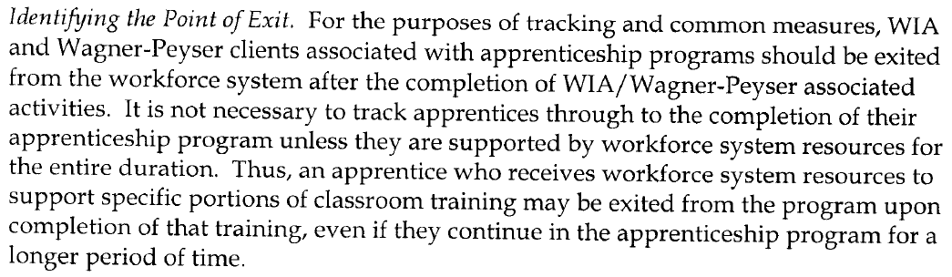
Another RA Myth:
This Pertains to “Exit”
“If it’s a five year program, I have to stay attached to these people for the full five years.”
  Not true. This was initially clarified in TEGL 2-07.
  Unless there’s a state policy that says otherwise, once WIOA is “done,” the individual can be allowed to exit

Slide 42
The Real Deal Regarding
WIOA Exit and Working with RA
Unless there’s a state policy stating otherwise, local staff can allow the individual to exit when WIOA is “done”
  Example: You’re supporting an apprentice through their largely front-loaded classroom training component (RTI); when the RTI is done, the individual can be allowed to exit
  Example: You will support 3 classes for the first semester of the RTI; allow exit after the first semester ends
Exit could be allowed to occur at the time of a scheduled wage increase
  Example: You supported a youth through a pre-apprenticeship program and your intent is to provide further support during their RA program participation through their first wage increase (or maybe their second)

Slide 43
Polling Question #4
A Local Board is supporting an apprentice only for the first year of a two-year registered apprenticeship program. Which of the following statements is TRUE?
Unless the program includes interim credentials, this will likely be a negative credential attainment rate outcome
If the Board is supporting only the OJT component, they can still take credit for credential attainment
The Board will be unable to take credit for the retention measure
This will be a negative outcome even without interim credentials

Slide 44
Five “Touchpoints” in WIOA
Funding Support for RA
ETPs and ETP Lists
Performance Outcomes
Board Membership
State and Local Planning

Slide 45
Requirements Specific to
Registered Apprenticeship
The State Board “shall include a representative, who shall be a member of a labor organization or a training director, from a joint labor-management apprenticeship program, or if no such joint program exists in the State, such a representative of an apprenticeship program in the State;”
The Local Board “shall include a representative, who shall be a member of a labor organization or a training director, from a joint labor-management apprenticeship program, or if no such joint program exists in the area, such a representative of an apprenticeship program in the area, if such a program exists;”
…unless there’s a grandfathered board

Slide 46

Functions of State Board
(Sec. 101(d))
State Plan
Review of statewide policies to support alignment
Development/continuous improvement of workforce system
Performance accountability metrics
Identify/disseminate info on best practices
Development/review of statewide policies
Development of strategies for technological improvements
Development of strategies for aligning technology and data systems across partners
Development of allocation formulas
Preparation of annual reports
Development of statewide workforce LMI system
Additional policy development to support the system
= new

Slide 47

Functions of Local Board
(Sec. 107(d))
Local Plan
Workforce Research and Regional Labor Market Analysis
Convening, Brokering, Leveraging
Employer Engagement
Career Pathways Development
Proven and Promising Practices
Technology
Program Oversight
Negotiation of Local Performance Accountability Measures
Selection of Operators and Providers
Coordination with Education Providers
Budget and Administration
Accessibility for Individuals with Disabilities
= new

Slide 48

Polling Question #5
Which of the following statements is TRUE?
Registered Apprenticeship (RA) program sponsors are required partners under WIOA
RA is expected to be represented on both State and Local Boards
RA is a core program with required representation on State Boards
An RA representative on the State Board can also be an RA representative on a Local Board
A and B
B and D

Slide 49
Five “Touchpoints” in WIOA
Funding Support for RA
ETPs and ETP Lists
Performance Outcomes
Board Membership
State and Local Planning

Slide 50

State Plans (Sec. 102 and 103)
The WIOA State Plan provides the strategic framework for collaborative strategies, and states can use the plan as a roadmap for advancing registered apprenticeship under WIOA
Whether the State submitted a Unified State Plan or a Combined State Plan, there are strategic planning elements and operational planning elements, both of which include Registered Apprenticeship

Slide 51
Model Language from a
Draft State Plan (1)
“Under WIA, local boards were reluctant to support registered apprenticeship with workforce funding for multiple reasons, including concerns regarding perceived performance implications. With the new provisions in WIOA that clearly support the expansion and incorporation of [RA] as an evidence-based approach to workforce development, the State of _______ sees this as an opportunity to create a statewide vision that supports substantive partnerships between Local Boards and [RA] program sponsors and opportunities. Aligning RA opportunities with WIOA service design and delivery in a holistic and comprehensive manner, however, will take time and a great deal of education, in addition to policy development at the State level clarifying broad parameters within which local staff can operate in order to achieve the high ROI that studies clearly indicate a [RA] yields.

Slide 52
Model Language from a
Draft State Plan (2)
Looking forward towards the next several years, we envision a workforce development system where Local Boards and their One-Stop Operators are robustly involved in supporting [RA] programs, including the provision of assistance with screening and testing potential applicants for programs, well-informed and appropriate referrals to available [RA] programs, in addition to supporting apprentices throughout all or part of their program, using WIOA funds to help defray the costs of OJT and the provision of required classroom training. Getting to this point will be a statewide endeavor that fully utilizes our State Apprenticeship Director in addition to staff from USDOL’s Office of Apprenticeship. We are committed to doing what is necessary to make this happen and to not let the fear and reluctance that existed under WIA continue throughout our implementation of WIOA.”

Slide 53

Local Plans (Sec. 108)
Contents to include 21 elements
  Sec.108(b)(3) – “…how the local board will facilitate the development of career pathways…and improve access to activities leading to a recognized post-secondary credential…”
  Sec. 108(b)(4) – strategies and services to facilitate engagement of employers, better coordinate with economic development, support a workforce system that “meets the needs of businesses…”
  Sec. 108(b)(18) – “a description of the actions the local board will take toward becoming or remaining a high-performing board…”

Slide 54

The Big Question:
Strategic Planning
How is registered apprenticeship incorporated into your strategic planning? How is it incorporated into your service design and service delivery?

Slide 55
Polling Question #6
What is the expectation or intent behind strategic planning under WIOA in terms of Registered Apprenticeship?
Substantive engagement between the workforce system and RA sponsors/programs
Working in alignment with apprenticeship staff to meet the needs of business in the State or local area
The development of policy guidance that supports and does not burden RA program sponsors
Highlighting positive and promising practices of workforce system engagement with RA
All of the above

Slide 56
Tools and Resources

Slide 57

Apprenticeship Staff!
Remember that every state has a State Director!
  http://www.doleta.gov/oa/contactlist.cfm
Many states have ATRs (Apprenticeship Training Representatives) and other staff dedicated to supporting registered apprenticeship
Technical Assistance is provided at no cost

Slide 58





DOL.GOV/Apprenticeship: Tools & Resources
Quick-Start Toolkit
5 Step Format to take you from “exploring” to “launching” a Registered Apprenticeship Program.
http://www.doleta.gov/oa/employers/apprenticeship_toolkit.pdf
Federal Resources Playbook for Registered Apprenticeship
Guide to resources from the Departments of Labor, Education, Veterans Affairs, Agriculture, Transportation, and Housing and Urban Development to support Registered Apprenticeship
http://www.doleta.gov/oa/federalresources/playbook.pdf
DOL Registration Site
An electronic apprenticeship standards builder that allows potential new sponsors to build and register their program online.
http://www.doleta.gov/oa/registration/
Pre-Apprenticeship information
https://wdr.doleta.gov/directives/attach/TEN/TEN_13-12.pdf
https://doleta.gov/oa/preapp/pdf/Pre_Apprenticeship_GuideforWomen.pdf
RACC Site
Find information on becoming a RACC member and a database of college members and sponsors.
https://www.doleta.gov/oa/racc.cfm

Slide 59

NAW 2016
National Apprenticeship Week (NAW) is November 14-20, 2016
Goal to double the number of NAW events this year

